Slide 1

Tech@Lilly Bengaluru​ Hackathon 2023​
Team Name : Pattern Detectives
Team Members:
Anshuman Patra Vivek Singh Bisht
Aditya Malviya Kapil Shyam Zadpe
Use Case 1: Pharma Sales Data analysis & Forecasting

Slide 2

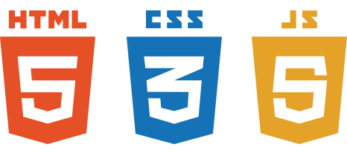


Tech@Lilly Bengaluru​ Hackathon 2023​
ML Models
Deepar
Prophet
ARIMA
Solution
+ + +
Descriptive
Predictive Analytics
Approach
Choose Model with Highest Accuracy
Train & Test Model
Present the Forecast
Analyze historical Data

Slide 3
Tech@Lilly Bengaluru​ Hackathon 2023​
01
Top performers in terms of Sales
Factors influencing Sales volume e.g., Marketing Campaigns, Price & Seasonality
02
Questions in Use Case
03
Optimize Sales force Allocation
04
Forecast Future

Slide 4
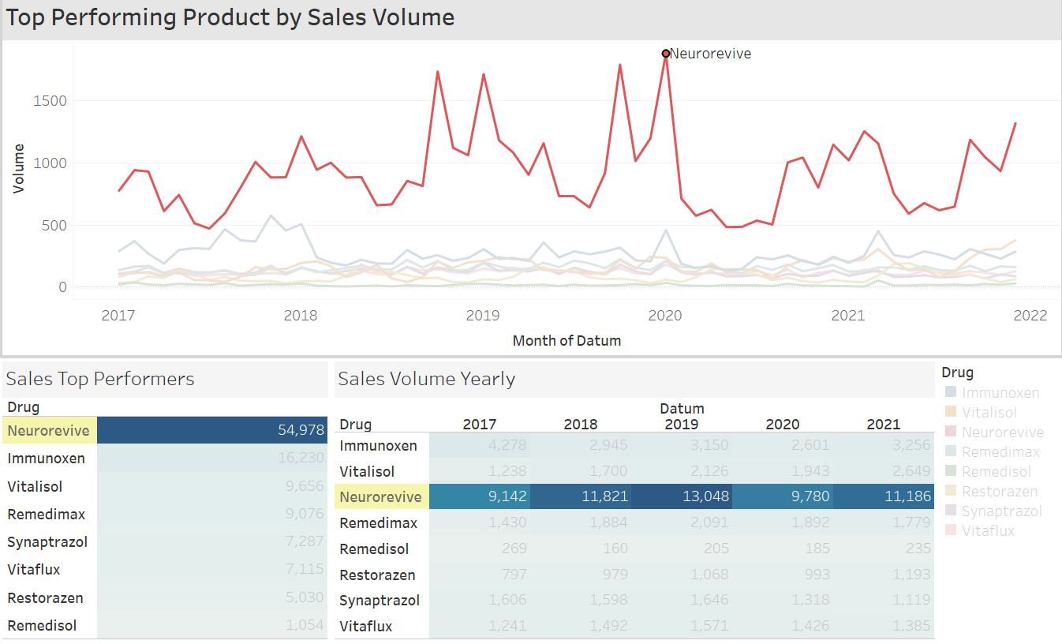
Tech@Lilly Bengaluru​ Hackathon 2023​
Top Performers in terms of Sales Now you know that Neurorevive is the top performer in Sales volume

Slide 5
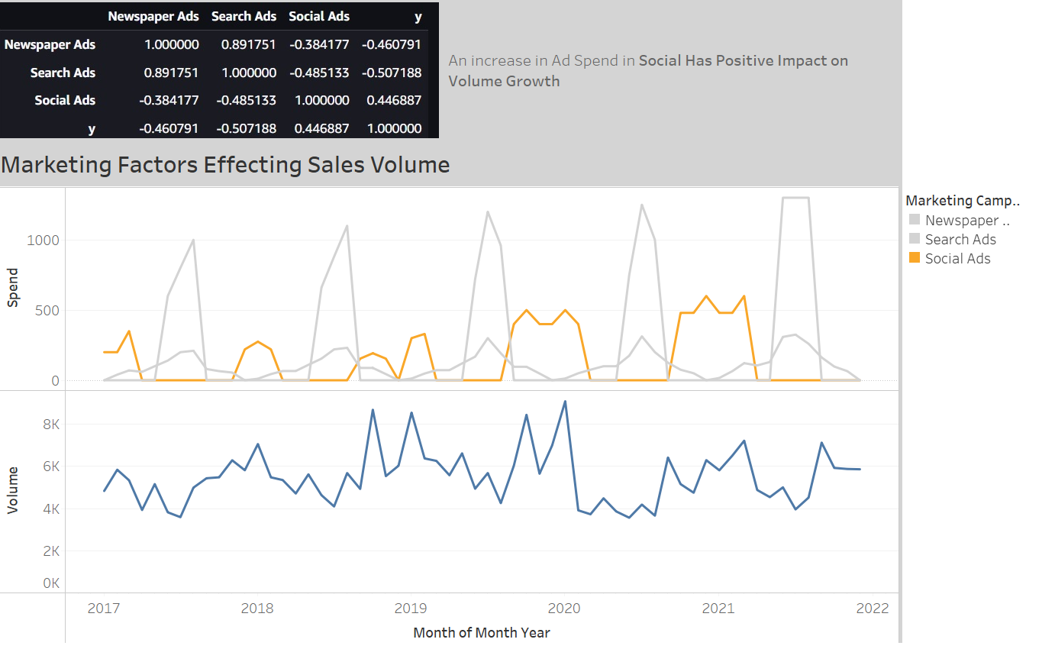
Tech@Lilly Bengaluru​ Hackathon 2023​
Factors Influencing Sales Our team created Marketing activity data and merged with use case data to answer this question. Further Correlation & (MMM)Market Mix Modelling can be done to arrive at pinpoint answers.
Now you know where to invest more; in which channels and at what time/seasonality

Slide 6
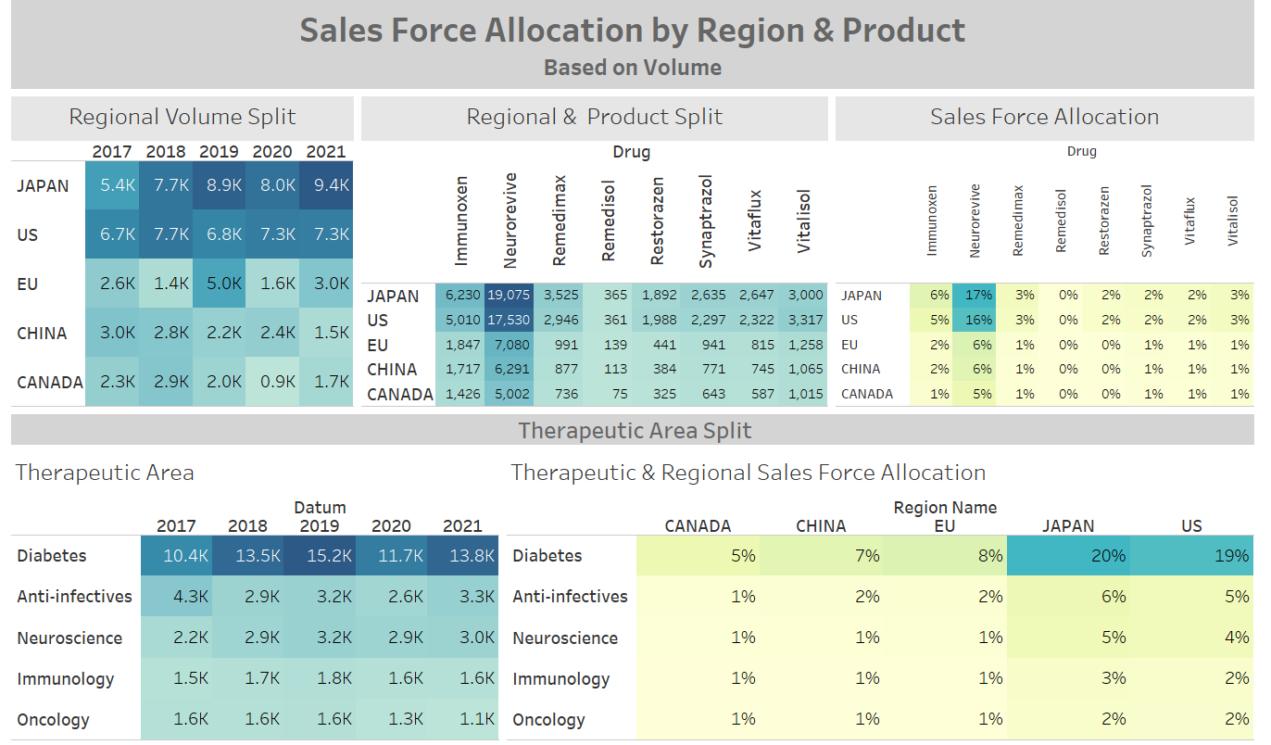
Tech@Lilly Bengaluru​ Hackathon 2023​
Optimize Sale Force Allocation Based on latest volume trends we should be able to allocate sales force per Region/Zip code. Our team decided to Add Region/Therapeutic area to the data to be able to answer this question more accurately for a Brand Manager.
Now you can optimize Resource Allocation per product per Region per Therapeutic Area

Slide 7
Tech@Lilly Bengaluru​ Hackathon 2023​
Forecast We have Trained & tested multiple models and picked the highest accurate one to forecast future volume growth – Also we have given the user some selection functionality to view model outputs
Forecast timeline
Frequency
Models Used
ARIMA: ARIMA (Autoregressive Integrated Moving Average) is a popular time series forecasting model that combines autoregression, differencing, and moving average components to capture the patterns and dynamics in time series data. It is used to make predictions based on the linear relationship between past observations and the current observation.
Prophet : Prophet is a time series forecasting model developed by Facebook that utilizes an additive model to capture trend, seasonality, and holiday effects in the data. It is designed to handle time series with various patterns and provides intuitive parameters for customization and interpretation.
Deepar : Deepar is a deep learning-based time series forecasting model implemented in GluonTS that uses a combination of recurrent neural networks to capture complex temporal patterns and dependencies in the data, enabling accurate predictions and uncertainty estimation. It is particularly effective in handling long-term dependencies and non-linear relationships in time series data.

Slide 8
MAPE VS SMAPE
Scenario 1: Underestimation
Actual demand: [100, 200, 300, 400]
Forecasted demand: [80, 150, 250, 350]
Absolute percentage error = |(Actual - Forecast) / Actual| * 100
Individual MAPE = [20%, 25%, 16.67%, 12.5%]
MAPE = 18.04%
Scenario 2: Overestimation
Actual demand: [100, 200, 300, 400]
Forecasted demand: [120, 250, 350, 500]
Individual MAPE = [20%, 25%, 16.67%, 25%]
MAPE = 21.6%

Slide 9
Tech@Lilly Bengaluru​ Hackathon 2023​
Implementation and Demo

