Slide 1
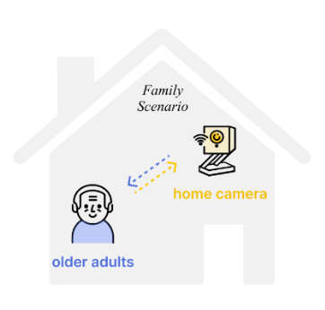
Sep 2021 - Mar 2022
Invisible Guardian
Home Cameras with Fall Detection for Older Adults
Motivation
Falls are a major cause of unintentional injury deaths worldwide.
Adults over 60 suffer the greatest number of fatal falls.
Home cameras with fall detection can provide life-saving alerts.
Privacy concerns exist around the use of cameras in homes.
Methods
Qualitative methods with multiple approaches
Surveys (N=389)
Semi-structured interviews (N=20)
Focus group & Co-design workshop (N=6)
Diary studies (N=11)
Notes:
The third project is designing home cameras with fall detection for older adults. Since fall for older adults can be fatal and home cameras can provide life-saving alerts. We have examined older adults' perceptions and attitudes towards home cameras with fall detection, and their needs for privacy concerns in design by several qualitative methods.
Falls are a leading cause of unintentional injury deaths, resulting in approximately 684,000 deaths annually worldwide, with adults over 60 suffering the most fatal falls.
It is a significant problem of fall for older adults since it can be fatal and
Home cameras with fall detection can provide life-saving alerts, but privacy concerns remain. Our study examined older adults' perceptions and attitudes towards home cameras with fall detection, and their needs for privacy and dignity in design. We also offer novel insights on privacy for older adults to inform AI product development.
Our study used a qualitative approach and employed multiple methods, including surveys (n=389), interviews (n=20), a focus group (n=6), a co-design workshop (n=6), and diary studies (n=11). We assessed older adults' attitudes towards privacy issues related to home cameras, investigated their scenarios and requirements for fall detection, and collaborated with older adults to develop a home camera appearance prototype. Additionally, we explored the potential functions of home cameras based on older adults’ everyday routines.

Slide 2
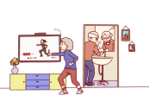
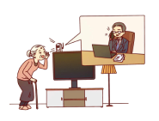
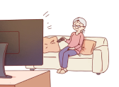
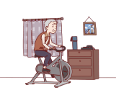
Sep 2021 - Mar 2022
Invisible Guardian
Home Cameras with Fall Detection for Older Adults
Surveys & Interviews
Understand older adults' attitudes, experiences, expectations, and preferences related to home cameras with fall detection.
Over 50% of older adults were willing to use home cameras, but others had concerns such as high costs, complicated features, and privacy issues.
Type I
Full acceptance of camera (FAC)
Type II
Conditional acceptance of camera (CAC)
Type III
Steadfast rejection of camera (SRC)
Notes:
We first surveyed and interviewed older adults to assess their attitudes, privacy perceptions, and design preferences, and we found that older adults can be categorized as three types based on their attitudes towards home camera.
Results show over half are willing to use home cameras for remote viewing and fall detection, while concerns include cost, privacy, and psychological issues. Older adults were classified into three types: Type I (full acceptance), prioritize automatic fall detection and emergency contact notification; Type II (conditional acceptance), prioritize price-to-performance ratio; Type III (steadfast rejection), view home cameras as surveillance and restriction of their freedom, with concerns about privacy and self-esteem.
Firstly, we conducted surveys and semi-structured interviews to assess older adults’ basic attitudes, privacy perceptions, and design preferences. In addition, interviews collected deeper information about older adults’ health and living conditions, technology use habits, experiences with falls, and expectations and worries regarding home cameras.
Results from the surveys indicate that more than half of the older adults are willing to use home cameras for remote viewing and fall detection features, while those who are not willing have various concerns including cost, privacy, and psychological issues. Based on the results of interviews, older adults were classified into three types based on their attitudes toward home cameras.
Type I, known as older adults with full acceptance of cameras (FAC), view home cameras as essential for life-saving and prioritize automatic fall detection and emergency contact notification.
Type II, referred to as older adults with conditional acceptance of cameras (CAC), generally acknowledge the benefits of fall detection technology, but compare the camera's performance to their own solutions and prioritize price-to-performance ratio.
Type III, known as older adults with steadfast rejection of cameras (SRC), view home cameras as surveillance and restriction of their freedom, and are concerned about privacy and self-esteem issues associated with aging and incapacity.

Slide 3
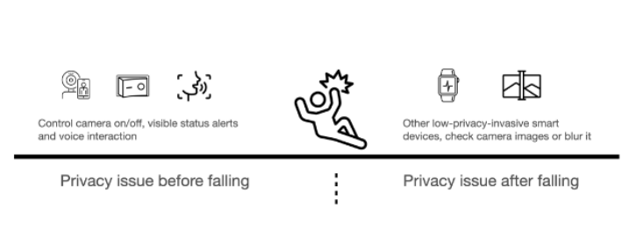
Sep 2021 - Mar 2022
Invisible Guardian
Home Cameras with Fall Detection for Older Adults
Focus Group
To gain older adults' thoughts on the key stages of fall detection and rescue
Scenario-based: conscious and unconscious after falls
If conscious, voice activation is preferred, wearable device is a plus
If unconscious, cameras should automatically call emergency contacts
High-decibel alarms if poor network connections
Notes:
We conducted a scenario-based focus group to understand older adults' ideas and potential solutions.
Participants discussed two scenarios - one where the person is conscious after a fall and one where they are unconscious.
For the conscious scenario, participants preferred voice interaction as the most user-friendly way to seek help, wristbands to detect physiological signals during sleep, and tapping the ground or grabbing something to generate loud sounds. Survival instinct
For the unconscious scenario, participants suggested the camera should detect unusual sounds and contact emergency if there is no response, and pre-record personal medical information on the camera.
Participants also expressed concerns about poor network connectivity and suggested local alarms with high decibels and frequencies to increase the chances of someone noticing them.
To gain a deeper understanding of older adults' ideas and potential solutions, we conducted a focus group through a scenario-based approach. Two typical scenarios were presented, one where the person is conscious after the fall and one where they are unconscious. Participants discussed how to efficiently seek help and the role of cameras in this process. Finally, privacy issues related to the use of cameras were also discussed.
For conscious scenario, they indicated a preference for voice interaction as the most intuitive and user-friendly means of seeking help. Additionally, they suggested the use of wristbands to detect physiological signals during sleep. Another viable option, based on survival instinct, is to tap the ground or grab something to generate loud sounds and attract the attention of the camera.
For unconscious scenario, participants suggested that the camera should be active when detecting unusual sounds and initiating contact with emergency contact if there is no response. They also proposed to pre-record relevant personal medical information on the camera in case of doctors’ need.
On the other hand, Participants also raised concerns about poor network connectivity and suggested that the device should trigger local alarms with high decibels and frequencies to increase the chances of someone noticing them.

Slide 4
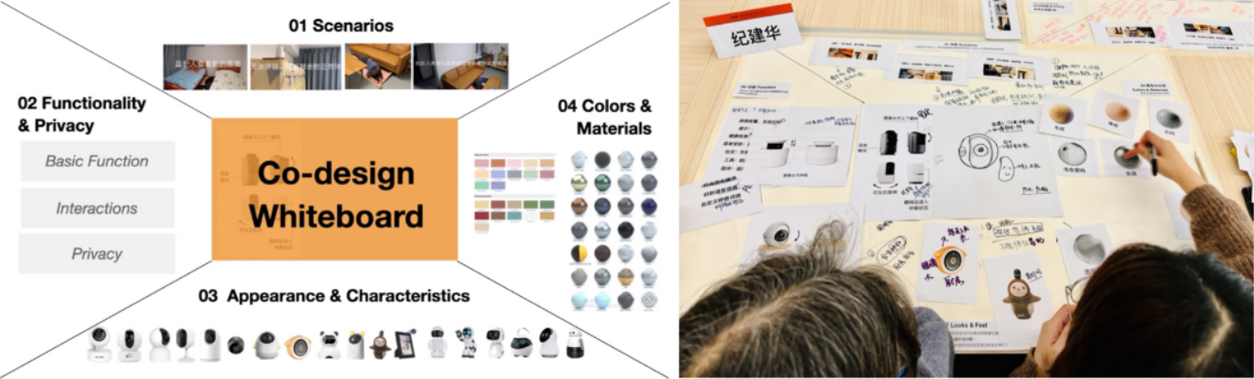
Sep 2021 - Mar 2022
Invisible Guardian
Home Cameras with Fall Detection for Older Adults
Co-Design Workshop
To investigate how older users' privacy preferences influenced the design of home cameras
Usage scenarios, functionality, appearance, and materials
Developed ideal home camera prototypes
Co-designing with researchers in Whiteboard
Notes:
We then conducted a co-design workshop with older adults to design the appearance of home cameras.
Participants discussed usage scenarios, functionality, appearance, and materials of the home cameras, and developed ideal prototypes.
Older adults expressed concerns about privacy, including personal privacy, their families privacy and psychological privacy which we highlighted on the study.
The first psychological privacy issue identified is the sense of dignity. Older adults are concerned about how others perceive them, and home cameras may give the impression that they are no longer capable. Moreover, they are concerned about the potential social consequences of having a camera, as their friends and visitors may feel uncomfortable or prejudiced. Also, they no longer have a space for expressing their private emotions.
The second psychological privacy issue is the sense of control. Poor design and User interaction may present a challenge for older adults. Fear of complicated functions and the inability to troubleshoot camera problems were the greatest concerns of older adults. Seeking assistance from family members may exacerbate feelings of incompetence and reduce their self-efficacy since they will compare the ability to present with the situation when they were young.
The study aimed to investigate how older users' privacy preferences were considered in the design of home cameras by facilitating their direct and comprehensive feedback through the co-design process. The older adults engaged in extensive discussions with researchers to articulate their expectations for usage scenarios, functionality, appearance, and materials of the home cameras. With the assistance of researchers, they developed ideal home camera prototypes in the whiteboard.
We found that older adults are usually sensitive to privacy issues caused by constant monitoring, both in terms of personal privacy and that of their families. They believe that their home should be a private and comfortable place, and the presence of a camera can cause anxiety and insecurity unless there is specific safety protection and strict regulations. For older adults, the psychological privacy concerns of older adults go beyond traditional digital privacy concerns, such as images from cameras, which have rarely been expressed directly in the past. we highlight the privacy demands related to dignity and face that older adults may find difficult to express.
The first psychological privacy issue identified is the sense of dignity. Older adults are concerned about how others perceive them, and technology such as home cameras may give the impression that they are no longer valuable. Moreover, they are concerned about the potential social consequences of having a camera, as their friends and visitors may feel uncomfortable or prejudiced. Also, they no longer have a private space for expressing their private emotions if there is a camera in the bedroom.
The second psychological privacy issue is the sense of control. Poor design and User interaction may present a challenge for older adults. Fear of complicated functions and the inability to troubleshoot camera problems were the greatest concerns of older adults. Seeking assistance from family members may exacerbate feelings of incompetence and reduce their self-efficacy since they will compare the ability to present with the situation when they were young.
Older adults expressed a desire for switch control authority to avoid privacy disclosure, allowing them to turn off the camera when there are others at home. Another suggestion is that the camera can automatically turn on when abnormal sound is detected and turn off when everything is normal.
Their ideal cameras should be invisible, durable, and reliable. The prototypes developed in the co-design workshop included cameras that were simple and practical, beautiful and hidden (sugar jar or jewelry box), or had a soothing appearance that did not feel intrusive.
To avoid privacy disclosure, older adults hope to have the switch control authority, they can turn off the camera when there is someone else at home, or the lens of the camera will automatically turn on when abnormal sound is detected while off when everything is normal.
From the perspective of cameras' appearance, they have some common requirements, such as the camera should be invisible, durable, and reliable.
There are three kinds of design generated in our co-design workshop.
The first type is simple and practical, older adults hope they won't be cartoonish to avoid their grandchildren would like to play with the camera. They prefer the camera to be professional and reliable and act as a family doctor. Additionally, their color and material should blend into the home so as to be invisible.
The second type is beautiful and hidden decoration, the camera should have an appearance that is not easily recognizable as a camera, it can look like a sugar jar or jewelry box. Additionally, the camera should be lightweight and have festive colors.
The third type of camera has a lovely, relaxing, and soothing appearance that doesn't feel intrusive or like a typical camera.

Slide 5
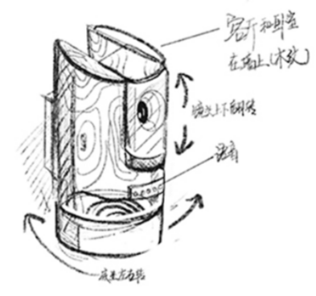
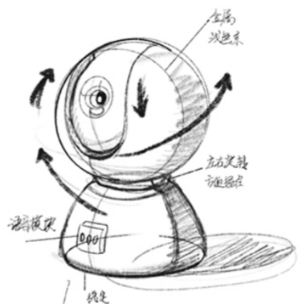
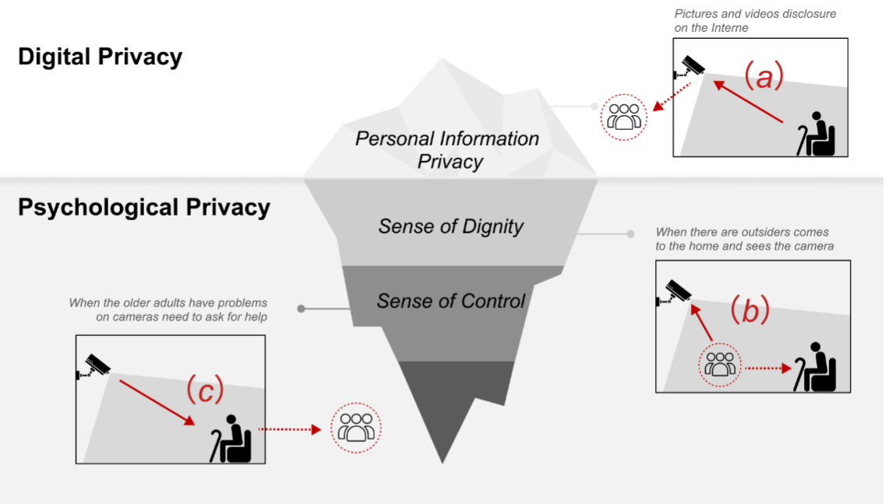
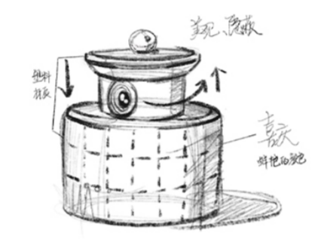
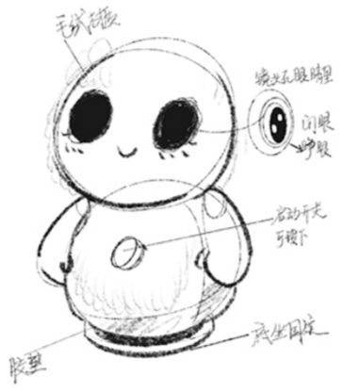
Sep 2021 - Mar 2022
Invisible Guardian
Home Cameras with Fall Detection for Older Adults
Co-Design Workshop
→ Avoid cartoonish design
→ Professional and reliable image, akin to doctor
→ Integrated with home decoration
Simple and Practical
→ “The appearance of camera is expected to give people a sense of security. It can be used as a small decoration in the home, making outsiders not treat it as a camera”
Beautiful and Hidden
→ Not intrusive
Perceptions of Older Adults towards Privacy
Lovely, Relaxing and Soothing
Notes:
We then conducted a co-design workshop with older adults to design the appearance of home cameras.
Participants discussed usage scenarios, functionality, appearance, and materials of the home cameras, and developed ideal prototypes.
Older adults expressed concerns about privacy, including personal privacy, their families privacy and psychological privacy which we highlighted on the study.
The first psychological privacy issue identified is the sense of dignity. Older adults are concerned about how others perceive them, and home cameras may give the impression that they are no longer capable. Moreover, they are concerned about the potential social consequences of having a camera, as their friends and visitors may feel uncomfortable or prejudiced. Also, they no longer have a space for expressing their private emotions.
The second psychological privacy issue is the sense of control. Poor design and User interaction may present a challenge for older adults. Fear of complicated functions and the inability to troubleshoot camera problems were the greatest concerns of older adults. Seeking assistance from family members may exacerbate feelings of incompetence and reduce their self-efficacy since they will compare the ability to present with the situation when they were young.
The study aimed to investigate how older users' privacy preferences were considered in the design of home cameras by facilitating their direct and comprehensive feedback through the co-design process. The older adults engaged in extensive discussions with researchers to articulate their expectations for usage scenarios, functionality, appearance, and materials of the home cameras. With the assistance of researchers, they developed ideal home camera prototypes in the whiteboard.
We found that older adults are usually sensitive to privacy issues caused by constant monitoring, both in terms of personal privacy and that of their families. They believe that their home should be a private and comfortable place, and the presence of a camera can cause anxiety and insecurity unless there is specific safety protection and strict regulations. For older adults, the psychological privacy concerns of older adults go beyond traditional digital privacy concerns, such as images from cameras, which have rarely been expressed directly in the past. we highlight the privacy demands related to dignity and face that older adults may find difficult to express.
The first psychological privacy issue identified is the sense of dignity. Older adults are concerned about how others perceive them, and technology such as home cameras may give the impression that they are no longer valuable. Moreover, they are concerned about the potential social consequences of having a camera, as their friends and visitors may feel uncomfortable or prejudiced. Also, they no longer have a private space for expressing their private emotions if there is a camera in the bedroom.
The second psychological privacy issue is the sense of control. Poor design and User interaction may present a challenge for older adults. Fear of complicated functions and the inability to troubleshoot camera problems were the greatest concerns of older adults. Seeking assistance from family members may exacerbate feelings of incompetence and reduce their self-efficacy since they will compare the ability to present with the situation when they were young.
Older adults expressed a desire for switch control authority to avoid privacy disclosure, allowing them to turn off the camera when there are others at home. Another suggestion is that the camera can automatically turn on when abnormal sound is detected and turn off when everything is normal.
Their ideal cameras should be invisible, durable, and reliable. The prototypes developed in the co-design workshop included cameras that were simple and practical, beautiful and hidden (sugar jar or jewelry box), or had a soothing appearance that did not feel intrusive.
To avoid privacy disclosure, older adults hope to have the switch control authority, they can turn off the camera when there is someone else at home, or the lens of the camera will automatically turn on when abnormal sound is detected while off when everything is normal.
From the perspective of cameras' appearance, they have some common requirements, such as the camera should be invisible, durable, and reliable.
There are three kinds of design generated in our co-design workshop.
The first type is simple and practical, older adults hope they won't be cartoonish to avoid their grandchildren would like to play with the camera. They prefer the camera to be professional and reliable and act as a family doctor. Additionally, their color and material should blend into the home so as to be invisible.
The second type is beautiful and hidden decoration, the camera should have an appearance that is not easily recognizable as a camera, it can look like a sugar jar or jewelry box. Additionally, the camera should be lightweight and have festive colors.
The third type of camera has a lovely, relaxing, and soothing appearance that doesn't feel intrusive or like a typical camera.

Slide 6
Sep 2021 - Mar 2022
Invisible Guardian
Home Cameras with Fall Detection for Older Adults
Diary Studies
“Indoor falling is an accidental event,
but being watched by a home camera every day is an inevitable event for me.”
Not just “watch” but consider diverse needs of older adults
Scenarios
Photography to record life and memories
Health-related reminders and information
Remote companionship through video calls
Notes:
We suggest that home cameras should not only focus on surveillance and security functions but also incorporate features that cater to older adults' daily needs and desires. Through dairy studies, we found out that providing functions such as photo-taking, health reminders, remote companionship may enhance the user experience and improve the overall quality of life for older adults.
Home cameras should not only have a surveillance function, but should also establish a more relaxed and free connection with older adults' activities, consider diverse needs, and provide a user-friendly experience.
By conducting diary studies within 10 days, 100 hours in total for each older adult, we found some main scenarios. (rest, recuperation, leisure, travel, activity, and care)
Firstly, taking photos to record daily life and regularly organizing them as memories, as well as enjoying taking selfies and sharing short videos, are highly valued by older adults since they like going through those photos taken in the past to share their memories.
Secondly, providing health-related information is crucial for older adults who commonly seek health-related knowledge, watch health courses and live streams, purchase health products, and have medication needs, so timely reminders to take medication and check for medication interactions are also important.
Thirdly, remote companionship through video allows older adults who live alone to not only check on each other's status but also facilitate communication with their families without needing to use a phone.

Slide 7
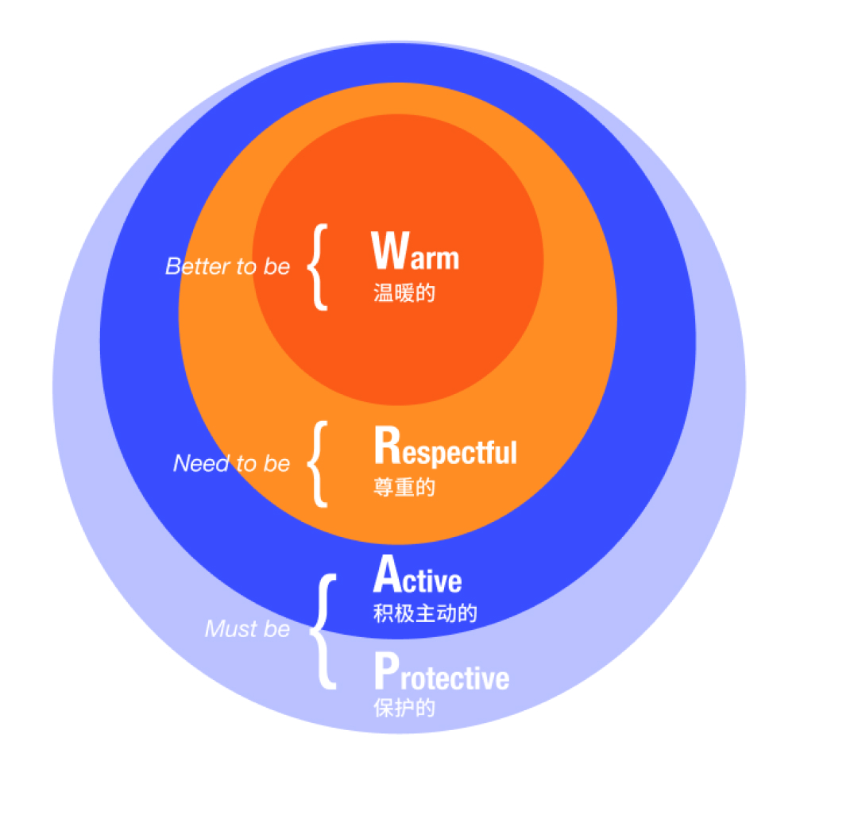
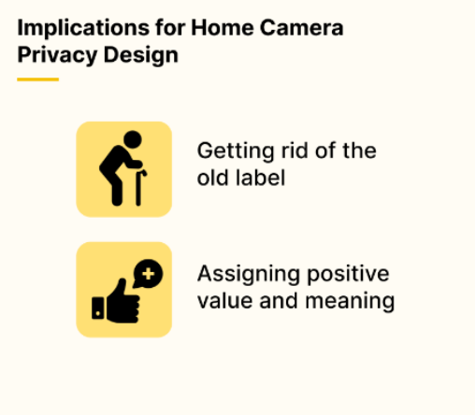
Sep 2021 - Mar 2022
Invisible Guardian
Home Cameras with Fall Detection for Older Adults
Conclusion
“Indoor falling is an accidental event,
but being watched by a home camera every day is an inevitable event for me.”
PARW Model
Notes:
We have concluded a PARW model, which stands for warm, respectful, active, and protective for the design of home cameras for older adults. Also, we suggested that smart products designed for older adults should prioritize privacy, avoid stigmatization, and provide a valuable sense of meaning.
Older adults desire an independent, autonomous life, and resist vulnerability.
We have explored in these five aspects, then we concluded with a design guideline model called PARW model.
(Protective and Active) To make it trustworthy and easy to use for older adults
(Respectful) In terms of considering user privacy and providing emotional support
(Warm) Technology should be warm instead of cold, the home camera can be integrated into the home as a companion
“Home cameras should be inconspicuous but available in critical moments to act as protective family members. “
Acceptance
Health, living condition, and subjective acceptance
Fall experience increases willingness
Needs
Clear functions and active feedback
Control authority and privacy protection
Scenario
Notify and call emergency contact
Reassure older adults during waiting
Interaction
Voice / wearable device / knocking / automatic
Appearance
“Invisible” shape
Dignity design
Acceptance, needs, scenario, interactive approach, and appearance are important factors to consider in designing a home camera for older people. Older people's health condition, living condition, and subjective acceptance are key factors that influence their willingness to use the product. The product should have clear functions, give them control authority, and protect their privacy. In emergency situations, the camera should actively call for help and play a reassuring role in the waiting process. Voice call for help is the most supported way to call for help, and the design should be in line with the cognition and aesthetics of older adults while also alleviate their privacy concerns and maintaining their dignity.

