Slide 1
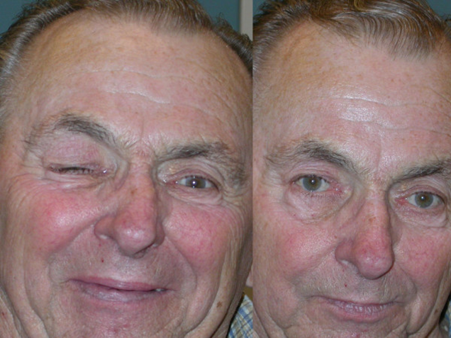
Hemifacial Spasm
Monitoring and Grading Hemifacial Spasm in Postoperative Rehabilitation
Jun 2023 - Present
Motivation
Late surgery intervention → poorer outcomes of surgery
Post operation → delayed cure
Involuntary facial muscle contractions
Methods
Semi-structured interview with 3 neurosurgeons and 12 HFS patients (done)
App design based on the results of interview
User study to understand the effectiveness and user experience of the app, and explore potential design implications for future work
Notes:
The first project is about hemifacial spasm (HFS), it is a chronic condition characterized by involuntary facial muscle contractions caused by nerve compression. It significantly impacts patients' quality of life. However, surgery carries risks and some patients experience delayed cure during postoperative rehabilitation. And long-term HFS patients tend to have poorer outcomes following surgery, so we hope to help with their early recognition and postoperative intervention. To do this, we hope to design a mHealth app that can monitor and grade the severity of HFS.
The research approach involves semi-structured interviews with HFS patients and physicians t Subsequently, an mHealth application integrating a monitoring and grading algorithm will be developed using HFS datasets, which will be labeled by experience neurosurgeons. The algorithm development will employ keypoint detection or deep learning techniques. Finally, a two-week user study will be conducted to evaluate the app's usability and effectiveness with HFS patients and physicians.
This research contributes by providing insights into the challenges and needs of HFS patients and physicians, developing a mHealth application with a monitoring and grading algorithm, and assessing its usability and effectiveness. The expected outcomes include improved self-management and rehabilitation for HFS, an algorithm for convenient HFS assessment using mobile phone cameras, and a user-friendly app to support postoperative rehabilitation.

Slide 2
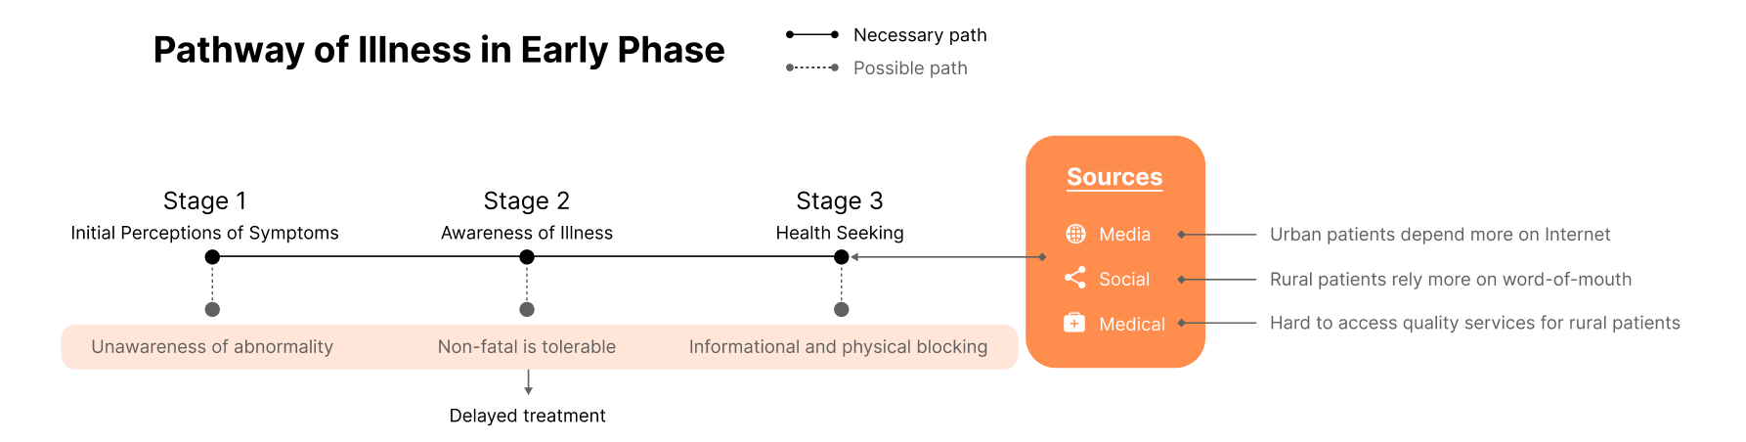
Hemifacial Spasm
Monitoring and Grading Hemifacial Spasm in Postoperative Rehabilitation
Jun 2023 - Present
Findings of Interviews
Still working in progress…
Notes:
For now, we have done the semi-structured interview part. It aims to investigated HFS patients’ healthcare circumstances and challenges, exploring their information-seeking practices in Chinese context. Our research identified a common pathway in the early illness phase, categorized into three stages, each with potential determinants of delayed treatment. In the third stage of health seeking, patients typically utilize three major sources, revealing nuanced differences in sources utilization between rural and urban patients.

