Slide 1
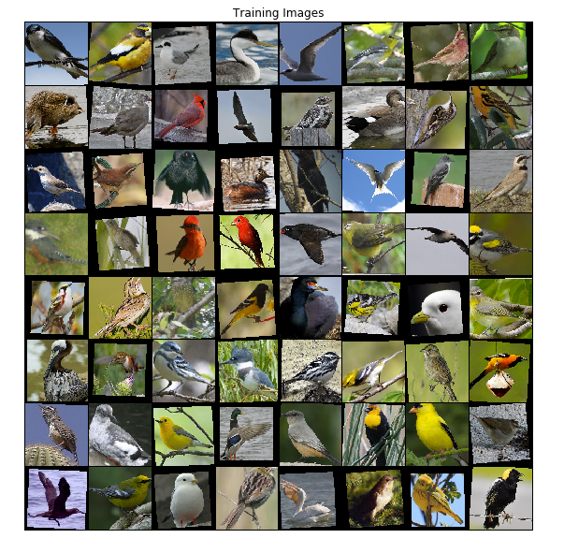
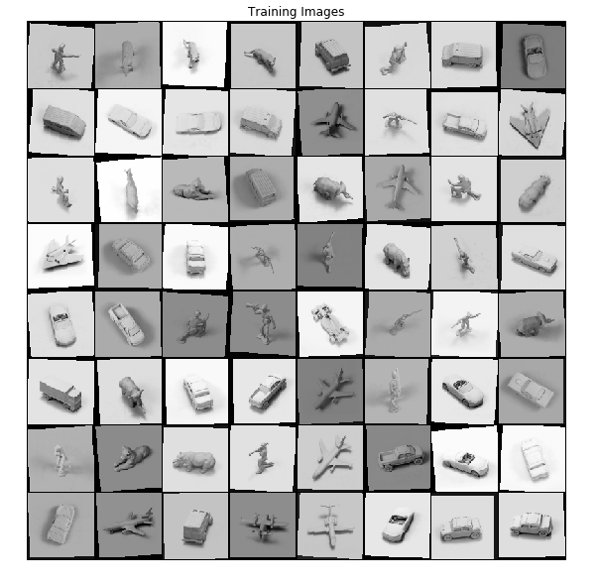

Slide 2

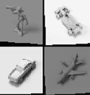

Training classifier
Query image
ResNet block
ResNet block
Reused feature extractor
Conv 3x3, BatchNorm
Conv 3x3, BatchNorm
Training images
Feature extraction
ReLU
ReLU
Gallery
Conv 3x3, BatchNorm
Conv 3x3, BatchNorm
+
ReLU
similarity
Top k retrieval images
classifier

Slide 3
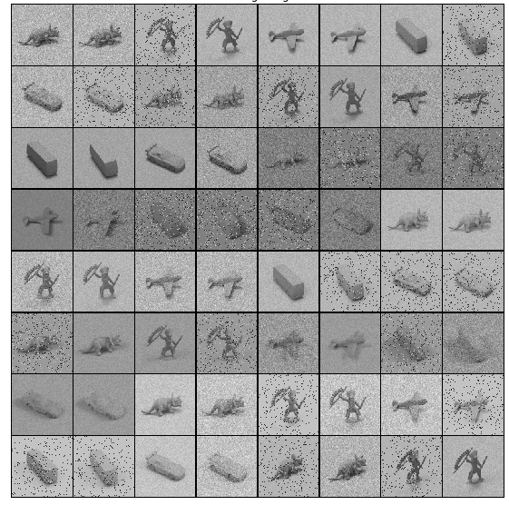
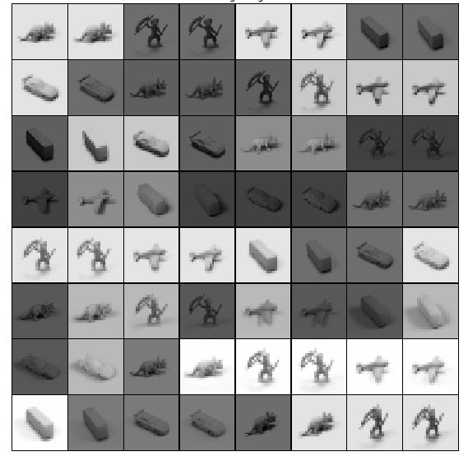

Slide 4
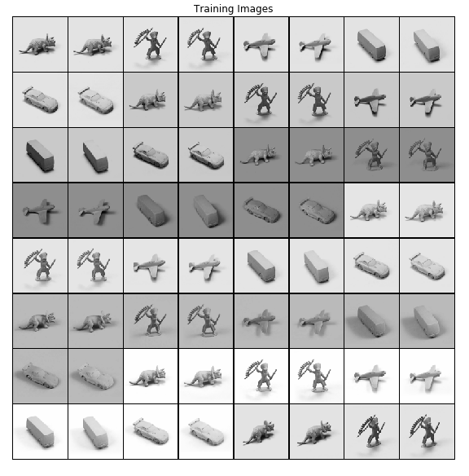
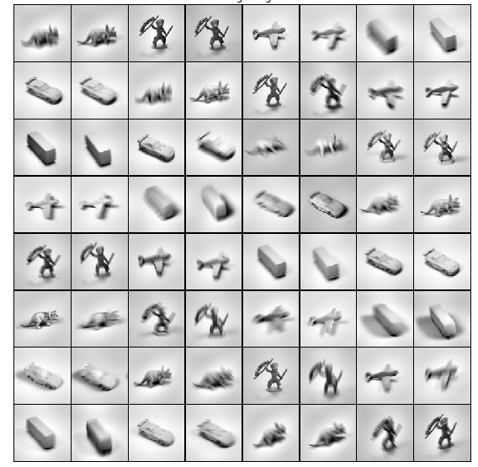

Slide 5
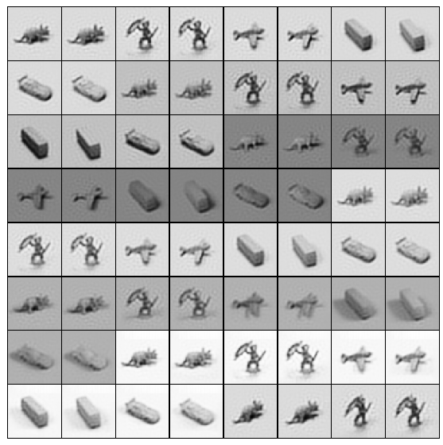
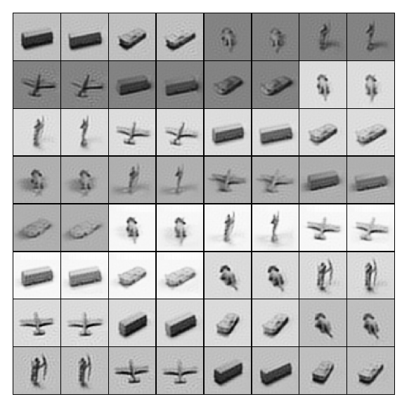

Slide 6



(1, 96, 96)
Transposed Conv (3x3), LeakyReLU , BN
Reconstruction loss: MSE
(16, 48, 48)
(32, 24, 24)
(64, 12, 12)
Decoder
(128, 6, 6)
256 x 3 x 3
Latent $Z$
(128, 6, 6)
Encoder
(64, 12, 12)
(32, 24, 24)
(16, 48, 48)
(1, 96, 96)
Conv (3x3), ReLu, BN,

Slide 7




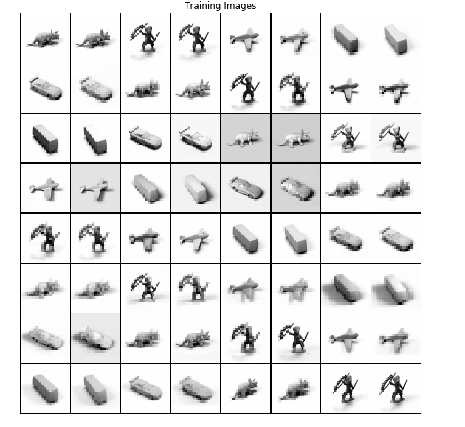
a)
b)
c)
d)
low

Slide 8
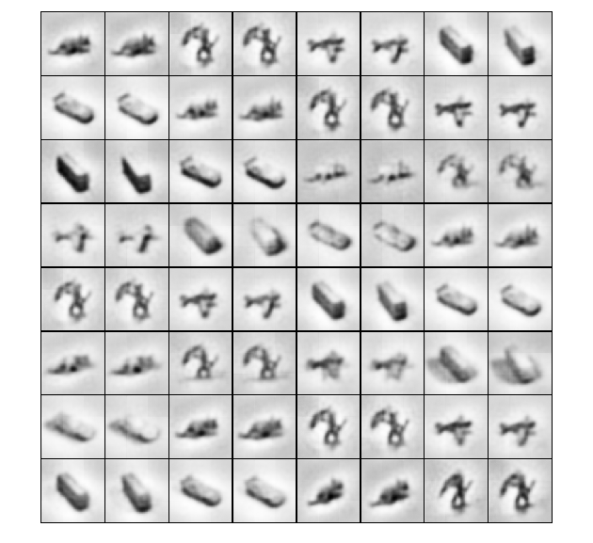

Slide 9
New

Slide 10


96
32 x 96 x 96
64 x 96 x 96
128 x 96 x 96
64 x 96 x 96
1 x 96 x 96
96
Conv K = 5 x 5, p = 2
Conv K = 5 x 5, p = 2
Conv K = 5 x 5, p = 2
Conv K = 3 x 3, p = 1
Conv K = 3 x 3, p = 1

Slide 11
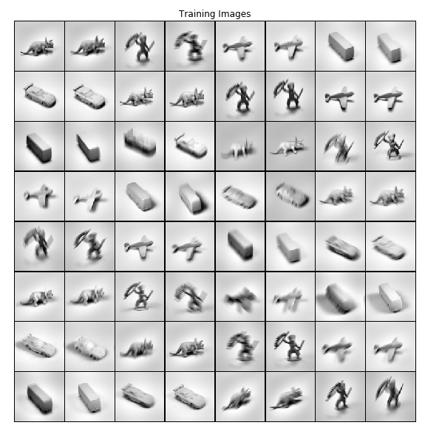
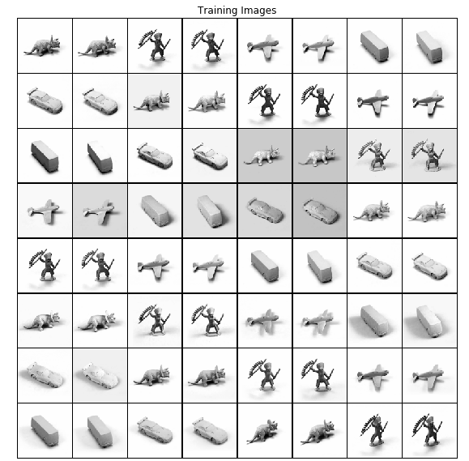

Slide 12
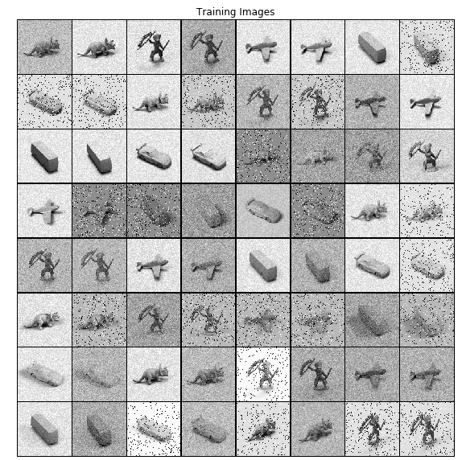

Slide 13
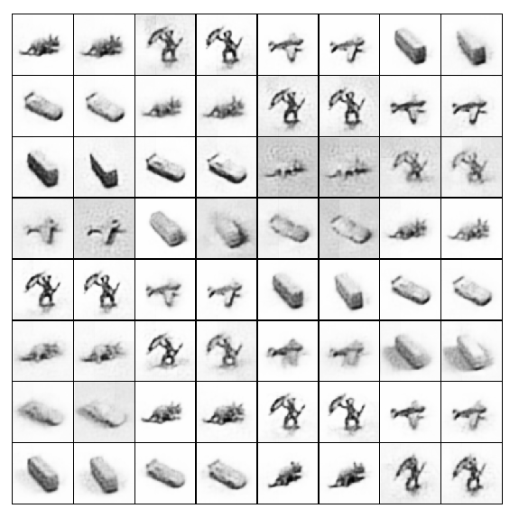
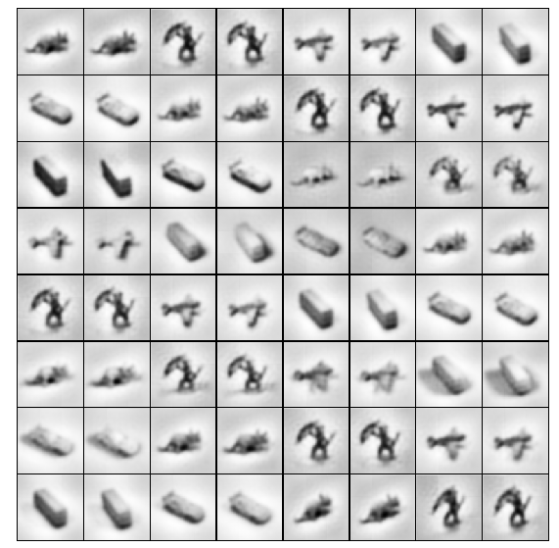
denoise
deblur

Slide 14
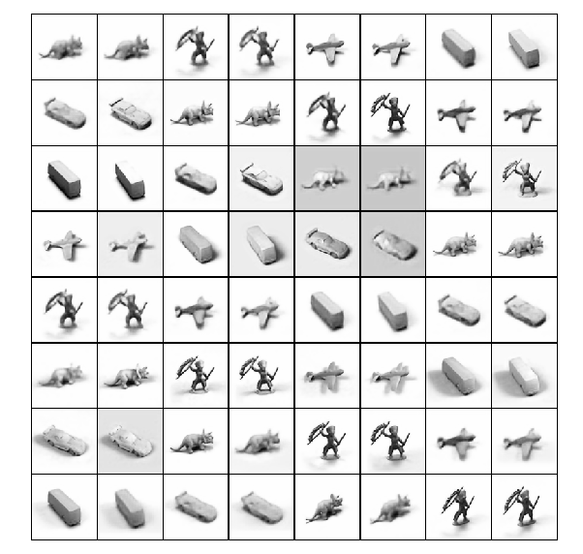




a)
b)
c)
d)
Up scale

