Slide 1
Economic Imbalance The Growing Divide between Housing Affordability and Wage Stagnation in the United States
KaCee Unruh
12/31/2023

Slide 2
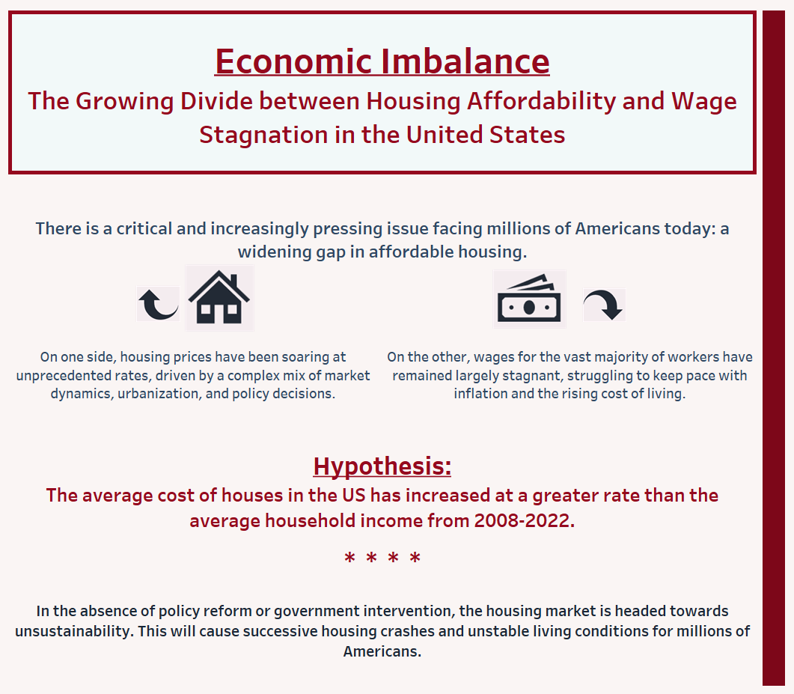

Slide 3



Slide 4
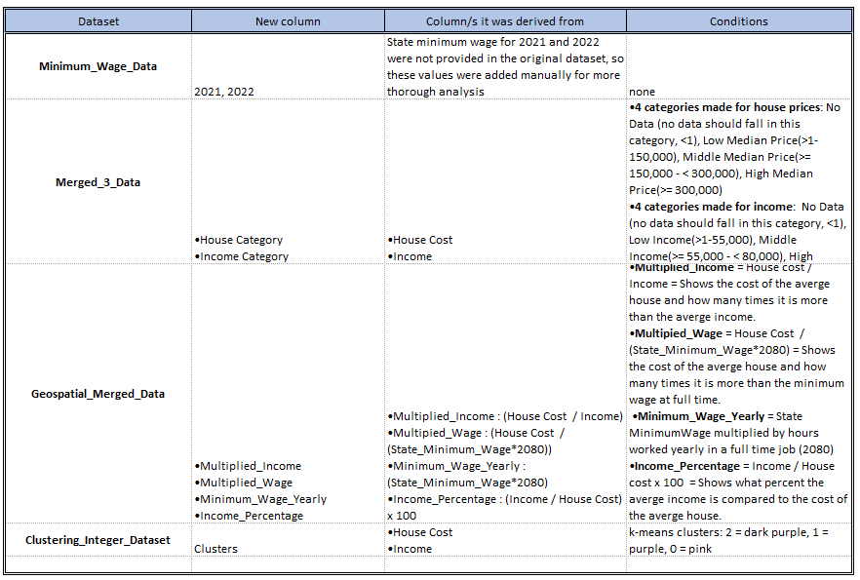

Slide 5
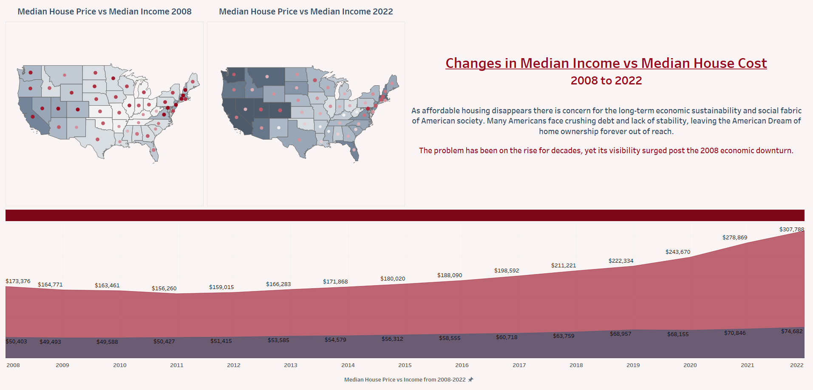

Slide 6
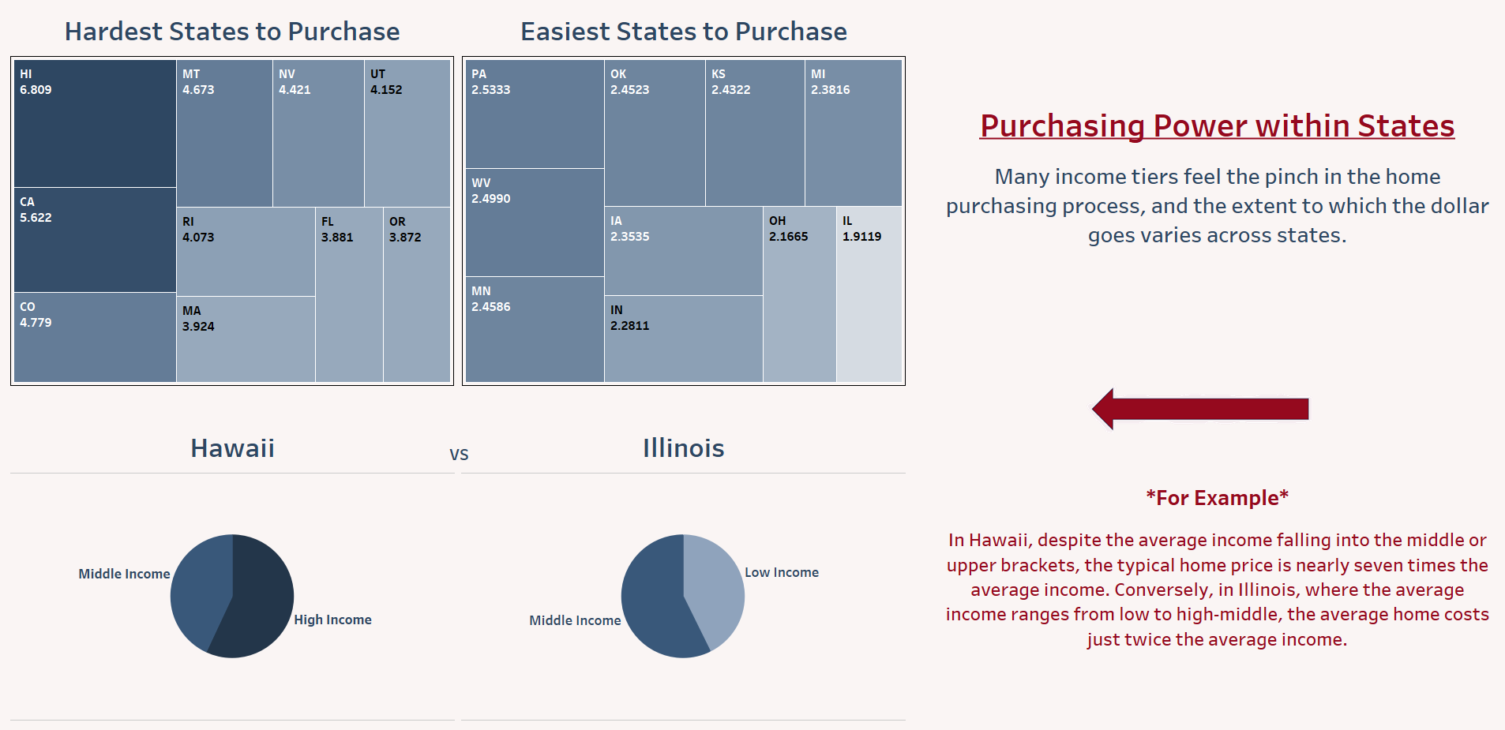

Slide 7
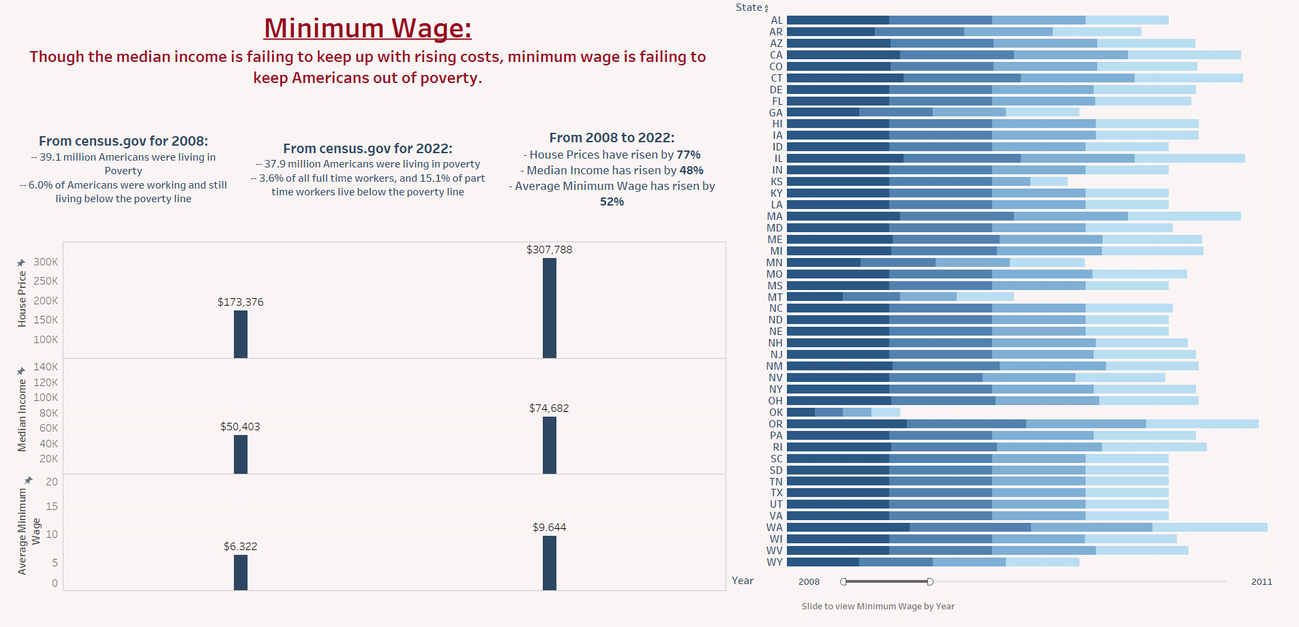

Slide 8
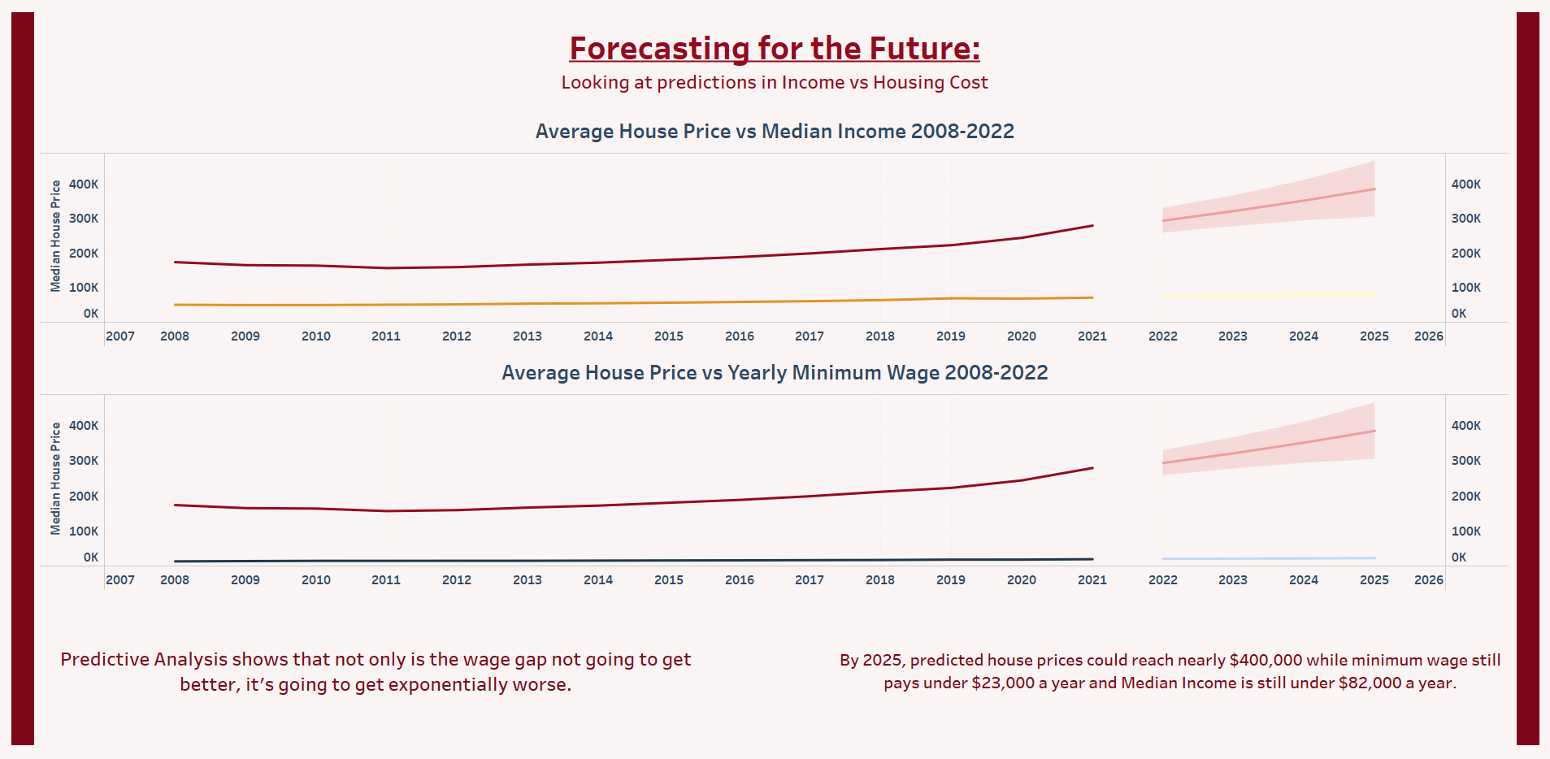

Slide 9
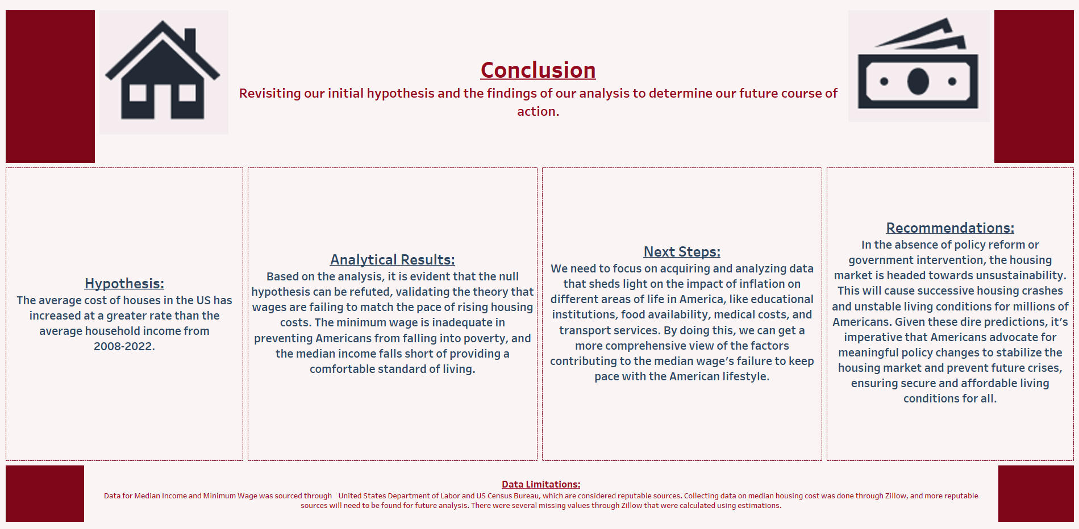

Slide 10
