Slide 1
Custom Applications 1
Competency Summary

Slide 2
Overview of team
Person 1
-Person 2
Person 3

Slide 3
Overview of team
- Person 1
- Person 2
- Person 3
- Person 4

Slide 4
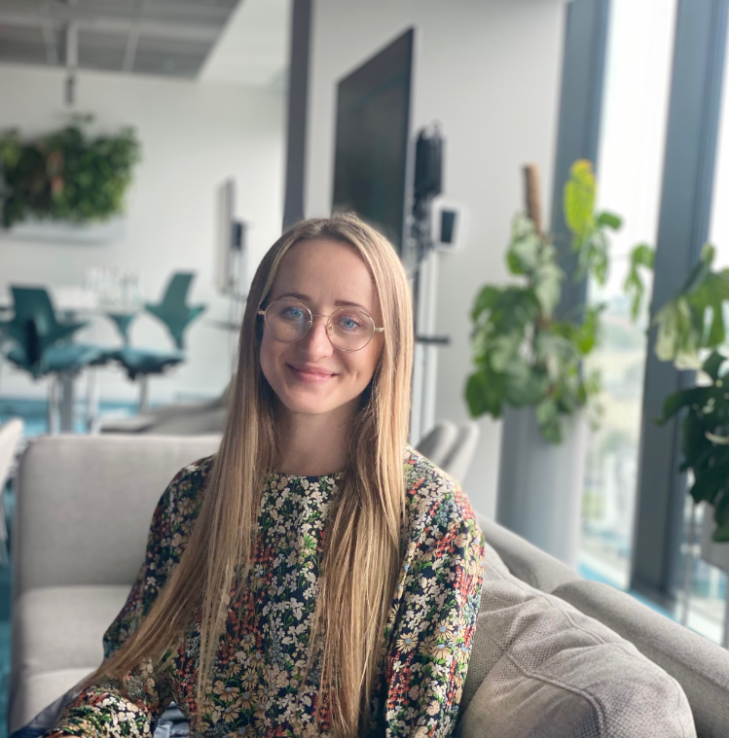
Kamila Kazimierska
Junior Full Stack Developer, E-ART
Education: Mathematics, Statistics
Experience: Developer, Risk Analyst
Competencies: Python, Angular, R
Interest: Mentoring, Programming

