Slide 1
Custom Applications 1
Competency Summary

Slide 2
Overview of team
Person 1
Person 2
Person 3
Person 4
Person 5
Person 6
Person 7
Person 8
Person 9
Person 10

Slide 3
Overview of team
Person 1
Person 2
Person 3
Person 4
Person 5
Person 6
Person 7
Person 8
Person 9
Person 10

Slide 4
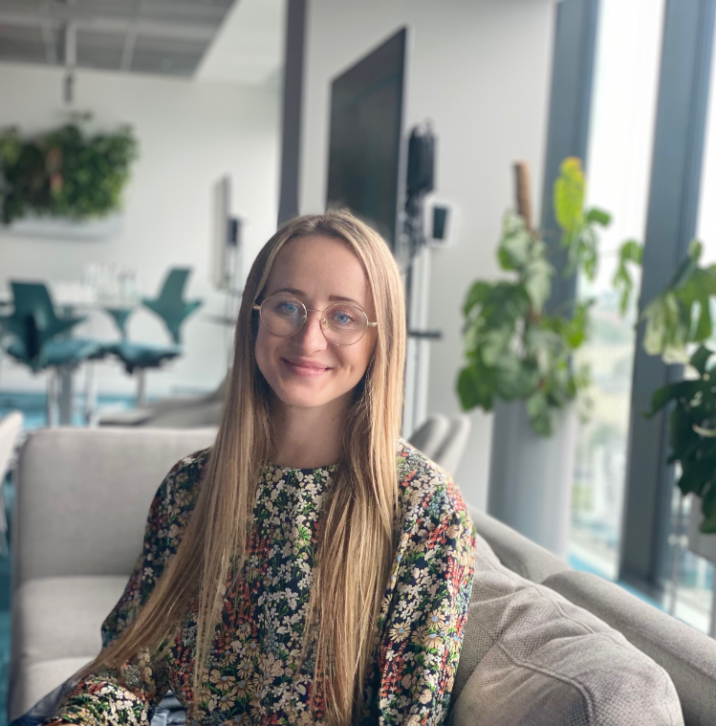
Kamila Kazimierska
Junior Full Stack Developer, E-ART
Education: Mathematics, Statistics
Experience: Developer, Risk Analyst
Competencies: Python, Angular, R
Interest: Mentoring, Programming

