Slide 1
Facebook

Slide 2
Main Competencies & Skills
Education
Experience
Competencies
Area of interest
JJJJJJJ
JJJJJJJ
JJJJJJJ
JJJJJJJ

Slide 3

Team
JJJJJJJ
JJJJJJJ
JJJJJJJ
JJJJJJJ
JJJJJJJ
JJJJJJJ
JJJJJJJ
JJJJJJJ

Slide 4
Team
JJJJJJJ
JJJJJJJ
JJJJJJJ
JJJJJJJ
JJJJJJJ
JJJJJJJ
JJJJJJJ
JJJJJJJ

Slide 5
Team
JJJJJJJ
JJJJJJJ
JJJJJJJ
JJJJJJJ

Slide 6
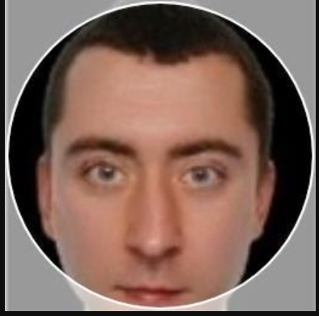
Jan Bielecki (JBIEL)
Full Stack Developer
Experience:
Software Engineer (5 years)
E-ART.
Education:
Professional competencies:
Engr.: Computational Physics,
MSc: Data exploration and interdisciplinary modelling
Languages: Python, Go, Typescript, Javascript, Physics
Frameworks: Angular, Fast Api;
Database: Sql Server;
DevOps: Azure Piplelines, Docker;
Other: Machine learning, Mathematical programming, Physics
Professional interest:
Programming, automation, optimization,
energy systems, science

