Slide 1
REPORT ON ANALYSIS OF BUSINESS LAYOFF TREND
Created by,
Karthik

Slide 2
REQUIREMENTS
1
Analysis of Industry Layoff Trend
To analyse the trends that is recently going on in the industry.
To analyse how the companies have laid-off employees.
To gather insights and knowledge with layoffs.
6
Business Requirement
A layoff is the temporary or permanent termination of employment by an employer for reasons unrelated to the employee's performance. Employees may be laid off when companies aim to cut costs, due to a decline in demand for their products or services, seasonal closure, or during an economic downturn. The COVID-19 pandemic disrupted and closed down numerous businesses around the world, forcing many employers to layoff or furlough their employees. As Big Tech companies reported less-than-stellar earnings over the past few years, they also also flashed warning signs about the months ahead. The looming threat of a recession was causing customers to scale back spending, companies said — with few signs of a rebound on the horizon. The tech industry layoffs are basically an instance of social contagion, in which companies imitate what others are doing. If you look for reasons for why companies do layoffs, the reason is that everybody else is doing it. Layoffs are the result of imitative behavior and are not particularly evidence-based.
OBJECTIVE
2
7
The main objective / goal of this analysis is to explore and gather insights from the data using python by utilising different methods and techniques to analyse about the trend that is happening in industries.
FACTORS TO ANALYSE
3
8
10 Companies with high layoff's
10 Location's with high layoff
10 industries with high layoff's
Every year layoff count
Which year high layoff happened
Relation between fund raised and layoff count
10 Countries with highest layoff
Relation between location and fund raised
Which industry is in what location
4
9
5
10

Slide 3
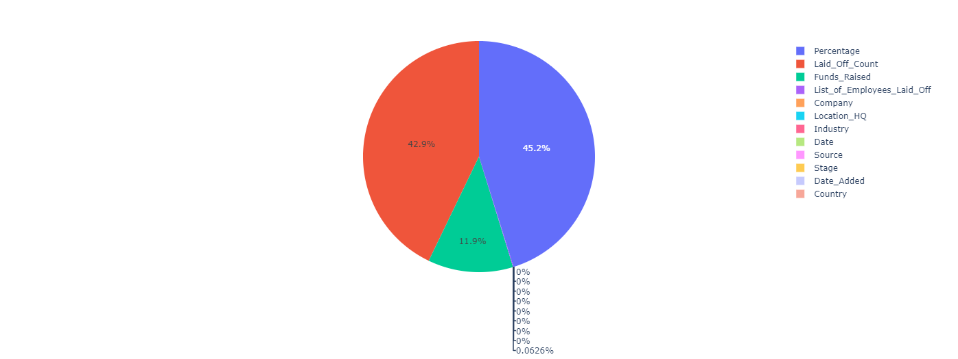
10 cities with high layoff
Checking the distribution
Layoffs in indian
Industry with most affected in india
Which location has most affected in india
Total fund raised
Relation between fund raised and industry
MAANG company analysis
Which stage has most layoff
Time series analysis
Company - Name of the Company
Location - Location of the Company
Industry - Type of Industry the company is
Laid_Off_Count - Total count
Percentage - Percentage of layoff
Date - Date of layoff
Source - Data gathered from source
Funds_Raised - Total funds raised
Stage - Stage of the company
Date_Added - data added in database
Country - Country of company located
List_of_Employees_Laid_Off - employee list
1
6
2
7
3
8
DATASET DESCRIPTION
MISSING VALUES
Original dataset can be tracked at https://layoffs.fyi/
Credits: Roger Lee
4
9
5
Percentage, Laid_Off_Count and Fund raised has significantly more number of missing values percentage.
10

Slide 4
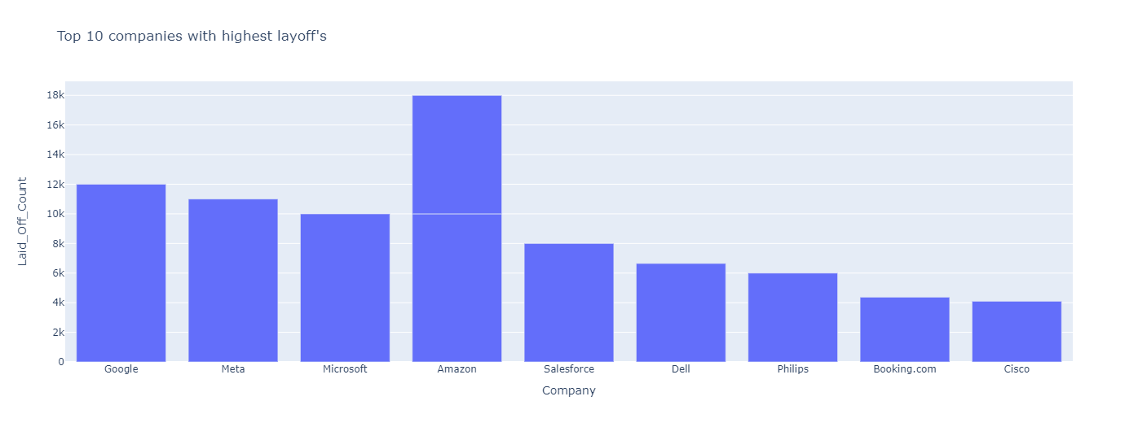
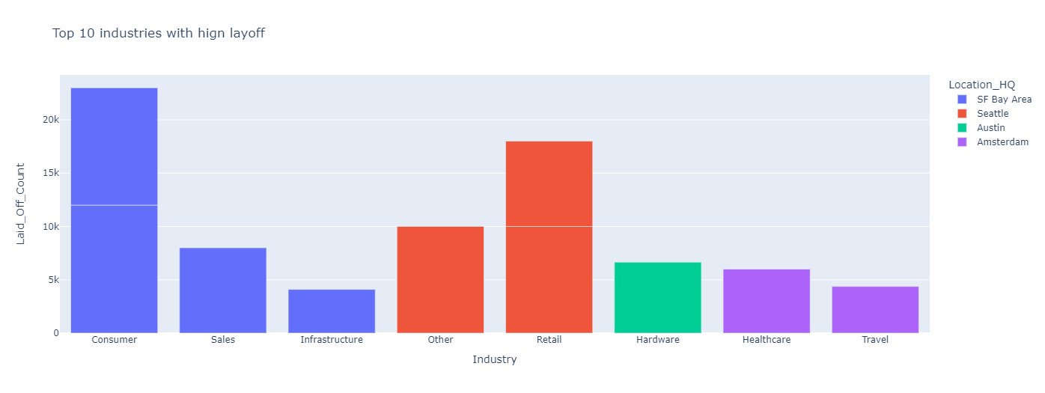
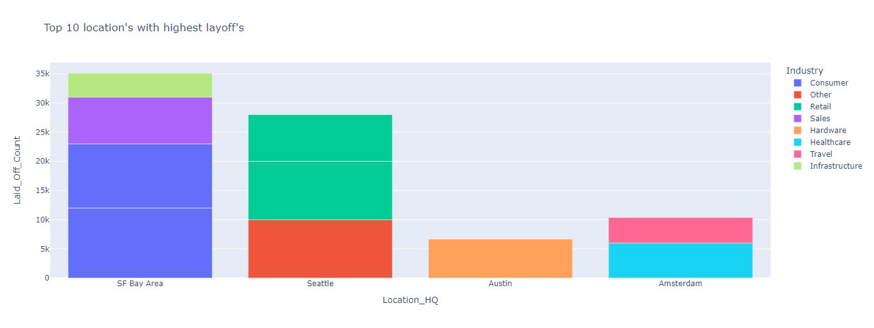
TOP 10 COMPANIES WITH HIGH LAYOFF
SF bay area has most number of layoff counting more than 35k.
Each location has high number of layoff including different industries.
Consumer has 23k layoffs in SF bay area.
Retail has 18k layoffs in Seattle.
1
6
TOP 10 INDUSTRIES WITH HIGH LAYOFF
2
7
Amazon has laid off more employees compared to other companies , which includes 2 different industries from amazon itself (1.10K and other 8K)
MAANG companies has laid off more employees
3
8
TOP 10 LOCATIONS WITH HIGH LAYOFF
Consumer and retail industries got most affected in industries with layoff count.
Healthcare domain got affected due to sudden increase in people and managing resources, beds and medicine is also hectic.Digital resources was not popular that time.
Travel domain got affected due to supply chain demand and sudden raise in covid-19 which resulted in lockdown , which also increased the demand for the products, which resulted in demand for sales and hardware industries.
4
9
5
10

Slide 5
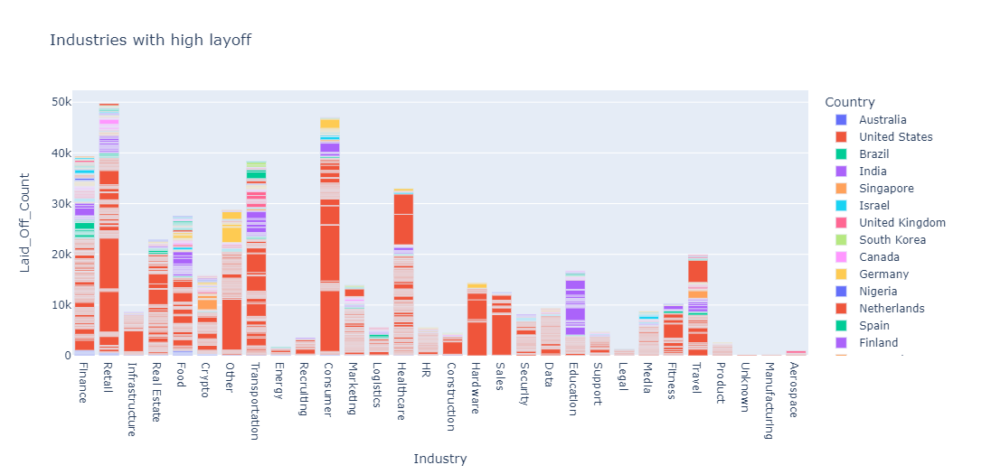
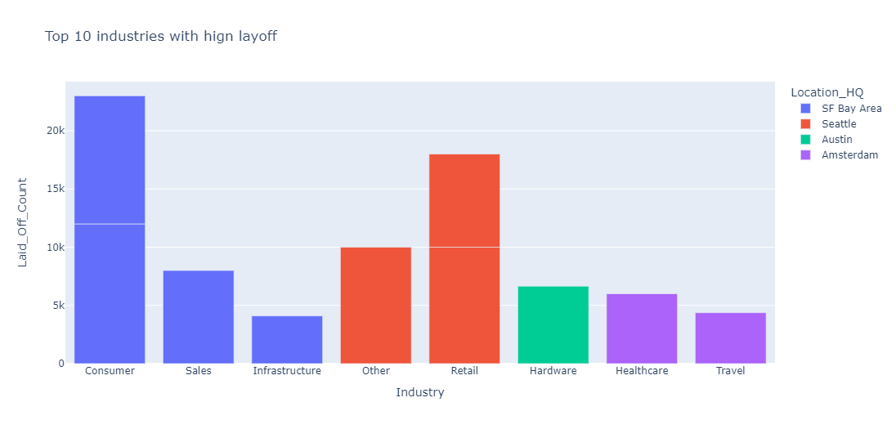
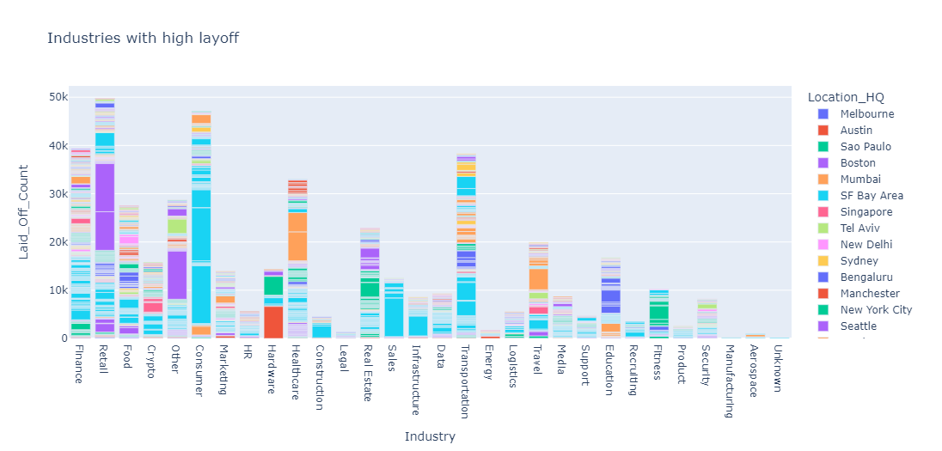
TOP 10 INDUSTRIES WITH HIGH LAYOFF
1
6
2
USA has laid off more people when compared to other countries, and hold more laid off employees in all sector.
Since US has more number of companies,they had layed off employees in almost all industries.
Retail, consumer and finance are the top 3 industries that are affected the most due to covid-19.
Retail got affected due to transportation demand as it depends on hardware supply and since people lost jobs and they cant afford to buy anything.
Demand for the food industry is also high due to this lockdown.
Crypto got affected due to lockdown due to return of captial and people has no money to invest.
As discussed earlier transportation got affected in big cities too.Lockdown has increased the affected rate for transportation, which in turn directly affects logistics too.
Healthcare got affected due to raise in demand for medicine,resource,hardware resources and physical resources(i.e,Doctors,nurses) to manage the overwhelming patients.
7
Consumer and retail industries got most affected in industries with layoff count.
Healthcare domain got affected due to sudden increase in people and managing resources, beds and medicine is also hectic.Digital resources was not popular that time.
Travel domain got affected due to supply chain demand and sudden raise in covid-19 which resulted in lockdown , which also increased the demand for the products, which resulted in demand for sales and hardware industries.
3
8
4
9
5
10

Slide 6
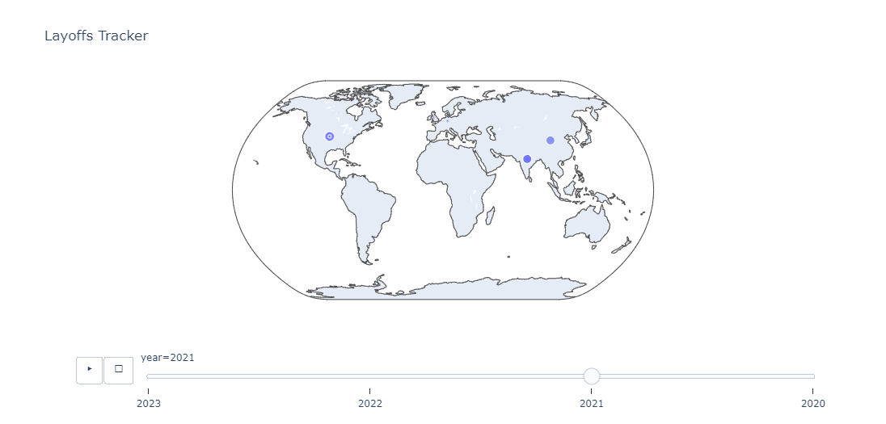
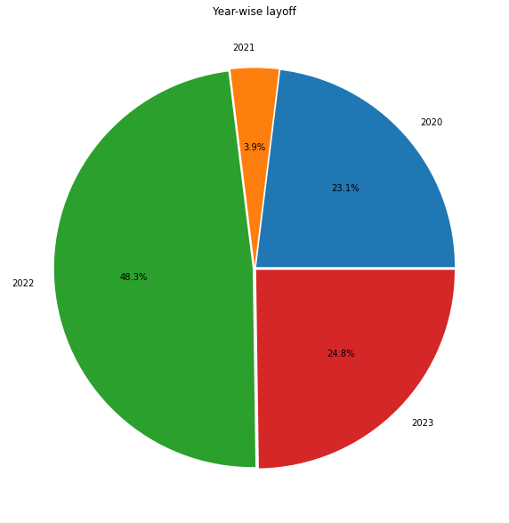

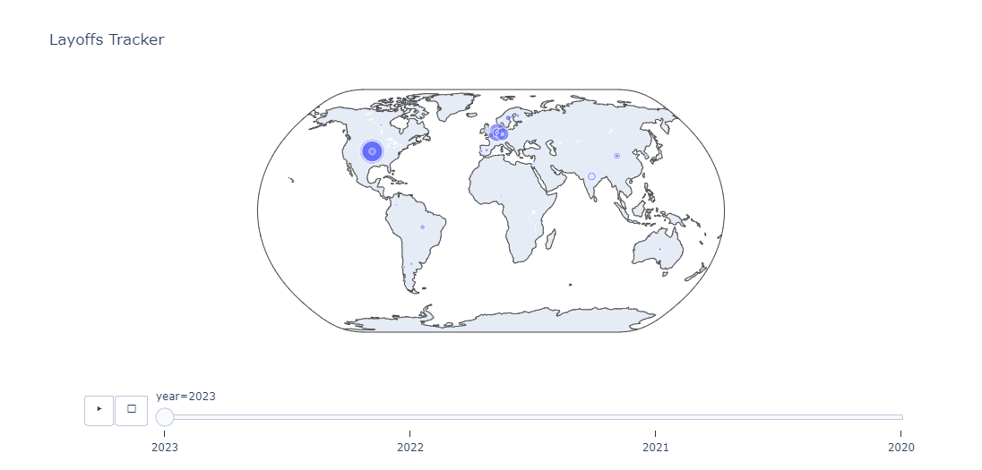
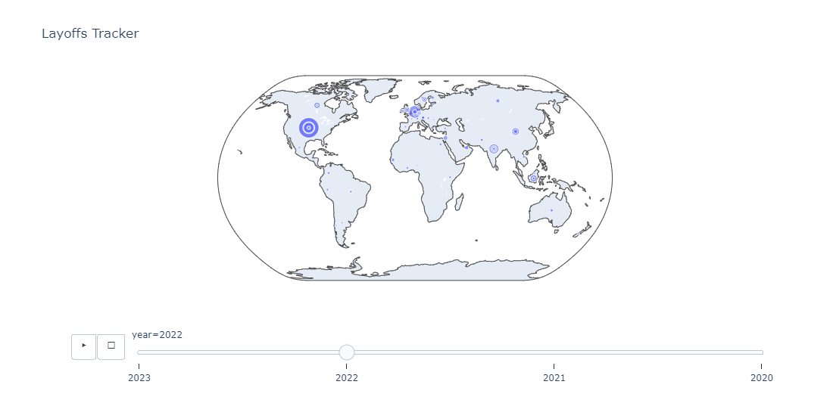
EVERY YEAR LAYOFF COUNT
1
6
2
7
3
8
Total number of laid off is 455550
No. of layoff per year,
2020 - 105007
2021 - 17786
2022 - 219884
2023 - 112873.
4
9
5
10

Slide 7
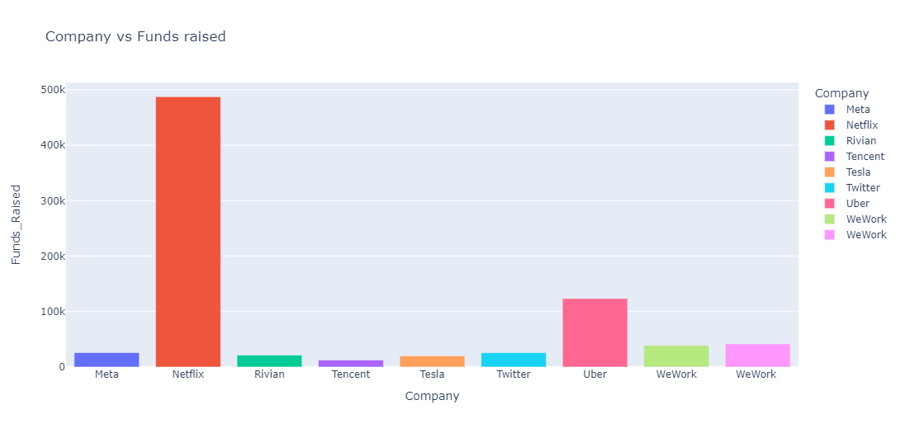
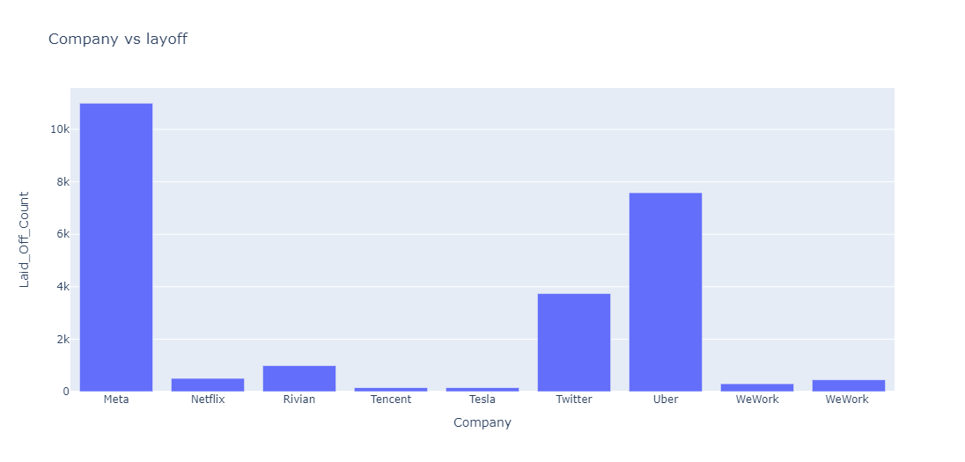
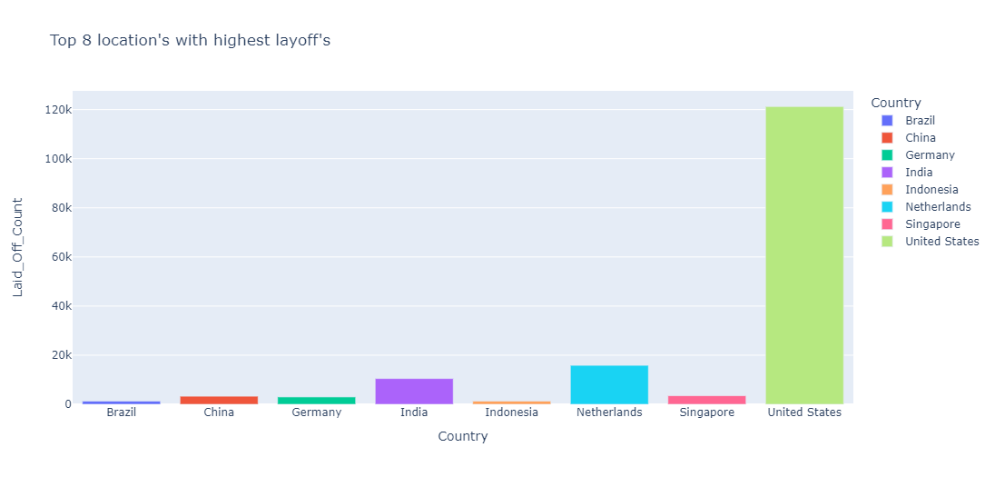
1
In year 2022 has laid off more people comparing other years due to recovery phase of industries and to meet the business needs and investments,planning to layoff and cost cut 2022 has higher rate of laying off people.
It's only the 2nd month of 2023 but it already has a high rate of laid off people, which is noticeable.
6
2
7
RELATION BETWEEN FUND RAISED AND LAYOFF
Meta,Uber and Twitter has laid off employees with respect to fund raised.
Fund raised my meta and laid off count is not so correlated.
Fund raised by netflix is high and they have laid off only few people and same applicable for uber too.
3
8
TOP 8 COUNTRIES WITH HIGH LAYOFF
4
9
5
10

Slide 8
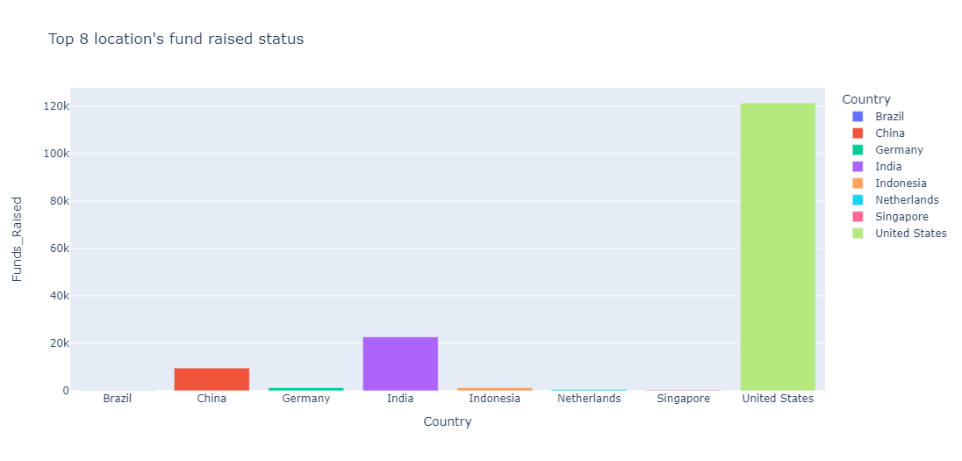
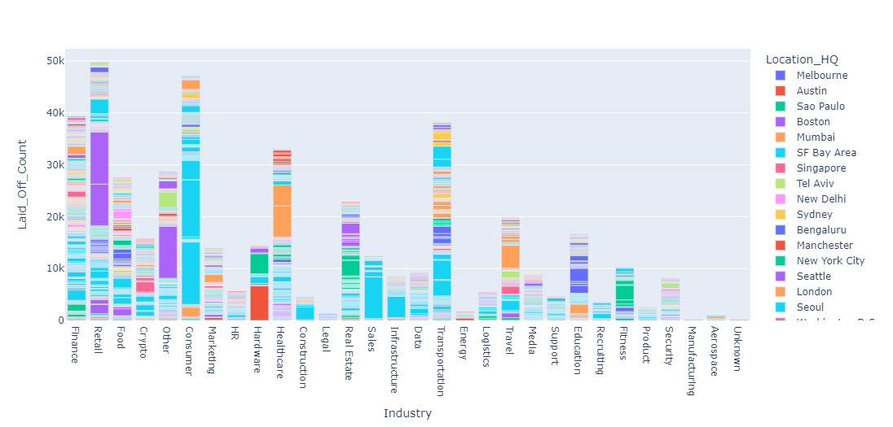
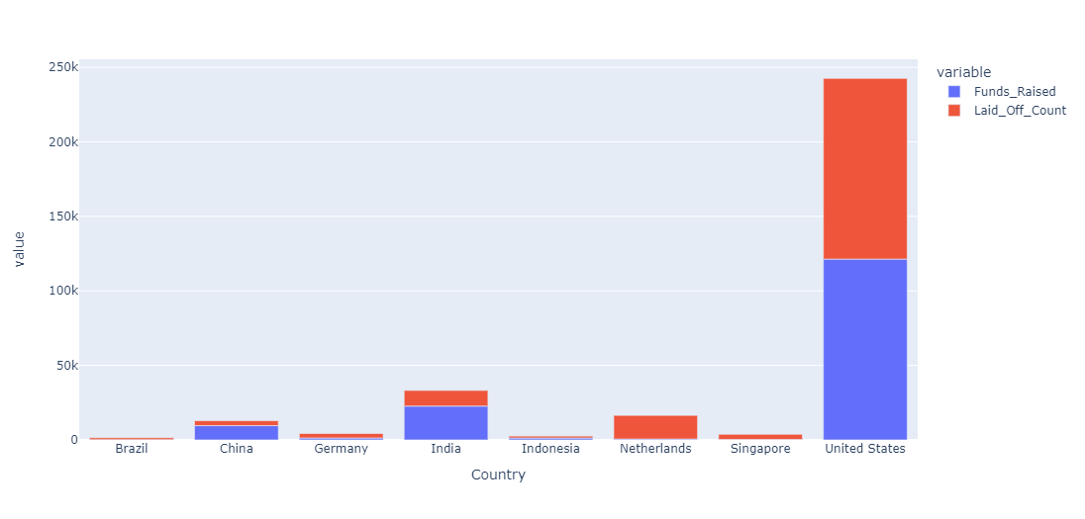
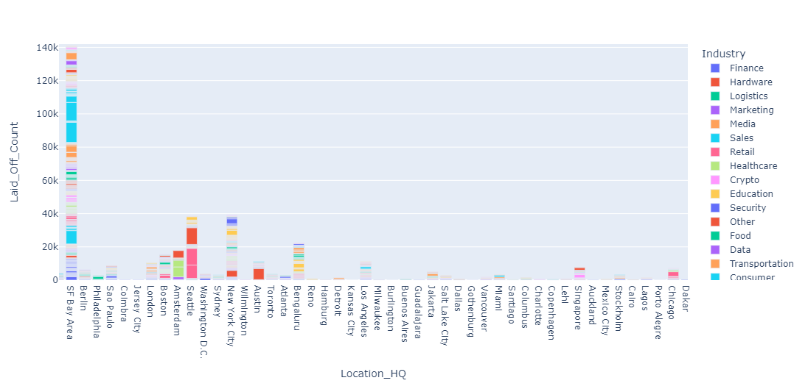
WHICH INDUSTRY IS IN WHICH LOCATION
1
6
2
7
3
8
4
9
As by reference there is no relationship between fun raised and layoff count by companies.
United states,Netherlands and India has more number of layoff count with respect to funds collected.
San Francisco bay area followed by seattle, New york and bangalore locations has more number of layoffs.
Retail,Consumer and finance has affected more in the locations that is mentioned above.
5
10

Slide 9
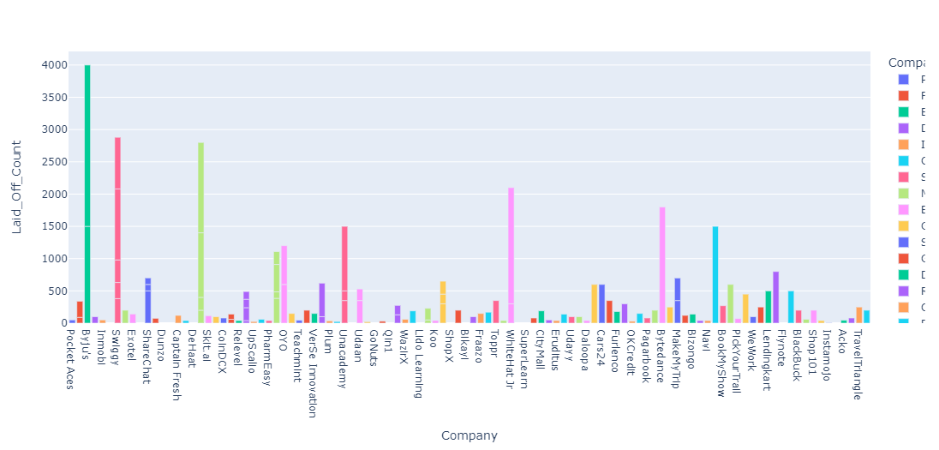
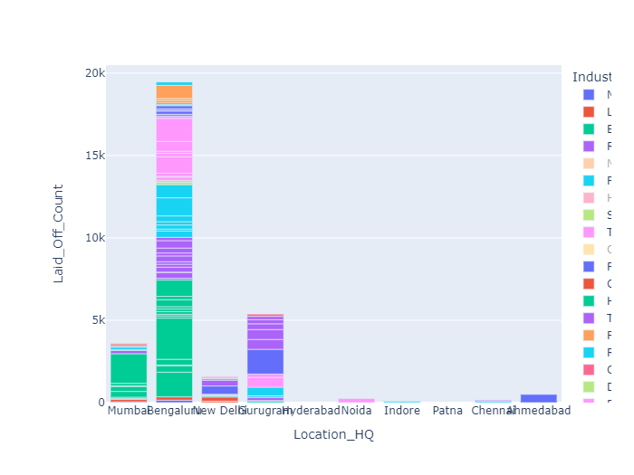
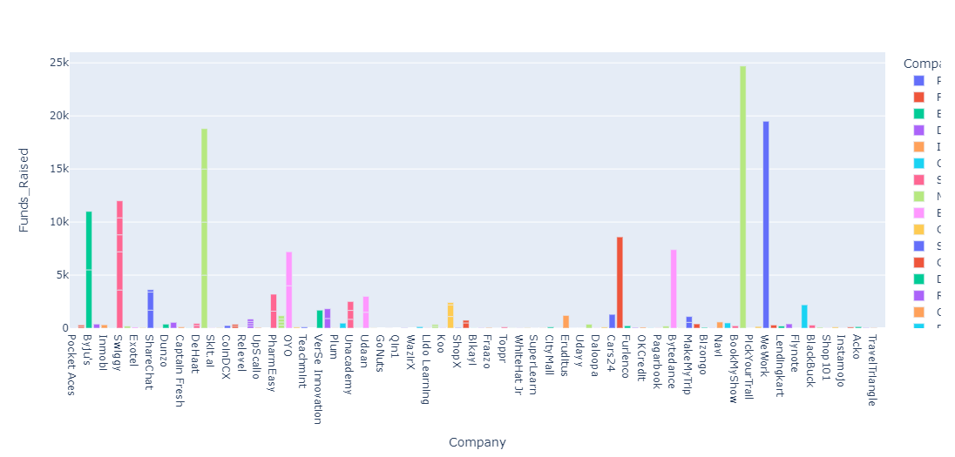
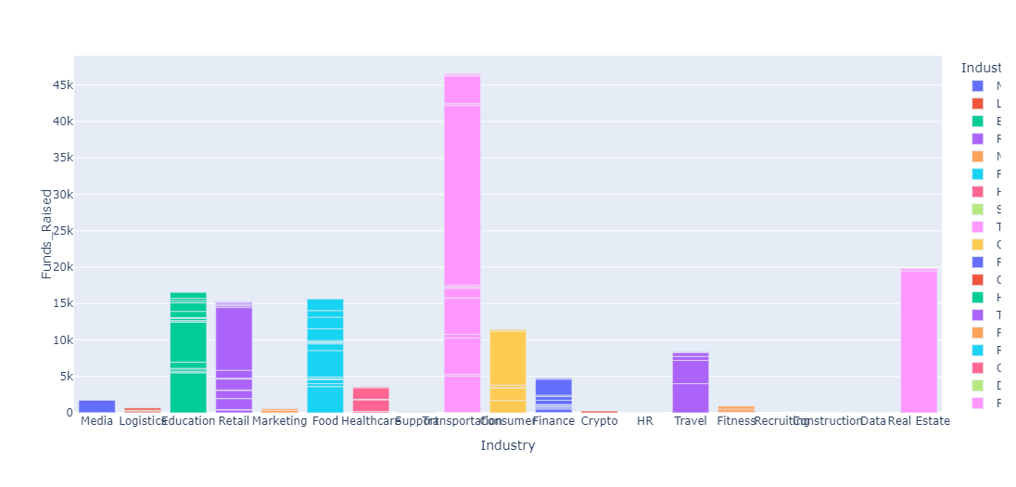
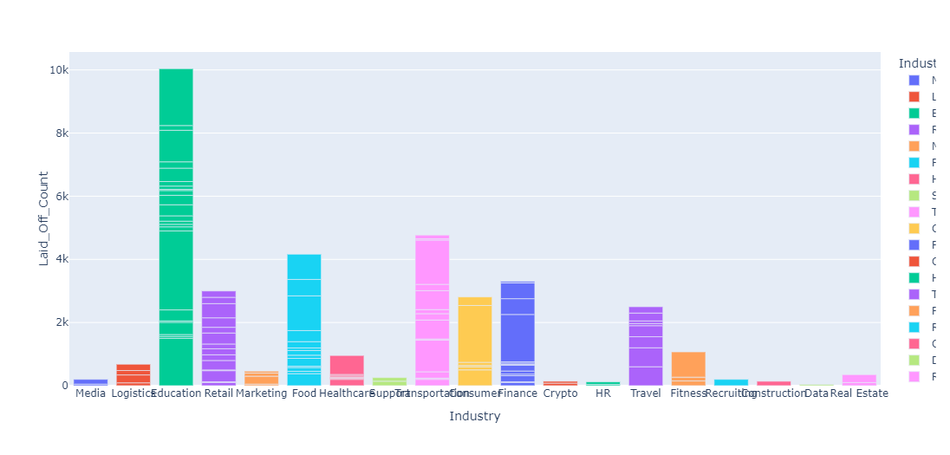
LAYOFF IN INDIA
1
6
2
7
3
8
In total of 106 companies in India itself has involved in laying off employees in 10 different locations.
IT capital of india Bangalore had laid of more employess as most of the companies resided here followed by mumbai and guguram.
India has laid off 35203 employees which is 7.72% in total layoff.
Funds raised by indian companies are around 146370
4
9
5
10

Slide 10
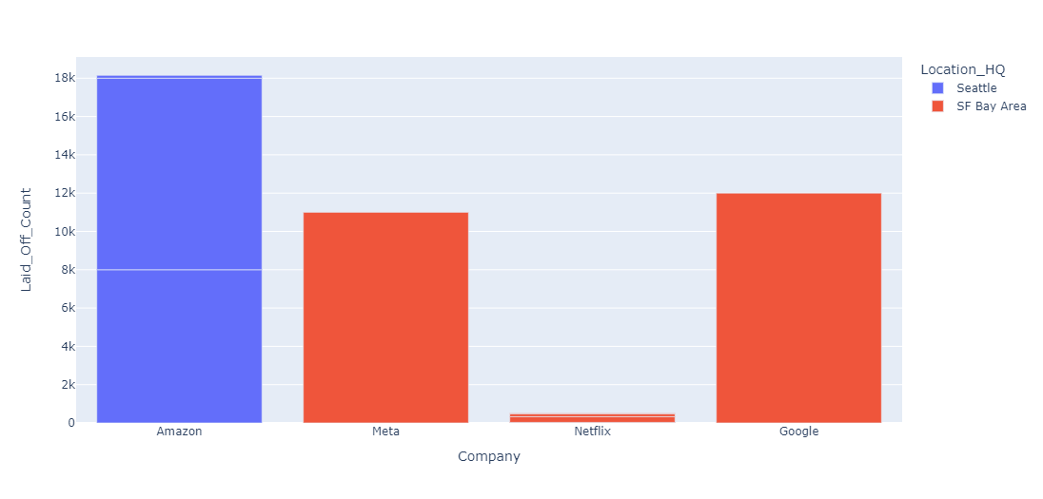
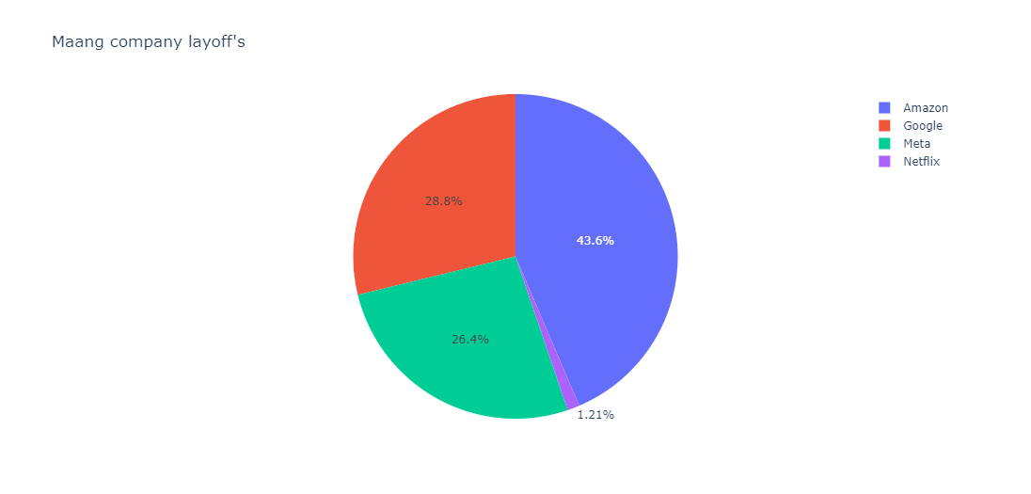
Transportation followed by Real Estate and Education industry in india has raised fund alot because transportation system can broaden the market for goods.
Real estate has raised funds to advertise people to buy as it is a good investment as the shares and crypto has affected and in future it is a good return.
Education industries hs raised funds expanding their teaching in online as every schools were in lockdown so in order to avoid gaps in learning they raised funds.
Most of the education companies are startups and to make company profitable and accountable it has laid off more employees followed by transportation and food industries.
Education sector Byju's transportation company ola followed by food industry swiggy had laid-off more employees.
top 3 companies that raised more funds is ola, uber and wework.
1
6
2
7
3
8
4
9
MAANG COMPANY ANALYSIS
5
10

Slide 11
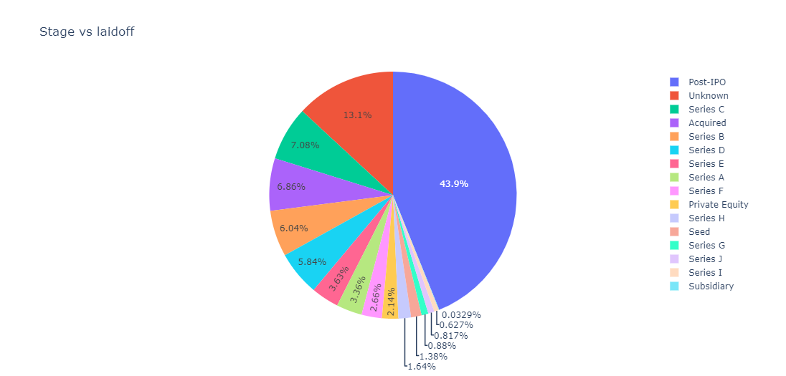
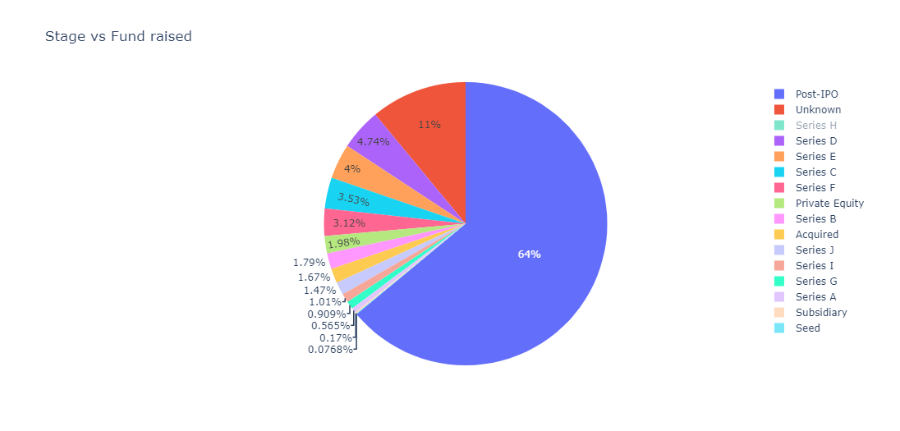
Total in together MAANG companies has laid-off 41655 employees out of 455550 which is 9.14% in total contributing to layoff.
Funds raised in year 2020 and 2021 has no count since these years were affected by covid-19 and year 2023 has small numbers in count as it's the beginning of this year and in 2022 the fund raised is higher and Meta is a provider of social networking, advertising, and business insight solutions has raised more as the covid-19 as the demand in entertainment and urging people who needs to watch social media and entertainment has raised, which in turn contributing this and the development of meta in Metaverse also contributing this.
Amazon - 18150 Meta - 11000 Google - 12000 Netflix - 505 Amazon has laid off more employees to manage this inflation.
1
6
2
7
Stage Post-IPO has laid off more as "Post-IPO" refers to the period after a company's initial public offering of stock.Since the market has crashed it has affected this stage more compared to other.
Funds raised for the stage Post-IPO is more as the shares by a company that's already listed on the stock exchange. It is done to acquire additional capital.so the fund raised for the IPO is higher.
Series C financing is one of the stages in the capital-raising process by a startup, so some startup's requires some fund to process, so it also has some considerable amount raised.
Lay-off happened in Post-IPO is comparatively higher compared to other sectors as most of the Industries falls in Post-IPO and retail and consumer as mentioned previously has highest rate of lay-off.
3
8
4
9
WHICH STAGE HAS MORE LAYOFF
5
10

Slide 12
Thank you

