Slide 1

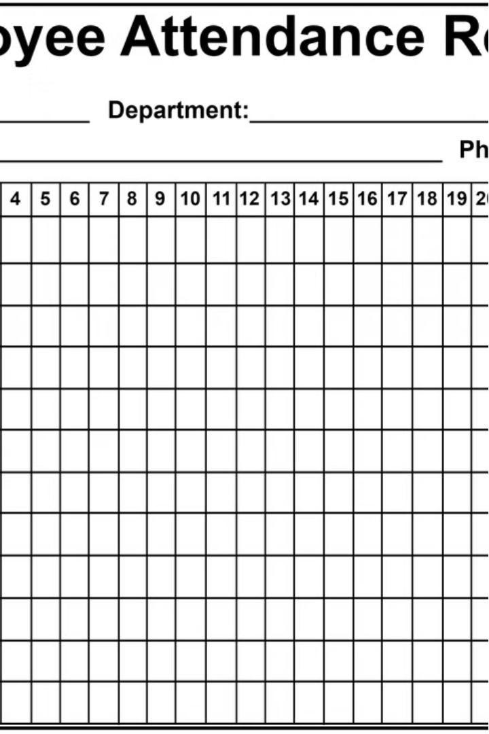
Employee Attendance Tracking
KAVIN V
29/05/2024
Maintaining accurate employee attendance records is crucial for effective workforce management. This presentation will provide a comprehensive overview of implementing a robust attendance tracking system using Python, ensuring your organization stays on top of employee presence and productivity.

Slide 2
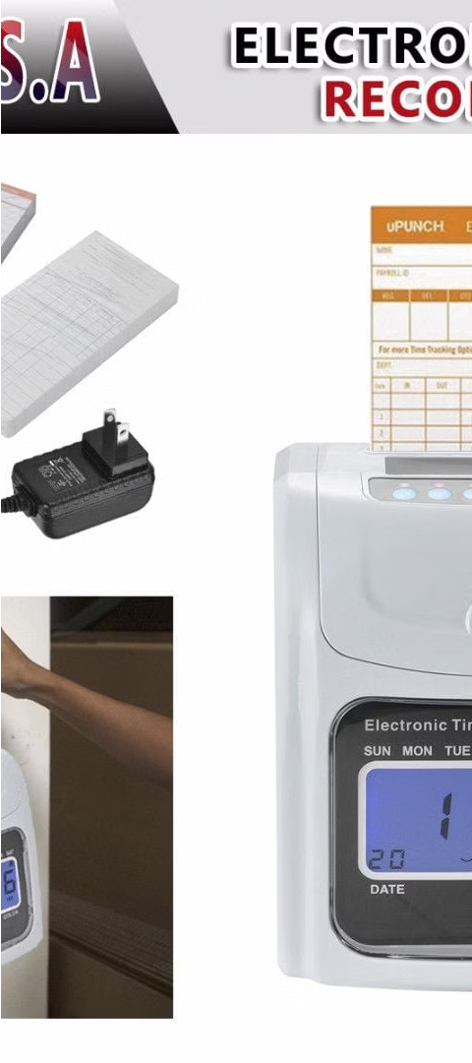
Importance of Attendance Monitoring
1
Payroll Accuracy
2
Productivity Insights
Precise attendance data enables accurate payroll processing, ensuring employees are compensated fairly for their work.
Attendance tracking allows you to identify patterns and optimize workforce utilization for maximum productivity.
3
Compliance and Regulations
Maintaining detailed attendance records helps organizations comply with labor laws and avoid costly penalties.

Slide 3
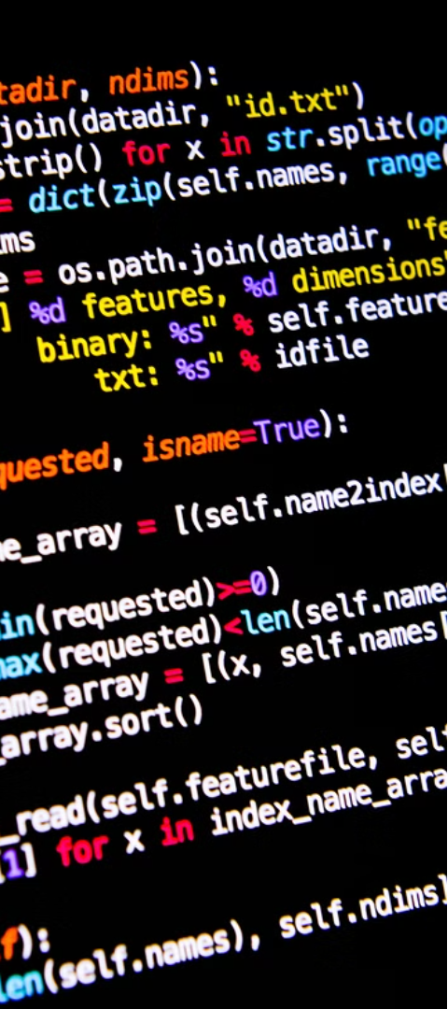
Python as the Programming
Language
Versatile and Powerful
Cross-Platform Compatibility
Python's simplicity and extensive libraries make it an ideal choice for developing attendance tracking systems.
Python's ability to run on multiple operating systems ensures your solution can be deployed seamlessly.
Thriving Developer Community
The active Python community provides a wealth of resources, libraries, and support for your project.

Slide 4
Problem Statement
The existing manual methods are time-consuming, error-prone, and do not provide real-time data access.
This leads to inaccuracies in payroll processing, potential non-compliance with labour laws, and a lack of transparency for both management and employees.
Automating the attendance tracking process using Python can provide a robust solution that improves accuracy, saves time, and enhances overall operational efficiency.
This system is intended to replace traditional manual methods of attendance tracking with a more efficient, accurate, and user-friendly solution.

Slide 5
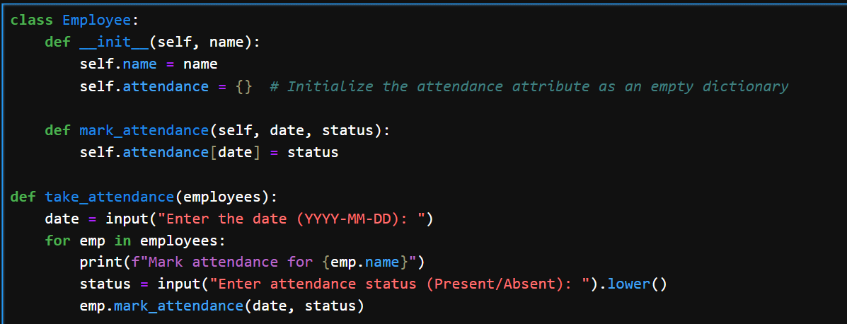
Code Implementation

Slide 6
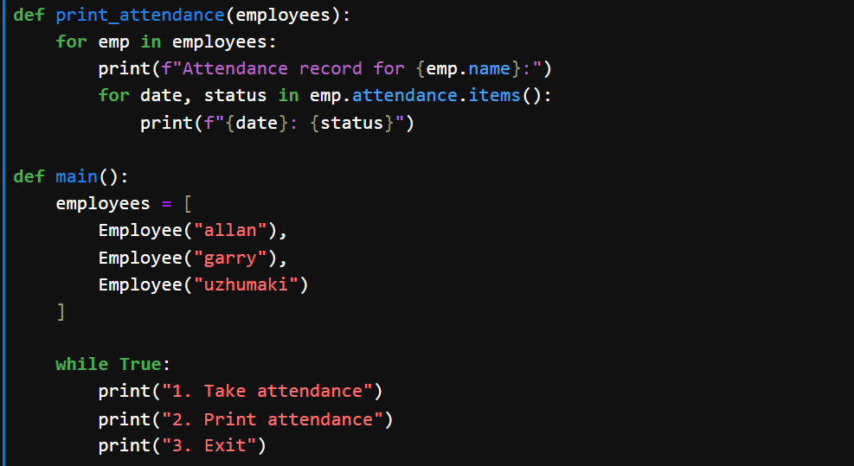

Slide 7
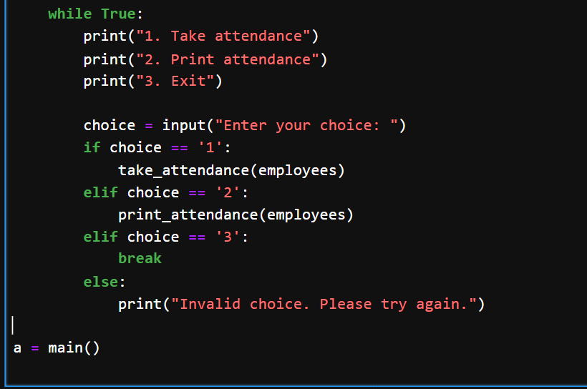

Slide 8
Conclusion
Begin the development process, gather feedback, and continuously improve the attendance tracking solution to meet your organization's evolving needs.

Slide 9
Future Enhancements
Input Validation: Add validation for date formats and attendance status inputs.
Data Storage: Implement persistent data storage to retain attendance records across sessions.
Reporting: Generate detailed attendance reports and analytics.
Integration: Integrate with other HR and payroll systems for seamless data flow.

Slide 10
THANK YOU

