Slide 1

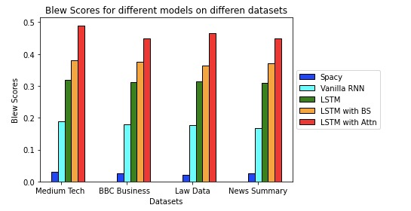
Title Generation using NLP
Aditi Singh (MT19110), Ishita Agarwal (MT19013), Kaamraan Khan (MT19064), Vedant Desai (MT19074)
Introduction
Work Done
Literature Review
Heading plays a vital role for any article as it the first thing that gains reader’s attention. Headline generation is really important as it is the title only that catch the reader’s eyes first. The aim of this project is to develop an architecture that can generate heading for articles, paragraphs, news paper contents, legal documents etc. A generalized model is proposed which makes use of encoder– decoder recurrent neural network architecture consisting of LSTM and attention units.
Dataset collection from diverse domains to make a generic architecture.
Implementation of paper “Automated title generation in English language using NLP”.
Using Simple RNN model to generate Titles.
Implemented LSTM model.
Using LSTM with beam search predicted titles.
Implemented LSTM with attention which is our proposed model , which gave good predictions.
In the paper “Generating News Headlines with RNN”, an encoder-decoder model of RNN with LSTM. The model gave mixed performance.
The paper “Automated title generation using NLP”, gives output by using different approaches such as frequency prioritizing, combination of noun, adjective etc.
In the paper “A neural attention model for abstractive sentence summarization” the authors have applied the local attention model to generate words for the summary based on the input fed to the model.
In the paper “The Impact of Local Attention in LSTM for Abstractive Text Summarization”, the author proposed to use the local attention model together with LSTM.
Input Data
Pre Processing
Bleu score evaluation
Word embedding
Combined feature
Training Architecture
Dataset Used
Dataset used | Description
BBC news data (Business ) | 2225 documents and 737 documents from the BBC news and Sports website respectively.
Medium tech articles | This dataset was scraped from Medium and contains summary and title of the article.
Department of justice press | 13,087 press releases which is scraped from data.gov site of USA using beautiful soup.
All news dataset | Archive.org is used to scrape data from fox news, CNN etc. using beautiful soup
Results
Fig 1. Proposed Architecture
Headlines
Fully connected
Attention
Input
LSTM
(Encoder)
Hidden
LSTM
(Decoder)
The models which out performed all the other models was LSTM with attention. As seen from the graph it gave maximum BLEU score for all the given datasets.
Output
Fig 2. Training Architecture explained

