Slide 1
Electricity Billing System
Submitted in the partial fulfillment for the award of the degree of
BACHELOR OF ENGINEERING
in
COMPUTER SCIENCE - ARTIFICIAL INTELLIGENCE AND MACHINE LEARNING
Submitted by:
RHYTHM GOEL(19BCS6094)
DEPANSHI TOMAR(19BCS6095)
VASUDHA GOYAL(19BCS6097)
KAAMYA SARDA(19BCS6098)
Under the Supervision of:
PRAMOD VISHWAKARMA SIR
Department of AIT-CSE
DISCOVER . LEARN . EMPOWER

Slide 2
Outline
Introduction to Project
Problem Formulation
Objectives of the work
Methodology used
Project Modules
Results and Outputs
Conclusion
Future Scope
References

Slide 3
INTRODUCTION..
Electricity Billing System is a software-based application.
i. This project aims at serving the department of electricity by computerizing the billing system.
ii. It mainly focuses on the calculation of units consumed during the specified time and the money to be charged by the electricity offices.
iii. This computerized system will make the overall billing system easy, accessible, comfortable, and effective for consumers.

Slide 4
INTRODUCTION..
The software provides facility of data sharing, it does not require any staff as in the conventional system. Once it is installed on the system only the meter readings are to be given by the admin where customer can view all details, it has the provision of security restriction.
The electricity billing software calculates the units consumed by the customer and makes bills, it requires small storage for installation and functioning.
The system excludes the need of maintaining paper electricity bill, administrator does not have to keep a manual track of the users, users can pay the amount without visiting the office. Thus, it saves human efforts and resources.

Slide 5
FEATURES
The system would be having two logins: the administrative and user login. The administrator can view the user's account details and can add the customer's information of consuming units of energy of the current month in their account. The Admin must feed the system with the electricity usage data into respective user’s account. The system then calculates the electricity bill for every user and updates the information into their account every month. Users can then view their electricity bill and pay before the month end.

Slide 6
PROBLEM FORMULATION
The manual system is suffering from a series of drawbacks. Since whole of the bills is to be maintained with hands the process of keeping and maintaining the information is very tedious and lengthy to customer. It is very time consuming and laborious process because, staff need to be visited the customers place every month to give the bills and to receive the payments. For this reason, we have provided features Present system is partially automated(computerized), existing system is quite laborious as one must enter same information at different places.

Slide 7
OBJECTIVES
The manual meter reading and bill data entry process is automated.
To reduce data collection costs.
To improve meter reading accuracy.
To enable faster, more efficient reading times and billing process.
To improve customer service and enable conservation of resources.
To provide accurate information to the customer
To keep the information of the consuming unit of energy of current month.

Slide 8
METHODOLOGY USED
Gather data and knowledge about the previous approaches / existing models .
Research regarding relevant domains and papers for enriching domain knowledge.
Constitution of the dataset after cleansing raw data.
Implementing Java Swing for making web pages.
Adding dataset to those programs for working of the system.
Adding additional functionalities to the system.
Granting required access to user depending on whether they are admin or a consumer.

Slide 9
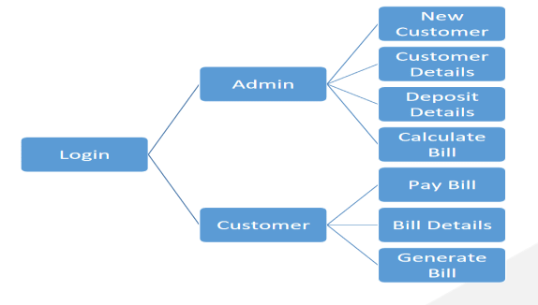
Modules of the project

Slide 10
Login:
This module allows customer and admin to login using their credentials. If the entered credentials are correct, then the login will be successful otherwise need to be signup with the meter_no which is given by admin.
Sign Up :
The customer can sign-up and create their account for bill payment using meter no.
New Customer:
This module allows admin to add new customer .
Customer Details:
This module shows details of the customer to admin.

Slide 11
Deposit Details:
This module shows the the paid/unpaid status of all customer’s bill.
Calculate Bill:
This module allows admin to calculate the bill of user by entering the meter readings.
Pay Bill:
This module allows user to pay their monthly bill.
Bill Details:
This module display the monthly bill and its status to user.
Generate Bill:
This module gives the detailed bill to the customer.

Slide 12
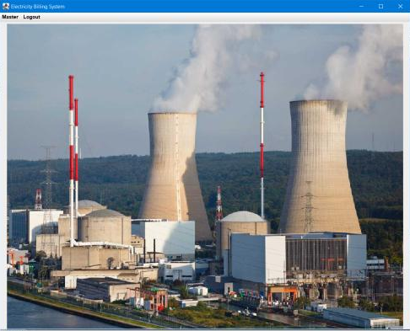
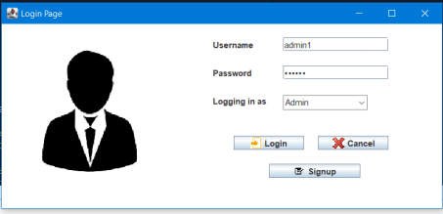
Results and Outputs
Login (as admin)

Slide 13

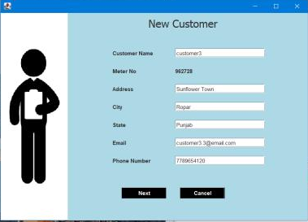
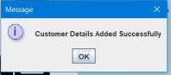
Admin adding new customer details.

Slide 14
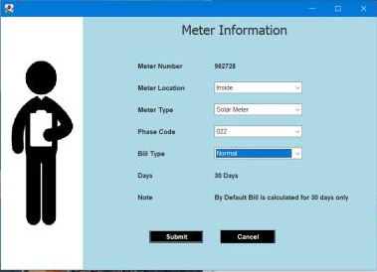
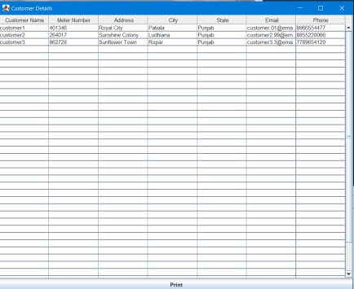
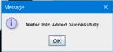
Entering meter information of customer.
Customer Details

Slide 15
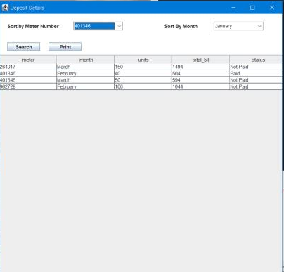
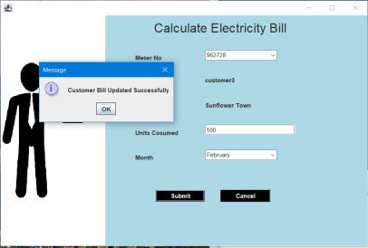
Customer Bill Details
Calculating Customers' Bill

Slide 16
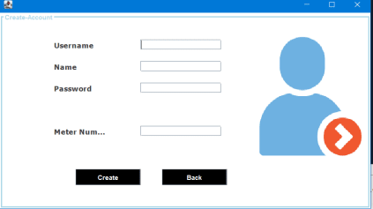
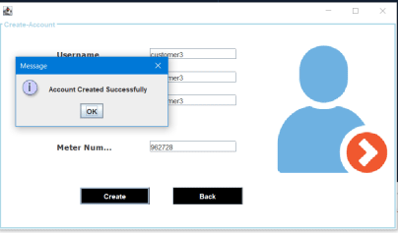
Customer can create an account using their meter number

Slide 17

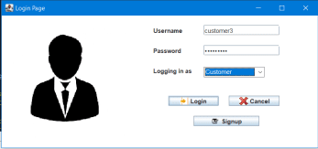
Login as Customer

Slide 18
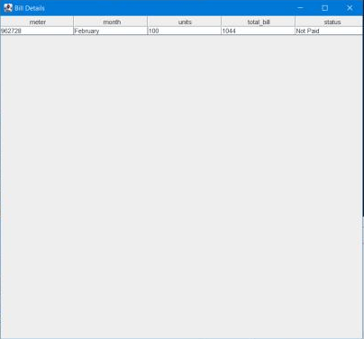
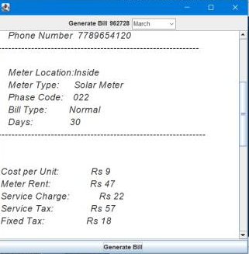
Customer Bill Details
Customers' Bill Receipt

Slide 19
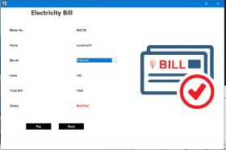
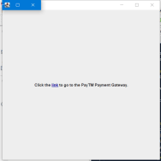
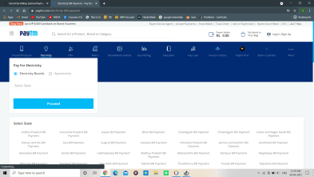

Paytm Gateway link
Bill Pay Window
Customer Bill Details

Slide 20
CONCLUSION
Using this system the operators would get rid of manual time consuming bill calculation.
Moreover, a manual procedure for electricity bill calculation becomes ineffective as it requires the utilization of a lot of resources; so this automated system would be beneficial in terms of cost as well as time consumption.
It is simple and user friendly. Since this system is implemented in Java, it is platform independent
The accuracy and reliability are surely increased. It makes sure that unauthorized personal cannot execute this program. This system provides secured processing without any threats.

Slide 21
FUTURE SCOPE
We can add functionalities like automated meter reading collection.
To make it more user friendly we can add more features like updating the customer information, help customer to recover password, notify customer to pay their bill.
Another features like allow admin to delete the customer record can be added.
Other features like error reporting or allowing customer to send a feedback .
We can make it more secure by adding two-step verfication method.

Slide 22
References
https://www.freeprojectz.com/project-source-code-database-download/electricity-billing-system-project
https://www.youtube.com/watch?v=iL_5MhKSSN0&list=PL5BFcXE899zxmT9vmSuleorXKrxj OOErp (Code for Interview YouTube Channel)
http://www.github.com
www.youtube.com
www.stackoverflow.com
www.google.com
http://www.javatpoint.com/

