Slide 1
ACM476 TERM PROJECT PHASE 1
Melbourne Housing
Kaan Akkök, Hasan Emir Çilesiz
14.05.2025

Slide 2
Content
1
Introduction
2
Preprocessing of data
3
EDA
4
Clustering

Slide 3
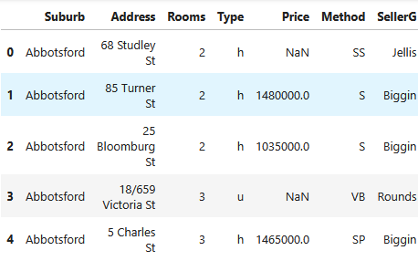
Introduction:
The aim of this project is to analyze and predict house prices in Melbourne (Australia) using various data mining techniques, including preprocessing, regression, classification, clustering, feature selection, and dimensionality reduction.
Dataset Information:
Data Source: Kaggle – Melbourne Housing Dataset
Total Observations: 34,857
Sample Used: 2,000 rows (random_state=5006)
Number of Features (columns): 21, These are:
[o: object, i: integer, f: float]
Suburb (o), Address (o), Rooms (i), Type (o), Price (f), Method (o), SellerG (o), Date (o), Distance (f), Postcode (f), Bedroom2 (f), Bathroom (f), Car (f), Landsize (f), BuildingArea (f), YearBuilt (f), CouncilArea (o), Lattitude (f), Longtitude (f), Regionname (o), Propertycount (f)

Slide 4
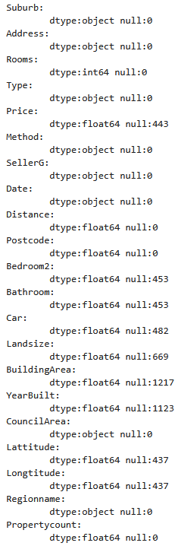
Preprocessing of data:
We identified missing values from the sample dataset in the following columns:
“Price”: 443
“Bedroom2”: 453
“Bathroom”: 453
“Car”: 482
“Landsize”: 669
“BuildingArea”: 1217
“YearBuilt”: 1123
“Lattitude”: 437
“Longtitude”: 437
These are all numerical variables. There is no missing values on categorical variables.

Slide 5
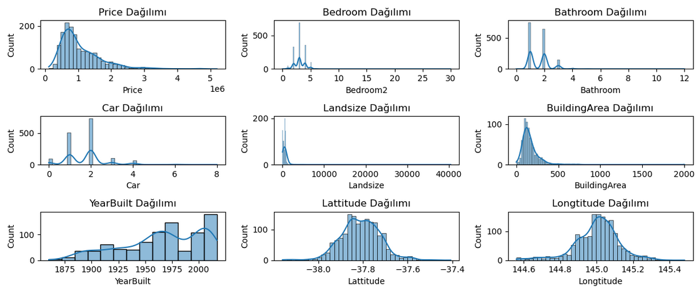
Preprocessing of data:
We inspected the graph showing the distribution of missing values to determine how to fill them.
“Price”: Filled with the average price of properties that have the same number of 'Rooms'.
“Bedroom2” : (numeric categorical value) Filled missing values with the most frequent value (mode).
“Bathroom”: (numeric categorical value) Filled missing values with the most frequent value (mode).
“Car”: (numeric categorical value) Filled missing values with the most frequent value (mode).
“Landsize”: Filled missing values with the average landsize of properties in the same 'Suburb'.
“BuildingArea”: Filled missing values with the average BuildingArea of properties in the same 'Rooms'.
“YearBuilt”: Filled missing values with the median year.
“Lattitude” and “Longtitude”: Filled missing values with the average Lattitude and Longtitude values of properties in the same 'Suburb'.

Slide 6
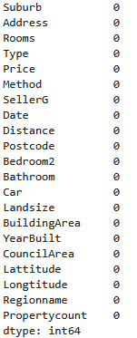
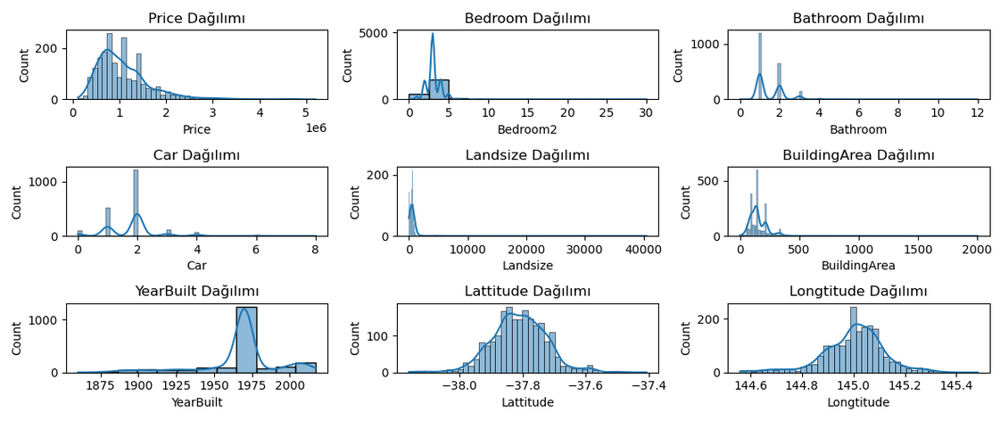
Preprocessing of data:
After the handling the missing values, we saved the sample dataset.

Slide 7
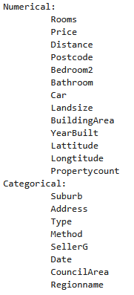
EDA:
We separated numerical and categorical columns:
We applied detailed statistics for numerical columns
We found the unique values in the categorical columns and noticed that 'address' has too many unique values. For this reason, we concluded that 'address' is unnecessary.
We graphed the distribution of numerical values and noticed that “Bedroom2”, “Bathroom” and “Car” values behave like categorical values.
We graphed the distribution of categorical values.
We graphed the comparison between “Price” and other numerical variables.
We graphed the comparison between “Price” and categorical variables and noticed that “Type”, “Method” and “Regionname” are related to “Price”.
We graphed the distribution of house type based on region name.
We have created a table showing the which types of houses are sold more frequently in each region and by which method.
We have created a table showing the number of houses sold by sellers in different areas.

Slide 8
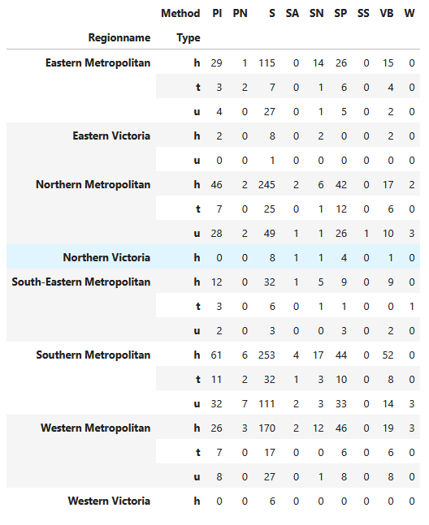
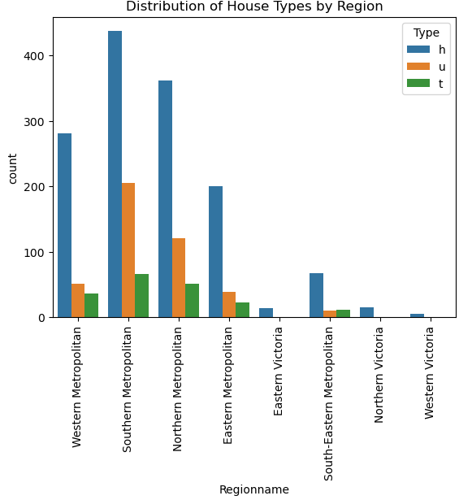
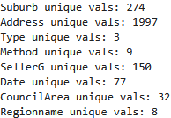
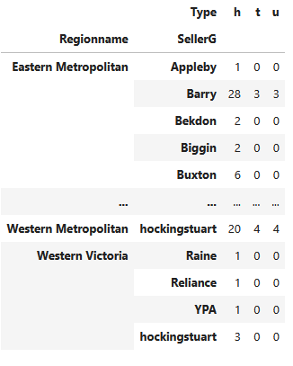
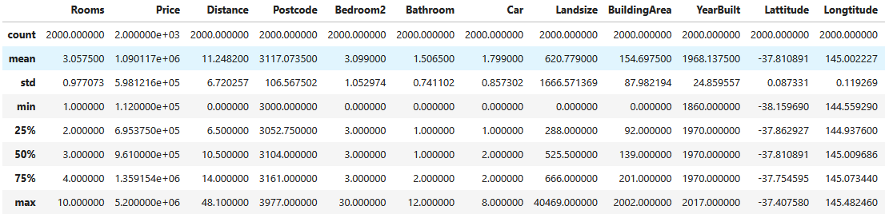
EDA:

Slide 9
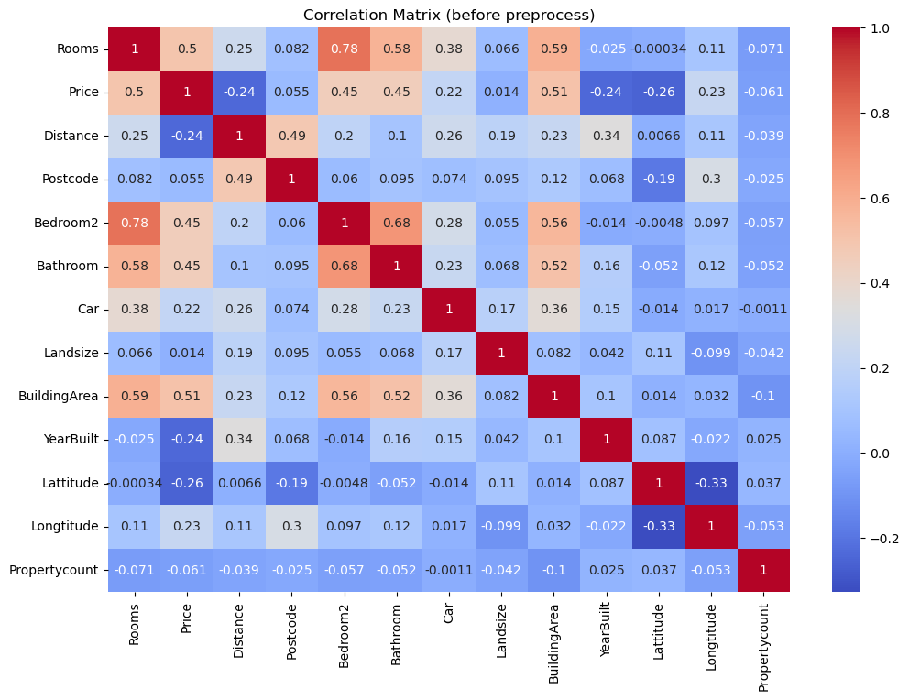
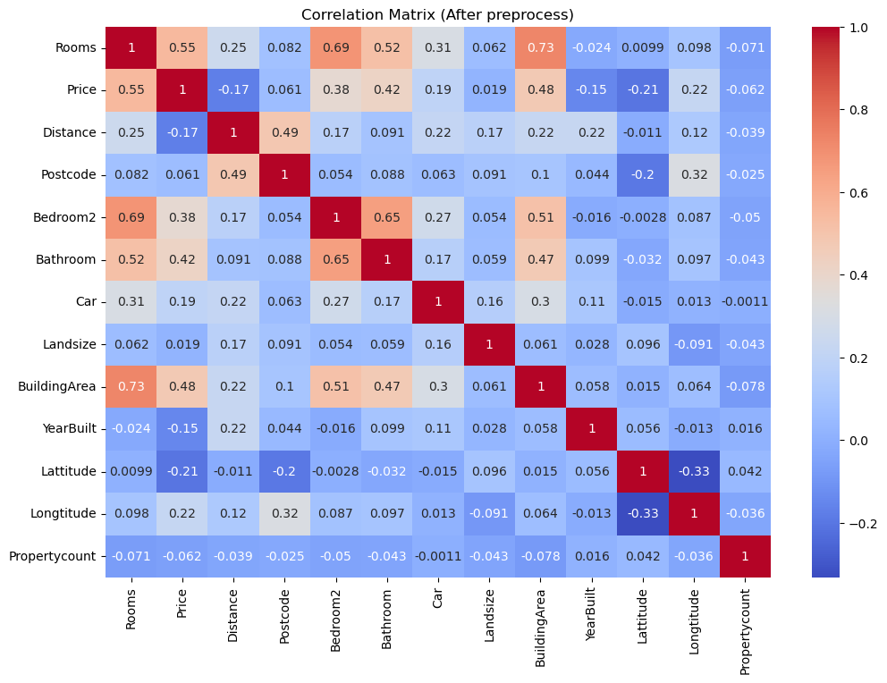
EDA:

Slide 10

Clustering
After removing the class label and non-numerical features, we used the remaining 12 numerical attributes. These features represent the physical and locational characteristics of the properties
ROOMS
DISTANCE
POSTCODE
BEDROOM2
BATHROOM
CAR
LANDSIZE
BUILDINGAREA
YEARBUILT
LATTITUDE
LONGTITUDE PROPERTYCOUNT
INT64
FLOAT64
INT64
INT64
INT64
INT64
INT64
INT64
INT64
FLOAT64
FLOAT64
INT64
--- Necessity of the Stardartization
In our dataset, features like 'Landsize' and 'BuildingArea' have much larger scales compared to features like 'Bathroom' or 'Car'.
Without standardization, these large-scale features would dominate the clustering process and distort the grouping structure.

Slide 11
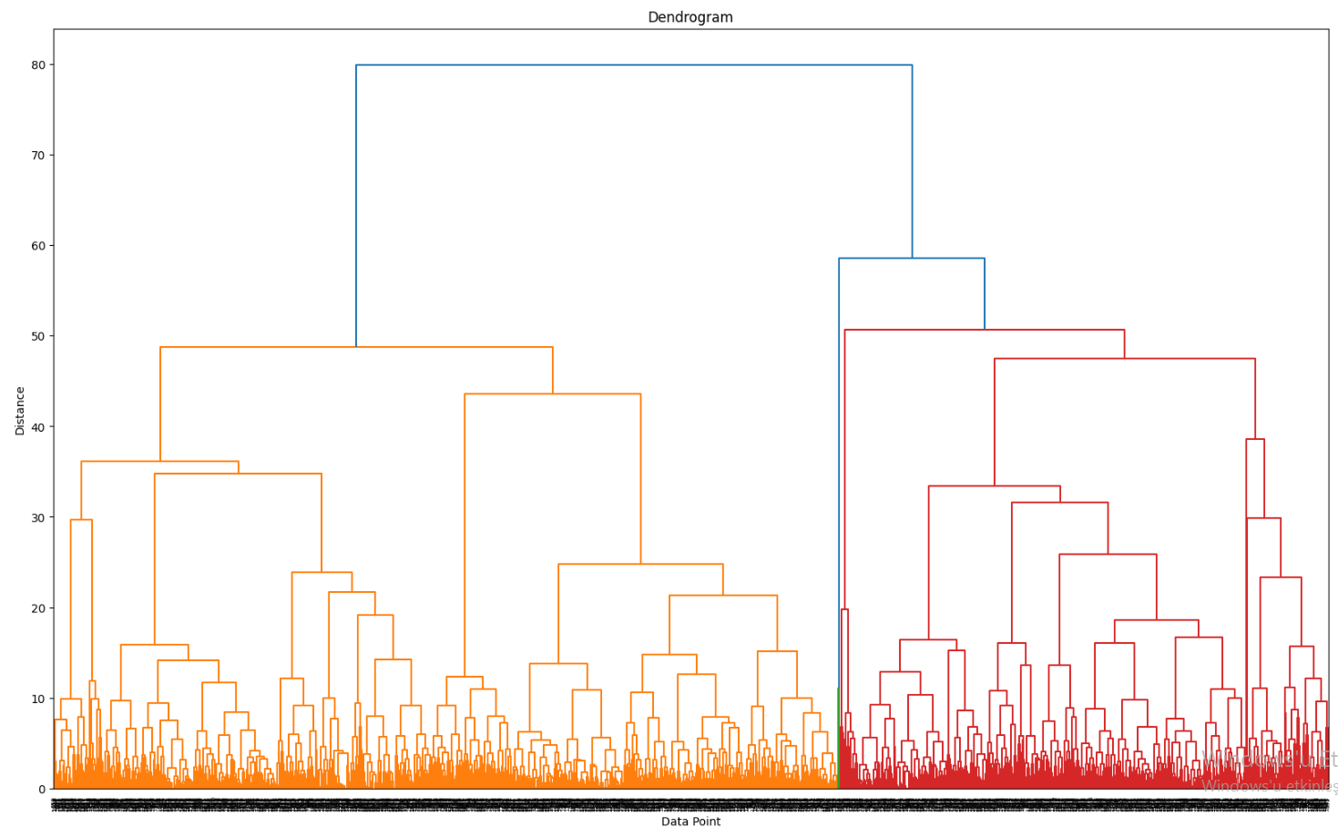
Dendrogram

Slide 12
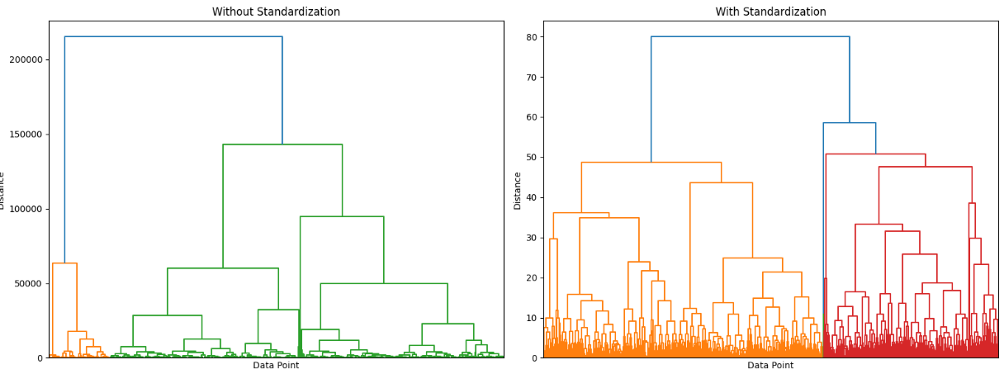
Impact of Stardardization

