Slide 1

CSE_445_Image_Processing Final Project Submission
Tuna Bahadır 220610018
Kaan Türk 220611028

Slide 2
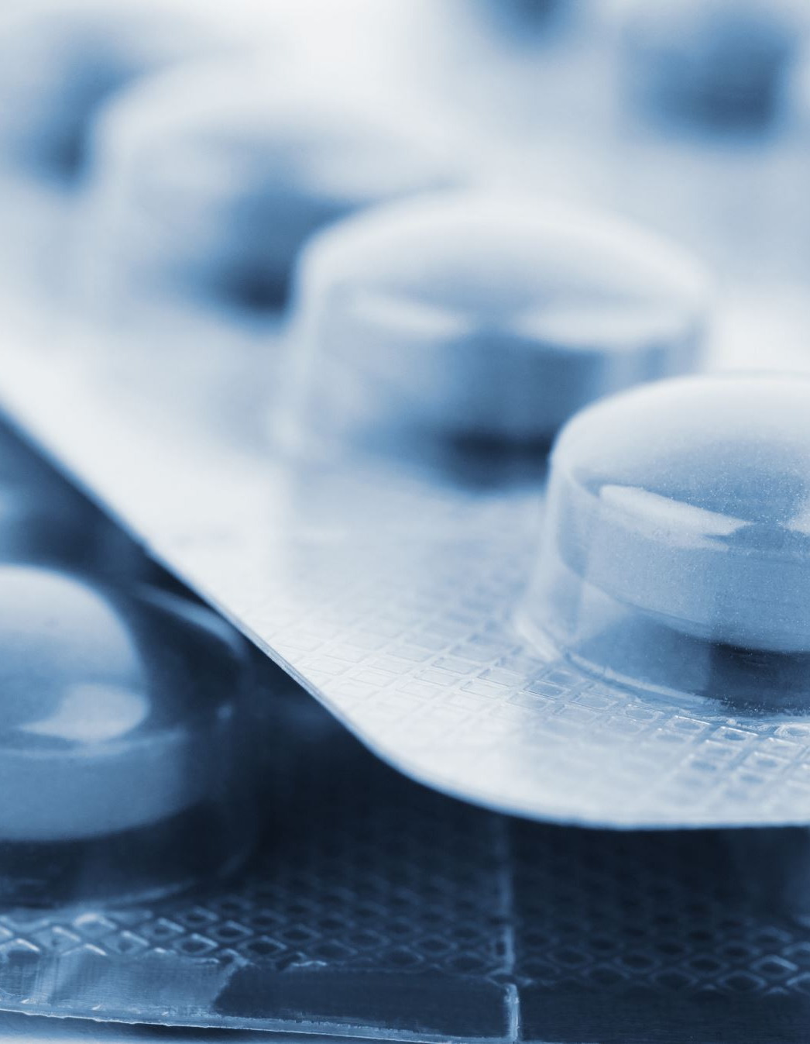
Problem Definition
Overview: Counterfeit drugs pose a global health threat. These counterfeit drugs can lead to patients receiving incorrect diagnosis and treatment, antibiotic resistance, and even death. Detecting counterfeit drugs is crucial for protecting public health.
Current Problems:
Manual barcode verification: The traditional method of detecting counterfeit drugs is manual barcode verification by pharmacists. This method is time-consuming, prone to errors, and difficult to implement on a large scale.
Lack of a database: There is a lack of a central database containing information about counterfeit drugs. This makes it difficult to detect and track counterfeit drugs.
Easily counterfeitable barcodes: Counterfeit drug manufacturers can easily counterfeit original barcodes. This limits the effectiveness of counterfeit drug detection systems based on barcode verification.

Slide 3
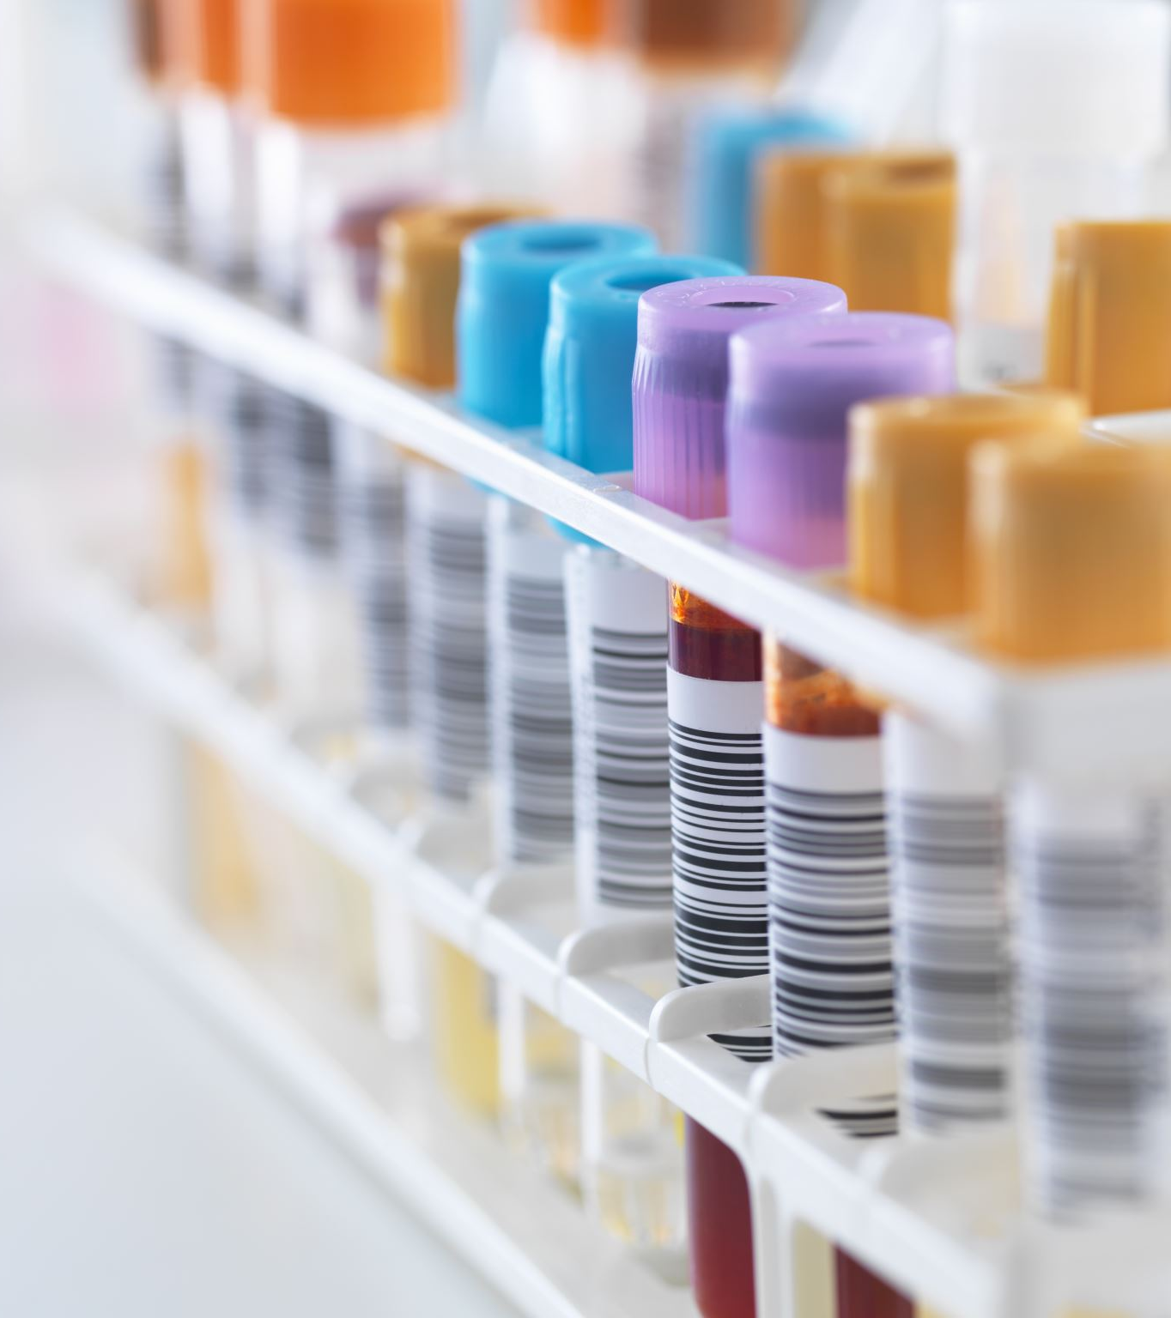
Problem Solution
Proposed Solution:
A barcode comparison solution can help improve counterfeit drug detection by addressing these issues.
This solution would consist of the following:
Automatic barcode reading: An automatic barcode reader will be able to read the barcodes of drugs quickly and accurately.
Central database: A central database containing information about counterfeit drugs will be created. This database will be compared to the barcodes read by the automatic barcode reader.
Advanced barcode verification algorithms: Advanced barcode verification algorithms will be developed to distinguish original barcodes from counterfeit ones.

Slide 4

Benefits and Conclusion
Benefits:
Improved efficiency: Counterfeit drug detection will be faster and more efficient with the use of automatic barcode reading and a central database.
Increased accuracy: Counterfeit drug detection will be more accurate with the use of advanced barcode verification algorithms. Better tracking: A central database will help track the source of counterfeit drugs and apprehend counterfeiters.
Conclusion:
A barcode comparison solution is a promising approach that can help improve counterfeit drug detection and protect public health. With automatic barcode reading, a central database, and advanced barcode verification algorithms, this solution can provide an effective tool in the fight against the global threat of counterfeit drugs.

Slide 5
Literature Review
Summaries of International Articles on Fake Medicine Detection using Image Processing
Universal Detection Method: An article published in "Sensors" presents a universal method for detecting fake images and adversarial examples. This method involves observing the output distribution differences between normal and fake samples, encompassing both detector training and online detection stages. Using CIFAR10 and CIFAR100 datasets, experiments demonstrated that the detector effectively generalizes across different model structures and accurately detects fake images. This method can be applied to detect fake medicines, potentially achieving high accuracy rates (MDPI).
Medify Solution: The "Medify" solution, featured on the MIT Solve platform, aims to tackle the fake medicine problem in Bangladesh using a barcode detection machine and an image processing algorithm-based Android app. This solution targets pharmaceutical manufacturers, medicine vendors, and the general public to identify counterfeit medicines. Fake medicines are detected using unique barcodes on medicine packets and pre-defined image processing algorithms. Supported by cloud server databases, this solution aims to reduce and eventually eliminate fake medicine production (MIT SOLVE).
These articles offer different approaches to fake medicine detection, highlighting the significant role of image processing technologies in addressing this issue. These technologies provide effective solutions for both industrial and individual users in the pharmaceutical sector.

Slide 6
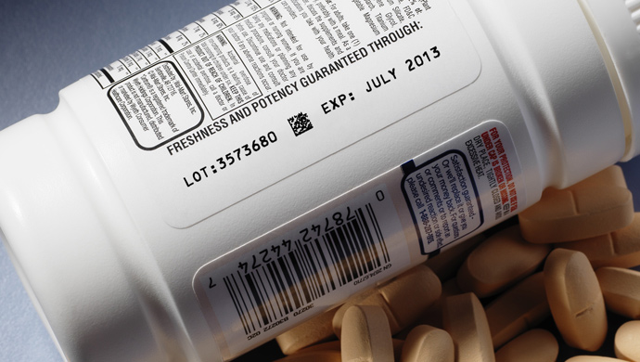
Why Using This Method?
We use this solution because counterfeit drugs pose a significant threat to the healthcare sector, jeopardizing consumer health and undermining trust in the healthcare system. Counterfeit drugs often manipulate the barcodes on their packaging to appear as genuine products. The barcode comparison solution offers a quick and effective method to prevent this dangerous situation. This method involves reading the barcodes on drug packaging using a camera and comparing these barcodes with those in a relevant database of genuine barcodes. In this way, the authenticity of the drug can be quickly verified, and counterfeit drugs can be easily detected and prevented from being marketed. This solution protects consumer health, enhances reliability and quality standards in the healthcare sector, and minimizes the negative impacts that counterfeit drugs can cause.

Slide 7
Algorithms That Used to Solve Problem
To solve this problem, various algorithms in the field of image processing are used. Here are some of these algorithms:
1)Barcode Detection and Reading:
Barcode Detection: Edge detection algorithms (e.g., Canny Edge Detection) are used to identify the location of the barcode in the image. Once the edges are detected, specific patterns such as the horizontal lines of the barcode are searched.
Barcode Reading: Barcode reading libraries (e.g., ZBar or pyzbar) are used to convert the detected barcode region's lines into numerical data.
2)Preprocessing:
Grayscale Conversion: Converts the color image to grayscale to reduce processing load and facilitate easier analysis.
Noise Reduction: Filters like Gaussian Blur or Median Filter are used to reduce noise in the image.
Thresholding: A specific threshold value is used to binarize the image, making the barcode more prominent.
3)Barcode Detection:
Hough Transform: Used to detect straight lines in the image. This method can be effective in finding the vertical lines of the barcode.
Contour Detection: Contour detection algorithms are used to determine the perimeter of the barcode, helping to isolate the barcode region.
4)Barcode Verification and Comparison:
Optical Character Recognition (OCR): OCR technology can be used to read the numerical or alphanumeric information contained in the barcode.
Database Comparison: The read barcode data is compared with the original barcode information in the database. If no match is found, the drug is likely to be counterfeit.

Slide 8
References
[1] Gonzalez, R. C., & Woods, R. E. (2008). Digital Image Processing (3rd ed.). Pearson.
[2] Jain, A. K. (1989). Fundamentals of Digital Image Processing. Prentice Hall.
[3] Canny, J. (1986). A Computational Approach to Edge Detection. IEEE Transactions on Pattern Analysis and Machine Intelligence, PAMI-8(6), 679-698.
[4] Haralick, R. M., Shanmugam, K., & Dinstein, I. (1973). Textural Features for Image Classification. IEEE Transactions on Systems, Man, and Cybernetics, SMC- 3(6), 610-621.
[5] Ojala, T., Pietikäinen, M., & Harwood, D. (1996). A Comparative Study of Texture Measures with Classification Based on Featured Distributions. Pattern Recognition, 29(1), 51-59.
[6] Smith, A. R. (1978). Color Gamut Transform Pairs. Computer Graphics, 12(3), 12- 19.
[7] Gonzalez, R. C., & Woods, R. E. (2008). Digital Image Processing (3rd ed.). Pearson.
[8] Breiman, L. (2001). Random Forests. Machine Learning, 45(1), 5-32.
[9] LeCun, Y., Bengio, Y., & Hinton, G. (2015). Deep Learning. Nature, 521(7553), 436-444.
[10] www.chatgpt.com
[11] https://gemini.google.com/app/487db94270da6566?hl=tr

