Slide 1
Adaptive Mail: A Flexible Email Client App
Submitted by
Dina. R
Fredrick Joe. T
Gowsin . S
Mohamed Faiz . J

Slide 2
GitHub link :
https://github.com/Fredrickjoe-27/Flexible-mail-app.git

Slide 3
DISCRIPTION Adaptive Mail is an innovative email client designed to enhance productivity and provide users with a seamless, customizable email experience. Built with flexibility and efficiency in mind, Adaptive Mail caters to both personal and professional communication needs. Key Features:
-Multi-Account Support : Easily manage multiple email accounts from various providers in a unified interface. -Customizable Interface : Tailor the app’s layout, themes, and notification settings to suit your workflow. -Smart Inbox : Automatically categorize emails (e.g., Primary, Social, Promotions) for better organization and focus. -Offline Mode : Access, draft, and queue emails without an active internet connection, ensuring productivity anywhere. - Advanced Search : Quickly find specific emails or attachments using robust search filters and AI-powered suggestions. -Secure and Private : Incorporates end-to-end encryption, secure login options, and regular updates to protect user data. -Integration with Productivity Tools : Sync with calendars, task managers, and cloud storage platforms for enhanced functionality. -Accessibility : Designed with user-friendly features like voice commands, adjustable text sizes, and dark mode.

Slide 4
Package com.example.adaptivemail import android.os.Bundle import androidx.activity.ComponentActivity import androidx.activity.compose.setContent import androidx.activity.enableEdgeToEdge import androidx.compose.foundation.layout.fillMaxSize import androidx.compose.foundation.layout.padding import androidx.compose.material3.Scaffold import androidx.compose.material3.Text import androidx.compose.runtime.Composable import androidx.compose.ui.Modifier import androidx.compose.ui.tooling.preview.Preview importcom.example.adaptivemail.ui.theme.AdaptiveMailTheme import java.lang.reflect.Modifier class MainActivity : ComponentActivity() { override fun onCreate(savedInstanceState: Bundle?) { super.onCreate(savedInstanceState) enableEdgeToEdge() setContent AdaptiveMailTheme { Scaffold( modifier = Modifier.fillMaxSize() ) { innerPadding Greeting(name = “Android”,modifier = Modifier.padding(innerPadding) ) }
}
}
}

Slide 5
Package com.example.emailapplication import android.annotation.SuppressLint import android.content.ContentValues import android.content.Context import android.database.Cursor import android.database.sqlite.SQLiteDatabase import android.database.sqlite.SQLiteOpenHelper // Define a data class to represent the User object data class User( val id: Int, val firstName: String, val lastName: String, val email: String, val password: String ) class UserDatabaseHelper(context: Context) : SQLiteOpenHelper(context, DATABASE_NAME, null, DATABASE_VERSION) { companion object { private const val DATABASE_VERSION = 1 private const val DATABASE_NAME = “UserDatabase.db” private const val TABLE_NAME = “user_table” private const val COLUMN_ID = “id” private const val COLUMN_FIRST_NAME = “first_name” private const val COLUMN_LAST_NAME = “last_name” private const val COLUMN_EMAIL = “email” private const val COLUMN_PASSWORD = “password” }

Slide 6
override fun onCreate(db: SQLiteDatabase?) { val createTable = “”” CREATE TABLE $TABLE_NAME ( $COLUMN_ID INTEGER PRIMARY KEY AUTOINCREMENT, $COLUMN_FIRST_NAME TEXT, $COLUMN_LAST_NAME TEXT, $COLUMN_EMAIL TEXT, $COLUMN_PASSWORD TEXT ) “”” db?.execSQL(createTable) } override fun onUpgrade(db: SQLiteDatabase?, oldVersion: Int, newVersion: Int) { db?.execSQL(“DROP TABLE IF EXISTS $TABLE_NAME”) onCreate(db) } fun insertUser(user: User) { val db = writableDatabase val values = ContentValues().apply { put(COLUMN_FIRST_NAME, user.firstName) put(COLUMN_LAST_NAME, user.lastName) put(COLUMN_EMAIL, user.email) put(COLUMN_PASSWORD, user.password) } db.insert(TABLE_NAME, null, values) db.close() }

Slide 7
@SuppressLint(“Range”) fun getUserByUsername(username: String): User? { val db = readableDatabase val cursor: Cursor = db.rawQuery( “SELECT * FROM $TABLE_NAME WHERE $COLUMN_FIRST_NAME = ?”, arrayOf(username) ) var user: User? = null if (cursor.moveToFirst()) { user = User( id = cursor.getInt(cursor.getColumnIndex(COLUMN_ID)), firstName = cursor.getString(cursor.getColumnIndex(COLUMN_FIRST_NAME)), lastName = cursor.getString(cursor.getColumnIndex(COLUMN_LAST_NAME)), email = cursor.getString(cursor.getColumnIndex(COLUMN_EMAIL)), password = cursor.getString(cursor.getColumnIndex(COLUMN_PASSWORD)) ) } cursor.close() db.close() return user }

Slide 8
@SuppressLint(“Range”) fun getUserById(id: Int): User? { val db = readableDatabase val cursor: Cursor = db.rawQuery( “SELECT * FROM $TABLE_NAME WHERE $COLUMN_ID = ?”, arrayOf(id.toString()) ) var user: User? = null if (cursor.moveToFirst()) { user = User( id = cursor.getInt(cursor.getColumnIndex(COLUMN_ID)), firstName = cursor.getString(cursor.getColumnIndex(COLUMN_FIRST_NAME)), lastName = cursor.getString(cursor.getColumnIndex(COLUMN_LAST_NAME)), email = cursor.getString(cursor.getColumnIndex(COLUMN_EMAIL)), password = cursor.getString(cursor.getColumnIndex(COLUMN_PASSWORD)) ) } cursor.close() db.close() return user }

Slide 9
@SuppressLint(“Range”) fun getAllUsers(): List<User> { val users = mutableListOf<User>() val db = readableDatabase val cursor: Cursor = db.rawQuery(“SELECT * FROM $TABLE_NAME”, null) if (cursor.moveToFirst()) { do { val user = User( id = cursor.getInt(cursor.getColumnIndex(COLUMN_ID)), firstName = cursor.getString(cursor.getColumnIndex(COLUMN_FIRST_NAME)), lastName = cursor.getString(cursor.getColumnIndex(COLUMN_LAST_NAME)), email = cursor.getString(cursor.getColumnIndex(COLUMN_EMAIL)), password = cursor.getString(cursor.getColumnIndex(COLUMN_PASSWORD)) ) users.add(user) } while (cursor.moveToNext()) } cursor.close() db.close() return users } }

Slide 10
Plugins { id ‘com.android.application’ id ‘org.jetbrains.kotlin.android’ } android { namespace ‘com.example.emailapplication’ compileSdk 33 defaultConfig { applicationId “com.example.emailapplication” minSdk 21 targetSdk 33 versionCode 1 versionName “1.0” testInstrumentationRunner “androidx.test.runner.AndroidJUnitRunner” vectorDrawables { useSupportLibrary true } } buildTypes { release { minifyEnabled false proguardFiles getDefaultProguardFile(‘proguard-android-optimize.txt’), ‘proguard-rules.pro’ } }

Slide 11
compileOptions { sourceCompatibility JavaVersion.VERSION_1_8 targetCompatibility JavaVersion.VERSION_1_8 } kotlinOptions { jvmTarget = ‘1.8’ } buildFeatures { compose true } composeOptions { kotlinCompilerExtensionVersion ‘1.2.0’ } packagingOptions { resources { excludes += ‘/META-INF/{AL2.0,LGPL2.1}’ } } }

Slide 12
Dependencies { implementation ‘androidx.core:core-ktx:1.7.0’ implementation ‘androidx.lifecycle:lifecycle-runtime-ktx:2.3.1’ implementation ‘androidx.activity:activity-compose:1.3.1’ implementation “androidx.compose.ui:ui:$compose_ui_version” implementation “androidx.compose.ui:ui-tooling-preview:$compose_ui_version” implementation ‘androidx.compose.material:material:1.2.0’ implementation ‘androidx.room:room-common:2.5.0’ implementation ‘androidx.room:room-ktx:2.5.0’ testImplementation ‘junit:junit:4.13.2’ androidTestImplementation ‘androidx.test.ext:junit:1.1.5’ androidTestImplementation ‘androidx.test.espresso:espresso-core:3.5.1’ androidTestImplementation “androidx.compose.ui:ui-test-junit4:$compose_ui_version” debugImplementation “androidx.compose.ui:ui-tooling:$compose_ui_version” debugImplementation “androidx.compose.ui:ui-test-manifest:$compose_ui_version” }

Slide 13
Import android.os.Bundle import android.widget.Button import android.widget.TextView import androidx.appcompat.app.AppCompatActivity import kotlinx.coroutines.* class MainActivity : AppCompatActivity() { private lateinit var fetchButton: Button private lateinit var resultTextView: TextView override fun onCreate(savedInstanceState: Bundle?) { super.onCreate(savedInstanceState) setContentView(R.layout.activity_main) fetchButton = findViewById(R.id.fetchButton) resultTextView = findViewById(R.id.resultTextView) fetchButton.setOnClickListener { GlobalScope.launch(Dispatchers.Main) { // Run the email fetching in the background thread val emailClient = EmailClient() val emails = withContext(Dispatchers.IO) { emailClient.fetchEmails() } resultTextView.text = “Emails fetched successfully!” } } } }

Slide 14
Import java.util.* import javax.mail.* import javax.mail.internet.* class EmailSender { private val smtpHost = "smtp.gmail.com" private val smtpPort = "587" private val emailAddress = your-email@gmail.com private val emailPassword = "your-password" fun sendEmail(recipient: String, subject: String, body: String) { val properties = Properties() properties["mail.smtp.host"] = smtpHost properties["mail.smtp.port"] = smtpPort properties["mail.smtp.auth"] = "true" properties["mail.smtp.starttls.enable"] = "true" try { val session = Session.getInstance(properties, object : Authenticator() { override fun getPasswordAuthentication(): PasswordAuthentication { return PasswordAuthentication(emailAddress, emailPassword) } }) val message = MimeMessage(session) message.setFrom(InternetAddress(emailAddress)) message.setRecipients(Message.RecipientType.TO, InternetAddress.parse(recipient)) message.subject = subject message.setText(body) Transport.send(message) println("Email sent successfully!") } catch (e: MessagingException) { e.printStackTrace() } } }

Slide 15
Class LoginActivity : ComponentActivity() { private lateinit var databaseHelper: UserDatabaseHelper override fun onCreate(savedInstanceState: Bundle?) { super.onCreate(savedInstanceState) databaseHelper = UserDatabaseHelper(this) setContent { LoginScreen(this, databaseHelper) } } } @Composable fun LoginScreen(context: Context, databaseHelper: UserDatabaseHelper) { var username by remember { mutableStateOf(“”) } var password by remember { mutableStateOf(“”) } var error by remember { mutableStateOf(“”) } Column( modifier = Modifier.fillMaxSize().background(Color.White), horizontalAlignment = Alignment.CenterHorizontally, verticalArrangement = Arrangement.Center ) { Image( painterResource(id = R.drawable.email_login), contentDescription = “” )

Slide 16
Text( fontSize = 36.sp, fontWeight = FontWeight.ExtraBold, fontFamily = FontFamily.Cursive, text = “Login” ) Spacer(modifier = Modifier.height(10.dp)) TextField( value = username, onValueChange = { username = it }, label = { Text(“Username”) }, modifier = Modifier.padding(10.dp) .width(280.dp) ) TextField( value = password, onValueChange = { password = it }, label = { Text(“Password”) }, visualTransformation = PasswordVisualTransformation(), modifier = Modifier.padding(10.dp) .width(280.dp) )

Slide 17
If (error.isNotEmpty()) { Text( text = error, color = MaterialTheme.colors.error, modifier = Modifier.padding(vertical = 16.dp) ) } Button( onClick = { if (username.isNotEmpty() && password.isNotEmpty()) { val user = databaseHelper.getUserByUsername(username) if (user != null && user.password == password) { error = “Successfully log in” context.startActivity( Intent( context, MainActivity::class.java ) )//onLoginSuccess() } } else { error = “Please fill all fields” } },

Slide 18
colors = ButtonDefaults.buttonColors(backgroundColor = Color(0xFFd3e5ef)), modifier = Modifier.padding(top = 16.dp) ) { Text(text = “Login”) } Row { TextButton(onClick = {context.startActivity( Intent( context, RegisterActivity::class.java ) )} ) { Text(color = Color(0xFF31539a),text = “Sign up”) } TextButton(onClick = { }) { Spacer(modifier = Modifier.width(60.dp)) Text(color = Color(0xFF31539a),text = “Forget password?”) } } } } private fun startMainPage(context: Context) { val intent = Intent(context, MainActivity::class.java) ContextCompat.startActivity(context, intent, null) }

Slide 19
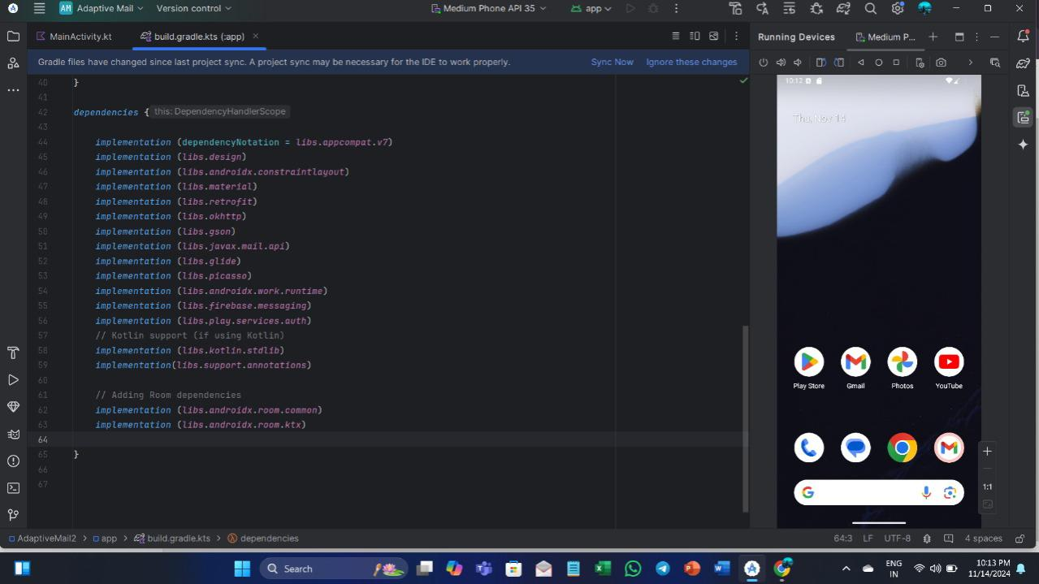
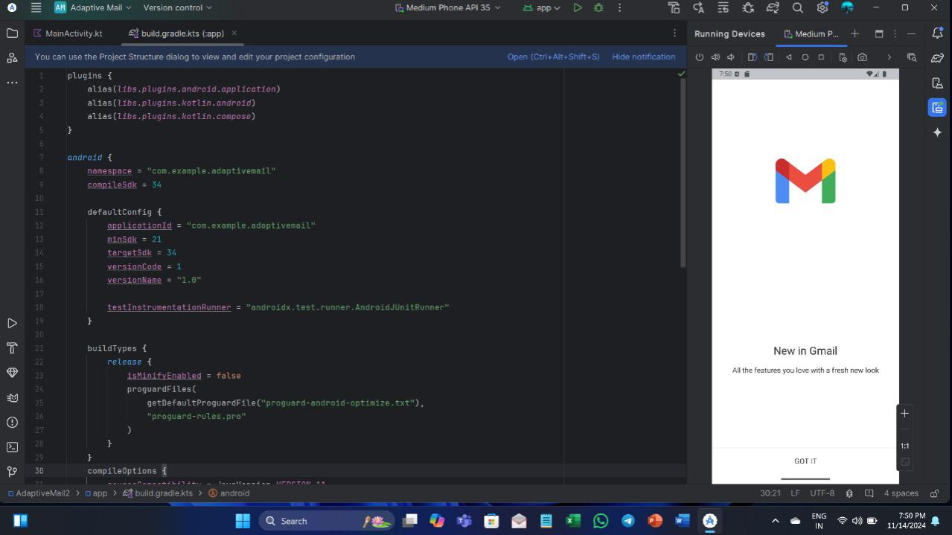
Output :

Slide 20
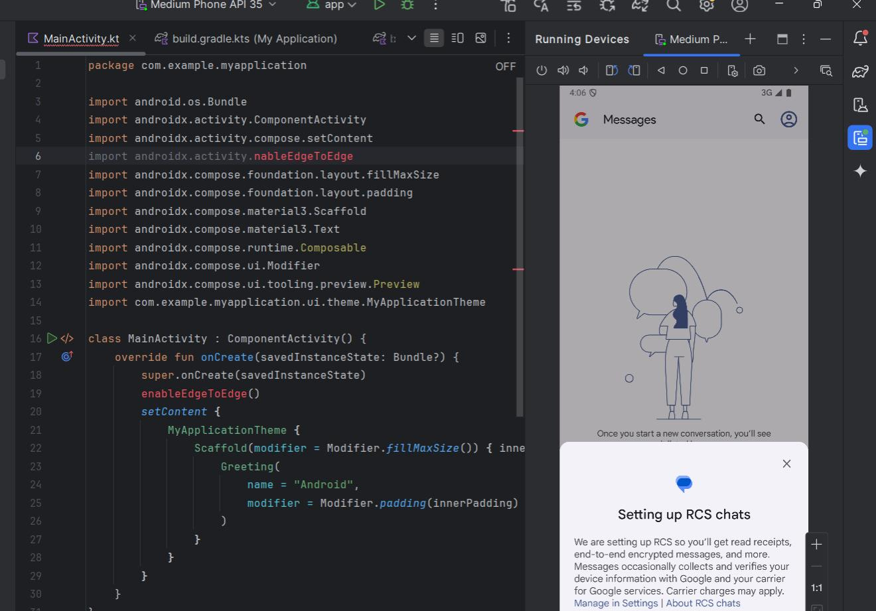
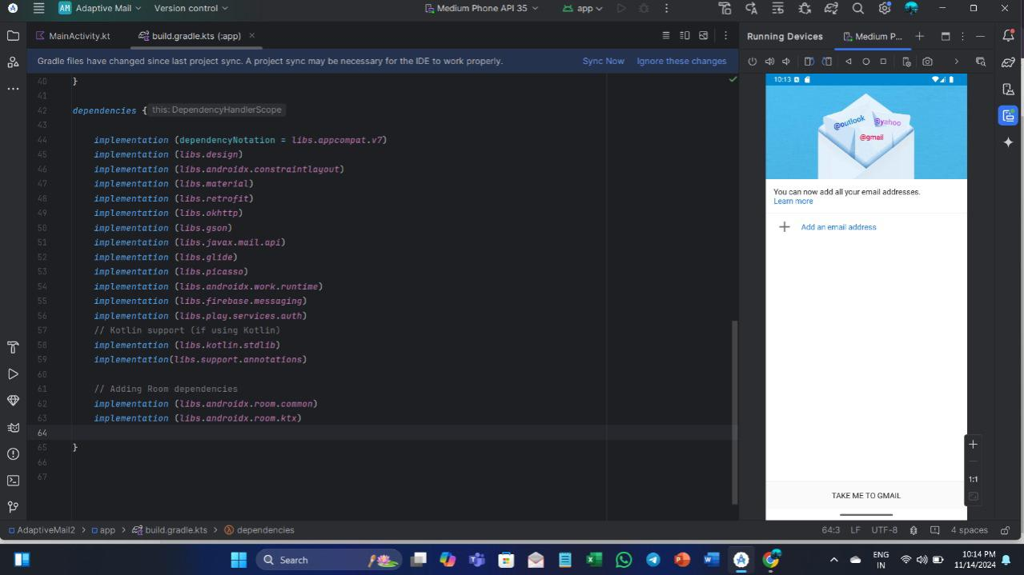

Slide 21
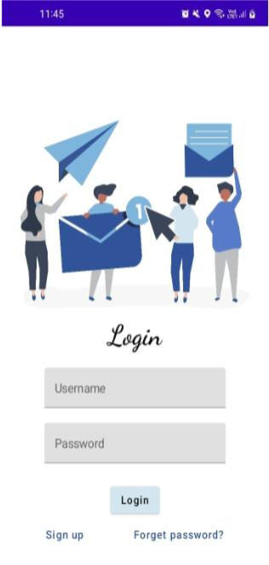
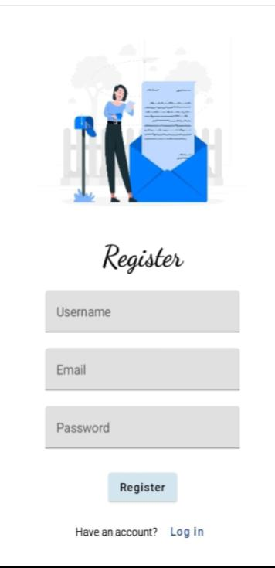

Slide 22
Thank you !!

