Slide 1


Fake News Detection System CSA1706- ARTIFICIAL INTELLIGENCE
Supervised by:
Dr. Krishna Kumar Kathiresan
Presented by:
Asha Sarthiwika.V(192311066)
K.Deeksha Sree(192424097)
S.R.Kaarthika(192412294)

Slide 2


Introduction
Fake news is false or misleading information that is shared as real news.
The spread of fake news on social media and websites can create confusion among people.
It is difficult to manually check every news article to know whether it is real or fake.
This project uses Natural Language Processing (NLP) to process and understand news text.
Machine learning algorithms such as Naive Bayes, Logistic Regression, and SVM are used to classify news as Real or Fake.
A Flask web application provides a simple interface where users can enter or upload news and get the prediction result.

Slide 3
Problem Statement
Fake news is spreading quickly through social media, websites, and online platforms.
Many people find it difficult to identify whether a news article is real or fake.
Checking every news article manually takes a lot of time and effort.
Fake news can create confusion and spread incorrect information among people.
There is a need for an automated system that can analyze news text and identify fake information.
Therefore, this project develops a Fake News Detection System using NLP and Machine Learning to classify news as Real or Fake.

Slide 4
Objectives
To collect and prepare news articles for fake news detection.
To clean the news text by removing unwanted symbols, punctuation, and unnecessary words.
To convert the news text into numerical data using TF-IDF.
To train and compare Naive Bayes, Logistic Regression, and SVM machine learning models.
To identify whether a given news article is Real or Fake with good accuracy.
To develop a user-friendly web dashboard where users can upload datasets, enter news, and view prediction results.

Slide 5
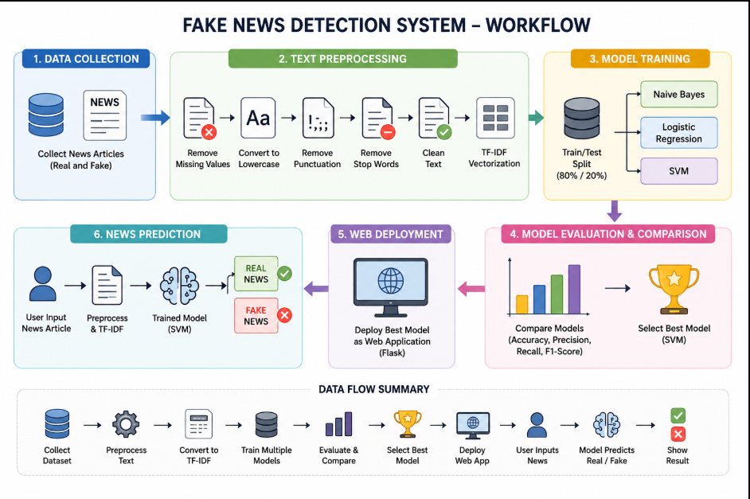
System Workflow

Slide 6
Module 1 :Text Preprocessing
Collects the news article entered by the user.
Removes unwanted symbols, numbers, and punctuation.
Converts all text into a common format.
Removes unnecessary words such as stop words.
Cleans and prepares the text for analysis.
Converts the cleaned text into a suitable format for the machine learning model.

Slide 7
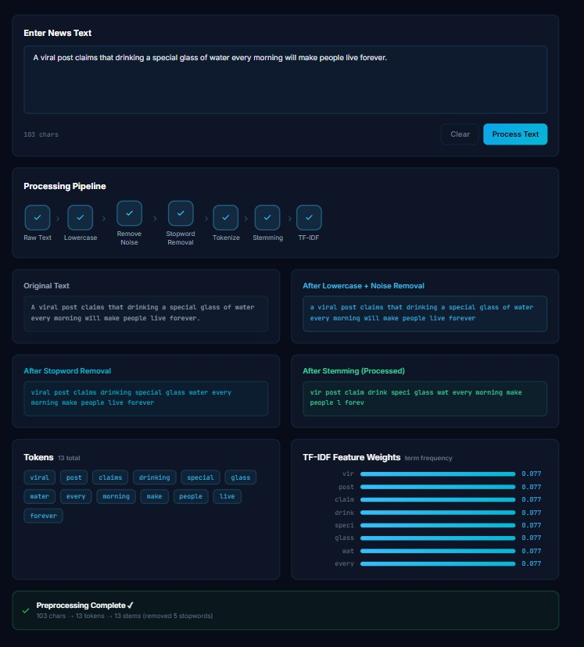

Slide 8
Module 2 :NLP Model Training
Uses the cleaned news data from Module 1.
Converts the text into numerical features using TF-IDF.
Trains different machine learning models: Naive Bayes, Logistic Regression, and SVM.
The models learn patterns from Real and Fake news.
Compares the accuracy of all three models.
Selects the SVM model as the best-performing model for prediction.

Slide 9
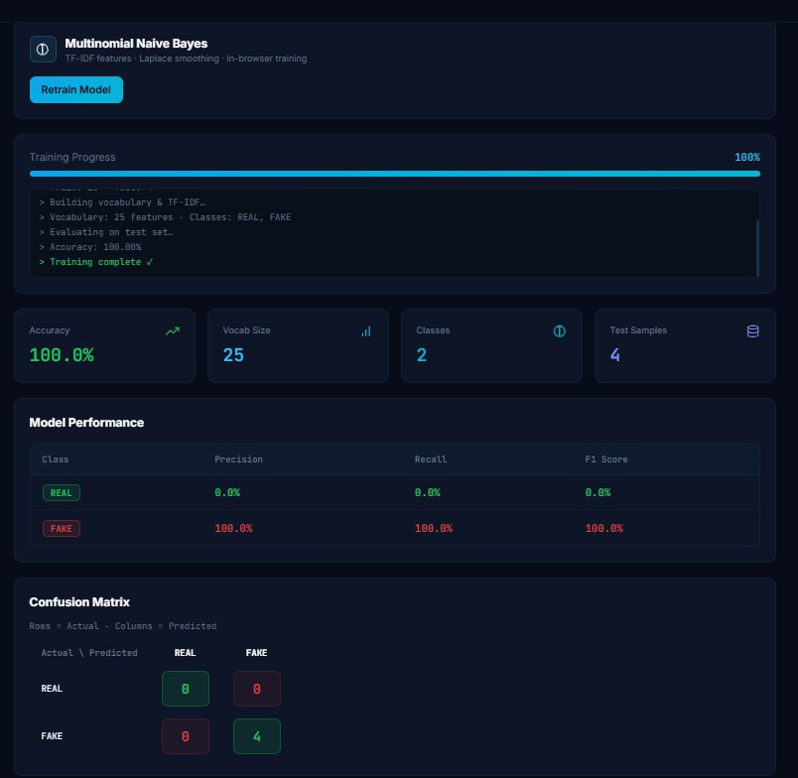

Slide 10
Module 3 :Web Deployment
Develops a simple and user-friendly web interface.
Allows users to enter or upload news content.
Sends the news text to the trained SVM model.
The system processes the input using the TF-IDF vectorizer.
The model predicts whether the news is Real or Fake.
Displays the prediction result clearly on the web dashboard.

Slide 11
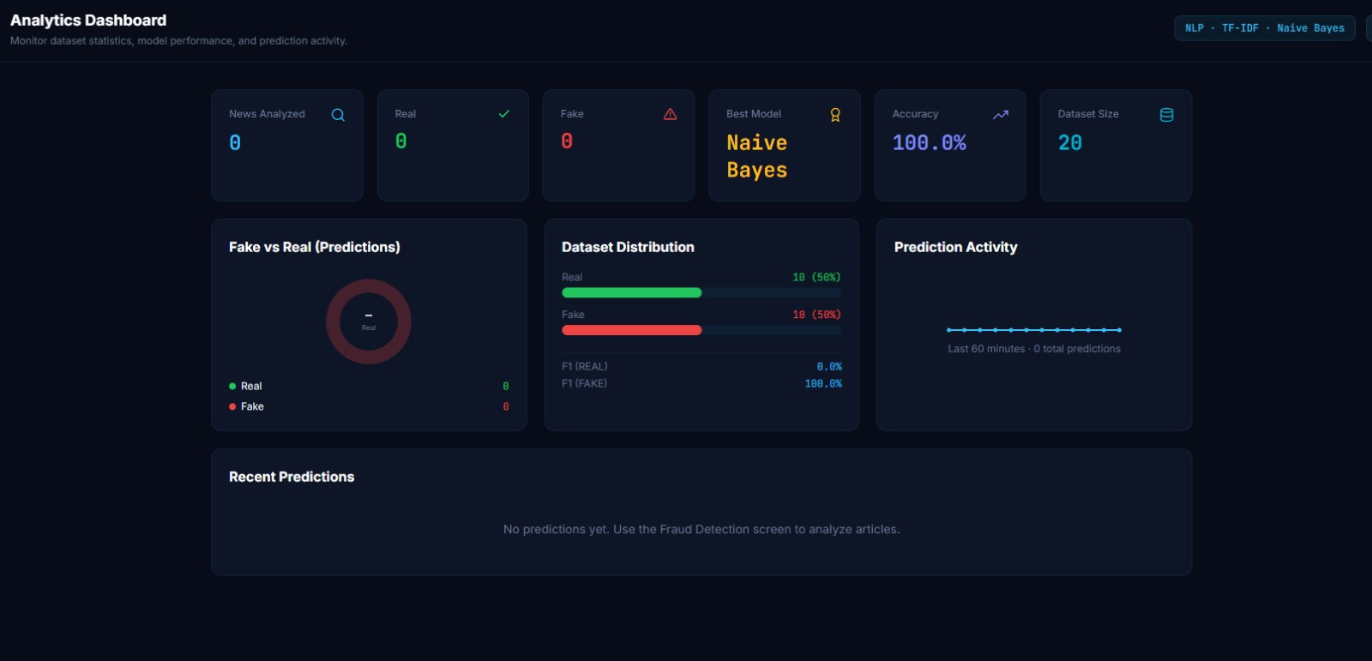

Slide 12
Result
The system successfully preprocesses and cleans news text.
The news data is converted into numerical features using TF-IDF.
Three models—Naive Bayes, Logistic Regression, and SVM—are trained and compared.
SVM achieved the highest accuracy of 98% on the test data.
The web application allows users to enter or upload news for checking.
The system displays the final result as Real News or Fake News

Slide 13
Conclusion
The Fake News Detection System successfully identifies whether a news article is Real or Fake.
NLP and TF-IDF help clean and convert news text into useful features.
Naive Bayes, Logistic Regression, and SVM were trained and compared.
SVM achieved the highest accuracy of 98% among the tested models.
The web dashboard provides a simple way for users to upload datasets and check news.
The system helps users identify potentially fake news quickly and reduces the effort of manual checking.

Slide 14
THANK YOU

