Slide 1
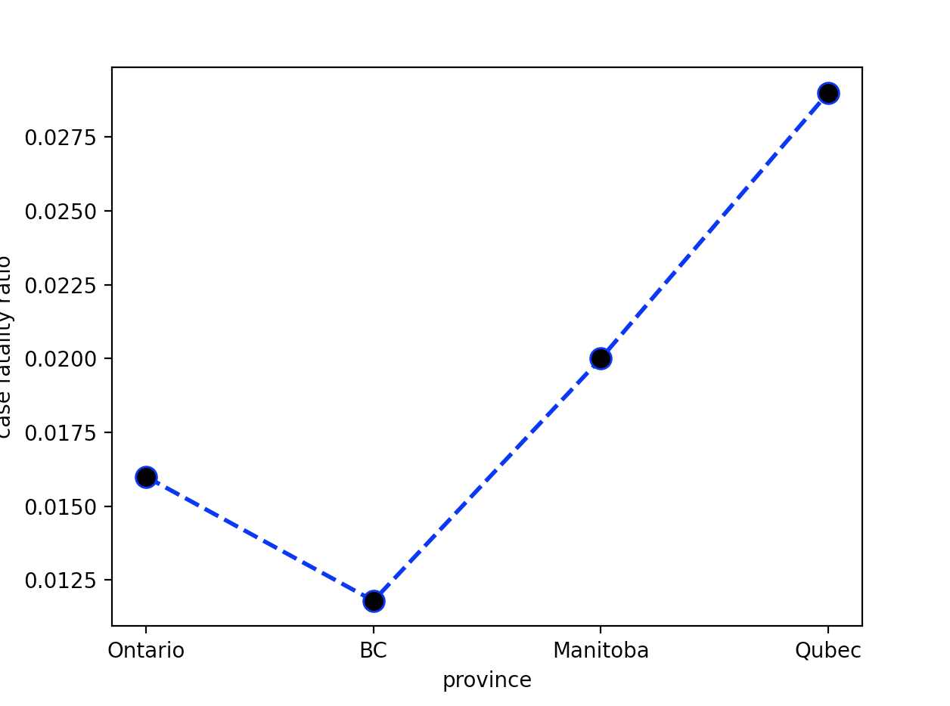
Ontario is Canada’s worst hit province, when it comes to the COVID-19 outbreak. It has by far the highest number of cases of COVID-19 in whole of Canada. Despite suffering from the most number of cases, its case fatality ratio is among the lowest. This shows that despite having the most pressure on their medical system, Ontario has excellent medical health care infrastructure to felicitate the treatment of patients and save lives.

Slide 2
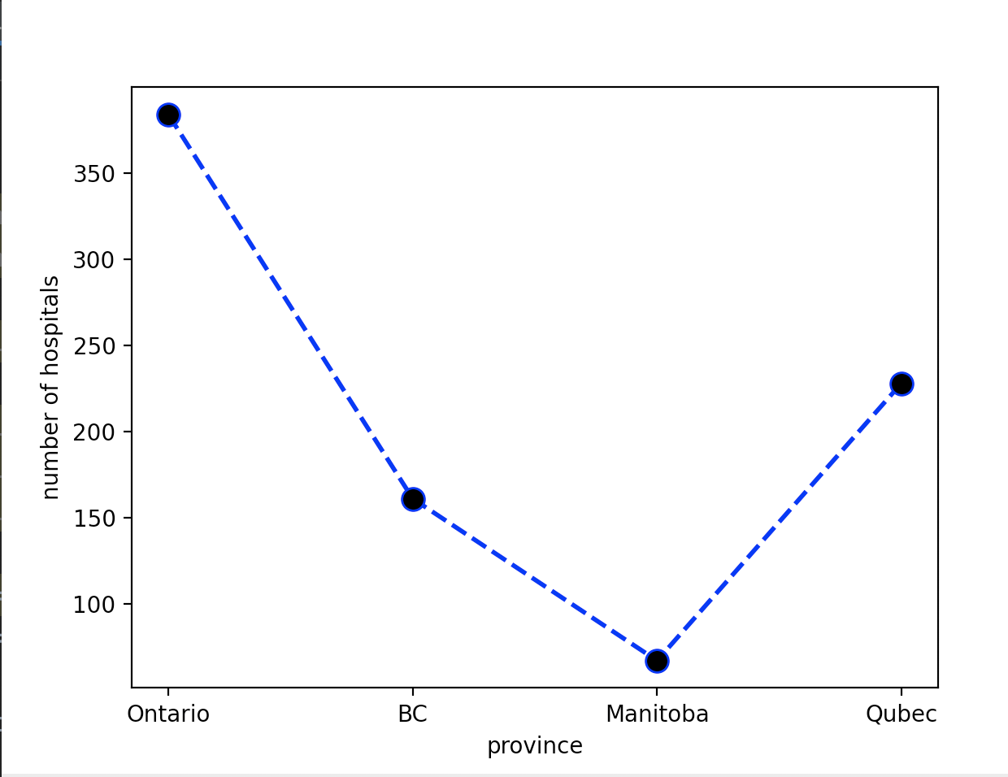
The following graph shows the comparison of number of hospitals in different major provinces of Canada. As it is clear, Ontario has significantly more hospitals in comparison to others. Now one might suggest that this is because of the high population of Ontario, and rightfully so, but this also tells us that despite being heavily populated, Ontario and Toronto’s governments have manged to build an excellent volume of infrastructure, in order to felicitate the high needs of the heavily populated area.

Slide 3
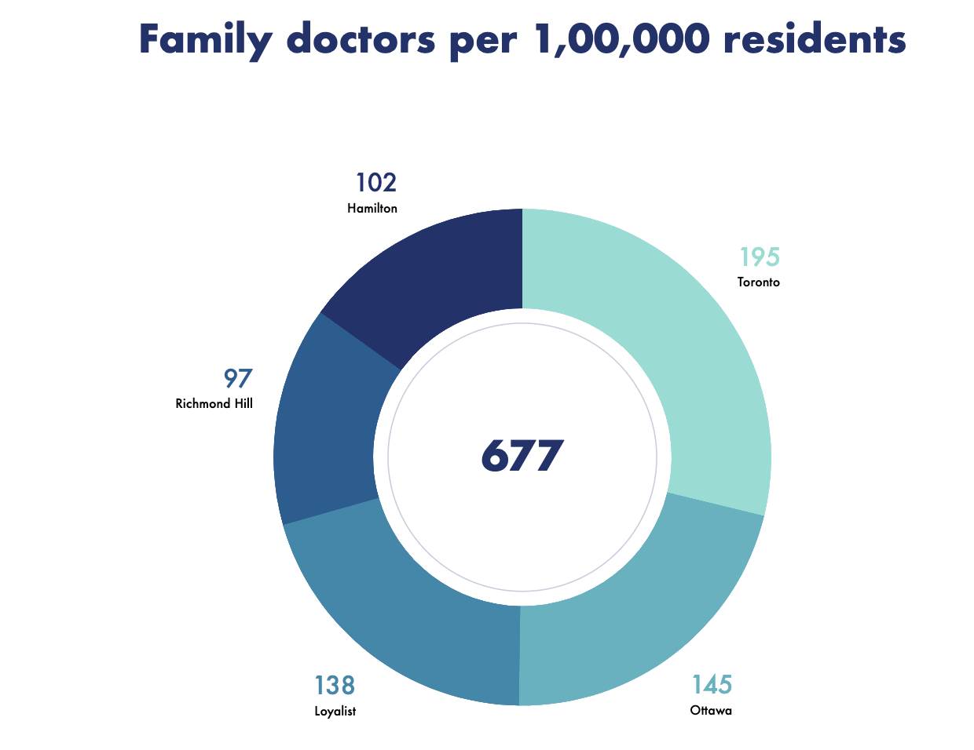
Toronto has one of the highest number of doctors and specialists per 1,00,000 residents. This number is among the highest not only in Canada but also globally. Having a large team of medical experts at your bay not only helps the residents address their medical queries and problems easily but also increases the life expectancy of the area

Slide 4
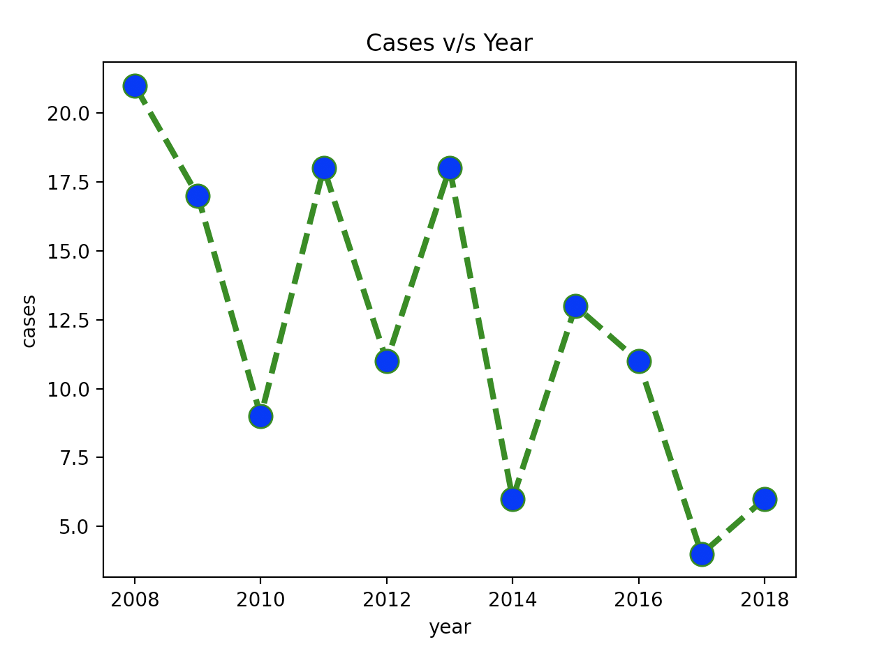
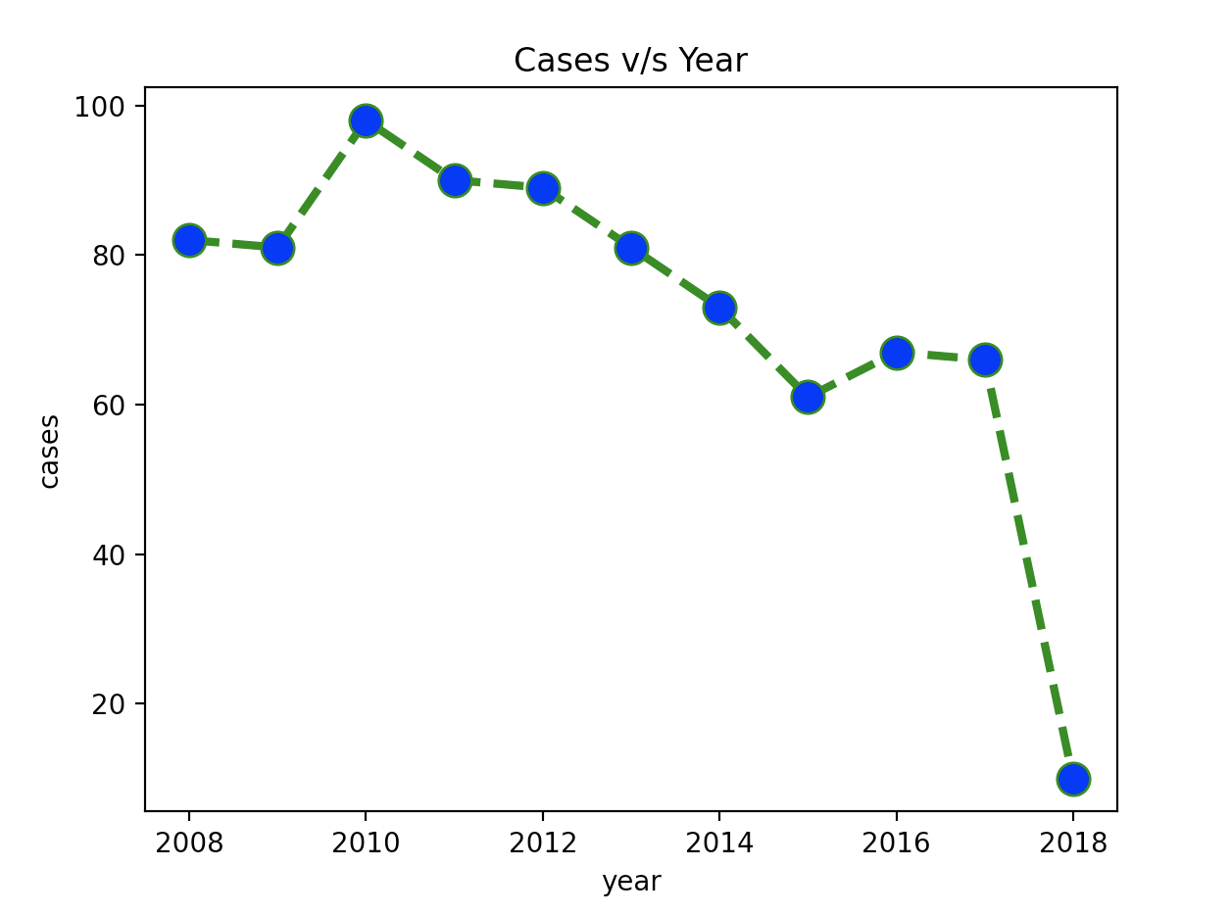
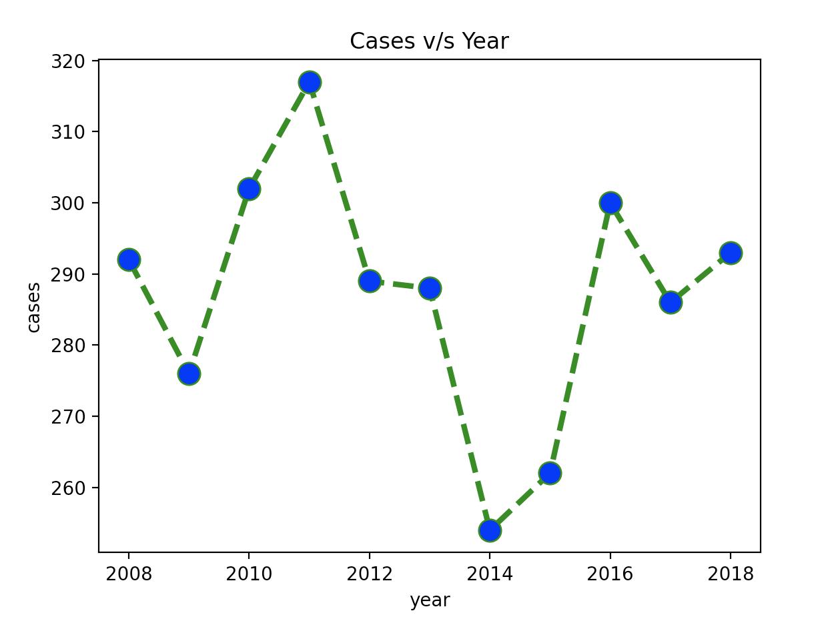
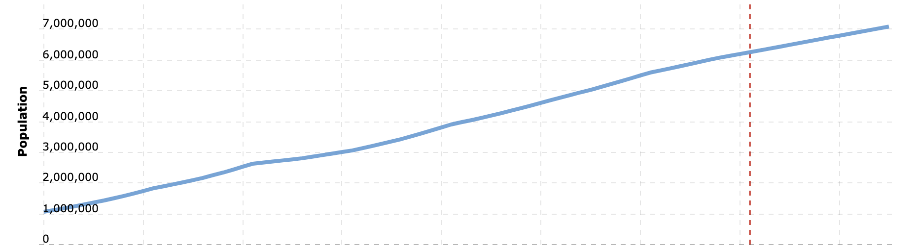
We see that there has been a consistent growth in population of Toronto, however, there has been a significant decline in the case count of numerous diseases. This shows that despite there being a constant increase in the population density of Toronto (Since population is increasing and area is constant), there has been a decline in number of cases of the following diseases as shown in the graph. This implies that Toronto’s health care system has not only contained spread of the diseases, but also utilised vaccines, and excellent infra to curtail certain diseases

