Slide 1
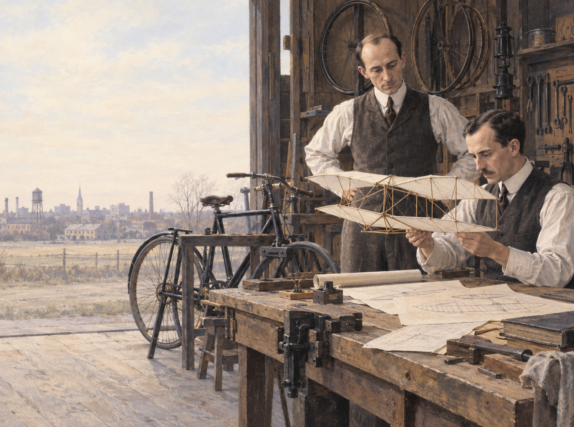
THE PROBLEM
Flight needed control,
not just lift
A machine could rise into the air. The harder problem was keeping it balanced and steering it safely.
01 / 05
Notes:
Historical context: The Wright brothers approached flight as a control problem as well as a problem of lift and power. Source: National Park Service, Wright Brothers, https://www.nps.gov/articles/wright-brothers.htm

Slide 2
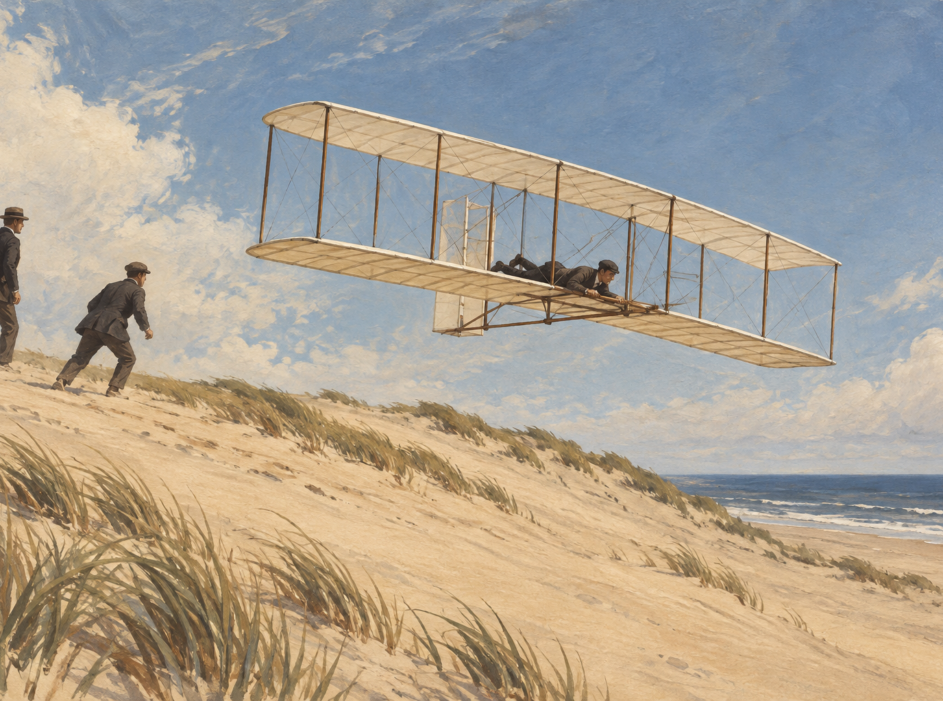
THE EXPERIMENTS
They learned by
flying gliders
At Kitty Hawk, repeated glides gave Wilbur and Orville practical flying skill and exposed what their designs could not yet do.
02 / 05
Notes:
The brothers conducted extensive glider experiments at the Outer Banks before powered flight. Source: National Park Service, The First Flight, https://www.nps.gov/wrbr/learn/historyculture/thefirstflight.htm

Slide 3
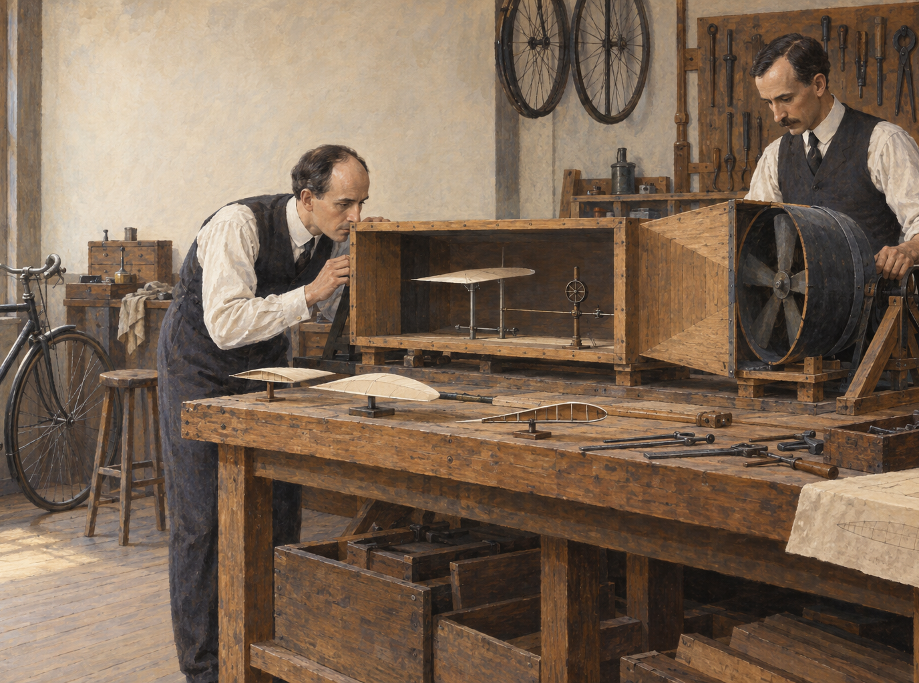
THE BREAKTHROUGH
A wind tunnel turned
guesswork into data
Their own tests showed that published lift figures were unreliable. A small wind tunnel let them compare wing shapes and design with evidence.
03 / 05
Notes:
The Wrights built a small wind tunnel after concluding that existing lift tables were inaccurate. Source: National Park Service, The First Flight, https://www.nps.gov/wrbr/learn/historyculture/thefirstflight.htm

Slide 4
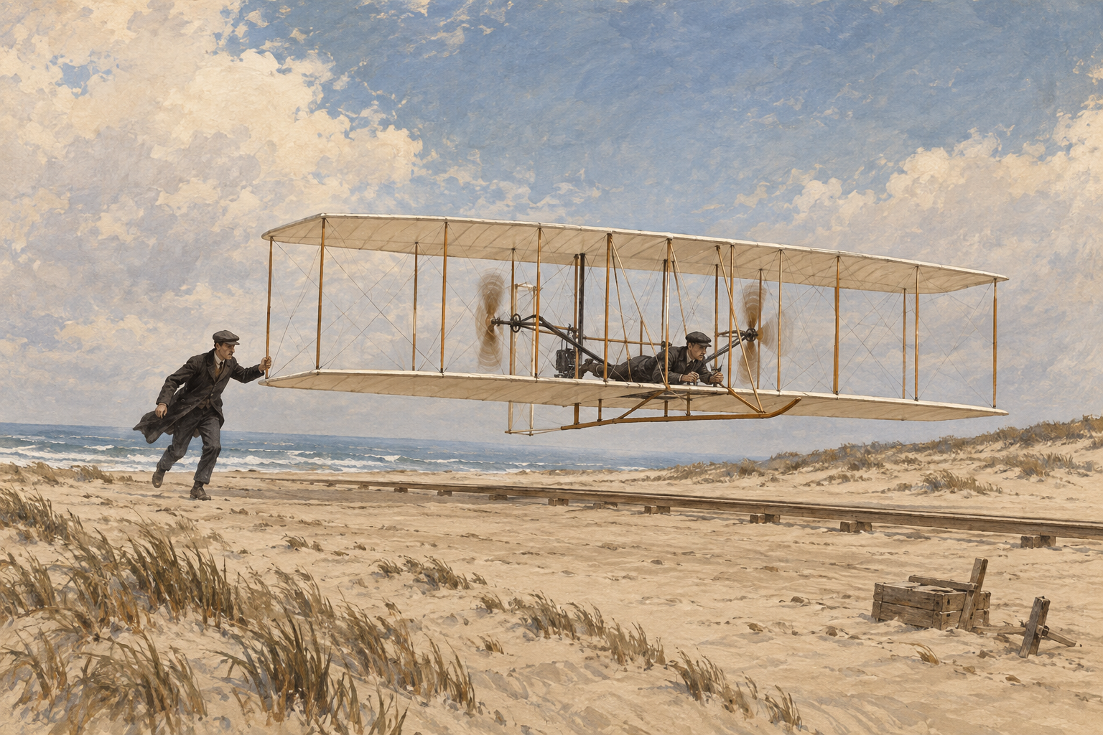
THE FIRST FLIGHT
December 17, 1903
Kitty Hawk, North Carolina
Orville piloted the first successful powered flight. The brothers made four flights that morning, improving their distance each time.
12
120
SECONDS
FEET
04 / 05
Notes:
The first flight lasted 12 seconds and covered 120 feet; four powered flights took place that day. Sources: Smithsonian National Air and Space Museum, 1903 Wright Flyer, https://airandspace.si.edu/collection-objects/wright-1903-flyer/nasm_A19610048000; National Park Service, Four Powered Flights, https://www.nps.gov/places/3-four-powered-flights.htm

Slide 5
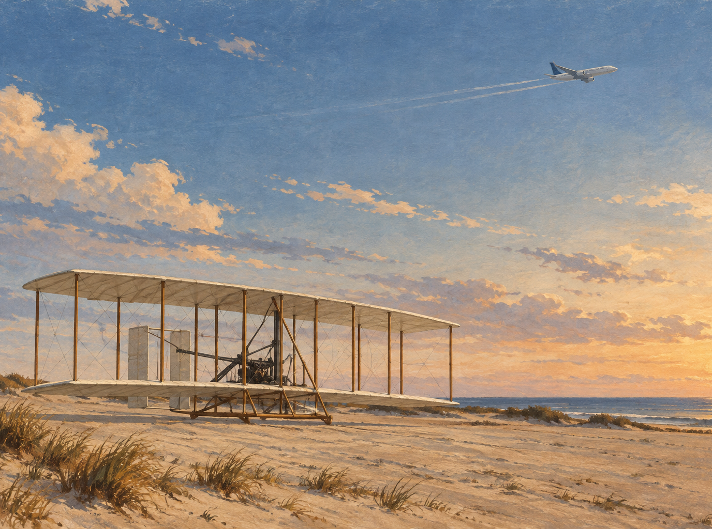
THE ENDURING LESSON
Progress came from
learning what failed
They tested, measured, and redesigned before adding an engine. Careful evidence and steady iteration made controlled flight possible.
05 / 05
Notes:
The Wrights used wind tunnel research and flight testing as design tools, establishing a foundation for aeronautical engineering. Source: Smithsonian National Air and Space Museum, 1903 Wright Flyer, https://airandspace.si.edu/collection-objects/wright-1903-flyer/nasm_A19610048000

