Slide 1
Longest Substring Without Repeating Characters
Brute Force Approach
Steps
Start with a variable maxLen = 0.
Use two loops:
  Outer loop selects starting index i.
  Inner loop selects ending index j.
For each substring from i to j, maintain a frequency array or set.
Check if the current character is already present (means repeating).
If not repeating, increase substring length and update maxLen.
If repeating, stop extending this substring and move to next i.
After checking all possible substrings, return maxLen.

Slide 2
Time Complexity
Outer loop → O(n)
Inner loop → O(n)
Checking unique characters → O(n)
Total: O(n³) (Worst case)
Space Complexity
O(n) (for checking characters)

Slide 3
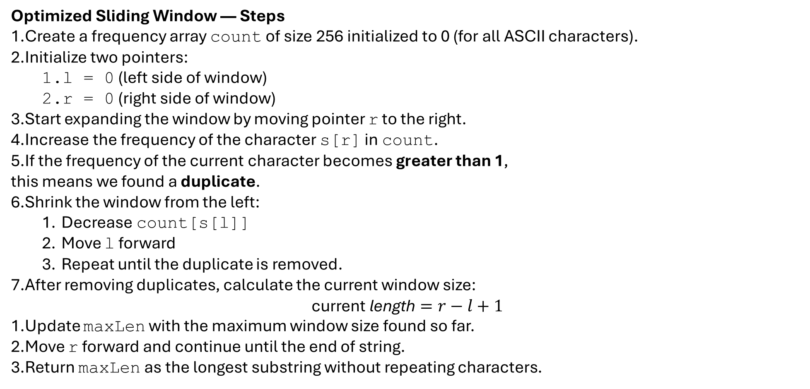
Optimized Sliding Window — Steps
Create a frequency array count of size 256 initialized to 0 (for all ASCII characters).
Initialize two pointers:
  l = 0 (left side of window)
  r = 0 (right side of window)
Start expanding the window by moving pointer r to the right.
Increase the frequency of the character s[r] in count.
If the frequency of the current character becomes greater than 1,
this means we found a duplicate.
Shrink the window from the left:
  Decrease count[s[l]]
  Move l forward
  Repeat until the duplicate is removed.
After removing duplicates, calculate the current window size:
$$\text{current} \text{length}=r−l+1$$
Update maxLen with the maximum window size found so far.
Move r forward and continue until the end of string.
Return maxLen as the longest substring without repeating characters.

Slide 4
Time Complexity
Sliding Window processes each character at most 2 times:
r moves n times
l moves n times
So: O(n)
Space Complexity
count array = O(1) fixed size 256
Final Comparison Table
Approach | Time Complexity | Space | Explanation
Brute Force | O(n³) | O(n) | Check all substrings and verify uniqueness
Sliding Window | O(n) | O(1) | Always maintain a non-repeating window

Slide 5
974. Subarray Sums Divisible by K
Brute Force Approach — Steps
Convert the array into prefix sum form.
Count how many prefix sums are divisible by k.
Check every pair of prefix sums (i, j).
If difference of the two prefix sums is divisible by k, increase count.
Return count.
Brute Force Approach (Using Prefix Sums + Checking All Pairs)
Time Complexity
Step 1: Building prefix sum → O(n)
Step 2: Counting prefix sum divisible by k → O(n)
Step 3: Checking every pair (i, j) → O(n²)
This is because there are ≈ n(n−1)/2 pairs.
Total Time Complexity = O(n²)
Space Complexity
Prefix array: O(n)
No extra significant space.
Total Space Complexity = O(n)

Slide 6
Optimal Approach — Steps (Prefix Sum + Hashmap)
Start with sum = 0 and result = 0.
Store remainder 0 with frequency 1 in the hashmap.
For every element in the array:
  Add the element to sum.
  Find remainder of sum when divided by k.
  If remainder is negative, make it positive by adding k.
  Add the frequency of this remainder to result.
  Increase the frequency of this remainder in hashmap.
Return result.
Optimal Approach — Prefix Sum + Hashmap (Remainder Frequency)
Time Complexity
You traverse the array once → O(n)
All operations (add, mod, hashmap lookup, update) = O(1) average.
Total Time Complexity = O(n)
Space Complexity
Hashmap stores at most k remainders (0 to k−1)
Space Complexity = O(k)
(If k is constant compared to n, this becomes O(1).)

Slide 7
Final Answer
Approach | Time Complexity | Space Complexity
Brute Force | O(n²) | O(n)
Optimal (Prefix + Hashmap) | O(n) | O(k)

Slide 8
Find Pair Given Difference
1. Brute-Force Approach — Steps
Start from the first element of the array.
For each element arr[i], compare it with every element after it (arr[j]).
Calculate abs(arr[j] – arr[i]).
If the result is equal to x, return true (pair found).
If all pairs are checked and no match is found, return false.
2. Two-Pointer Approach (Optimized) — Steps
Sort the array in increasing order.
Initialize two pointers: i = 0 and j = 1.
While pointer j is within the array:
  Compute the difference arr[j] – arr[i].
If the difference equals x, return true.
If the difference is greater than x, move the i pointer forward.
If the difference is less than x, move the j pointer forward.
Ensure i never becomes equal to j; if it does, increase j.
If no pair is found, return false.

Slide 9
3. Hashmap Approach (Most Efficient) — Steps
Create an empty hashmap.
Traverse the array from left to right.
For every element arr[i]:
  Check if arr[i] + x exists in the map.
  Check if arr[i] - x exists in the map.
If any of the above exists, return true (pair found).
If not found, insert the current element into the map.
If the loop ends and no valid pair appears, return false.

Slide 10
1. Brute Force — O(n²) Time, O(1) Space
For every element, you compare it with every other element → two nested loops.
Nested loops = n × n = O(n²)
No extra data structure used → O(1) space.
2. Two-Pointer Approach — O(n log n) Time, O(1) Space
First step is sorting, which takes O(n log n).
After sorting, the two pointers move only forward → O(n).
Overall dominated by sorting → O(n log n).
Only few variables used → O(1) space.
3. Hashmap Approach — O(n) Time, O(n) Space
You traverse the array once → O(n).
Each lookup and insert in hashmap takes O(1) average time.
You store elements in the hashmap → needs O(n) space.

Slide 11
Swap two numbers
Swap using temp variable (simple method)
Take two numbers a and b.
Store a in a temporary variable temp.
Assign b to a.
Assign temp to b.
Return the new values of a and b.
Swap using addition–subtraction
Add a and b and store the result in a.
Subtract the new value of a (which is a+b) with b to get original a, and store it in b.
Subtract the new value of b from the new value of a to get original b, and store it in a.
Return the swapped values.
Swap using XOR
XOR a with b and store in a.
XOR the new value of a with b and store the result in b.
XOR the new value of a with the new value of b and store in a.
Return the swapped values.

Slide 12
Addition–Subtraction Swap
Time Complexity: O(1)
Space Complexity: O(1)
Only uses constant number of arithmetic operations
No loop, no extra memory
2. XOR Swap
Time Complexity: O(1)
Space Complexity: O(1)
Only bitwise operations (XOR)
No extra variable needed
Constant work

Slide 13
Toggle bits in the given range
Step 1:- Create a mask
[1<<(r-l+1)]-1
Step 2:- Update mask
mask = mask << (l-1)
Step 3:- Find result
result = n ^mask

Slide 14
Time Complexity: O(1)
Only a few bitwise operations
No loop
Constant-time shifting and XOR
Space Complexity: O(1)
Only a few integer variables
No extra array or data structure used

Slide 15
Number is sparse or not
Approach 1: Brute Force (Check Adjacent Bits by Shifting Right One-by-One)
Logic
Take the number n.
Repeatedly check the last two bits using n & 3.
  3 in binary is 11, so n & 3 checks two adjacent bits at once.
If (n & 3) == 3, then two consecutive 1s → not sparse.
Right shift n by 1 bit and continue.
Time Complexity: O(log n)
Because you check each bit once.
Space Complexity: O(1)
Only variable used.

Slide 16
Approach 2: Optimized Using (n & (n >> 1))
Logic
This is the most efficient and most popular method.
If a number has consecutive 1s, then
n & (n >> 1)
will produce a non-zero value.
Because shifting right aligns adjacent bits, and AND reveals where both are 1.
Example:
n = 12 → 1100
n >> 1 = 0110
n & (n >> 1) = 0100 ≠ 0 → not sparse
If result == 0 → sparse
Time Complexity: O(1)
Only two operations: shift + AND.
Space Complexity: O(1)

Slide 17
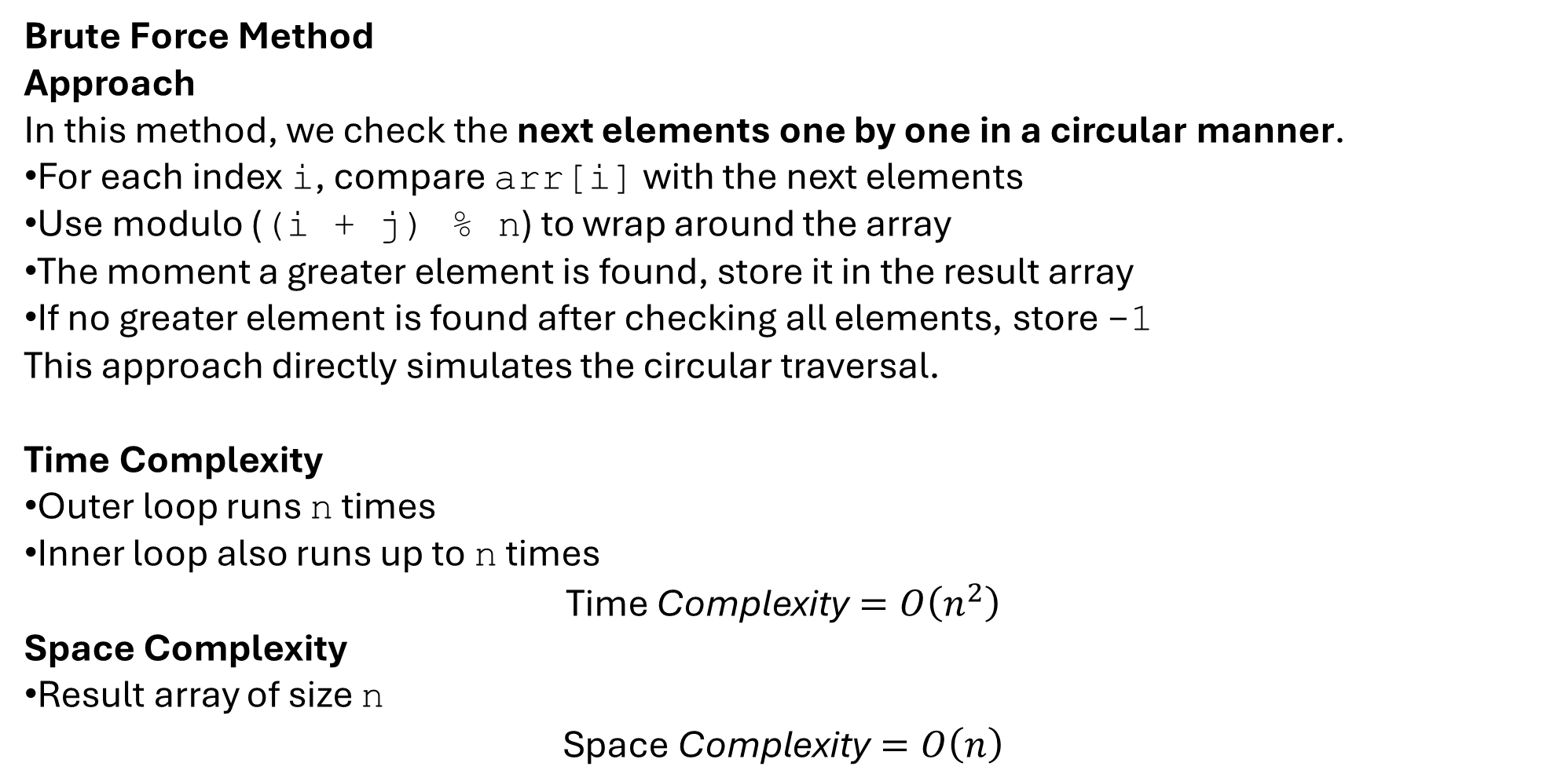
Next Greater Element in Circular Array
Brute Force Method
Approach
In this method, we check the next elements one by one in a circular manner.
For each index i, compare arr[i] with the next elements
Use modulo ((i + j) % n) to wrap around the array
The moment a greater element is found, store it in the result array
If no greater element is found after checking all elements, store -1
This approach directly simulates the circular traversal.
Time Complexity
Outer loop runs n times
Inner loop also runs up to n times
$$\text{Time} \text{Complexity}=O\left(n^{2}\right)$$
Space Complexity
Result array of size n
$$\text{Space} \text{Complexity}=O\left(n\right)$$

Slide 18
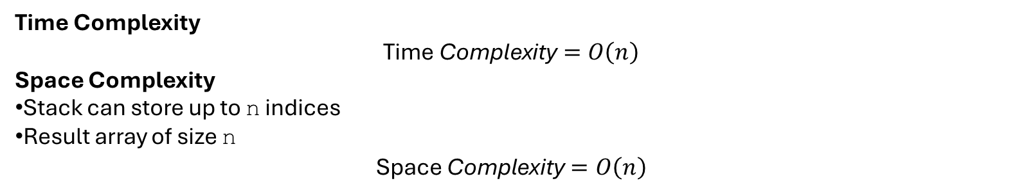
Optimal Solution (Using Stack)
Approach
This approach uses a stack to efficiently find the next greater element.
Traverse the array twice (0 to 2n−1) to simulate circular behavior
Use modulo (i % n) to access circular indices
Maintain a stack of indices whose next greater element is not found yet
When the current element is greater than the element at the stack top:
  Pop the index from the stack
  Assign the current element as its next greater element
Push indices only during the first traversal
This ensures each element is processed efficiently.
Time Complexity
$$\text{Time} \text{Complexity}=O\left(n\right)$$
Space Complexity
Stack can store up to n indices
Result array of size n
$$\text{Space} \text{Complexity}=O\left(n\right)$$
Approach | Time Complexity | Space Complexity | Efficient
Brute Force | O(n²) | O(n) | No
Stack (Optimal) | O(n) | O(n) | Yes

Slide 19
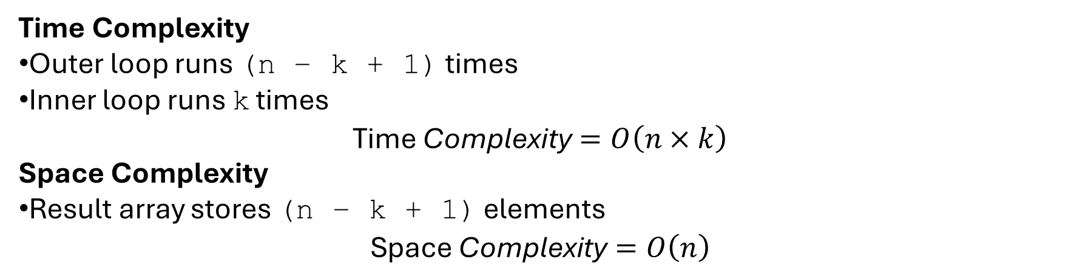
K Sized Subarray Maximum
Brute Force Method
Approach
In the brute force approach, we consider each possible subarray of size k one by one.
Start from index i = 0 to i = n − k
For each starting index i, traverse the next k elements
Find the maximum among these k elements
Store this maximum in the result array
This approach checks all elements in every window explicitly.
Time Complexity
Outer loop runs (n − k + 1) times
Inner loop runs k times
$$\text{Time} \text{Complexity}=O\left(n×k\right)$$
Space Complexity
Result array stores (n − k + 1) elements
$$\text{Space} \text{Complexity}=O\left(n\right)$$

Slide 20
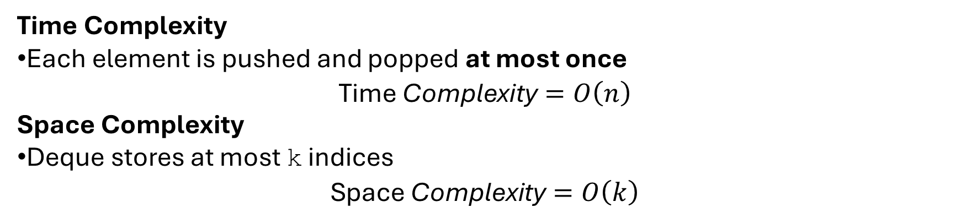
Optimal Method (Deque / Sliding Window)
Approach
This approach uses a deque (double-ended queue) to store indices of array elements.
The deque maintains elements in decreasing order of values.
Steps:
Remove indices from the front if they are outside the current window
Remove indices from the back whose values are smaller than the current element
Insert the current index at the back
The front of the deque always holds the index of the maximum element
Once the first window is formed (i ≥ k−1), add the maximum to the result
Time Complexity
Each element is pushed and popped at most once
$$\text{Time} \text{Complexity}=O\left(n\right)$$
Space Complexity
Deque stores at most k indices
$$\text{Space} \text{Complexity}=O\left(k\right)$$

Slide 21
Time Needed to Buy Tickets
Problem Statement
You are standing in a queue to buy tickets.
Each person i needs tickets[i] tickets
In one second, the person at the front buys one ticket
If they still need tickets, they go to the end of the queue
Otherwise, they leave the queue
You are given an index k.
Find the total time (in seconds) required for person k to finish buying all their tickets.

Slide 22
Example 1
tickets = [2,3,2]
k = 2
Time | Person Buying | Tickets After Purchase
1 | Person 0 | [1,3,2]
2 | Person 1 | [1,2,2]
3 | Person 2 | [1,2,1]
4 | Person 0 | [0,2,1]
5 | Person 1 | [0,1,1]
6 | Person 2 | [0,1,0] stop
Person k = 2 finishes at time = 6
Answer = 6
Example 2
tickets = [5,1,1,1]
k = 0

Slide 23
Approach 1: Brute Force (Queue Simulation)
Logic
Push all people with their index into a queue
Every second:
  Front person buys one ticket
  If tickets left → push back
  If index == k and tickets become 0 → stop
Count total seconds
Pseudocode
queue = all people with index
time = 0
while true:
person = pop front
tickets[person]--
time++
if person == k and tickets[person] == 0:
return time
if tickets[person] > 0:
push person back

Slide 24
Approach 2: Optimal (Mathematical Observation)
Key Observation
Person k needs tickets[k] rounds.
For each round:
People before or equal to k can buy up to tickets[k] tickets
People after k can buy up to tickets[k] - 1 tickets
Formula
For each person i:
If i ≤ k
time += min(tickets[i], tickets[k])
If i > k
time += min(tickets[i], tickets[k] - 1)
Logic
Store required tickets of person k
Traverse all people
Add their contribution using the formula
Return total time

Slide 25
Example Walkthrough
tickets = [2,3,2]
k = 2
kTickets = 2
Person | Contribution
0 | min(2,2) = 2
1 | min(3,2) = 2
2 | min(2,2) = 2
Total time = 6

Slide 26
Pseudocode
time = 0
kTickets = tickets[k]
for i = 0 to n-1:
if i <= k:
time += min(tickets[i], kTickets)
else:
time += min(tickets[i], kTickets - 1)
return time
Approach | Time | Space | Use Case
Queue Simulation | O(total tickets) | O(n) | Basic understanding
Mathematical (Optimal) | O(n) | O(1) | Interview preferred

Slide 27
225. Implement Stack Using Queues
Approach 1: Using Two Queues
Idea
Always keep latest element at front of the main queue
Use the second queue as a helper during push
Logic
Push operation:
Insert element into empty helper queue
Move all elements from main queue to helper queue
Swap the queues
Pop operation:
Remove front element from main queue
Problem Statement
You have to implement a stack using only queues.
A stack follows LIFO (Last In, First Out).
A queue follows FIFO (First In, First Out).
You must implement the following operations:
push(x) → insert element into stack
pop() → remove top element
top() → return top element
empty() → check if stack is empty
Example
push(1)
push(2)
top() → 2
pop() → 2
empty() → false

Slide 28
Walkthrough
Suppose initially:
q1 = [10, 20] (10 is top)
q2 = []
Now we do push(30).
Step 1: Push new element into q2
q2 = [30]
Step 2: Move all elements from q1 to q2
q2 = [30, 10, 20]
q1 = []
Now the new element (30) is at the front → correct stack behavior.
Step 3: Swap q1 and q2
q1 = [30, 10, 20] ← updated stack
q2 = []

Slide 29
Pseudocode
push(x):
q2.push(x)
while q1 not empty:
q2.push(q1.front)
q1.pop()
swap(q1, q2)
pop():
q1.pop()
top():
return q1.front
empty():
return q1 is empty
Complexity
Operation | Time | Space
push | O(n) | O(n)
pop | O(1) | O(1)
top | O(1) | O(1)

Slide 30
Approach 2: Using One Queue
Key Idea
Use one queue
After inserting a new element, rotate the queue
This makes the new element come to the front
Example Walkthrough
push(1)
Queue: [1]
push(2)
Insert 2 → [1,2]
Rotate → [2,1]
top() → 2
pop() → removes 2
Logic
Push operation:
Insert element into queue
Rotate previous elements behind it
Pop operation:
Remove front element

Slide 31
Pseudocode
Complexity
push(x):
q.push(x)
for i = 1 to q.size - 1:
q.push(q.front)
q.pop()
pop():
q.pop()
top():
return q.front
empty():
return q is empty
Operation | Time | Space
push | O(n) | O(n)
pop | O(1) | O(1)
top | O(1) | O(1)
Comparison
Approach | Queues Used | Push | Pop | Space
Two Queues | 2 | O(n) | O(1) | O(n)
One Queue | 1 | O(n) | O(1) | O(n)

Slide 32
Merge 2 Sorted Linked Lists
Problem Explanation (Easy Language)
You are given two linked lists, both already sorted in increasing order.
Your task is to merge them into one single sorted linked list by rearranging nodes, not by creating new values.
Example
Input
List1: 1 → 2 → 4
List2: 1 → 3 → 4
Output
1 → 1 → 2 → 3 → 4 → 4
Key Observation
Since both lists are already sorted
Always pick the smaller head node
Move forward in that list
This is similar to the merge step of merge sort.

Slide 33
Approach 1: Brute Force
Idea
Store all values from both lists
Sort them
Create a new linked list
Logic
Traverse list1 → store values
Traverse list2 → store values
Sort the array
Create a new linked list from sorted values
Pseudocode
arr = []
while l1 != NULL:
arr.add(l1.val)
l1 = l1.next
while l2 != NULL:
arr.add(l2.val)
l2 = l2.next
sort(arr)
create new linked list from arr
Walkthrough
Step 1: Collect values
arr = [1, 2, 4, 1, 3, 4]
Step 2: Sort
arr = [1, 1, 2, 3, 4, 4]
Step 3: Create list
1 → 1 → 2 → 3 → 4 → 4
Complexity
Time: O((n+m) log (n+m))
Space: O(n+m)

Slide 34
Approach 2: Optimal (Iterative Pointer Method)
Idea
Use a dummy node
Compare heads of both lists
Attach the smaller node
Move pointer forward
Logic
Create a dummy node
Use a pointer curr
While both lists are not empty:
  Compare l1.val and l2.val
  Attach smaller node to curr
  Move that list forward
Attach remaining nodes

Slide 35
Walkthrough
Input
List1: 1 → 2 → 4
List2: 1 → 3 → 4
Step | l1 | l2 | Chosen Node | Merged List
1 | 1 | 1 | 1 (l1) | 1
2 | 2 | 1 | 1 (l2) | 1 → 1
3 | 2 | 3 | 2 (l1) | 1 → 1 → 2
4 | 4 | 3 | 3 (l2) | 1 → 1 → 2 → 3
5 | 4 | 4 | 4 (l1) | 1 → 1 → 2 → 3 → 4
6 | NULL | 4 | attach rest | 1 → 1 → 2 → 3 → 4 → 4

Slide 36
Pseudocode
dummy = new Node(-1)
curr = dummy
while l1 != NULL and l2 != NULL:
if l1.val <= l2.val:
curr.next = l1
l1 = l1.next
else:
curr.next = l2
l2 = l2.next
curr = curr.next
if l1 != NULL:
curr.next = l1
else:
curr.next = l2
return dummy.next

Slide 37
Approach 3: Optimal (Recursive)
Idea
Choose smaller head
Recursively merge remaining lists
Pseudocode
if l1 == NULL: return l2
if l2 == NULL: return l1
if l1.val <= l2.val:
l1.next = merge(l1.next, l2)
return l1
else:
l2.next = merge(l1, l2.next)
return l2
Walkthrough (Call Stack)
merge(1→2→4, 1→3→4)
→ pick 1
merge(2→4, 1→3→4)
→ pick 1
merge(2→4, 3→4)
→ pick 2
merge(4, 3→4)
→ pick 3
merge(4, 4)
→ pick 4
merge(NULL, 4)
→ return 4
Complexity
Time: O(n + m)
Space: O(n + m) (recursion stack)
1 → 1 → 2 → 3 → 4 → 4

Slide 38
Complexity Summary
Approach | Time | Space
Brute Force | O((n+m) log(n+m)) | O(n+m)
Iterative Optimal | O(n+m) | O(1)
Recursive | O(n+m) | O(n+m)

Slide 39
Rotate Linked List
Problem Explanation (Easy Language)
You are given a singly linked list and an integer k.
Rotate the list to the right by k positions.
Rotation means:
Take the last node
Move it to the front
Repeat k times
Example
Input
List: 1 → 2 → 3 → 4 → 5
k = 2
Output
4 → 5 → 1 → 2 → 3
Key Observations
Rotating n times gives the same list
So:
k = k % length
New head will be at position:
length - k

Slide 40
Approach 1: Brute Force (Rotate One by One)
Idea
Rotate the list one step at a time, k times.
Logic
Repeat k times:
  Traverse to last node
  Detach last node
  Move it to the front
Pseudocode
for i = 1 to k:
prev = NULL
curr = head
while curr->next != NULL:
prev = curr
curr = curr->next
prev->next = NULL
curr->next = head
head = curr
Walkthrough (k = 2)
Initial
1 → 2 → 3 → 4 → 5
Rotation 1
5 → 1 → 2 → 3 → 4
Rotation 2
4 → 5 → 1 → 2 → 3
Complexity
Time: O(n * k)
Space: O(1)

Slide 41
Approach 2: Better (Convert to Array)
Idea
Store nodes in array
Rearrange using index math
Rebuild list
Logic
Store all nodes in array
Compute new starting index
Reconnect nodes in order
Pseudocode
arr = []
while head != NULL:
arr.push_back(head)
head = head->next
n = arr.size()
k = k % n
newHeadIndex = n - k
for i = 0 to n-1:
arr[(newHeadIndex + i) % n]->next =
arr[(newHeadIndex + i + 1) % n]
arr[(newHeadIndex+n-1)%n]->next = NULL
return arr[newHeadIndex]
Walkthrough
arr = [1,2,3,4,5]
k = 2
newHeadIndex = 3
Order:
4 → 5 → 1 → 2 → 3
Complexity
Time: O(n)
Space: O(n)

Slide 42
Approach 3: Optimal (Make List Circular)
Idea
Find length
Make list circular
Break at correct point
Logic
Find length n
Do k = k % n
Connect last node to head
New tail at position n - k - 1
Break the circle
Walkthrough
Step 1: Length
len = 5
k = 2
Step 2: Circular
1 → 2 → 3 → 4 → 5
↑________________↓
Step 3: Find New Tail
steps = 5 - 2 = 3
newTail = 3
Step 4: Break
newHead = 4
Final
4 → 5 → 1 → 2 → 3

Slide 43
Pseudocode
if head == NULL or head->next == NULL:
return head
len = 1
tail = head
while tail->next != NULL:
tail = tail->next
len++
k = k % len
if k == 0:
return head
tail->next = head // make circular
steps = len - k
newTail = head
for i = 1 to steps-1:
newTail = newTail->next
newHead = newTail->next
newTail->next = NULL
return newHead

Slide 44
Complexity Summary
Approach | Time | Space
Brute Force | O(nk) | O(1)
Array Method | O(n) | O(n)
Optimal (Circular) | O(n) | O(1)

Slide 45
Rotate a Linked List
APPROACH 1: Brute Force (Rotate One-by-One)
Brute Force Idea
Rotate the list one step k times
Each step:
  Remove head
  Attach it at the tail
Brute Force Logic (Text Form)
Repeat k times:
Store head node
Move head to head->next
Traverse to last node
Attach stored node at the end
Problem in Simple Words
You are given a singly linked list and an integer k.
Rotate the linked list counter-clockwise by k nodes
The first k nodes move to the end of the list
Example
Input
List: 1 → 2 → 3 → 4 → 5 → NULL
k = 2
Output
3 → 4 → 5 → 1 → 2 → NULL
What “Rotate” Means (Very Important)
Nodes 1 and 2 are removed from front
They are attached at the end
Relative order is preserved

Slide 46
Brute Force Walkthrough
Initial List
1 → 2 → 3 → 4 → 5
Rotation 1
2 → 3 → 4 → 5 → 1
Rotation 2
3 → 4 → 5 → 1 → 2
Brute Force Complexity
Metric | Value
Time | O(n × k)
Space | O(1)
Brute Force Pseudocode
for i = 1 to k:
temp = head
head = head->next
temp->next = NULL
curr = head
while curr->next != NULL:
curr = curr->next
curr->next = temp

Slide 47
APPROACH 2: Optimal Approach (One Traversal)
Key Insight
Instead of rotating many times:
Find the k-th node
Break the list there
Attach the first part at the end
Optimal Logic
If list is empty or k = 0, return head
Traverse to find length
If k >= length, do k = k % length
Traverse to the k-th node
Store (k+1)-th node as newHead
Break link at k-th node
Connect last node to old head

Slide 48
Optimal Walkthrough
Input
1 → 2 → 3 → 4 → 5
k = 2
Step 1: Length
length = 5
Step 2: Locate k-th node
k-th node = 2
Step 3: Break link
2 → NULL
Step 4: New Head
3 → 4 → 5
Step 5: Connect tail to old head
3 → 4 → 5 → 1 → 2

Slide 49
2 Optimal Pseudocode (C++-Style)
if head == NULL or k == 0:
return head
curr = head
length = 1
while curr->next != NULL:
curr = curr->next
length++
k = k % length
if k == 0:
return head
curr = head
for i = 1 to k-1:
curr = curr->next
newHead = curr->next
curr->next = NULL
tail = newHead
while tail->next != NULL:
tail = tail->next
tail->next = head
return newHead

Slide 50
3 Optimal Complexity
Metric | Value
Time | O(n)
Space | O(1)

Slide 51
Group Anagrams
Problem in Simple Words
You are given a list of strings.
Two strings are anagrams if they contain the same characters with the same frequency, but possibly in a different order.
Your task is to group all anagrams together.
Example
Input
strs = ["eat", "tea", "tan", "ate", "nat", "bat"]
Output
[
["eat", "tea", "ate"],
["tan", "nat"],
["bat"]
]
What Makes Two Strings Anagrams?
Same length
Same characters
Same frequency of characters
Example:
eat → {a:1, e:1, t:1}
tea → {a:1, e:1, t:1}

Slide 52
APPROACH 1: Brute Force (Compare Every String)
Brute Force Idea
Pick one string
Compare it with every other string
If anagram, put in same group
Brute Force Logic
Create a visited array
For each string:
  If not visited, create a new group
  Compare with remaining strings
  Add anagrams to the group
Mark grouped strings as visited
Brute Force Walkthrough
Input
["eat", "tea", "tan", "ate"]
Pick "eat"
  "tea" → anagram → same group
  "tan" → not anagram
  "ate" → anagram → same group
Group formed:
["eat", "tea", "ate"]
Pick "tan"
  "nat" → anagram

Slide 53
Brute Force Pseudocode (C++-Style)
class Solution {
public:
vector<vector<string>> groupAnagrams(vector<string>& strs) {
int n = strs.size();
vector<bool> visited(n, false);
vector<vector<string>> result;
for (int i = 0; i < n; i++) {
if (visited[i] == true)
continue;
vector<string> group;
group.push_back(strs[i]);
visited[i] = true;
for (int j = i + 1; j < n; j++) {
if (visited[j] == false && isAnagram(strs[i], strs[j])) {
group.push_back(strs[j]);
visited[j] = true;
}
}
result.push_back(group);
}
return result;
}
bool isAnagram(string a, string b){
if length(a) != length(b):
return false
sort(a)
sort(b)
return a == b
}
};

Slide 54
Brute Force Complexity
Metric | Value
Time | O(n² × m)
Space | O(n)
(m = average length of string)

Slide 55
APPROACH 2: Optimal (Sorting as Key)
Key Observation
Anagrams become identical after sorting.
eat → aet
tea → aet
ate → aet
Optimal Logic
Create a map: sorted_string → list of strings
For each string:
  Sort it
  Use sorted string as key
  Add original string to map
Return map values

Slide 56
Optimal Walkthrough
Input
["eat", "tea", "tan", "ate", "nat", "bat"]
String | Sorted | Map State
eat | aet | aet → [eat]
tea | aet | aet → [eat, tea]
tan | ant | ant → [tan]
ate | aet | aet → [eat, tea, ate]
nat | ant | ant → [tan, nat]
bat | abt | abt → [bat]

Slide 57
Pseudocode
map<string, vector<string>> mp
vector<vector<string>> result
for i = 0 to strs.size() - 1:
key = strs[i]
sort(key)
mp[key].push_back(strs[i])
for each entry in mp:
result.push_back(entry.second)
return result
Optimal Complexity
Metric | Value
Time | O(n × m log m)
Space | O(n × m)

Slide 58
APPROACH 3: Most Optimal (Frequency Count Key)
Key Observation
Sorting is costly
Character frequency uniquely identifies an anagram
Logic
Create a frequency array of size 26
Convert frequency array into a string key
Use key in map
Walkthrough (One Word)
eat → [1,0,0,0,1,0,0,0,0,0,0,0,0,0,0,0,0,0,0,1,...]
Same key for all anagrams
Pseudocode (C++-Style)
map<string, vector<string>> mp
for s in strs:
freq[26] = {0}
for ch in s:
freq[ch - 'a']++
key = buildString(freq)
mp[key].push_back(s)
return all values of mp

Slide 59
Most Optimal Complexity
Metric | Value
Time | O(n × m)
Space | O(n × m)

Slide 60
74. Search a 2D Matrix
Problem in Simple Words
You are given a 2D matrix with these properties:
Each row is sorted in ascending order
The first element of each row is greater than the last element of the previous row
You must determine whether a given target value exists in the matrix.
Example
Matrix
[
[1, 3, 5, 7],
[10, 11, 16, 20],
[23, 30, 34, 60]
]
Target
3
Output
true

Slide 61
Key Insight About the Matrix
Because of the given properties, the matrix behaves like a single sorted 1D array:
[1, 3, 5, 7, 10, 11, 16, 20, 23, 30, 34, 60]
APPROACH 1: Brute Force (Linear Search)
Brute Force Idea
Scan every element in the matrix
Compare each element with target
Brute Force Logic
Loop through all rows
Loop through all columns
If element == target → return true
After complete scan → return false

Slide 62
Brute Force Walkthrough
Target = 16
Step | Element Checked
1 | 1
2 | 3
3 | 5
4 | 7
5 | 10
6 | 11
7 | 16 ✅
Brute Force Pseudocode (C++-Style)
for i = 0 to rows-1:
for j = 0 to cols-1:
if matrix[i][j] == target:
return true
return false

Slide 63
Brute Force Complexity
Metric | Value
Time | O(m × n)
Space | O(1)
APPROACH 2: Better (Binary Search on Rows)
Idea
First, find the row where target may exist
Then perform binary search in that row
Logic (Text Form)
For each row:
  Check if target lies between first and last element
If yes:
  Binary search in that row

Slide 64
Walkthrough
Target = 16
Row | Range | Action
Row 1 | 1–7 | Skip
Row 2 | 10–20 | Search
Binary search in [10,11,16,20] → Found

Slide 65
Pseudocode (C++-Style)
for each row in matrix:
if target >= row[0] and target <= row[last]:
return binarySearch(row, target)
return false
binarySearch(row, target):
left = 0
right = row.size() - 1
while left <= right:
mid = left + (right - left) / 2
if row[mid] == target:
return true
else if row[mid] < target:
left = mid + 1
else:
right = mid - 1
return false

Slide 66
Complexity
Metric | Value
Time | O(m + log n)
Space | O(1)
APPROACH 3: Optimal (Binary Search on Virtual 1D Array)
Key Observation
The matrix is equivalent to a sorted 1D array.
We use index mapping:
row = mid / cols
col = mid % cols
Optimal Logic (Text Form)
Treat matrix as 1D array of size m × n
Perform binary search
Convert mid index to row & column
Compare with target

Slide 67
Optimal Walkthrough (Table)
Target = 16
low | high | mid | row | col | value | Action
0 | 11 | 5 | 1 | 1 | 11 | low = mid+1
6 | 11 | 8 | 2 | 0 | 23 | high = mid-1
6 | 7 | 6 | 1 | 2 | 16 | FOUND ✅
Optimal Pseudocode (C++-Style)
rows = matrix.size()
cols = matrix[0].size()
low = 0
high = rows*cols - 1
while low <= high:
mid = (low + high) / 2
r = mid / cols
c = mid % cols
if matrix[r][c] == target:
return true
else if matrix[r][c] < target:
low = mid + 1
else:
high = mid - 1
return false

Slide 68
Optimal Complexity
Metric | Value
Time | O(log (m×n))
Space | O(1)

Slide 69
Linked List Cycle
Problem in Simple Words
You are given the head of a linked list.
Return:
true → if the linked list contains a cycle
false → otherwise
A cycle means:
Some node’s next pointer points back to a previous node.

Slide 70
Example 1
1 → 2 → 3 → → 4
↑ ↓
← ← ← ←
Output:
true
Example 2
1 → 2 → 3 → 4 → NULL
Output:
false

Slide 71
APPROACH 1: Using Hash Set
Idea
Store visited nodes in a set.
If we ever visit a node again → cycle exists.
Logic
Create empty set
Traverse list
If node already in set → return true
Else insert node in set
If traversal ends → return false
Walkthrough
List:
1 → 2 → 3 → 4 → 2

Slide 72
Step | Current Node | In Set? | Action
1 | 1 | No | Insert
2 | 2 | No | Insert
3 | 3 | No | Insert
4 | 4 | No | Insert
5 | 2 | Yes | Return true
Pseudocode
set visited
while head != NULL:
if head in visited:
return true
insert head into visited
head = head->next
return false

Slide 73
Complexity
Metric | Value
Time | O(n)
Space | O(n)

Slide 74
APPROACH 2: Floyd’s Cycle Detection
Idea
Use two pointers:
Slow → moves 1 step
Fast → moves 2 steps
If cycle exists:
They will meet.
If no cycle:
Fast pointer reaches NULL.
Why It Works?
Inside cycle:
Fast pointer eventually catches slow pointer.
Logic
Initialize slow = head
Initialize fast = head
While fast and fast->next not NULL:
  slow = slow->next
  fast = fast->next->next
  If slow == fast → return true
Return false
Walkthrough
List:
1 → 2 → 3 → 4 → 2
Step | Slow | Fast
1 | 1 | 1
2 | 2 | 3
3 | 3 | 2
4 | 4 | 4
They meet → Cycle exists

Slide 75
Pseudocode
slow = head
fast = head
while fast != NULL and fast->next != NULL:
slow = slow->next
fast = fast->next->next
if slow == fast:
return true
return false
Complexity
Metric | Value
Time | O(n)
Space | O(1)

Slide 76
73. Set Matrix Zeroes
Problem in Simple Words
You are given a matrix.
If any cell contains 0, then:
Set its entire row to 0
Set its entire column to 0
You must do it in-place.
APPROACH 1: Brute Force (Using Extra Matrix)
Idea
Create a copy of matrix
Whenever you find 0 → mark entire row & column in copy
Pseudocode
copy = duplicate of matrix
for i = 0 to rows-1:
for j = 0 to cols-1:
if matrix[i][j] == 0:
for k = 0 to cols-1:
copy[i][k] = 0
for k = 0 to rows-1:
copy[k][j] = 0
matrix = copy
Example
Input
matrix =
[
[1,1,1],
[1,0,1],
[1,1,1]
]
Output
[
[1,0,1],
[0,0,0],
[1,0,1]
]

Slide 77
Complexity
Metric | Value
Time | O(m × n × (m + n))
Space | O(m × n)
APPROACH 2: Using Row & Column Arrays
Idea
Store which rows and columns should become zero
Logic (Text Form)
Create row[] and col[]
Mark rows and columns having zero
Traverse again and set values to zero

Slide 78
Pseudocode
row[rows] = {0}
col[cols] = {0}
for i = 0 to rows-1:
for j = 0 to cols-1:
if matrix[i][j] == 0:
row[i] = 1
col[j] = 1
for i = 0 to rows-1:
for j = 0 to cols-1:
if row[i] == 1 OR col[j] == 1:
matrix[i][j] = 0
Complexity
Metric | Value
Time | O(m × n)
Space | O(m + n)

Slide 79
APPROACH 3: Optimal (Using First Row & Column)
Key Idea
Use:
First row → to mark columns
First column → to mark rows
No extra space required
Important Trick
We need one extra variable:
col0 → to track first column separately
Logic (Text Form)
Traverse matrix:
  If element is 0:
    Mark row: matrix[i][0] = 0
    Mark col: matrix[0][j] = 0
Traverse again (excluding first row/col):
  If marked → set to 0
Handle first row separately
Handle first column using col0
Walkthrough
Matrix:
1 1 1
1 0 1
1 1 1
Step 1: Marking
1 0 1
0 0 1
1 1 1
Step 2: Update remaining cells
1 0 1
0 0 0
1 0 1

Slide 80
Optimal Pseudocode (C++-Style)
rows = matrix.size()
cols = matrix[0].size()
col0 = 1
for i = 0 to rows-1:
if matrix[i][0] == 0:
col0 = 0
for j = 1 to cols-1:
if matrix[i][j] == 0:
matrix[i][0] = 0
matrix[0][j] = 0
for i = rows-1 down to 0:
for j = cols-1 down to 1:
if matrix[i][0] == 0 OR matrix[0][j] == 0:
matrix[i][j] = 0
if col0 == 0:
matrix[i][0] = 0

Slide 81
Complexity (Optimal)
Metric | Value
Time | O(m × n)
Space | O(1)

Slide 82
Top K Frequent Elements
Problem in Simple Words
You are given an array nums and an integer k.
Return the k most frequent elements.
Example
Input
nums = [1,1,1,2,2,3], k = 2
Output
[1,2]
Explanation
1 appears → 3 times
2 appears → 2 times
3 appears → 1 time
Top 2 frequent → 1, 2
Approach 1: Brute Force (Sorting by Frequency)
Idea
Count frequency using map
Store pairs (element, frequency)
Sort by frequency (descending)
Take first k elements

Slide 83
Walkthrough
nums:
[1,1,1,2,2,3]
Map:
1 → 3
2 → 2
3 → 1
After sorting:
[(1,3), (2,2), (3,1)]
Take first 2 → [1,2]
Complexity
Metric | Value
Time | O(n log n)
Space | O(n)
Pseudocode
map mp
for each num in nums:
mp[num]++
convert mp to list of pairs
sort list by frequency descending
take first k elements

Slide 84
Approach 2: Min Heap (Better)
Idea
Use min heap of size k
Keep only top k frequent elements
Logic
Count frequencies
Push into min heap (frequency, element)
If heap size > k → remove smallest
Heap contains k most frequent
Walkthrough
Map:
1 → 3
2 → 2
3 → 1
Heap process:
Step | Insert | Heap
1 | (3,1) | [(3,1)]
2 | (2,2) | [(2,2),(3,1)]
3 | (1,3) | [(1,3),(3,1),(2,2)] → remove (1,3)

Slide 85
Final heap:
[(2,2), (3,1)]
Answer → [2,1]
Pseudocode
map mp
for each num:
mp[num]++
create minHeap
for each (num, freq) in mp:
push (freq, num) into heap
if heap size > k:
pop
extract elements from heap

Slide 86
Complexity
Metric | Value
Time | O(n log k)
Space | O(n)

Slide 87
Approach 3: Bucket Sort
Key Idea
Frequency can be at most n.
Create buckets where index = frequency
Logic (Text Form)
Count frequency
Create array of vectors bucket[n+1]
Place numbers into bucket based on frequency
Traverse from back → collect k elements
Walkthrough (Detailed)
nums:
[1,1,1,2,2,3]
Step 1: Frequency Map
1 → 3
2 → 2
3 → 1
Step 2: Buckets
Index = frequency
bucket[1] → [3]
bucket[2] → [2]
bucket[3] → [1]
Step 3: Traverse from end

Slide 88
i | bucket[i] | Result
6 | empty | -
5 | empty | -
4 | empty | -
3 | [1] | [1]
2 | [2] | [1,2]
Stop when k = 2

Slide 89
Pseudocode (C++-Style)
map mp
for each num:
mp[num]++
bucket[n+1]
for each (num, freq):
bucket[freq].push_back(num)
result = []
for i = n down to 1:
for each num in bucket[i]:
result.push_back(num)
if result.size() == k:
return result
Complexity (Optimal)
Metric | Value
Time | O(n) ✅
Space | O(n)

Slide 90
Count Pairs with Absolute Difference = k
Problem in Simple Words
You are given:
An array nums
An integer k
Count number of pairs (i, j) such that:
|nums[i] - nums[j]| = k
Example
Input
nums = [1,2,2,1], k = 1
Output
4
Explanation
Valid pairs:
(1,2), (1,2), (2,1), (2,1)
Total = 4

Slide 91
Approach 1: Brute Force
Idea
Check all pairs (i, j)
Walkthrough
nums:
[1,2,2,1]
Pairs checked:
Pair | Condition | Count
(1,2) | ✔ | 1
(1,2) | ✔ | 2
(2,1) | ✔ | 3
(2,1) | ✔ | 4

Slide 92
Pseudocode
count = 0
for i = 0 to n-1:
for j = 0 to n-1:
if i != j AND abs(nums[i] - nums[j]) == k:
count++
return count
Complexity
Metric | Value
Time | O(n²)
Space | O(1)

Slide 93
Approach 2: Sorting + Two Pointer
Idea
Sort array
Use two pointers to find difference
Walkthrough
nums:
[1,1,2,2]
Step | i | j | nums[i] | nums[j] | diff | Action | leftCount | rightCount | Count
1 | 0 | 1 | 1 | 1 | 0 | diff < k → j++ | — | — | 0
2 | 0 | 2 | 1 | 2 | 1 | diff == k | 2 | 2 | 4
3 | 2 | 4 | — | — | — | loop ends | — | — | 4

Slide 94
sort(nums)
i = 0
j = 1
count = 0
while j < n:
if i == j:
j++
continue
diff = nums[j] - nums[i]
if diff == k:
leftCount = 1
rightCount = 1
// count duplicates for nums[i]
while i+1 < n AND nums[i] == nums[i+1]:
leftCount++
i++
// count duplicates for nums[j]
while j+1 < n AND nums[j] == nums[j+1]:
rightCount++
j++
count += leftCount * rightCount
i++
j++
else if diff < k:
j++
else:
i++
return count

Slide 95
Complexity
Metric | Value
Time | O(n log n)
Space | O(1)

Slide 96
Approach 3: HashMap (Optimal)
Key Idea
Instead of checking all pairs:
Check:
num + k
num - k
Logic (Text Form)
Store frequency of each number
For each number:
  Check if (num + k) exists
Add count accordingly
Special Case
If k = 0:
Count pairs with same numbers
Use combination formula
Walkthrough
nums:
[1,2,2,1], k = 1
Map:
1 → 2
2 → 2
Check:
1 → check 2 → exists → 2 × 2 = 4
2 → check 3 → no
Answer:
4

Slide 97
Pseudocode (C++-Style)
create map mp
for each num:
mp[num]++
count = 0
if k == 0:
for each num in map:
freq = mp[num]
count += freq * (freq - 1)
else:
for each num in map:
if mp contains (num + k):
count += mp[num] * mp[num + k]
return count
Complexity
Metric | Value
Time | O(n)
Space | O(n)

