Slide 1
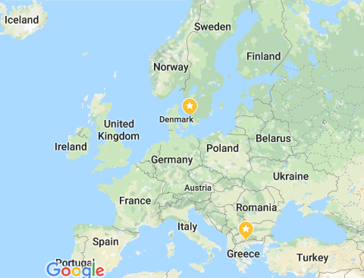
Gamesgekks
Statistics

Slide 2
GameGekks
Statistics
Sold games\Module income
Active Gamers\Population
Sold games\weather
Help
Exit

Slide 3
GameGekks
Back
Help Screen

Slide 4
Sold games\Module income
Country
Year
Statistics’ Method
Other filters
Back
Help

Slide 5
The Netherlands
2010
Bar Charts (H)
Other filters
Back
Data sets
Help

Slide 6
Country
Year
Statistics’ Method
Other filters
Austria.
Bulgaria.
Belgium.
Croatia.
Czech Republic.
Cyprus.
Denmark.
Estonia.
2005
2006
2007
2008
Bar chart (H)
Bar chart (V)
Line chart
Pie chart
Men
Women
Under 18
Above 18
Back
Data sets
Help

Slide 7
The Netherlands
2010
Bar Charts (H)
Other filters
Back
Data sets
Help

Slide 8
The Netherlands
2010
Line chart
Other filters
Back
Data sets
Help

Slide 9
The Netherlands
2010
Pie chart
Other filters
Back
Data sets
Help

Slide 10
The Netherlands
2010
Pie chart
Other filters
2005 | 2006 | 2007 | 2008 | 2009 | 2010
Estonia | 12.3 | 13 | 14 | 15 | 16
Ireland | 18 | 19.5 | 21 | 22 | 24
Greece | 12.3 | 13 | 14 | 15 | 16
Spain | 18 | 19.5 | 21 | 22 | 24
France | 12.3 | 13 | 14 | 15 | 16
Croatia | 18 | 19.5 | 21 | 22 | 24
Italy | 12.3 | 13 | 14 | 15 | 16
Cyprus | 18 | 19.5 | 21 | 22 | 24
Back
Help

