Slide 1

Dungeon Company
Art Style (thus far)

Slide 2

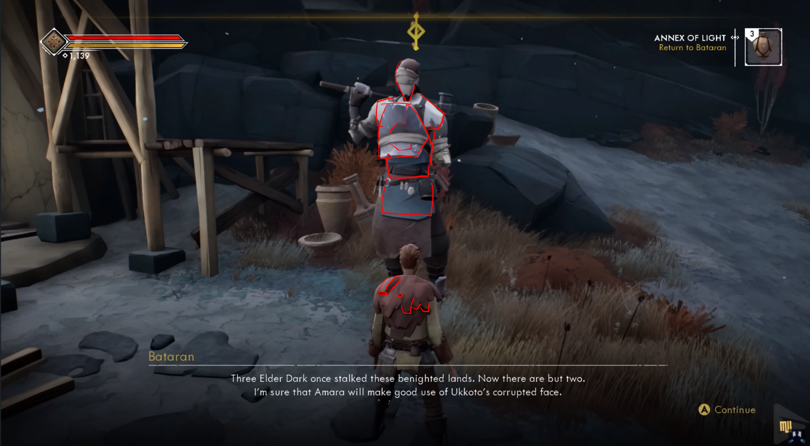
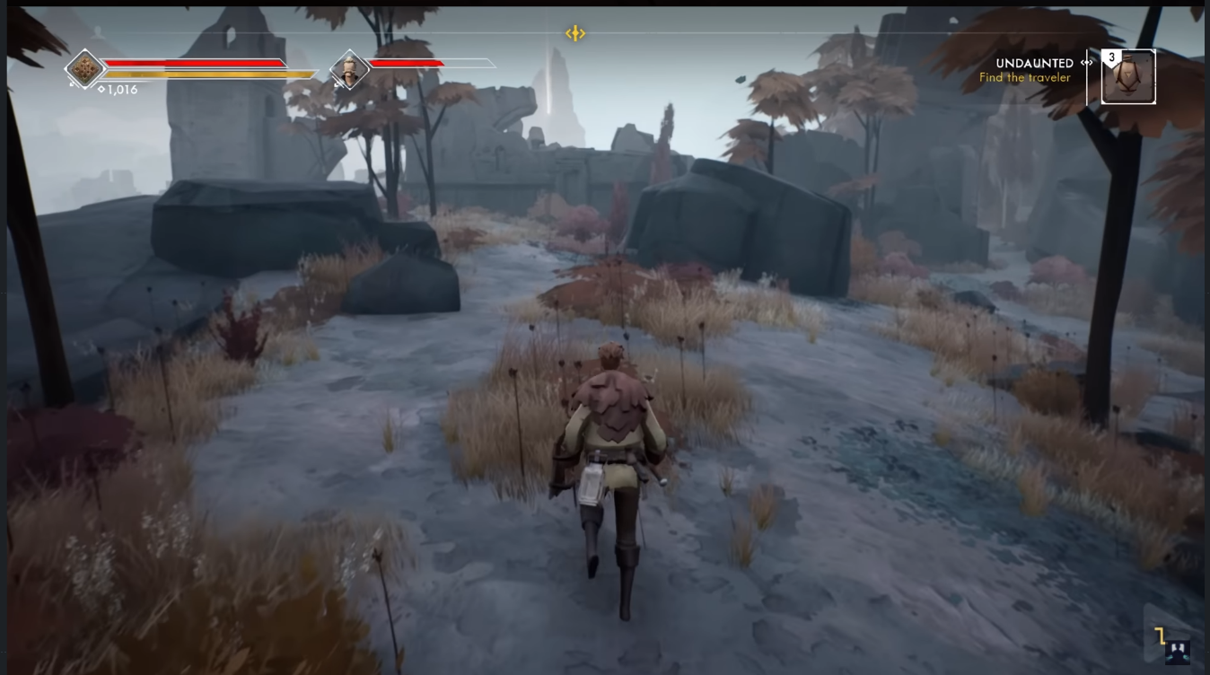
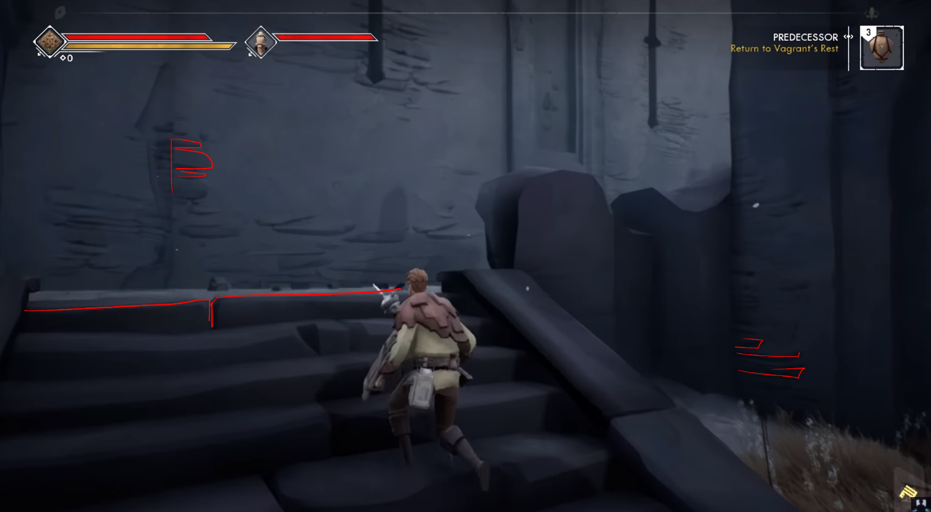
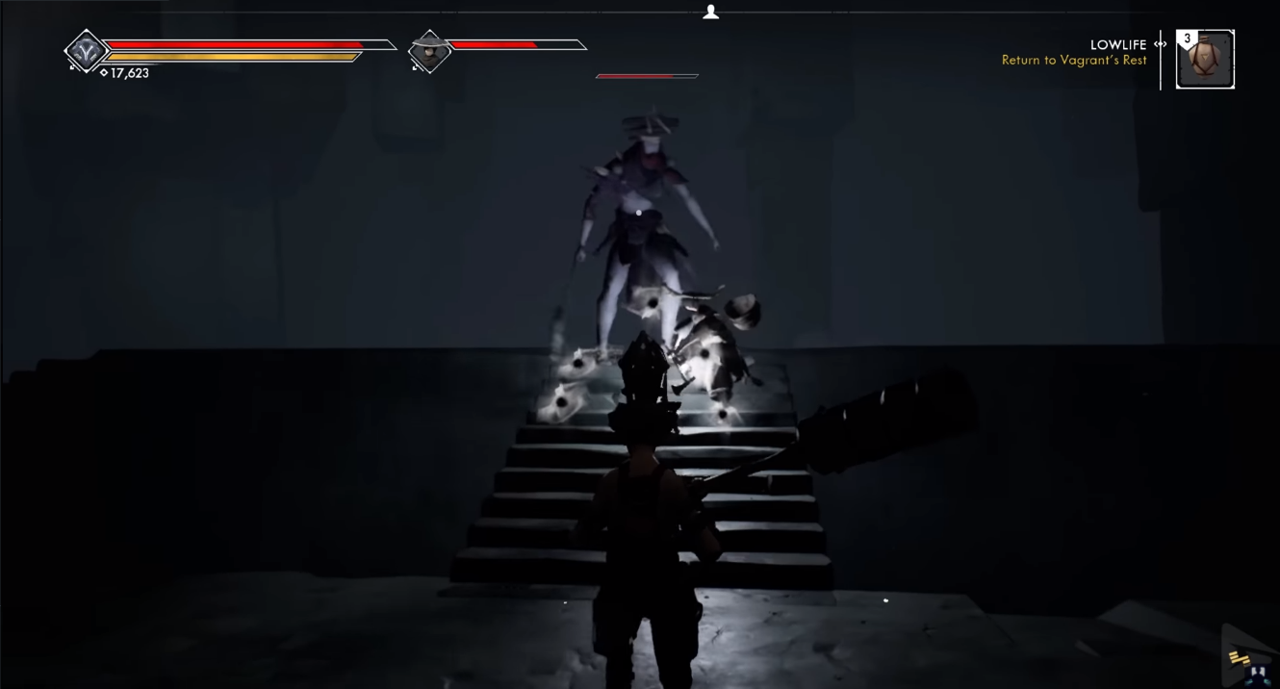
Ashen

Slide 3
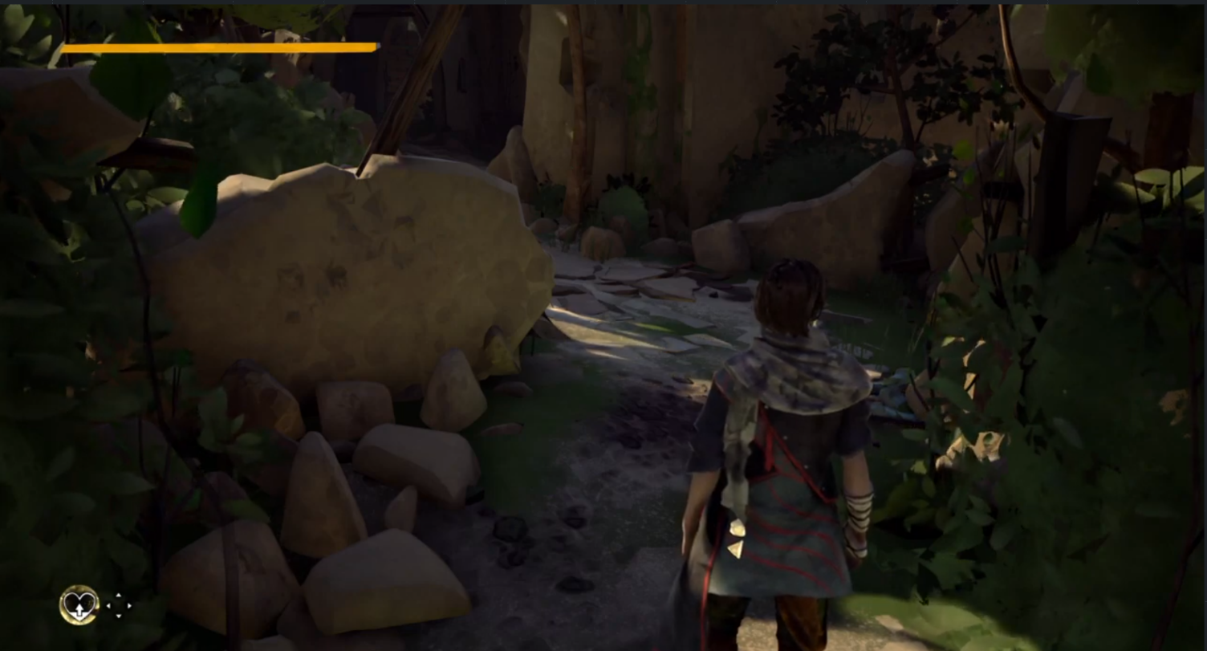
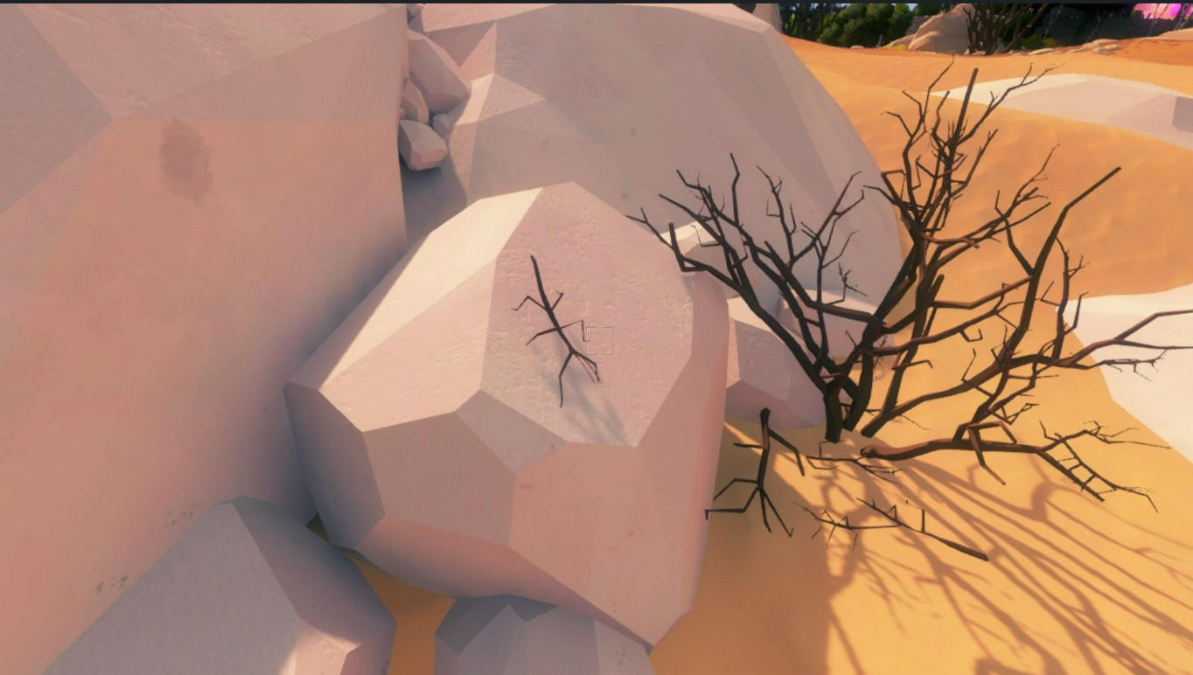
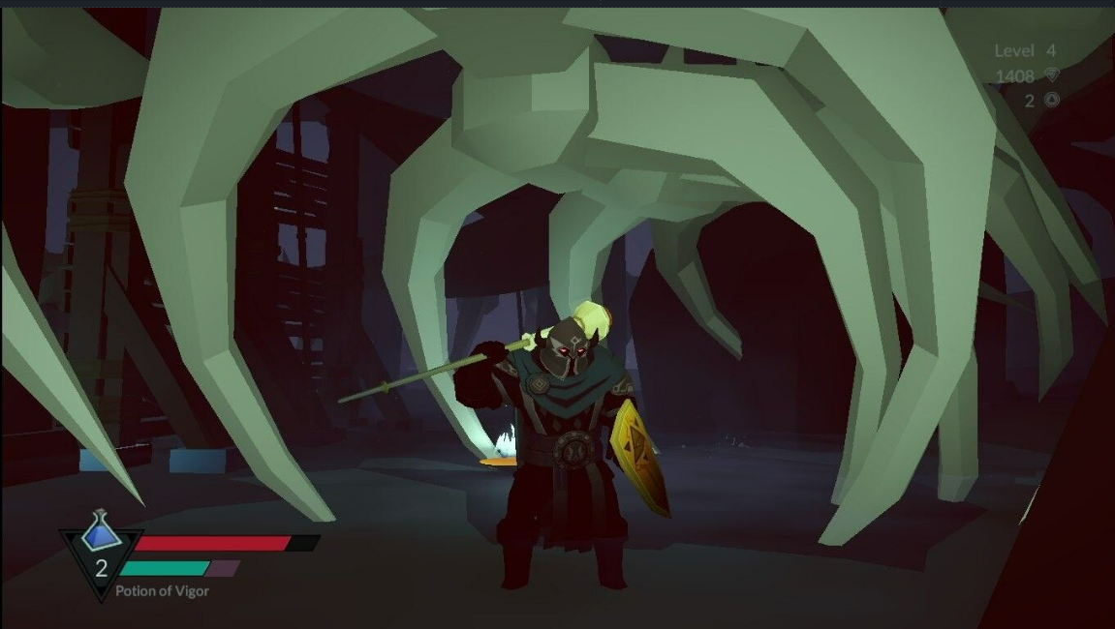
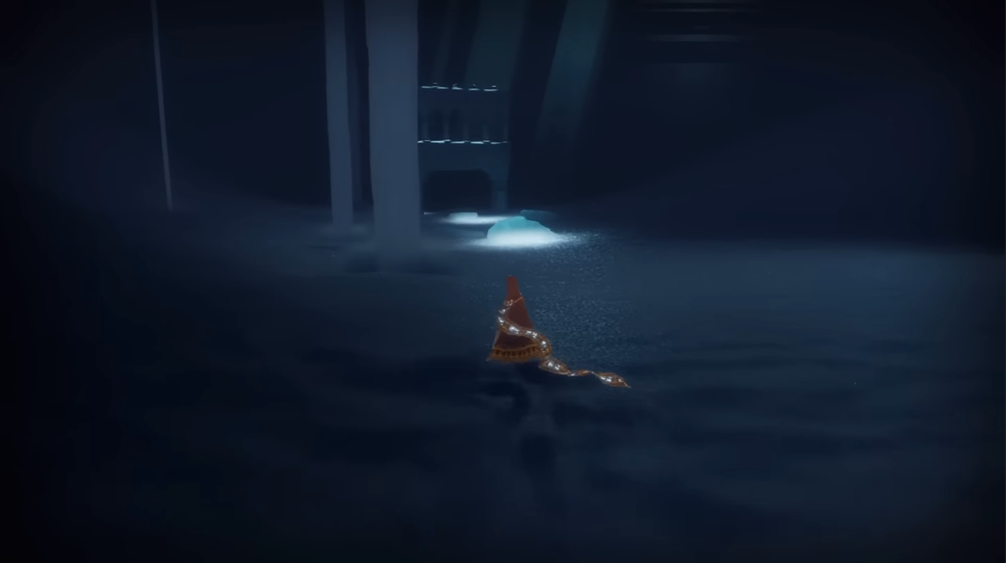
The
Witness
Absolver
Necropolis
Journey

Slide 4
Style Guidlines
Low Poly -> Clear Shapes
Low level of detail
Wear & Tear
Desaturated Colors
High Contrast lighting
Medieval Fantasy
Notes:
Clear Shapes -> Exaggerate them cartoony style
Low level of detail: e.g. no faces, pointed textures
Show object story by adding wear and tear to textures
High Contrast lighting

Slide 5
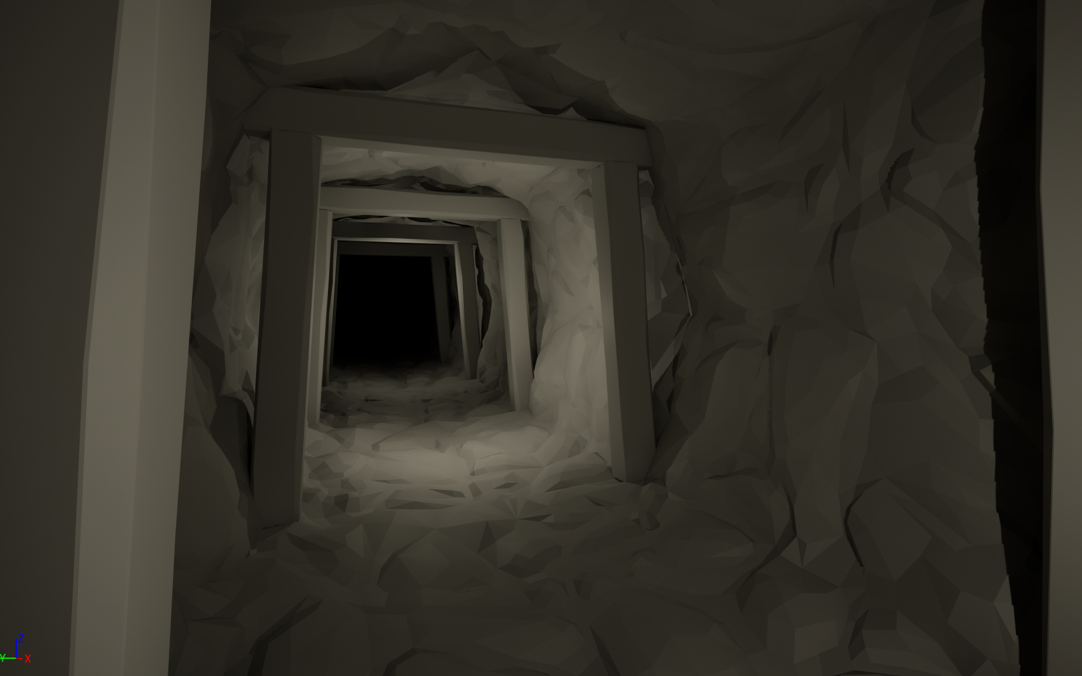

Slide 6
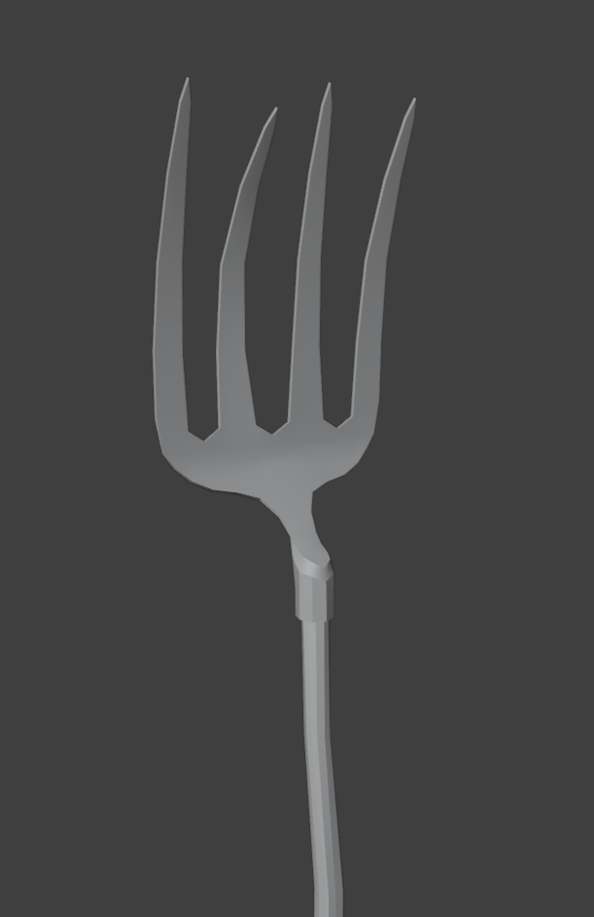
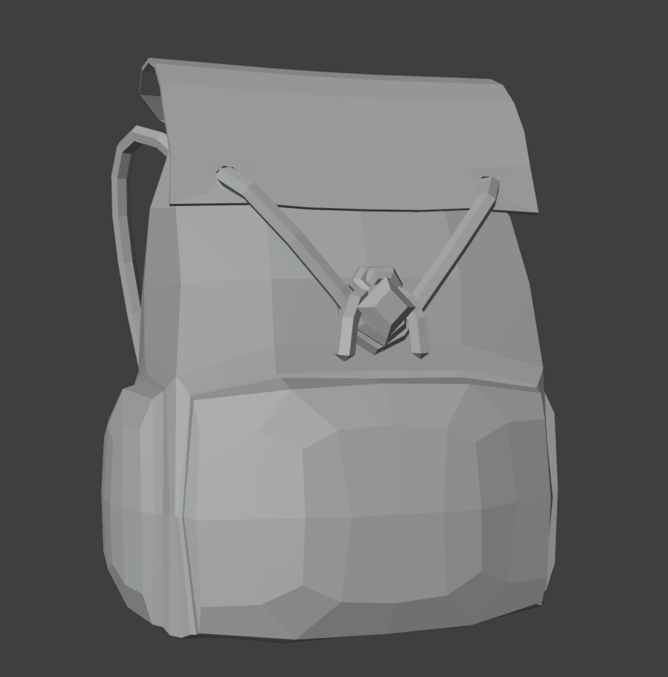
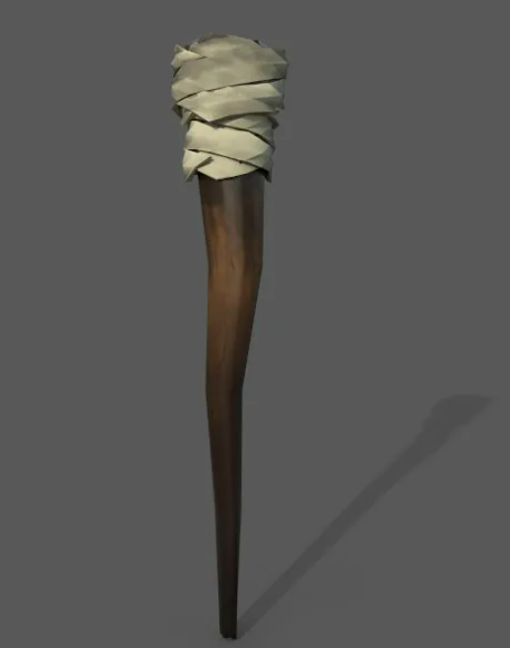

Slide 7
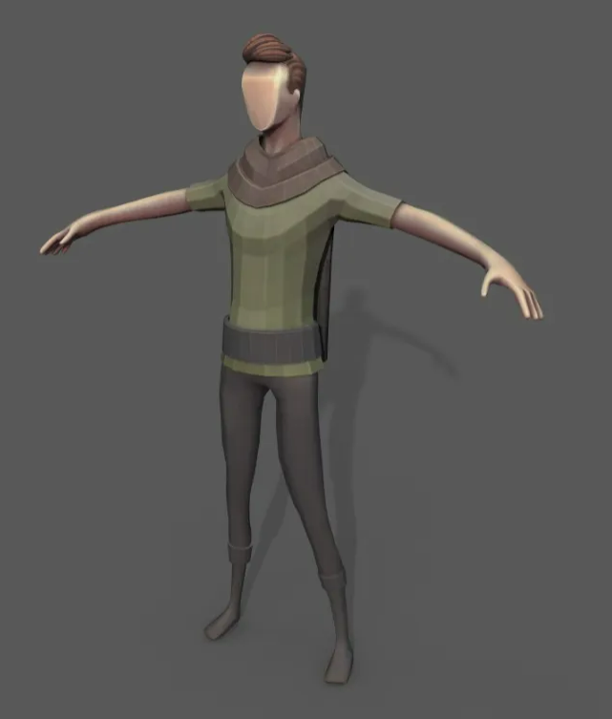

Slide 8


