Slide 1
HEIMDALL
Campus Access & Hostel Management System
A production-grade, highly scalable, and secure QR permission architecture.
VITE/REACT • EXPRESS • REDIS • MONGODB
Heimdall Smart Hostel Management Platform | Slide 1

Slide 2
The Campus Gate Challenge
Traditional systems fail during rush hours (5 PM returns, weekend exit crowds):
01
02
03
04
Logbook Bottlenecks
Proxy Outpasses
Approval Delays
No Real-time Auditing
Manual logs create massive queues, holding students at the gate for up to 30 mins.
No check on screenshot sharing, manual slip falsification, or fake permissions.
Hostel wardens and parents disconnected from gate logs, resulting in manual validation.
IT & admin cannot monitor active students in campus or track emergency missing students.
Heimdall Smart Hostel Management Platform | Slide 2

Slide 3
High-Availability Architecture
CLIENT LAYER (SPA)
ROUTING & API LAYER
MEMCACHE & TASK QUEUE
PERSISTENCE LAYER
▪ React / Vite Web Portal
▪ Express REST Endpoints
▪ Redis Cache (Dashboard)
▪ MongoDB Atlas (M0/M30)
▪ Tailwind & Custom CSS UI
▪ Socket.io Event Servers
▪ Scan Lock Service (Lua NX)
▪ Indexed Query Collections
▪ html5-qrcode Web Scanner
▪ Helmet & CORS Middleware
▪ BullMQ Asynchronous Workers
▪ Mongoose Schemas
▪ Socket.io Event Client
▪ Brute-force Rate Limiters
▪ JWT Token Blacklist
▪ Auto Reconnection Pool
Heimdall Smart Hostel Management Platform | Slide 3

Slide 4
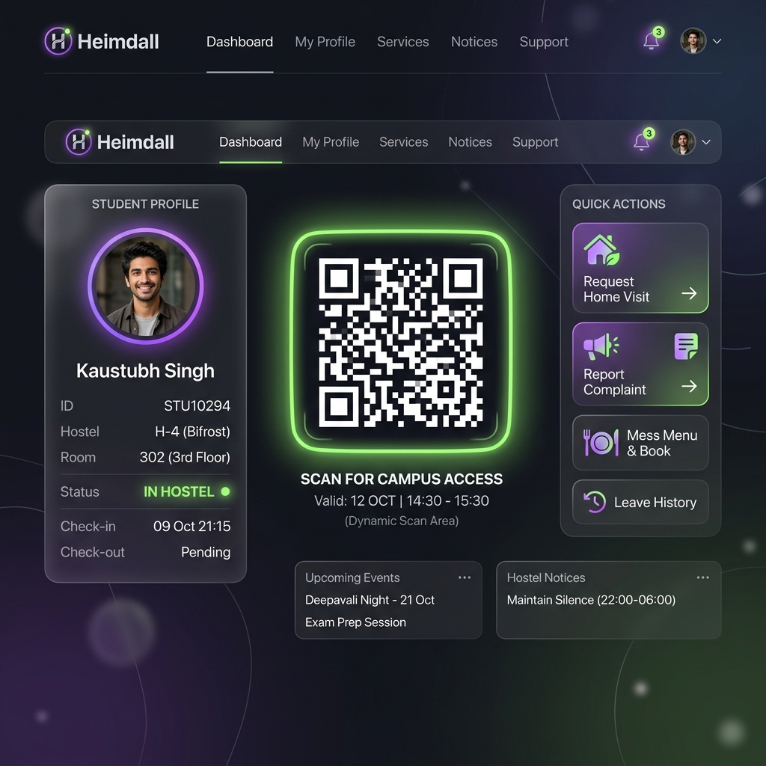
Student Portal & Dynamic QR Flow
Features for Students:
✔ Dynamic QR Codes: Uses cryptographically signed JWT tokens and dynamic OTP salts that change every 60 seconds.
✔ Screenshots Prevention: Prevents QR reuse, sharing, and out-of-campus code generation.
✔ Home-Visit Requests: Input travel destination and date targets to request outpass approvals.
✔ Parent Webhook Integration: Sends SMS alerts and monitors replies in the background.
Heimdall Smart Hostel Management Platform | Slide 4

Slide 5
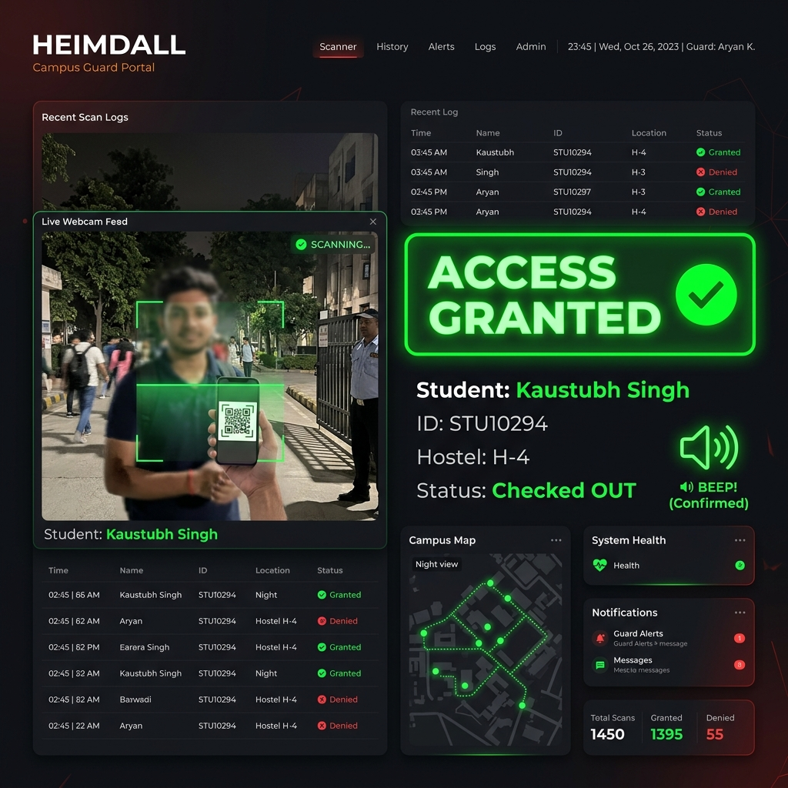
Security Guard Scanner Dashboard
High-Throughput Gate Terminal Features:
✔ Zero-Latency Scanner: Instant camera capture on laptop webcams or mobile tablet lenses.
✔ Access Approved Signal: Renders a fullscreen neon green indicator and emits a confirmation audio beep.
✔ Scan Lock Service: Prevents double-scans and multiple entry trials at different gates via atomic Redis locking.
✔ Live Gate Feed: Lists last 5 scanned logs on a live sidebar for security personnel monitoring.
Heimdall Smart Hostel Management Platform | Slide 5

Slide 6
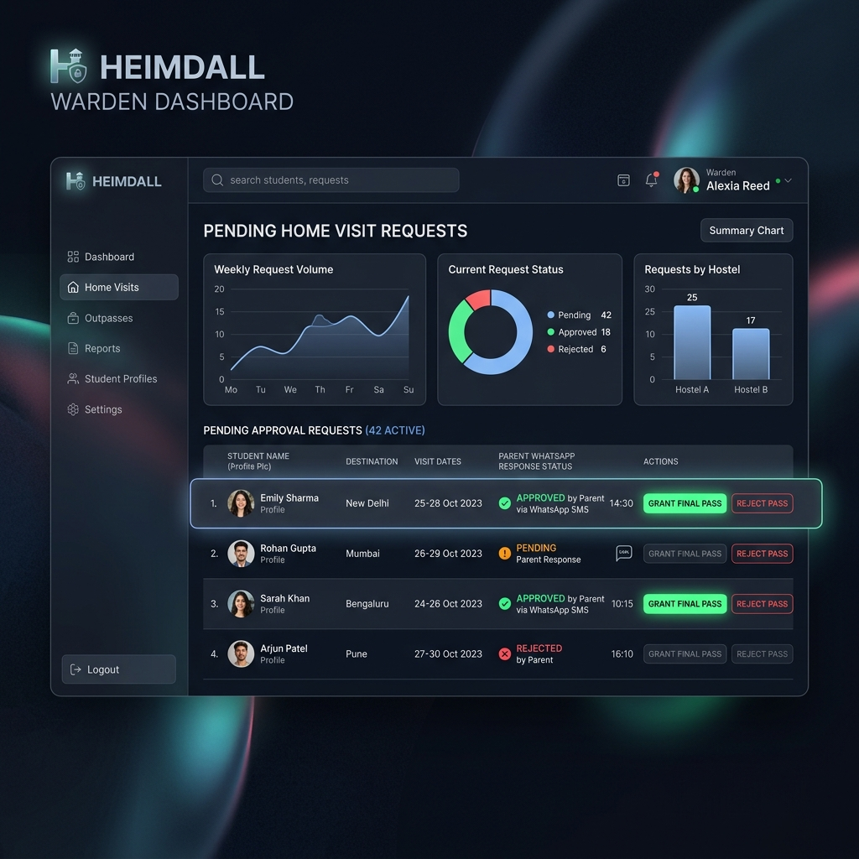
Warden Operations & Approvals
Home Visits & Grievance Controls:
✔ Pending Outpass Auditing: Shows student outpass details, destinations, and visit timeframes.
✔ WhatsApp Approval Status: Indicates if parent approved (green), rejected (red) or is pending response.
✔ One-Click Pass Controls: Wardens can "Grant Final Pass" or "Reject Pass" directly from their panel.
✔ Aggregated Analytics: Visualization charts on outpass counts, hostel ratios, and pending tasks.
Heimdall Smart Hostel Management Platform | Slide 6

Slide 7
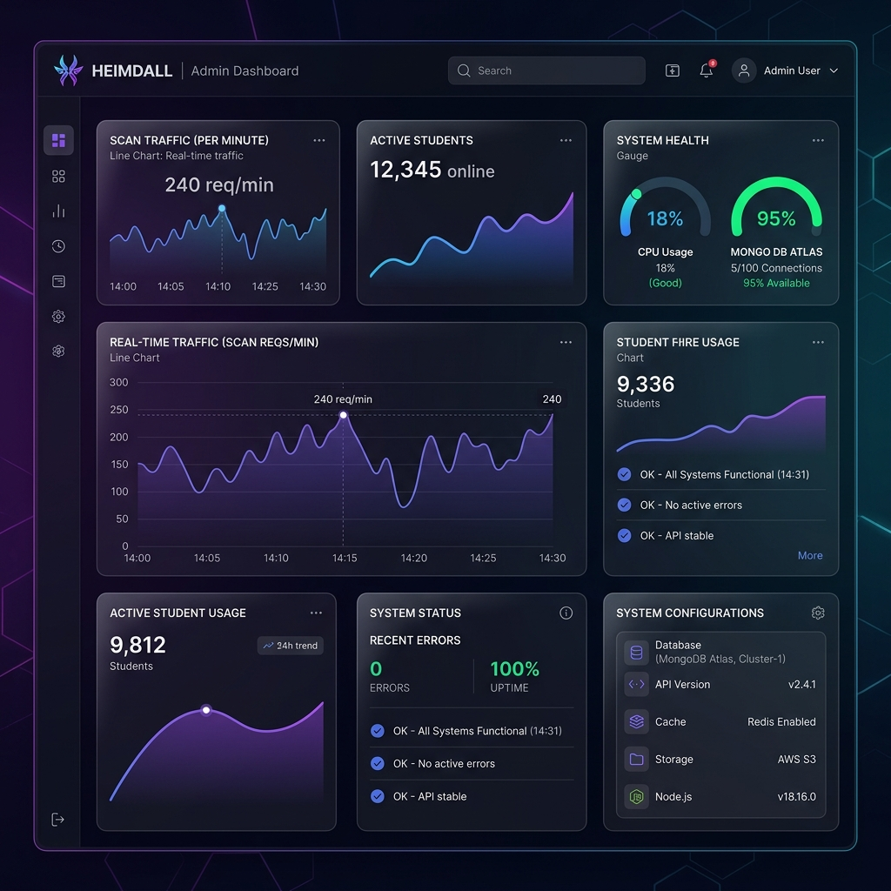
Admin Telemetry & Health
System Configuration & Monitoring:
✔ Live Telemetry Monitors: Real-time graphs showing scan traffic, server uptime, and active connection ratios.
✔ Database Connection Pools: Checks pool status (max 5 in free tier mode, up to 100 on paid cluster).
✔ Cache Validation Stats: Real-time monitoring of Redis client and BullMQ workers.
✔ Active Occupancy Tracking: Charts current campus/hostel ratios and lists recent system warnings.
Heimdall Smart Hostel Management Platform | Slide 7

Slide 8
Scalability & Performance Benchmarks
Engineered Concurrency Mitigations:
API Latency & Capacity Benchmarks:
▪ Atomic Redis Lock: Blocks double-scanning at separate gate terminals concurrently.
Endpoint | Average Latency | Status
GET /api/ready | 2 ms | Fast Healthcheck
GET /api/dashboard/summary | 5 ms (Cached) | Redis Cache Hit
POST /api/gatescan/scan | 35 ms | DB Auth + Lock
POST /api/auth/login | 120 ms | Bcrypt verification
GET /api/student/status | 24 ms | Indexed query
▪ Aggressive Dashboard Caching: Saves MongoDB aggregate CPU loads by caching Warden counters in Redis.
▪ BullMQ Notification Queues: Offloads Twilio SMS & WhatsApp notifications to background threads.
▪ Atlas Free-Tier Caps: Caps pool size and schedules idle timeouts to run reliably on free plans.
Heimdall Smart Hostel Management Platform | Slide 8

Slide 9
Local Run & Operational Rollout
DEVELOPMENT INITIALIZATION
PRODUCTION DEPLOYMENT
1. Install dependencies across client & server:
$ npm run install:all
2. Seed database with credentials:
$ npm run seed
3. Start concurrent backend & frontend:
$ npm run dev
4. Orchestrate complete local services:
$ docker-compose up --build
1. Deploy frontend client to Vercel CDN
Root directory: frontend/
Redirect config: vercel.json
2. Deploy stateless API backend to Render
Root directory: backend/
Configured with auto-scaling instances
3. Provision Atlas & Redis Cloud instances
Cap MongoDB connections pool to 5 on free tier
Set redis memory-policy = allkeys-lru
Heimdall Smart Hostel Management Platform | Slide 9

