Slide 1
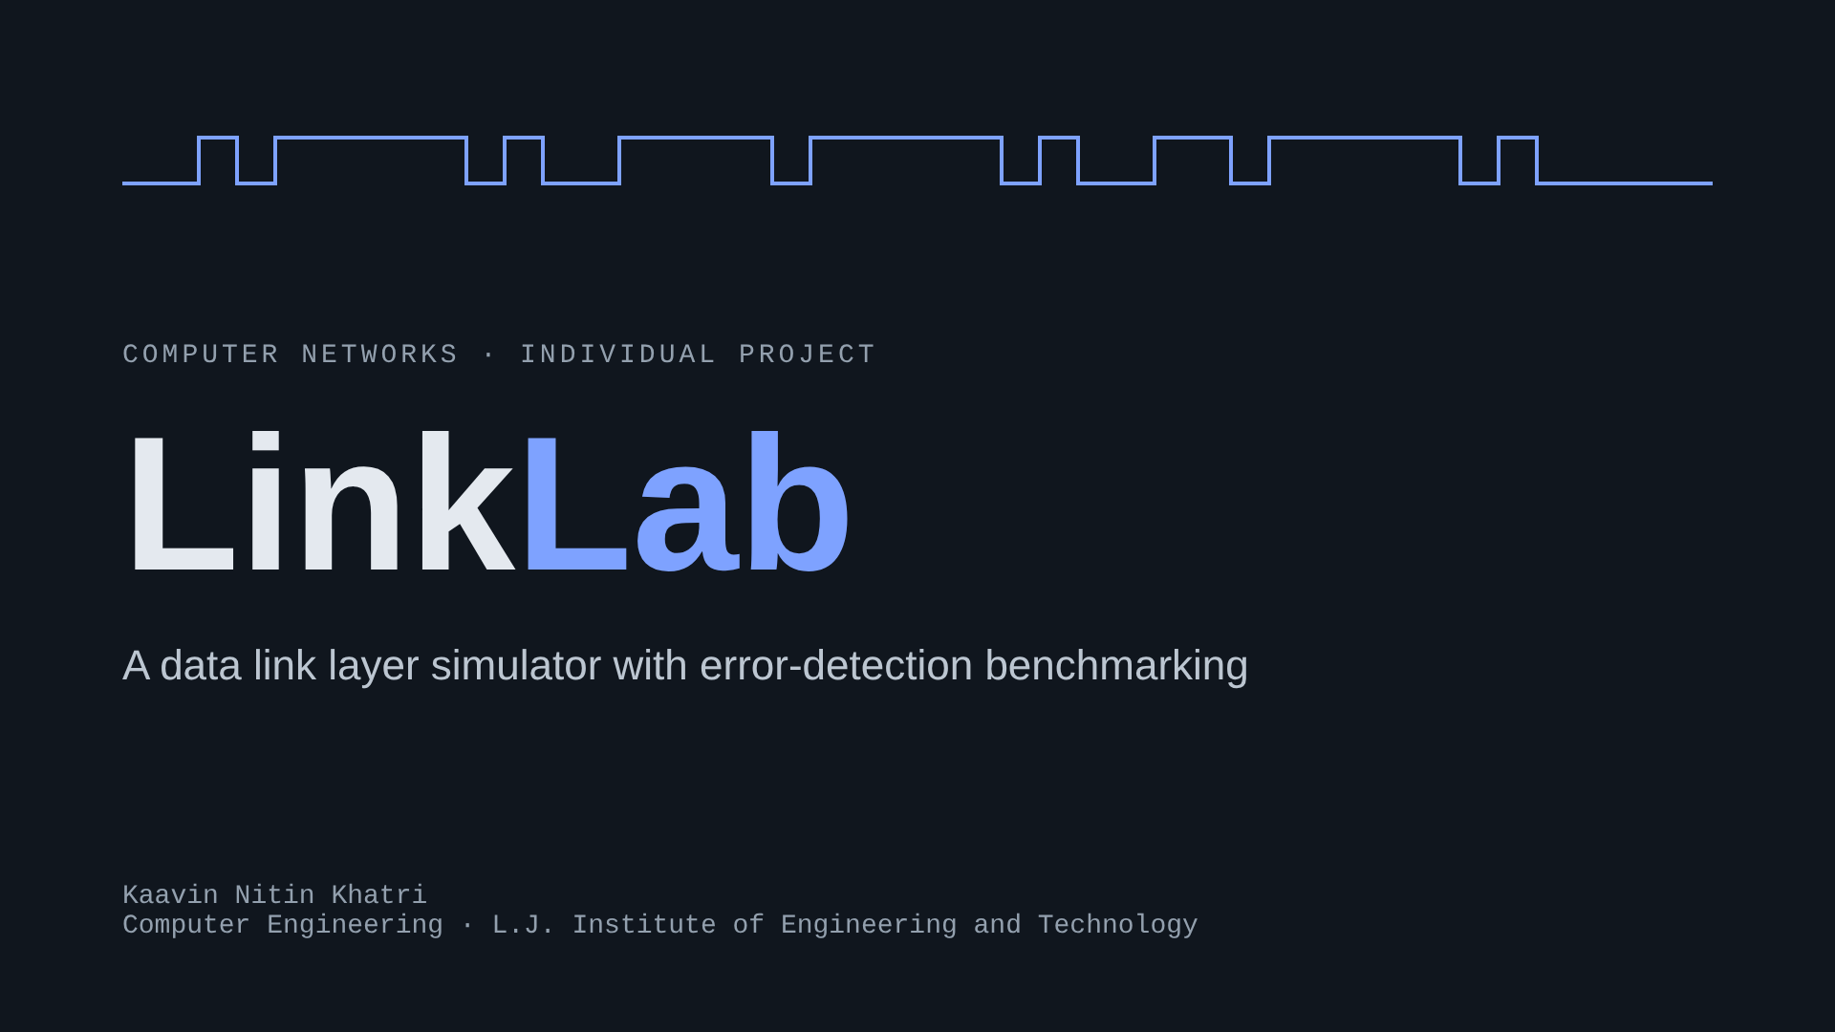
Notes:
Introduce yourself and the project title. LinkLab joins framing, error detection and flow control into one working pipeline, then measures how well each technique works.

Slide 2
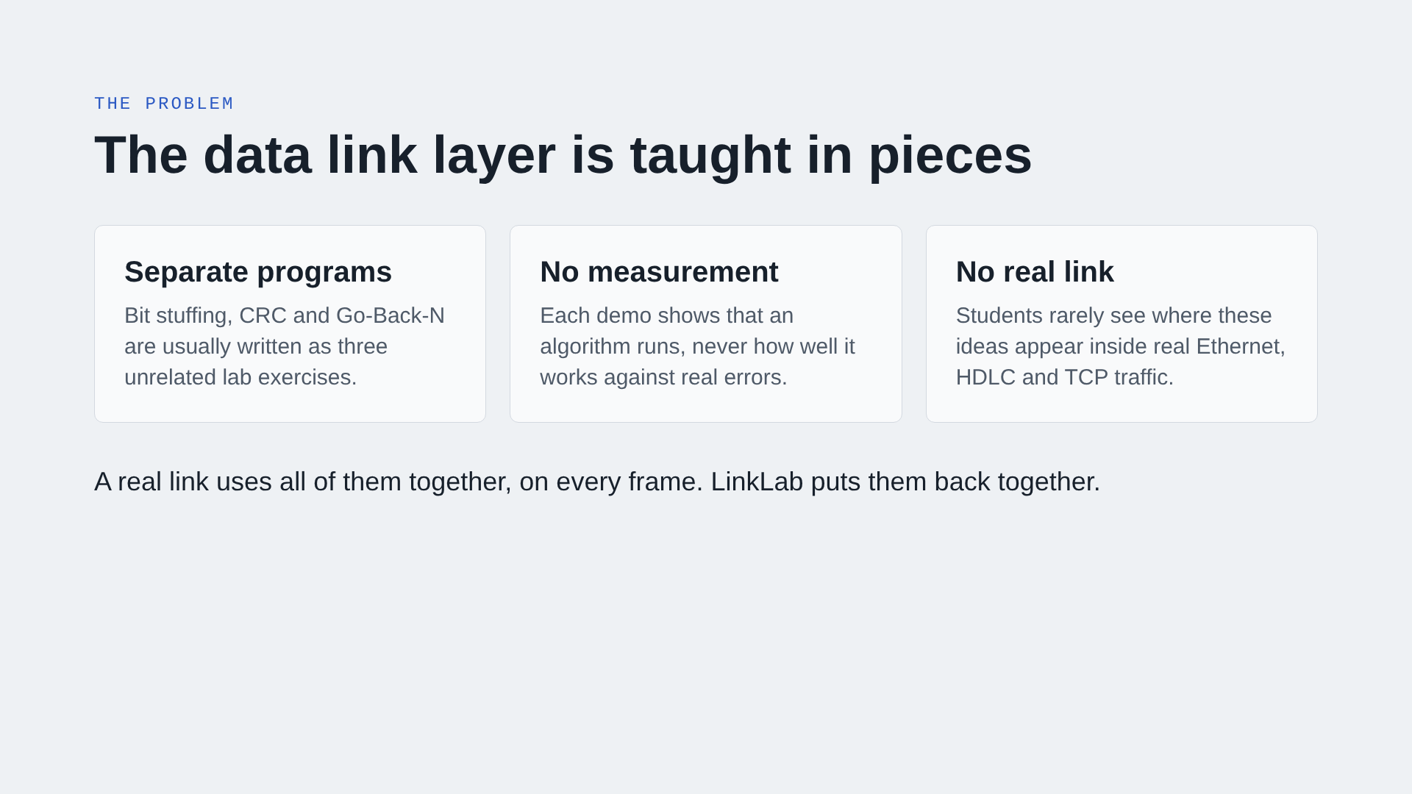
Notes:
Most items on the project list are a single algorithm. In practice, framing, error detection and flow control work together on every frame. That gap is what this project addresses.

Slide 3
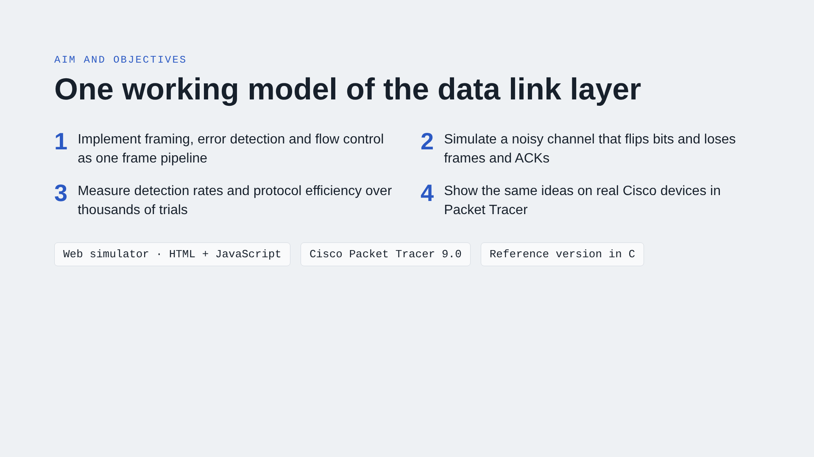
Notes:
Four objectives. The tools: the main simulator runs in any browser, the network lab is in Packet Tracer, and a C version of the algorithms exists as a reference.

Slide 4
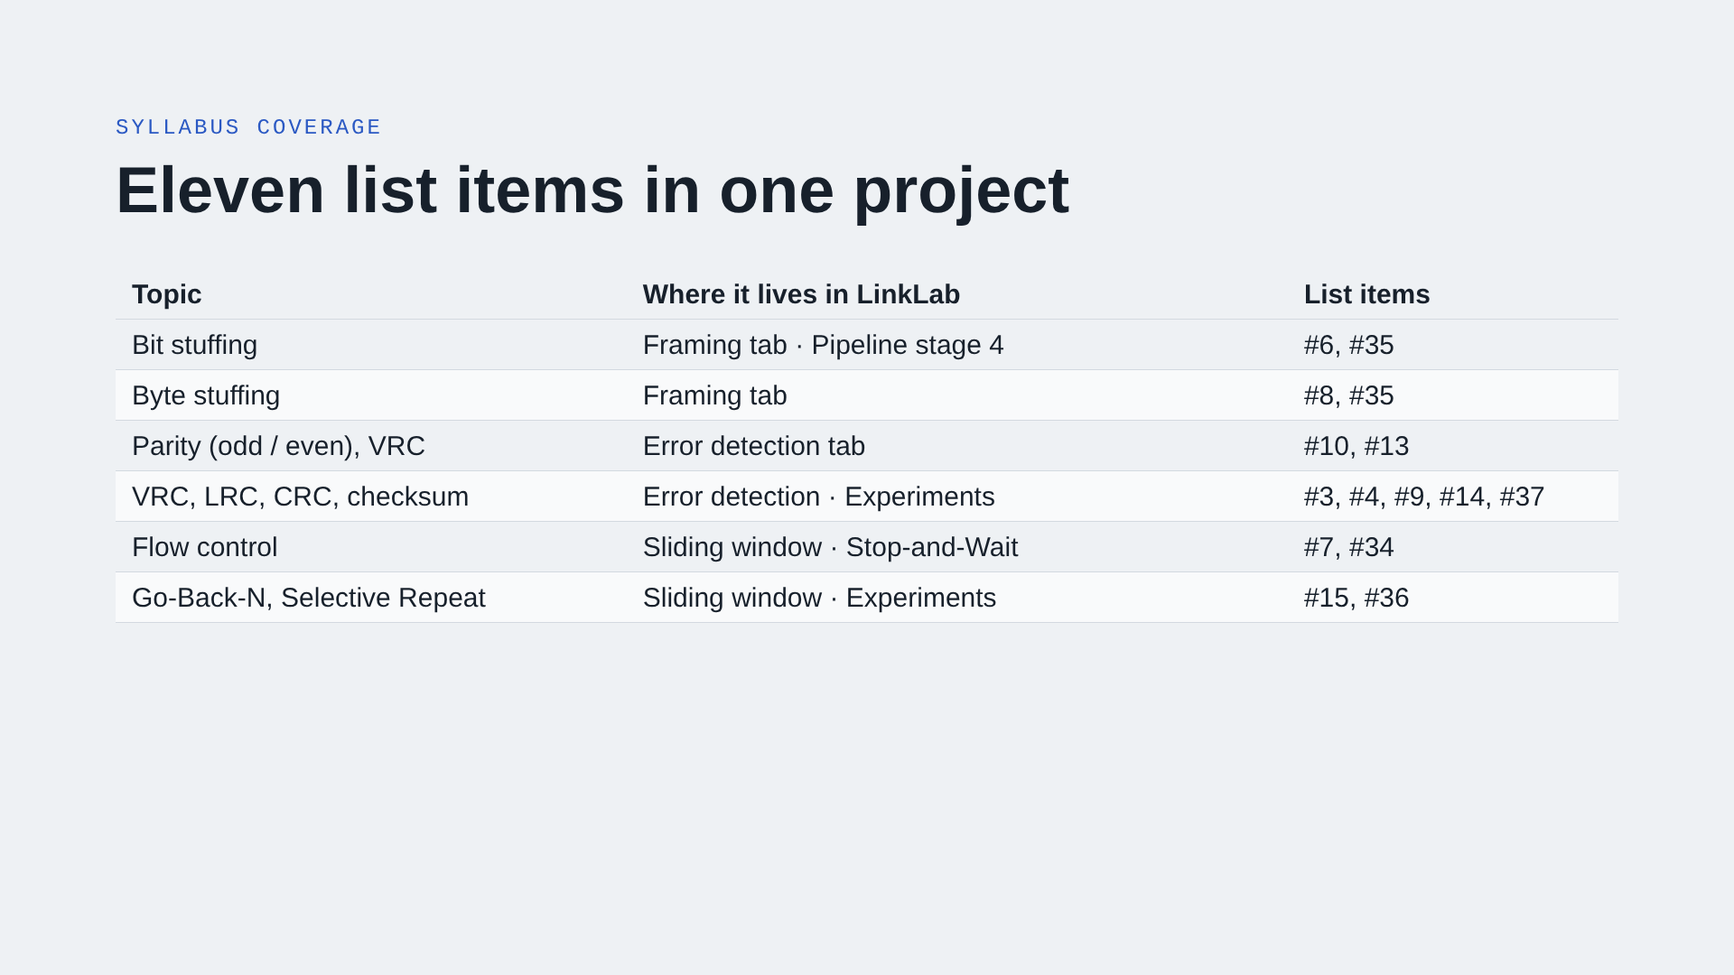
Notes:
Numbers refer to the college list of project definitions. Every topic is something you can click on and run during the demo.

Slide 5
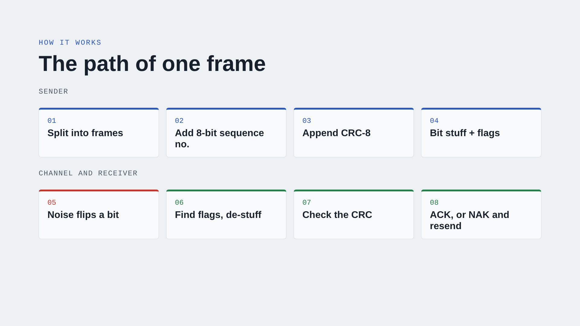
Notes:
This is the Pipeline tab. A message is cut into frames. Each gets a sequence number and a CRC-8 using x^8 + x^2 + x + 1, is bit-stuffed and wrapped in 01111110 flags. Noise flips a random bit. The receiver de-stuffs, recomputes the CRC, and replies ACK or NAK. A NAK makes the sender retransmit until the message arrives intact.

Slide 6
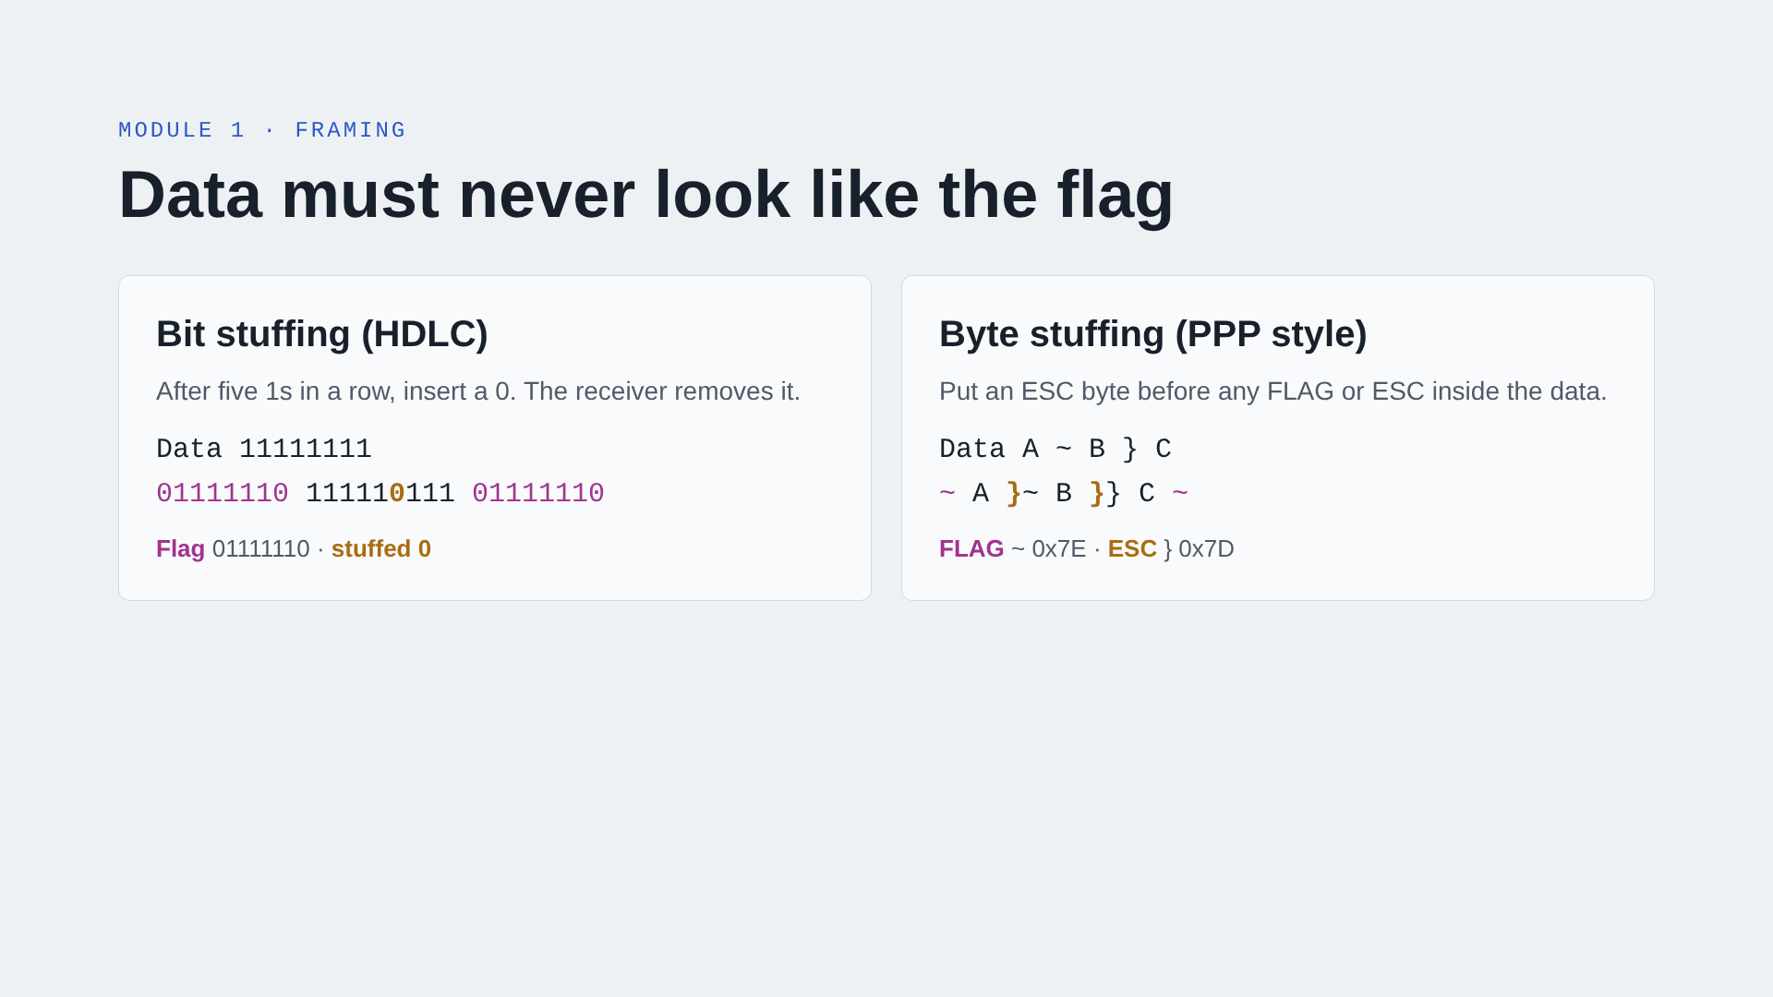
Notes:
The flag 01111110 marks where a frame starts and ends. Stuffing guarantees six 1s never appear inside the data, so the receiver can always find the boundary. Byte stuffing does the same job with whole characters.

Slide 7
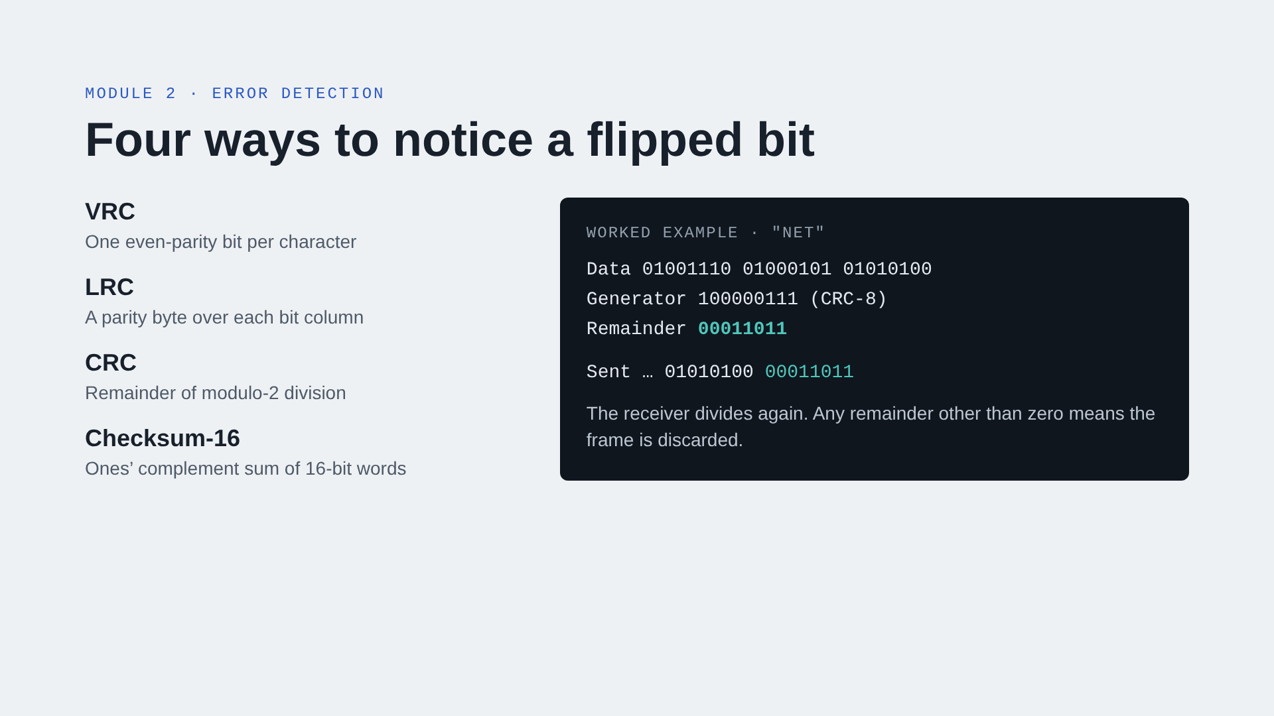
Notes:
All four methods are implemented and can be switched live on the Error detection tab. Clicking any received bit flips it and shows the receiver’s verdict. For CRC the full long division is printed step by step.

Slide 8
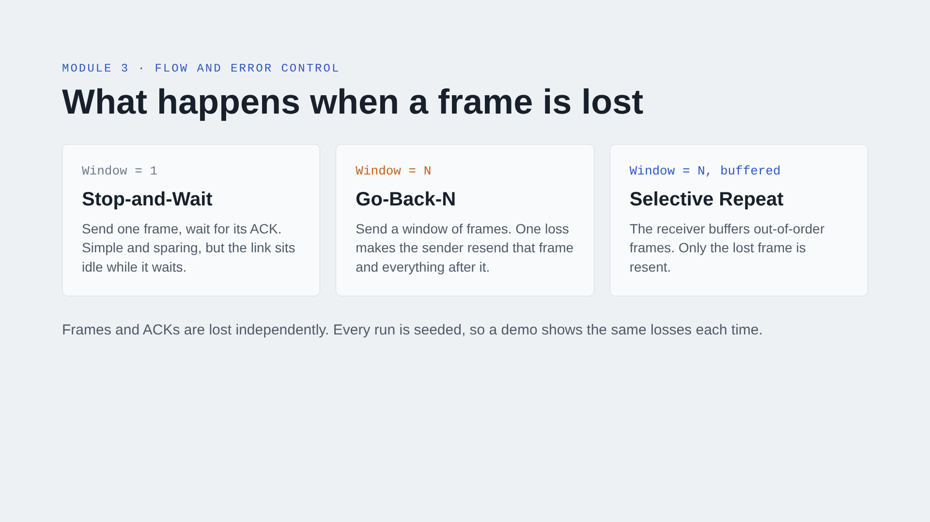
Notes:
The Sliding window tab animates each protocol on a sender–receiver ladder diagram, with a step slider and play button. The sender window and receiver buffer update at every step.

Slide 9
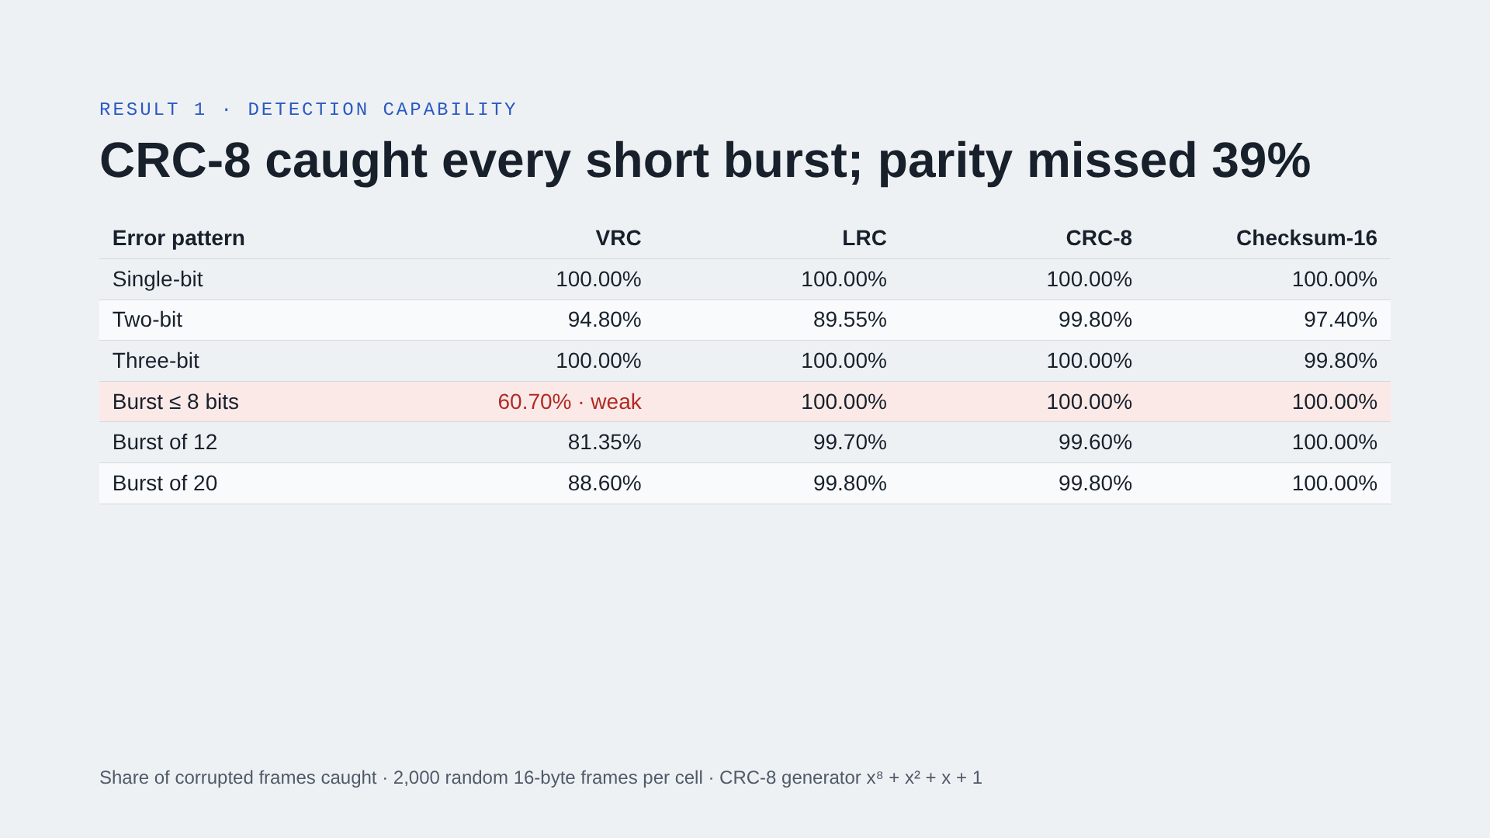
Notes:
Key points: VRC misses any even number of flips inside one character, which is why it caught only 61% of short bursts. LRC misses two flips in the same bit column. CRC-8 caught every burst up to 8 bits long, as theory predicts for 8 check bits, and misses about 1 long burst in 256.

Slide 10
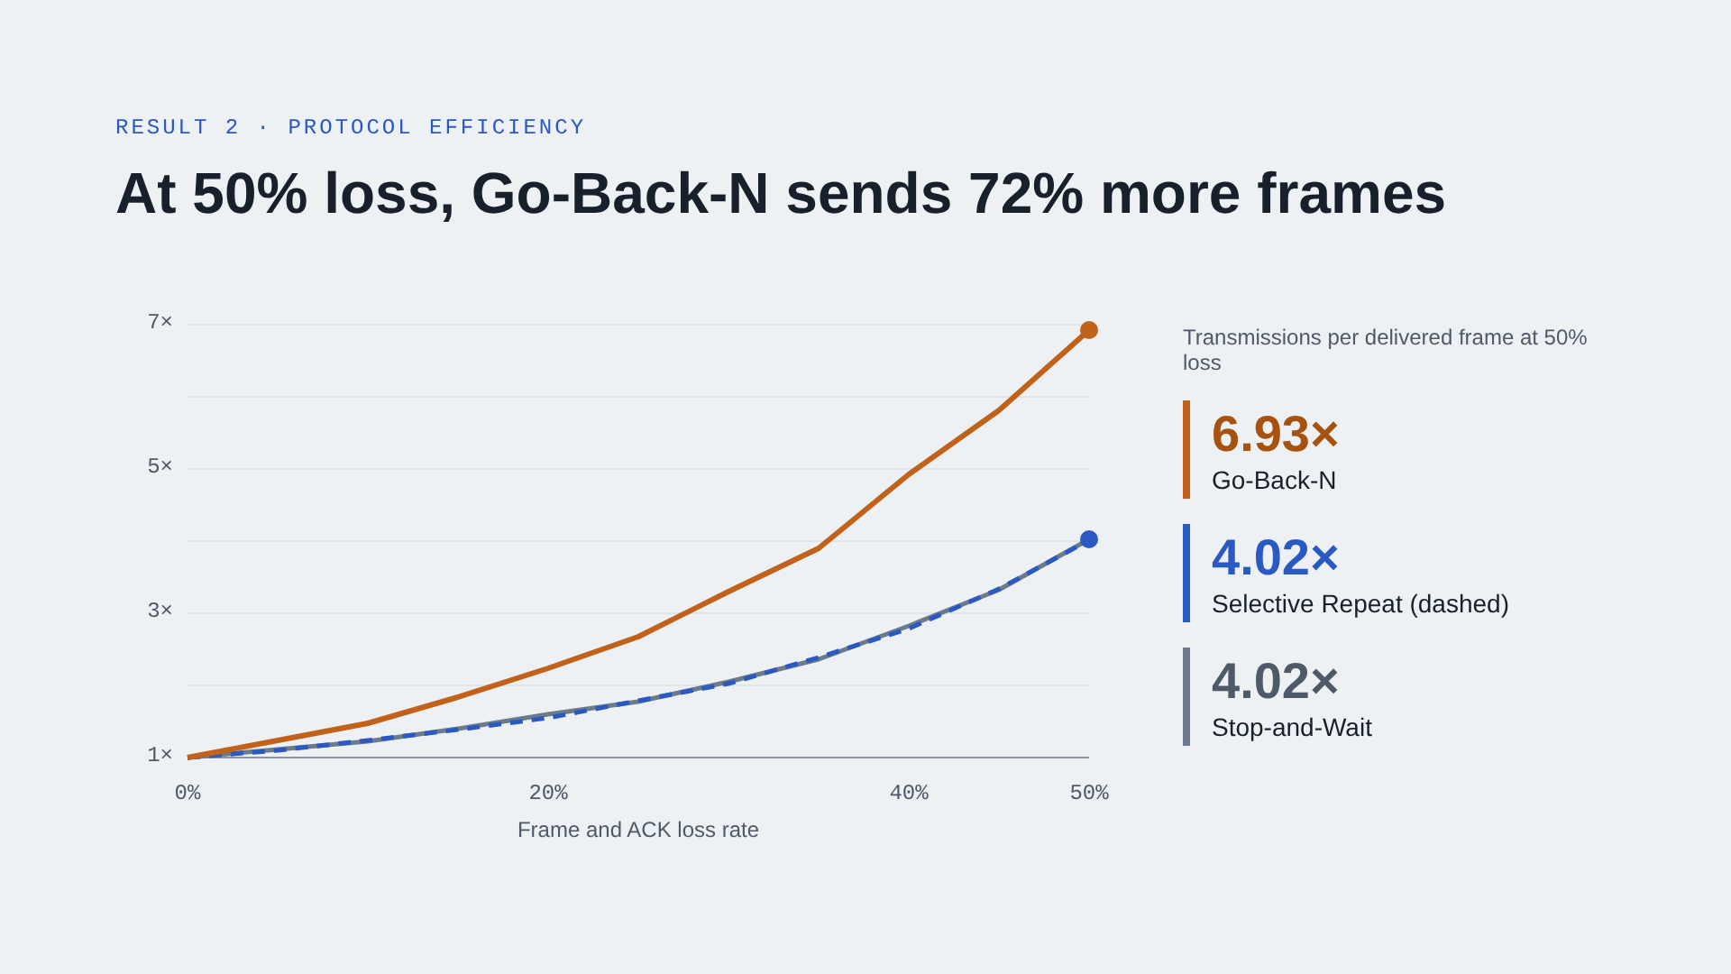
Notes:
50 frames, window of 7, 200 runs averaged per point. Go-Back-N pays for every loss with a whole window of resends. Selective Repeat uses about as few transmissions as Stop-and-Wait while still sending a window at a time, so it is the best choice on a lossy link. The Selective Repeat and Stop-and-Wait lines overlap almost exactly.

Slide 11
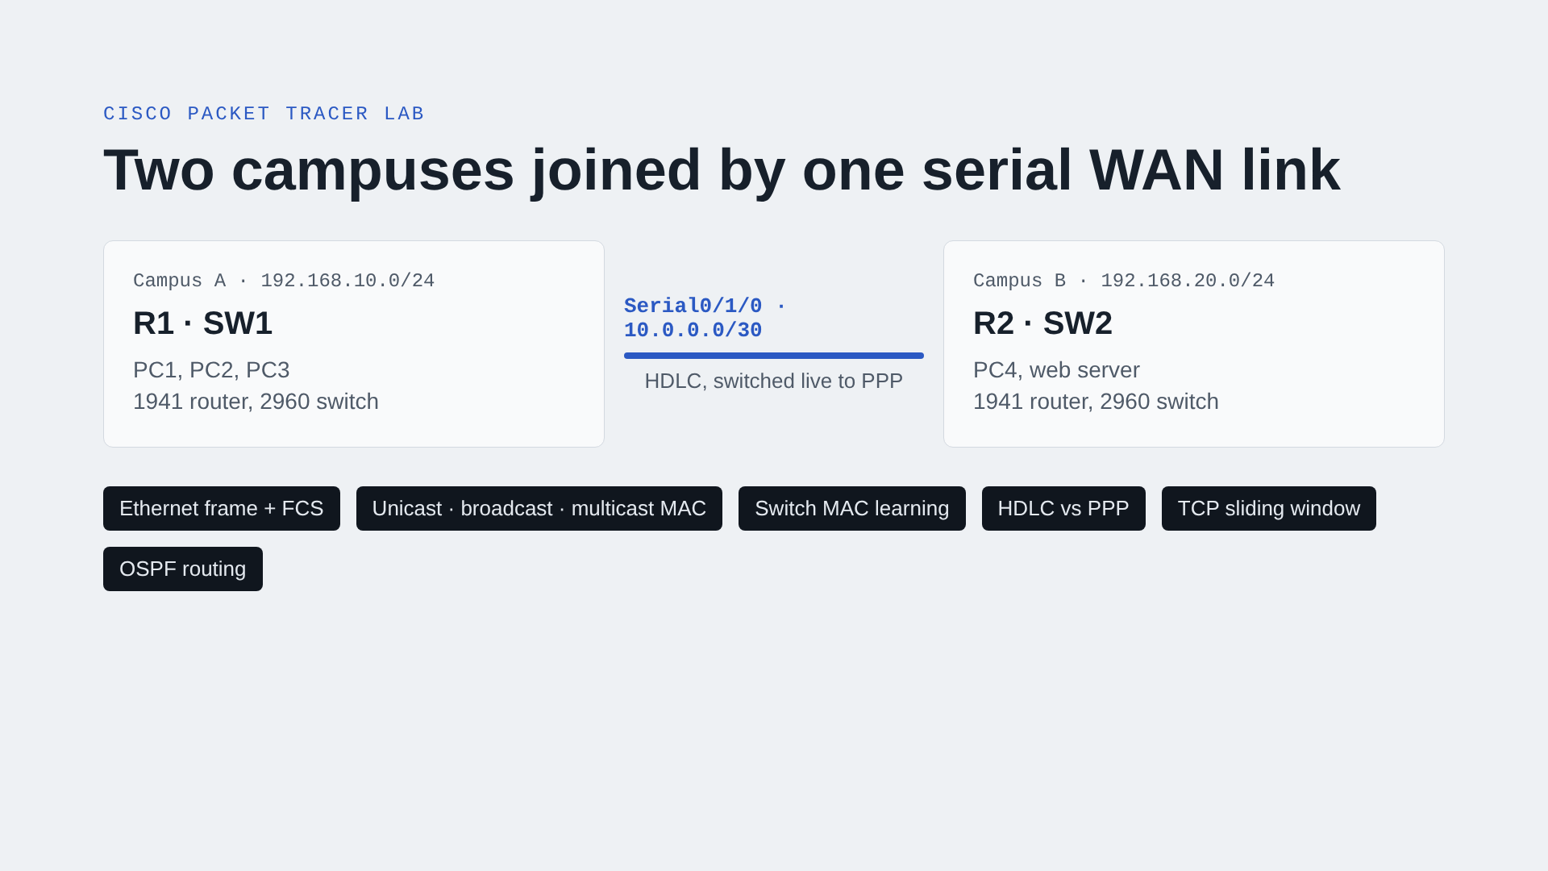
Notes:
Nine devices: two 1941 routers with serial modules, two 2960 switches, four PCs and a web server. OSPF joins the two LANs. The Physical view places each LAN in its own campus building with its own wiring closet. The dark pills are the five live demos in Simulation mode, plus routing.

Slide 12
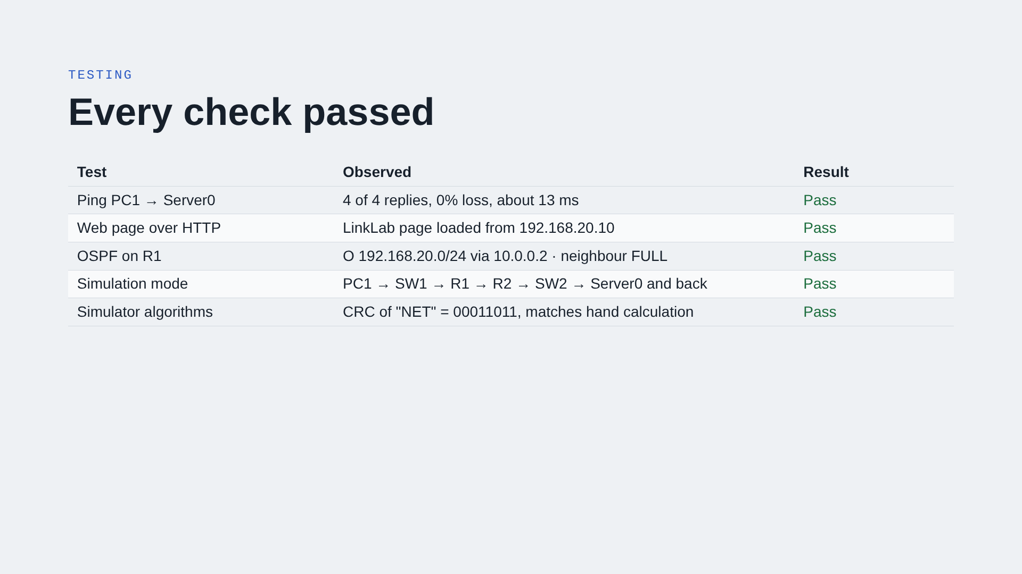
Notes:
The first ping of a session loses one reply while ARP resolves the gateway’s MAC address, which is expected behaviour. The simulator’s CRC result was checked against an independent calculation.

Slide 13
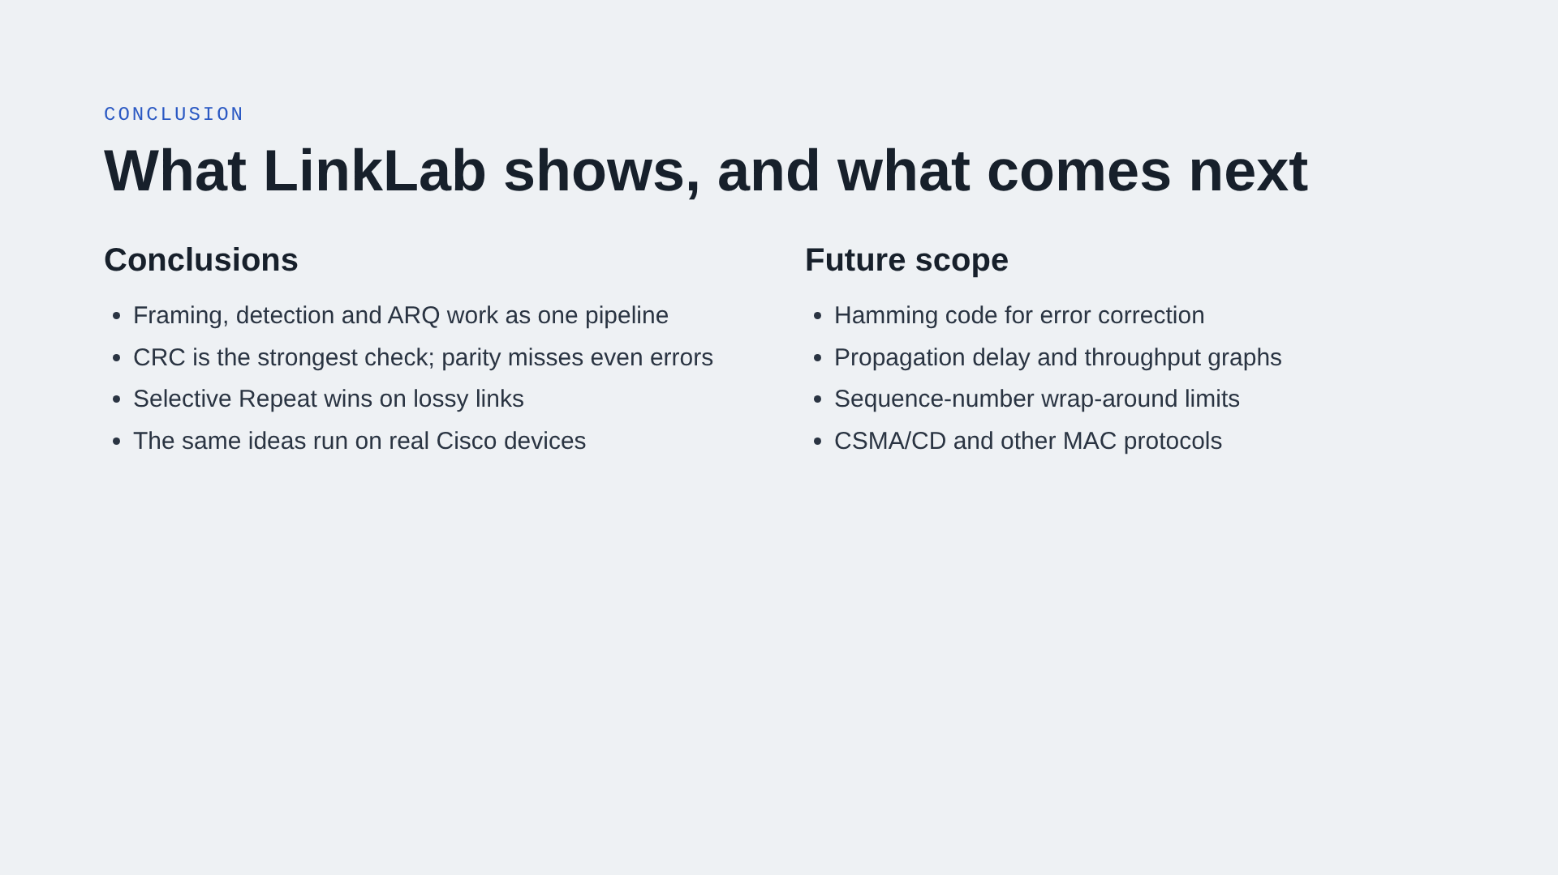
Notes:
Summarise the four findings, then mention future work. Hamming code would move from detecting errors to correcting them.

Slide 14

Notes:
Open the LinkLab website and Packet Tracer for the demo. Suggested order: Pipeline tab with 40% noise, Sliding window comparison, Experiments, then a ping in Packet Tracer Simulation mode.

