Slide 1
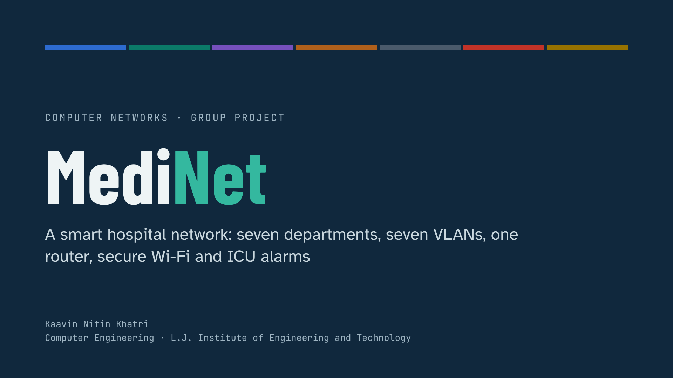
Notes:
Introduce the group and the title. MediNet is a hospital network built in Cisco Packet Tracer and in a browser simulator. The seven coloured bars at the top are the seven department VLANs, and the same colours are used throughout the deck.

Slide 2
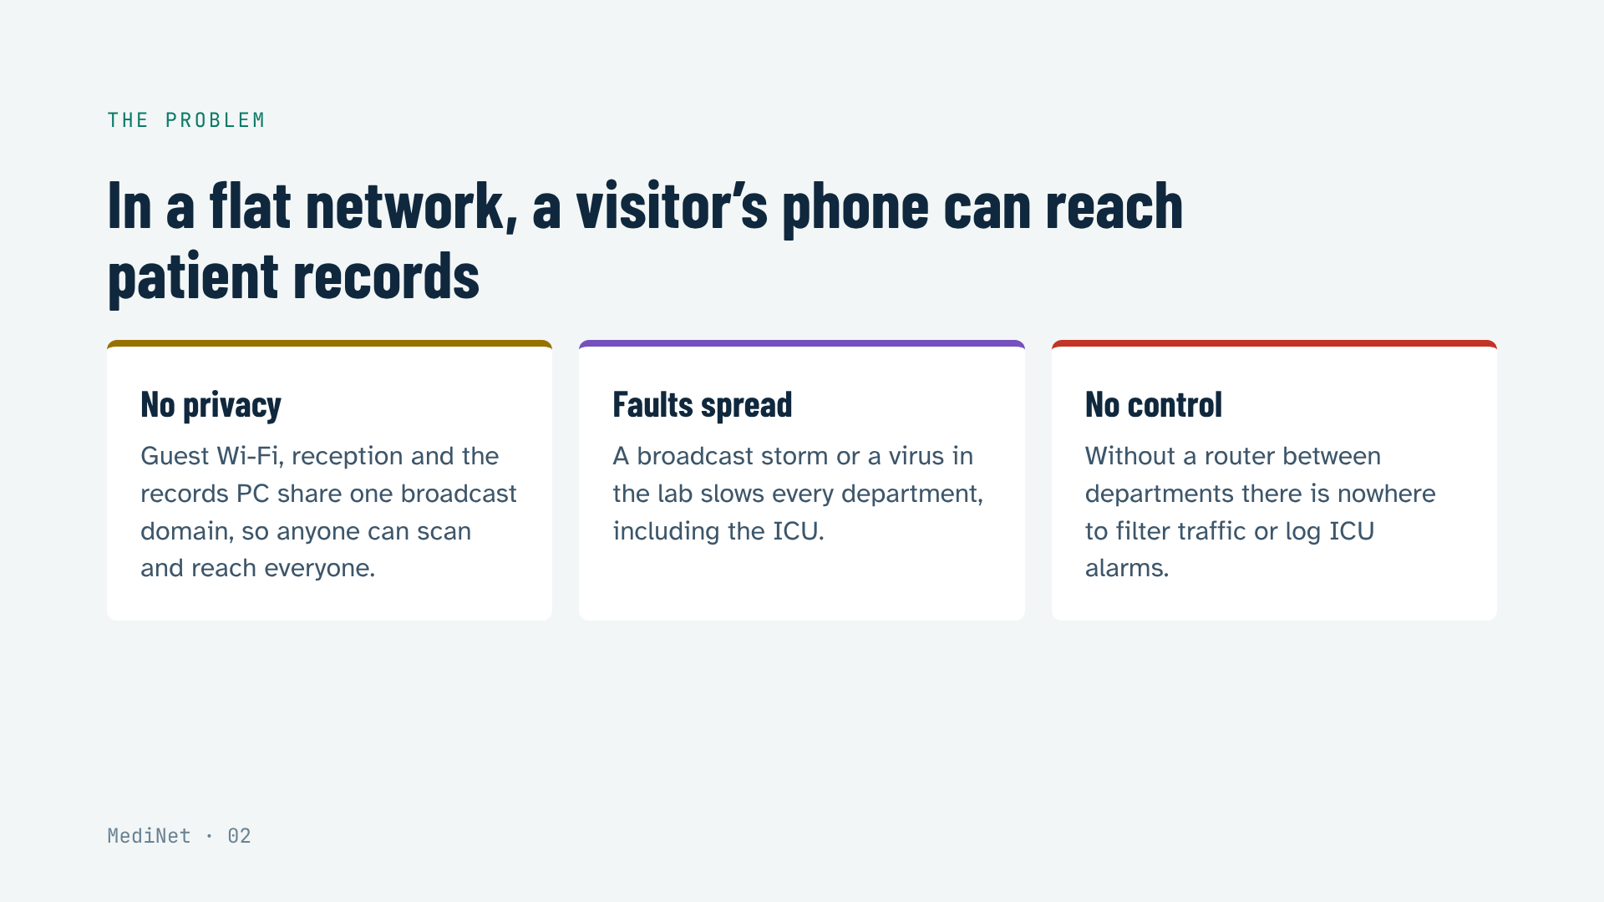
Notes:
Start with why. A hospital that plugs everything into one network has three problems: no privacy between visitors and clinical systems, faults that spread to every department, and no point where traffic can be filtered. MediNet solves all three.

Slide 3
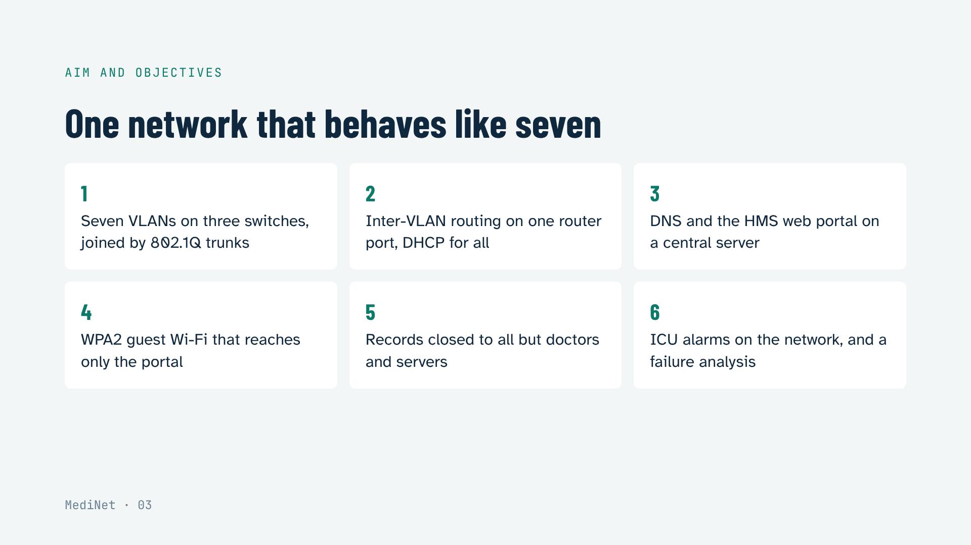
Notes:
The aim is one physical network that behaves like seven separate ones. Read the six objectives; each one maps to a member’s part and to a tab of the simulator.

Slide 4
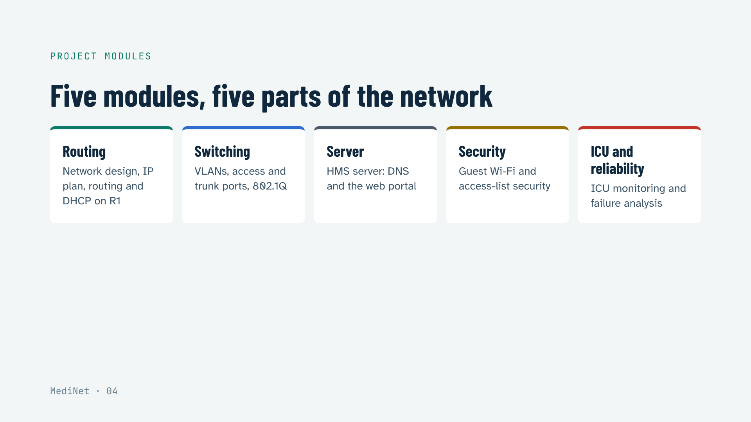
Notes:
The project has five modules, each built and tested on its own. The deck follows the same order.

Slide 5
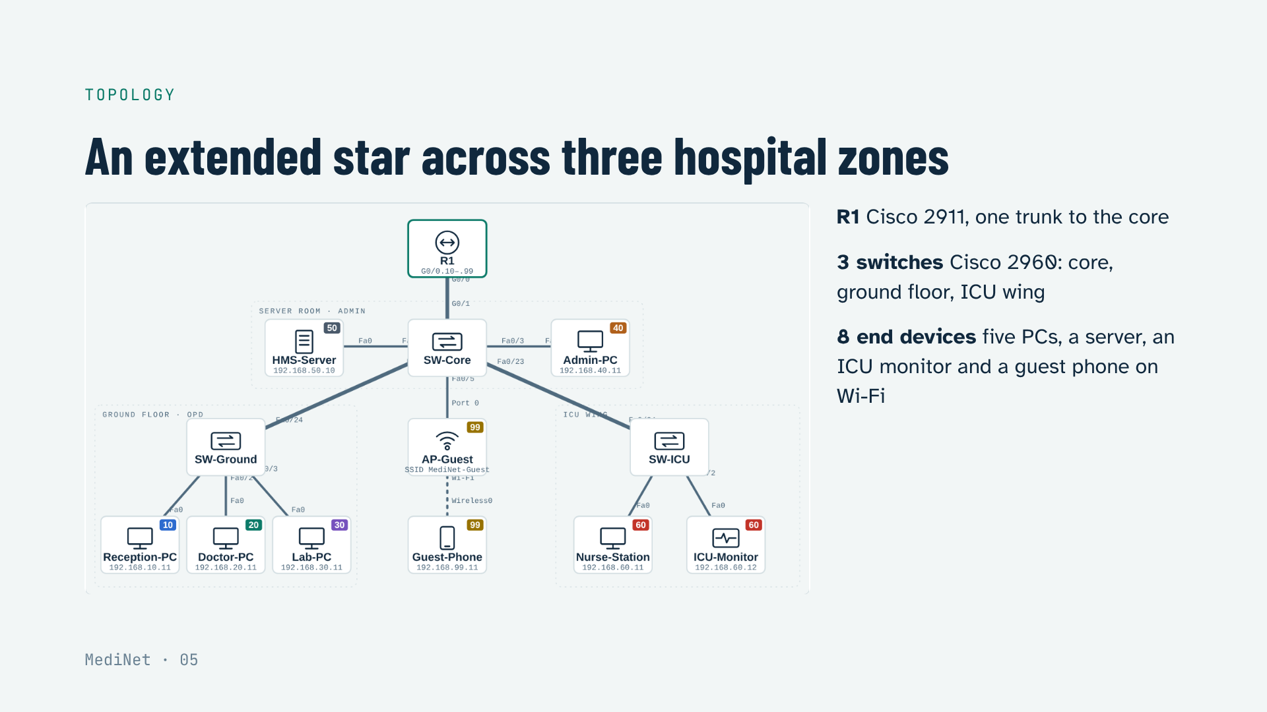
Notes:
This is the same topology as the Packet Tracer file and the website. Thick lines are trunks. The ground floor switch serves reception, doctors and the lab; the core switch serves the server room, admin and the guest access point; the ICU switch serves the nurse station and the monitor.

Slide 6
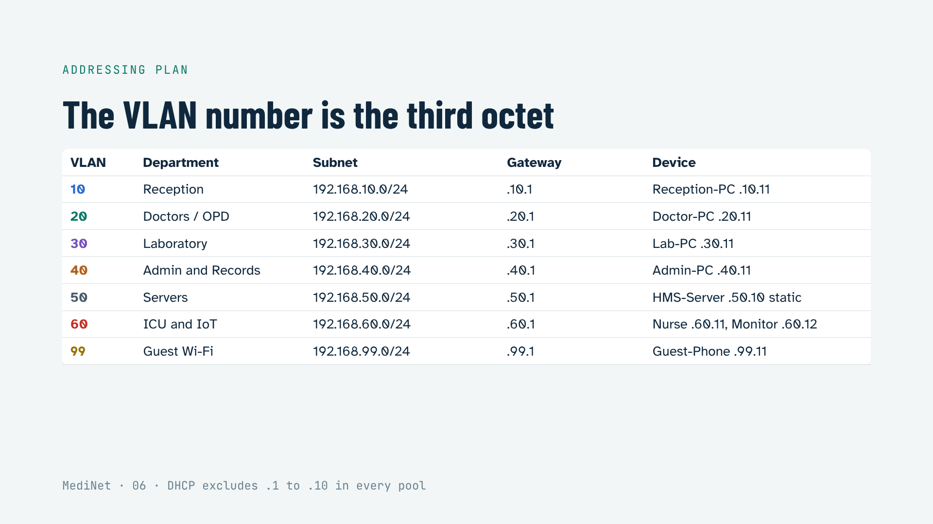
Notes:
Matching the VLAN number to the third octet makes troubleshooting instant: an address starting 192.168.20 is always a doctor. Every gateway is .1 on R1. Every client gets its address from DHCP; only the server is static.

Slide 7
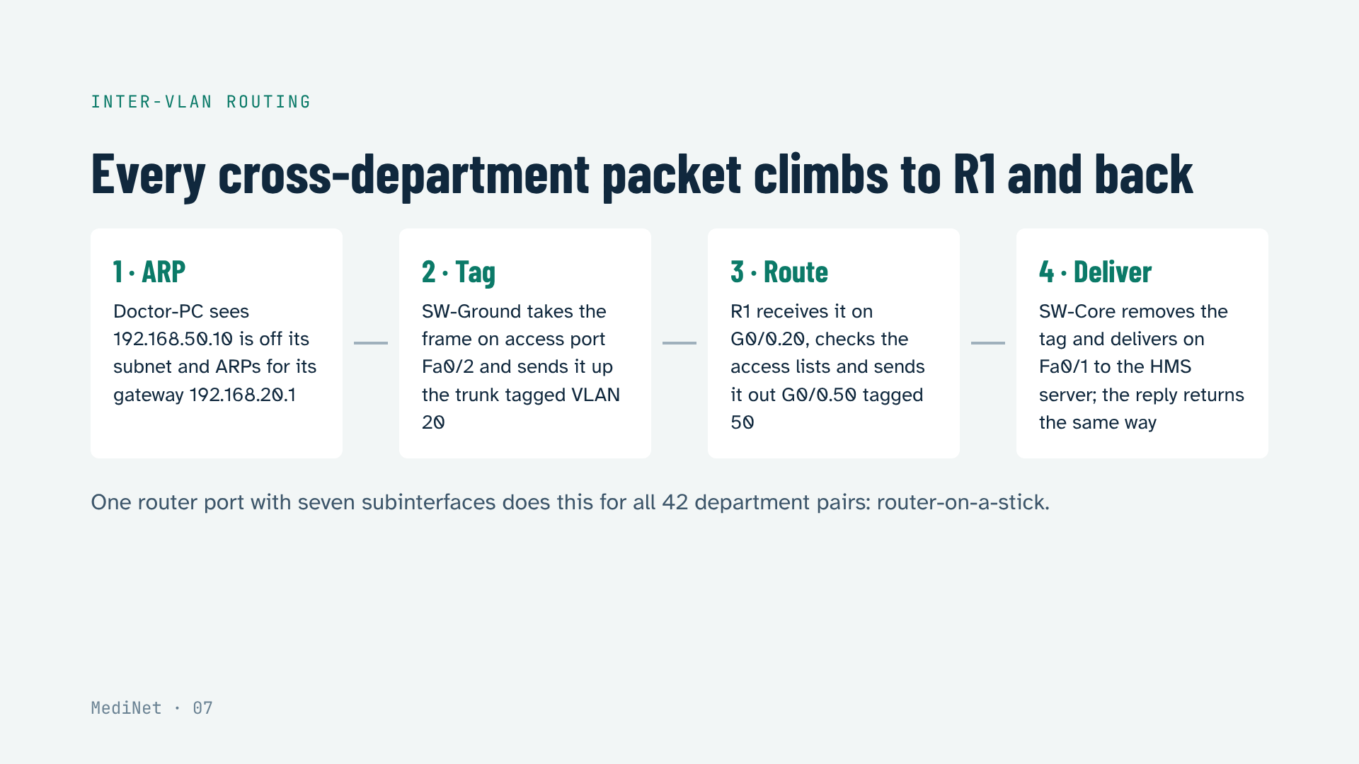
Notes:
Walk through the four steps. The key words are ARP, 802.1Q tag, subinterface and access port. This is exactly what the Packet trace tab of the website animates; the tagged frame shows a ring around the dot.

Slide 8
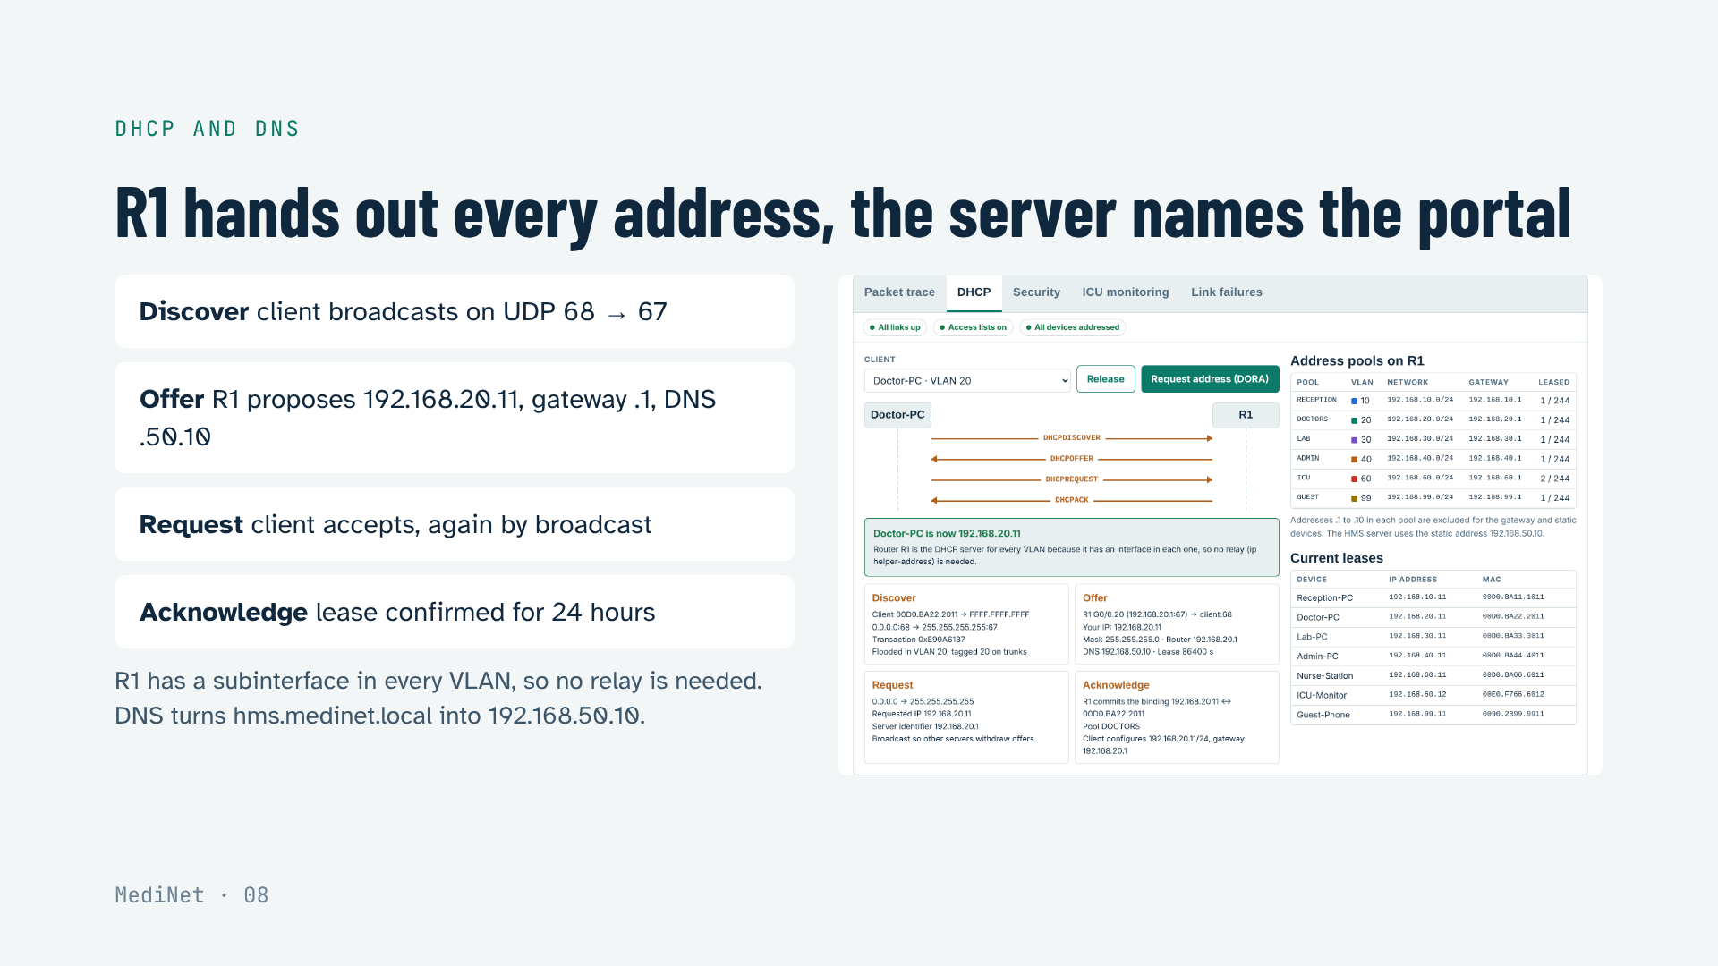
Notes:
DHCP in four messages, DORA. Mention that a discover is a broadcast and routers do not forward broadcasts; that is why a separate DHCP server would need ip helper-address, and why we put the pools on R1. Then DNS: the browser asks the server for hms.medinet.local and gets 192.168.50.10.

Slide 9
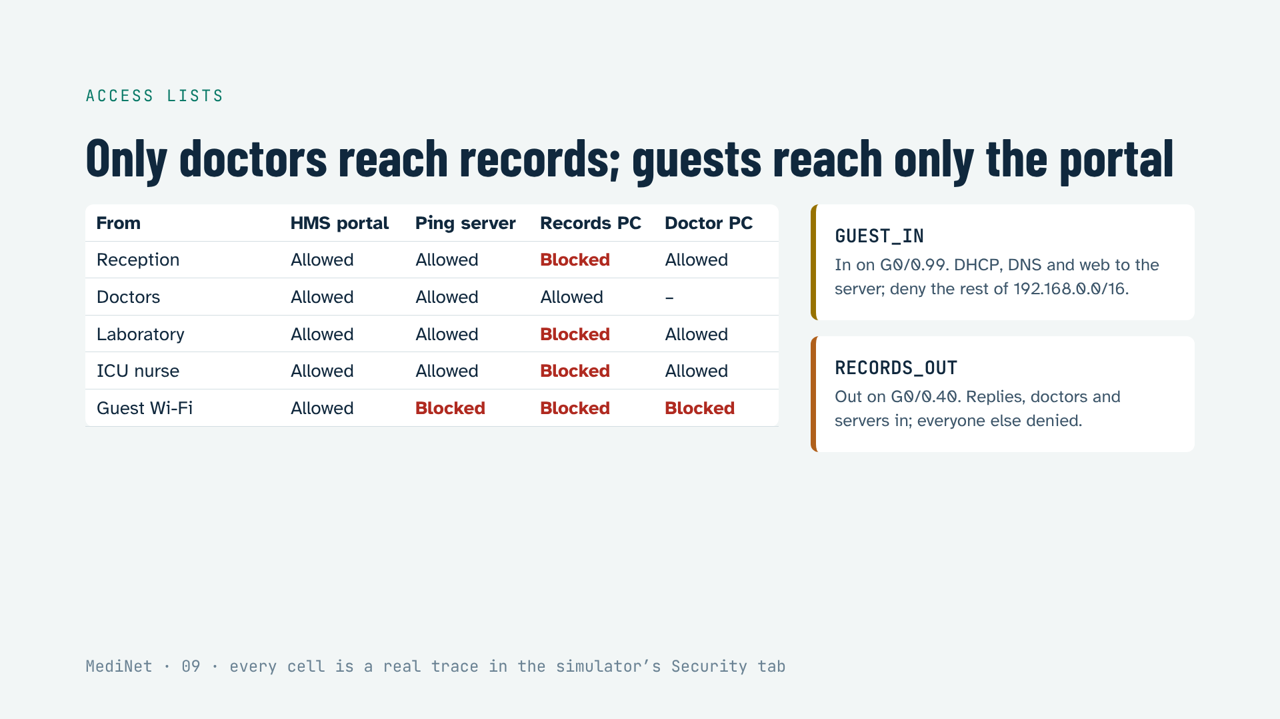
Notes:
Two extended access lists. GUEST_IN sits on the guest subinterface, inbound, close to the source. RECORDS_OUT sits on the records subinterface, outbound, so one list protects VLAN 40 from all others. The keyword established lets Admin-PC open web sessions and get replies, while nobody can open a new connection into the records VLAN.

Slide 10
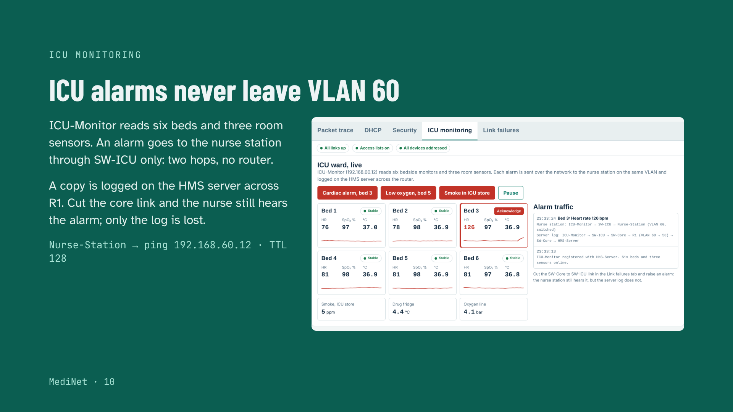
Notes:
Life-safety traffic should take the shortest, most reliable path. Because the ICU monitor and the nurse station share VLAN 60 on one switch, their traffic is switched, not routed. TTL 128 on the ping proves no router was crossed. Demo: Cardiac alarm on bed 3 in the website.

Slide 11
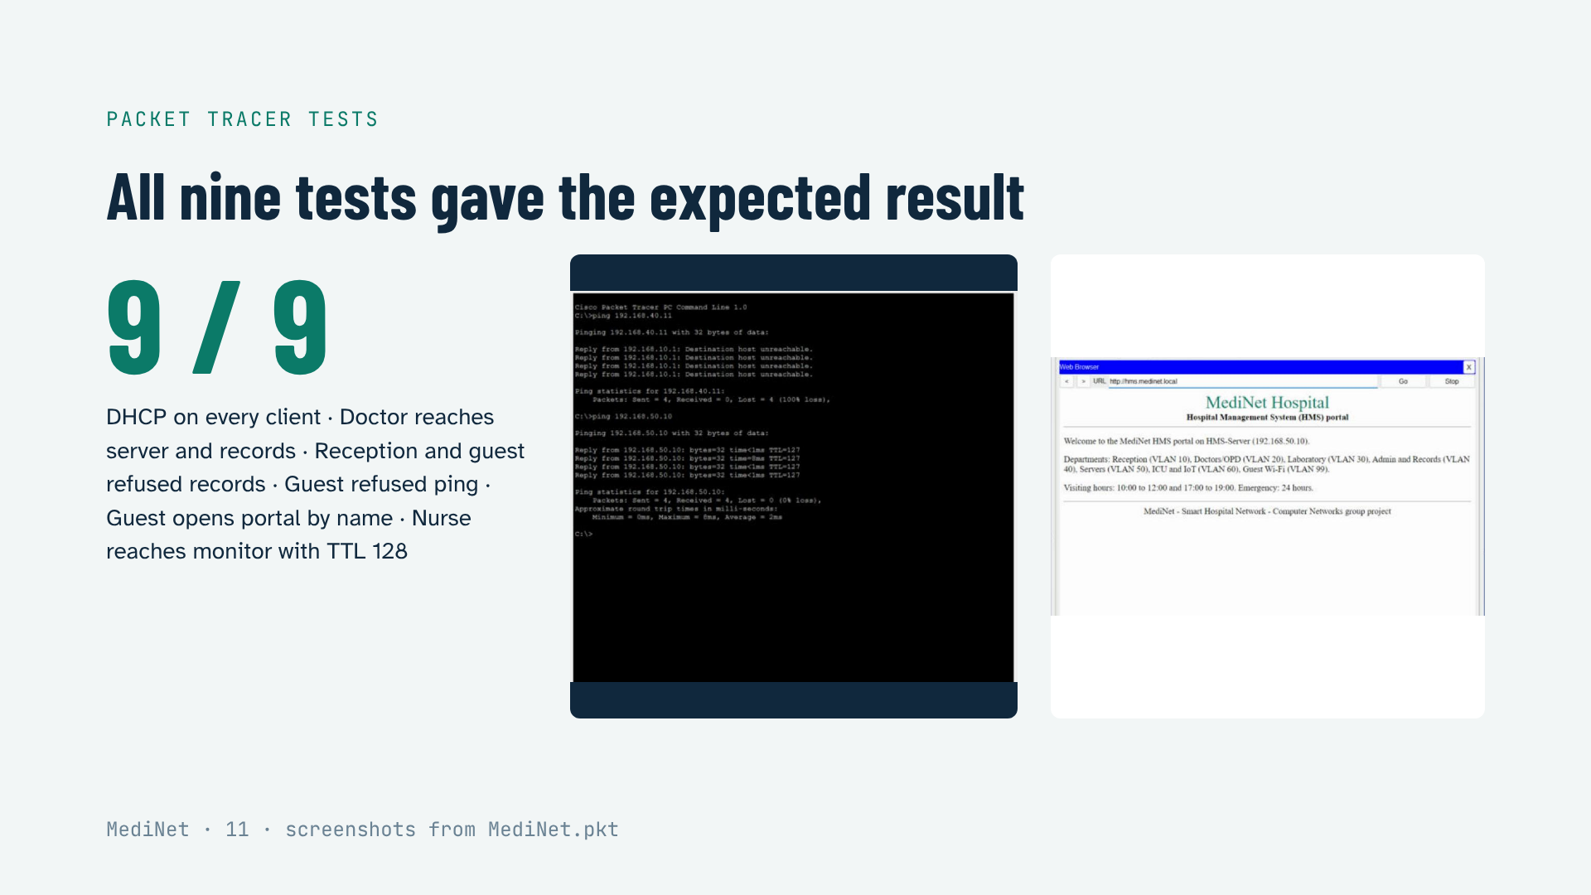
Notes:
Left: Reception-PC is refused the records PC by RECORDS_OUT but still reaches the server. Right: the guest phone, over WPA2 Wi-Fi, opens the HMS portal by name, which proves DHCP, DNS, HTTP and the guest ACL all at once. The full list of nine tests is in the report.

Slide 12
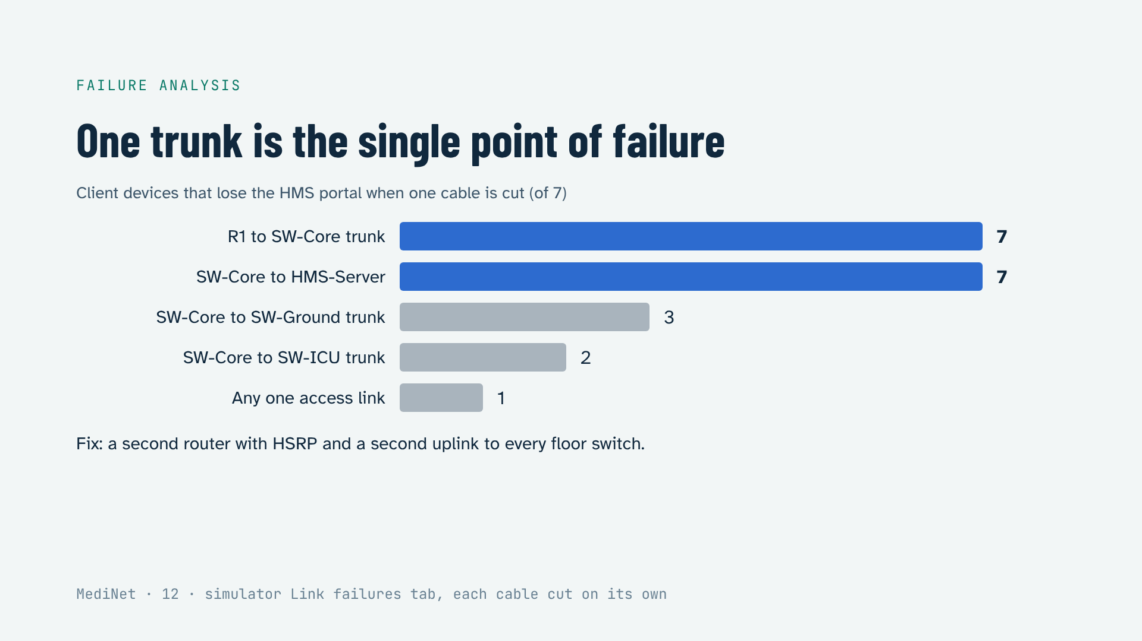
Notes:
The simulator cut each of the 12 cables one at a time and re-ran every trace. Losing the R1 trunk takes down all inter-VLAN traffic and DHCP. The server cable is also critical because every department depends on the portal. The answer is redundancy: HSRP and dual uplinks.

Slide 13
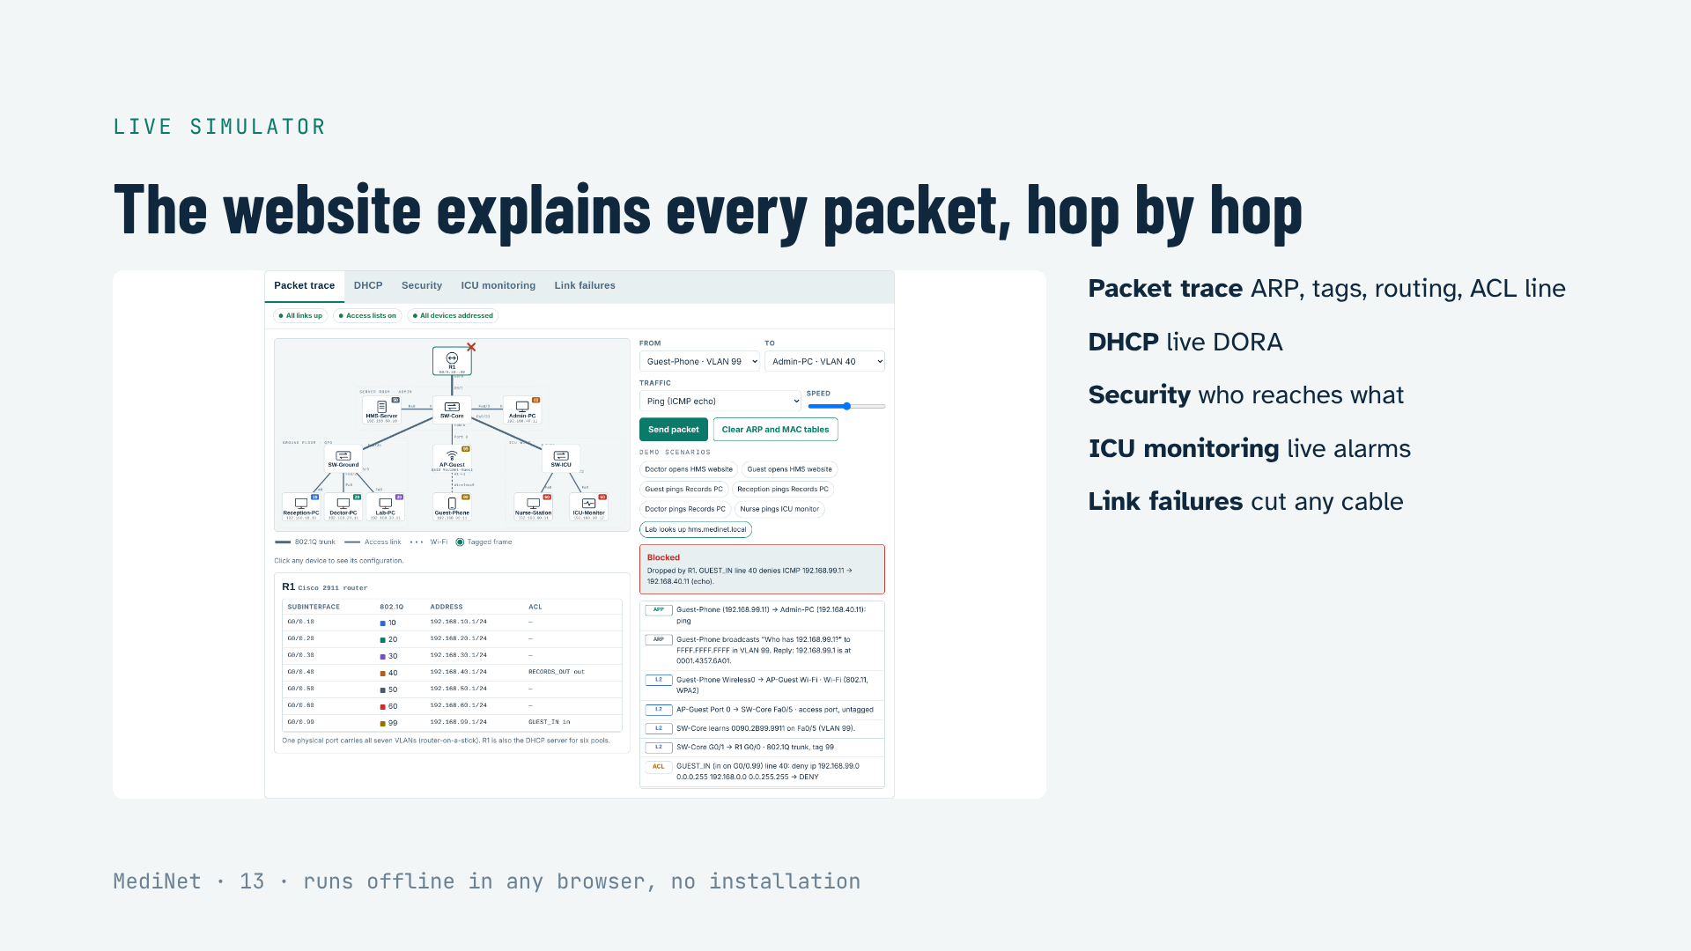
Notes:
Open the website now for the live demo. Suggested order: Packet trace scenario “Guest pings Records PC”, then the Security tab, then ICU monitoring with the cardiac alarm, then Link failures: cut SW-Core to SW-ICU and raise an alarm again.

Slide 14
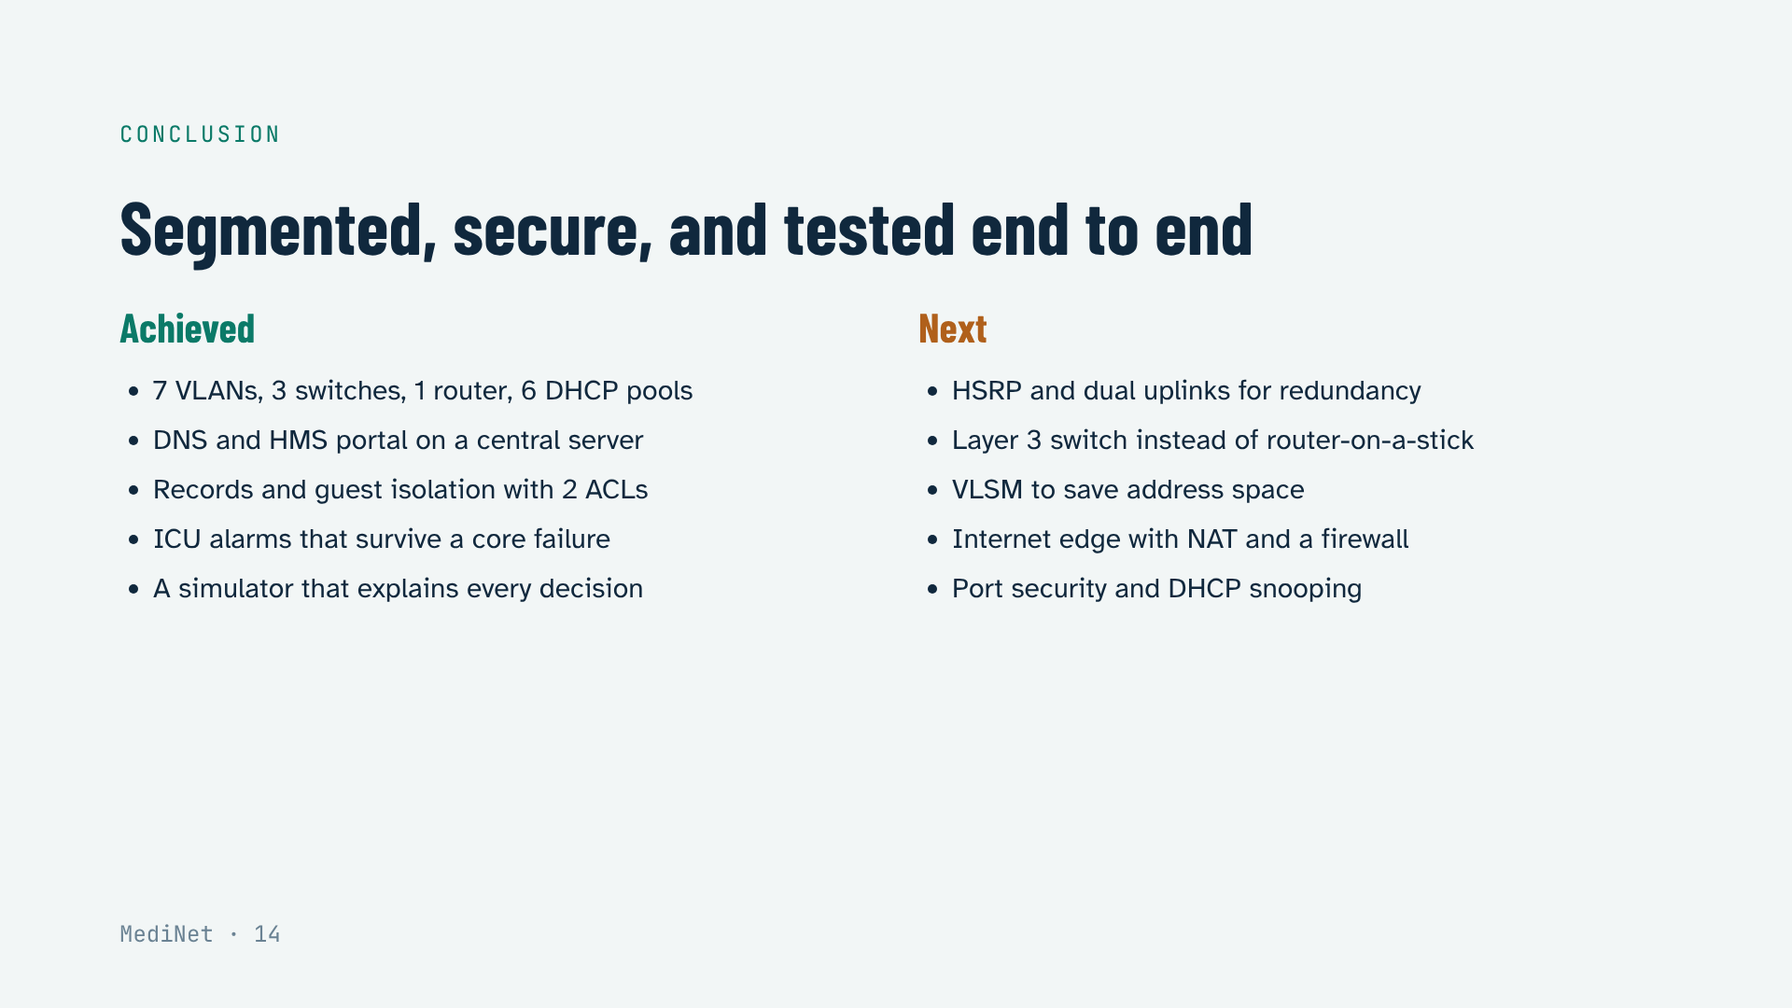
Notes:
Summarise what was built and what the tests proved, then name the improvements. HSRP is the first, because the failure analysis showed the router trunk is the single point of failure.

Slide 15
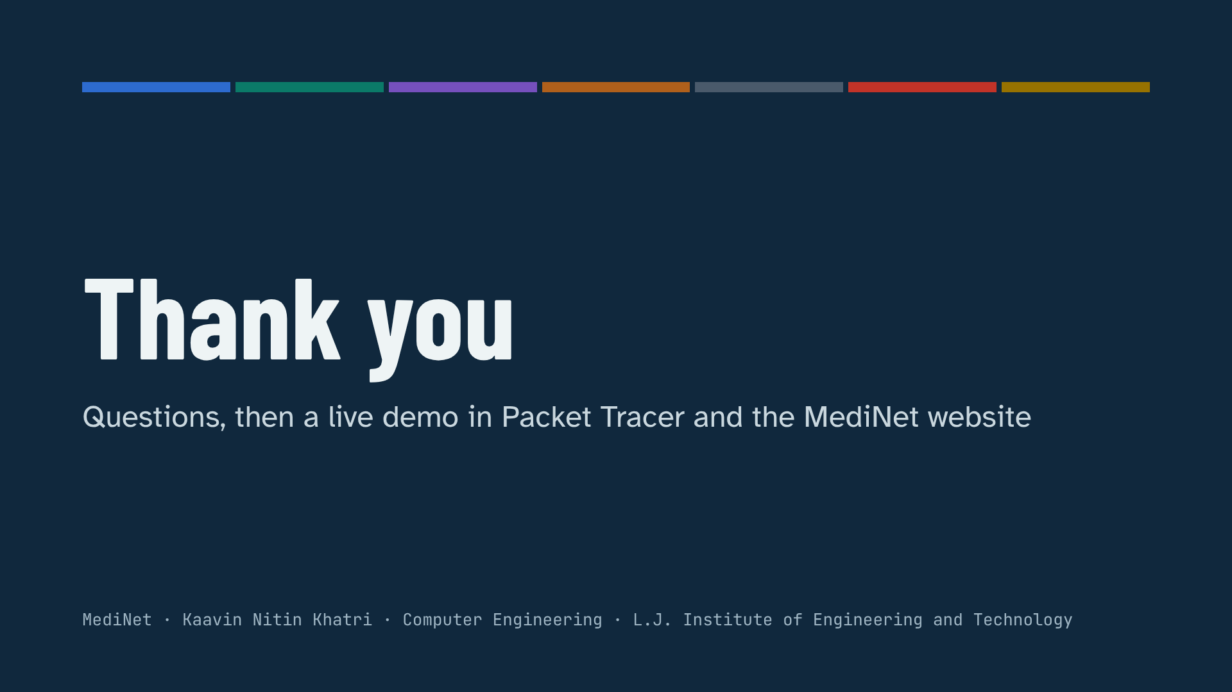
Notes:
Open MediNet.pkt and the website side by side. Run each demo from the Packet Tracer guide’s demo script.

