Slide 1
Employee Data Analysis using Excel
STUDENT NAME: Kaaviya P
REGISTER NO: 312202995
NM ID:2DC82216DA94FF7ABEC41EA2B4FD2F1D
DEPARTMENT: B.COM GENERAL
COLLEGE: ASAN MEMORIAL COLLEGE OF ARTS AND SCIENCE

Slide 2
PROJECT TITLE
Employee Performance Analysis using Excel

Slide 3


AGENDA
Problem Statement
Project Overview
End Users
Our Solution and Proposition
Dataset Description
Modelling Approach
Results and Discussion
Conclusion
3/21/2024 Annual Review

Slide 4

PROBLEM STATEMENT
In an organization, there are employees give good, average and poor performances.
By analyzing this performances data, we can focus on the overall growth of the organization and particular employee’s personal development.

Slide 5

PROJECT OVERVIEW
Analyzing the performance of the employees by considering the various factors like gender, achievements, ratings, performance score.
In order to identify the trends and patterns of different categories of employees like high, medium and low.
To identify the strengths, weaknesses, opportunities of the employees.

Slide 6
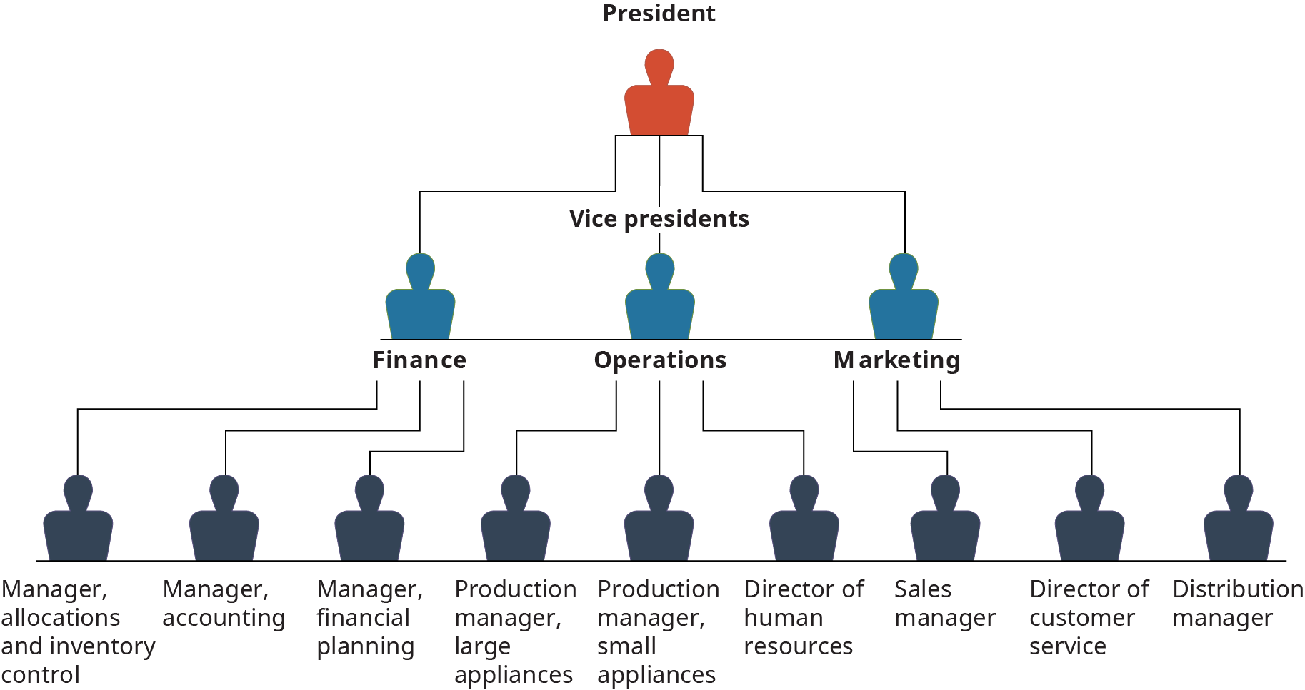

WHO ARE THE END USERS?

Slide 7

OUR SOLUTION AND ITS VALUE PROPOSITION
Conditional formatting – missing values
1. Quick identification of missing values.
2. Easy data cleaning and preprocessing.
3. Improved data quality and accuracy.
Filter – remove
1. Filters save time by automating the process of finding and selecting specific data.
2. By reducing data clutter, filters minimize errors and improve data accuracy.
Formula – performance
1. Streamline calculations and reduce manual errors.
2. Save time by performing complex calculations quickly.
Pivot table – summary
1. Quickly summarize large datasets.
2. Easily analyze and compare data from different perspective
Graph – data visualization
1. Present complex data in an easy to understand format.
2. Quickly spot trends, patterns and correlations.

Slide 8
Dataset Description
Employee dataset = Kaggle
26 features
Features – 9 features
Employee ID
Name-text
Employee type
Performance level
Gender- male, female
Employee rating – numerical
Business unit

Slide 9

THE "WOW" IN OUR SOLUTION
Performance level=IFS(Z8>=5,"VERY HIGH",Z8>=4,"HIGH",Z8>=3,"MED",TRUE,"LOW")
3/21/2024 Annual Review
9

Slide 10
MODELLING
Data collection
1. Data has been downloaded from Edunet.
2. used the data collected from edunet.
Feature collection
1. Feature selected from the given 26 features
2. Selected 9 features from the given features.
Data collection
1. Found out the missing values.
2. Calculated the performance level of every employee.
Performance level
1. Performance level was considered using the rating of the employees.
2. Each employee was rated from high to low based on their performances.
3. At the end, graph was displayed to show the visual representation of the performance level.
Summary
1. Graph was presented for a visualization of the performance level representation.
2. Pie chart provided for the high level candidates to display the performance.
3. Perfect summary of the performance level has been displayed.
10

Slide 11
RESULTS
11

Slide 12
conclusion
While comparing employee performance, it’s notable that the majority of employees exhibit average performances. Motivating these employees can significantly enhance the organization’s overall efficiency. Additionally, since the number of high-performing employees is relatively low, tasks can be allocated based on individual strengths to maximize their impact. Meanwhile, tasks can be tailored to high-performing employees to maximize their impact.
By recognizing and encouraging their efforts, providing opportunities for growth and development, addressing any challenges they face, you can unlock their potential and improve their performance.

