Slide 1
KrishiMitra
Technical Walkthrough
CAPSTONE PROJECT
Frontend, MobileNetV2, Gemini chatbot, backend and Docker
Notes:
Opening: KrishiMitra combines a crop health classifier with an agriculture chatbot.
The walkthrough follows the real request path from the browser to FastAPI, AI services and PostgreSQL.
The team divides the presentation equally across frontend, machine learning and backend infrastructure.

Slide 2
Presentation ownership
01 | Frontend stack and user journeys | Member 1
02 | Crop health and chatbot interfaces | Member 1
03 | Dataset processing and class design | Member 2
04 | MobileNetV2 training and evaluation | Member 2
05 | FastAPI, Gemini and persistence | Member 3
06 | Docker, migrations and demo startup | Member 3
Notes:
Each member owns three content slides and one live demonstration.
Member 1 presents the browser experience. Member 2 presents the data and model lifecycle. Member 3 presents server execution and infrastructure.
All members should understand the two end to end paths shown on the next slide.

Slide 3
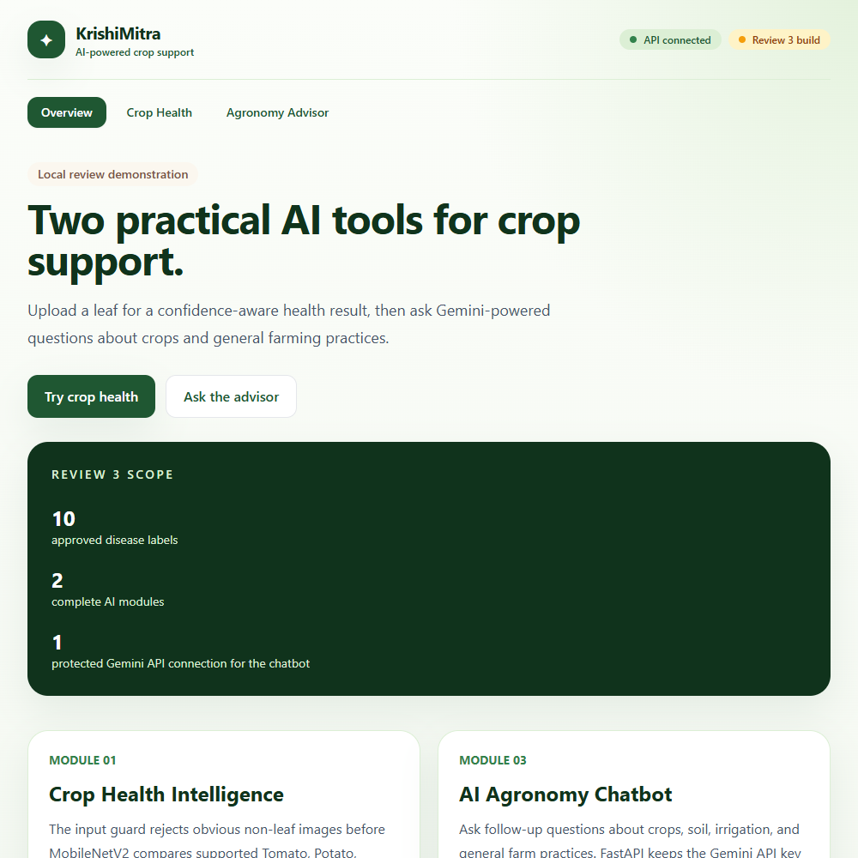
System architecture
Crop health path
React sends an image and crop hint. FastAPI validates the file, MobileNetV2 predicts one of ten labels, and PostgreSQL records the scan.
Chatbot path
React sends a question and conversation ID. FastAPI adds recent context, Gemini 3.6 Flash generates the answer, and PostgreSQL stores the exchange.
Notes:
Shared architecture: React never runs the model and never sees the Gemini key.
FastAPI coordinates validation, inference, generation and database writes.
PostgreSQL stores prediction metadata and chatbot history. Docker runs the PostgreSQL and pgvector service.
Screenshot source: the local KrishiMitra frontend at http://127.0.0.1:5173.

Slide 4
Member 1: Frontend stack and responsibilities
FOUNDATION
DEVELOPMENT
INTEGRATION
React + TypeScript
Single-page views, typed API responses and local component state control the user experience.
Vite + Tailwind CSS
Vite provides the local server and production build. Tailwind creates responsive layouts and warning states.
Fetch + React Query
Fetch sends requests. React Query checks API health every 15 seconds. Loading and error states guide the user.
Notes:
Contribution: Member 1 explains the complete browser-side application in frontend/src/App.tsx.
React useState stores selected views, files, questions, messages and loading state. useMemo creates the local image preview.
VITE_API_BASE_URL controls the backend address. The default points to http://127.0.0.1:8000/api/v1.

Slide 5
Crop health interface states
Input
The user selects Tomato, Potato, Maize or Grape and previews a PNG, JPG or WebP leaf image.
Request
FormData sends image and crop_hint to POST /api/v1/health/predict.
Validated result
The page shows label, confidence, model version, detected crop and supported conditions.
Safety state
Low confidence, crop mismatch and invalid images receive clear review or rejection messages.
Notes:
Live flow: choose the expected crop, select an image, inspect the preview and click Analyse leaf.
The crop hint does not force a class. The backend compares it with the crop encoded in the predicted label.
Confidence below 0.75 becomes review-only. A crop mismatch must not be used as a diagnosis.

Slide 6
Chatbot interface and live demo
Browser responsibilities
The UI sends questions and conversation IDs. It never handles the Gemini key.
Demo 1
Upload a leaf and explain the preview, result details and safety warnings.
Messages appear as user and assistant bubbles. The loading state blocks duplicate requests, while backend errors appear without exposing provider secrets.
Demo 2
Ask one farming question, then ask a follow-up that reuses the conversation ID.
Notes:
Contribution summary for Member 1: interface components, form handling, file preview, typed responses, API calls and user-facing warnings.
The chatbot sends JSON to /api/v1/advisor/chat. The first response returns a conversation ID, which React sends with later questions.
The frontend production build uses tsc -b followed by vite build.

Slide 7
Member 2: Data processing
PlantVillage subset
10 labels cover healthy and selected disease classes for Tomato, Potato, Maize and Grape. Source folders map to fixed canonical labels and class indices.
Class mapping
prepare_plantvillage.py converts source folder names into the project label scheme.
Reproducible split
Seed 20260912 creates the same stratified 70, 15 and 15 percent split.
Training set
7,427 images teach the classifier weights with random augmentation.
Holdout sets
1,591 validation and 1,591 test images support selection and final evaluation.
Notes:
Contribution: Member 2 explains data/prepare_plantvillage.py, data/create_splits.py and the training script.
Class balance varies. Macro-F1 therefore matters because it gives each class equal weight.
The test set remains separate until the final evaluation, which avoids test-data leakage.

Slide 8
MobileNetV2 training lifecycle
STAGE 1
STAGE 2
STAGE 3
Prepare
Convert to RGB, build labels and load the deterministic manifest.
Train classifier head
Freeze the feature extractor and train the new 10-class head for 3 epochs.
Fine-tune and evaluate
Unfreeze the final four feature blocks for 7 epochs. Select by validation macro-F1, then test once.
Notes:
MobileNetV2 starts with ImageNet weights. Transfer learning reuses general visual features such as edges and textures.
Training uses CrossEntropyLoss and AdamW. The head learning rate is 0.001, then fine-tuning uses 0.0001.
Augmentation includes random resized crop, horizontal flip, rotation and colour jitter. Evaluation uses resize and center crop only.

Slide 9
Model evaluation
Controlled PlantVillage benchmark
The best checkpoint uses validation macro-F1. Independent test metrics measure classification quality, while CPU latency measures local inference speed. These figures do not establish accuracy on field photographs.
98.68%
98.63%
40.85 ms
Independent test accuracy
Test macro-F1
Median CPU inference latency
Notes:
Best validation macro-F1: 99.16 percent. Test accuracy: 98.68 percent. Test macro-F1: 98.63 percent.
CPU latency p50: 40.85 ms. CPU latency p95: 43.52 ms.
Important limitation: the model only compares ten known classes. It cannot confirm unsupported diseases such as Northern Leaf Blight.
Source: docs/model_registry/mobilenetv2-10class-v1.json.

Slide 10
Member 3: FastAPI request pipelines
Browser | FastAPI | AI service | PostgreSQL | Response
Health check
Leaf upload + crop hint
Validation + MobileNetV2
Gemini chat + context
Persist + return JSON
Transactions commit on success and roll back on failure
Notes:
Contribution: Member 3 explains FastAPI, Pydantic, SQLAlchemy, Gemini and infrastructure.
GET /api/v1/health checks readiness. POST /api/v1/health/predict receives multipart image data. POST /api/v1/advisor/chat receives JSON.
FastAPI validates requests, calls the relevant service, writes metadata through SQLAlchemy and returns a typed response.
CORS permits the Vite frontend at localhost or 127.0.0.1 on port 5173.

Slide 11
Database, Docker and startup
Docker | PostgreSQL | Alembic | Secrets | Demo
# | # | # | # | #
# | # | # | # | #
# | # | # | # | #
# | # | # | # | #
pgvector image
port 5432
health check
upgrade head
.env only
API docs
Notes:
Docker Compose runs pgvector/pgvector:pg16 with a persistent volume and a readiness check.
Alembic creates the prediction, conversation and future vector-document tables, then adds the HNSW cosine index.
The Gemini API key stays in backend/.env and never enters React or Git. The active text model is gemini-3.6-flash.
Startup sequence: check prerequisites, start the database, wait for readiness, apply migrations, launch FastAPI, then launch Vite.

Slide 12
A traceable platform
for two AI modules
MEMBER 3 SUMMARY
FastAPI coordinates validation, AI calls and database writes. Docker makes the database reproducible.
Notes:
Closing summary: the frontend captures user intent, FastAPI coordinates the workflow, MobileNetV2 and Gemini provide the AI functions, and PostgreSQL records traceable outputs.
Current limitations: PlantVillage results do not prove field accuracy. Gemini answers require verification for pesticide and high-risk decisions. The chatbot does not yet use citation-grounded retrieval.
End with the live URLs: website at http://localhost:5173 and API docs at http://127.0.0.1:8000/docs.

