Slide 1
In Silico Evolution of Proteins
Kaavya Uppala
SURF Student

Slide 2
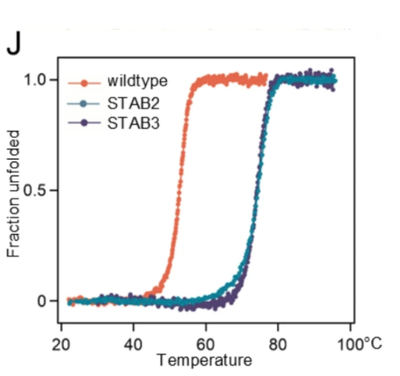
Naturally-occurring proteins are unstable
Evolution prioritizes function over stability
← Protein design can be used to stabilize proteins
Czyrek et al
Notes:
Heat-stable FGF10 (goes from melting at 50C to 70C → Done w/ Circular Diochroism
Nature prioritizes function over stability, but there are times when stability is important (ex: using proteins in experiments or for therapeutics)

Slide 3
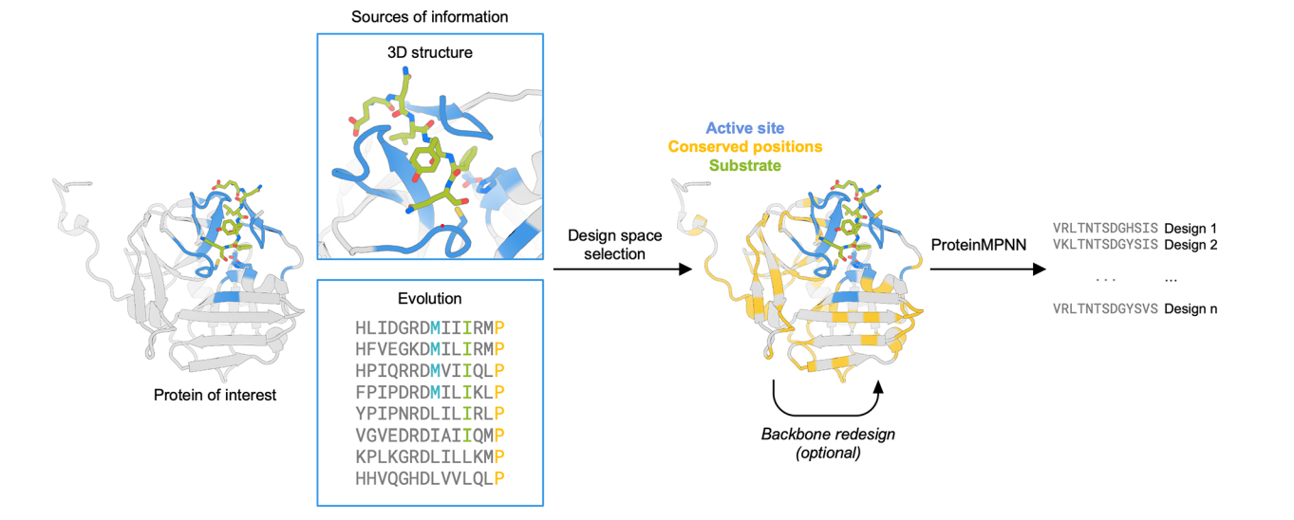
Conservation-guided protein design
Sumida et al
Notes:
Used a MSA to determine residues of key importance
Redesigned proteins, keeping high conservation residues constant

Slide 4
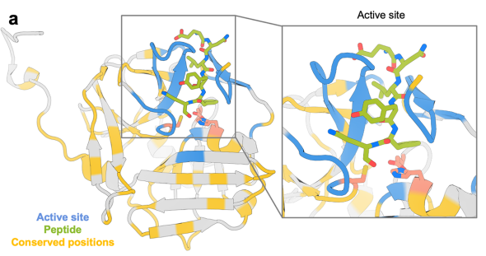
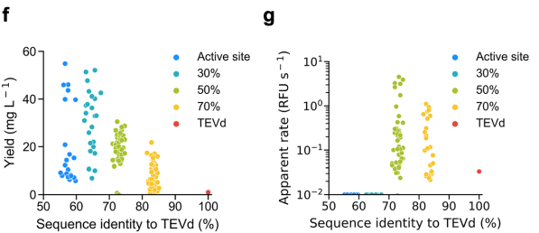
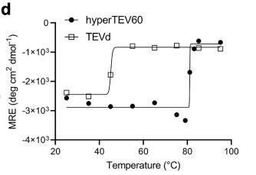
Stabilizing TEV Protease
Improved designs for TEV protease
  improved expression
  better function
  elevated melting temperatures
Sumida et al
Notes:
Yield = soluble expression; Allowing more of the structure to be redesigned meant that more properly-folded protease was observed
Apparent Rate = The amount of active proteins → Actually fulfilling their function (50% is the sweet spot)
CD: Redesigning TEV led to a more heat-stable form; Went from a melting temp of around 40C to 80C
All this goes to show that redesigning proteins is helpful for improving stability and potentially even function

Slide 5
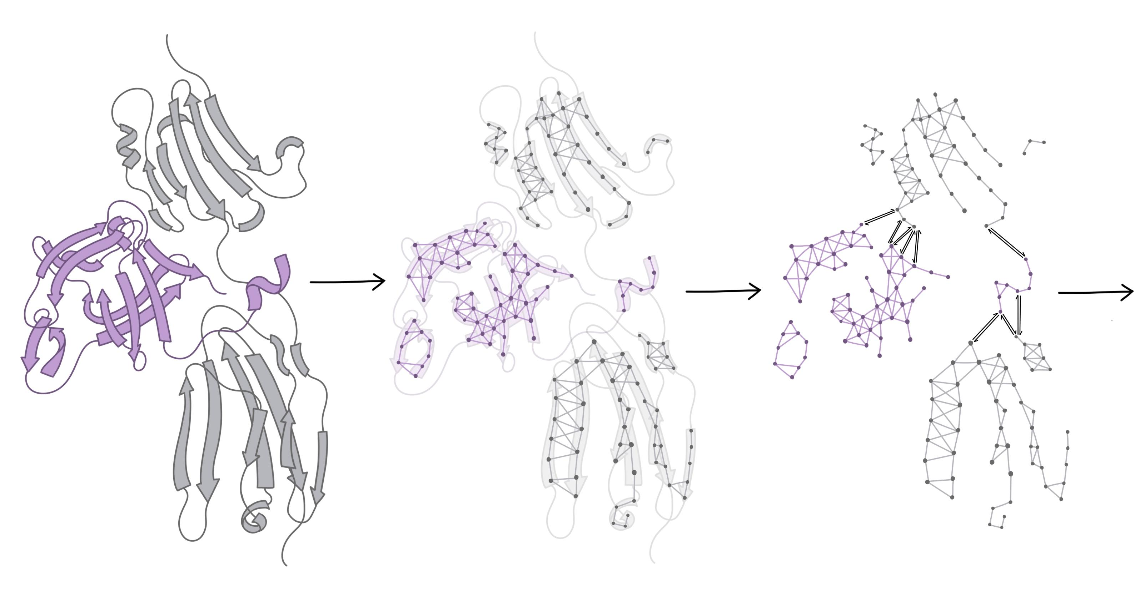
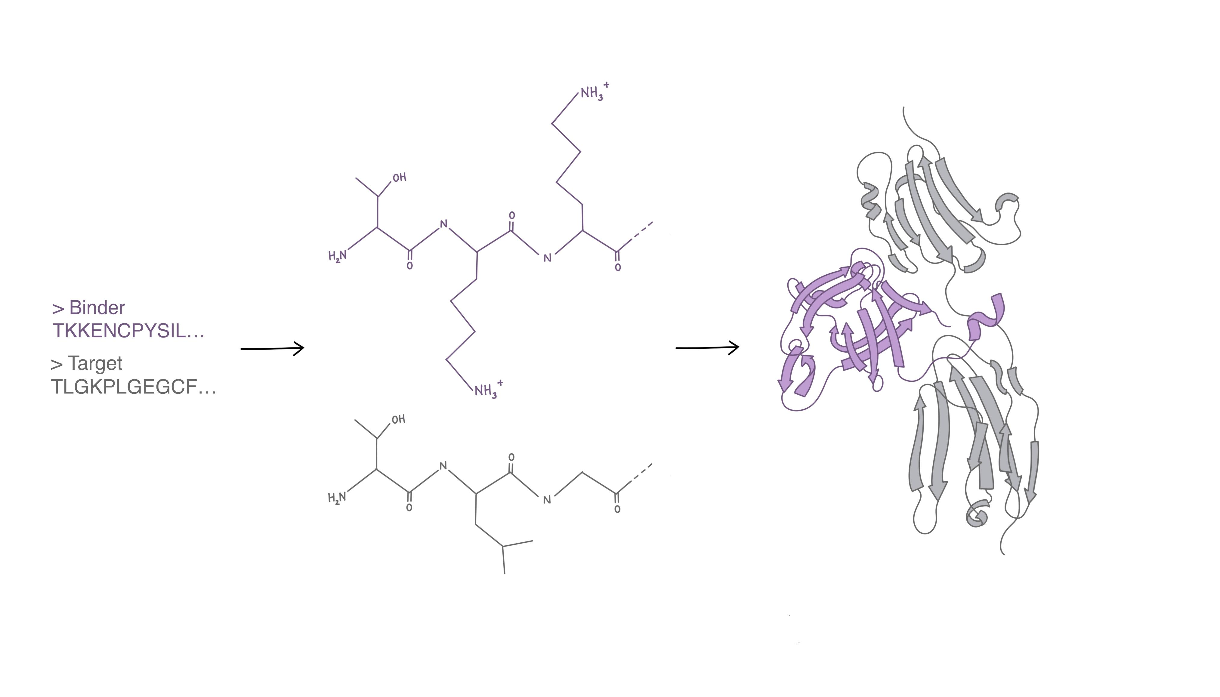
ProteinMPNN to design sequences
P(Sequence | Structure)
FGFR2B
FGF10
Notes:
P(sequence|structure)
Add fgf10 and fgfr2b labels
Trained on pdb → Looks at the 15 closest residues and determines the most biophysically likely residues to fold into that structure

Slide 6
Chai1 to predict structures
P(Structure | Sequence)
FGFR2B
FGF10
Notes:
P(structure|seq)
Learns the statistical relationships between molecular inputs and experimentally determined structures (has a latent understanding of protein biophysics) → From the UNIREF30 database
Infers which residues are likely to be close together, what their orientations would be, and how the different chains would interact
Puts all this information together into a structure

Slide 7
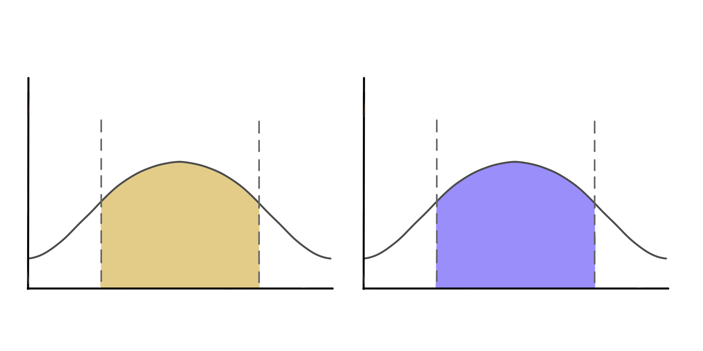
Co-Optimization of Models
ProteinMPNN and Chai1 have slightly different understandings of protein biophysics
Co-optimizing the models will cause them to converge on a consensus
ProteinMPNN
Chai1
CHAMP

Slide 8
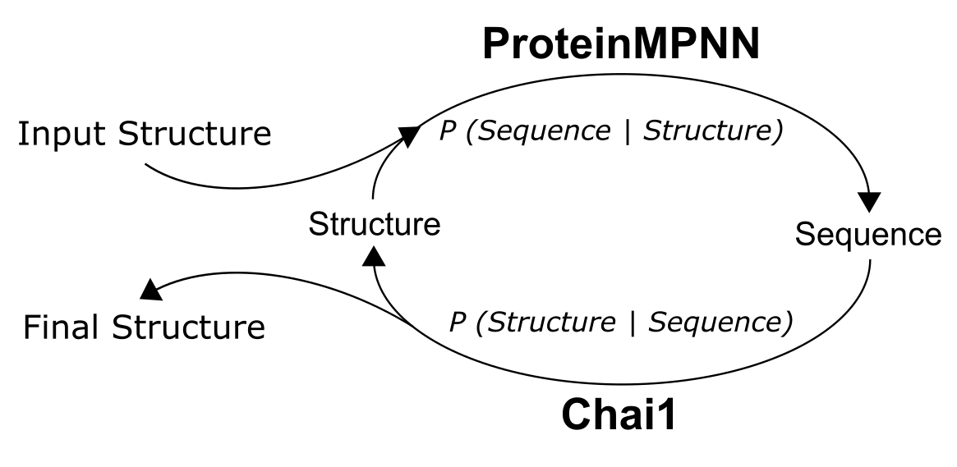
Chai1 + MPNN = CHAMP

Slide 9
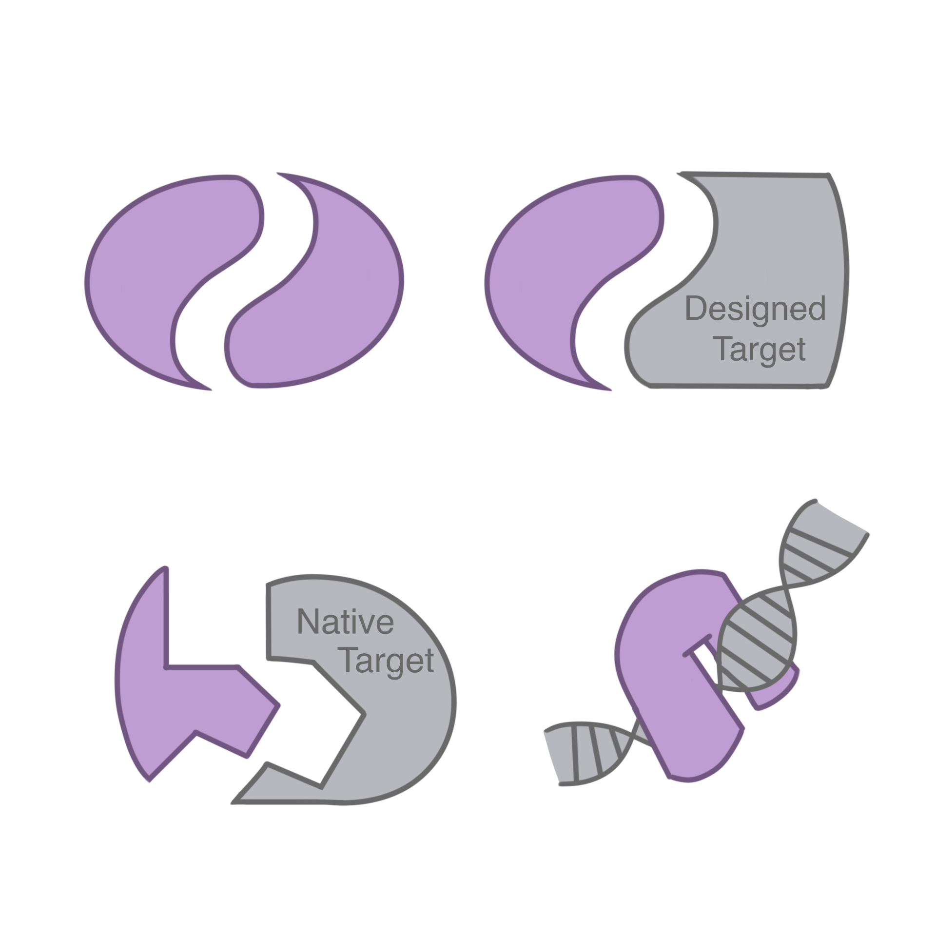
What contexts could CHAMP work in?
Case 1: Homodimers
Case 2: de novo interface binders
Case 3: Native interface binders
Case 4: DNA binders
Converging on final structure based on confidence metrics
  IPTM: Interface confidence
  PLDDT: Fold confidence
Notes:
Visuals for the use cases

Slide 10
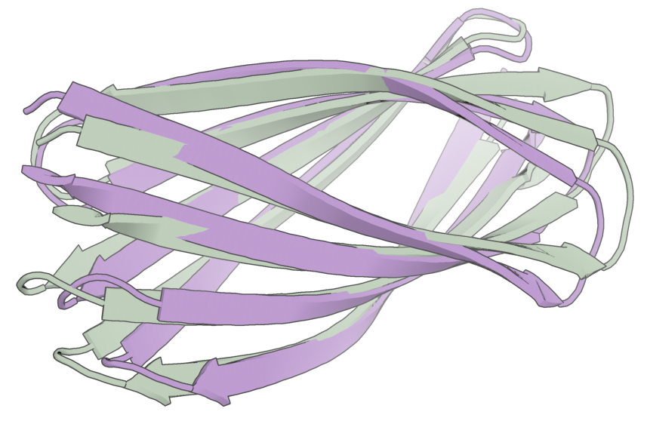
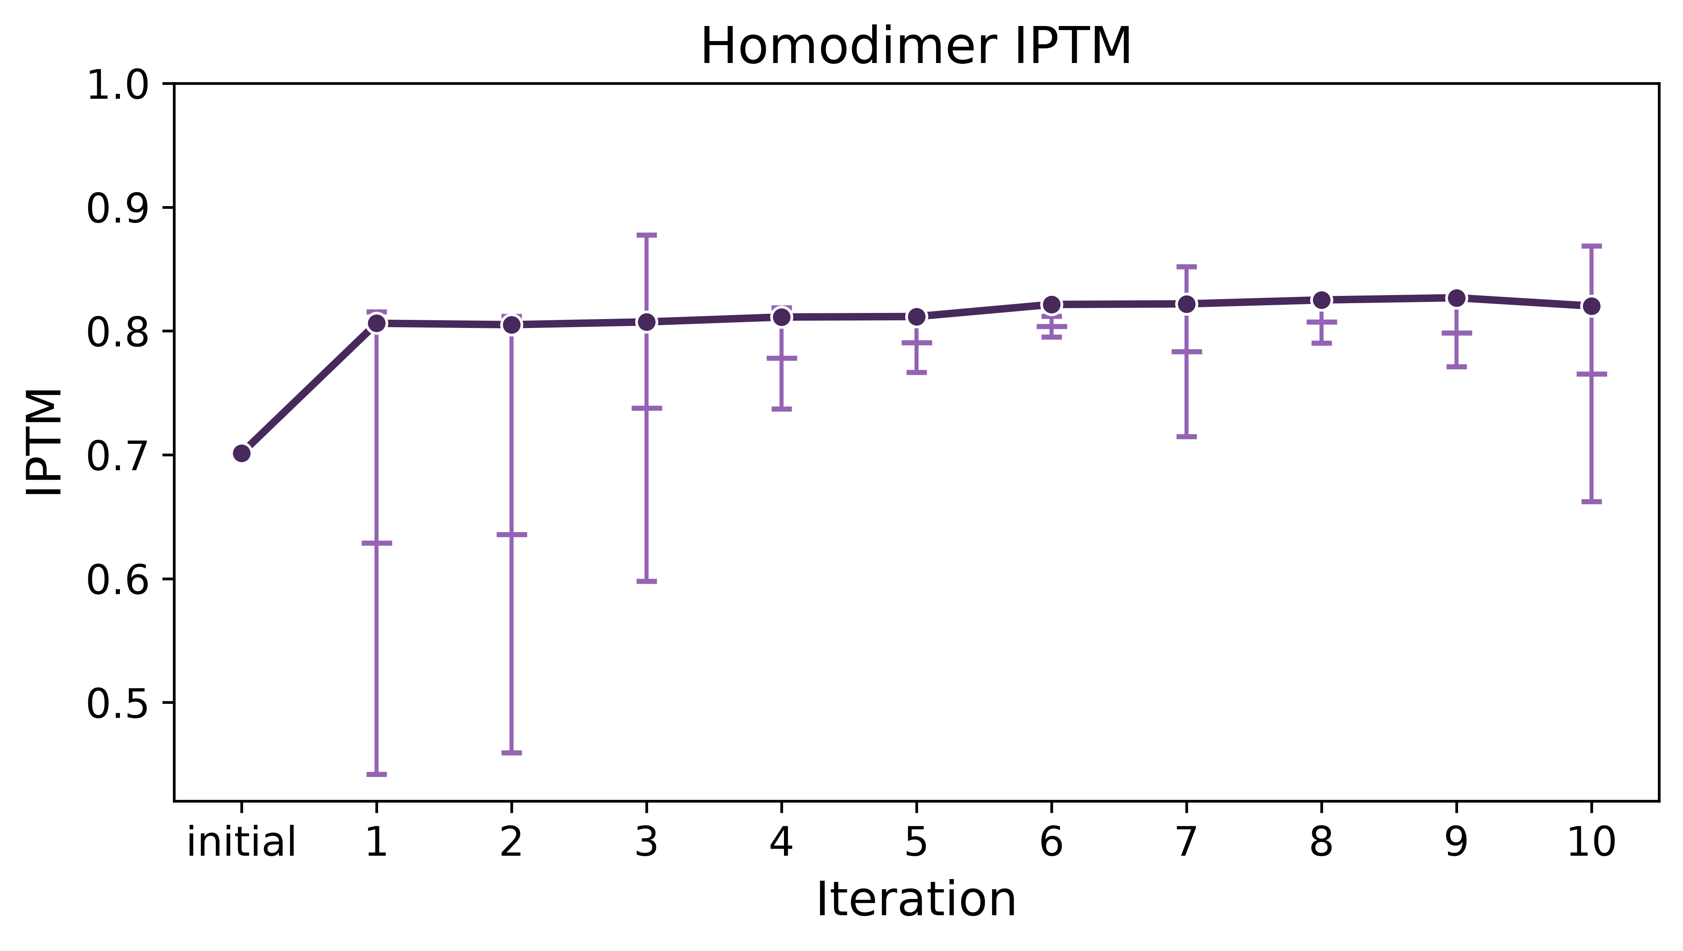
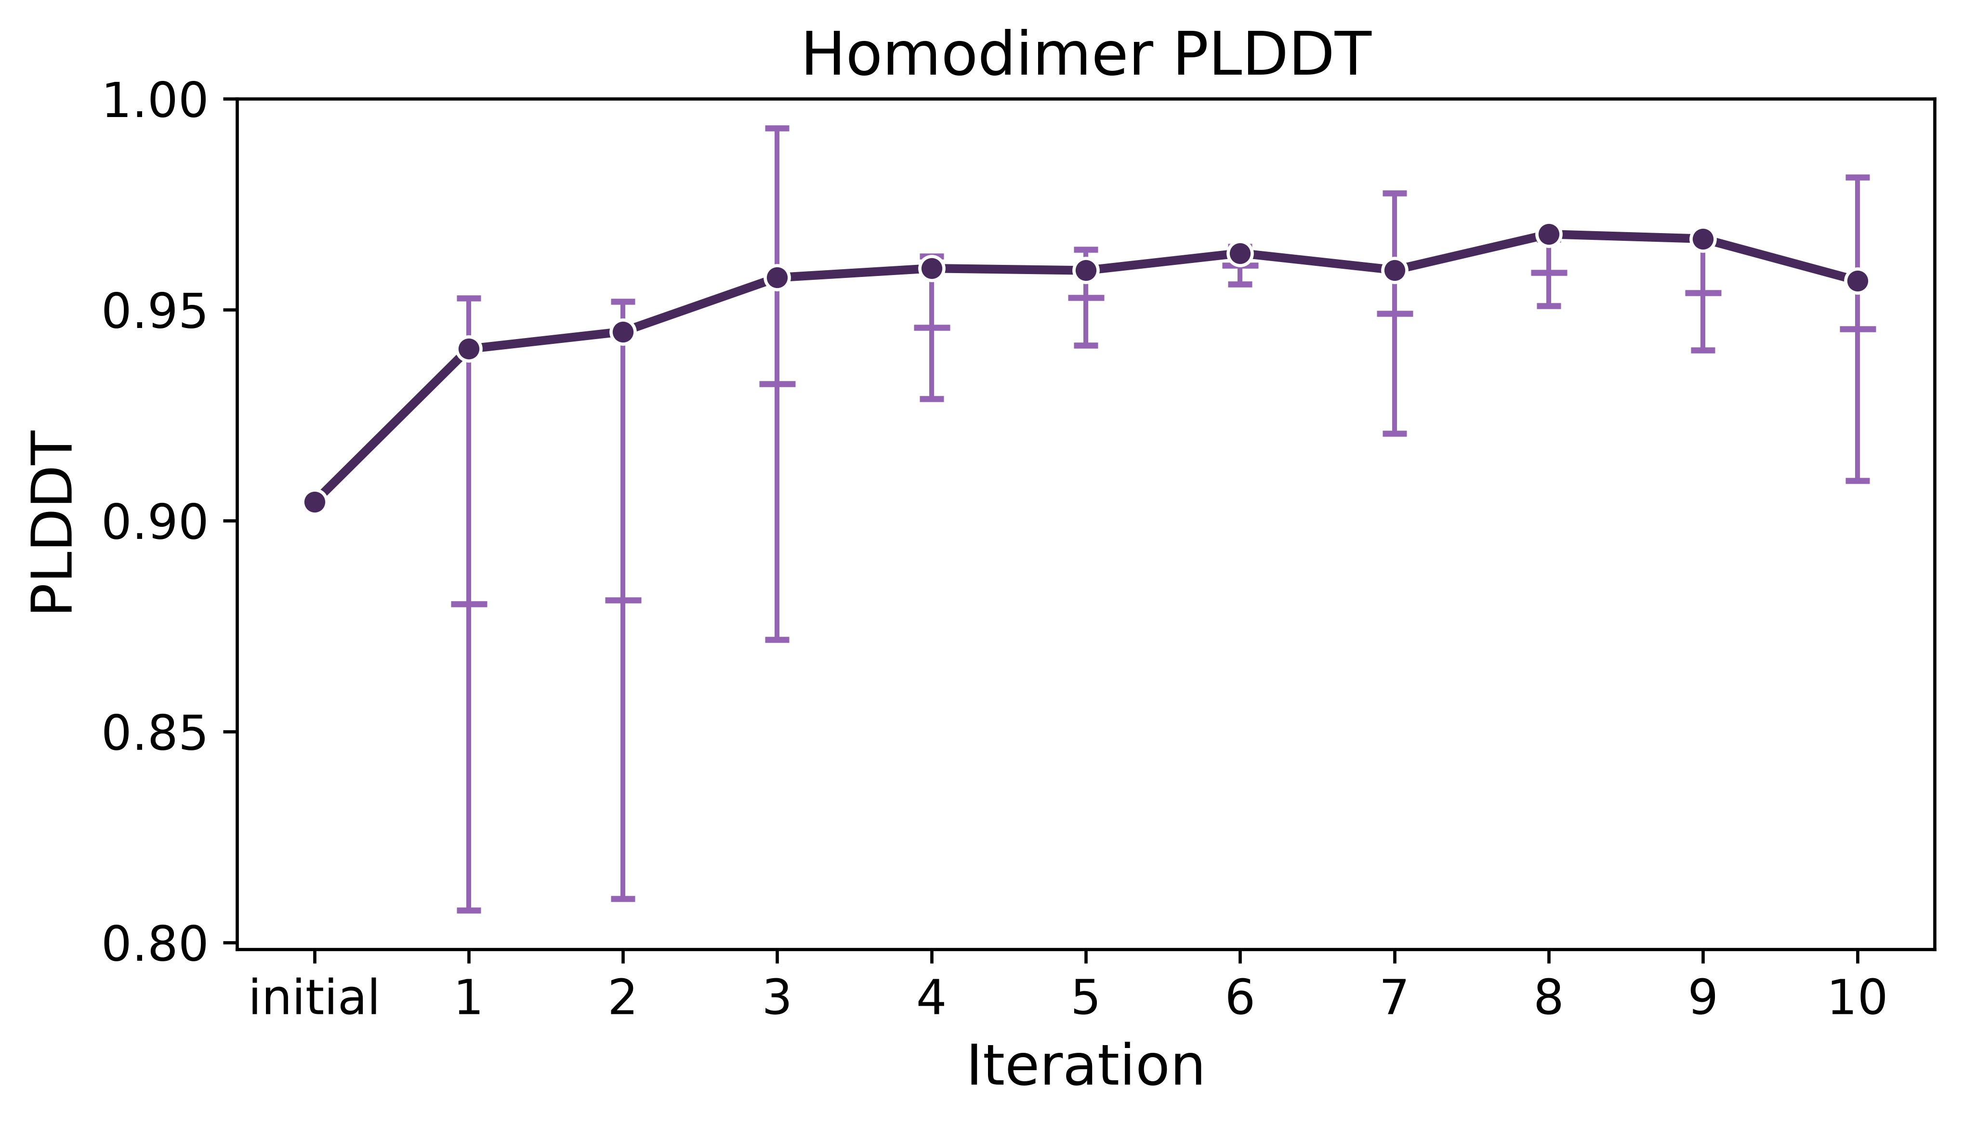
Case 1: Homodimers
initial
iter 10
IPTM improves, then plateaus
PLDDT improves, despite not being the convergence metric
RMSD = 2.44 Å
Notes:
Rep1
Not just trying to pad our numbers. Chai has a latent understanding of protein biophysics, so maxing these scores should theordically get us closer to chai’s understanding of protein structure
Bad iptm: <0.75
Bad plddt: <0.9

Slide 11
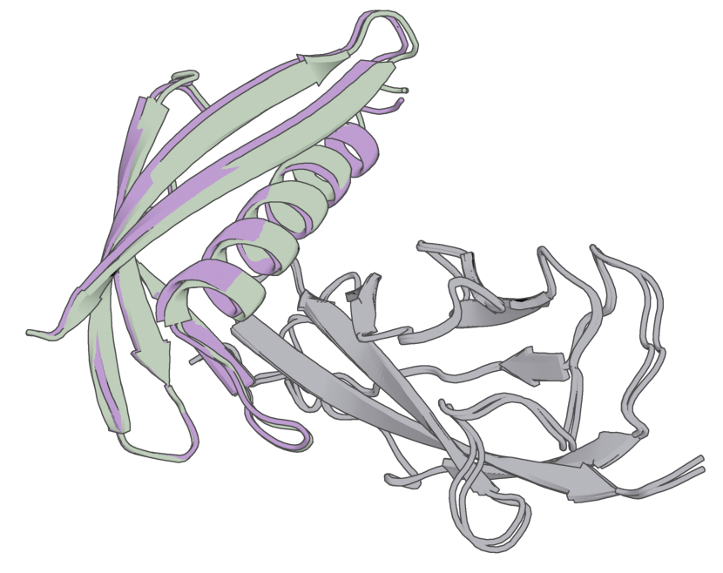
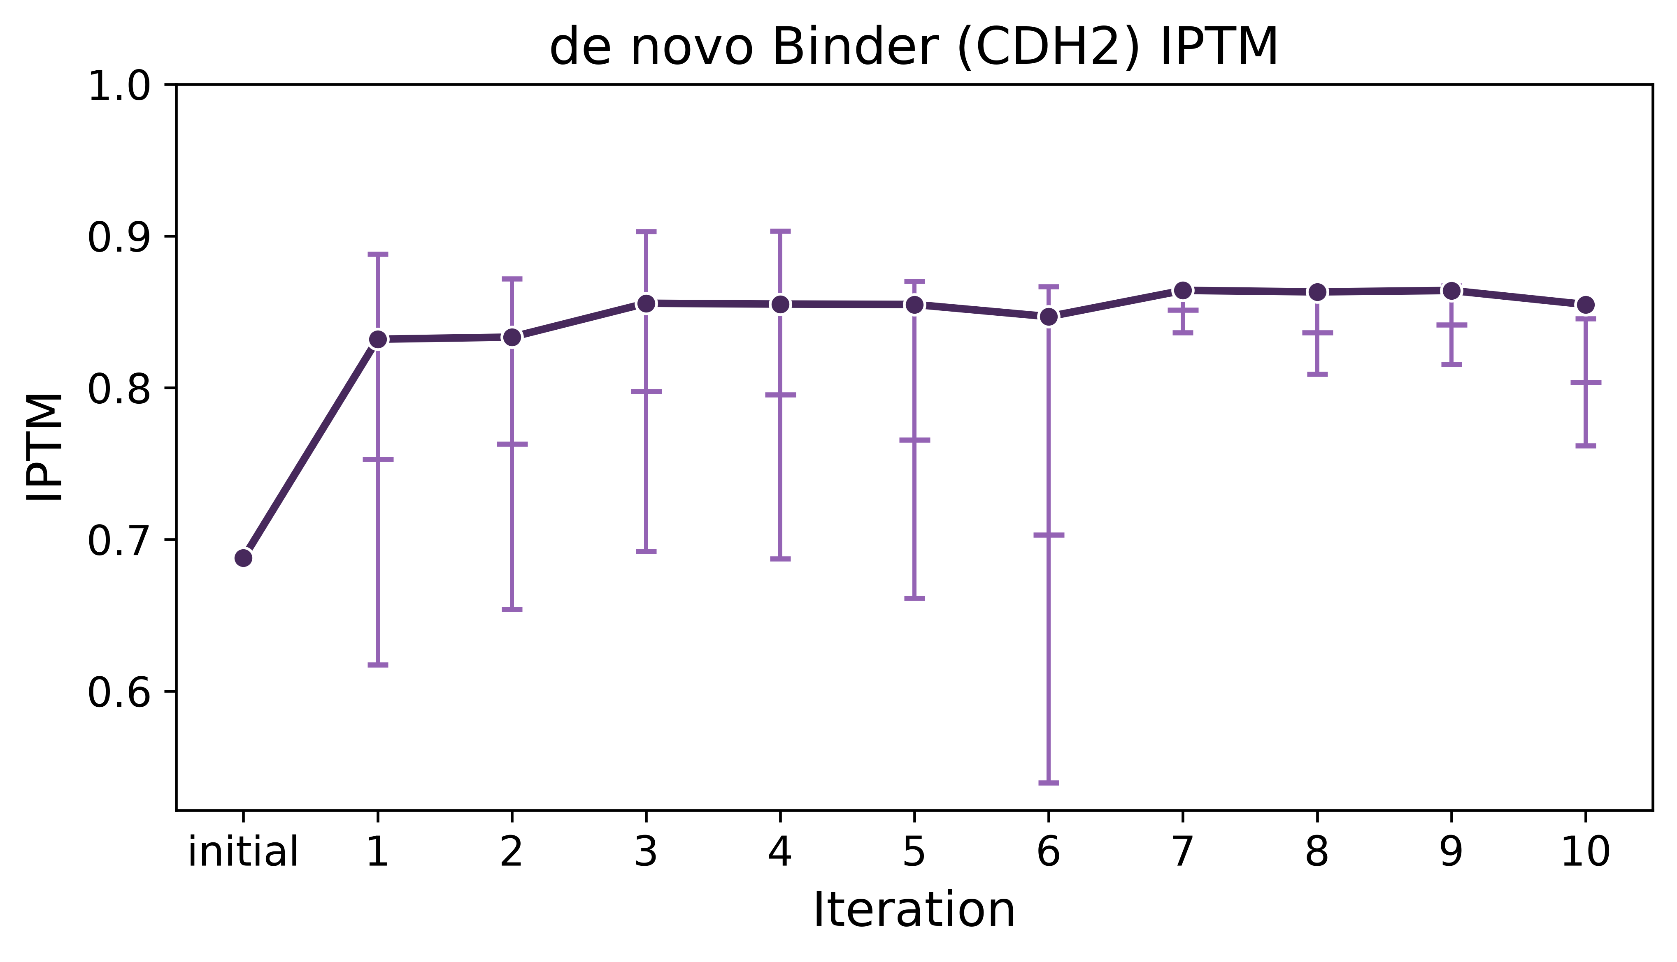
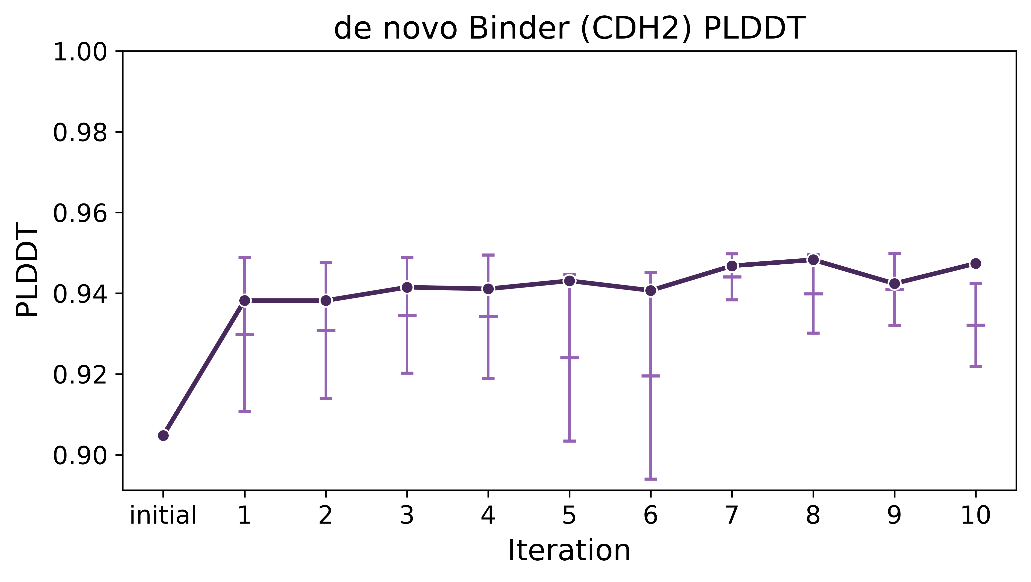
Case 2: de novo Binders
initial
iter 10
target
IPTM improves, then plateaus
PLDDT improves, despite not being the convergence metric
RMSD = 0.737 Å
Notes:
Rep1
Not just trying to pad our numbers. Chai has a latent understanding of protein biophysics, so maxing these scores should theordically get us closer to chai’s understanding of protein structure
Bad iptm: <0.75
Binder against CDH2
Show structure
Binder that failed filters originally

Slide 12
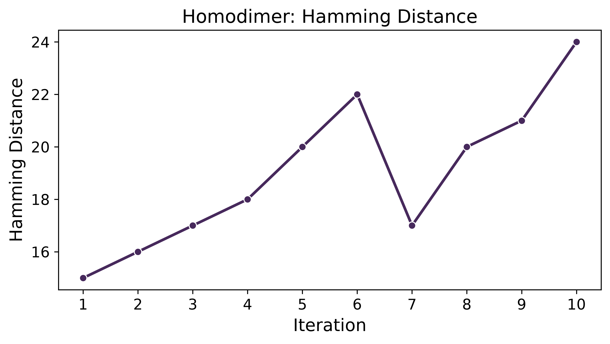
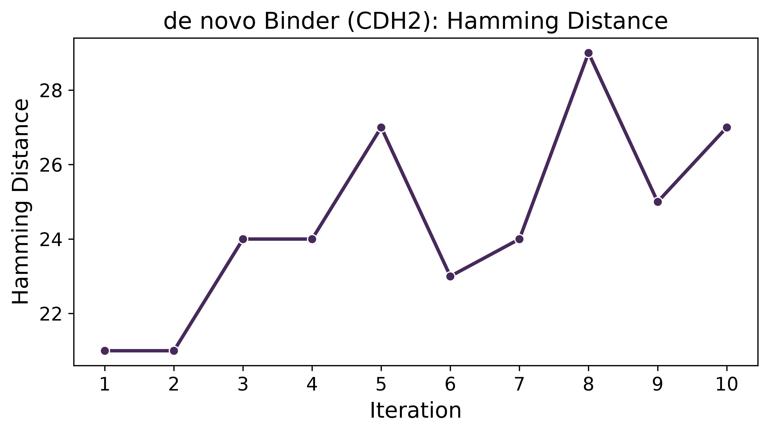
CHAMP Extensively Diversifies Sequence
Hamming Distance – Total number of unequal residues
Length = 55 residues
Length = 78 residues
Notes:
Call back to the IPTM plot to explain that this hamming increases as confidence stays good
Explain hamming more

Slide 13
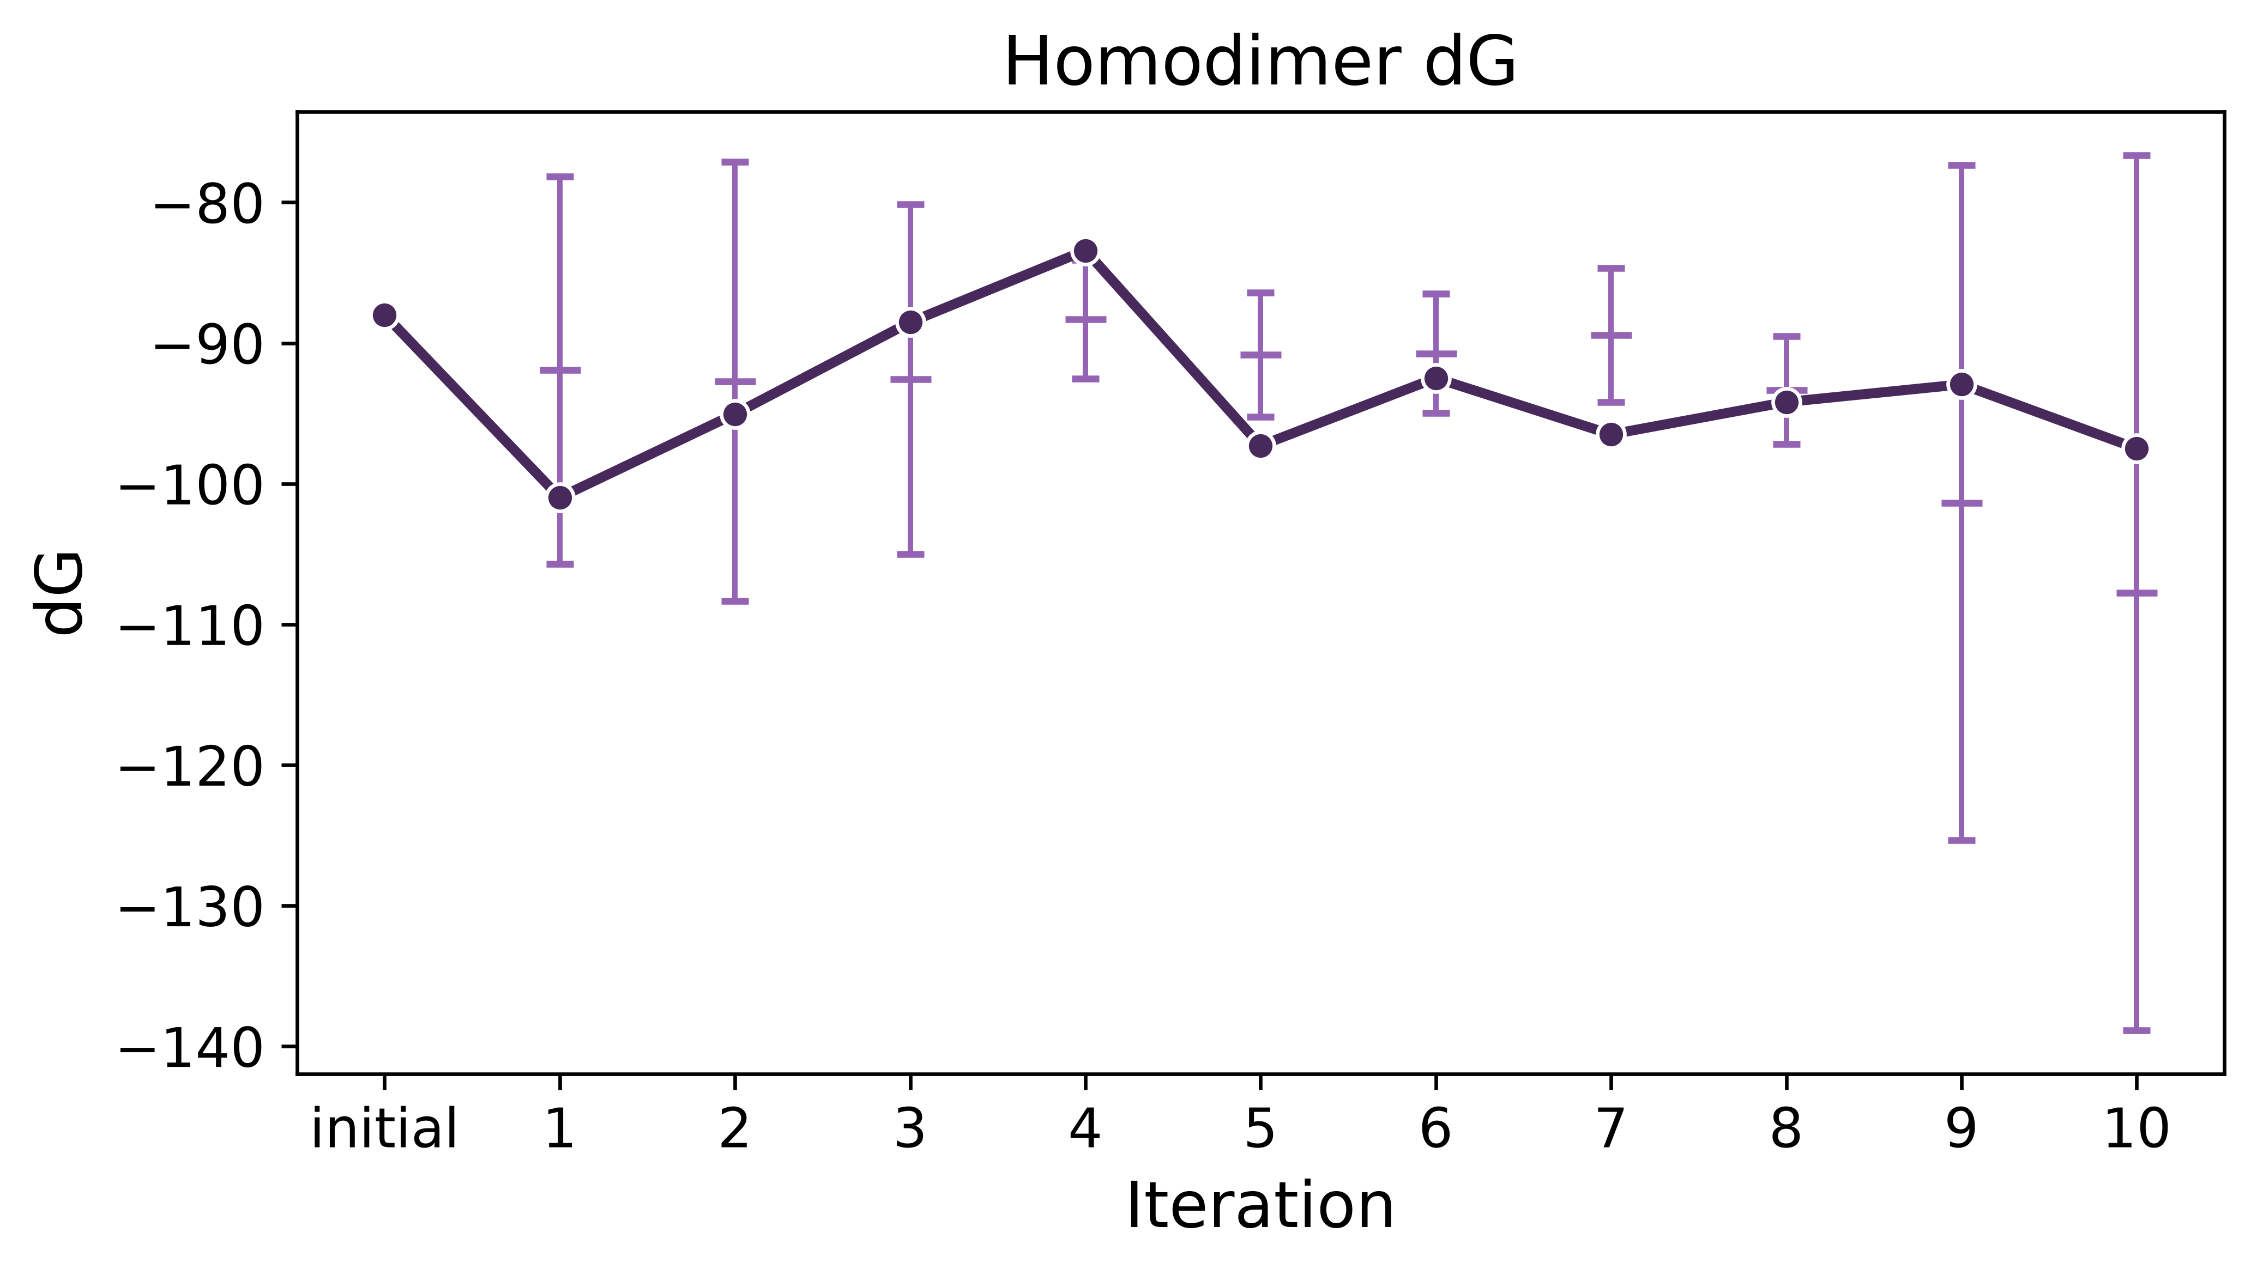
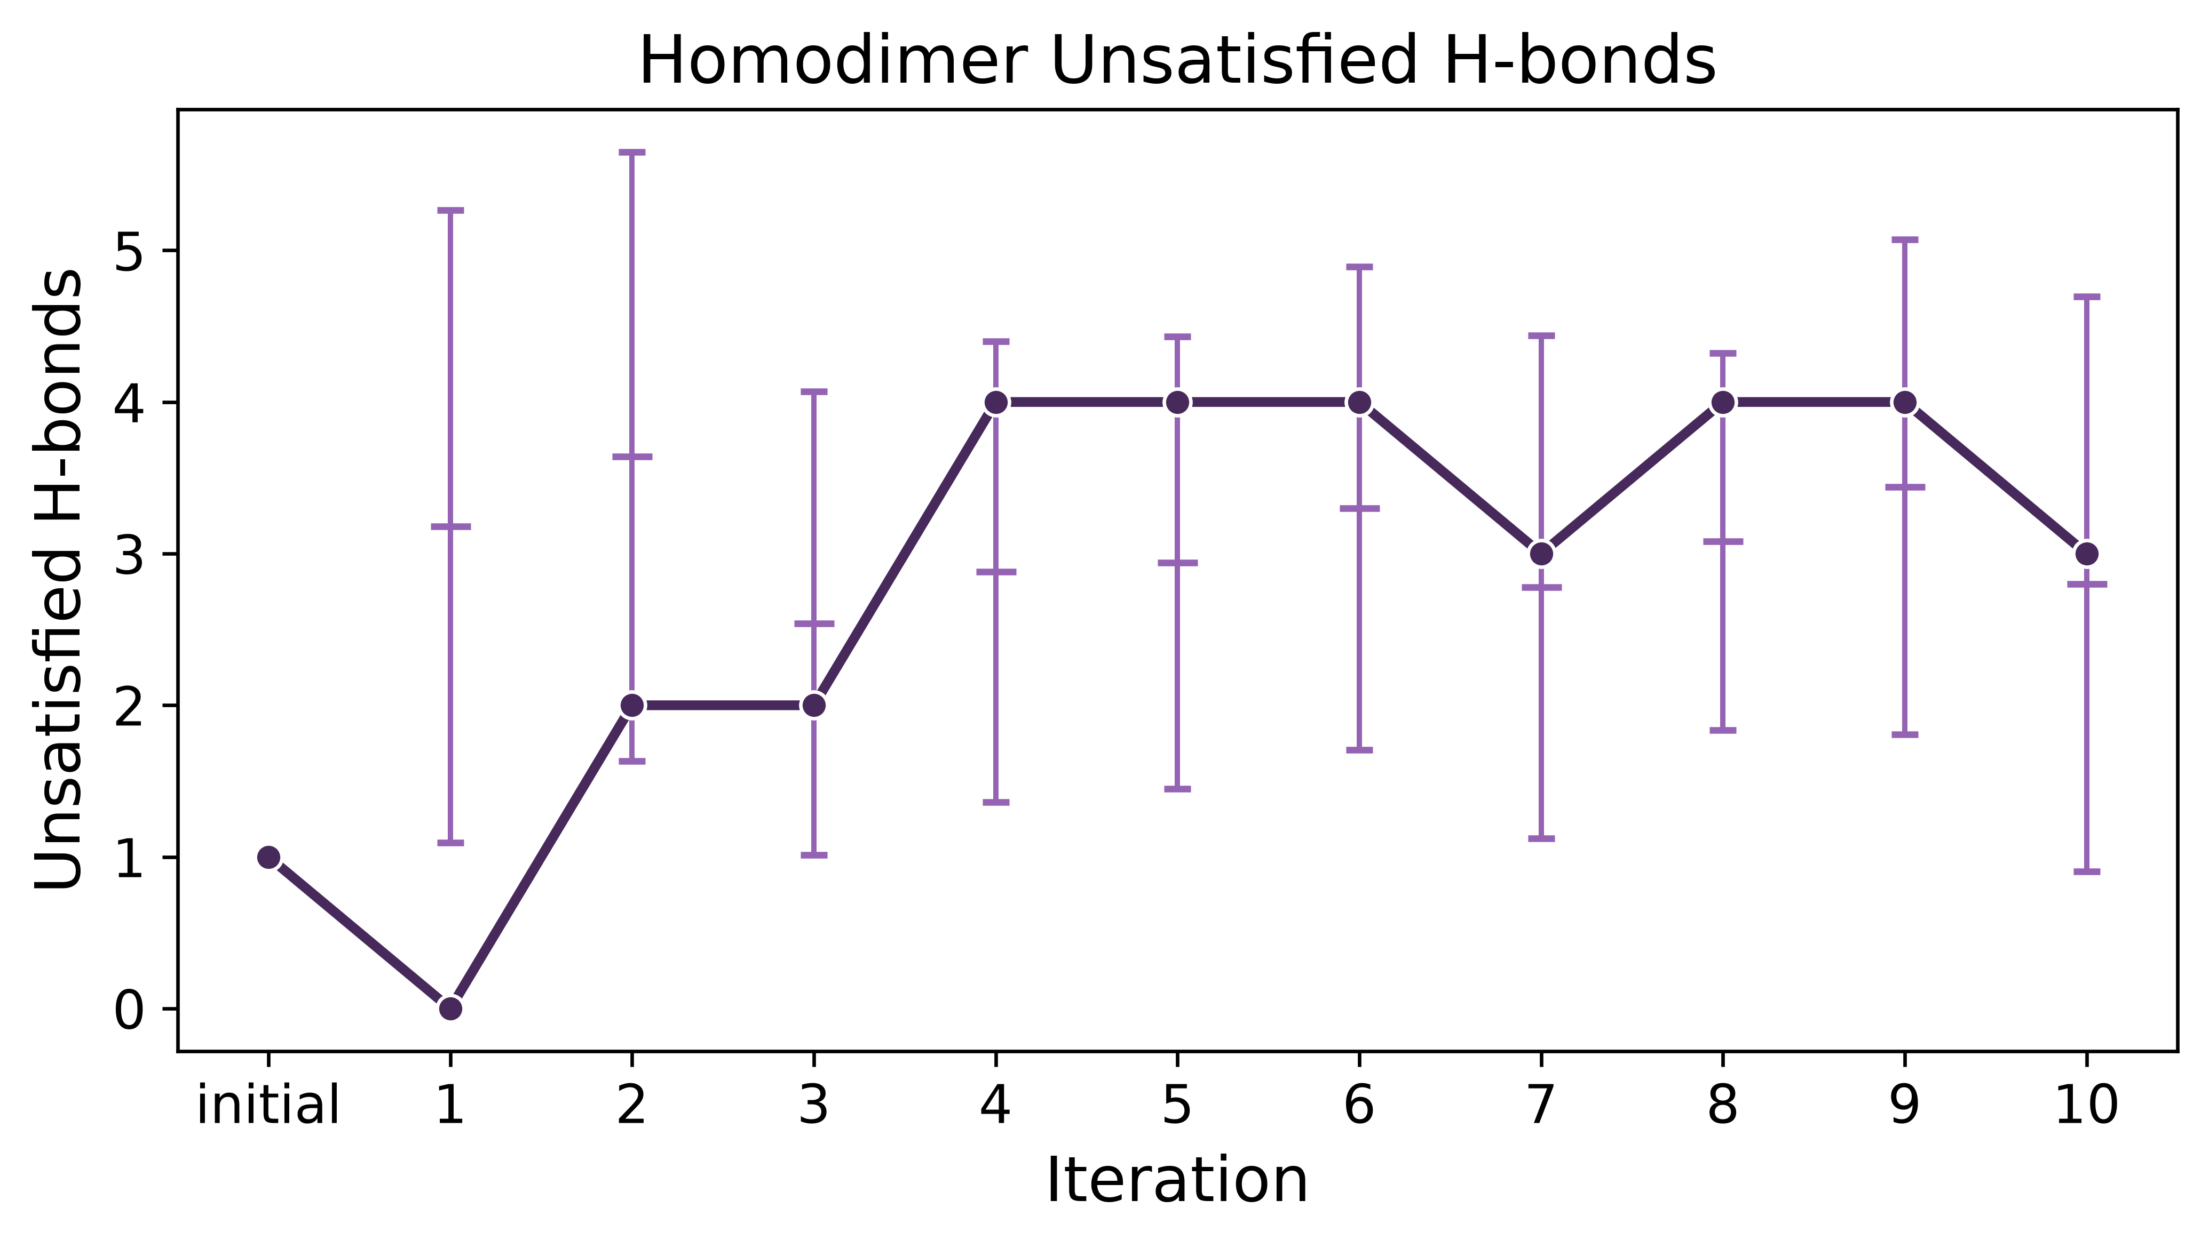
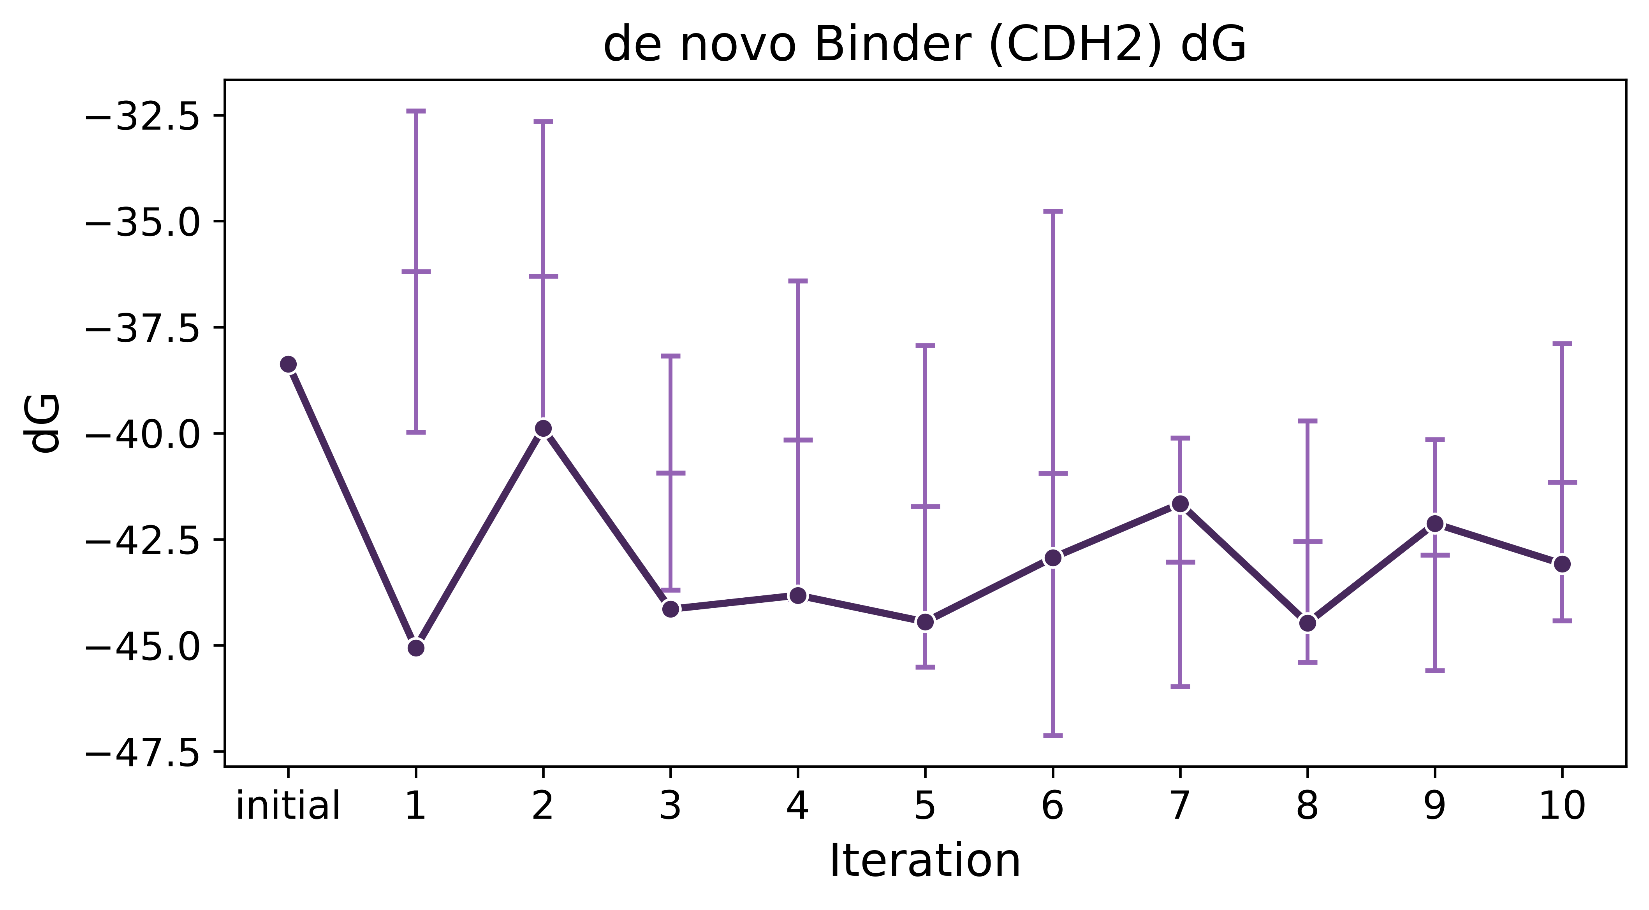
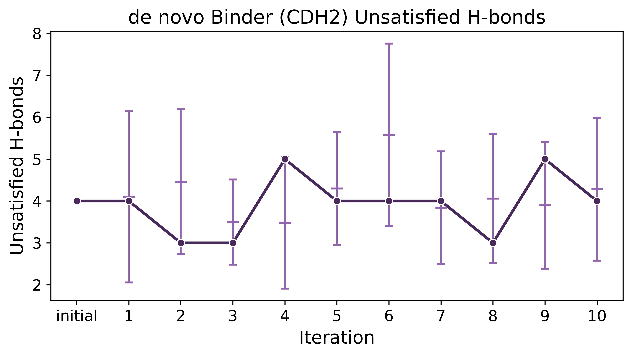
Eventual multi-parameter optimization
Currently just converging based on confidence
Homodimer
de novo Binder

Slide 14
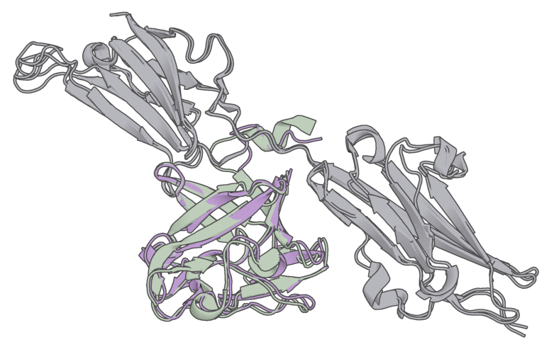
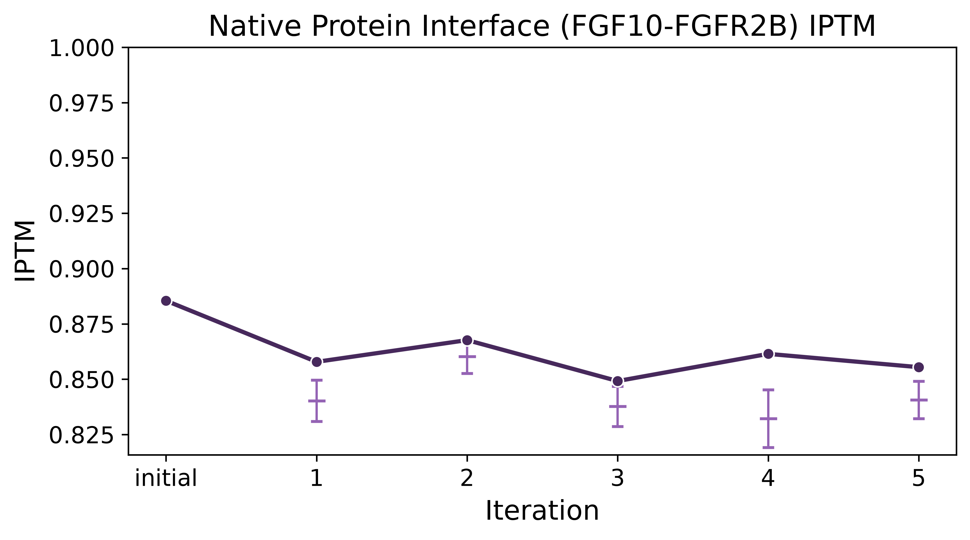
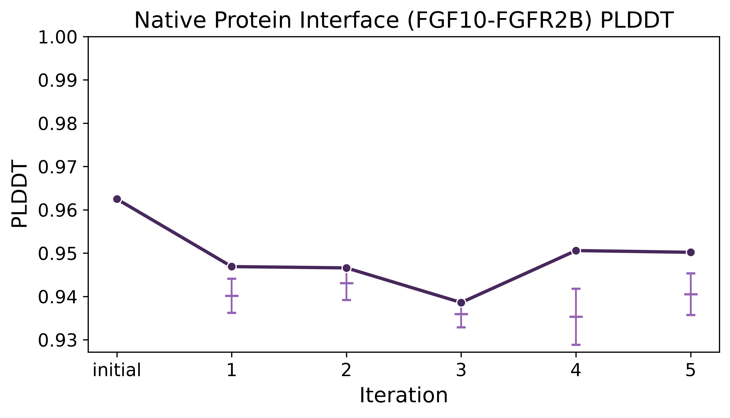
Case 3: Native Interfaces
initial
Iter 5
target
Less improvement than de novo designs
Results may improve if interface residues are not redesigned
RMSD = 1.18 Å

Slide 15
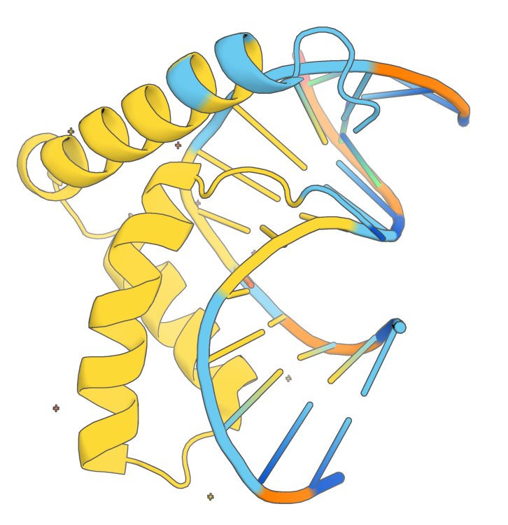
Future Directions
Case 4: DNA Binders (ex: Sox9)
Ability to constrain which residues to redesign
  Preserve key interface residues
  Constrain on conservation
Monte Carlo-like multi-parameter optimization to better guide design evolution
Notes:
Sox9 protein structure

