Slide 1
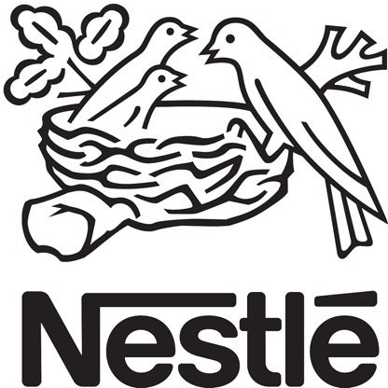
"Optimizing Manufacturing Process" Performance Tracking in Nestlé Morocco’s Dairy Department via Power BI
Internship presentation by Achraf Kabbour, April 2025

Slide 2
Outline:
6.Implementation Challenges
7.Recommendations
8.Internship Reflections
9.Conclusion
Executive Summary
Nestlé and Dairy Context
Business Problem
Power BI Solution
Key Findings

Slide 3
Executive Summary
Internship at Nestlé Morocco’s Dairy Department, spring 2025.
Goal: Address inefficient manual tracking of Nestlé Continuous Excellence (NCE) processes.
Solution: Developed a Power BI dashboard for real-time tracking of 7 Key Success Requirements (KSRs) and 4 Digital Tools (DTs).
Impact: Improved visibility, identified 35 overdue tasks, and proposed Industry 4.0-aligned solutions.
Key stat: KRONES line at 86% KSR compliance vs. OCTABINE at 37%.

Slide 4
Nestlé and Dairy Context
Nestlé Global: World’s largest food & beverage company, USD 91.2B revenue (2023), 180+ countries.
Nestlé Morocco: Nido, top-selling powdered milk, drives revenue in USD 2B dairy sector.
Dairy Market Trends: Growing demand (USD 729.8B by 2030), digitalization, sustainability challenges.
Morocco’s Industry 4.0: Government push for digitization aligns with project goals.

Slide 5
Business Problem
Issue: Manual Excel tracking of NCE (7 KSRs: Safety, Quality, etc.; 4 DTs: POKA, DMO, etc.) led to:
Delays: 3-day reporting lag.
Errors: Inaccurate data risking safety/quality.
Non-simultaneous reviews: Hindered decision-making.
Impact: Threatened Nido’s quality compliance and operational efficiency.
Relevance: Aligns with Nestlé’s digitization goals and Morocco’s Industry 4.0 initiative.

Slide 6
Power BI Solution
Methodology:
Data Sourcing: Extracted ~300 tasks from Excel.
Data Transformation: Cleansed data, added fields (e.g., “Days Remaining”).
Analysis: Used DAX for stats (e.g., avg KSR progress).
Dashboard: Built KPIs, slicers, and visualizations (bar charts, tables).
Key Features: Real-time tracking, drill-downs for 5 production lines (SCHMUKER, OPTIMA, KRONES, OCTABINE, MATEER BURT).

Slide 7
Key Findings
KSR Compliance: Quality (82%) strong, Maintenance (50%) weak.
Digital Tools: Low adoption (35% avg), PROMETHEUS at 0%.
Line Performance: KRONES (86%) excels, OCTABINE (37%) lags.
Overdue Tasks: 35, mostly Tagging (KSR3) and POKA (DT1).
Insight: Maintenance and digital tool gaps risk downtime and efficiency losses.

Slide 8
Implementation Challenges
Limited Live Data: Manual Excel updates slowed analysis.
Operator Resistance: Preference for Excel, viewed Power BI as complex.
Resource Constraints: Production prioritized over dashboard adoption.
Tech Skills Gap: Operators needed training (e.g., POKA at 45% progress).
Mitigation: Conducted training and town halls, but time constraints persisted.

Slide 9
Strategic Recommendations
Full Power BI Integration: Live data by Q3 2025.
Resource Reallocation: Shift from KRONES to OCTABINE by May 2025.
Digital Tools: 100% POKA compliance by Q2 2025, plan PROMETHEUS for Q3.
Maintenance Committee: Form by June 2025 to address 50% compliance.
Feedback System: Weekly via Power BI by May 2025.
Alignment: Supports Nestlé’s sustainability and Morocco’s Industry 4.0 goals

Slide 10
Internship Reflections
Objectives: Master Power BI, enhance transparency, gain management experience.
Achievements: Functional dashboard, $20,000 theoretical savings.
Lessons: Flexibility and persuasion are key; digital transformation needs cultural shifts.
Future: Prepared for management roles and Industry 4.0 contributions in Morocco.

Slide 11
Thank You
Summary: Power BI dashboard improved transparency, addressed inefficiencies, and aligned with Industry 4.0.
Impact: Enhanced operational efficiency, supported Nestlé’s sustainability goals, and set a model for Morocco’s dairy sector.
Call to Action: Nestlé should adopt recommendations to stay competitive and lead in digital transformation.
Closing: “Thank you for your attention! Let’s drive innovation together.”

