Slide 1
CS112 – Programming fundamentals
Week 04 – Imperative programming
Course Instructor :
Engr.Asma Khan
Assistant Professor,SE dept

Slide 2
Flow chart for two-way program
If the condition temp > 86 is true, the body of the if statement gets executed;
if false, the body of the else clause gets executed.
In both cases, execution resumes with the statements after the if/else pair of statements.

Slide 3
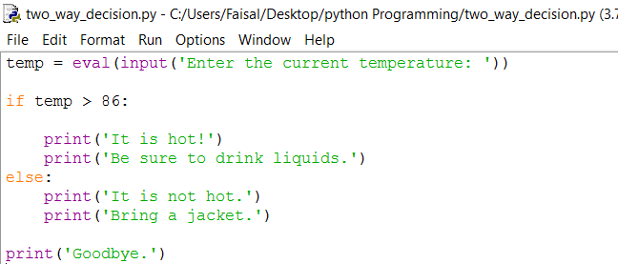
Two-way decisions

Slide 4
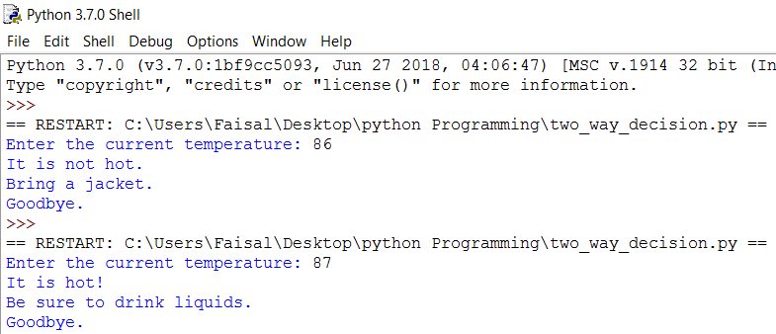
Execution of two-way decision program
When temperature is less than the desired condition
When temperature is greater than the desired condition

Slide 5
Structure of if – else condition
The more general version of the if statement has the following format:
if <condition>:
<indented code block 1>
else:
<indented code block 2>

Slide 6
Iteration structures
In previous chapter we introduced strings and lists.
Both are sequences of objects. A string can be viewed as a sequence of one-character strings; a list is a sequence of objects of any type (strings, numbers, even other lists).
A task that is common to all sequences is to perform an action on every object in the sequence.
For example, you could go down your list of contacts and send a party invite to contacts living nearby.
Or you could go through a shopping list to check that you purchased everything on it.
Or you could go through the characters of your name in order to spell it.
0
1
2
name
F
A
I
S
A
L
animal
‘fish’
‘cat’
‘dog’

Slide 7
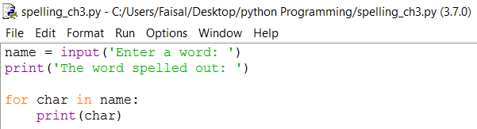
Analysis of for loop execution
The for loop statement encompasses lines 4 and 5 of the program. In line 4, char is a variable name.
The for loop statement will repeatedly assign characters of string name to variable char.
If name is string ‘FAISAL', char will first have value ‘F', then ‘A', then ‘I', then ‘S', then ‘A', and finally ‘L'.
For each value of char, the indented print statement print(char) is executed.

Slide 8
Loop in execution
Let’s use this last example. Suppose we would like to implement a short program that spells the string entered by the user:
Enter a word: FAISAL
The word spelled out:
F
A
I
S
A
L
The program first requests the user to enter a string. Then, after printing the line 'The word spelled out:', the characters of the string entered by the user are printed one per line.

Slide 9
Coding for Simple loop
We can start the implementation of this program as follows:
name = input('Enter a word: ')
print('The word spelled out:')
In order to complete this program, we need a method that will allow us to execute a print() statement for every character of the string name.

Slide 10
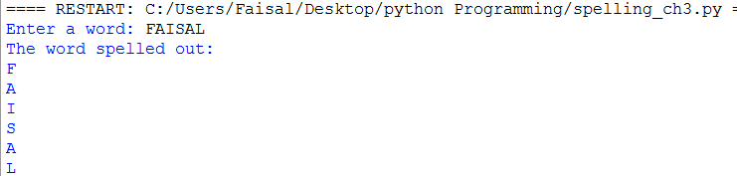
Execution of for loop
The Python for loop statement can be used to do exactly this. This program implements the behavior we want:
Code with iteration using for loop
Executing the code using for loop

Slide 11
Illustration of for loop over string
Figure below illustrates the workings of this loop.
Iteration 1: char =
Iteration 2: char =
Iteration 3: char =
Iteration 4: char =
Iteration 5: char =
Iteration 6: char =
F
A
I
S
A
L
The variable char is assigned ‘F' in iteration 1, ‘A' in iteration 2, ‘I' in iteration 3,
‘S' in iteration 4, ‘A' in iteration 5 , and ‘L' in iteration 6; in every iteration, the current value of char is printed.
So when char is ‘F', ‘F' gets
printed; when char is ‘A',
‘A' gets printed, and so on.
name
F
A
I
S
A
L

Slide 12
For loop over the list
The for loop can also be used to iterate over the items of a list. In the next example, we use, in the interactive shell, a for loop to iterate over string objects representing my pets:
>>> animals = ['fish', 'cat', 'dog']
>>> for animal in animals:
print(animal)
fish
cat
dog

Slide 13
Analysis of for- loop over list
The for loop executes the indented section print(animal) three times, once for each value of animal; the value of animal is first 'fish', then 'cat', and finally 'dog', as illustrated in Figure below.
Iteration 1: animal =
Iteration 2: animal =
Iteration 3: animal =
0
1
2
animal
‘fish’
‘cat’
‘dog’
‘fish’
‘cat’
‘dog’

Slide 14
The for loop variable
!
The variable char in
for char in name:
print(char)
and the variable animal in
for animal in animals:
print(animal)
are just variable names, chosen to make the program more meaningful.
We could have just as easily written the loops with, say, variable name x:
for x in name:
print(x)
for x in animals:
print(x)
Note: If we change the name of the for loop variable, we also need to change any occurrence of it in the body of the for loop.

Slide 15
For loop format
In general, the for loop statement has this format:
for <variable> in <sequence>:
<indented code block >
<non-indented code block>

Slide 16
Nesting control flow structures
Let’s use the for loop to write a program that combines a for loop and an if statement.
We would like to write an application that starts by asking the user to enter a phrase.
After the user has done so, the program will print all the vowels in the phrase, and no other letter.
The program should behave like this:
Enter a phrase: test case
e
a
e

Slide 17
Strategy for nesting loop
This program will consist of several components.
We need an input() statement to read in the phrase, a for loop to iterate over the characters of the input string, and, in every iteration of the for loop, an if statement to check whether the current character is a vowel.
If so, it gets printed.
Next is the complete program.

Slide 18
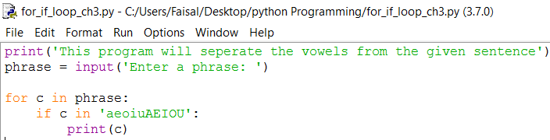
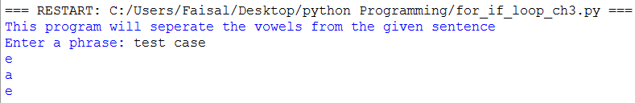
For loop with condition statement code and execution
Code with for loop and if condition
Executing the code using nesting loop

Slide 19
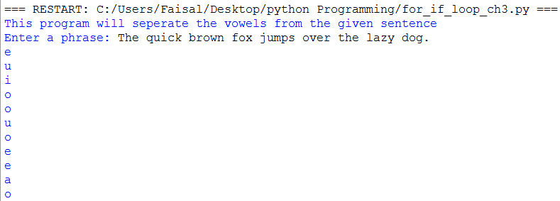
Another sentence for finding the vowels
Note that we combined a for loop and an if statement and that indentation is used to specify the body of each.
The if statement body is just print(c) while the for loop statement body is:
if c in 'aeiouAEIOU':
print(c)

Slide 20
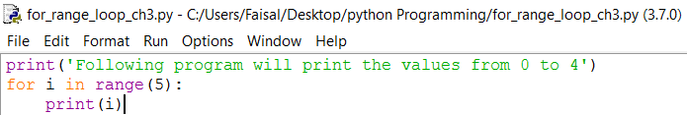
Function range()
We just saw how the for loop is used to iterate over the items of a list or the characters of a string. It is often necessary to iterate over a sequence of numbers in a given range, even if the list of numbers is not explicitly given. For example, we may be searching for a divisor of a number.
Or we could be iterating over the indexes 0, 1, 2, . . . of a sequence object. The built-in function range() can be used together with the for loop to iterate over a sequence of numbers in a given range. Here is how we can iterate over the integers 0, 1, 2, 3, 4:

Slide 21
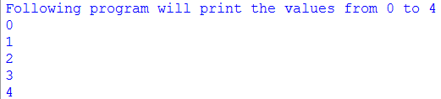
Function range()

Slide 22
Function range()
Function range(n) is typically used to iterate over the integer sequence 0, 1, 2, . . . , (n -1).
In the last example, variable i is set to 0 in the first iteration; in the following iterations, i gets assigned values 1, 2, 3, and finally 4 (as n = 5).
As in previous for loop examples, the indented code section of the for loop is executed in every iteration, for every value of i.

Slide 23
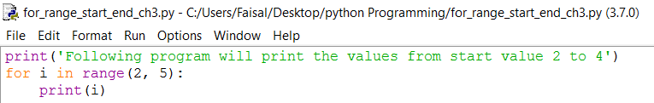
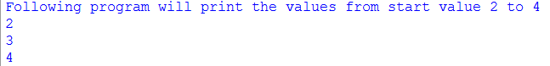
Function range(start, end)
The range() function can also be used to iterate over more complex sequences of numbers.
If we would like the sequence to start at a nonzero number start and end before number end, we make the function call range(start, end). For example, this for loop iterates over the sequence 2, 3, 4:

Slide 24
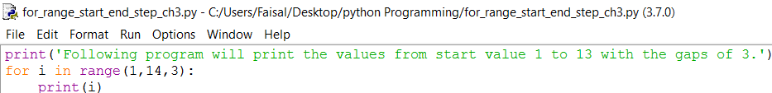
Function range(start, end, step)
In order to generate sequences that use a step size other than 1, a third argument can be used.
The function call range(start, end, step) can be used to iterate over the sequence of integers starting at start, using a step size of step and ending before end. For example, the next loop will iterate over the sequence 1, 4, 7, 10, 13:
The sequence printed by the for loop starts at 1, uses a step size of 3, and ends before 14.
Therefore it will print 1, 4, 7, 10, and 13.

Slide 25
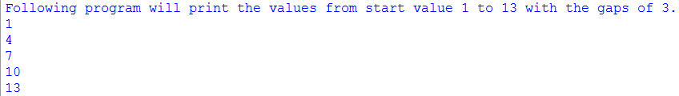
Function range(start, end, step) program execution

Slide 26
Assignment # 3
To be submitted by solving it on python idle & email it to me. Remember to read chapter 3

Slide 27
Practice problem 3.1
Translate these conditional statements into Python if statements:
(a) If age is greater 62, print 'You can get your pension benefits'.
(b) If name is in list ['Musial', 'Aaraon', 'Williams', 'Gehrig', 'Ruth'],
print 'One of the top 5 baseball players, ever!'.
(c) If hits is greater than 10 and shield is 0, print 'You are dead...'.
(d) If at least one of the Boolean variables north, south, east, and west is True, print
'I can escape.'.

Slide 28
Practice problem 3.3
Translate these into Python if/else statements:
(a) If year is divisible by 4, print 'Could be a leap year.'; otherwise print 'Definitely not
a leap year.'
(b) If list ticket is equal to list lottery, print 'You won!'; else print 'Better luck next
time...'

Slide 29
Practice problem 3.4
Implement a program that starts by asking the user to enter a login id (i.e., a string). The program then checks whether the id entered by the user is in the list ['joe', 'sue', 'hani', 'sophie'] of valid users. Depending on the outcome, an appropriate message should be printed. Regardless of the outcome, your function should print 'Done.' before terminating. Here is an example of a successful login:
Login: joe
You are in!
Done.
And here is one that is not:
>>>
Login: john
User unknown.
Done.

Slide 30
Practice problem 3.5
Implement a program that requests from the user a list of words (i.e., strings) and then prints on the screen, one per line, all four-letter strings in the list.
>>>
Enter word list: ['stop', 'desktop', 'top', 'post']
stop
post

Slide 31
Practice problem 3.6
Write the for loop that will print these sequences of numbers, one per line, in the interactive shell.
(a) Integers from 0 to 9 (i.e., 0, 1, 2, 3, 4, 5, 6, 7, 8, 9)
(b) Integers from 0 to 1 (i.e., 0, 1)

Slide 32
Practice problem 3.7
Write the for loop that will print the following sequences of numbers, one per line.
(a) Integers from 3 up to and including 12
(b) Integers from 0 up to but not including 9, but with a step of 2 instead of the default
of 1 (i.e., 0, 2, 4, 6, 8)
(c) Integers from 0 up to but not including 24 with a step of 3
(d) Integers from 3 up to but not including 12 with a step of 5

