Slide 1
Programming fundamentals
Week 04 – Imperative programming
Course Instructor :
Engr.Asma Khan
Assistant Professor,SE dept

Slide 2
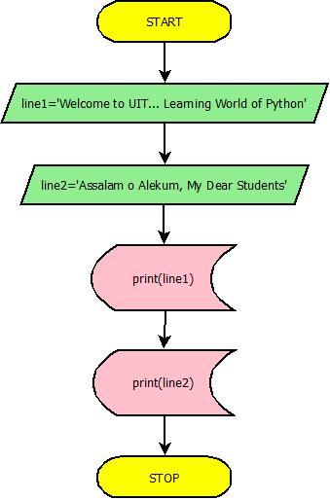
Flow chart for the first program using shell idle

Slide 3
Build-in function print()
Our first program has two lines of code in which the function print() is used. This function prints, within the interactive shell, whatever argument is given to it. For example, if given a number, it prints the number:
>>> print(0)
0
Similarly, if given a list, it prints it:
>>> print([0, 0, 0])
[0, 0, 0]
A string argument is printed without the quotes:
>>> print('zero')
zero

Slide 4
Build-in function print()
If the input argument contains an expression, the expression is evaluated and the result is printed:
>>> x = 0
>>> print(x)
0
Note that, in our first program, each print() statement "printed" its argument on a separate line.

Slide 5
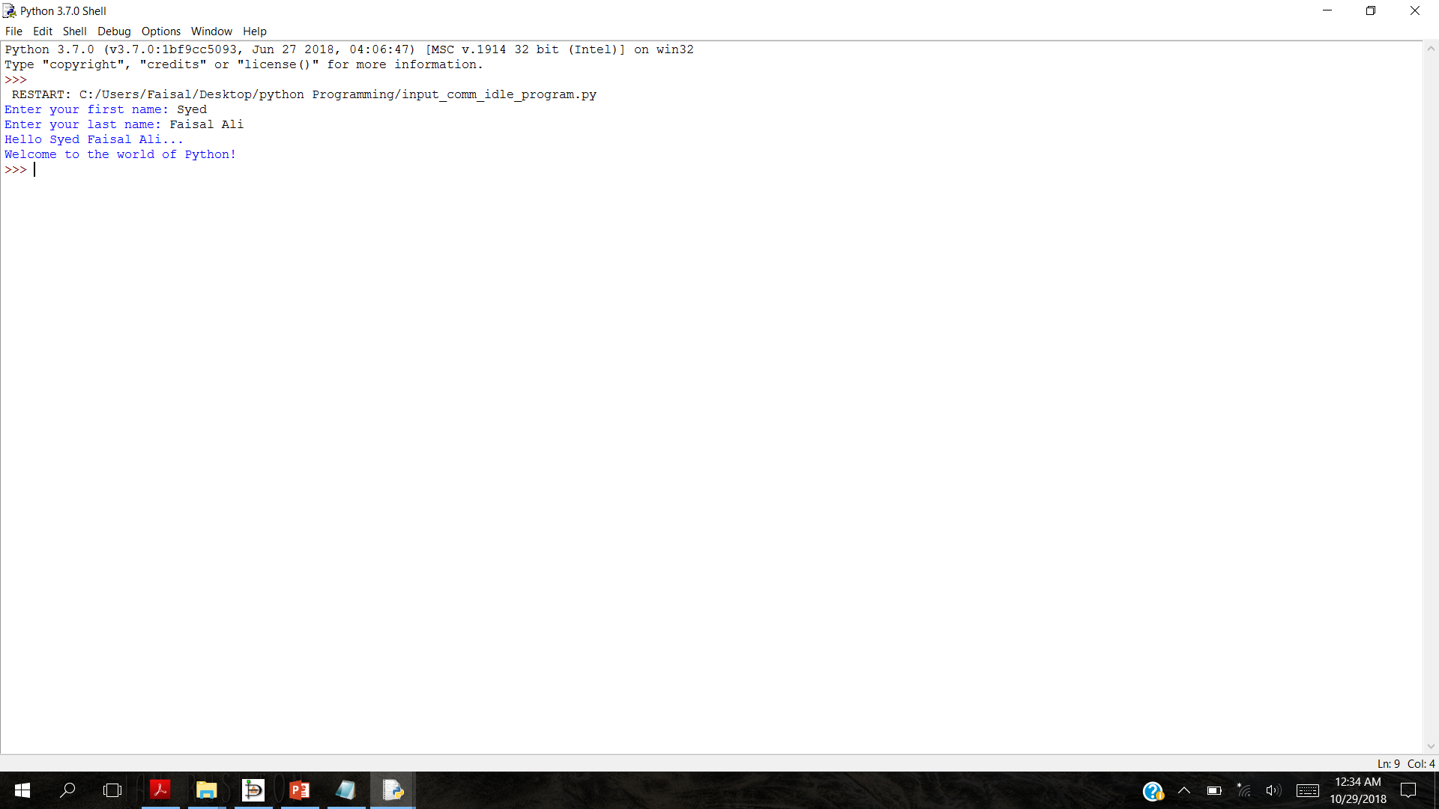
Interactive input with input()
first = input('Enter your first name: ')
last = input('Enter your last name: ')
line1 = 'Hello '+ first + ' ' + last + '...'
print(line1)
print('Welcome to the world of Python!')

Slide 6
Function input() Returns a String
!
!
We just saw that when the input function is called, whatever the user types is treated as a string. Let’s check what happens when the user enters a number:
>>> x = input('Enter a value for x: ')
Enter a value for x: 5
>>> x
'5'
The Python interpreter treats the value entered as a string '5', not integer 5. We check this:
>>> x == 5
False
>>> x == '5'
True
The input() function will always treat whatever the user types as a string.

Slide 7
Function eval()
If you expect the user to enter a value that is not a string, you need to explicitly ask Python to evaluate what the user types as a Python expression using the eval() function.
The function eval() takes a string as input and evaluates the string as if it were a Python expression. Here are some examples:
>>> eval('3')
3
>>> eval('3 + 4')
7
>>> eval('len([3, 5, 7, 9])')
4

Slide 8
Eval() function with input()
The function eval() can be used together with the function input() when we expect the user to type an expression (a number, a list, etc.) when requested. All we need to do is wrap the eval() function around the input() function: The effect is that whatever the user types will be evaluated as an expression. For example, here is how we would ensure that a number entered by the user is treated as a number:
>>> x = eval(input('Enter x: '))
Enter x: 5
We check that x is indeed a number and not a string:
>>> x == 5
True
>>> x == '5'
False

Slide 9
Execution of control structures
A Python program is a sequence of statements that are executed in succession.
In the short programs we have seen so far, the same sequence of statements is executed, in order starting from the statement in line 1 and regardless of the values input by the user, if any.
That is not what we usually experience when using an application on a computer.
Computer applications usually do different things depending on the values input.
For example, the game you just finished playing may stop or continue running, depending on whether you click on the Exit or the Play Again button.
We now introduce Python statements that can control which statements are executed and which statements should be executed repeatedly.

Slide 10
One-way decisions
Suppose we want to develop a program that asks the user to enter the current temperature and then prints an appropriate message only if it is more than 86 degrees. This program would behave as shown if the user enters 87:
Enter the current temperature: 87
It is hot!
Be sure to drink liquids.
The program would behave as shown if the user enters 67:
Enter the current temperature: 67
In other words, if the temperature is 86 or less, no message is printed. If the temperature is more than 86, then the message
It is hot!
Be sure to drink liquids.
is printed.

Slide 11
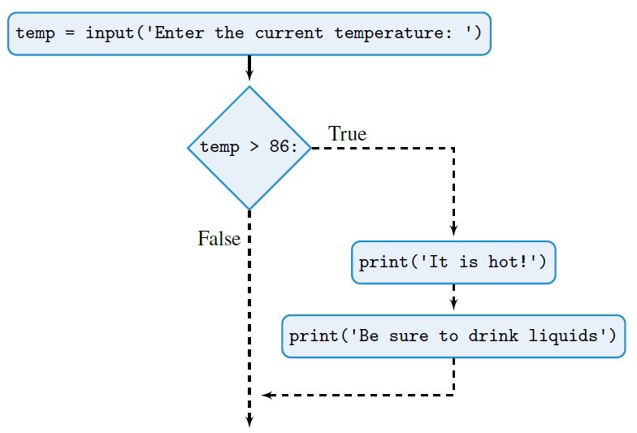
Flow chart for the program (one-way)
The input() statement is executed first, and the value entered by the user is assigned name temp.
The if statement checks condition temp > 86.
If true, the two print() statements are executed
and the program terminates;
if false, the program just terminates.

Slide 12
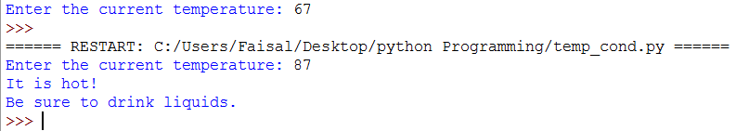
Condition statement If()
temp = eval(input('Enter the current temperature: '))
if temp > 86:
print('It is hot!')
print('Be sure to drink liquids.')

Slide 13
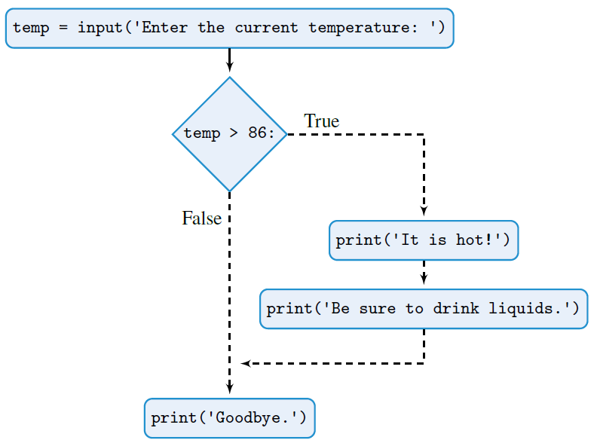
Flow chart for the program (one-way) – Program 2
Regardless of whether the if statement condition is true or false, the statement print('Goodbye.') is executed after the if statement.

Slide 14
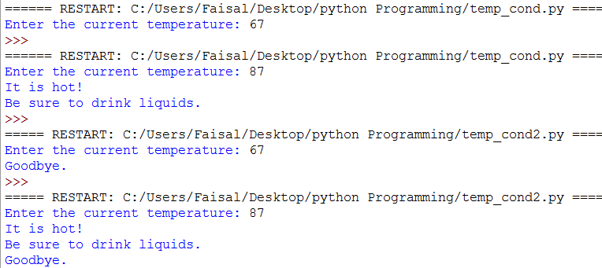
If condition program 2
temp = eval(input('Enter the current temperature: '))
if temp > 86:
print('It is hot!')
print('Be sure to drink liquids.')
print('Goodbye.')

Slide 15
Structure of if ( ) condition statement
The first line of an if statement consists of the if keyword, followed by Boolean expression <condition> (i.e., an expression that evaluates to True or False), followed by a colon, which indicates the end of the condition.
Below the first line and indented with respect to the if keyword will be the block of code that is executed if condition evaluates to True.
If <condition> evaluates to False, the indented block of code is skipped.
In either case, regardless of whether the indented code has been executed, the execution continues with the Python statement <non-indented statement> directly below, and with the same indentation as, the first line of the if statement.
In general, the format of an if statement is:
if <condition>:
<indented code block>
<non-indented statement>

Slide 16
indentation
!
In Python, proper indentation of Python statements is critical. Compare
if temp > 86:
print('Its hot!')
print('Be sure to drink liquids.')
print('Goodbye.')
with
if temp > 86:
print('It is hot!')
print('Be sure to drink liquids.')
print('Goodbye.')
Print Good Bye will execute, no matter condition is true or false
Print Good Bye will execute, only if the condition is true other wise it will not print

Slide 17
Practice problem 3.1
Translate these conditional statements into Python if statements:
(a) If age is greater 62, print 'You can get your pension benefits'.
(b) If name is in list ['Musial', 'Aaraon', 'Williams', 'Gehrig', 'Ruth'],
print 'One of the top 5 baseball players, ever!'.
(c) If hits is greater than 10 and shield is 0, print 'You are dead...'.
(d) If at least one of the Boolean variables north, south, east, and west is True, print
'I can escape.'.

