Slide 1
Programming fundamentals
Week 05 – Imperative programming
Course Instructor :
Engr.Asma Khan

Slide 2
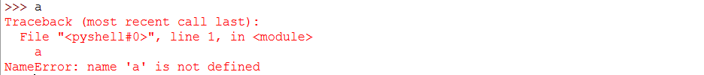
Python variables and assignments
Functions are either called from within the interactive shell or by another program, which we will refer to as the calling program. In order to be able to design functions, we need to understand how values created in the calling program—or the interactive shell—are passed as input arguments to the function.
To do this, however, we first need to understand exactly what happens in an assignment statement.
Let’s consider this question in the context of the assignment a = 3. First, let’s note that before executing this assignment, the identifier a does not exists:
>>>a
In general, a Python assignment statement has this syntax:
<variable> = <expression>

Slide 3
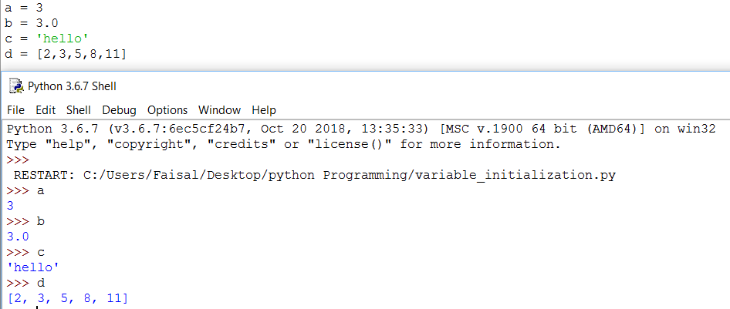
After execution the initialization of variables

Slide 4
Mutable and immutable types
Subsequent assignments to a, such as
>>> a = 6
Will reuse the existing name a.
The result of this assignment is that variable a will refer to another object, integer object 6. The int object 3 no longer is referred to by a variable, as shown in Figure

Slide 5
Mutable and immutable types
The important thing to note is that the assignment a = 6 did not change the value of the integer object 3.
Instead, a new integer object 6 is created, and variable a now refers to it.
In fact, there is no way to change the value of the object containing value 3.
This illustrates an important feature of Python: Python int objects cannot be changed.
Integer objects are not the only objects that cannot be modified.
Types whose objects cannot be modified are called immutable.
All Python number types (bool, int, float, and complex) are immutable.

Slide 6
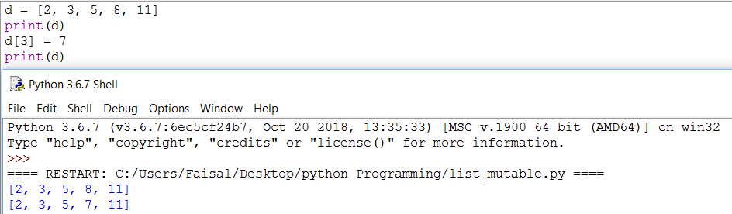
Lists are mutable

Slide 7
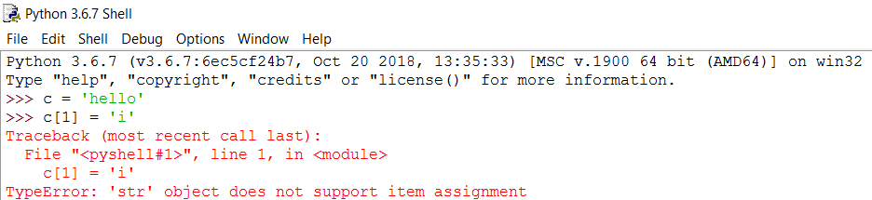
What about strings?
We cannot modify a character of string object.
The string type is immutable.

Slide 8
Assignments and mutability
We often have the situation when multiple variables refer to the same object.
(This is, in particular, the case when a value is passed as an input to a function.)
We need to understand what happens when one of the variables is assigned another object. For example, suppose
we do:
>>> a = 3
>>> b = a
The first assignment creates an integer object with value 3 and gives it name a.
In the second assignment, the expression a evaluates to the integer object 3, which then receives another name, b, as shown in Figure

Slide 9
Assignment and mutability
Variables a and b both refer to the same integer object 3. Now, what happens when we assign something else to a?
>>> a = 6
The assignment a = 6 does not change the value of the object from 3 to 6 because the int type is immutable. Variable a should now refer to a new object with value 6.
What about b?
>>> a
6
>>> b
3
Variable b still refers to the object with value 3, as shown in Figure
The point is this: If two variables refer to the same immutable object, that modifying one variable will not affect the other.

Slide 10
Multiple mutability
Now let’s consider what happens with lists. We start by assigning a list to a and then assigning a to b.
>>> a = [3, 4, 5]
>>> b = a
We expect a and b to refer to the same list.
That is indeed the case, as shown in Figure
Now let’s see what happens when we assign a new object to b[1]: a and vice versa.
>>> b[1] = 8
>>> b
[3, 8, 5]
>>> a
[3, 8, 5]

Slide 11
swapping
We now consider a fundamental assignment problem. Let a and b refer to two distinct integer values:
>>> a = 6
>>> b = 3
Suppose we need to swap the values of a and b. In other words, after the swap, a will refer to 3 and b will refer to 6, as shown in Figure

Slide 12
Swapping (regular method)
If we start by assigning the value of b to a:
a = b
then variable a will refer to the same object that variable b refers to. So we will have both a and b refer to 3, and we would have “lost” integer object 6.
Before we execute a = b, we must save a reference to 6 and then assign that to b at the end:
>>> temp = a # temp refers to 6
>>> a = b # a refers to 3
>>> b = temp # b refers to 6

Slide 13
Swapping (the python way)
In Python, there is a much simpler way to achieve the swap. Python supports the multiple assignment statement:
>>> a = 6
>>> b = 3
>>> a, b = b, a
>>> a
3
>>> b
6
In the multiple assignment statement a, b = b, a, the two expressions on the right of = are evaluated to two objects and then each is assigned to the corresponding variable.

Slide 14
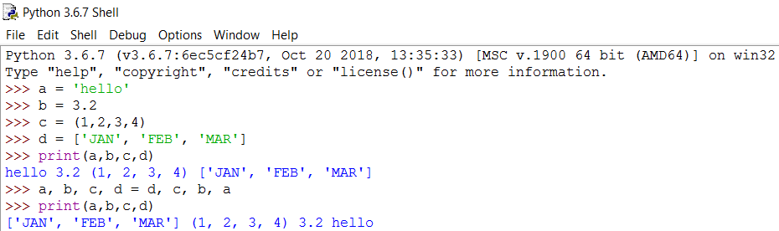
Swapping values and data types at a time

Slide 15
Parameter passing
we can understand how input arguments are passed in function calls.
Functions are either called from within the
interactive shell or by another program.
We refer to either as the calling program.
The input arguments in a function call are names of objects created in the calling program.
These names may refer to objects that are mutable or immutable.
We consider each case separately.

Slide 16
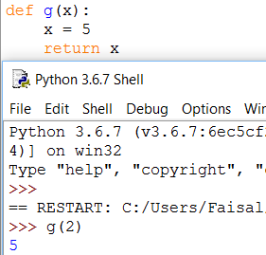
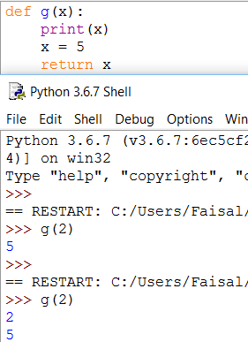
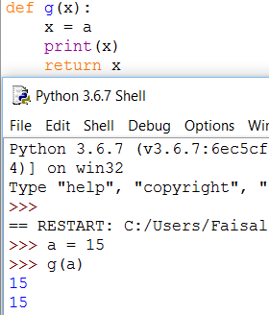
Immutable Parameter passing
We use the function g() to discuss the effect of passing a reference to an immutable object in a function call.

Slide 17
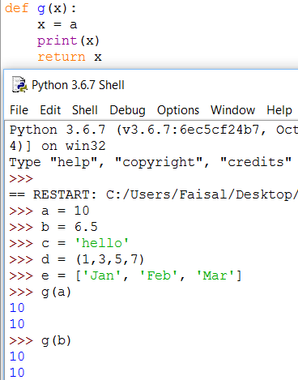
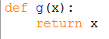
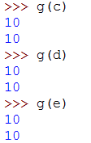
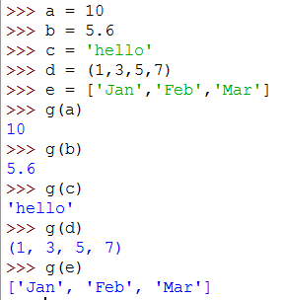
Immutable Parameter passing

Slide 18
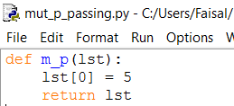
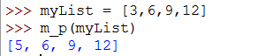
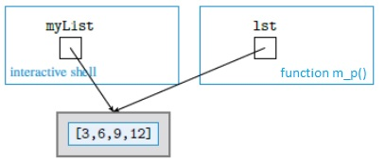
Mutable parameter passing
In the assignment statement, a list object is created and assigned name myList.
Then the function call h(myList) is made.
When function m_p() starts executing, the list referred to by myList will be assigned to variable name lst defined in the function definition of m_p().
So we have the situation illustrated in Figure.
This example illustrates that when a mutable object, like list object [3,6,9,12], is passed as an argument in a function call, it may be modified by the function

Slide 19
Programming Practice
Based on udf (User defined functions), conditions, loop

Slide 20
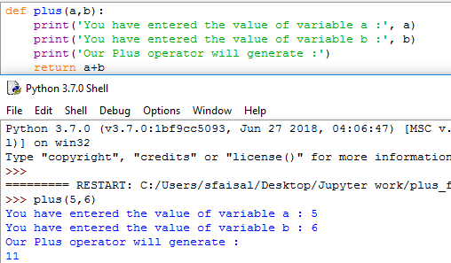
Plus function( )
Define a function which can plus two parameters either integer or float.

Slide 21
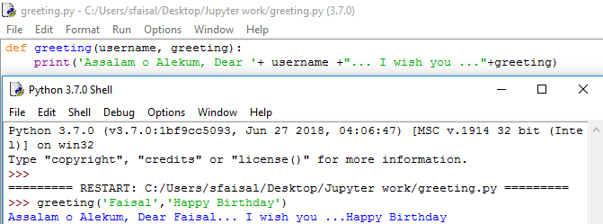
Greeting function( )
Write a function which takes two inputs from the user as arguments one is user name and the other is greeting message.
The function will then generate the message with user name and greetings.

Slide 22
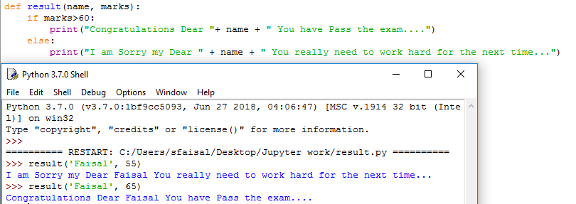
Pass/Fail Function( )
Write a function which asks user to write his/her name, and the score in exam (1 to 100). If the marks are less than 60 it will reply a sorry message, otherwise it will congratulate the user.

Slide 23
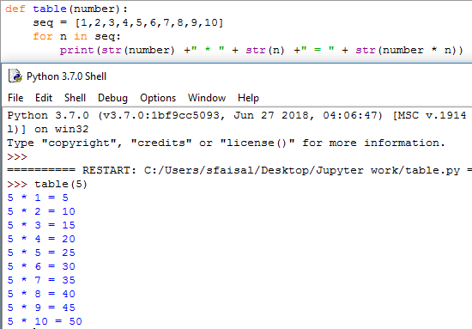
Table function( )
Write a function which will generate a table starting from 1 till 10. The function will take one parameter as integer or float and generate the table such as 4 * 1 = 4.

Slide 24
Assignment # 3
To be submitted by solving it on python idle & email it to me. Remember to read chapter 3

Slide 25
Practical problem 3.14
Draw a diagram representing the state of names and objects after this execution:
>>> a = [5, 6, 7]
>>> b = a
>>> a = 3

Slide 26
Practical problem 3.15
Suppose a nonempty list team has been assigned. Write a Python statement or statements that swap the first and last value of the list. So, if the original list is:
>>> team = ['Ava', 'Eleanor', 'Clare', 'Sarah']
then the resulting list should be:
>>> team
['Sarah', 'Eleanor', 'Clare', 'Ava']

Slide 27
Reading assignment
Read chapter 3 complete. In case of any problem please come to my office.
Consultation / Tutorial hours are available for your help.

Slide 28
End of Lecture – Week 5

