Slide 1

Object-Oriented Programming (OOP)
Lecture No. 3
Engr.Asma Khan
Assistant Professor
Software Engineering Dept

Slide 2
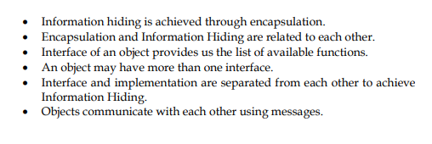
Summary of Lecture No.2

Slide 3
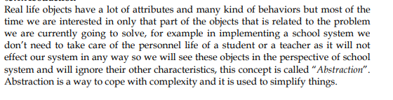
Abstraction
Abstraction is a way to cope with complexity.
Principle of abstraction:
“Capture only those details about an object that are relevant to current perspective”

Slide 4
Example – Abstraction
Suppose we want to implement abstraction for the following statement
Ali is a PhD student and teaches BS students
Attributes
  - Name - Employee ID
  - Student Roll No - Designation
  - Year of Study - Salary
  - CGPA - Age

Slide 5
Example – Abstraction
Ali is a PhD student and teaches BS students
behaviour
  - Study - DevelopExam
  - GiveExam - TakeExam
  - PlaySports - Eat
  - DeliverLecture - Walk

Slide 6
Example – Abstraction
Student’s Perspective
Attributes
  - Name - Employee ID
  - Student Roll No - Designation
  - Year of Study - Salary
  - CGPA - Age

Slide 7
Example – Abstraction
Student’s Perspective
behaviour
  - Study - DevelopExam
  - GiveExam - TakeExam
  - PlaySports - Eat
  - DeliverLecture - Walk

Slide 8
Example – Abstraction
Teacher’s Perspective
Attributes
  - Name - Employee ID
  - Student Roll No - Designation
  - Year of Study - Salary
  - CGPA - Age

Slide 9
Example – Abstraction
Teacher’s Perspective
behaviour
  - Study - DevelopExam
  - GiveExam - TakeExam
  - PlaySports - Eat
  - DeliverLecture - Walk

Slide 10
Example – Abstraction
A cat can be viewed with different perspectives
Ordinary Perspective
  A pet animal with
  Four Legs
  A Tail
  Two Ears
  Sharp Teeth
Surgeon’s Perspective
  A being with
  A Skeleton
  Heart
  Kidney
  Stomach

Slide 11
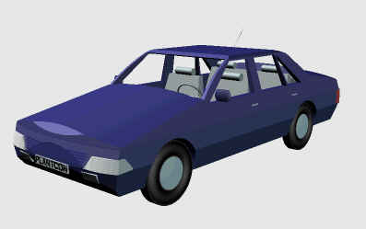
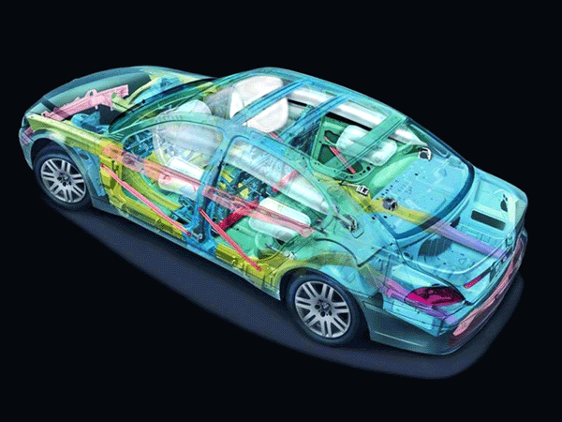
Example – Abstraction
Engineer’s View
Driver’s View

Slide 12
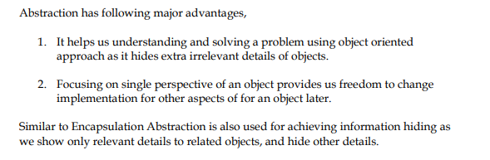
Abstraction – Advantages
Simplifies the model by hiding irrelevant details
Abstraction provides the freedom to defer implementation decisions by avoiding commitment to details

Slide 13

Classes
In an OO model, some of the objects exhibit identical characteristics (information structure and behavior)
We say that they belong to the same class

Slide 14
Example – Class
Ali studies mathematics
Anam studies physics
Sohail studies chemistry
Each one is a Student
We say these objects are instances of the Student class

Slide 15
Example – Class
Ahsan teaches mathematics
Aamir teaches computer science
Atif teaches physics
Each one is a teacher
We say these objects are instances of the Teacher class

Slide 16
Graphical Representation of Classes
(Class Name)
(Class Name)
(attributes)
(operations)
Suppressed Form
Normal Form

Slide 17
Example – Graphical Representation of Classes
Circle
center
radius
Circle
draw
computeArea
Suppressed Form
Normal Form

Slide 18
Example – Graphical Representation of Classes
Person
name
age
gender
Person
Suppressed Form
eat
walk
Normal Form

Slide 19
Inheritance
A child inherits characteristics of its parents
Besides inherited characteristics, a child may have its own unique characteristics

Slide 20
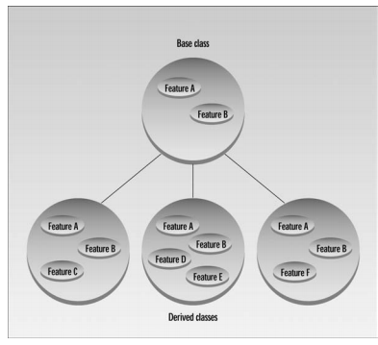

Slide 21
Inheritance in Classes
If a class B inherits from class A then it contains all the characteristics (information structure and behaviour) of class A
The parent class is called base class and the child class is called derived class
Besides inherited characteristics, derived class may have its own unique characteristics

Slide 22
Example – Inheritance
Person
Student
Doctor
Teacher

Slide 23
Example – Inheritance
Shape
Line
Triangle
Circle

Slide 24
Inheritance – “IS A” or
“IS A KIND OF” Relationship
Each derived class is a special kind of its base class

Slide 25
Example – “IS A” Relationship
Person
name
age
gender
eat
walk
Student
Teacher
Doctor
program
studyYear
designation
salary
designation
salary
study
heldExam
teach
takeExam
checkUp
prescribe

Slide 26
Example – “IS A” Relationship
Shape
color
coord
draw
rotate
setColor
Triangle
Circle
radius
Line
angle
draw
computeArea
length
draw
computeArea
draw

Slide 27
Inheritance – Advantages
Reuse
Less redundancy
Increased maintainability

Slide 28
Reuse with Inheritance
Main purpose of inheritance is reuse
We can easily add new classes by inheriting from existing classes
  Select an existing class closer to the desired functionality
  Create a new class and inherit it from the selected class
  Add to and/or modify the inherited functionality

Slide 29
Example Reuse
Shape
color
coord
draw
rotate
setColor
Triangle
Circle
radius
Line
angle
draw
computeArea
length
draw
computeArea
draw

Slide 30
Example Reuse
Person
name
age
gender
eat
walk
Student
Teacher
Doctor
program
studyYear
designation
salary
designation
salary
study
heldExam
teach
takeExam
checkUp
prescribe

Slide 31
Example Reuse
Person
name
age
gender
eat
walk
Student
Teacher
Doctor
program
studyYear
designation
salary
designation
salary
study
heldExam
teach
takeExam
checkUp
prescribe

Slide 32
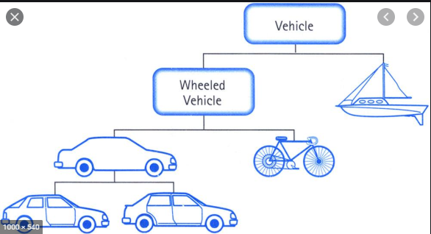
Example:

Slide 33
class student
{
private int rollno;
private string name;
private string address;
private float CGPA;
};

