Slide 1
Object-Oriented Programming (OOP)
Lecture No. 5
Engr. Asma Khan
Assistant Professor
Software Engineering Dept.
NED University Karachi

Slide 2
Recap of Previous Lecture
Inheritance
Generalization
Subtyping
Specialization
Abstract Class
Concrete Class

Slide 3
Types of Inheritance
Public,Protected and Private
Public Inheritance − When deriving a class from a public base class, public members of the base class become public members of the derived class and protected members of the base class become protected members of the derived class. A base class's privatemembers are never accessible directly from a derived class, but can be accessed through calls to the public and protected members of the base class.
Protected Inheritance − When deriving from a protected base class, public and protected members of the base class become protected members of the derived class.
Private Inheritance − When deriving from a private base class, public and protected members of the base class become privatemembers of the derived class.

Slide 4
Multiple Inheritance
We may want to reuse characteristics of more than one parent class

Slide 5

Example – Multiple Inheritance
Mermaid

Slide 6
Example – Multiple Inheritance
Woman
Fish
Mermaid

Slide 7

Example – Multiple Inheritance
Amphibious Vehicle

Slide 8
Example – Multiple Inheritance
Vehicle
Land Vehicle
Water Vehicle
Car
Amphibious Vehicle
Boat

Slide 9
Problems with Multiple Inheritance
Increased complexity
Reduced understanding
Duplicate features

Slide 10
Problem – Duplicate Features
Woman
Fish
eat
…
eat
…
Mermaid
Which eat operation Mermaid inherits?

Slide 11
Solution – Override the Common Feature
Woman
Fish
eat
…
eat
…
Mermaid
eat
…
Invoke eat operation of desired class

Slide 12
Problem – Duplicate Features (Diamond Problem)
Vehicle
changeGear
Land Vehicle
Water Vehicle
Car
Amphibious Vehicle
Boat
Which changeGear operation Amphibious Vehicle inherits?

Slide 13
#include <conio.h>
#include <iostream>
Using namespace std;
Using namespace std;
Class vehicle
{public:
Void changeGear()
{cout<<“I am vehicle gear changer\n”;}
Class watervehicle:public Vehicle
{public:
void Float()
{cout<<“I am float function of watervehicle\n”;}
};

Slide 14
Class Landvehicle:public Vehicle
{public:
Void Move()
{cout<<“I am move method of landvehicle\n”;}
};
Class AmphibiousVehicle:public Landvehicle,public watervehicle
{ };

Slide 15
Int main()
{
AmphibiousVehicle amphivious;
Amphibious.Float();
Amphibious.Move();
Getche();
Return 0;
}

Slide 16
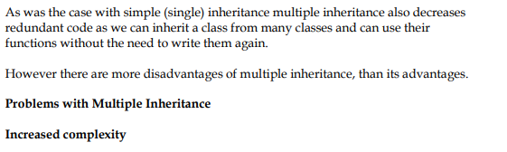
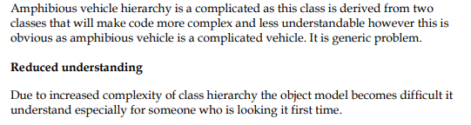
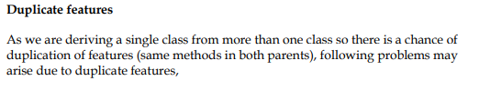
Advantages and Disadvantages of Multiple Inheritance

Slide 17
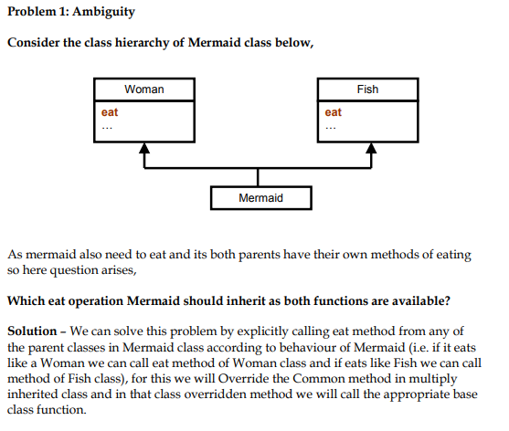
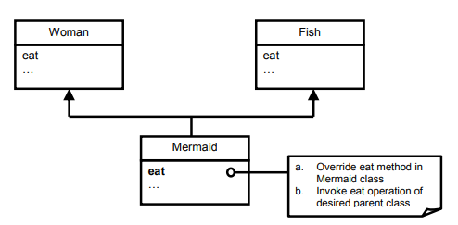

Slide 18
Association
Objects in an object model interact with each other
Usually an object provides services to several other objects
An object keeps associations with other objects to delegate tasks

Slide 19
Kinds of Association
Class Association
  Inheritance
Object Association
  Simple Association
  Composition
  Aggregation

Slide 20
Simple Association
Is the weakest link between objects
Is a reference by which one object can interact with some other object
Is simply called as “association”

Slide 21
Kinds of Simple Association
w.r.t navigation
  One-way Association
  Two-way Association
w.r.t number of objects
  Binary Association
  Ternary Association
  N-ary Association

Slide 22
One-way Association
We can navigate along a single direction only
Denoted by an arrow towards the server object

Slide 23
Example – Association
Ali
lives-in
House
1
1
Ali lives in a House

Slide 24
Example – Association
Ali
drives
Car
1
*
Ali drives his Car

Slide 25
Two-way Association
We can navigate in both directions
Denoted by a line between the associated objects

Slide 26
Example – Two-way Association
Employee
works-for
Company
*
1
Employee works for company
Company employs employees

Slide 27
Example – Two-way Association
Yasir
friend
Ali
1
1
Yasir is a friend of Ali
Ali is a friend of Yasir

Slide 28
Binary Association
Associates objects of exactly two classes
Denoted by a line, or an arrow between the associated objects

Slide 29
Example – Binary Association
Employee
works-for
Company
*
1
Association “works-for” associates objects of exactly two classes

Slide 30
Example – Binary Association
Ali
drives
Car
1
*
Association “drives” associates objects of exactly two classes

Slide 31
Ternary Association
Associates objects of exactly three classes
Denoted by a diamond with lines connected to associated objects

Slide 32
Example – Ternary Association
Student
Teacher
*
1
*
Course
Objects of exactly three classes are associated

Slide 33
Example – Ternary Association
Project
Language
*
*
1
Person
Objects of exactly three classes are associated

Slide 34
N-ary Association
An association between 3 or more classes
Practical examples are very rare

Slide 35
Composition
An object may be composed of other smaller objects
The relationship between the “part” objects and the “whole” object is known as Composition
Composition is represented by a line with a filled-diamond head towards the composer object

Slide 36
Example – Composition of Ali
Head
1
Arm
Ali
Leg
2
2
1
Body
Notes:
Head
State: Eyes, Nose, Mouth, Ears, Hair
behaviour: Look, Sniff, Eat, Listen
Body
State: Waist, Chest Width, Shape
behaviour: Digest Food, Circulates Blood, Respiration
Arms
State: Hands, Fingers, Nails
behaviour: Move, Hold, Stretch
Legs
State: Feet, Fingers, Nails
behaviour: Walk, Turn, Stop

Slide 37
Example – Composition of Chair
Back
1
Chair
2
1
4
Arm
Seat
Leg
Notes:
Gear Box
State: 1, 2, 3, 4, Back
behaviour: Change Gear
Doors
State: Open, Closed, Locked, Unlocked
behaviour: Open, Close, Lock, Unlock
Lights
State: On, Off, Low, Medium, High
behaviour: Turn On, Turn Off, Set Intensity
Steering Wheel
State: Angle
behaviour: Turn Right, Turn Left

Slide 38
Composition is Stronger
Composition is a stronger relationship, because
  Composed object becomes a part of the composer
  Composed object can’t exist independently

Slide 39
Example – Composition is Stronger
Ali is made up of different body parts
They can’t exist independent of Ali

Slide 40
Example – Composition is Stronger
Chair’s body is made up of different parts
They can’t exist independently

Slide 41
Aggregation
An object may contain a collection (aggregate) of other objects
The relationship between the container and the contained object is called aggregation
Aggregation is represented by a line with unfilled-diamond head towards the container

Slide 42
Example – Aggregation
Bed
1
Chair
Room
Table
*
1
1
Cupboard

Slide 43
Example – Aggregation
Garden
Plant
*

Slide 44
Aggregation is Weaker
Aggregation is weaker relationship, because
  Aggregate object is not a part of the container
  Aggregate object can exist independently

Slide 45
Example – Aggregation is Weaker
Furniture is not an intrinsic part of room
Furniture can be shifted to another room, and so can exist independent of a particular room

Slide 46
Example – Aggregation is Weaker
A plant is not an intrinsic part of a garden
It can be planted in some other garden, and so can exist independent of a particular garden

