Slide 1
Object Oriented Programming
(OOP)
Lecture No. 16(Week5)
Engr. Asma Khan
Assistant Professor
Software Engineering Dept.
NED University Karachi

Slide 2
Review
Class
  Concept
  Definition
Data members
Member Functions
Access specifier

Slide 3
Member Functions
Member functions are the functions that operate on the data encapsulated in the class
Public member functions are the interface to the class

Slide 4
Member Functions (contd.)
Define member function inside the class definition
OR
Define member function outside the class definition
  But they must be declared inside class definition

Slide 5
Function Inside Class Body
class ClassName {
…
public:
ReturnType FunctionName() {
…
}
};

Slide 6
Example
Define a class of student that has a roll number. This class should have a function that can be used to set the roll number

Slide 7
Example
class Student{
int rollNo;
public:
void setRollNo(int aRollNo){
rollNo = aRollNo;
}
};

Slide 8
Function Outside Class Body
class ClassName{
…
public:
ReturnType FunctionName();
};
ReturnType ClassName::FunctionName()
{
…
}
Scope resolution operator

Slide 9
Example
class Student{
…
int rollNo;
public:
void setRollNo(int aRollNo);
};
void Student::setRollNo(int aRollNo){
…
rollNo = aRollNo;
}

Slide 10
Inline Functions
Instead of calling an inline function compiler replaces the code at the function call point
Keyword ‘inline’ is used to request compiler to make a function inline
It is a request and not a command

Slide 11
Example
inline int Area(int len, int hi)
{
return len * hi;
}
int main()
{
cout << Area(10,20);
}

Slide 12
Inline Functions
If we define the function inside the class body then the function is by default an inline function
In case function is defined outside the class body then we must use the keyword ‘inline’ to make a function inline

Slide 13
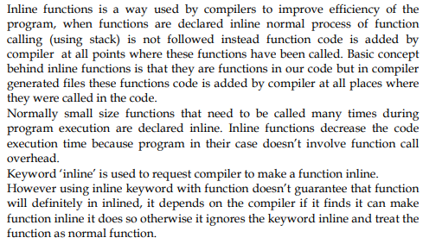

Slide 14
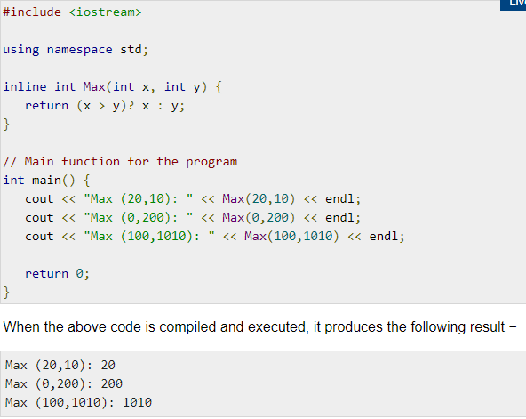

Slide 15
Example
class Student{
int rollNo;
public:
void setRollNo(int aRollNo){
…
rollNo = aRollNo;
}
};

Slide 16
Example
class Student{
…
public:
inline void setRollNo(int aRollNo);
};
void Student::setRollNo(int aRollNo){
…
rollNo = aRollNo;
}

Slide 17
Example
class Student{
…
public:
void setRollNo(int aRollNo);
};
inline void Student::setRollNo(int aRollNo){
…
rollNo = aRollNo;
}

Slide 18
Example
class Student{
…
public:
inline void setRollNo(int aRollNo);
};
inline void Student::setRollNo(int aRollNo){
…
rollNo = aRollNo;
}

Slide 19
Constructor

Slide 20
Constructor
Constructor is used to initialize the objects of a class
Constructor is used to ensure that object is in well defined state at the time of creation
Constructor is automatically called when the object is created
Constructor are not usually called explicitly

Slide 21
Constructor (contd.)
Constructor is a special function having same name as the class name
Constructor does not have return type
Constructors are commonly public members

Slide 22
Example
class Student{
…
public:
Student(){
rollNo = 0;
…
}
};

Slide 23
Example
int main()
{
Student aStudent;
/*constructor is implicitly called at this point*/
}

Slide 24
Default Constructor
Constructor without any argument is called default constructor
If we do not define a default constructor the compiler will generate a default constructor
This compiler generated default constructor initialize the data members to their default values

Slide 25
Example
class Student
{
int rollNo;
char *name;
float GPA;
public:
… //no constructors
};

Slide 26
Example
Compiler generated default constructor
{
rollNo = 0;
GPA = 0.0;
name = NULL;
}

Slide 27
Constructor Overloading
Constructors can have parameters
These parameters are used to initialize the data members with user supplied data

Slide 28
Example
class Student{
…
public:
Student();
Student(char * aName);
Student(char * aName, int aRollNo);
Student(int aRollNo, int aRollNo, float aGPA);
};

Slide 29
Example
Student::Student(int aRollNo,
char * aName){
if(aRollNo < 0){
rollNo = 0;
}
else {
rollNo = aRollNo;
}
…
}

Slide 30
Example
int main()
{
Student student1;
Student student2(“Name”);
Student student3(”Name”, 1);
Student student4(”Name”,1,4.0);
}

Slide 31
Constructor Overloading
Use default parameter value to reduce the writing effort

Slide 32
Example
Student::Student( char * aName = NULL,
int aRollNo= 0,
float aGPA = 0.0){
…
}
Is equivalent to
Student();
Student(char * aName);
Student(char * aName, int aRollNo);
Student(char * Name, int aRollNo, float aGPA);

Slide 33
Copy Constructor
Copy constructor are used when:
  Initializing an object at the time of creation
  When an object is passed by value to a function

Slide 34
Example
void func1(Student student){
…
}
int main(){
Student studentA;
Student studentB = studentA;
func1(studentA);
}

Slide 35
Copy Constructor (Syntax)
Student::Student(
const Student &obj){
rollNo = obj.rollNo;
name = obj.name;
GPA = obj.GPA;
}

Slide 36
Shallow Copy
When we initialize one object with another then the compiler copies state of one object to the other
This kind of copying is called shallow copying

Slide 37
Example
Student studentA;
Student studentB = studentA;
Memory
studentA
studentB
A
H
M
A
D
…
Name
Name
RollNo
RollNo
GPA
GPA

Slide 38
Copy Constructor (contd.)
Student::Student(
const Student & obj){
int len = strlen(obj.name);
name = new char[len+1]
strcpy(name, obj.name);
…
//copy rest of the data members
}

Slide 39
Copy Constructor (contd.)
Copy constructor is normally used to perform deep copy
If we do not make a copy constructor then the compiler performs shallow copy

Slide 40
Example
Memory
A
Student studentA;
Student studentB = studentA;
A
H
M
A
D
Name
RollNo
GPA
B
A
H
M
A
D
Name
RollNo
GPA

