Slide 1
Object Oriented Programming
(OOP)
Lecture No. 9
Engr. Asma Khan
Assistant Professor
Software Engineering Dept.
NED University Karachi

Slide 2
Review
Member functions implementation
Constructors
Constructors overloading
Copy constructors

Slide 3
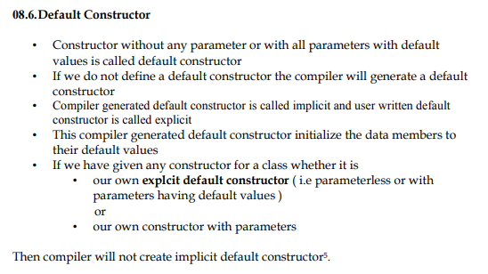

Slide 4
Copy Constructor
Copy constructor are used when:
  Initializing an object at the time of creation
  When an object is passed by value to a function

Slide 5
Example
void func1(Student student){
…
}
int main(){
Student studentA(“Ahmad”);
Student studentB = studentA;
func1(studentA);
}

Slide 6
Copy Constructor (contd.)
Student::Student(
const Student &obj){
rollNo = obj.rollNo;
name = obj.name;
GPA = obj.GPA;
}

Slide 7
Shallow Copy
When we initialize one object with another then the compiler copies state of one object to the other
This kind of copying is called shallow copying

Slide 8
Example
Student studentA(“Ahmad”);
Student studentB = studentA;
Heap
A
H
M
A
D
studentA
studentB
RollNn
RollNn
Name
Name
GPA
GPA

Slide 9
Example
int main(){
Student studentA(“Ahmad”,1);
{
Student studentB = studentA;
Heap
A
H
M
A
D
studentA
studentB
RollNn
RollNn
Name
Name
GPA
GPA

Slide 10
Example
int main(){
Student studentA(“Ahmad”,1);
{
Student studentB = studentA;
}
}
Heap
studentA
RollNn
Name
GPA

Slide 11
Copy Constructor (contd.)
Student::Student( const Student & obj){
int len = strlen(obj.name);
name = new char[len+1]
strcpy(name, obj.name);
…
/*copy rest of the data members*/
}

Slide 12
Example
int main(){
Student studentA(“Ahmad”,1);
{
Student studentB = studentA;
A
H
M
A
D
studentB
studentA
RollNn
RollNn
A
H
M
A
D
Name
Name
GPA
GPA

Slide 13
Example
int main(){
Student studentA(“Ahmad”,1);
{
Student studentB = studentA;
}
}
Heap
A
H
M
A
D
studentA
RollNn
Name
GPA

Slide 14
Copy Constructor (contd.)
Copy constructor is normally used to perform deep copy
If we do not make a copy constructor then the compiler performs shallow copy

Slide 15
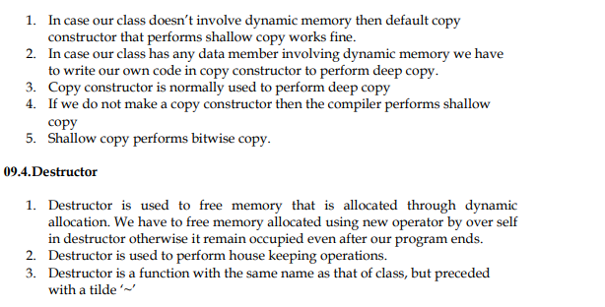

Slide 16
Destructor
Destructor is used to free memory that is allocated through dynamic allocation
Destructor is used to perform house keeping operations

Slide 17
Destructor (contd.)
Destructor is a function with the same name as that of class, but preceded with a tilde ‘~’

Slide 18
Example
class Student
{
…
public:
~Student(){
if(name){
delete []name;
}
}
}

Slide 19
Overloading
Destructors cannot be overloaded

Slide 20
Sequence of Calls
Constructors and destructors are called automatically
Constructors are called in the sequence in which object is declared
Destructors are called in reverse order

Slide 21
Example
Student::Student(char * aName){
…
cout << aName << “Cons\n”;
}
Student::~Student(){
cout << name << “Dest\n”;
}
};

Slide 22
Example
int main()
{
Student studentB(“Ali”);
Student studentA(“Ahmad”);
return 0;
}

Slide 23
Example
Output:
Ali Cons
Ahmad Cons
Ahmad Dest
Ali Dest

Slide 24
Accessor Functions
Usually the data member are defined in private part of a class – information hiding
Accessor functions are functions that are used to access these private data members
Accessor functions also useful in reducing error

Slide 25
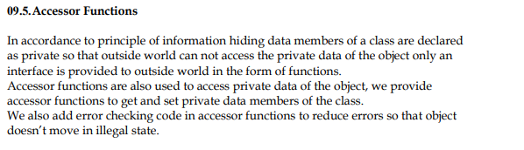

Slide 26
Example – Accessing Data Member
class Student{
…
int rollNo;
public:
void setRollNo(int aRollNo){
rollNo = aRollNo;
}
};
Notes:
Never return a handle to a data member
You are never sure that function accessing the reference will not change the value of the variable

Slide 27
Example – Avoiding Error
void Student::setRollNo(int aRollNo){
if(aRollNo < 0){
rollNo = 0;
}
else
{
rollNo = aRollNo;
}
}
Notes:
Never return a handle to a data member
You are never sure that function accessing the reference will not change the value of the variable

Slide 28
Example - Getter
class Student{
…
int rollNo;
public:
int getRollNo(){
return rollNo;
}
};
Notes:
Never return a handle to a data member
You are never sure that function accessing the reference will not change the value of the variable

Slide 29
this Pointer
class Student{
int rollNo;
char *name;
float GPA;
public:
int getRollNo();
void setRollNo(int aRollNo);
…
};

Slide 30
this Pointer
The compiler reserves space for the functions defined in the class
Space for data is not allocated (since no object is yet created)
Function Space
getRollNo(), …

Slide 31
this Pointer
Student s1, s2, s3;
s2(rollNo,…)
Function Space
getRollNo(), …
s3(rollNo,…)
s1(rollNo,…)

Slide 32
this Pointer
Function space is common for every variable
Whenever a new object is created:
  Memory is reserved for variables only
  Previously defined functions are used over and over again

Slide 33
this Pointer
Memory layout for objects created:
s1
rollNo, …
s2
rollNo, …
s3
rollNo, …
s4
rollNo, …
Function Space
getRollNo(), …
How does the functions know on which object to act?

Slide 34
this Pointer
Address of each object is passed to the calling function
This address is deferenced by the functions and hence they act on correct objects
s1
rollNo, …
s2
rollNo, …
s3
rollNo, …
s4
rollNo, …
address
address
address
address
The variable containing the “self-address” is called this pointer

Slide 35
Passing this Pointer
Whenever a function is called the this pointer is passed as a parameter to that function
Function with n parameters is actually called with n+1 parameters

Slide 36
Example
void Student::setName(char *)
is internally represented as
void Student::setName(char *, const Student *)

Slide 37
Declaration of this
DataType * const this;

Slide 38
Compiler Generated Code
Student::Student(){
rollNo = 0;
}
Student::Student(){
this->rollNo = 0;
}

