Slide 1

Data Structures and Algorithms
Topic: Binary Tree & Types
Lecture#20

Slide 2
Binary Tree
A binary tree has a root element
The remaining elements(if any) are partitioned into two binary trees
They are called left and right subtrees

Slide 3
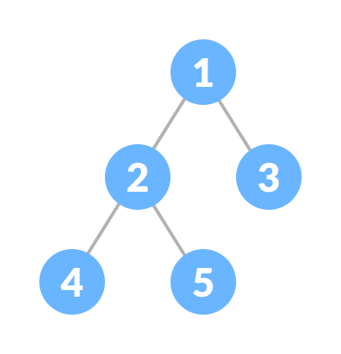
Binary tree
There are many variations on trees but we will start with binary trees
Binary tree: A binary tree is a tree data structure in which each parent node can have at most two children.
For example: In the image below, each element has at most two children which referred as left child and right child

Slide 4
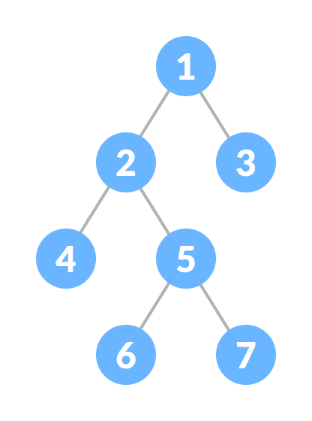
Types of Binary Tree
Full/proper Binary Tree
A full Binary tree is a special type of binary tree in which every parent node/internal node has either two or no children.
An improper Binary tree can be converted into proper binary tree by viewing missing nodes as Null nodes

Slide 5
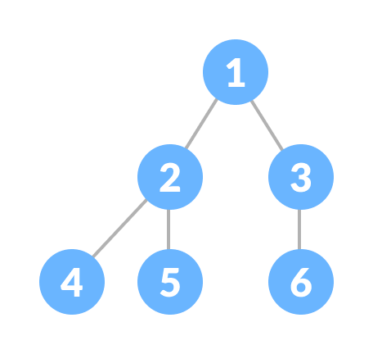
Complete Binary Tree
A complete binary tree is just like a full binary tree, but with some major differences
Every level must be completely filled
All the leaf elements must lean towards the left.
The last leaf element might not have a right sibling i.e. a complete binary tree doesn't have to be a full binary tree.

Slide 6
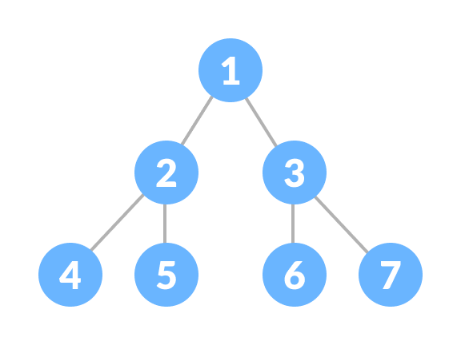
Perfect Binary Tree
A perfect binary tree is a type of binary tree in which every internal node has exactly two child nodes and all the leaf nodes are at the same level.
A perfect binary tree has the maximum no. of nodes for a given height .
It has (2^(n+1)-1)nodes where n is the height of the tree.
Height=0🡪 1 node
Height=1🡪 3 node
Height=2🡪 7 node

Slide 7
Max.no. of possible at any level i
Max. no. of possible at any level i=2^i
at level 0=2^0=1
at level 1=2^1=2 & so on

Slide 8
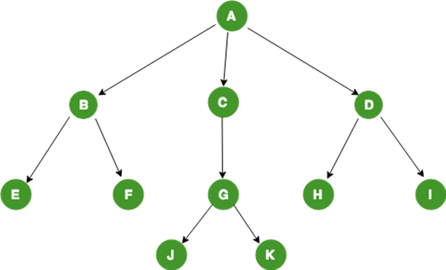
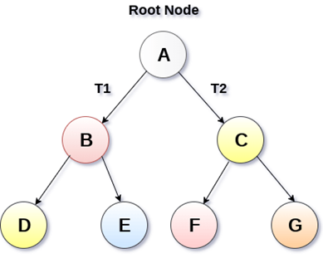
Difference between A tree & binary tree
In General Tree, each node can have infinite number of children.
Binary tree is the type of tree in which each parent can have at most two children. The children are referred to as left child or right child.(no node in a binary tree may have a degree more than 2)

Slide 9
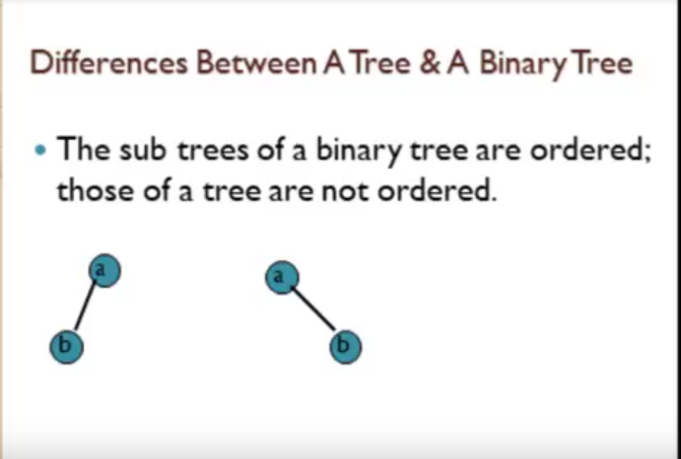

Slide 10
Difference between A tree & binary tree
GENERAL TREE | BINARY TREE
General tree is a tree in which each node can have many children or nodes. | Whereas in binary tree, each node can have at most two nodes.
The subtree of a general tree do not hold the ordered property. | While the subtree of binary tree hold the ordered property.
In data structure, a general tree can not be empty. | While it can be empty.
In general tree, a node can have at most n(number of child nodes) nodes. | While in binary tree, a node can have at most 2(number of child nodes) nodes.
In general tree, there is no limitation on the degree of a node. | While in binary tree, there is limitation on the degree of a node because the nodes in a binary tree can’t have more than two child node.
In general tree, there is either zero subtree or many subtree. | While in binary tree, there are mainly two subtree: Left-subtree and Right-subtree.

Slide 11
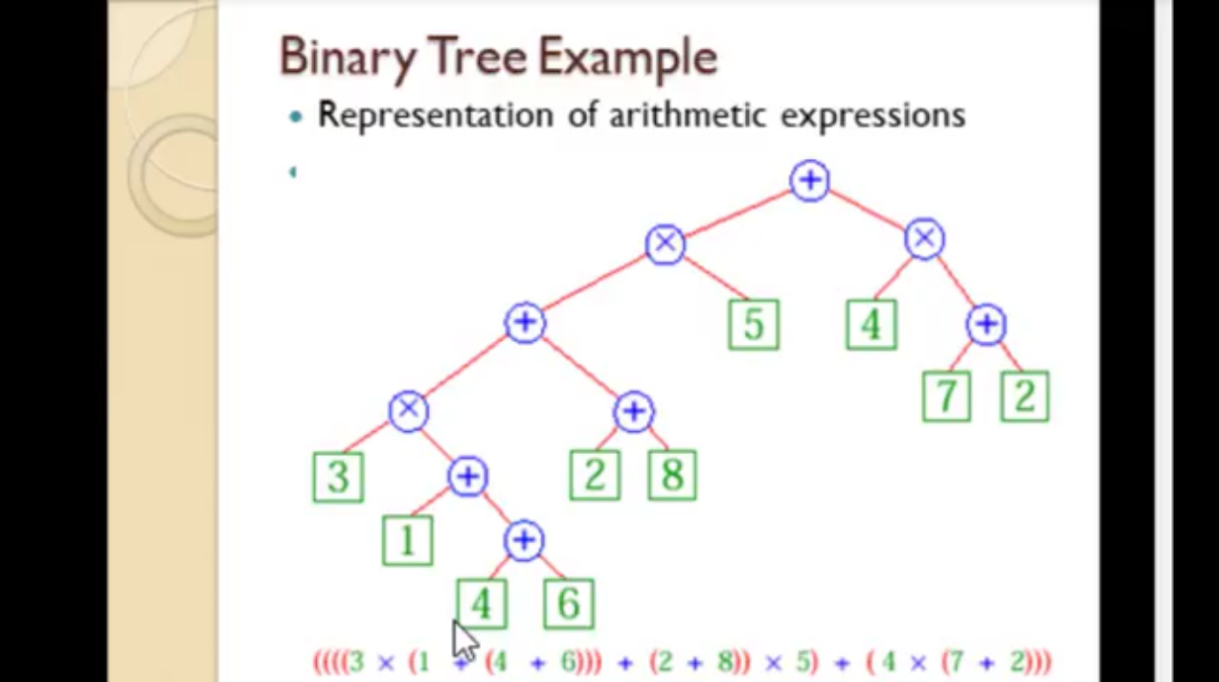

Slide 12
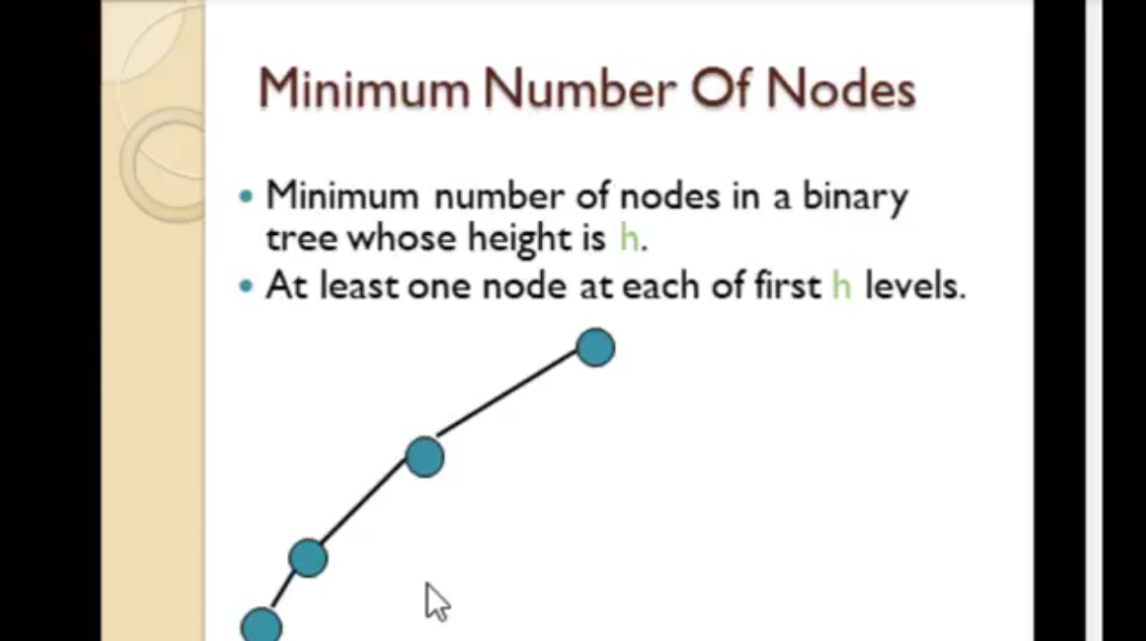
Min. no. of possible at height h
=h+1
at height 0(root)=0+1=1
& so on
Note: height will increases only when a node is added on (next)level.
in diagram :Min .no. of node at
(Max.)height (3)=3+1=4

Slide 13
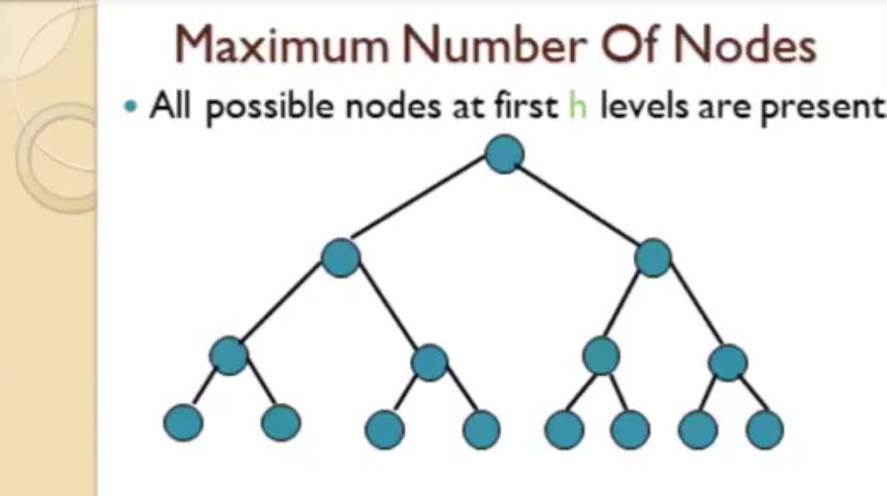

Slide 14
(2^(h+1)-1)🡪 Max no. of nodes present in a tree at height h.
h+1→ Min. no. of nodes present in a tree at height h.
2^(i) 🡪 gives total no. of nodes present at any level i in a tree.

Slide 15
Representation of binary tree
Through Array

Slide 16
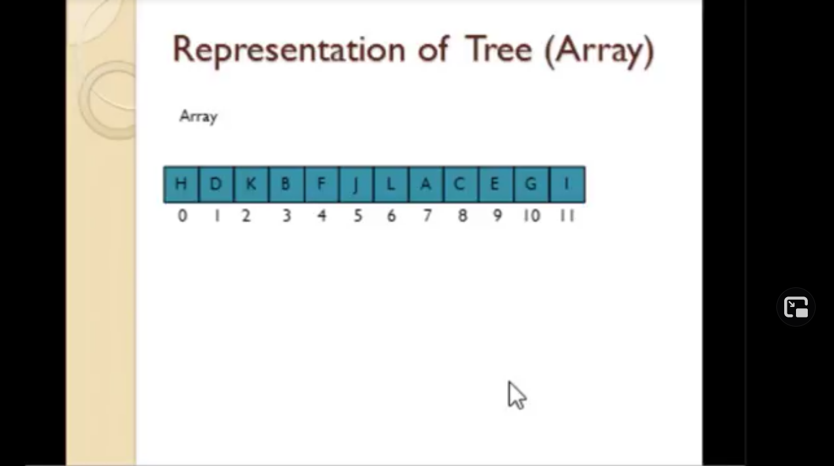

Slide 17
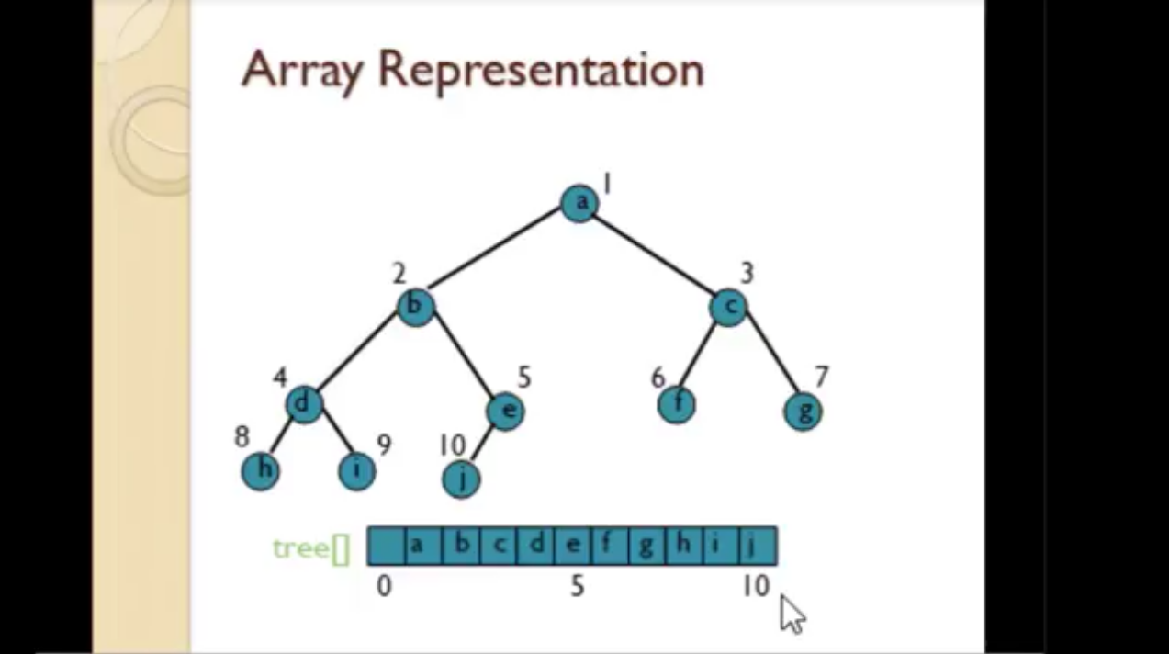

Slide 18


Slide 19


