Slide 1

Graphs
Week 9

Slide 2
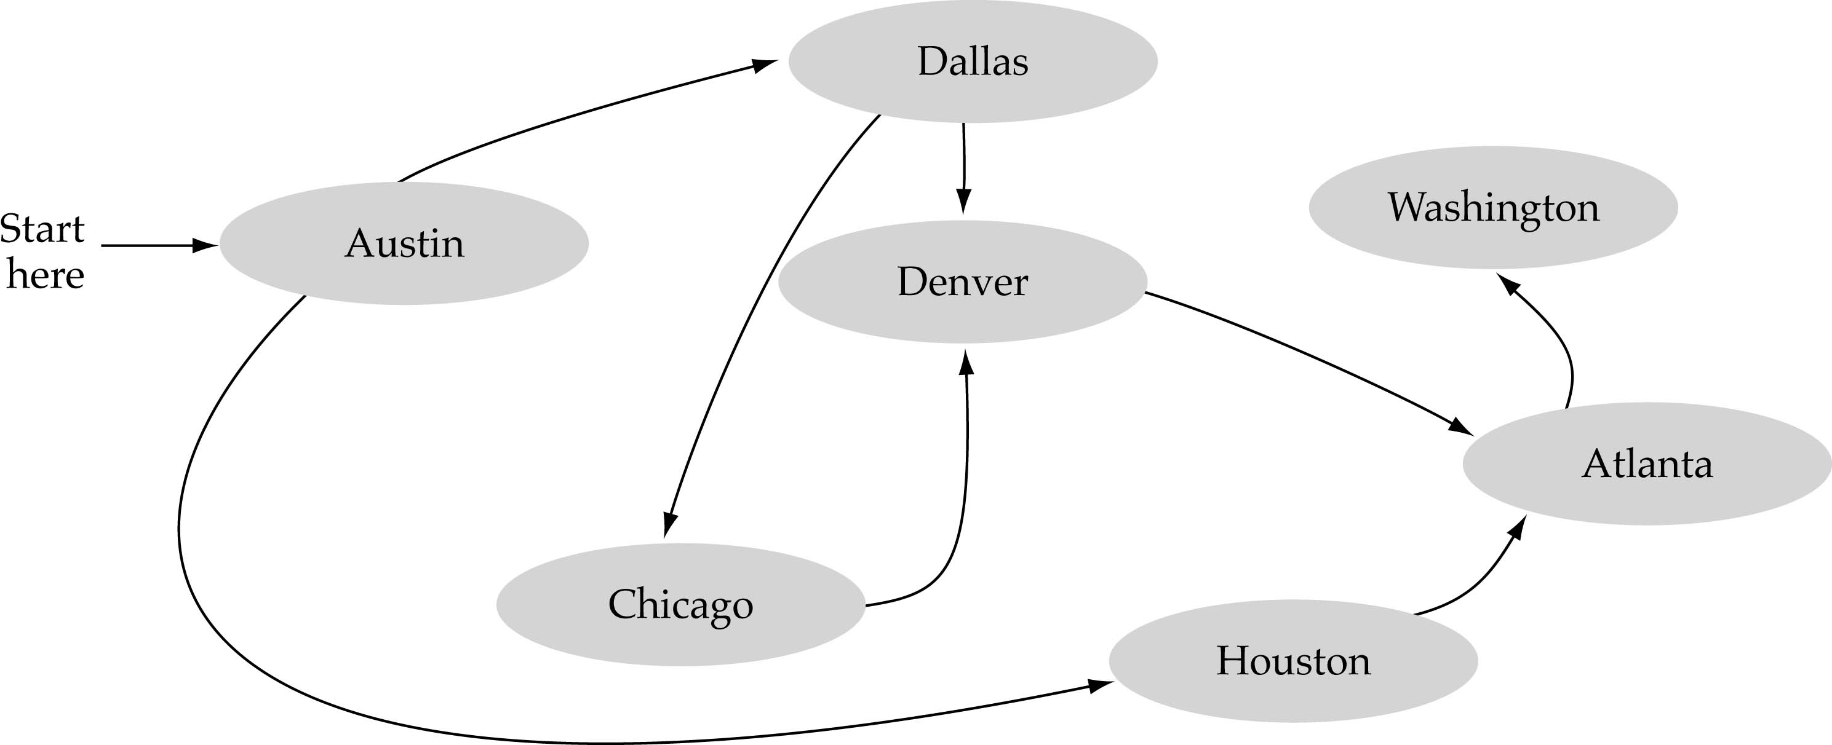
What is a graph?
A data structure that consists of a set of nodes (vertices) and a set of edges that relate the nodes to each other
The set of edges describes relationships among the vertices

Slide 3
Formal definition of graphs
A graph G is defined as follows:
G=(V,E)
V(G): a finite, nonempty set of vertices
E(G): a set of edges

Slide 4
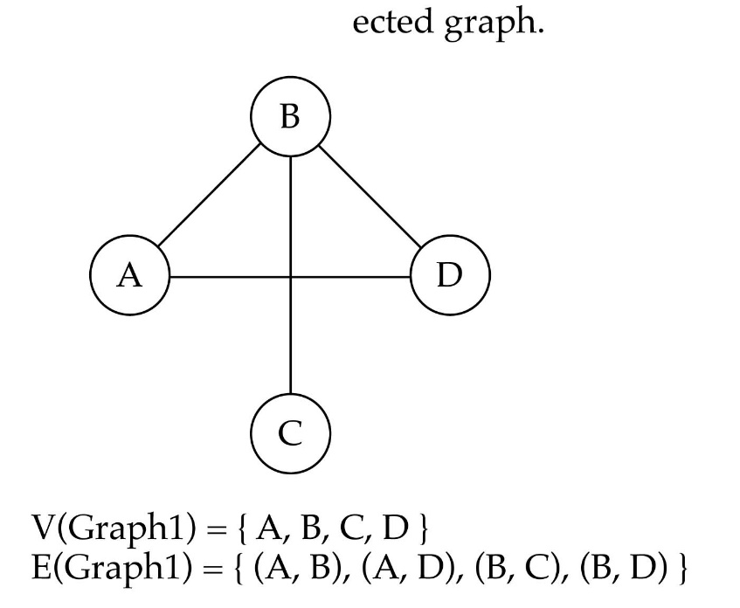
Undirected graphs
When the edges in a graph have no direction, the graph is called undirected

Slide 5

Directed graphs
When the edges in a graph have a direction, the graph is called directed (or digraph)
Warning: if the graph is directed, the order of the vertices in each edge is important !!
E(Graph2) = {(1,3) (3,1) (5,9) (9,11) (5,7)

Slide 6

Trees vs graphs
Trees are special cases of graphs!!
A graph with no cycles is called a tree.
A tree is an acyclic connected graph.

Slide 7

Graph terminology
Adjacent nodes: two nodes are adjacent if they are connected by an edge
Path: a sequence of vertices that connect two nodes in a graph
Complete graph: a graph in which every vertex is directly connected to every other vertex

Slide 8
Graph Definitions – types of Graphs
A simple path
  A simple path is one that contains no repeated vertices.
6
4
5
1
3
2
A cycle
  A path of non-zero length from and to the same vertex with no repeated edges.
A simple cycle
  A cycle with no repeated vertices except for the first and last one.
6
4
5
1
3
2

Slide 9

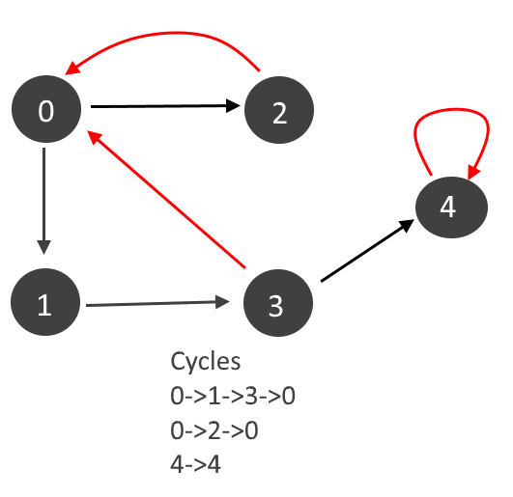
Cycle

Slide 10
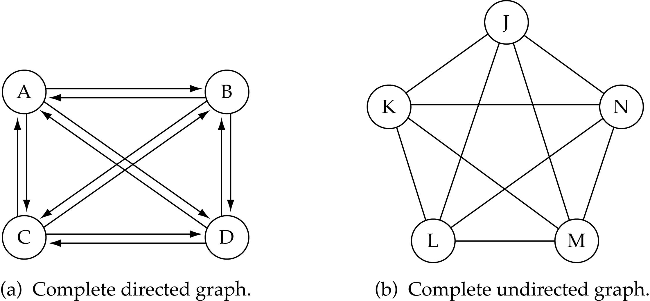
Graph terminology (cont.)
What is the number of edges in a complete directed graph with N vertices?
N * (N-1)=4(4-1)=12

Slide 11
Graph terminology (cont.)
What is the number of edges in a complete undirected graph with N vertices?
N * (N-1) / 2

Slide 12
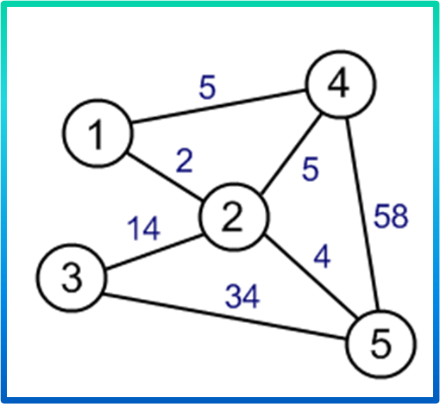
Graphs
Weighted Graph:
  where each edge also has an associated real number with it, known as the edge weight.
A labeled weighted graph:
Vertex set V = {1,2,3,4,5}

Slide 13
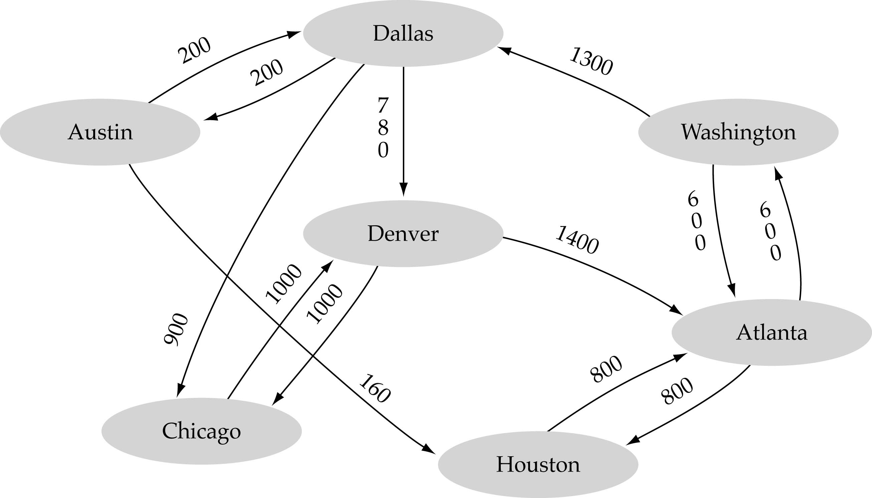
Graph terminology (cont.)
Weighted graph: a graph in which each edge carries a value

Slide 14
Graph implementation
Adjacency Matrix implementation
  A 2D array (adjacency matrix) is used to implement Graph DS.

Slide 15
Graph implementation
Adjacency Matrix implementation
  A 2D array (adjacency matrix) is used to represent the edges

Slide 16
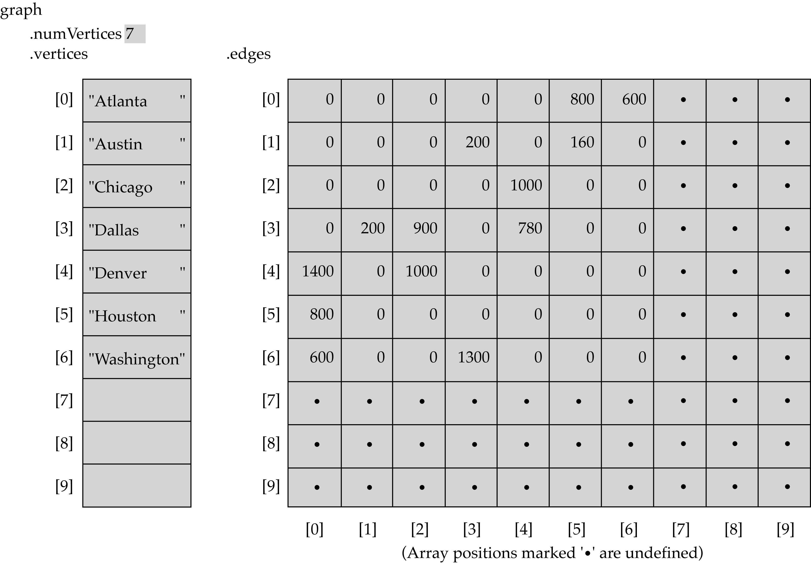
Graph implementation

Slide 17
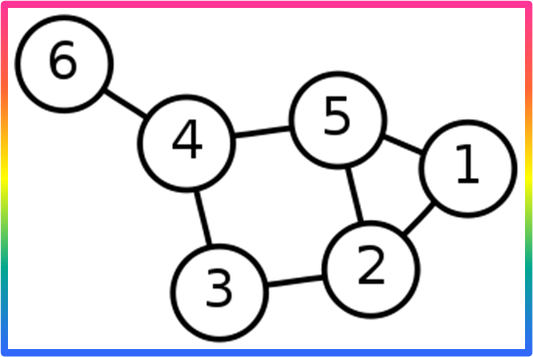
Data Structures to Store Graphs
Adjacency Matrix
  The standard adjacency matrix stores a matrix as a 2-D array with each slot in A[i][j] being a 1 if there is an edge from vertex i to vertex j, or storing a 0 otherwise.
    Can have a more O-O design:
      Each entry in the array is null if no edge is connecting those vertices, or an Edge object that stores all necessary information about the edge.
 | 1 | 2 | 3 | 4 | 5 | 6
1 | 0 | 1 | 0 | 0 | 1 | 0
2 | 1 | 0 | 1 | 0 | 1 | 0
3 | 0 | 1 | 0 | 1 | 0 | 0
4 | 0 | 0 | 1 | 0 | 1 | 1
5 | 1 | 1 | 0 | 1 | 0 | 0
6 | 0 | 0 | 0 | 1 | 0 | 0

Slide 18
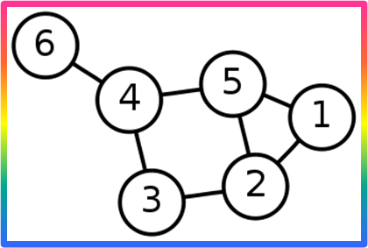
Graph Definitions – types of Graphs
The complement of a graph
  The complement of a graph G is a graph G' which contains all the vertices of G, but for each edge that exists in G, it is NOT in G', and for each possible edge NOT in G, it IS in G'.
1
3
5
6
4
2
 | 2 | 3 | 4 | 5 | 6
1 | 1 | 0 | 0 | 1 | 0
2 |  | 1 | 0 | 1 | 0
3 |  |  | 1 | 0 | 0
4 |  |  |  | 1 | 1
5 |  |  |  |  | 0
 | 2 | 3 | 4 | 5 | 6
1 | 0 | 1 | 1 | 0 | 1
2 |  | 0 | 1 | 0 | 1
3 |  |  | 0 | 1 | 1
4 |  |  |  | 0 | 0
5 |  |  |  |  | 1
Notes:
Just invert the matrix values(o→1 ,1→0)

Slide 19
Graph implementation (cont.)
Linked-list implementation
  A list is used for each vertex v which contains the vertices which are adjacent from v (adjacency list)

Slide 20
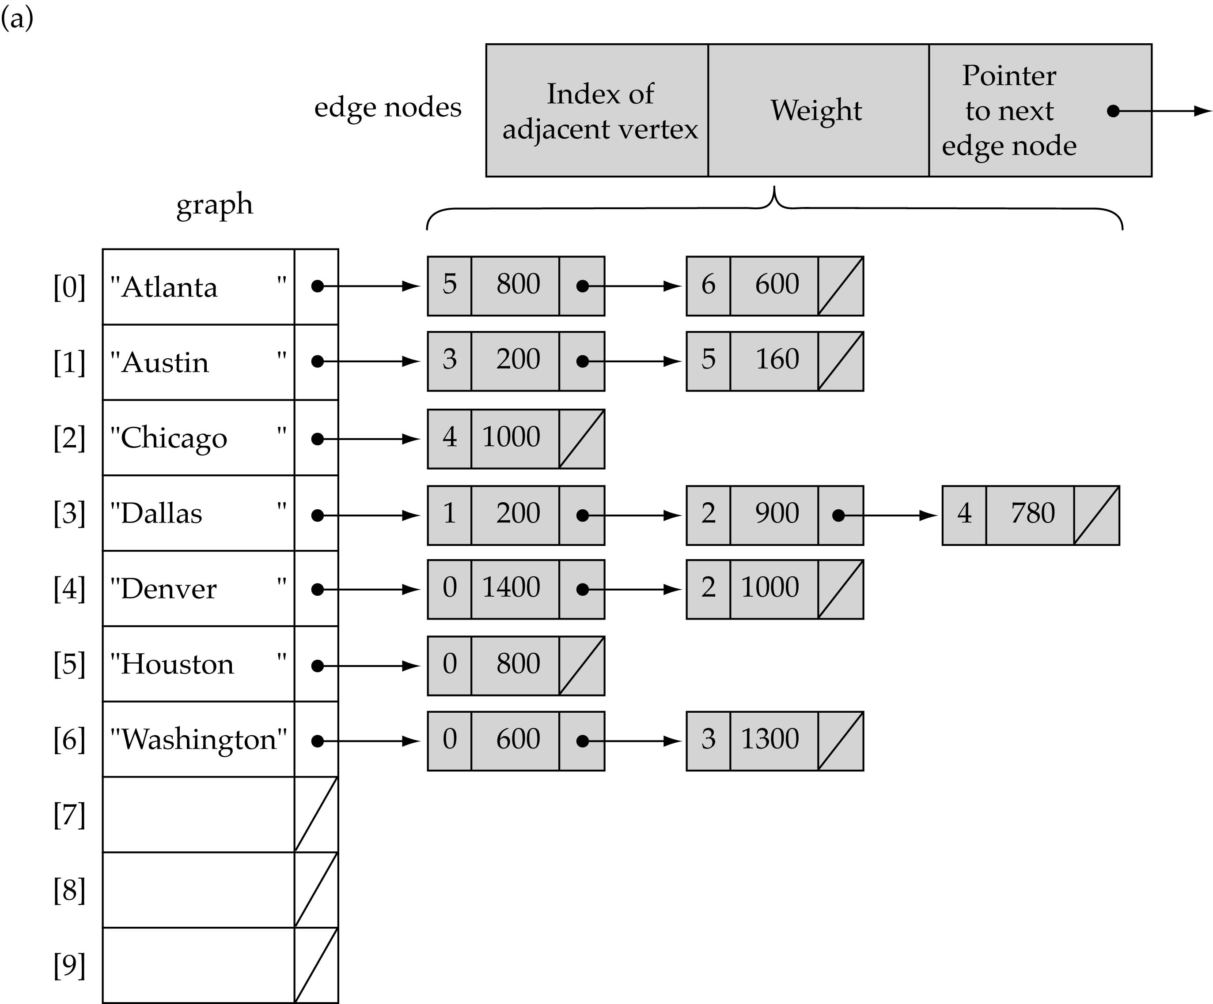
Linked-list implementation
Notes:
Austin is connected to dallas (3)and huston(5)

Slide 21
Linked-list implementation
An array of lists is used. The size of the array is equal to the number of vertices. Let the array be an array[]. An entry array[i] represents the list of vertices adjacent to the ith vertex. Following is the adjacency list representation of the above graph.

Slide 22
Graph searching
Problem: find a path between two nodes of the graph (e.g., Austin and Washington)
Methods: Depth-First-Search (DFS) or Breadth-First-Search (BFS)

Slide 23
BFS
As the name BFS suggests, you are required to traverse the graph breadthwise as follows:
First move horizontally and visit all the nodes of the current layer
Move to the next layer

Slide 24
BFS
As the name BFS suggests, you are required to traverse the graph breadthwise as follows:
First move horizontally and visit all the nodes of the current layer
Move to the next layer
BFS can be implemented efficiently using a Queue

Slide 25
BFS
Consider G as a graph which we are going to traverse using the BFS algorithm.
Let S be the root/starting node of the graph.
Step 1: Start with node S and enqueue it to the queue.
Step 2: Repeat the following steps for all the nodes in the graph.
Step 3: Dequeue S and process it.
Step 4: Enqueue all the adjacent nodes of S and process them.
[END OF LOOP]
Step 6: EXIT

Slide 26
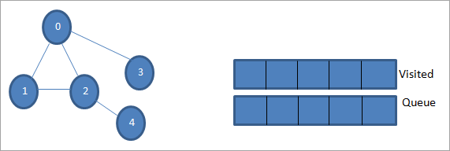
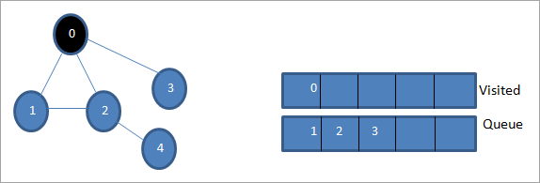
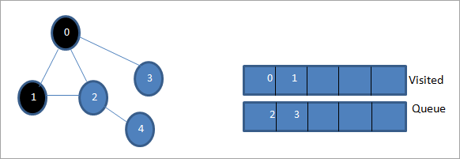
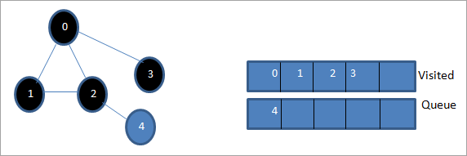
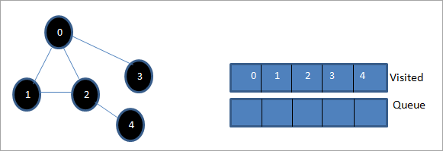
BFS
Notes:
https://www.softwaretestinghelp.com/cpp-bfs-program-to-traverse-graph/

Slide 27
Depth-First-Search (DFS)
What is the idea behind DFS?
  Travel as far as you can down a path
  Back up as little as possible when you reach a "dead end" (i.e., next vertex has been "marked" or there is no next vertex)
DFS can be implemented efficiently using a stack

Slide 28
DFS (Depth wise Search)
Algorithm
Step 1: Insert the root node or starting node of a tree or a graph in the stack.
Step 2: Pop the top item from the stack and add it to the visited list.
Step 3: Find all the adjacent nodes of the node marked visited and add the ones that are not yet visited, to the stack.
Step 4: Repeat steps 2 and 3 until the stack is empty.

Slide 29
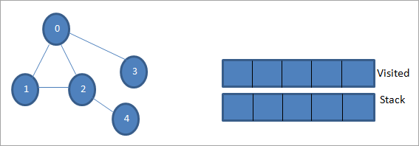
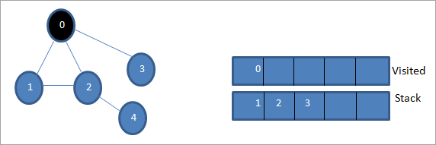
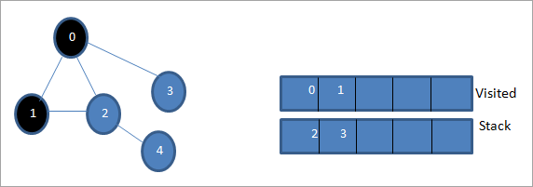
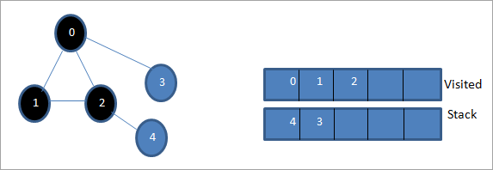
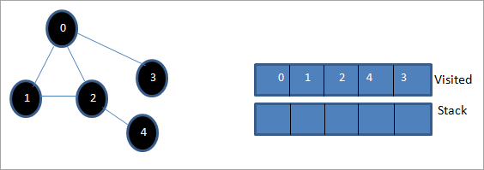
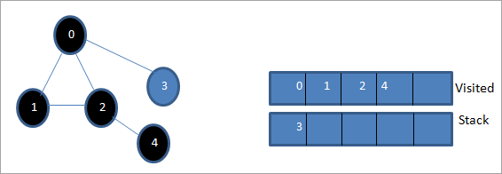
DFS

