Slide 1
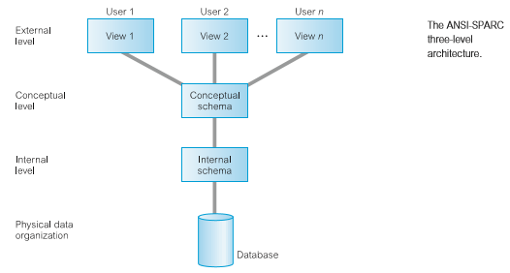
THE THREE-LEVEL ANSI-SPARC ARCHITECTURE
The levels form a three-level architecture comprising an external, a conceptual, and an internal level, as depicted in Figure

Slide 2
OBJECTIVES OF THREE LEVEL ARCHITECTURE
Each user should be able to access the same data, but have a different customized view of the data. Each user should be able to change the way he or she views the data, and this change should not affect other users.
Users should not have to deal directly with physical database storage details, such as indexing or hashing .In other words, a user’s interaction with the database should be independent of storage considerations.
The Database Administrator (DBA) should be able to change the database storage structures without affecting the users’ views.
The internal structure of the database should be unaffected by changes to the physical aspects of storage, such as the changeover to a new storage device.
The DBA should be able to change the conceptual structure of the database without affecting all users.

Slide 3
EXTERNAL LEVEL
The users’ view of the database. This level describes that part of the level database that is relevant to each user.
CONCEPTUAL LEVEL
The community view of the database. This level describes what data level is stored in the database and the relationships among the data.
The conceptual level represents:
all entities, their attributes, and their relationships
the constraints on the data
semantic information about the data
security and integrity information.

Slide 4
INTERNAL LEVEL
The physical representation of the database on the computer. This level describes how the data is stored in the database. The internal level is concerned with such things as:
storage space allocation for data and indexes
record descriptions for storage (with stored sizes for data items)
record placement
data compression and data encryption techniques

Slide 5
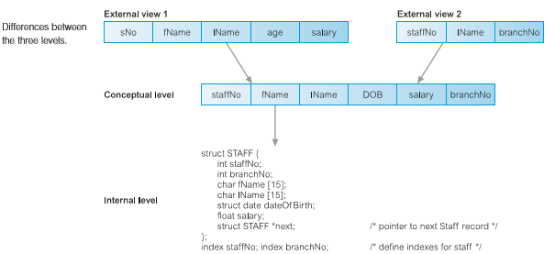
Difference between Three Levels of ANSI APARC Architecture

Slide 6
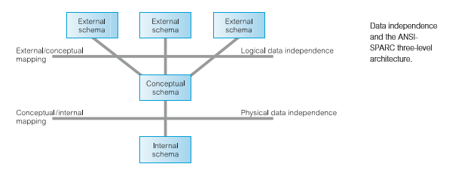
DATA INDEPENDENCE
LOGICAL DATA INDEPENDENCE
Logical data independence refers to the immunity of the external independence schemas to changes in the conceptual schema.
PHYSICAL DATA INDEPENDENCE
Physical data independence refers to the immunity of the conceptual independence schema to changes in the internal schema.

Slide 7
DATABASE LANGUAGES
The Data Deﬁnition Language (DDL)
A language that allows the DBA or user to describe and name the entities, attributes, and relationships required for the application, together with any associated integrity and security constraints.
The Data Manipulation Language (DML)
A language that provides a set of operations to support the basic data manipulation operations on the data held in the database. Data manipulation operations usually include the following:
insertion of new data into the database
modiﬁcation of data stored in the database
retrieval of data contained in the database
deletion of data from the database

Slide 8
DMLs are distinguished by their underlying retrieval constructs. We can distinguish between two types of DML: procedural and non-procedural.
PROCEDURAL DMLS
A language that allows the user to tell the system what data is needed and exactly how to retrieve the data.
NON-PROCEDURAL DMLS
A language that allows the user to state what data is needed rather than how it is to be retrieved.

Slide 9
Fourth-Generation Languages (4GLs)
Fourth generation languages encompass:
presentation languages, such as query languages and report generators;
speciality languages, such as spreadsheets and database languages;
application generators that deﬁne, insert, update, and retrieve data from the database to build applications;
very high-level languages that are used to generate application code.
SQL and QBE, mentioned above, are examples of 4GLs.
We now brieﬂy discuss some of the other types of 4GL.
Forms generators
Report generators
Graphics generators
Application generators

Slide 10

Data Models and Conceptual Modeling
DATA MODEL:
An integrated collection of concepts for describing and manipulating data, relationships between data, and constraints on the data in an organization.
Data model comprises:
a structural part, consisting of a set of rules according to which databases can be constructed
a manipulative part, defining the types of operation that are allowed on the data (this includes the operations that are used for updating or retrieving data from the database and for changing the structure of the database)
possibly a set of integrity constraints, which ensures that the data is accurate.

Slide 11
DATA MODEL
Purpose
To represent data in an understandable way.
To reflect the ANSI-SPARC architecture discussed in lecture 3, we can identify three related data models:
an external data model, to represent each user’s view of the organization, sometimes called the Universe of Discourse (UoD);
a conceptual data model, to represent the logical (or community) view that is DBMS independent;
an internal data model, to represent the conceptual schema in such a way that it can be understood by the DBMS.
Categories of data model includes:
object-based
record-based
physical

Slide 12
Object-Based Data Models
Object-based data models use concepts such as entities, attributes, and relationships.
An entity is a distinct object (a person, place, thing, concept, event) in the organization that is to be represented in the database.
An attribute is a property that describes some aspect of the object that we wish to record.
a relationship is an association between entities.
Some of the more common types of object-based data model are:
Entity–Relationship(ER)
Semantic
Functional
Object-Oriented

Slide 13
Record-Based Data Models
In a record-based model, the database consists of a number of fixed-format records possibly of differing types. Each record type defines a fixed number of fields, each typically of a fixed length.
There are three principal types of record-based logical data model:
the relational data model,
the network data model, and
the hierarchical data model.

Slide 14
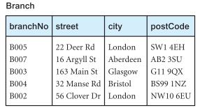
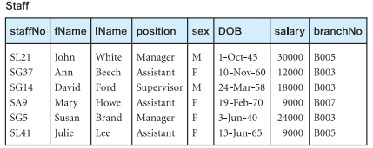
Relational data model
The relational data model is based on the concept of mathematical relations.
In the relational model, data and relationships are represented as tables, each of which has a number of columns with a unique name. Figure 4.1 is a sample instance of a relational schema for part of the DreamHome case study, showing branch and staff details.
Figure 4.1:A sample instance of a relational schema

Slide 15
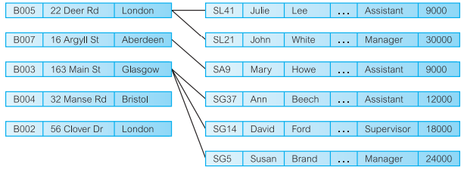
Network data model
In the network model, data is represented as collections of records, and relationships are represented by sets.
Compared with the relational model, relationships are explicitly modeled by the sets, which become pointers in the implementation. The records are organized as generalized graph structures with records appearing as nodes (also called segments) and sets as edges in the graph.
Figure 4.2 illustrates an instance of a network schema for the same data set presented in Figure 4.1. The most popular network DBMS is Computer Associates’ IDMS/ R.
Figure 4.2: A sample instance of a network schema.

Slide 16
Hierarchical data model
The hierarchical model is a restricted type of network model.
Again, data is represented as collections of records and relationships are represented by sets. However, the hierarchical model allows a node to have only one parent. A hierarchical model can be represented as a tree graph, with records appearing as nodes (also called segments) and sets as edges.
Figure 4.3 illustrates an instance of a hierarchical schema for the same data set presented in Figure 4.1. The main hierarchical DBMS is IBM’s IMS, although IMS also provides non-hierarchical features.

Slide 17
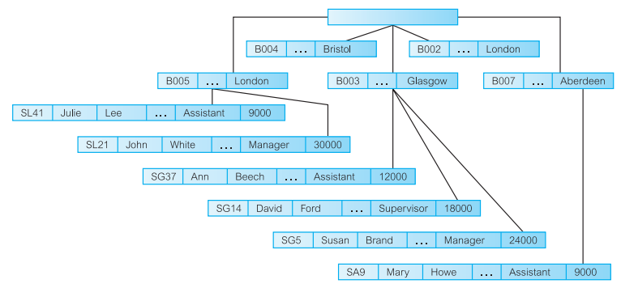
Figure 4.3: A sample instance of a hierarchical schema.

Slide 18
Physical Data Models
Physical data models describe how data is stored in the computer, representing information such as record structures, record orderings, and access paths.
There are not as many physical data models as logical data models, the most common ones being the unifying model and the frame memory.

Slide 19
Conceptual Modeling
Conceptual schema is the core of a system supporting all users views.
Should be complete and accurate representation of an organization’s data requirements.
Conceptual modeling is process of developing a model of information use that is independent of implementation details.
Result is conceptual data modeling.

Slide 20
Functions of DBMS
(1) Data storage, retrieval, and update
A DBMS must furnish users with the ability to store, retrieve, and update data in the database.
(2) A user-accessible catalog
A DBMS must furnish a catalog in which descriptions of data items are stored and which is accessible to users.
A key feature of the ANSI-SPARC architecture is the recognition of an integrated system catalog to hold data about the schemas, users, applications, and so on. The catalog is expected to be accessible to users as well as to the DBMS. A system catalog, or data dictionary, is a repository of information describing the data in the database: it is, the ‘data about the data’ or metadata. The amount of information and the way the information is used vary with the DBMS. Typically, the system catalog stores:
names, types, and sizes of data items;
names of relationships;
integrity constraints on the data;
names of authorized users who have access to the data;
the data items that each user can access and the types of access allowed; for example, insert, update, delete, or read access;
external, conceptual, and internal schemas and the mappings between the schema
usage statistics, such as the frequencies of transactions and counts on the number of accesses made to objects in the database.

Slide 21
Functions of DBMS
Some benefits of a system catalog are:
Information about data can be collected and stored centrally. This helps to maintain control over the data as a resource.
The meaning of data can be defined, which will help other users understand the purpose of the data.
Communication is simplified, since exact meanings are stored. The system catalog may also identify the user or users who own or access the data.
Redundancy and inconsistencies can be identified more easily since the data is centralized.
Changes to the database can be recorded.
The impact of a change can be determined before it is implemented, since the system catalog records each data item, all its relationships, and all its users.
Security can be enforced.
Integrity can be ensured.
Audit information can be provided.

Slide 22
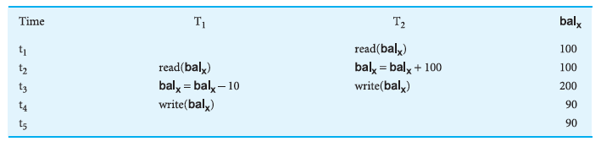
Functions of DBMS
(3) Transaction support
A DBMS must furnish a mechanism which will ensure either that all the updates corresponding to a given transaction are made or that none of them is made.
(4) Concurrency control services
A DBMS must furnish a mechanism to ensure that the database is updated correctly when multiple users are updating the database concurrently.
Figure 4.4: The lost update problem

Slide 23
Functions of DBMS
(5) Recovery services
A DBMS must furnish a mechanism for recovering the database in the event that the database is damaged in any way.
(6) Authorization services
A DBMS must furnish a mechanism to ensure that only authorized users can access the database.
(7) Support for data communication
A DBMS must be capable of integrating with communication software.
(8) Integrity services
A DBMS must furnish a means to ensure that both the data in the database and changes to the data follow certain rules.
(9) Services to promote data independence
A DBMS must include facilities to support the independence of programs from the actual structure of the database.
(10) Utility services
A DBMS should provide a set of utility services.

Slide 24

MULTI USER DBMS ARCHITECTURES
Common architectures that are used to implement multi-user database management systems are as follows:
Teleprocessing
File-server
Client–server

Slide 25
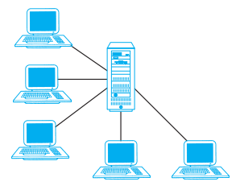
Teleprocessing
Traditional architecture.
Single mainframe with a number of terminals attached.
Trend is now downsizing.
Figure 5.1: Teleprocessing Topology

Slide 26
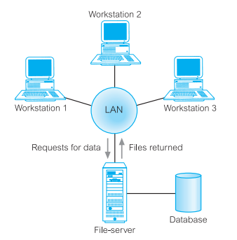
File-Server Architecture
File-server is connected to several workstations across a network.
Database resides on file-server.
DBMS and applications run on each workstation.
Figure 5.2: File-sever architecture

Slide 27

File-Server Architecture
Example: Consider a user request that requires the names of staff who work in the branch at 163 Main St. We can express this request in SQL:
As the file-server has no knowledge of SQL, the DBMS has to request the files corresponding to the Branch and Staff relations from the file-server, rather than just the staff names that satisfy the query.
The file-server architecture, therefore, has three main disadvantages:
There is a large amount of network traffic.
A full copy of the DBMS is required on each workstation.
Concurrency, recovery, and integrity control are more complex because there can be multiple DBMSs accessing the same files.

Slide 28
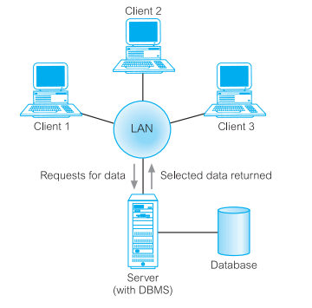
Traditional Two-Tier Client–Server Architecture
Client (tier 1) manages user interface and runs applications.
Server (tier 2) holds database and DBMS.
Figure 5.3: Client-server architecture

Slide 29
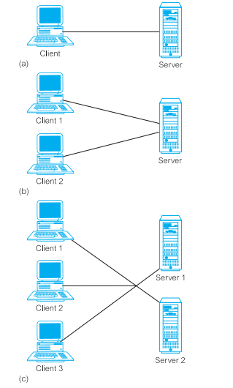
Figure 5.4: Alternative client–server topologies: (a) single client, single server; (b) multiple clients, single server; (c) multiple clients, multiple servers.

Slide 30
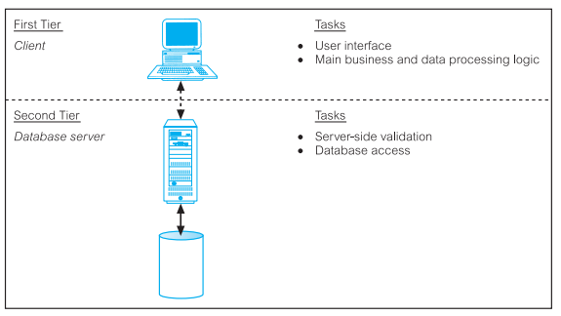
Data-intensive business applications consist of four major components: the database, the transaction logic, the business and data application logic, and the user interface.
The traditional two-tier client–server architecture provides a very basic separation of these components.
The client (tier 1) is primarily responsible for the presentation of data to the user, and the server (tier 2) is primarily responsible for supplying data services to the client, as illustrated in Figure 5.5
Figure 5.5: The traditional two-tier client–server architecture

Slide 31
There are many advantages to this type of architecture. For example:
wider access to existing databases
Increased performance
Possible reduction in hardware cost
Reduction in communication cost
Increased consistency
It maps on to open systems architecture quite naturally.

Slide 32
Three-Tier Client–Server Architecture
Client side presented two problems that prevented true scalability:
A ‘fat’ client, requiring considerable resources on the client’s computer to run effectively. This includes disk space, RAM, and CPU power.
A significant client-side administration overhead.
By 1995, three layers proposed, each potentially running on a different platform.
The user interface layer, which runs on the end-user’s computer (the client).
The business logic and data processing layer. This middle tier runs on a server and is often called the application server.
A DBMS, which stores the data required by the middle tier. This tier may run on a separate server called the database server.

Slide 33
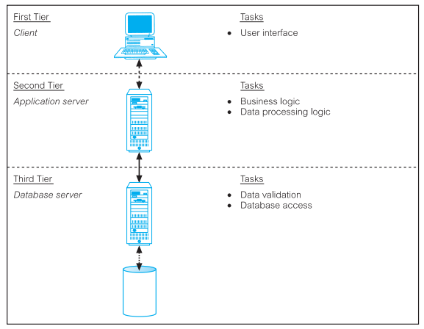
As illustrated in Figure 5.6 the client is now responsible only for the application’s user interface and perhaps performing some simple logic processing, such as input validation, thereby providing a ‘thin’ client. The core business logic of the application now resides in its own layer, physically connected to the client and database server over a local area network (LAN) or wide area network (WAN). One application server is designed to serve multiple clients.
Figure 5.6:The three-tier architecture

Slide 34
Advantages:
‘Thin’ client requiring less expensive hardware
Application maintenance centralized
easier to modify or replace one tier without affecting others
Separating business logic from database functions makes it easier to implement load balancing.
Maps quite naturally to web environment.

Slide 35
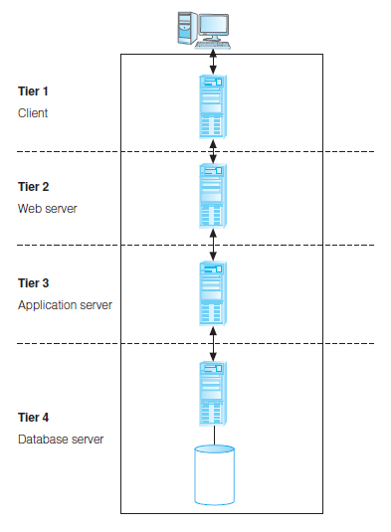
n-Tier Client-Server (e.g. 4-Tier)
The three-tier architecture can be expanded to n tiers, with additional tiers providing more flexibility and scalability.
Applications servers host API to expose business logic and business processes for use by other applications.
Figure 5.7: Four-tier architecture with the middle tier split into a Web server and application server

Slide 36
Middleware
Middleware is a generic term used to describe software that mediates with other software and allows for communication between disparate applications in a heterogeneous system.
The need for middleware arises when distributed systems become too complex to manage efficiently without a common interface.
Six main types of middleware are as follows:
Asynchronous Remote Procedure Call (RPC)
Synchronous RPC
Publish/subscribe
Message-oriented middleware (MOM)
Object-request broker (ORB)
SQL-oriented data access

Slide 37
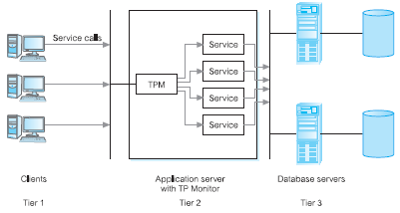
Transaction Processing Monitors
TP monitor is a program that controls data transfer between clients and servers in order to provide a consistent environment, particularly for online transaction processing (OLTP).
Figure 5.8: Transaction Processing Monitor as middle tier of 3-tier client-server

Slide 38
TP Monitors provide signiﬁcant advantages, including:
Transaction routing
Managing distributed transactions
Load balancing
Funneling
Increased reliability

Slide 39
Web Services and Service-Oriented Architectures
Web service is a software system designed to support interoperable machine-to-web service machine interaction over a network.
Web services share business logic, data, and processes through a programmatic interface across a network.
Developers can add the Web service to a Web page (or an executable program) to offer specific functionality to users.
Examples of Web services include:
Microsoft Bing Maps and Google Maps
Amazon Simple Storage Service
Geonames
DOTS
Xignite

Slide 40
Web Services and Service-Oriented Architectures
Web services approach uses accepted technologies and standards, such as:
XML (extensible Markup Language).
SOAP (Simple Object Access Protocol) is a communication protocol for exchanging structured information over the Internet and uses a message format based on XML. It is both platform and language-independent.
WSDL (Web Services Description Language) protocol, again based on XML, is used to describe and locate a Web service.
UDDI (Universal Discovery, Description, and Integration) protocol is a platform independent, XML-based registry for businesses to list themselves on the Internet.

Slide 41
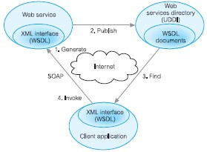
Web Services and Service- Oriented Architectures
Figure 6.1: Relationship between WSDL, UDDI, and SOAP

Slide 42
Service-Oriented Architectures (SOA)
A business-centric software architecture for building applications that implement business processes as sets of services published at a granularity relevant to the service consumer. Services can be invoked, published, and discovered, and are abstracted away from the implementation using a single standards-based form of interface.
The following are a set of common SOA principles that provide a unique design approach for building Web services for SOA:
Loose coupling
Reusability
Contract
Abstraction
Compatibility
Autonomy
Stateless
Discoverability

Slide 43
Distributed DBMSs
A distributed database is a logically interrelated collection of shared data (and a description of this data), physically distributed over a computer network.
A distributed DBMS is the software system that permits the management of the distributed database and makes the distribution transparent to users.
A DDBMS consists of a single logical database split into a number of fragments.
Each fragment is stored on one or more computers (replicas) under the control of a separate DBMS, with the computers connected by a network.
Each site is capable of independently processing user requests that require access to local data (that is, each site has some degree of local autonomy) and is also capable of processing data stored on other computers in the network.

Slide 44
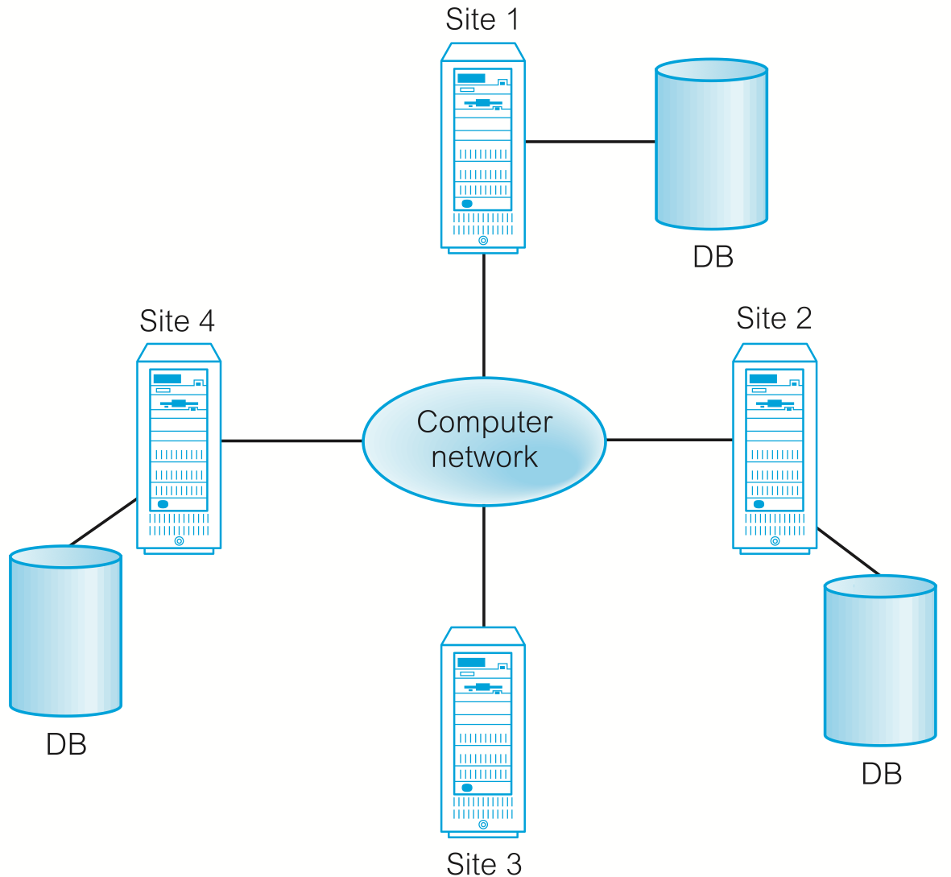
Figure 6.2: Distributed database management system

Slide 45
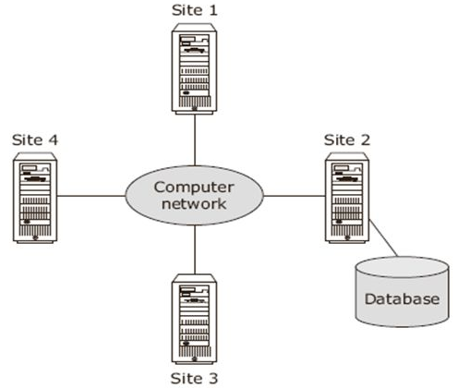
Distributed Processing
A centralized database that can be accessed over a computer network.
Figure 6.3: Distributed Processing

Slide 46
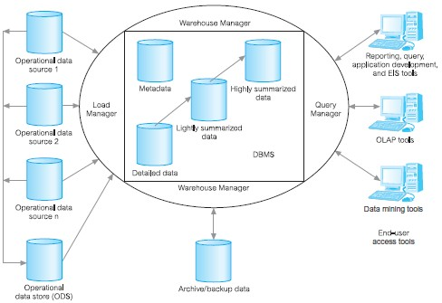
Data Warehousing
A data warehouse was deemed the solution to meet the requirements of a system capable of supporting decision making, receiving data from multiple operational data sources.
A data held in the data warehouse is described as being subject-oriented, integrated, time-variant and nonvolatile.
Figure 6.5: The typical architecture of a data warehouse

Slide 47
Cloud Computing
The National Institute of Standards and Technology (NIST) provided a definition.
Defined as “A model for enabling ubiquitous, convenient, on-demand network access to a shared pool of configurable computing resources (e.g. networks, servers, storage, applications, and services) that can be rapidly provisioned and released with minimal management effort or service provider interaction”.

Slide 48
Cloud Computing – Key Characteristics
On-demand self-service
Consumers can obtain, configure and deploy cloud services without help from provider.
Broad network access
Accessible from anywhere, from any standardized platform (e.g. desktop computers, laptops, mobile devices).
Resource pooling
Provider’s computing resources are pooled to serve multiple consumers, with different physical and virtual resources dynamically assigned and reassigned according to consumer demand. Examples of resources include storage, processing, memory, and network bandwidth.

Slide 49
Cloud Computing – Key Characteristics (contd..)
Rapid elasticity
Provider’s capacity caters for customer’s spikes in demand and reduces risk of outages and service interruptions. Capacity can be automated to scale rapidly based on demand.
Measured service
Provider uses a metering capability to measure usage of service (e.g. storage, processing, bandwidth, and active user accounts).

Slide 50
Cloud Computing – Service Models
Software as a Service (SaaS):
Software and data hosted on cloud. Accessed through using thin client interface (e.g. web browser). Consumer may be offered limited user specific application configuration settings.
Examples include Salesforce.com sales management applications, NetSuite’s integrated business management software, Google’s Gmail and Cornerstone OnDemand.

Slide 51
Cloud Computing – Service Models
Platform as a Service (PaaS)
Allows creation of web applications without buying/maintaining the software and underlying infrastructure. Provider manages the infrastructure including network, servers, OS and storage, while customer controls deployment of applications and possibly configuration.
Examples include Salesforce.com’s Force.com, Google’s App Engine, and Microsoft’s Azure.

Slide 52
Cloud Computing – Service Models
Infrastructure as a Service (IaaS)
Provider’s offer servers, storage, network and operating systems – typically a platform virtualization environment – to consumers as an on-demand service, in a single bundle and billed according to usage.
A popular use of IaaS is in hosting websites. Examples Amazon’s Elastic Compute Cloud (EC2), Rackspace and GoGrid.

Slide 53
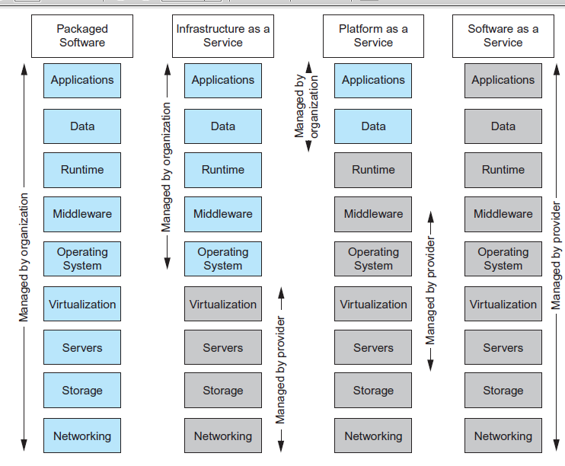
Cloud Computing – Comparison of Services Models

Slide 54
Four main deployment models for the cloud
Public cloud
Private cloud
Community cloud
Hybrid cloud

Slide 55
Benefits of Cloud Computing
Cost-Reduction: Avoid up-front capital expenditure.
Scalability/Agility: Organisations set up resources on an as-needs basis.
Improved Security: Providers can devote expertise & resources to security; not affordable by customer.
Improved Reliability: Providers can devote expertise & resources on reliability of systems; not affordable by customer.
Access to new technologies: Through use of provider’s systems, customers may access latest technology.
Faster development: Provider’s platforms can provide many of the core services to accelerate development cycle.

Slide 56
Benefits of Cloud Computing
Large scale prototyping/load testing: Providers have the resources to enable this.
More flexible working practices: Staff can access files using mobile devices.
Increased competitiveness: Allows organizations to focus on their core competencies rather than their IT infrastructures.

Slide 57
Risks of Cloud Computing
Network Dependency: Power outages, bandwidth issues and service interruptions.
System Dependency: Customer’s dependency on availability and reliability of provider’s systems.
Cloud Provider Dependency: Provider could became insolvent or acquired by competitor, resulting in the service suddenly terminating.
Lack of control: Customers unable to deploy technical or organisational measures to safeguard the data. May result in reduced availability, integrity, confidentiality, intervenability and isolation.
Lack of information on processing transparency: Insufficient information about a cloud service’s processing operations poses a risk to data controllers as well as to data subjects because they might not be aware of potential threats and risks and thus cannot take measures they deem appropriate

Slide 58
Cloud-based database solutions
As a type of Software as a Service (SaaS), cloud- based database solutions fall into two basic categories:
Data as a Service (DaaS) and Database as a Service (DBaaS).
Key difference between the two options is mainly how the data is managed.

Slide 59
Cloud-based database solutions
DBaaS
Offers full database functionality to application developers.
Provides a management layer that provides continuous monitoring and configuring of the database to optimized scaling, high availability, multi-tenancy (that is, serving multiple client organizations), and effective resource allocation in the cloud, thereby sparing the developer from ongoing database administration tasks.

Slide 60
Cloud-based database solutions
DaaS:
Services enables data definition in the cloud and subsequently querying.
Does not implement typical DBMS interfaces (e.g. SQL) but instead data is accessed via common APIs.
Enables organization with valuable data to offer access to others. Examples Urban Mapping (geography data service), Xignite (financial data service) and Hoovers (business data service.)

Slide 61

Components of a DBMS
A DBMS is partitioned into several software components (or modules), each of which is assigned a specific operation. As stated previously, some of the functions of the DBMS are supported by the underlying operating system.
The DBMS interfaces with other software components, such as user queries and access methods (file management techniques for storing and retrieving data records).

Slide 62
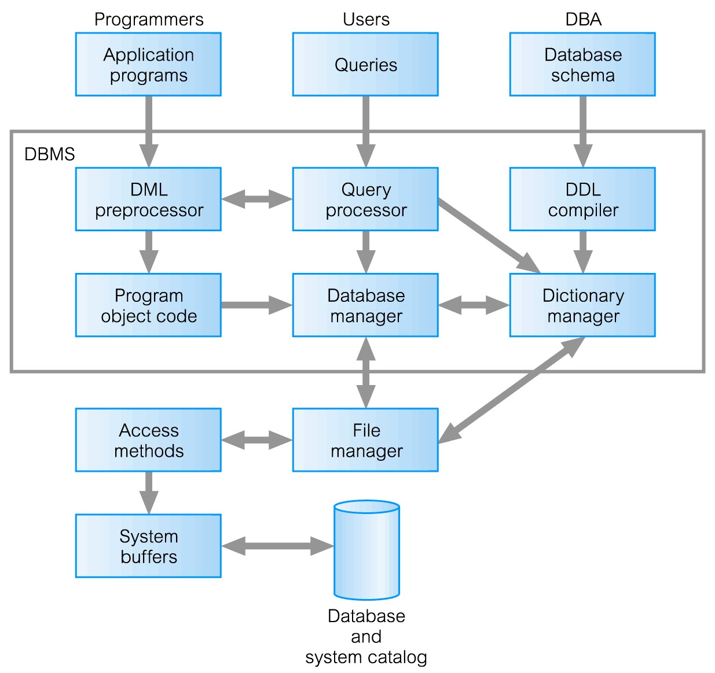
Components of a DBMS

Slide 63
Components of a DBMS (Continued)
Query processor is a major DBMS component that transforms queries into a series of low-level instructions directed to the database manager.
Database manager (DM) interfaces with user-submitted application programs and queries. The DM examines the external and conceptual schemas to determine what conceptual records are required to satisfy the request. The DM then places a
call to the file manager to perform⁴⁸ request.

Slide 64
Components of a DBMS (Continued)
File manager manipulates the underlying storage files and manages the allocation of storage space on disk. It establishes and maintains the list of structures and indexes defined in the internal schema.
DML preprocessor converts DML statements embedded in an application program into standard function calls in the host language. The DML preprocessor must interact with the query processor to
generate the appropriate code.

Slide 65
Components of a DBMS (Continued)
DDL compiler converts DDL statements into a set of tables containing metadata. These tables are then stored in the system catalog while control information is stored in data file headers.
Catalog manager manages access to and maintains the system catalog. The system catalog is accessed by most DBMS components.

Slide 66
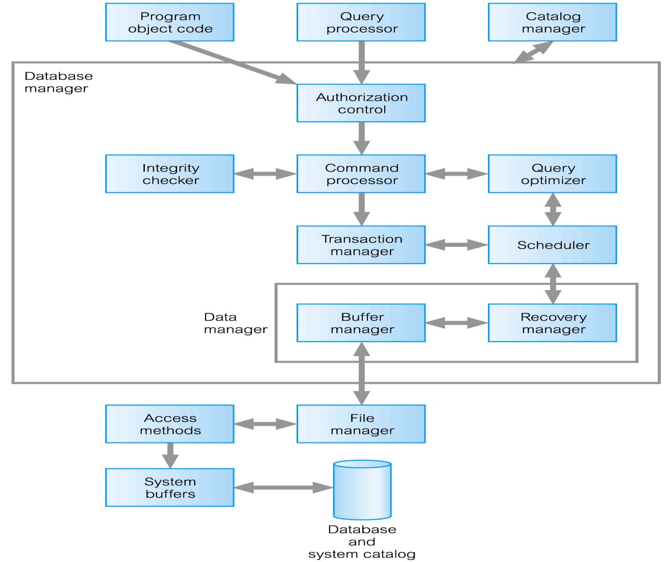
Components of Database Manager (DM)

Slide 67
Components of the Database Manager
Authorization control to confirm whether the user has the necessary permission to carry out the required operation.
Command processor on confirmation of user authority, control is passed to the command processor.
Integrity checker ensures that requested operation satisfies all necessary integrity constraints (e.g. key constraints) for an operation that changes the database.

Slide 68
Components of the Database Manager (Continued)
Query optimizer determines an optimal strategy for the query execution.
Transaction manager performs the required processing of operations that it receives from transactions.
Scheduler ensures that concurrent operations on the database proceed without conflicting with one another. It controls the relative order in which
transaction operations are executed.

Slide 69
Components of the Database Manager (Continued)
Recovery manager ensures that the database remains in a consistent state in the presence of failures. It is responsible for transaction commit and abort.
Buffer manager responsible for the transfer of data between main memory and secondary storage, such as disk and tape.
The recovery manager and the buffer manager also known as (aka) the data manager. The buffer manager is sometimes known as the
cache manager.

