Slide 1
Chapter 12
Entity-Relationship Modeling

Slide 2
Chapter 12 - Objectives
How to use Entity–Relationship (ER) modeling in database design.
Basic concepts associated with ER model.
Diagrammatic technique for displaying ER model using Unified Modeling Language (UML).

Slide 3
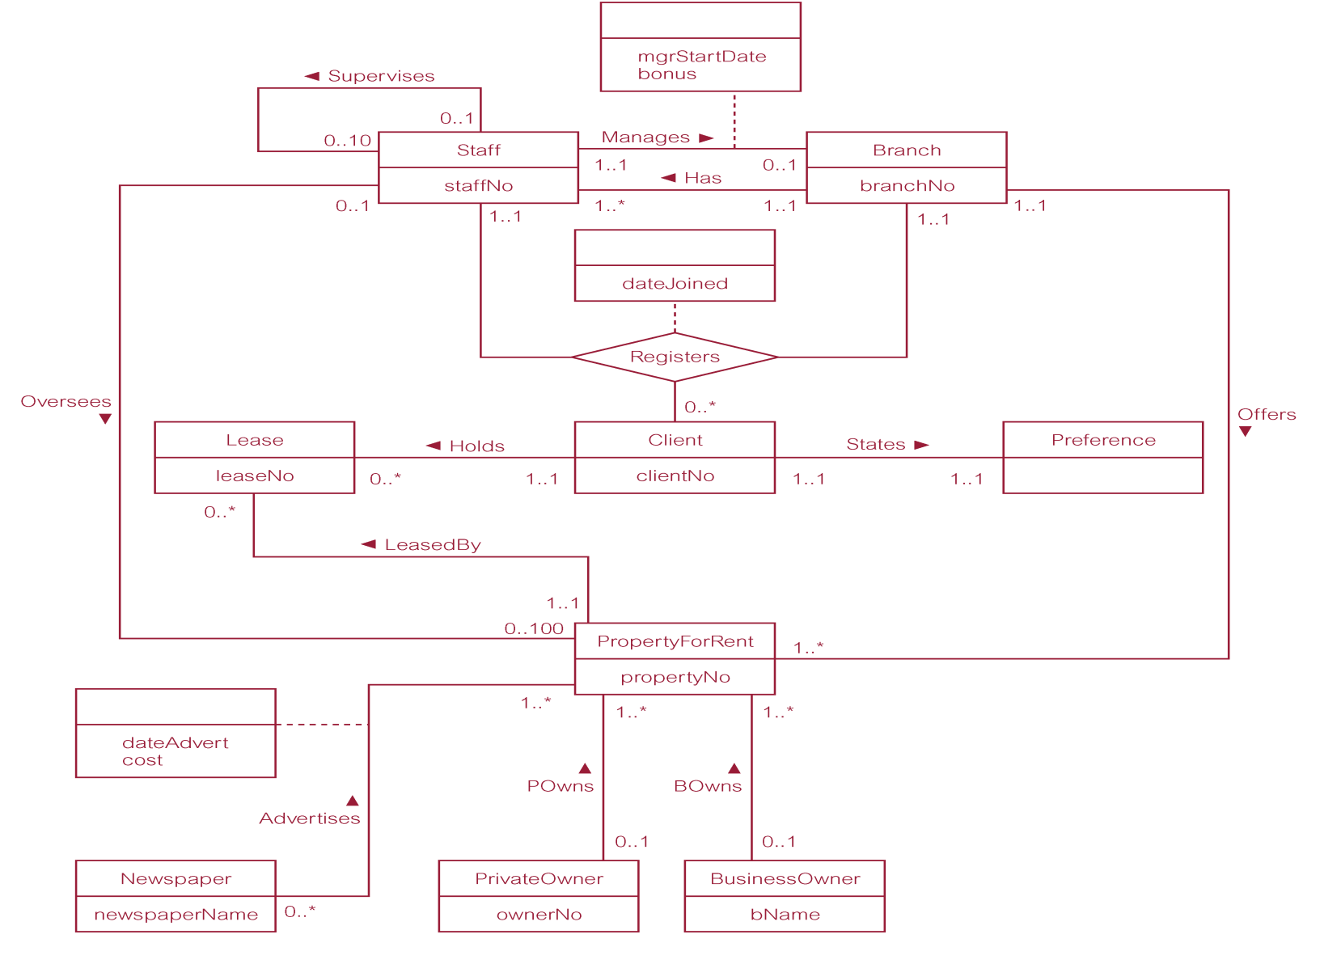
ER Diagram of Branch View of DreamHome

Slide 4
Concepts of the ER Model
Entity types
Relationship types
Attributes

Slide 5
Entity Type
Entity type
  Group of objects with same properties, identified by enterprise as having an independent existence.
Entity occurrence
  Uniquely identifiable object of an entity type.

Slide 6
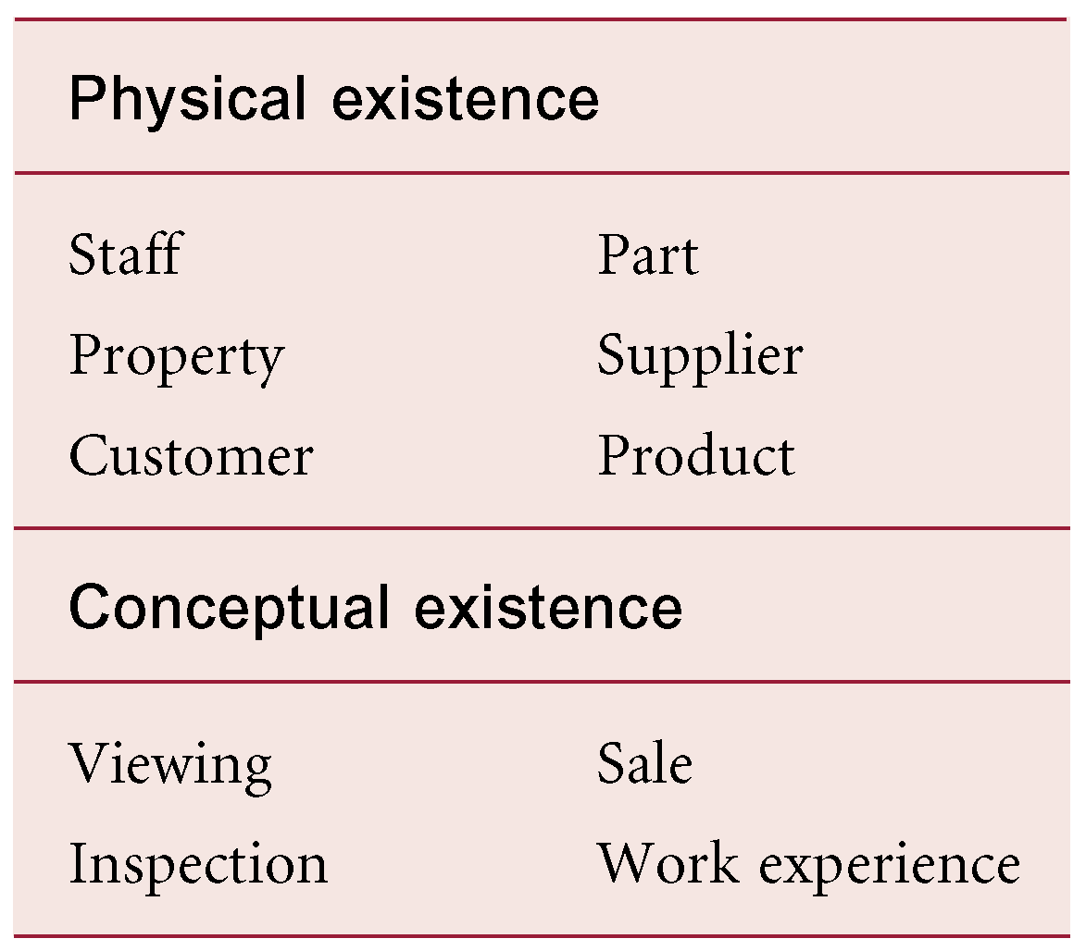
Examples of Entity Types

Slide 7
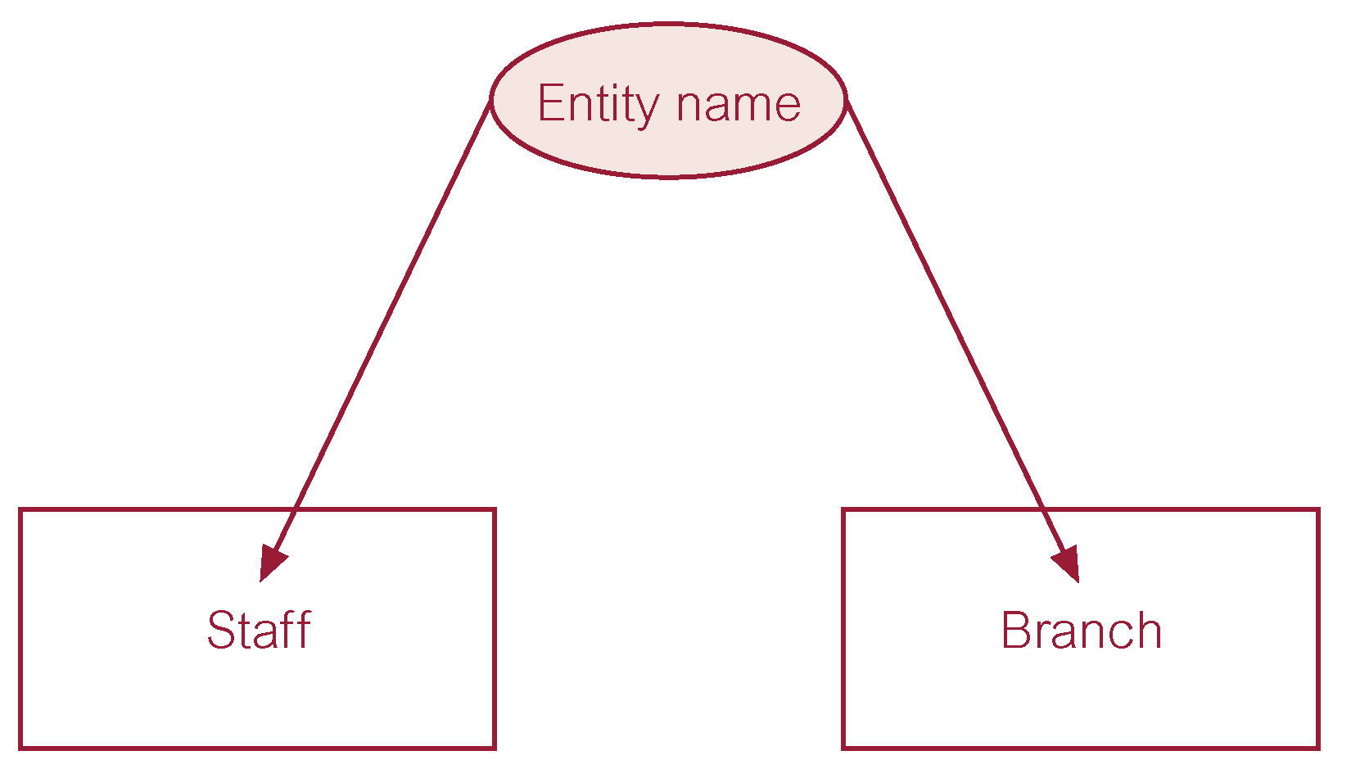
ER Diagram of Staff and Branch Entity Types

Slide 8
Relationship Types
Relationship type
  Set of meaningful associations among entity types.
Relationship occurrence
  Uniquely identifiable association, which includes one occurrence from each participating entity type.

Slide 9
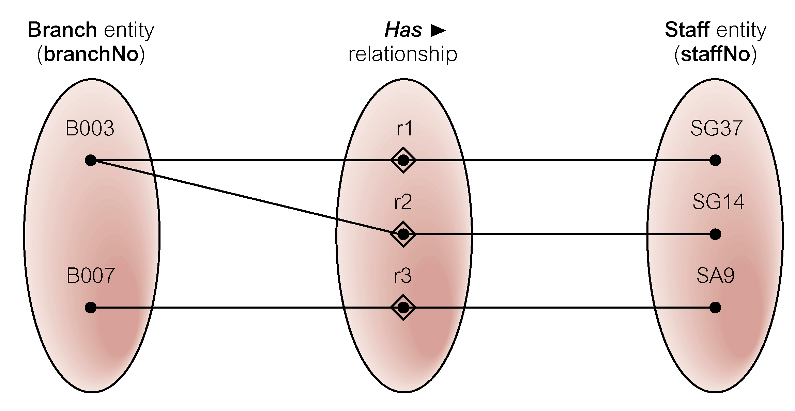
Semantic Net of Has Relationship Type

Slide 10
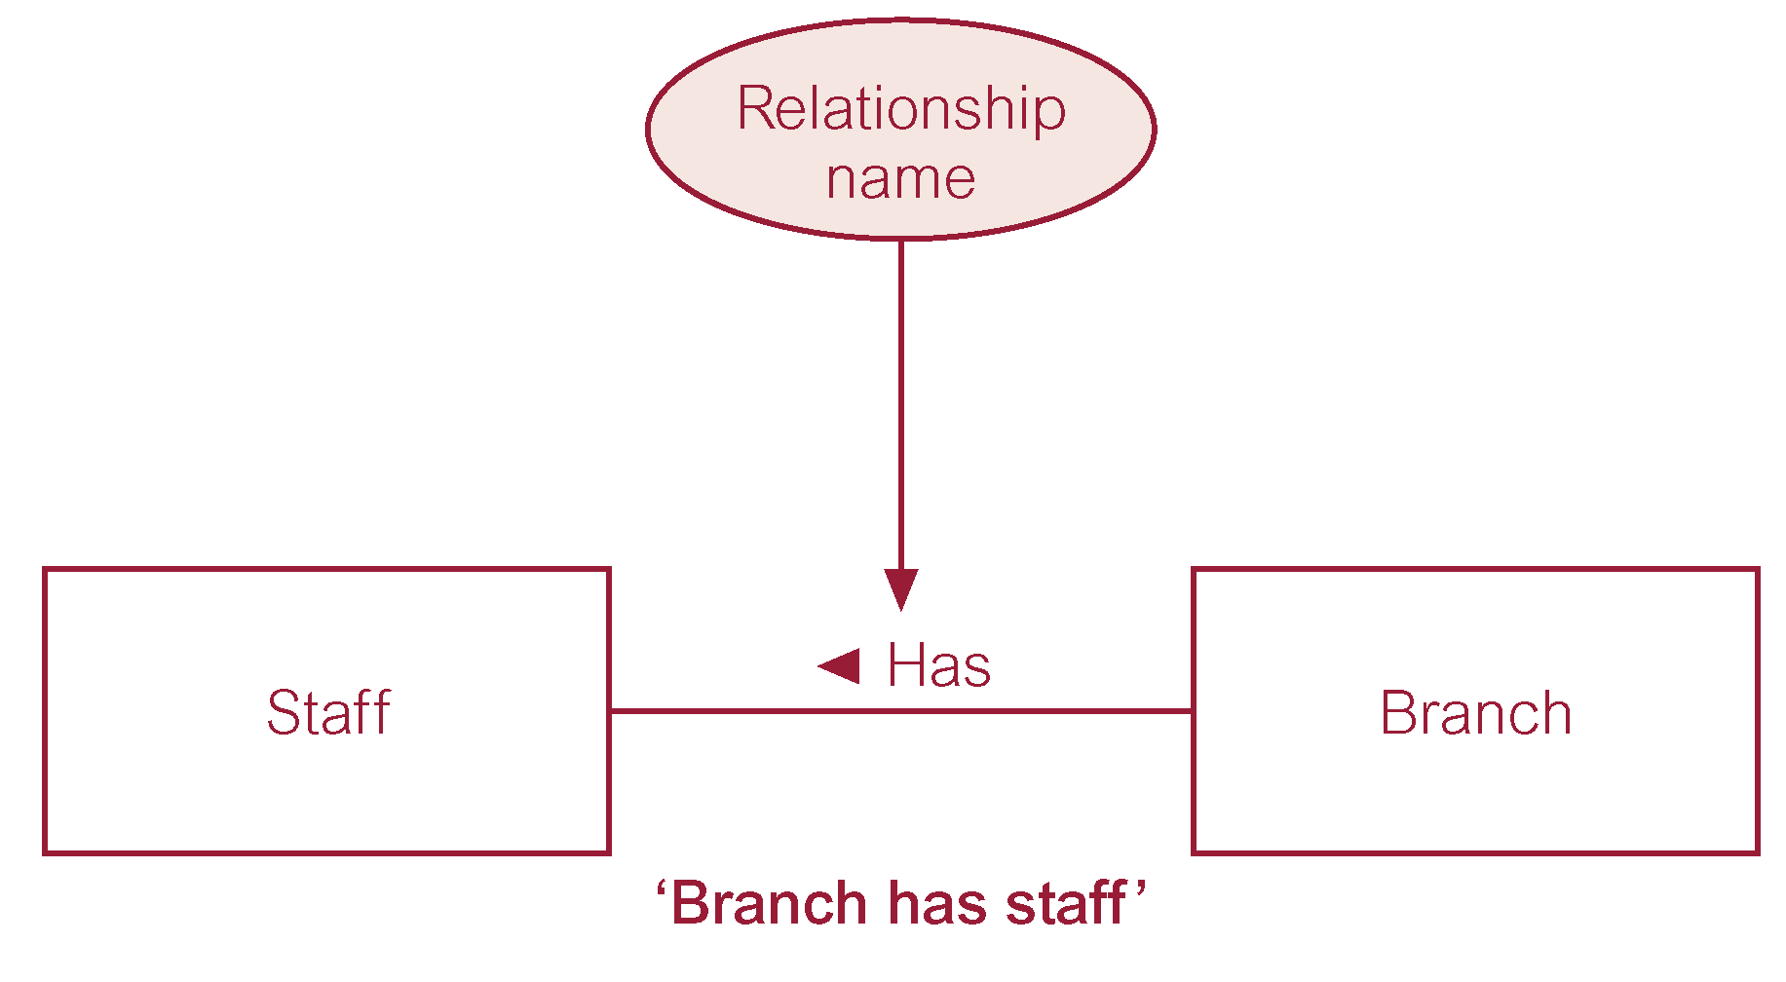
ER Diagram of Branch Has Staff Relationship

Slide 11
Relationship Types
Degree of a Relationship
  Number of participating entities in relationship.
Relationship of degree:
  two is binary;
  three is ternary;
  four is quaternary.

Slide 12
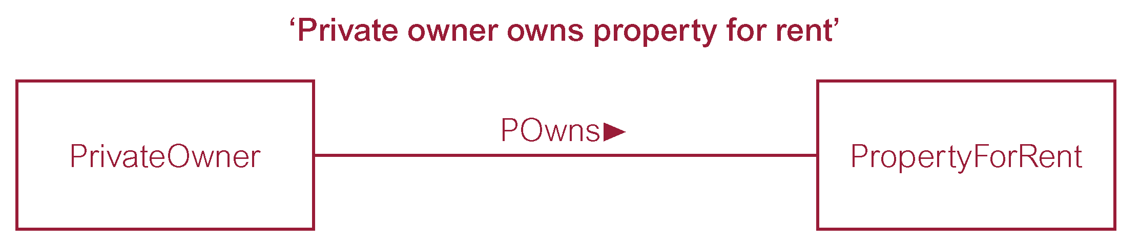
Binary Relationship called POwns

Slide 13
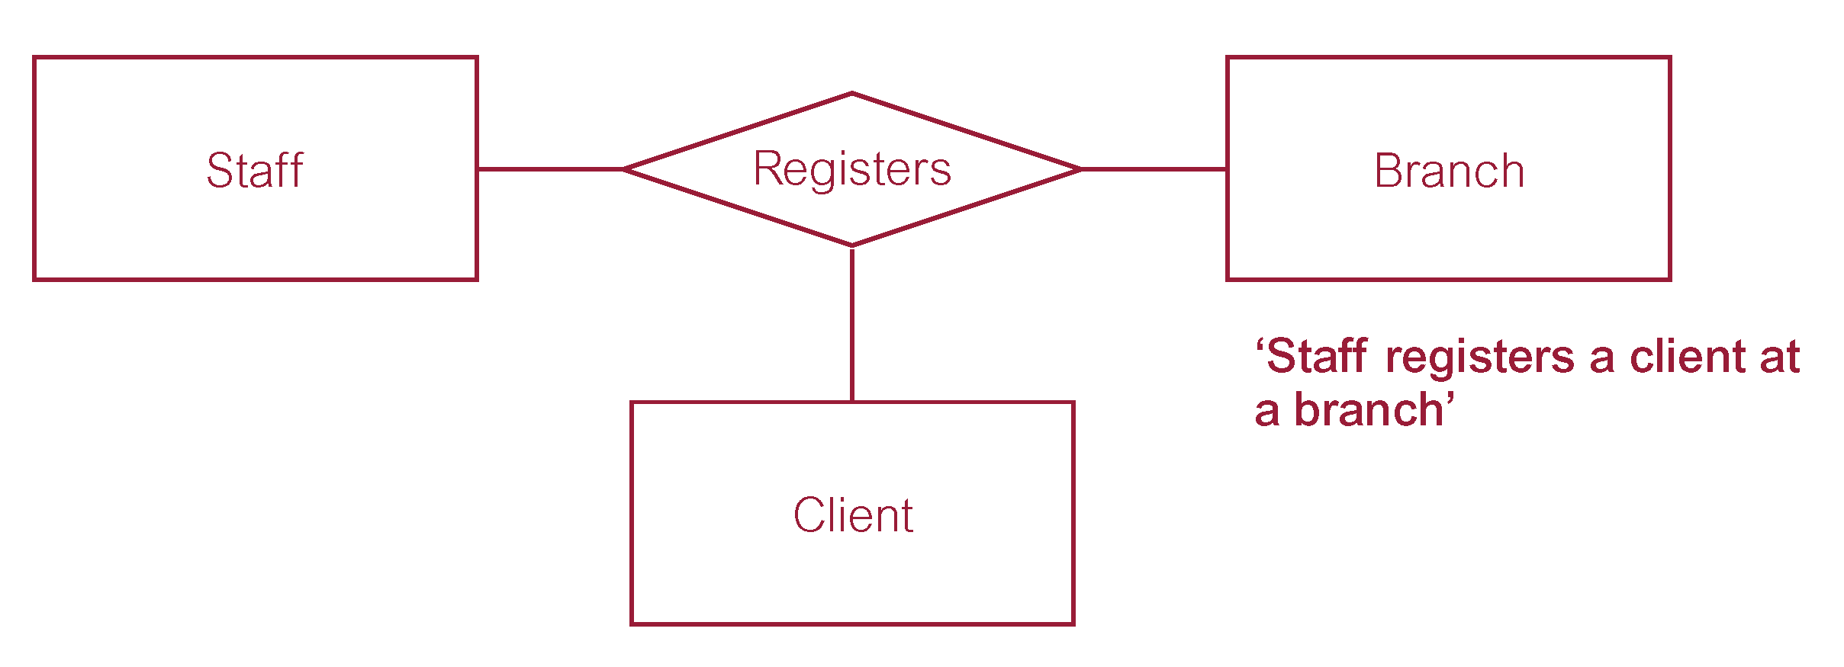
Ternary Relationship called Registers

Slide 14
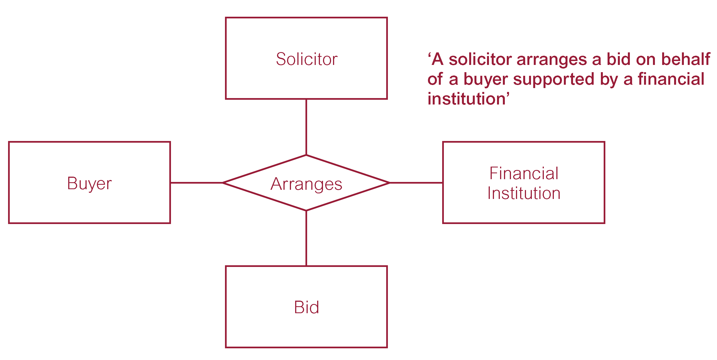
Quaternary Relationship called Arranges

Slide 15
Relationship Types
Recursive Relationship
  Relationship type where same entity type participates more than once in different roles.
Relationships may be given role names to indicate purpose that each participating entity type plays in a relationship.

Slide 16
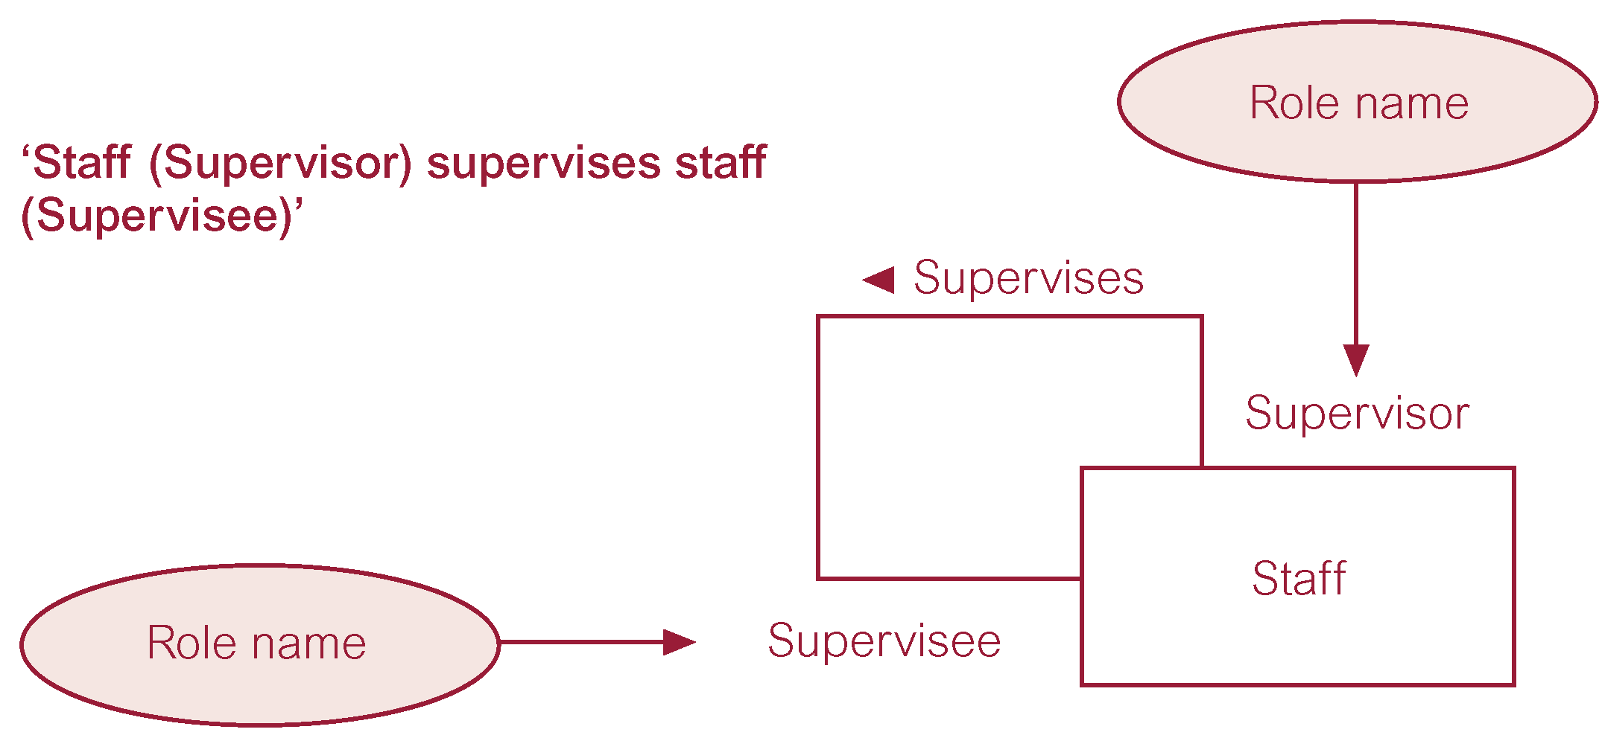
Recursive Relationship called Supervises with Role Names

Slide 17
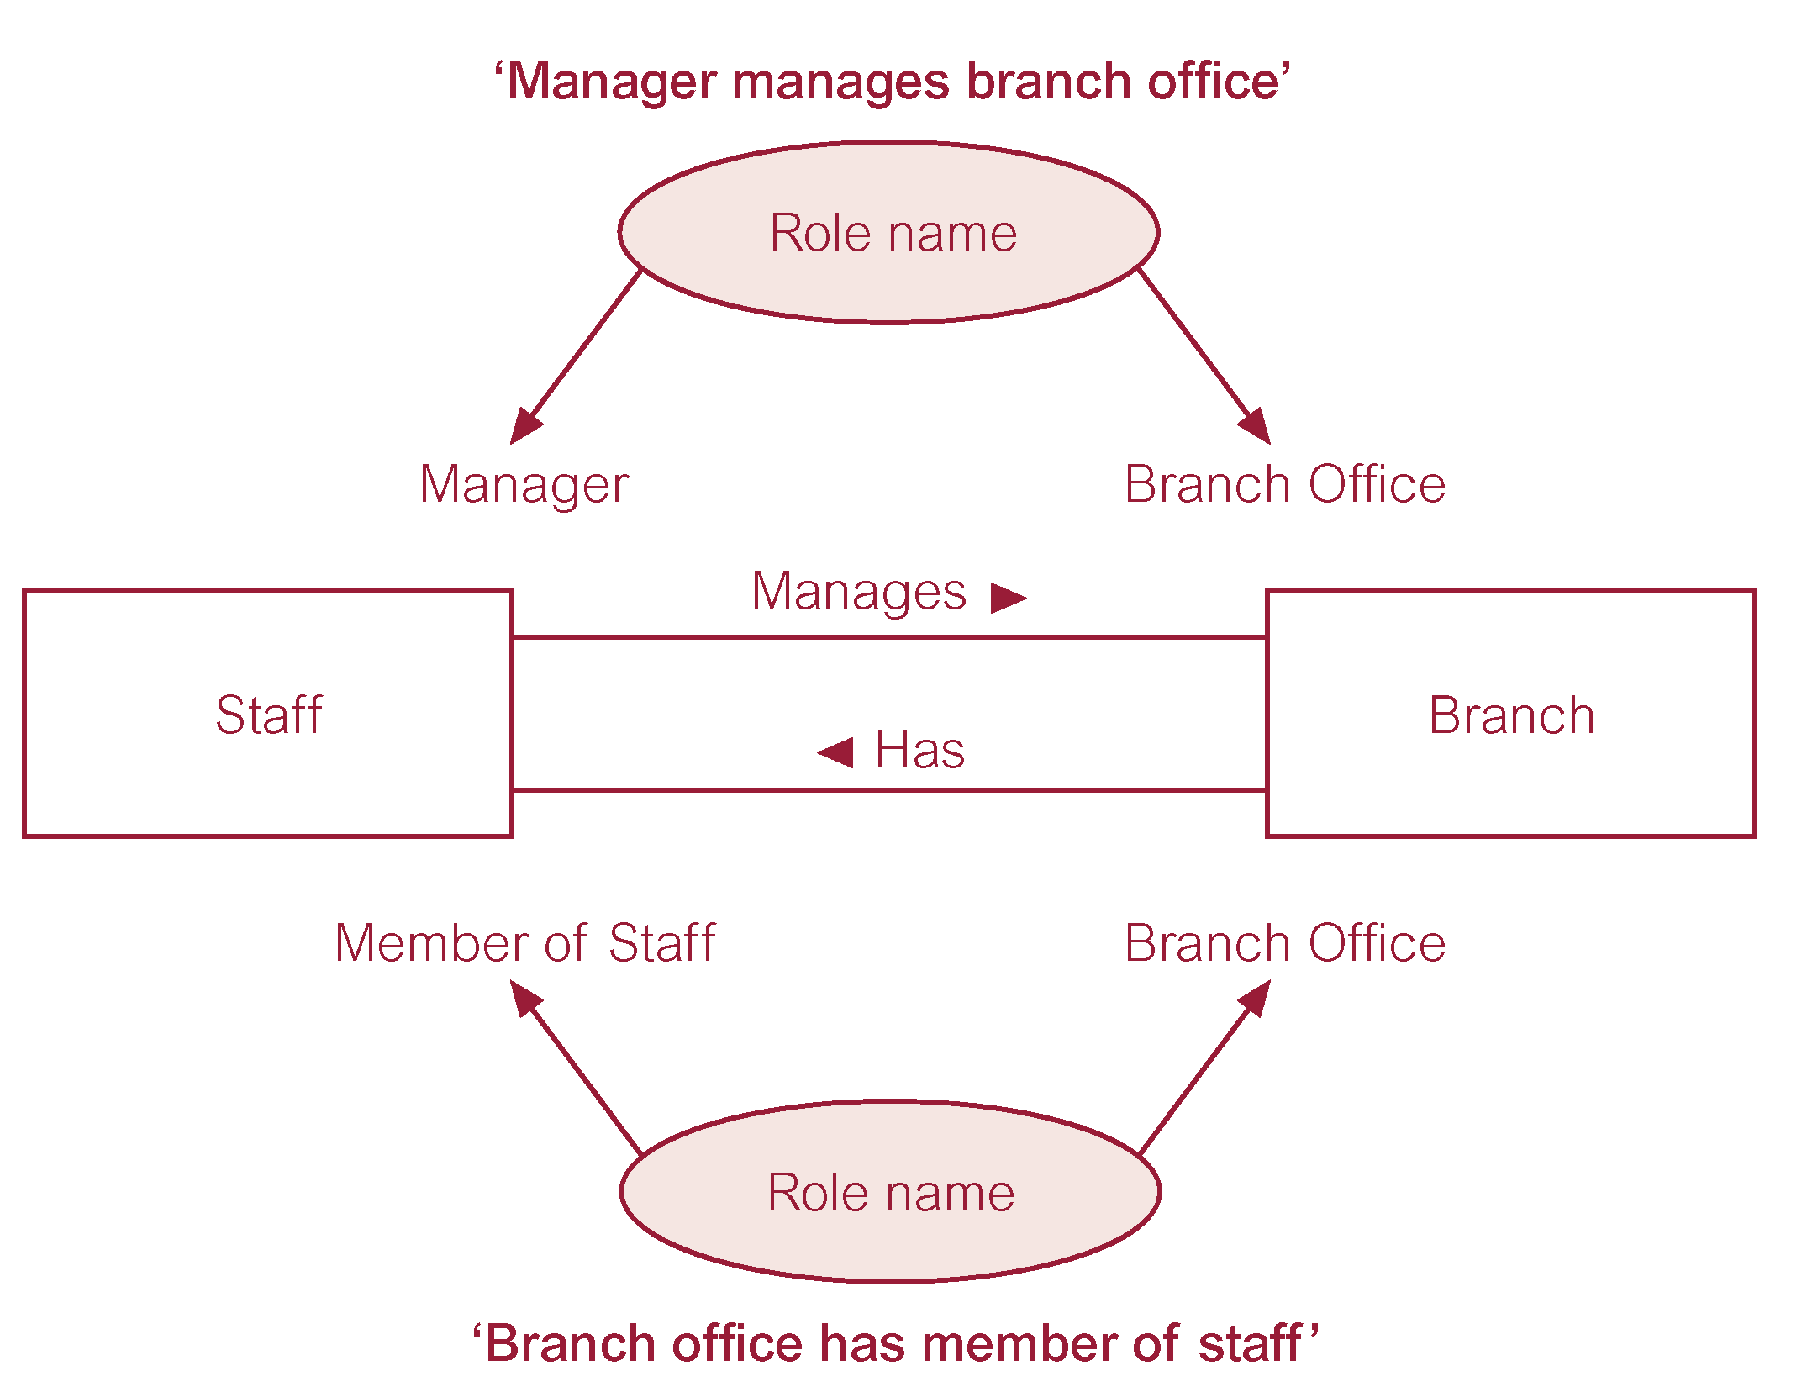
Entities associated through two distinct Relationships with Role Names

Slide 18
Attributes
Attribute
  Property of an entity or a relationship type.
Attribute Domain
  Set of allowable values for one or more attributes.

Slide 19
Attributes
Simple Attribute
  Attribute composed of a single component with an independent existence.
Composite Attribute
  Attribute composed of multiple components, each with an independent existence.

Slide 20
Attributes
Single-valued Attribute
  Attribute that holds a single value for each occurrence of an entity type.
Multi-valued Attribute
  Attribute that holds multiple values for each occurrence of an entity type.

Slide 21
Attributes
Derived Attribute
  Attribute that represents a value that is derivable from value of a related attribute, or set of attributes, not necessarily in the same entity type.

Slide 22
Keys
Candidate Key
  Minimal set of attributes that uniquely identifies each occurrence of an entity type.
Primary Key
  Candidate key selected to uniquely identify each occurrence of an entity type.
Composite Key
  A candidate key that consists of two or more attributes.

Slide 23
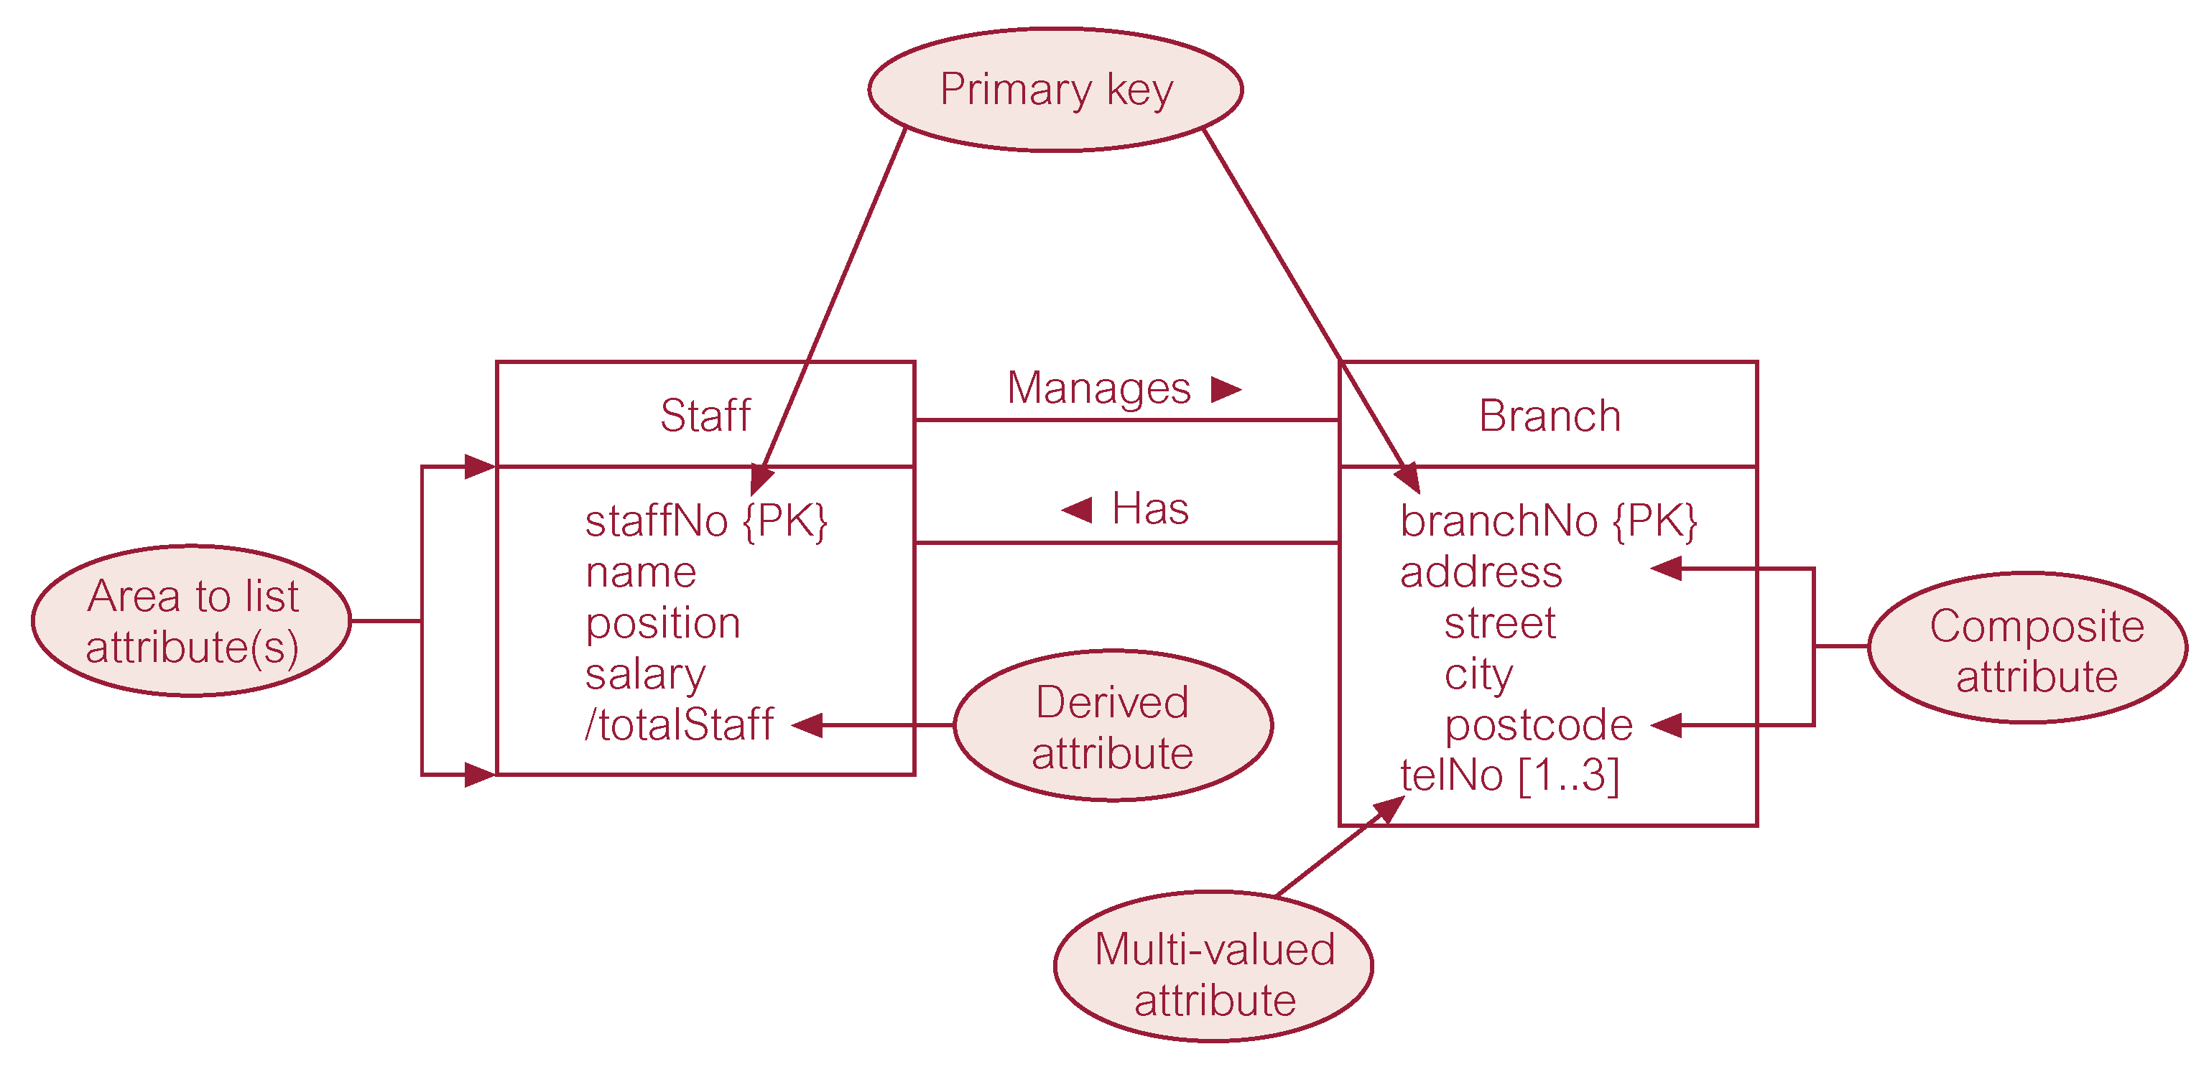
ER Diagram of Staff and Branch Entities and their Attributes

Slide 24
Entity Type
Strong Entity Type
  Entity type that is not existence-dependent on some other entity type.
Weak Entity Type
  Entity type that is existence-dependent on some other entity type.

Slide 25
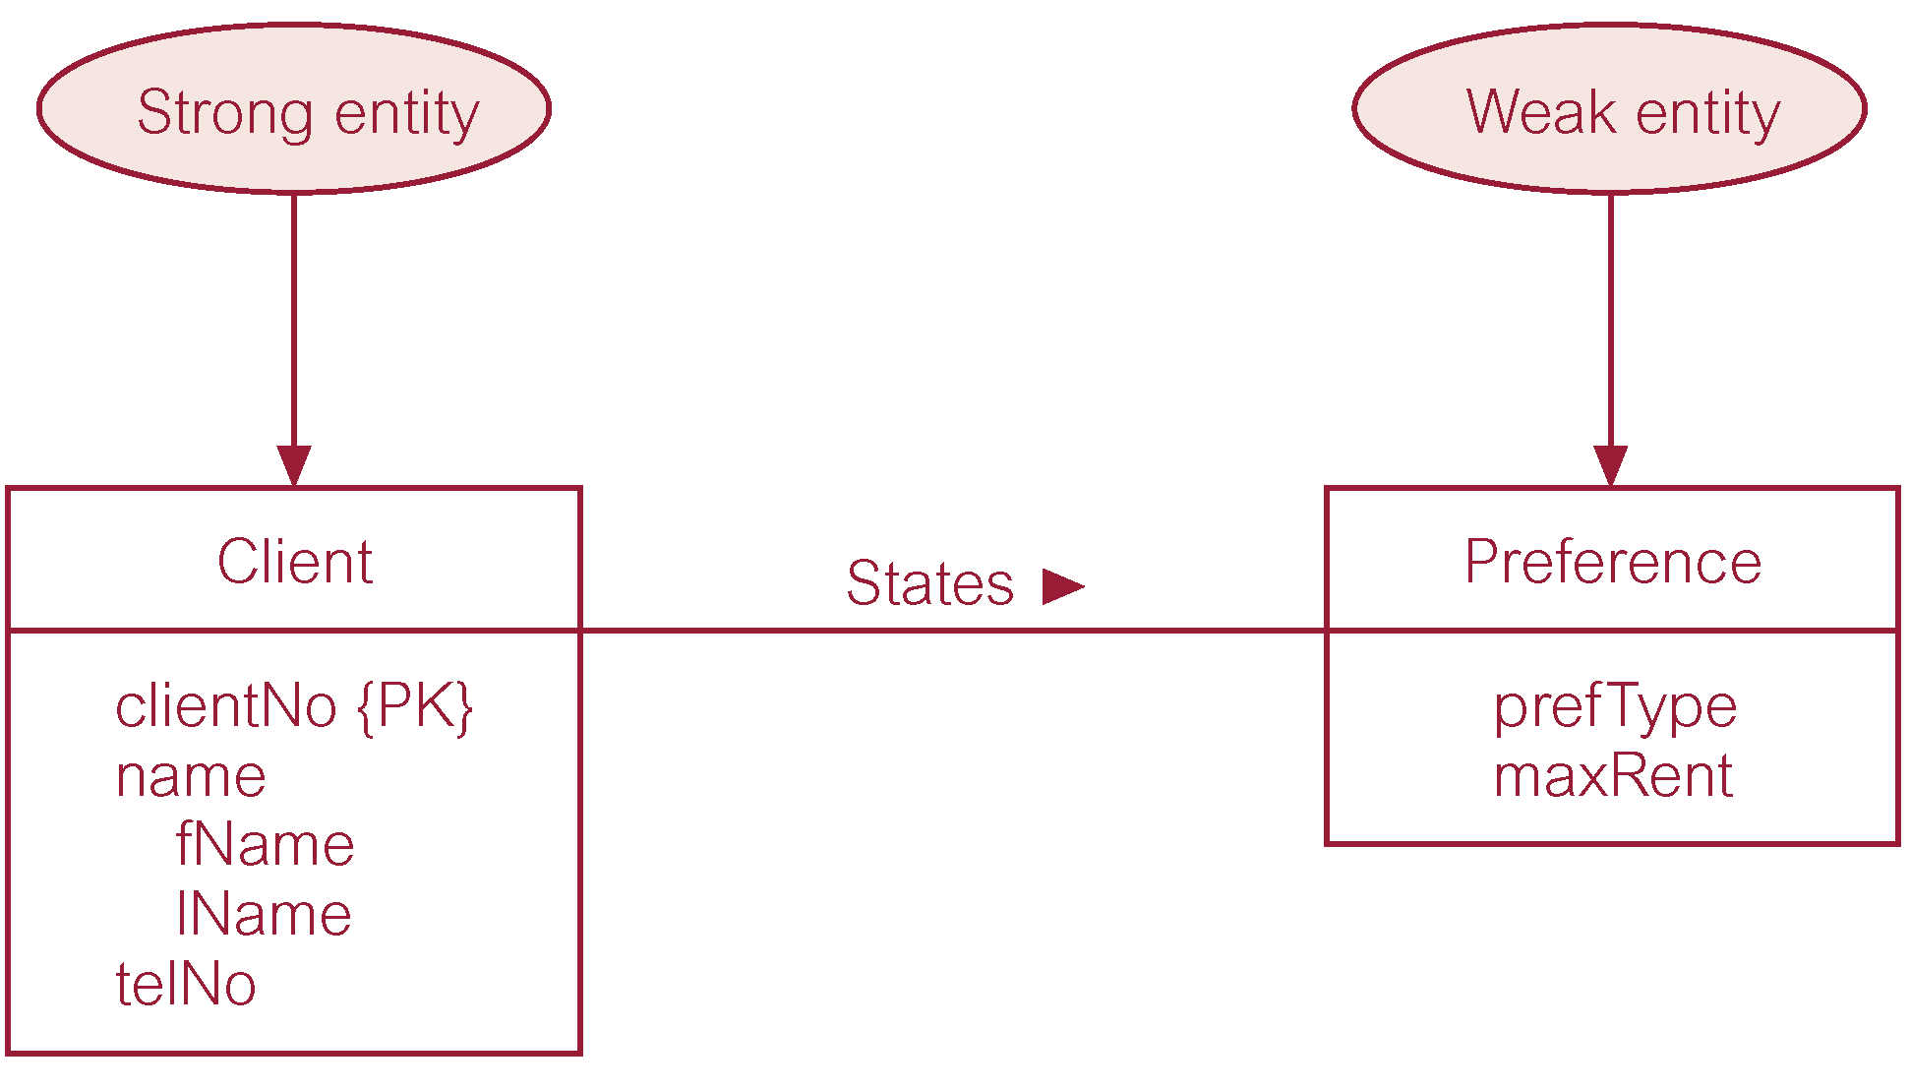
Strong Entity Type called Client and Weak Entity Type called Preference

Slide 26
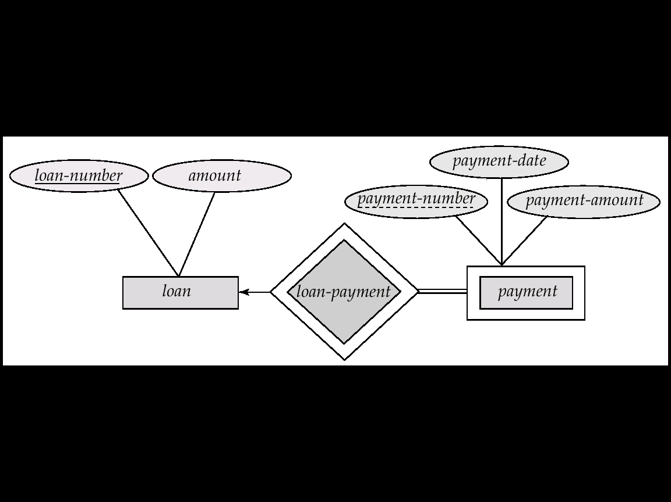
Strong Entity Type called loan and Weak Entity Type called payment

Slide 27
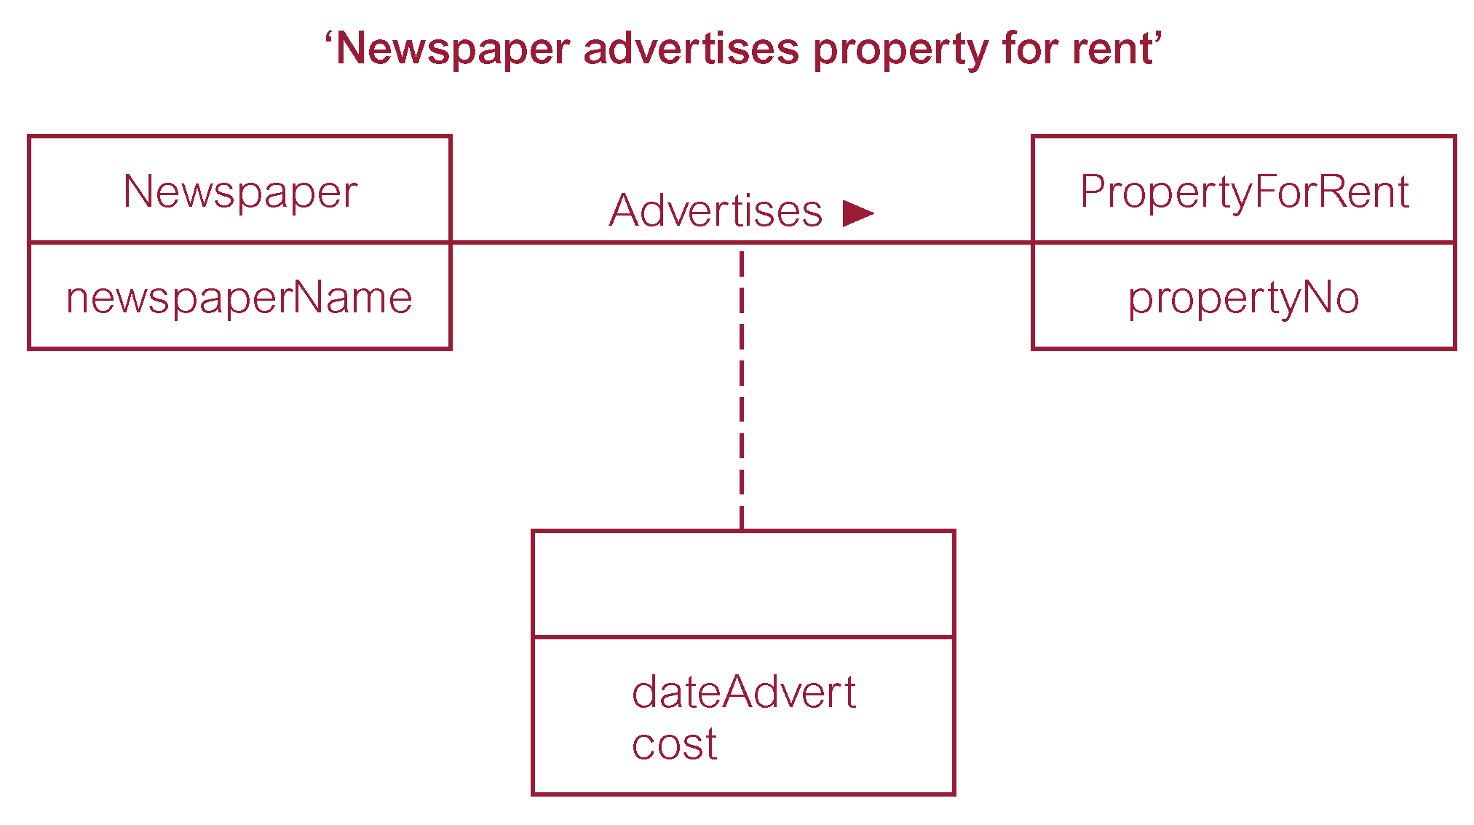
Relationship called Advertises with Attributes

Slide 28
Structural Constraints
Main type of constraint on relationships is called multiplicity.
Multiplicity - number (or range) of possible occurrences of an entity type that may relate to a single occurrence of an associated entity type through a particular relationship.
Represents policies (called business rules) established by user or company.

Slide 29
Structural Constraints
The most common degree for relationships is binary.
Binary relationships are generally referred to as being:
  one-to-one (1:1)
  one-to-many (1:*)
  many-to-many (*:*)

Slide 30
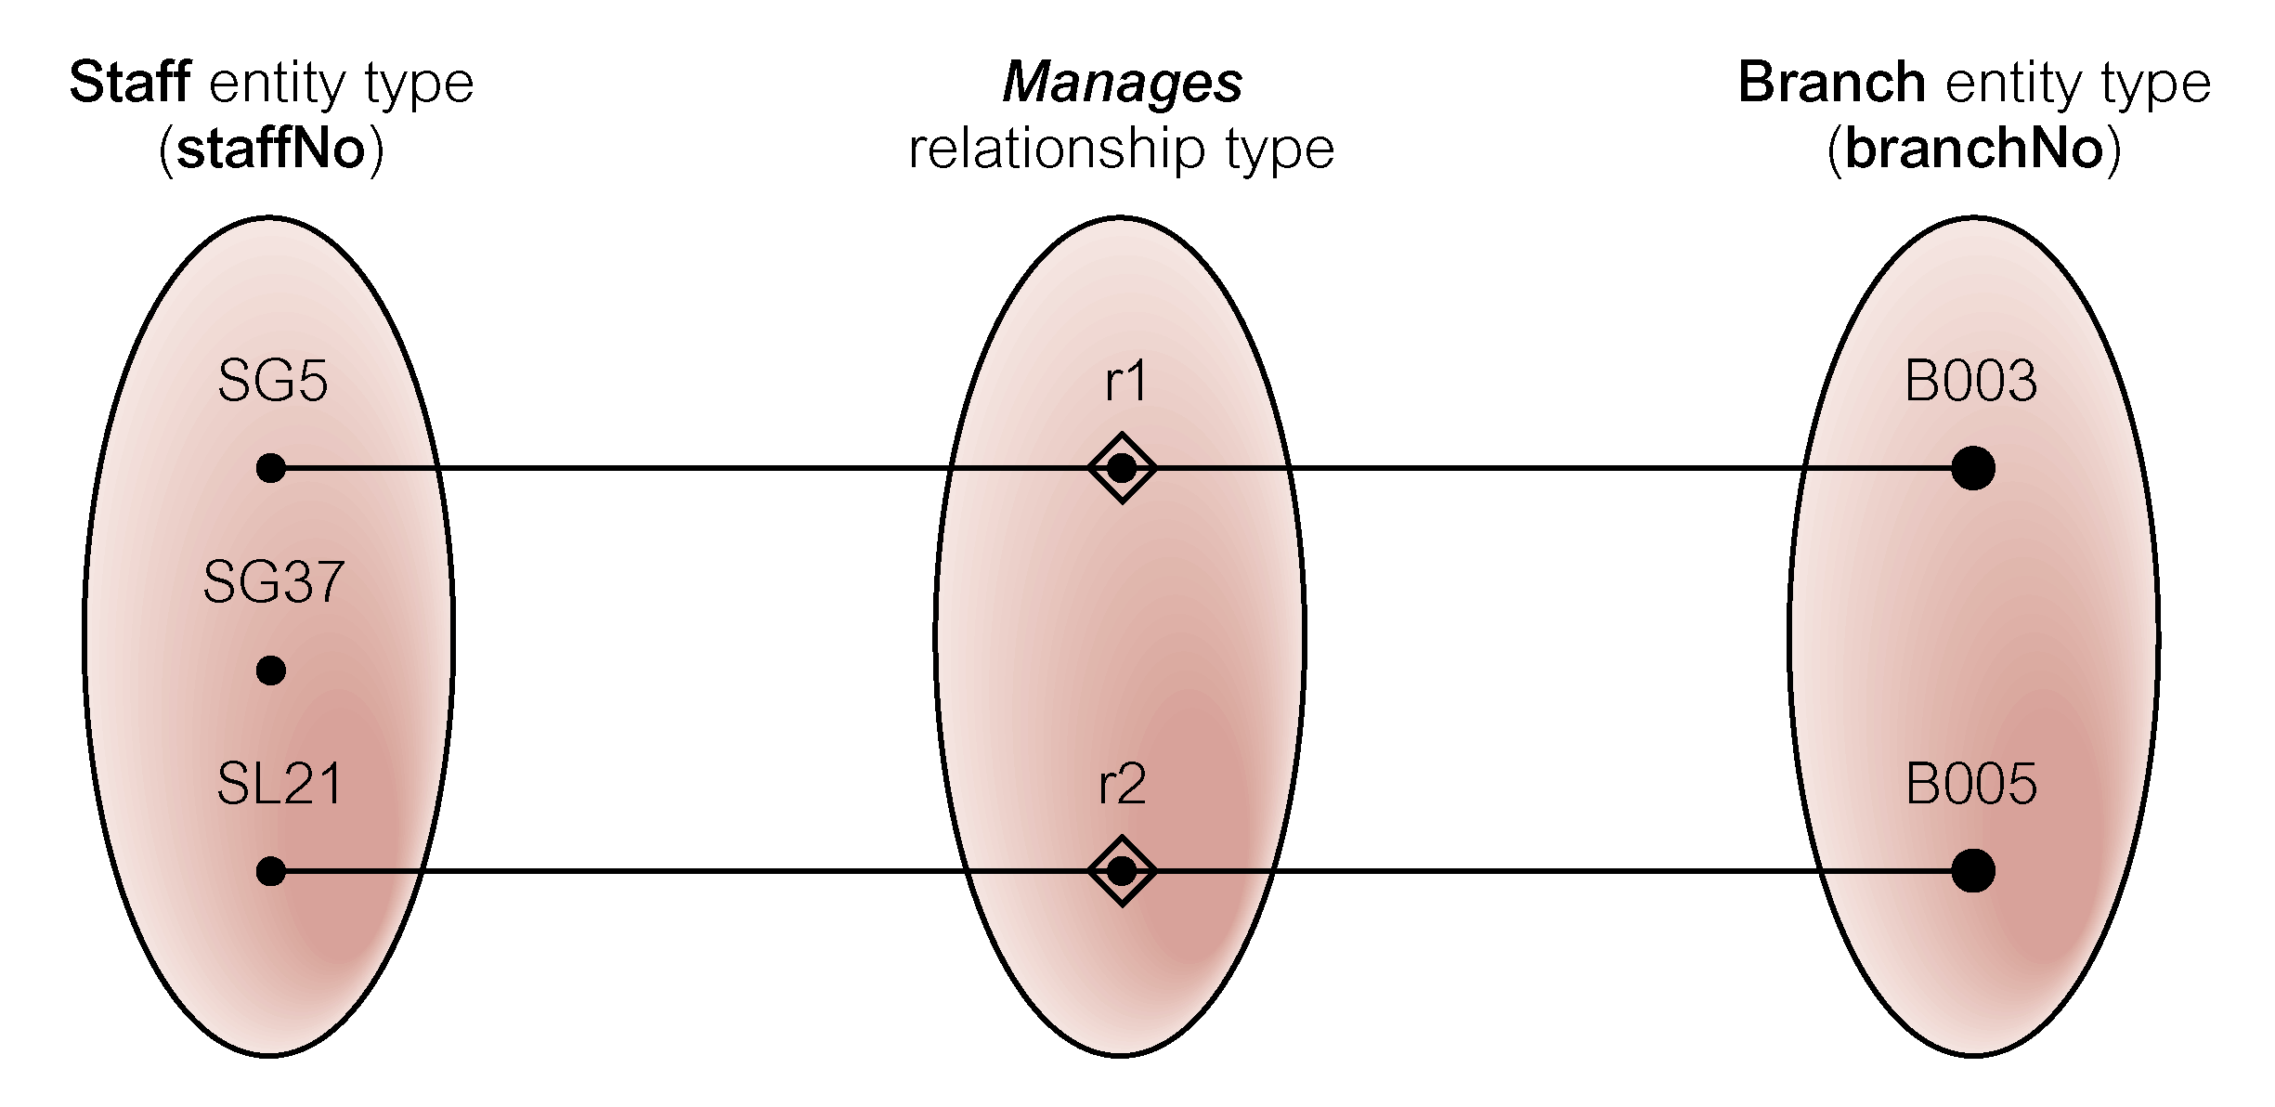
Semantic Net of Staff Manages Branch Relationship Type

Slide 31
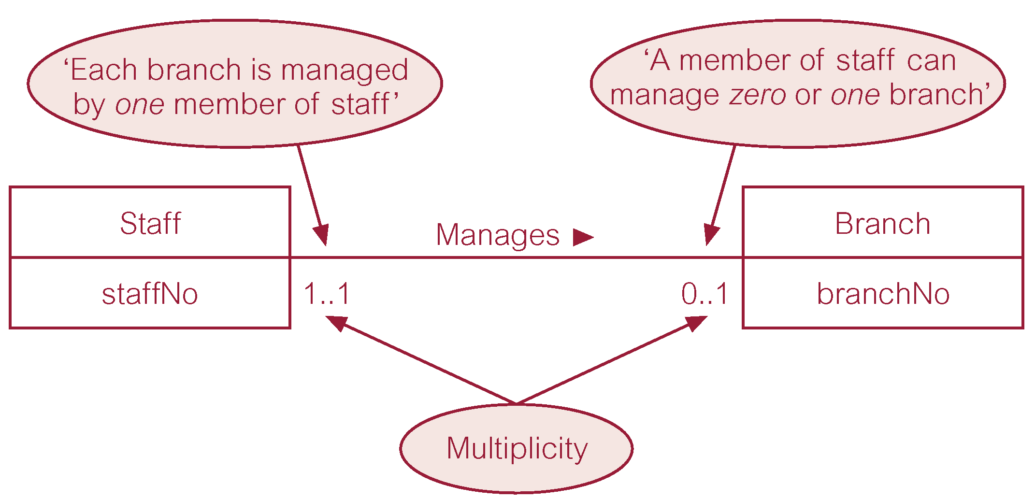
Multiplicity of Staff Manages Branch (1:1) Relationship Type

Slide 32
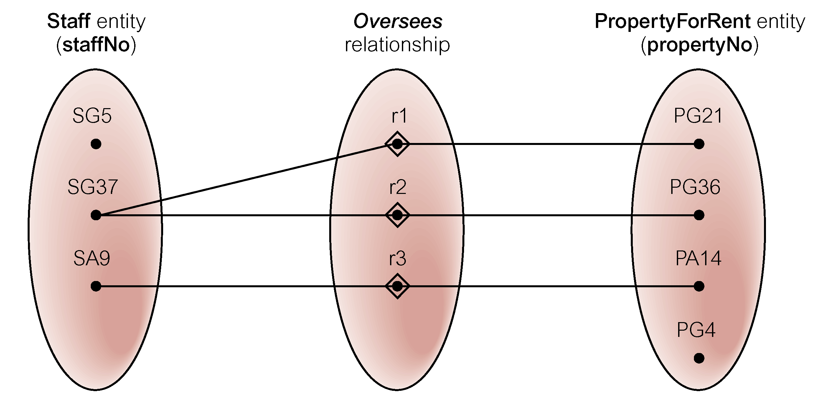
Semantic Net of Staff Oversees PropertyForRent Relationship Type

Slide 33
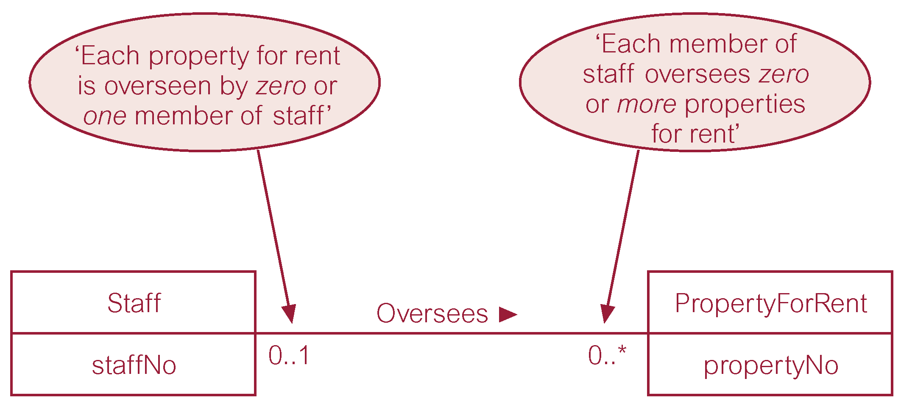
Multiplicity of Staff Oversees PropertyForRent (1:*) Relationship Type

Slide 34
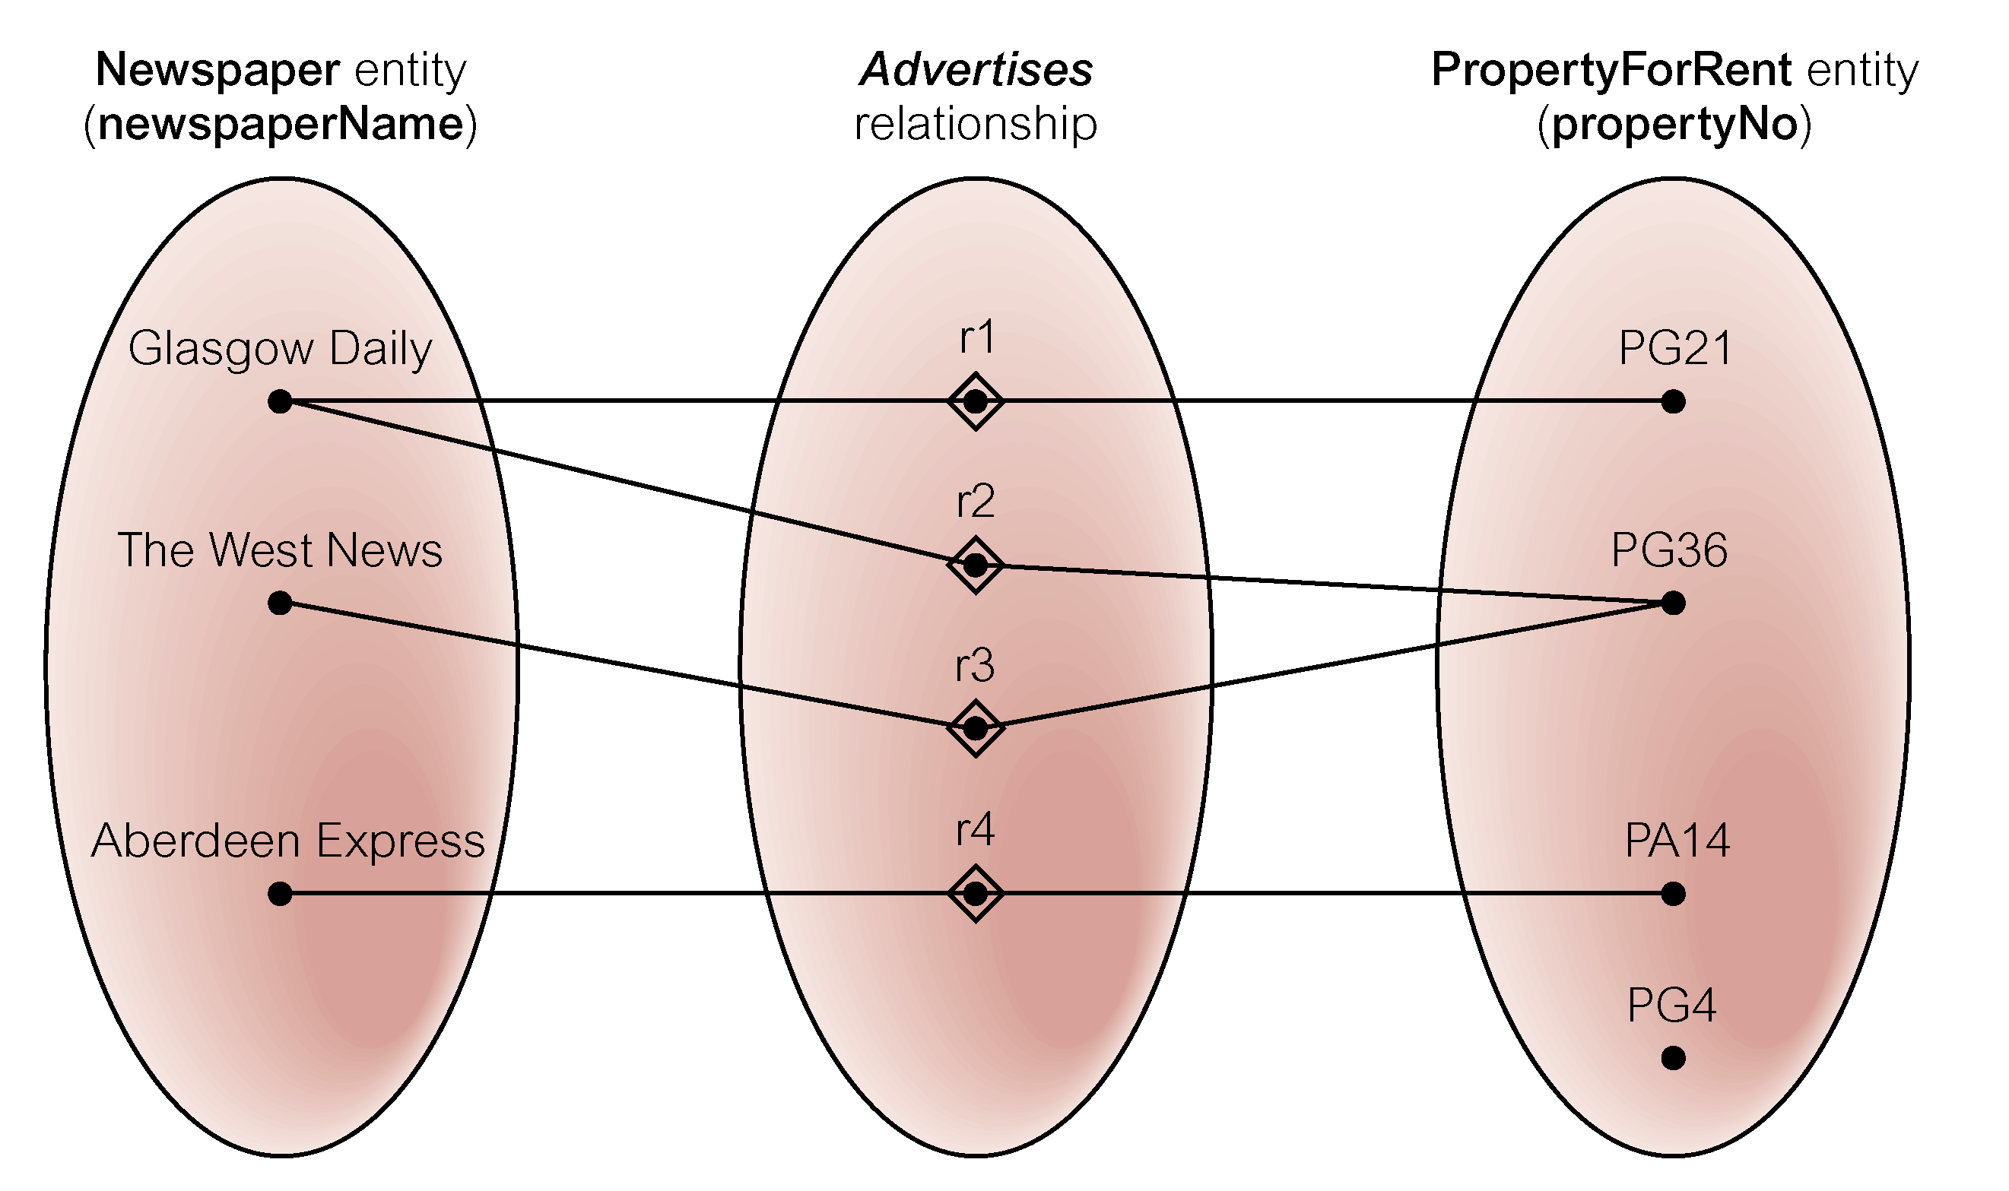
Semantic Net of Newspaper Advertises PropertyForRent Relationship Type

Slide 35
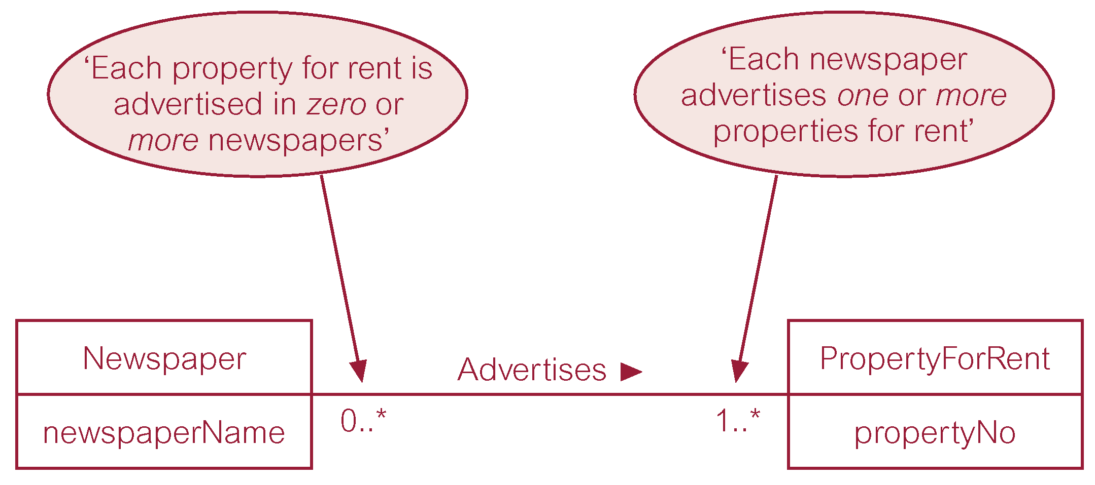
Multiplicity of Newspaper Advertises PropertyForRent (*:*) Relationship

Slide 36
Structural Constraints
Multiplicity for Complex Relationships
  Number (or range) of possible occurrences of an entity type in an n-ary relationship when other (n-1) values are fixed.

Slide 37
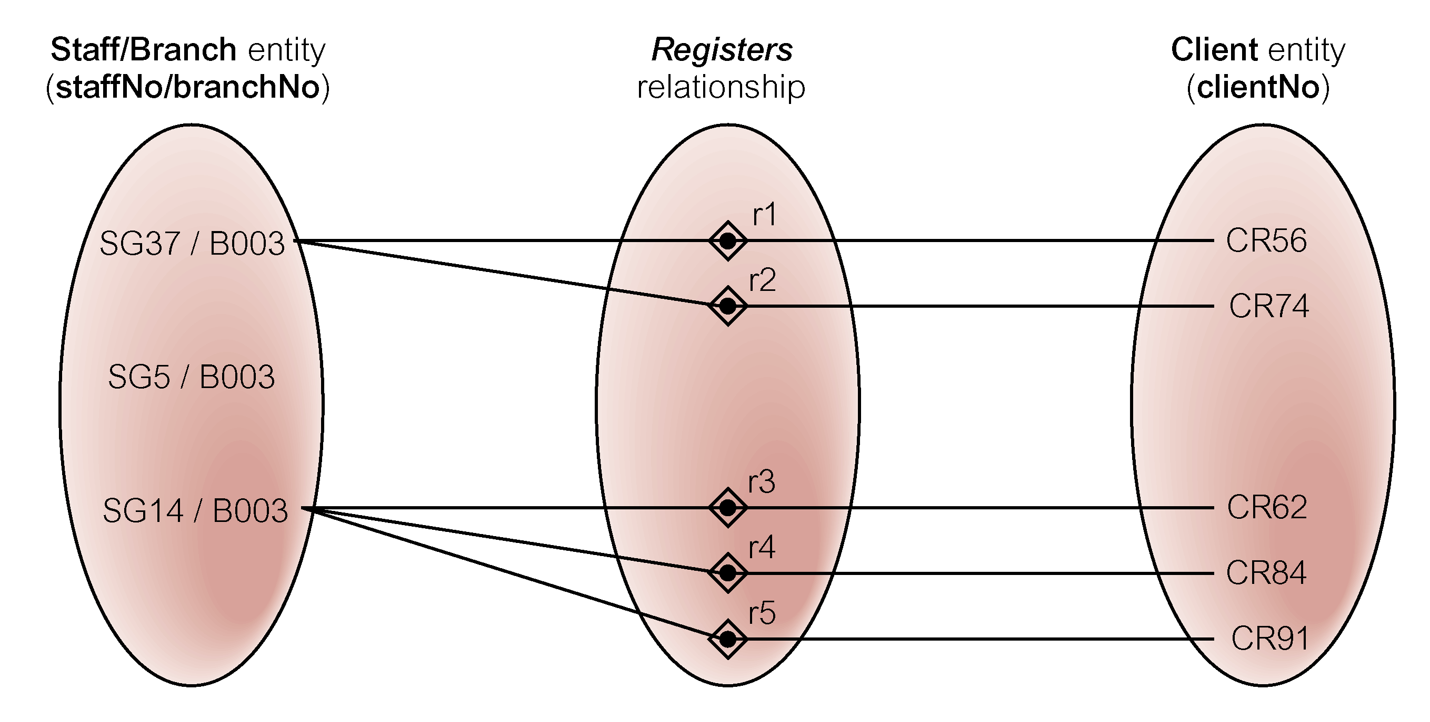
Semantic Net of Ternary Registers Relationship with Values for Staff and Branch Entities Fixed

Slide 38
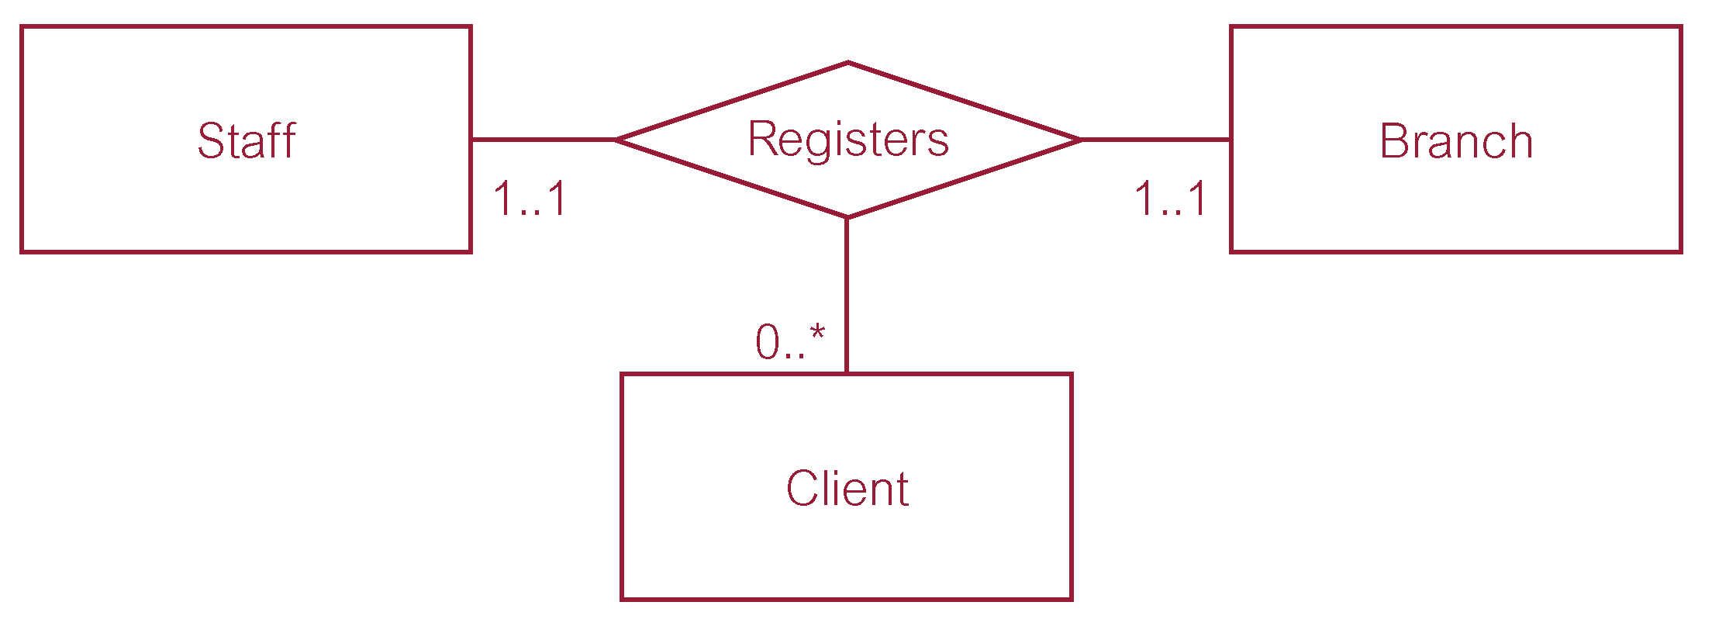
Multiplicity of Ternary Registers Relationship

Slide 39
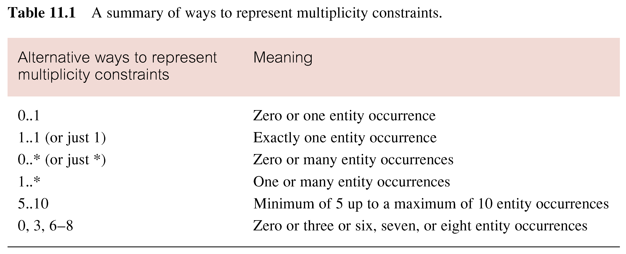
Summary of Multiplicity Constraints

Slide 40
Structural Constraints
Multiplicity is made up of two types of restrictions on relationships: cardinality and participation.
Cardinality
  Describes maximum number of possible relationship occurrences for an entity participating in a given relationship type.
Participation
  Determines whether all or only some entity occurrences participate in a relationship.

Slide 41
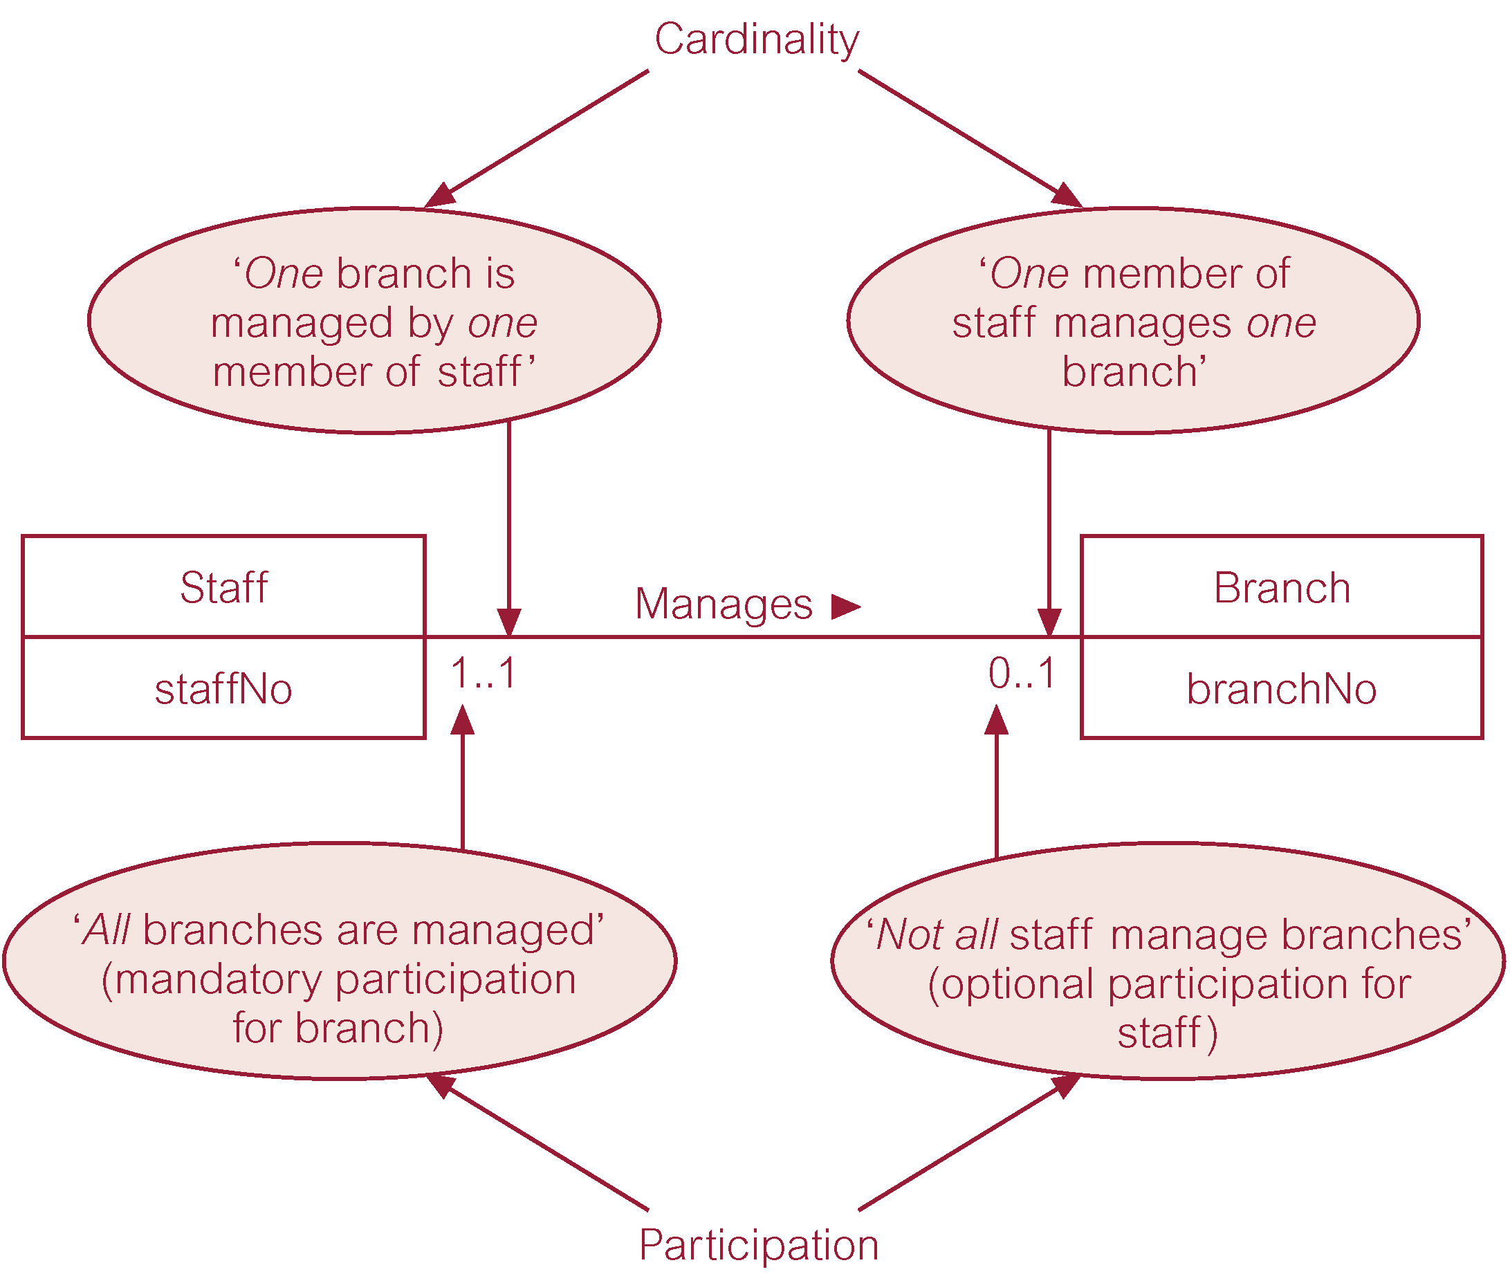
Multiplicity as Cardinality and Participation Constraints
1:1

