Slide 1
Cross-Security
(Android Malware Detection App)
By Haris Aqeel, Muhammad Saad, Muhammad Areeb Nadeem

Slide 2
Overview
Machine Learning Model
Previous Approaches
Current Approach
Application Development
Application UI
Integrating the DL Model
Additional Features
Final Thoughts

Slide 3
Machine Learning Model

Slide 4
Machine Learning Model
Previous Approaches
Traditional Machine Learning Approach
Classifier | Accuracy | Precision | Recall | F1-Score
Logistic Regression | 96% | 96% | 99% | 98%
Random Forest | 81% | 78% | 80% | 79%

Slide 5
Machine Learning Model
Previous Approaches
Deep Learning Model
Normal Approach
Early Stopping
Dropout Layers

Slide 6
Machine Learning Model
Current Approach
Deep Learning Model
Dataset
Data Cleaning & Feature Selection
Training the Model
Results
Accuracy: 94.95%
Precision: 94.02%
Recall: 95.66%
F1-Score: 94.83%

Slide 7
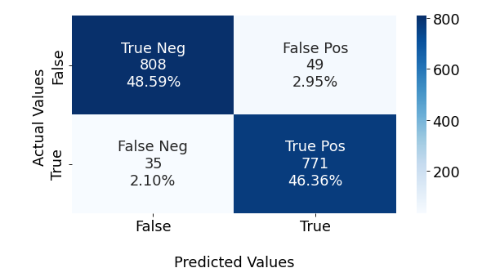
Machine Learning Model
Current Approach
Confusion Matrix

Slide 8
Application Development

Slide 9
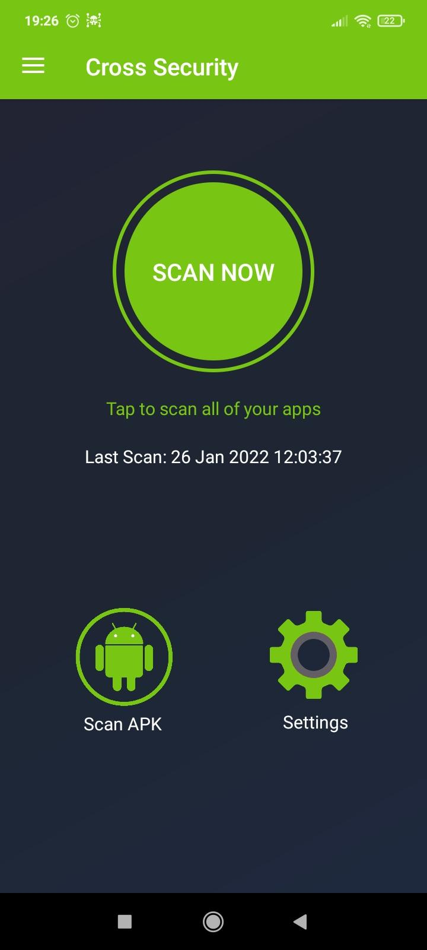
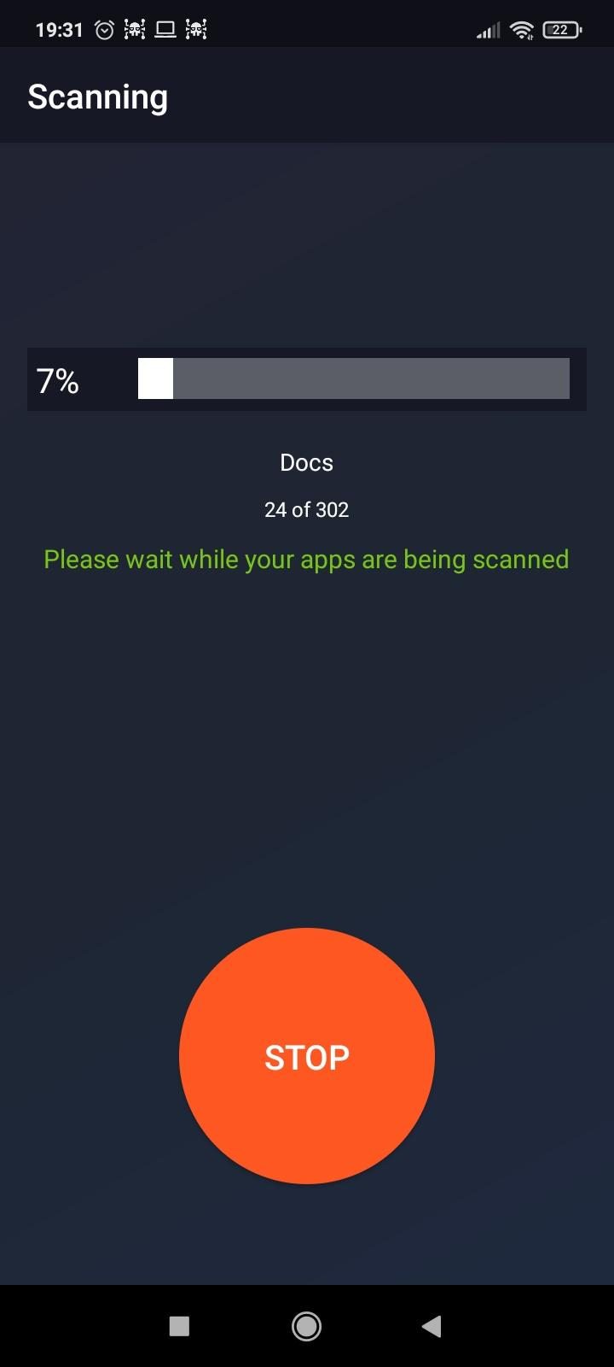
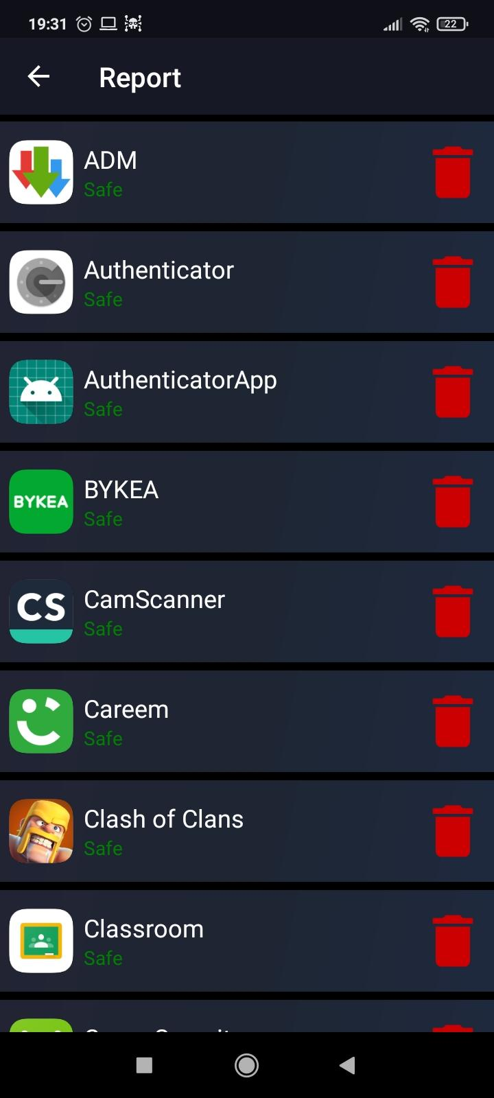


Slide 10
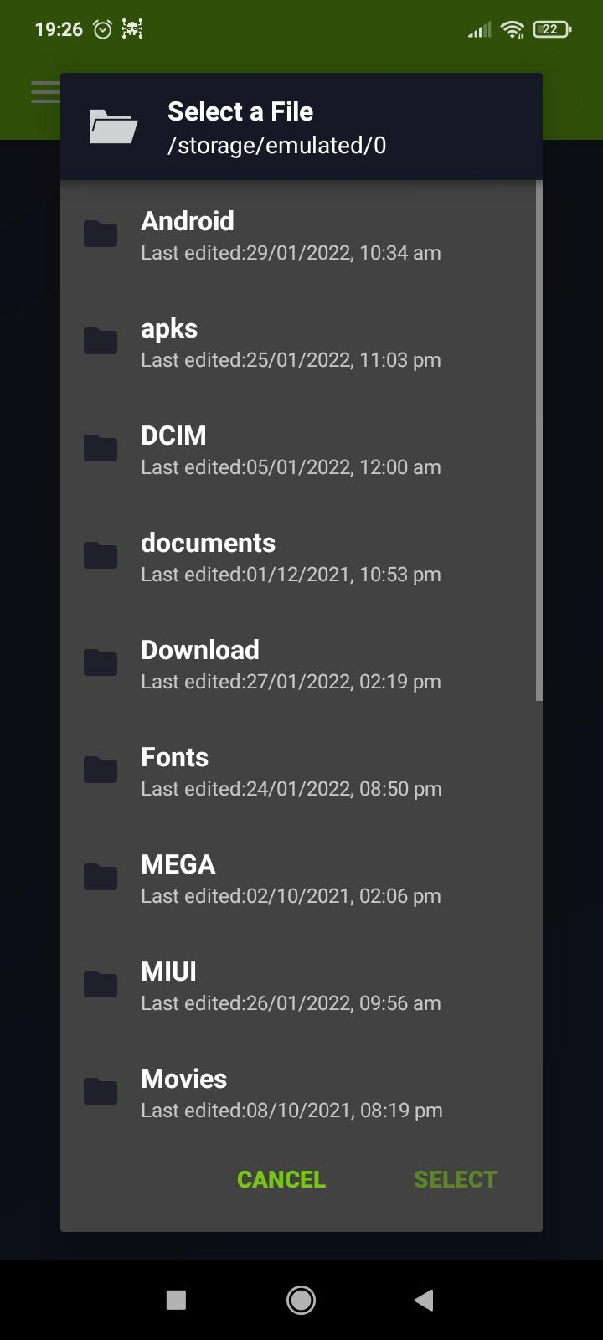
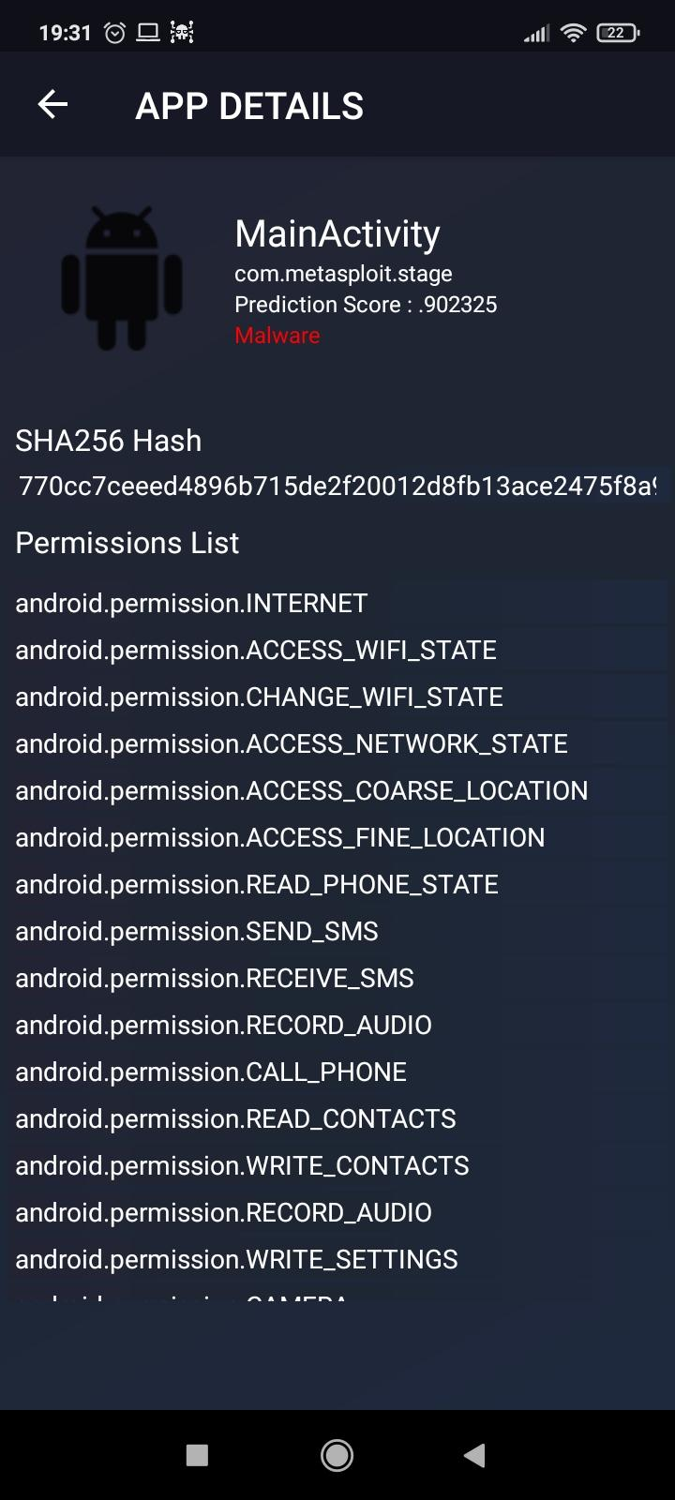



Slide 11
Application Development
Application UI
Integrating the Deep Learning Model
Additional Features
Real-Time Scan
Single APK & Custom Scan
SHA-256 Calculator

Slide 12
Final Thoughts!

Slide 13
Thank You

