Slide 1
IPV4,IPV6 PACKET FORMATTING AND ADDRESSING
Presented by:
Hiba Ejaz (CT-022)
Ariba Sadaf (CT-010)
Werda Farooq (CT-016)

Slide 2
TABLE OF CONTENTS
01
02
03
IPV6, IPV4 ADDRESSING
IPV6, IPV4 PACKET FORMATTING
TRANSITION FROM IPv4 TO IPv6

Slide 3
An Internet Protocol address is a unique number given to each device that is connected to internet for communication. The network layer protocol in internet is currently IPv4 . IPv4 provides host to host communication between system in the internet
INTRODUCTION

Slide 4
DEFICIENCY IN IPv4
Due to some deficiencies in IPv4, like
can’t accommodate encryption.
can’t accommodate authentication of data.
can’t accommodate security mechanism.
can’t accommodate audio and video transmission.

Slide 5
EMERGING OF IPv6
To overcome the deficiencies of IPv4, Internet Protocol , version 6 (IPv6), also known as Internetworking protocol was proposed and is now standard.

Slide 6
ADVANTAGES OF IPv6 OVER IPv4
LARGER ADDRESS SPACE
BETTER HEADER FORMAT
SUPPORT FOR SECURITY
NEW OPTIONS

Slide 7
IPv6 ADDRESSES
HEXADECIMAL COLON NOTATION: To make addresses more readable, IPv6 specifies hexadecimal colon notation.
ABBREVIATION: Although the IP address, even in hex format is so long and contain many zero’s, so in this case we abbreviate the address.
CIDR NOTATION: IPv6 allows CIDR notation.

Slide 8

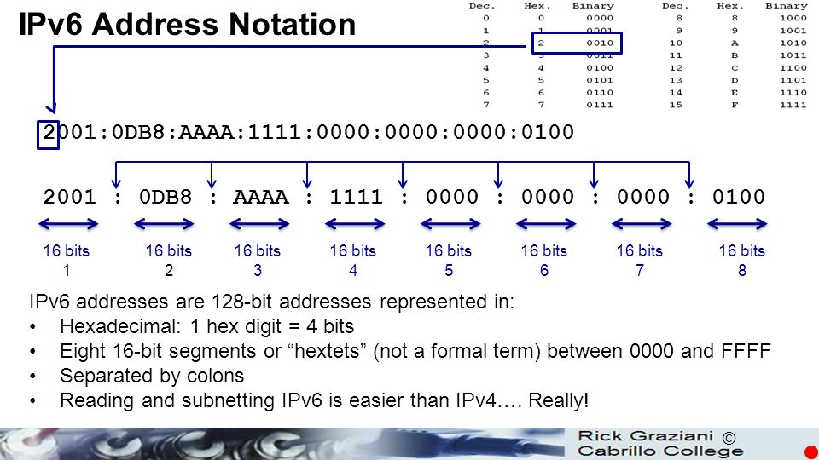
HEXADECIMAL COLON NOTATION

Slide 9
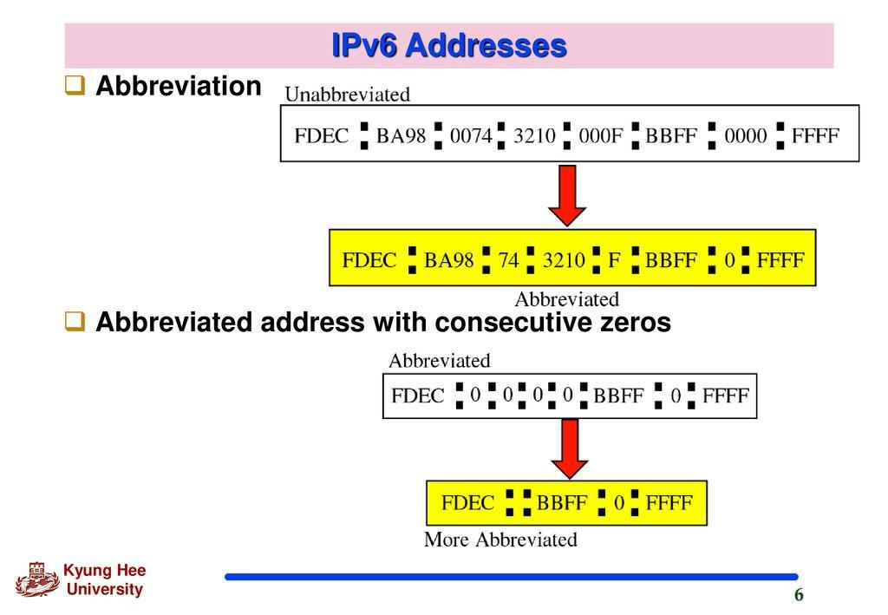
ABBREVIATION

Slide 10
CATEGORIES OF ADDRESSES
UNICAST ADDRESS: It defines a single computer
ANYCAST ADDRESS: It defines a group of computers with addresses that have the same prefix.
MULTICAST ADDRESS: It defines a group of computers that may or may not share the same prefix or may or may not connected to the same network.

Slide 11
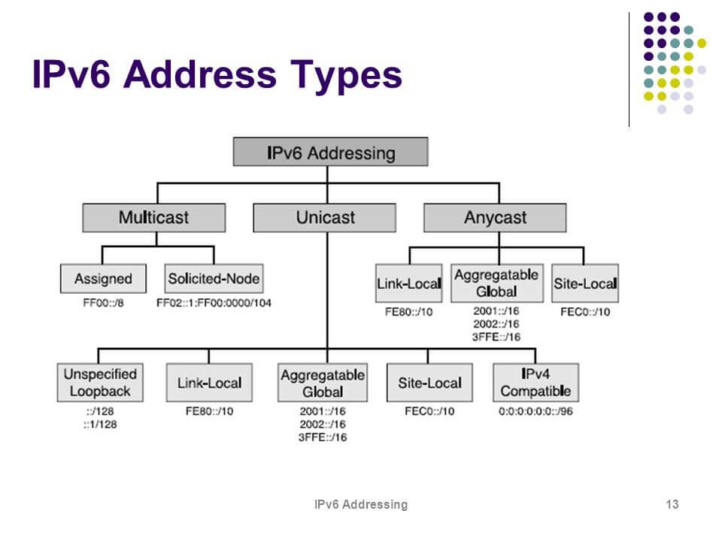

Slide 12
Packet format ( ipv4 & ipv6)
Presented by:
Ariba Sadaf
CT-010

Slide 13
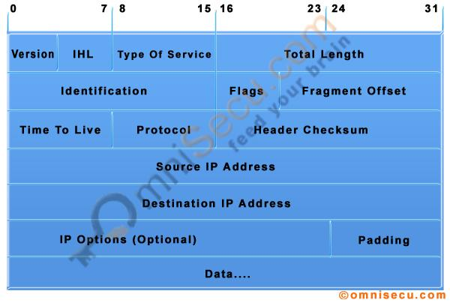
IPV4 DATAGRAM FORMAT

Slide 14
IPv4 header includes:
Version: Version no. of Internet Protocol used (e.g. IPv4).
IHL: Internet Header Length; Length of entire IP header.
DSCP: Differentiated Services Code Point; this is Type of Service.
ECN: Explicit Congestion Notification; It carries information about the congestion seen in route.
Total Length: Length of entire IP Packet (including IP header and IP Payload).
Identification: If IP packet is fragmented during the transmission, all the fragments contain same
identification number. to identify original IP packet they belong to.
Flags: As required by the network resources, if IP Packet is too large to handle, these ‘flags’ tells
if they can be fragmented or not. In this 3-bit flag, the MSB is always set to ‘0’.
Fragment Offset: This offset tells the exact position of the fragment in the original IP Packet.

Slide 15
Time to Live: To avoid looping in the network, every packet is sent with some TTL value set, which tells the network how many routers (hops) this packet can cross.
Protocol: Tells the Network layer at the destination host, to which Protocol this packet belongs to, i.e. the next level Protocol. For example protocol number of ICMP is 1, TCP is 6 and UDP is 17.
Header Checksum: This field is used to keep checksum value of entire header which is then used to check if the packet is received error-free
Source Address: 32-bit address of the Sender (or source) of the packet.
Destination Address: 32-bit address of the Receiver (or destination) of the packet.
Options: This is optional field, which is used if the value of IHL is greater than 5. These options may contain values for options such as Security, Record Route, Time Stamp, etc.

Slide 16
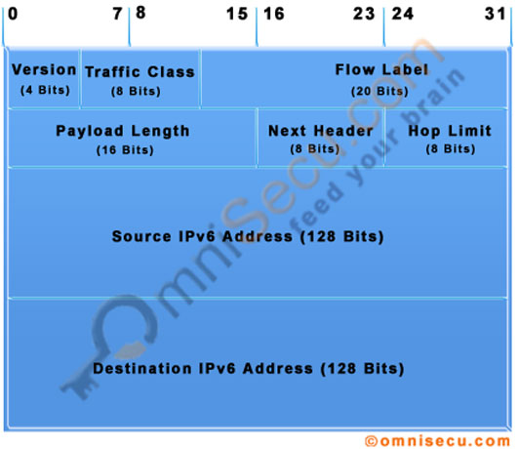
Ipv6 datagram format

Slide 17
Ipv6 Headers includes:
Version (4-bits): It represents the version of Internet Protocol, i.e. 0110.
Traffic Class (8-bits): These 8 bits are divided into two parts. The most significant 6 bits are used for Type of Service to let the Router Known what services should be provided to this packet. The least significant 2 bits are used for Explicit Congestion Notification (ECN).
Flow Label (20-bits): This label is used to maintain the sequential flow of the packets belonging to a communication. The source labels the sequence to help the router identify that a particular packet belongs to a specific flow of information. This field helps avoid re-ordering of data packets. It is designed for streaming/real-time media.

Slide 18
Payload Length (16-bits): This field is used to tell the routers how much information a packet contains in its payload. Payload is composed of Extension Headers and Upper Layer data. With 16 bits, up to 65535 bytes can be indicated; but if the Extension Headers contain Hop-by-Hop Extension Header, then the payload may exceed 65535 bytes and this field is set to 0.
Next Header (8-bits): This field is used to indicate either the type of Extension Header, or if the Extension Header is not present then it indicates the Upper Layer PDU. The values for the type of Upper Layer PDU are same as IPv4’s.
Hop Limit (8-bits): This field is used to stop packet to loop in the network infinitely. This is same as TTL in IPv4. The value of Hop Limit field is decremented by 1 as it passes a link (router/hop). When the field reaches 0 the packet is discarded.
Source Address (128-bits): This field indicates the address of originator of the packet.
Destination Address (128-bits): This field provides the address of intended recipient of the packet.

Slide 19
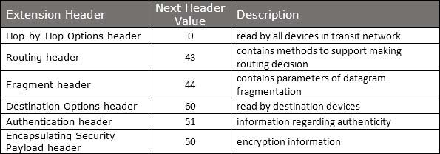

Slide 20
Transition From IPv4 To IPv6
Presented by:
Werda Farooq
CT-016

Slide 21
There are a couple of main methods that can be used when transitioning a network from ipv4 to ipv6; these include:
Dual Stack – Running both IPv4 and IPv6 on the same devices
Tunneling – Transporting IPv6 traffic through an IPv4 network transparently
Translation – Converting IPv6traffic to IPv4 traffic for transport and vice versa.

Slide 22
Dual stack
contact
Source
DNS
response
IPv4
IPv6
IPv4 System
IPv6 System
Destination

Slide 23
tunneling
IPv4
IPv6 packet is encapsulated in an IPv4 packet
IPv6
IPv4 Region
IPv6
Client
IPv6
Server
IPv6
IPv6
Tunnel

Slide 24
HEADER TRANSLATION
Header Translation
Input
Output
IPv6 Region
IPv6 Client1
IPv4 Client2
IPv6
IPv6
IPv4
When most of the systems are on IPv6 but some still uses IPv4

Slide 25
Thank you

