Slide 1
Data Communications and Networking
Chapter 5
Signal Encoding Techniques
References:
Book Chapter 5
Data and Computer Communications, 8th edition, by William Stallings

Slide 2
Encoding/modulation Techniques
Digital data, digital signal
  The equipment for encoding digital data into a digital signal is less complex and less expensive.
Analog data, digital signal
  Conversion of analog data (e.g., voice, video) to digital form permits the use of modern digital transmission & switching.
Digital data, analog signal
  Optical system and unguided media (wireless system) only propagate analog signals.
Analog data, analog signal
  Baseband: easy and cheap, e.g., in voice-grade telephone lines, voice signals are transmitted over telephone lines.

Slide 3
(I) Digital Data, Digital Signal
Digital signal is a sequence of discrete, discontinuous voltage pulses.
Each pulse is a signal element.
Binary data are transmitted by encoding the bit stream into signal elements.
In the simplest case, one bit is represented by one signal element.
  E.g., 1 is represented by a lower voltage level, and 0 is represented by a higher voltage level

Slide 4
Terminologies
Unipolar
  If all signal elements have the same algebraic sign (all positive or all negative), then the signal is unipolar.
Polar
  One logic state represented by positive voltage, the other by negative voltage
Data rate
  Rate of data transmission measured in bps: bits per second
Duration or length of a bit
  Time taken for transmitter to emit the bit
Modulation rate
  Rate at which the signal level changes
  Measured in baud: signal elements per second
Mark and Space
  Mark: Binary 1
  Space: Binary 0
How are they related?

Slide 5
Interpreting Signals at the Receiver
The receiver needs to know
  The timing of each signal element, i.e., when a signal element begins and ends
  signal levels
  These tasks are performed by sampling each element position in the middle of the interval and comparing the value to a threshold.
Factors affecting successful interpreting of signals
  Signal-to-noise ratio (SNR)
  Data rate
  Bandwidth
Some principles:
  An increase in data rate increases bit error rate (BER)
  An increase in SNR decreases BER
  An increase in bandwidth allows an increase in data rate
Another factor that can improve performance:
  Encoding scheme: the mapping from data bits to signal elements

Slide 6
Comparison of Encoding Schemes (2)
Error detection
  Various error-detection techniques will be covered in Chapter 9
  Some error detection capability can be built into signal encoding scheme
Signal interference and noise immunity
  Some codes are better than others in the presence of noise
  Performance is usually expressed in terms of BER
Cost and complexity
  Higher signal rate (thus data rate) leads to higher cost
  Some codes require a signal rate greater than the actual data rate

Slide 7
Encoding Schemes
Nonreturn to Zero (NRZ)
  Nonreturn to Zero-Level (NRZ-L)
  Nonreturn to Zero Inverted (NRZI)
Multilevel Binary
  Bipolar-AMI
  Pseudoternary
Biphase
  Manchester
  Differential Manchester
Scrambling techniques
  B8ZS
  HDB3

Slide 8
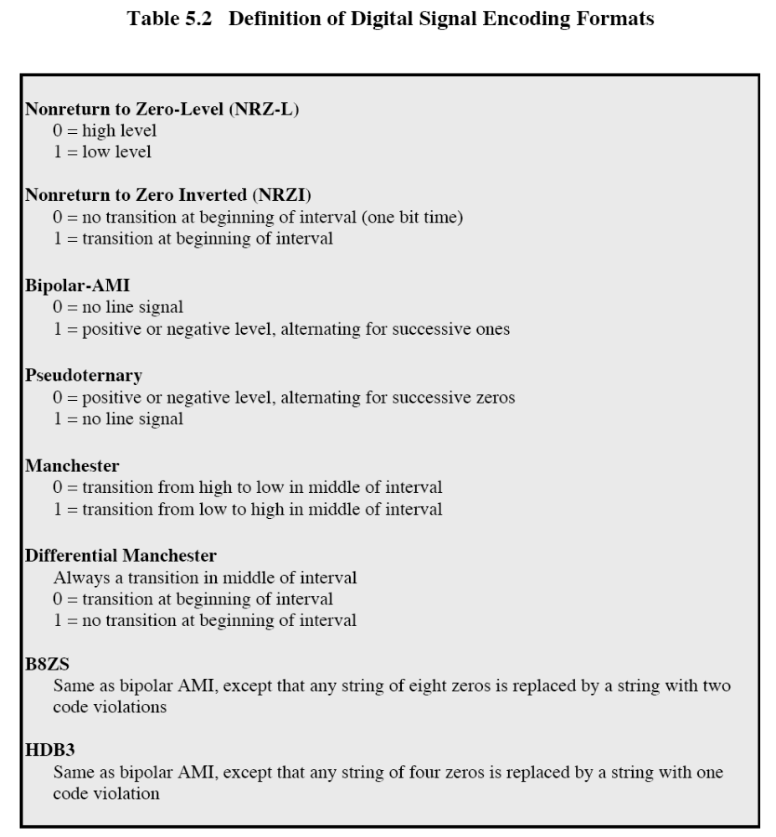

Slide 9
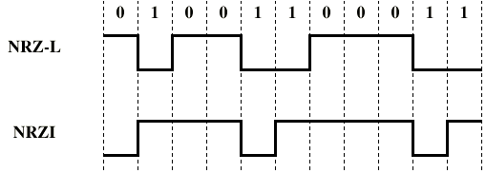
NRZ

Slide 10
Nonreturn to Zero-Level (NRZ-L)
Two different voltages for 0 and 1 bits
Voltage is constant during a bit interval
  no transition, i.e. no return to zero voltage
E.g. absence of voltage for zero, constant positive voltage for one
More often, negative voltage for one value and positive for the other
This is known as NRZ-L

Slide 11
Nonreturn to Zero Inverted
NRZI: Nonreturn to zero, invert on ones
Constant voltage pulse for duration of bit
Data are encoded as presence or absence of signal transition at the beginning of the bit time
A transition (low to high or high to low) denotes a binary 1
No transition denotes binary 0
NRZI is an example of differential encoding technique

Slide 12
Differential Encoding
Data are represented in terms of the changes between successive signal elements, rather than the signal elements themselves.
It is more reliable to detect a transition in the presence of noise than to compare a value to a threshold.
With a complex transmission layouts, it is easy to lose the sense of the polarity of the signal.

Slide 13
NRZ pros and cons
Pros
  Easy to engineer
  Make efficient use of bandwidth
Cons
  The presence of dc component
  The lack of synchronization capability
NRZ codes are commonly used for digital magnetic recording, but not often used for signal transmission.

Slide 14
Multilevel Binary
Use more than two levels
Bipolar-AMI: alternate mark inversion
  zero represented by no line signal
  one represented by a positive or negative pulse
  one pulses must alternate in polarity
  Advantages:
    No loss of synchronization if a long string of 1s occurs (0s still be a problem)
    No net dc component
    Provides a simple means of error detection

Slide 15
Pseudoternary
1 represented by the absence of line signal
0 represented by alternating positive and negative pulses
No advantage or disadvantage over bipolar-AMI

Slide 16
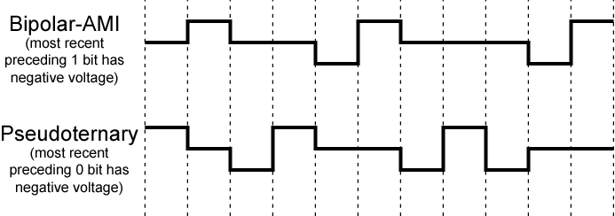
Bipolar-AMI and Pseudoternary
0 1 0 0 1 1 0 0 0 1 1

Slide 17
Trade-off for Multilevel Binary
Not as efficient as NRZ
  In a 3 level system, each signal element could represent log₂3 = 1.58 bits
  However, in biploar-AMI & pseudoternary, each signal element only represents one bit
  Receiver must distinguish between three levels
  (+A, -A, 0)
  Requires approx. 3dB more signal power for same probability of bit error, or
  The BER for NRZ codes, at a given SNR, is significantly less than for mulitlevel binary.

Slide 18
Biphase
Manchester
  There is a transition at the middle of each bit period.
  The midbit transition serves as a clock mechanism and also as data: low to high represents 1, high to low represents 0
  Used by IEEE 802.3 Ethernet LAN
Differential Manchester
  The midbit transition is used only to provide clocking.
  0 is represented by the presence of a transition at the beginning of a bit period.
  1 is represented by the absence of a transition at the beginning of a bit period.
  Note: this is a differential encoding scheme
  Used by IEEE 802.5 token ring LAN

Slide 19
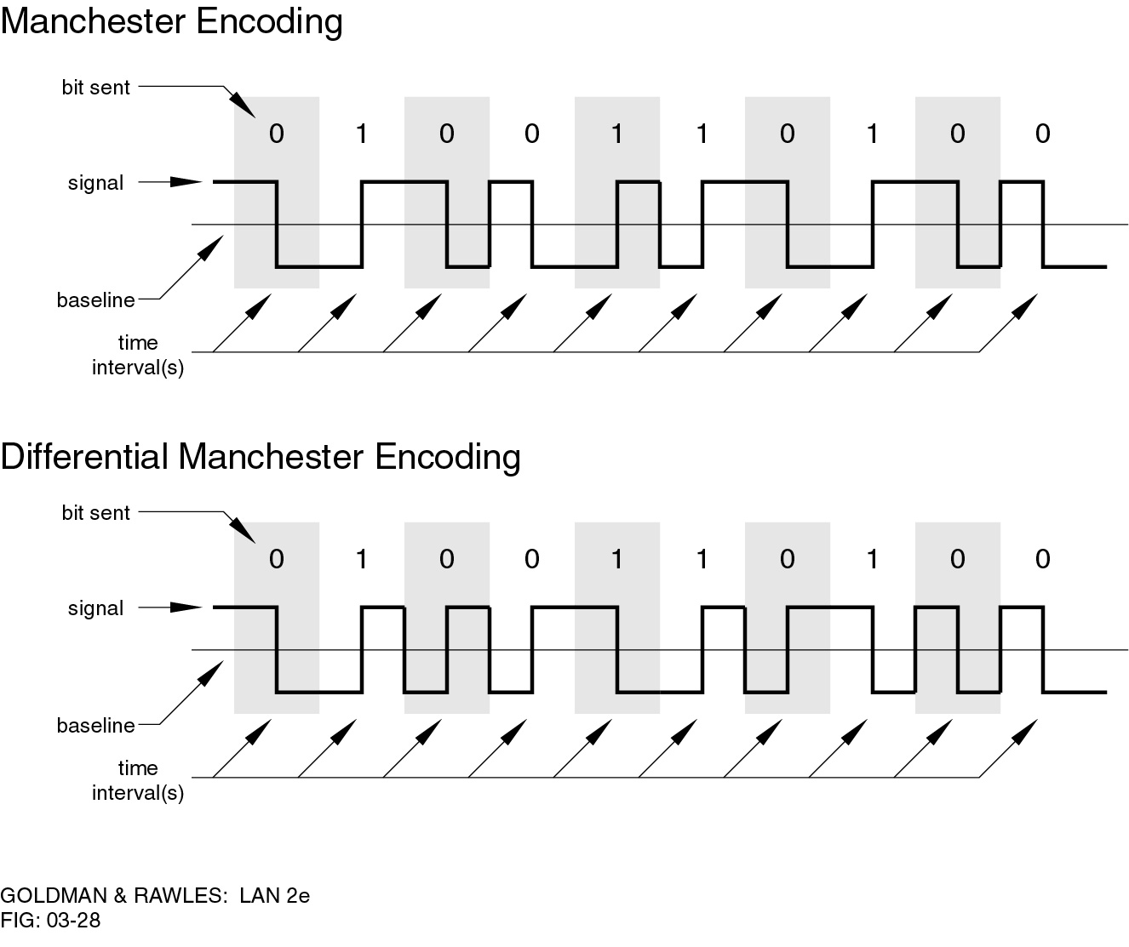
Manchester Encoding

Slide 20
Differential Manchester Encoding

Slide 21
Biphase Pros and Cons
Pros
  Self-clocking: Because there is a predictable transition during each bit time, the receiver can synchronize on that transition.
  No dc component
  Error detection: the absence of an expected transition can be used to detect errors
Con
  Requires at least one transition per bit time and may have as many as two transitions, thus,
  The maximum modulation rate is twice that for NRZ
  Requires more bandwidth

Slide 22
