Slide 1
Computer Communication & Networks
Lecture 10
Datalink Layer: Error Correction

Slide 2

Data Link Layer

Slide 3
Data Link Layer Topics to Cover
Error Detection and Correction
Data Link Control and Protocols
Multiple Access
Local Area Networks
Wireless LANs

Slide 4
Error Correction
By retransmission
  flow and error control protocols
Forward Error Correction (FEC)
  require more redundancy bits
  should locate the invalid bit or bits
  n-bit code word contains m data bits + r redundancy bits
    n=m+r
  m+r+1 bits discoverable by r bits
  2^{r}>=m+r+1

Slide 5
Data and redundancy bits
Number of data bits m | Number of redundancy bits r | Total bits m + r
1 | 2 | 3
2 | 3 | 5
3 | 3 | 6
4 | 3 | 7
5 | 4 | 9
6 | 4 | 10
7 | 4 | 11

Slide 6
Hamming Code
Hamming codes provide for FEC using a “Block Parity”
  i.e, instead of one parity bit send a block of parity bits
Allows correction of single bit errors
This is accomplished by using more than one parity bit
Each computed on different combination of bits in the data

Slide 7

Hamming code (Contd.)

Slide 8
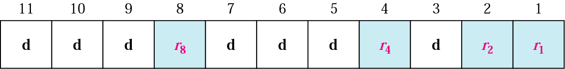
Positions of Redundancy Bits

Slide 9
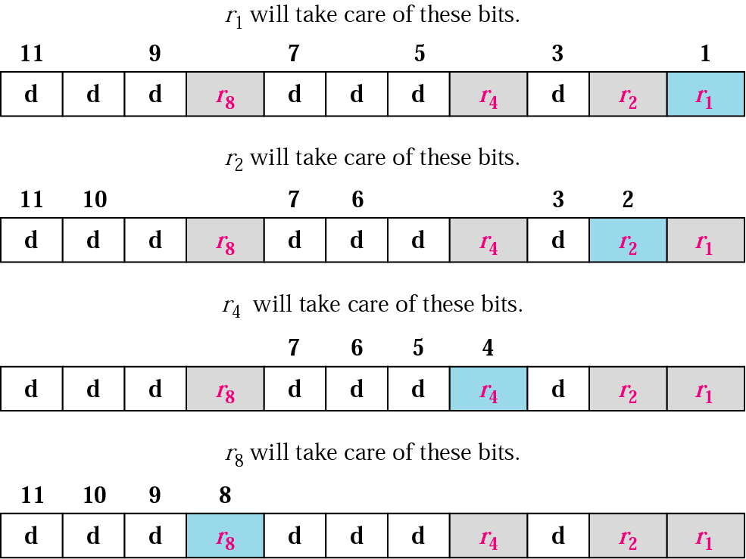
Redundancy Bits Calculation

Slide 10
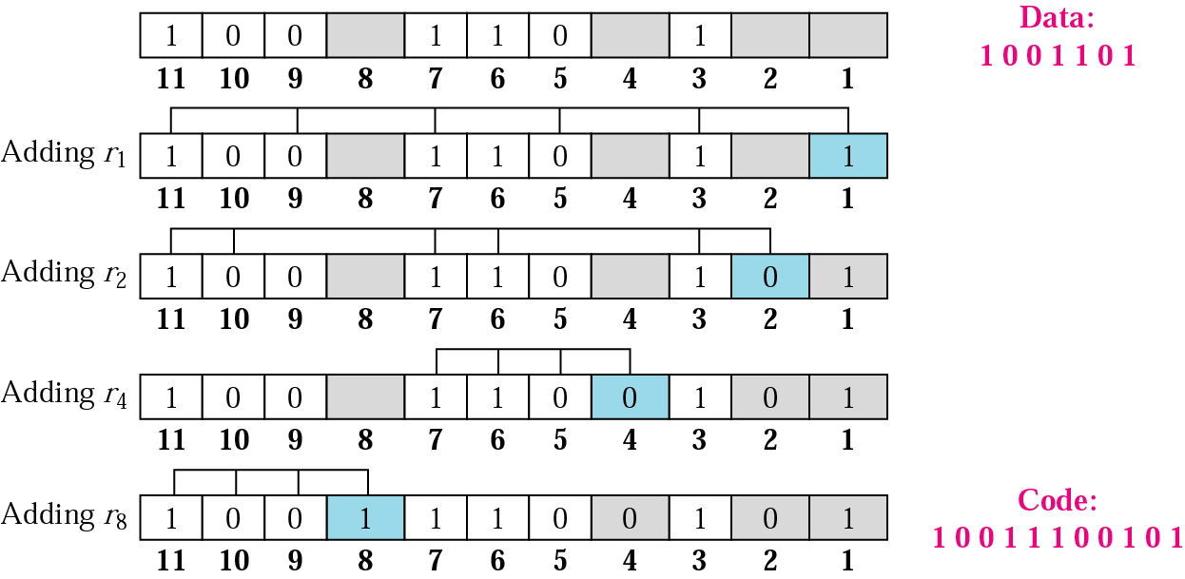
Example

Slide 11
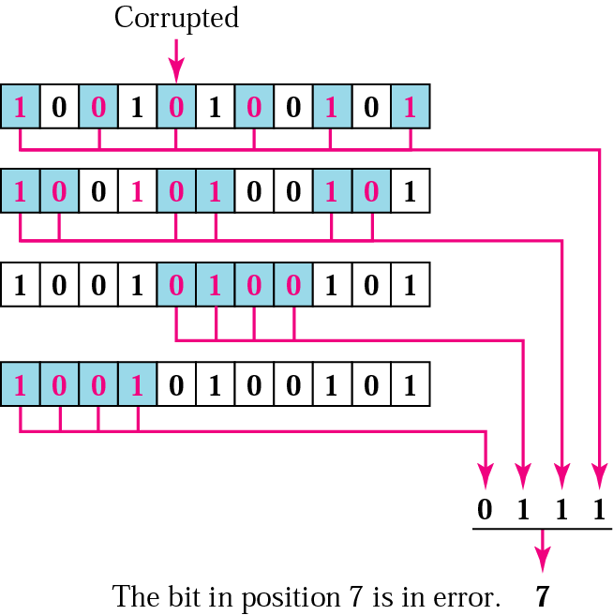
Error Correction using Hamming Code

Slide 12
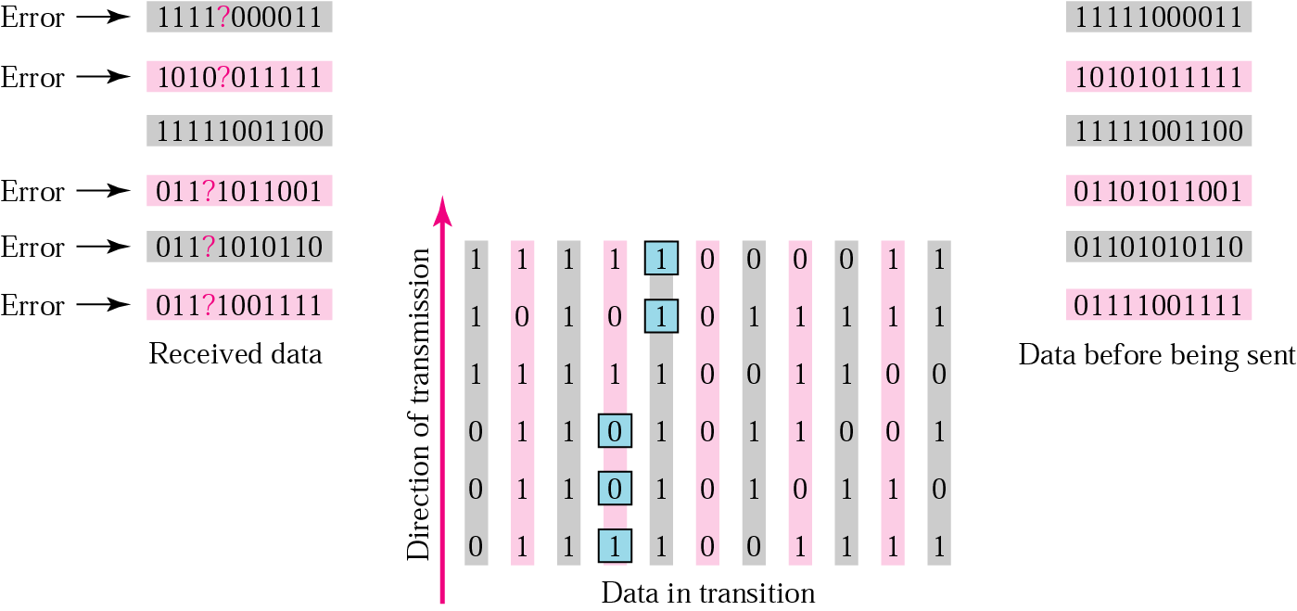
Burst Error Correction

Slide 13


