Slide 1
Aardvark Bug Tracking System
Red Gate Software’s browser- based bug, defect and issue tracking software.
Notes:
This presentation is about the Aardvark Bug Tracking System. It is designed to give a taster of what a bug tracking system does, why you should use one and why you should choose Aardvark.

Slide 2
Our Aims
Why do bug tracking?
Examples of Aardvark bug tracking software.
Who are Red Gate Software?
Notes:
This is an outline of what this presentation is about.

Slide 3
Process Diagram
Support
Testers
Developers
Project
Management
Account
Managers
Customers
Senior
Management
Issue
Input
Searching/
Tracking
Issue
assignment/
retrieval
Reporting
database
Knowledge base
(public)
Public Bugs/ Issues/ Defects
Knowledge base
(private)
Private Bugs/ Issues/ Defects
Notes:
In a software development project everyone needs access to the right information in order to do their jobs properly. Even in relatively small projects it can quickly turn into a full-time role just identifying and then telling people what they need to know.
This information management process can be split into 4 areas:
Gathering and recording the different tasks that need to be worked on.
Prioritising and assigning people to work on those tasks. Allowing people to know this and to have an audit trail of what has occurred.
Responding to that information (e.g. sending an automatic email when a high priority bug has not been fixed by its deadline).
Allowing management to understand the state of the project.
Different people need to see different things – both as a function of their roles within a company (e.g. your senior management don’t need to be able to see the detail of a bug) and as a function of their security rating. You may not want customers, contractors or potential competitors to have access to any or all of your issues.

Slide 4
What Aardvark Does
Support
Testers
Developers
Project
Management
Account
Managers
Customers
Senior
Management
Issue
Input
Searching/
Tracking
Issue
assignment/
retrieval
Reporting
database
Knowledge base
(public)
Public Bugs/ Issues/ Defects
Knowledge base
(private)
Private Bugs/ Issues/ Defects
Notes:
Aardvark automates the process encapsulated within the dotted line.
You need some way of working out what is useful information and what is not, what information needs to be acted on, and what doesn’t – this is something only the project manager can do. However if they spend all of their time chasing the information they will spend no time on making sensible decisions and juggling people’s activities. This is what a good bug tracking system is all about – it automates this part of the process.
Aardvark takes all these processes, and information, and wraps them up in an accessible, web-based, application. Not only can you use Aardvark to encapsulate this mess but, if you think it will add value, you can use the structures imposed by a bug tracking system to impose order on your project.
For these reasons an automated bug, defect or issue tracking system is standard in all leading software development projects.

Slide 5
Results of Red Gate Survey
Responses to the question ‘Did your last project finish on
time?'
Yes
No
I don't know
Nobody knows
Notes:
We ran a survey asking people if the last project they worked on finished on time. Worryingly, the majority didn’t. Even more worryingly, a sizeable minority said that nobody knew. Aardvark can help you run projects on time by providing you with the necessary information to decide how well the project is going. How many show stopper bugs are outstanding? Are the number of open bugs going up over time, or are they coming down?

Slide 6
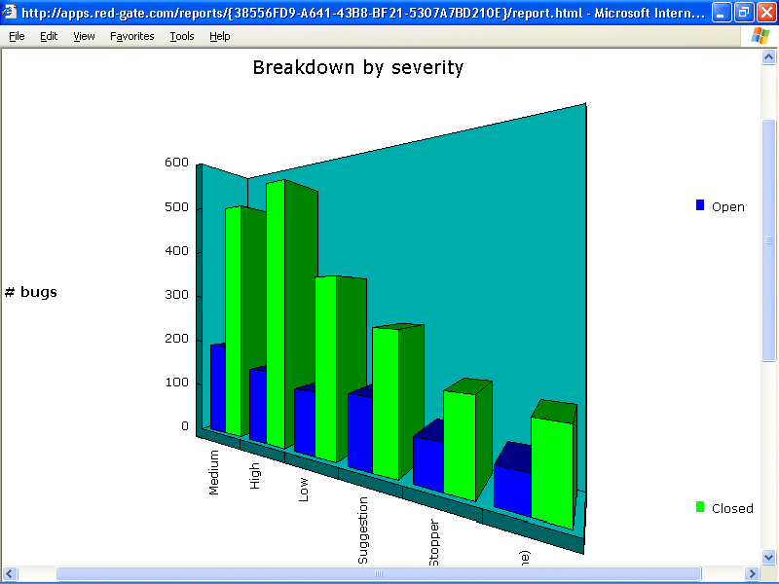
Sample report
Notes:
Reporting is a powerful way for management to get an overview of what is happening.

Slide 7
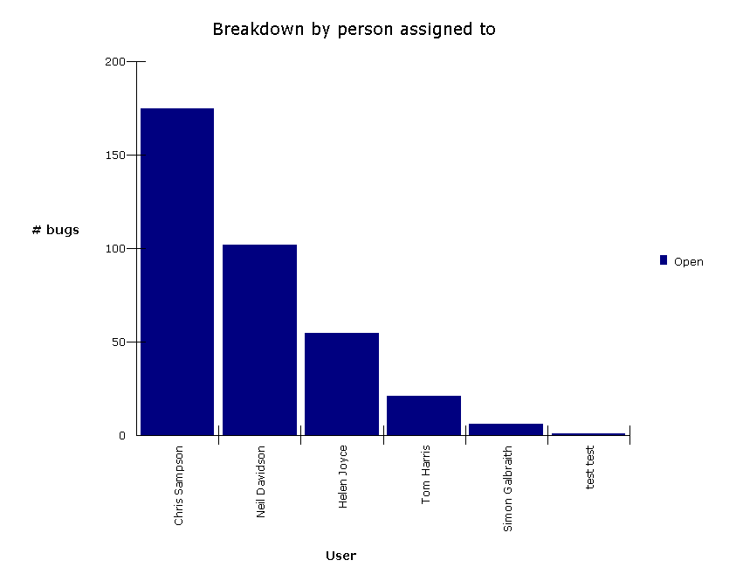
Understand who’s working
Notes:
A graph showing the number of bugs assigned to each user. In this case, Chirs Sampson was found to have 180 bugs outstanding three days before a product release. At this point management action was required.

Slide 8
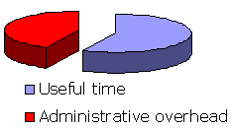
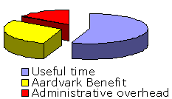
The Administrative Overhead
Before Aardvark
After Aardvark
Notes:
The aim of any software tool is ultimately to save you time and money. Aardvark can do this by reducing the administrative overhead associated with the tracking of issues and bugs, leaving your developers and testers with more time to do what they do best; develop and test.

Slide 9
The Aardvark Video
Show Bug raising
Searching
Reporting
Other features
NB – The latest version of the video is available from Red Gate’s website.
Notes:
This is an overview of the Aardvark Video

Slide 10
Red Gate Software
Founded 1999, low-cost business model.
Over 3,000 customers (2003)
Over 50,000 users (2003)
Specialise in simple tools for developers, testers and DBAs who use Microsoft technologies.
Notes:
About Red Gate Software

Slide 11
Conclusions
Aardvark is a web-based bug tracking system.
Implementing it will pay for itself many times over.
You can try it out for a month for nothing. If it isn’t for you, the records can be easily exported.
Notes:
Summary of Aardvark

