Slide 1

SOFTWARE
PROJECT MANAGEMENT

Slide 2
Course Contents -MS
Software Planning; Use of CASE Tools in planning and monitoring software development activities; The use of CASE Tools & Planning, Scheduling & Control of projects including cost estimation techniques, constraining & leveling, review of commercially available software & use of PC based project management package.
Differentiation between quality control and quality assurance; Defining standards for quality policy; Formal technical review, Designing quality policy.
Designing documents and their implementation at various phases of SDLC.

Slide 3
SE-310 TESE Syllabus (3+0)
Software Crisis and Software Engineering, Classic Mistakes, Overview of Project Management, PMI Process Groups, Software project Phases, Project charter, Statement of Work (SOW), Planning Phase: Development lifecycle models, matching lifecycles to projects, Project plans, Work Breakdown Structures (WBS), Estimation of effort and cost (Expert Judgment, FP and Use Case point methods), Scheduling: Project network diagram fundamentals, CPM, PERT, Gantt charts, Critical chain scheduling, Using MS-Project/PrimaVera Project Planner, Assigning Resources, Resource leveling, Team models, Managing conflict and motivating, Project Monitoring and Control: Status reporting, Project metrics, Communications Techniques, Risk management and Change control Project Recovery, Documentation, Cutover/Migration, Post Project Reviews, Closing.
Recommended Books:
“Software Project Management”, Bob Hughes and Mike Cotterell , McGraw-Hill Higher Education, 4th Edition, 2005.
“The Software Project Manager's Handbook - Principles that work at work”, Dwayne Phillips, Wiley-IEEE Computer Society Press, 2nd Edition, 2004.

Slide 4
Course Learning Outcome (CLO) | Taxonomy Level | Program Learning Outcome (PLO) | Assessment Tool
Will develop management skills and techniques to enable the student to overcome challenges associated with software projects and to successfully lead such projects and programs in today's complex systems environment. | C2 Comprehension | G11 Project Management | Quizzes, Midterm, Final Term
Will develop Skills to manage software Plan, cost, schedule and risk engineering | C3 Application | G2 Problem Analysis | Quizzes, Midterm, Final Term
Will develop skills to work effectively with stack holders for effective SPM | C3 Application | G9 Individual & Team Work | Quizzes, Midterm, Final Term

Slide 5
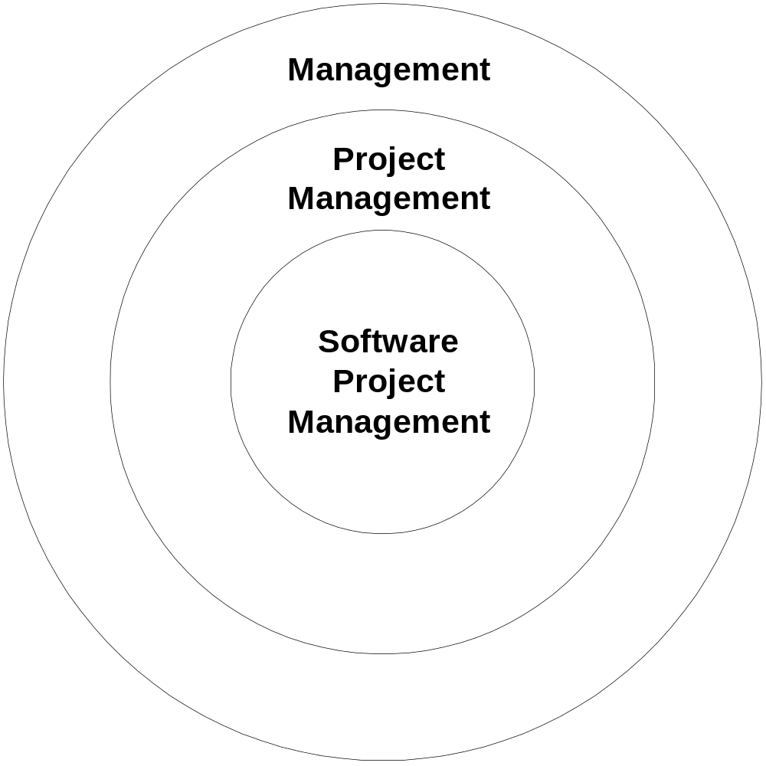
Software Project Management

Slide 6
Project Management History
Birth of modern PM: Manhattan Project (the bomb)
1970’s: military, defense, construction industry were using PM software
1990’s: large shift to PM-based models
  1985: TQM
  1990-93: Re-engineering, self-directed teams
  1996-99: Risk mgmt, project offices
  2000: M&A, global projects
Hist-1
Hist-2

Slide 7
Project Management
What’s a project?
PMI definition
  A project is a temporary endeavor undertaken to create a unique product or service
A project manager
  Analogy: conductor, coach, captain
Hist-1
Notes:
Temporary:
can be years
Result can be lasting
Team can be temporary
Finite duration
Ex: thousands of buildings, but each is unique
Scope s/b constant even as elaboration happens

Slide 8
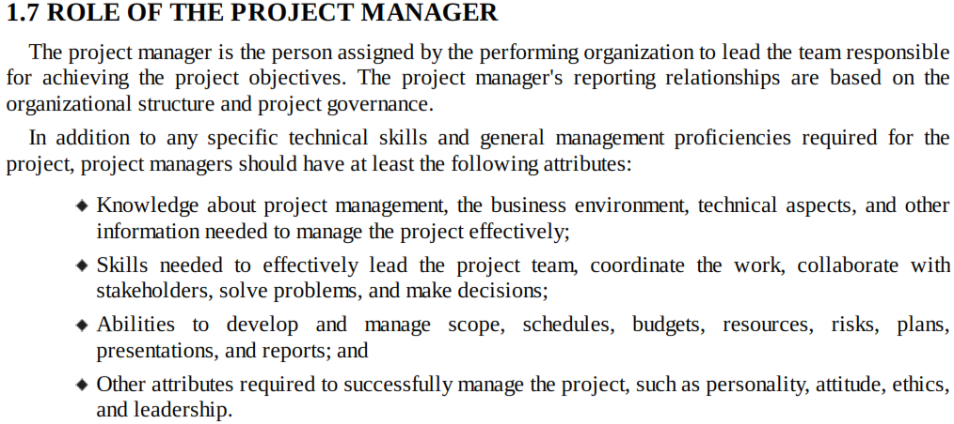

Slide 9
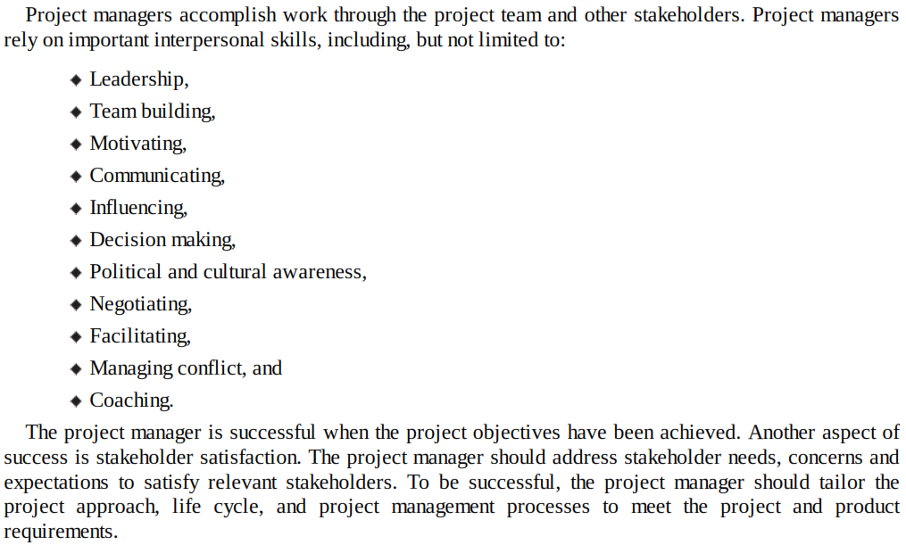

Slide 10
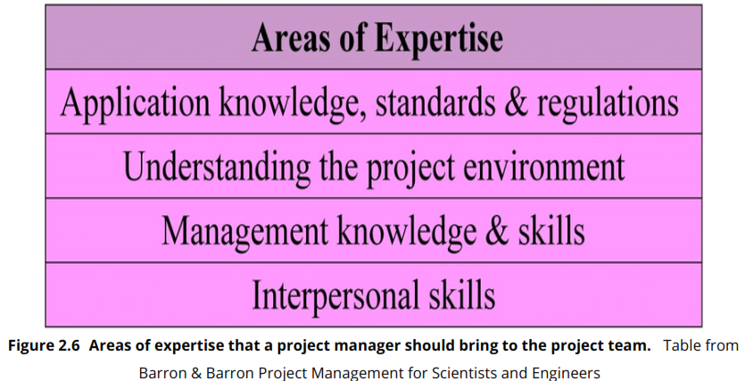

Slide 11
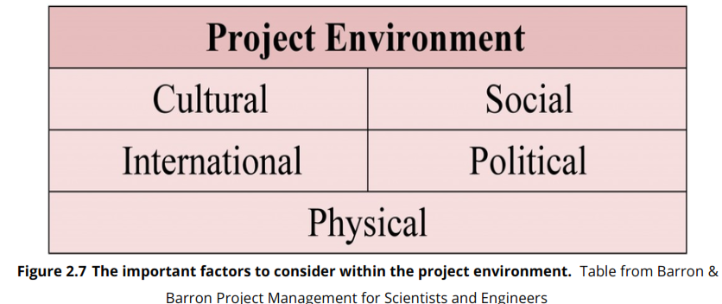

Slide 12
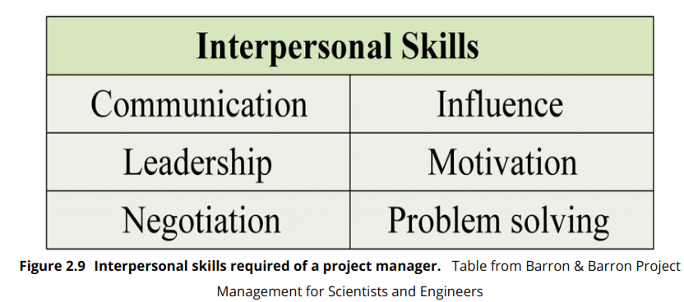

Slide 13
Project vs. Program Management
What’s a ‘program’?
Mostly differences of scale
Often a number of related projects
Longer than projects
Definitions vary
Ex: Program Manager for MS Word

Slide 14
INTRODUCTION
The definition of Software has changed a lot during the last two decades
Old Definition
    Set of Instructions
New Definition (3 Components)
1. Set of Instructions
2. Data Structures
3. Documentation

Slide 15
Interactions / Stakeholders
As a PM, who do you interact with?
Project Stakeholders
  Project sponsor
  Executives
  Team
  Customers
  Contractors
  Functional managers
Notes:
managing all stakeholder Expectations is challenging – conflict

Slide 16
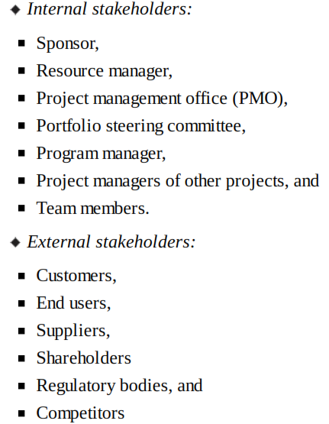

Slide 17
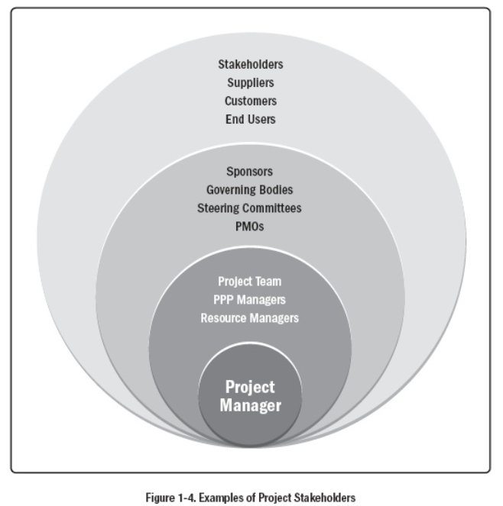

Slide 18
The Field
Professional Organizations
  Project Management Institute (PMI) (pmi.org)
  Software Engineering Institute (SEI)
  IEEE Software Engineering Group
Certifications
The “PMBOK” – PMI Body of Knowledge
Tools
Notes:
dice.com search “project management”
See everything from this class
Bridge Technical and non-technical
Other Certs don’t matter
Hundreds of PM programs like MS-Project
Project: the illusion of control

Slide 19
PM Tools: Software
Low-end
  Basic features, tasks management, charting
  MS Excel, Milestones Simplicity
Mid-market
  Handle larger projects, multiple projects, analysis tools
  MS Project (approx. 50% of market)
High-end
  Very large projects, specialized needs, enterprise
  AMS Realtime
  Primavera Project Manager

Slide 20
PMI’s 10 Knowledge Areas
Project integration management
Scope
Time
Cost
Quality
Human resource
Communications
Risk
Procurement
Stackholder Management
Notes:
If you study for the PMI certification you’ll need to know these

Slide 21
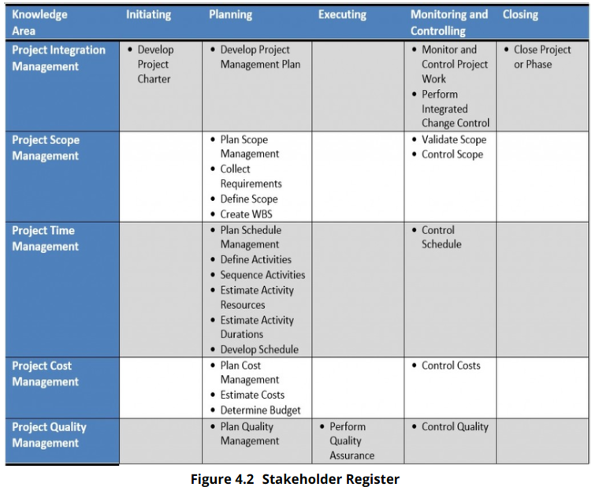

Slide 22
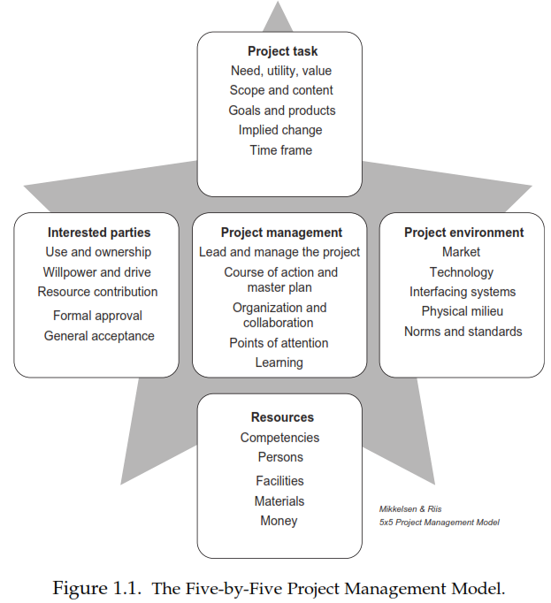

Slide 23
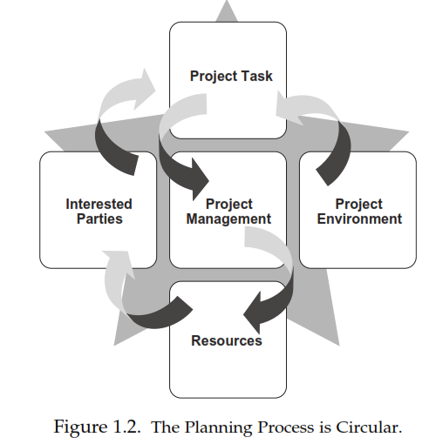

Slide 24
Four Project Dimensions
People
Process
Product
Technology
Notes:
Peopleware issues
10-to-1 difference in Dev productivity
Teams 3 or 5 to 1 diff
Process
Dev basics, risk mgmt, QA, lifecycle planning, customer orientation
Product
Most tangible dimension
Technology

Slide 25
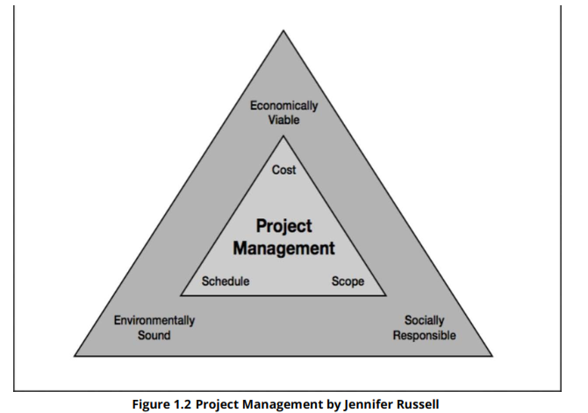

Slide 26
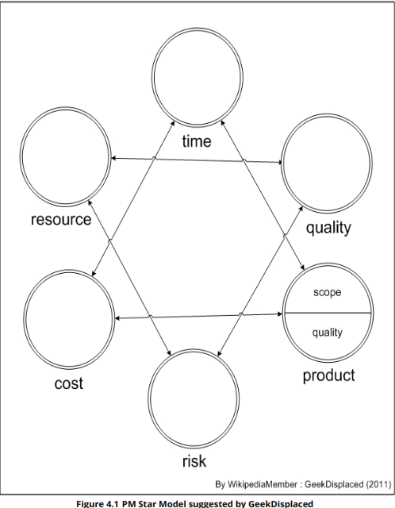

Slide 27
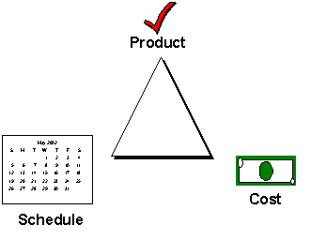
Trade-off Triangle
Fast, cheap, good. Choose two.

Slide 28
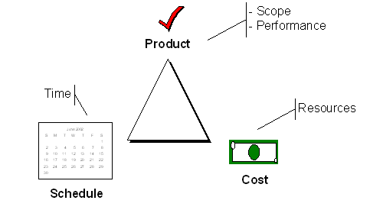
Trade-off Triangle
Know which of these are fixed & variable for every project

Slide 29
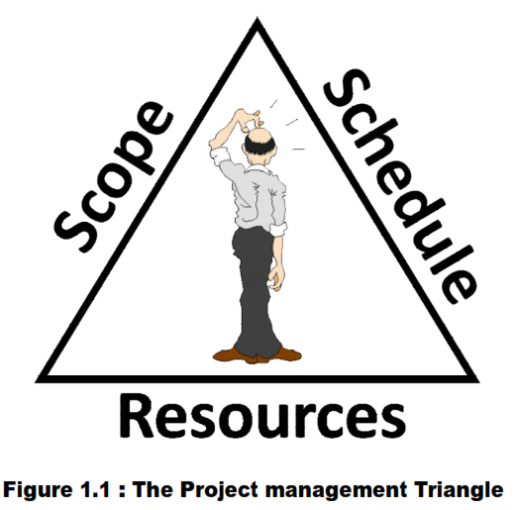

Slide 30
Work Breakdown Structure
To decompose the work of a project into a number of smaller task
For software project, start with the development process phases
  Continue decompose the tasks until each task can be
    Estimated
    Assigned to an individual or a team

Slide 31
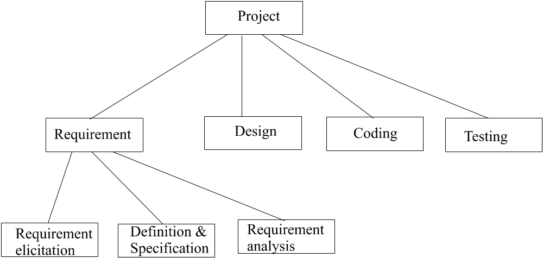
Work Breakdown Structure (cont’d)

Slide 32
People
“It’s always a people problem” Gerald Weinberg, “The Secrets of Consulting”
Developer productivity: 10-to-1 range
Improvements:
  Team selection
  Team organization
  Motivation
Notes:
Teams: 5-to-1 range

Slide 33
People 2
Other success factors
  Matching people to tasks
  Career development
  Balance: individual and team
  Clear communication

Slide 34
Process
Is process stifling?
2 Types: Management & Technical
Development fundamentals
Quality assurance
Risk management
Lifecycle planning
Avoid abuse by neglect
Notes:
cut time-to-market
Improve quality

Slide 35
Process 2
Customer orientation
Process maturity improvement
Rework avoidance

Slide 36
Product
The “tangible” dimension
Product size management
Product characteristics and requirements
Feature creep management

Slide 37
Technology
Often the least important dimension
Language and tool selection
Value and cost of reuse

Slide 38
Planning
Determine requirements
Determine resources
Select lifecycle model
Determine product features strategy

Slide 39
Tracking
Cost, effort, schedule
Planned vs. Actual
How to handle when things go off plan?

Slide 40
Measurements
To date and projected
  Cost
  Schedule
  Effort
  Product features
Alternatives
  Earned value analysis
  Defect rates
  Productivity (ex: SLOC)
  Complexity (ex: function points)

Slide 41
Technical Fundamentals
Requirements
Analysis
Design
Construction
Quality Assurance
Deployment

Slide 42
Project Phases
All projects are divided into phases
All phases together are known as the Project Life Cycle
Each phase is marked by completion of Deliverables
Identify the primary software project phases

Slide 43
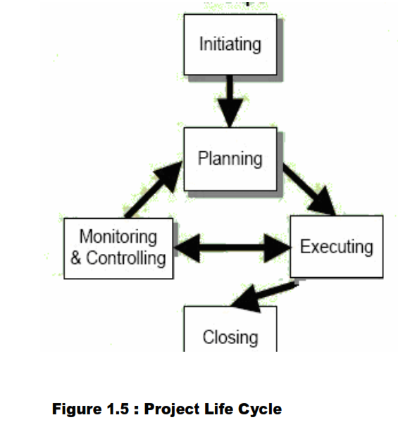
Project Management Process falls into five groups

Slide 44
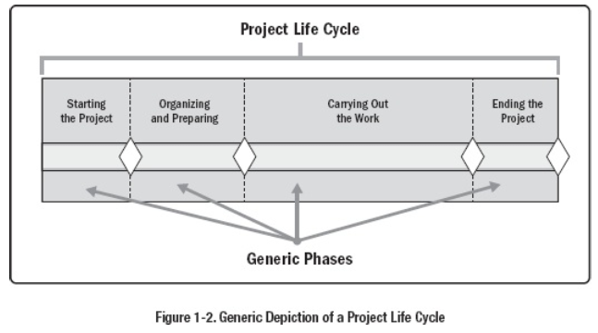
PMBoK Phases

Slide 46
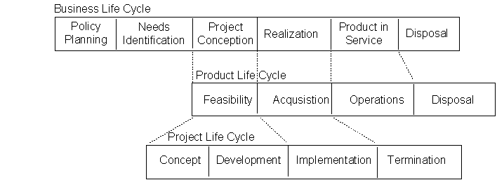
Lifecycle Relationships

Slide 47
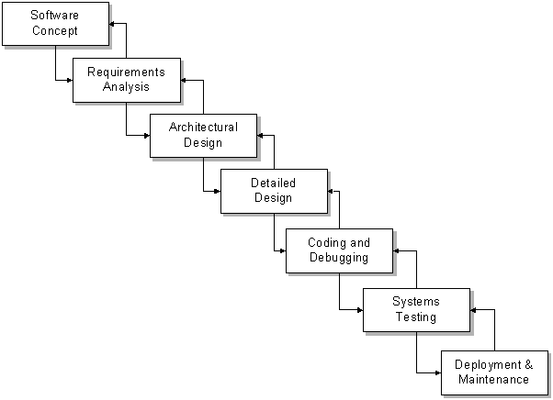
Seven Core Project Phases

Slide 48
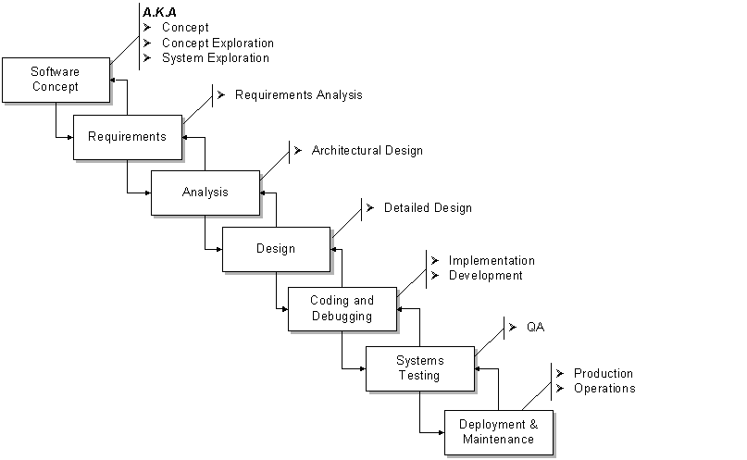
Project Phases A.K.A.

Slide 49
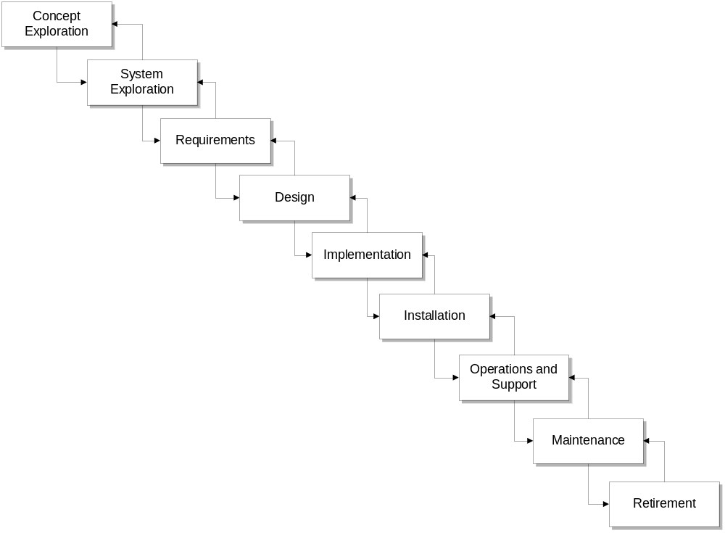
Phases Variation

Slide 50
36 Classic Mistakes
McConnell’s Anti-Patterns
Seductive Appeal
Types
  People-Related
  Process-Related
  Product-Related
  Technology-Related
Gilligan’s Island
Notes:
Seductive: good reason for decisions at the time
Some are IT, most not
We’ll visit these throughout course
Gilligan’s Island: new scheme, get off island, seems to work, then fails
Being aware can help prevent
Class discussion

Slide 51
People-Related Mistakes Part 1
Undermined motivation
Weak personnel
  Weak vs. Junior
Uncontrolled problem employees
Heroics
Adding people to a late project
Notes:
Motivation: studies show has largest impact
Don’t undermine Morale
2nd greatest influence on productivity
Junior != bad
Uncontrolled: most common developer complain about their managers
Heroics. Company hostage.
“Can-do”, “how high” attitudes
Brooks, reading assignment

Slide 52
People-Related Mistakes Part 2
Noisy, crowded offices
Customer-Developer friction
Unrealistic expectations
Politics over substance
Wishful thinking
Notes:
60%of developers feel unsatisfactory environment: need quite and privacy
MS offices
Friction: classic differing viewpoints
Results in ‘poor communication’
Passive-aggressive
Realistic Expectations: 1 of top 5 reasons for success of in-house projects
Perception woe
Politics
Managing-up
Wishful
Cognitive dissonance
Closing your eyes and hoping
McConnell: maybe causes the most problems in software development

Slide 53
People-Related Mistakes Part 3
Lack of effective project sponsorship
Lack of stakeholder buy-in
Lack of user input
Notes:
Sponsor: a must, no power
All players must buy-in
User input: Survey: number 1 reason for success
W/O input: guessing

Slide 54
Process-Related Mistakes Part 1
Optimistic schedules
Insufficient risk management
Contractor failure
Insufficient planning
Abandonment of plan under pressure
Notes:
Similar to wishful thinking
Puts unnecessary pressure
Risk Mgmt:
Risks will manage you
Contractor: late, poor quality, or fails to meet specifications
Requires lots of management
Insufficient planning: “if you don’t care where you’re going, any plan will do”
Abandonment
Out the window
Fall into code-and-fix mode

Slide 55
Process-Related Mistakes Part 2
Wasted time during fuzzy front end
Shortchanged upstream activities
Inadequate design
Shortchanged quality assurance
Notes:
fuzzy: before sign-off
Upstream:
Lack of analysis and design
10 to 100 times more costly
5 hrs vs. 50
Design:
Seen schedules w/o it at all
QA:
Seems easy to compress
1 day QA == 3 to 10 later

Slide 56
Process-Related Mistakes Part 3
Insufficient management controls
Frequent convergence
Omitting necessary tasks from estimates
Planning to catch-up later
Code-like-hell programming
Notes:
Management controls
Need to be able to track
We’ll cover lots of these
PMI
Convergence
Waste of time
Missing tasks
Often 20-30% of a schedule
Catch-up later
How many times have you seen a project catch-up?
Only by all-nighters
Like hell
“Entrepreneurial” approach
See catch-up later

Slide 57
Product-Related Mistakes
Requirements gold-plating
  Gilding the lily
Feature creep
Developer gold-plating
  Beware the pet project
Push-me, pull-me negotiation
Research-oriented development
Notes:
Gold
Gilding the lily
Performance is required more often than need be
Feature creep
25% average change in req.
Dev. Gold
Nifty new technology
Pet project
Push-me
Slip schedule + add features
Research vs. Development

Slide 58
Technology-Related Mistakes
Silver-bullet syndrome
Overestimated savings from new tools and methods
  Fad warning
Switching tools in mid-project
Lack of automated source-code control
Notes:
who’s heard of ‘silver bullet’ (not the beer)
SCM
Jones: 10% month, I see more

Slide 59
The change in definition was result of the change in Software Demand / Use and change in technology
Custom Made ➔ Software Product
Software Development ➔ Software Engineering Systems Analysis & Design

Slide 60
Software Engineering is the application of Systematic, Disciplined, Quantifiable approach to the development, operation and maintenance of software
Project Management
System Engineering
Quality Management
Computer Sc. & Technology
Software Engineering
Application Domain
Dependability
Safety

Slide 61
Project Management Concepts

Slide 62
Software Development Life cycle
Software has a lifetime, just like any other commercial product.
The life cycle is a project management tool. It defines phases and tasks that are essential to system development, no matter what type or size of system you may try to build.
    Analysis
    Specification
    Design
    Implementation
    Testing
    Installation
    Operation
    Maintenance
    Retirement

Slide 63
Software Process & Objectives
The SP consists of steps taken to produce software. Each step requires some tools, methods and practices.
“Set of tools, methods and practices used to produce a software product”
“To produce products according to a plan while simultaneously improving the organization’s capability to produce better products”

Slide 64
Software Development Process Model
A Software Development Process Model describes how, and in what order, Life Cycle stages are put together to trace the entire life history of the product.
A Process Model defines a framework for carrying out various activities.

Slide 65
Why SP is important?
If one build a product that has flaws, do not just fix the flaws. Fix the process that allowed flaws in the product
  Software product is complex and invisible
  The only way to control product quality is through the process
A good process also helps in
  Meeting cost and schedule constraints
  Increasing staff morale and job satisfaction

Slide 66
Why Different Companies Use Different Processes?
The process vary with project’s goals and available resources
The priorities are set by the relative composition of main goals:
  Time and Market, Cost, Quality, Consumer Satisfaction

Slide 67
Characteristics of SP
  Understandability
  Visibility
  Supportability
  Acceptability
  Reliability
  Robustness
  Maintainability
  Rapidity

