Slide 1

WELCOME TO FIRST 1st LECTURE OF
Software Testing Techniques and Strategies
COURSE CODE :SE-484

Slide 2
Software Testing Techniques and Strategies
COURSE CODE :SE-484
WEEK - 1

Slide 3
Course Outline:
Introduction to Software Testing Purpose and Scope
Software Quality factors
Software Testing Strategy
Approaches
Types and factors in choosing Software Strategy
Software Testing Life Cycle
Methods of Software Testing
Difference between Verification/Validation
Quality Assurance and Quality Control
Functional/Non Functional Requirements
Difference between Defects/Bug /Error/Failure
When to start Testing Activity Importance of Software
Testing Multiple Roles Of Software Testers

Slide 4
Course Outline:
Types of testing
Process of testing with respect to types
How to write Test Cases
Organizing Test Cases
Bug Life Cycle in software Testing and Bug Report
Levels in Software Testing
Techniques of Testing
Cyclomatic Complexity
Cost Quality Aspect /Cost Estimation
Used of Software tools

Slide 5
Overview
What is Software
Set of Instructions.

Slide 6
Overview
Engineering
on the other hand, is all about developing products, using well-defined, scientific principles and methods.

Slide 7
Overview
What is Software Engineering?
Software engineering is defined as a process of analyzing user requirements and then designing, building, and testing software which will satisfy those requirements.

Slide 8
Overview SDLC
The Software Development Life Cycle (SDLC) refers to a methodology with clearly defined processes for creating high-quality software.
Detail Definition:
SDLC or the Software Development Life Cycle is a process that produces software with the highest quality and lowest cost in the shortest time possible. SDLC provides a well-structured flow of phases that help an organization to quickly produce high-quality software which is well-tested and ready for production use.

Slide 9
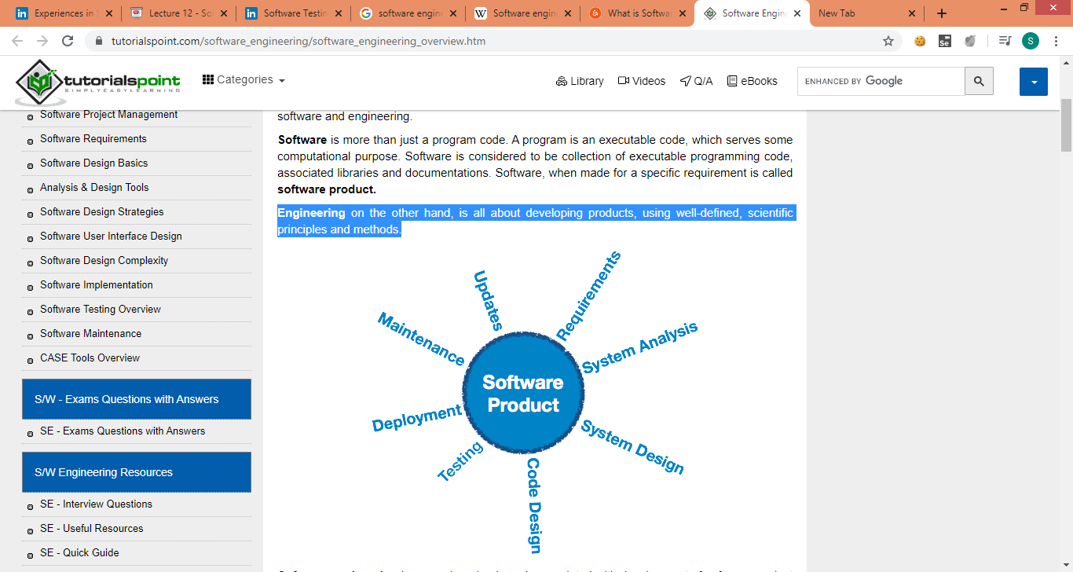
Software Engineering

Slide 10
SDLC
The SDLC methodology focuses on the following phases of software development:
Requirement analysis
Planning
Software design such as architectural design
Software development
Testing
Deployment/
Maintenance

Slide 11
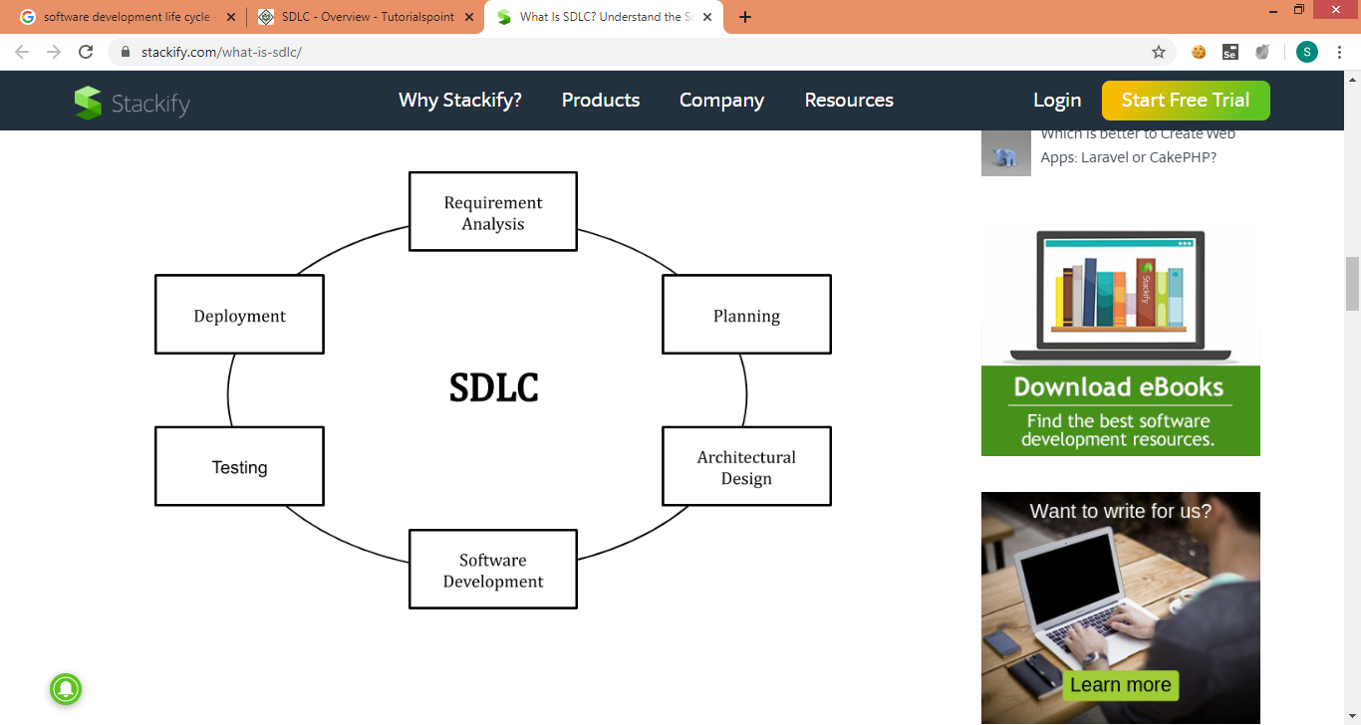
SDLC

Slide 12
Benefits of SDLC
SDLC works by lowering the cost of software development while simultaneously improving quality and shortening production time.
Next, it defines the requirements of the new system. It then creates the software through the stages of analysis, planning, design, development, testing, and deployment. By anticipating costly mistakes like failing to ask the end-user or client for feedback, SDLC can eliminate redundant rework and after-the-fact fixes.
It’s also important to know that there is a strong focus on the testing phase. As the SDLC is a repetitive methodology, you have to ensure code quality at every cycle. Many organizations tend to spend few efforts on testing while a stronger focus on testing can save them a lot of rework, time, and money. Be smart and write the right types of tests.

Slide 13
Software Crisis?
It was in the late 1960s when many software projects failed.
Many software became over budget.
Output was an unreliable software which is expensive to maintain.
Larger software was difficult and quite expensive to maintain.
Lots of software not able to satisfy the growing requirements of the customer.
Complexities of software projects increased whenever its hardware capability increased.
Demand for new software increased faster compared with the ability to generate new software.
All the above issues lead to 'Software Crisis.'

Slide 14
Solution of software crisis through software engineering principles

Slide 15
Challenges of Software Engineering or SOFTWARE ENGINEERS
Here are some critical challenges faced by software engineers:
In safety-critical areas such as space, aviation, nuclear power plants, etc. the cost of software failure can be massive because lives are at risk.
Increased market demands.
Dealing with the increased complexity of software need for new applications.
The diversity of software systems should be communicating with each other.

Slide 16
Introduction
Software
set of instructions
Testing:
In general, testing is finding out how well something works

Slide 17
Software Testing: is a process, to evaluate the functionality of a software application with an intent to find whether the developed software met the specified requirements or not and to identify the defects to ensure that the product is defect free in order to produce the quality product
Process to Identify:
QUALITY PRODUCT
Quality Software:
meets requirements and/or expectations,
reasonably bug or defect free
delivered on time
within budget
maintainable.

Slide 18
Introduction
SOFTWARE QUALITY FACTORS
Developing methods that can produce high-quality software is another fundamental goal of software engineering. We can view quality of a software product as having different dimensions:
ol.
Several models of software quality factors and their categorization have been suggested over the years. The classic model of software quality factors, suggested by McCall, consists of 11 factors (McCall et al., 1977). Similarly, models consisting of 12 to 15 factors, were suggested by Deutsch and Willis (ls do not differ substantially from McCall’s model. The McCall factor model provides a practical, up-to-date method for classifying software requirements (Pressman, 2000).

Slide 19
Introduction and Basic Concept of Software Testing & its Importance
Software Quality Factors:
Flexibility and Extensibility
Maintainability and Readability
Performance and Efficiency
Scalability

Slide 20
Software Quality Factors:
v. Availability, Robustness, Fault Tolerance and
Reliability
vi. Usability and Accessibility
vii. Platform Compatibility and Portability
viii. Testability and Manageability
Security
Functionality and Correctness
ix. Functionality and Correctness

Slide 21
Introduction and Basic Concept of Software Testing & its Importance
Software Quality Factors:
Flexibility and Extensibility:
Flexibility is the ability of software to add/modify/remove functionality without damaging current system. Extensibility is the ability of software to add functionality without damaging system, so it may be thought as a subset of flexibility. Those functionality changes may occur according to changing requirements or an obligation if development process is one of the iterative methods. Change is inevitable in software development and so, this is one of the most important properties of quality software
Maintainability and Readability
Maintainability is a little similar with flexibility but it focuses on modifications about error corrections and minor function modifications, not major functional extensibilities. It can be supported with useful interface definitions, documentations and also self-documenting code and/or code documentation. The more correct and useful documentation exists, the more maintainability can be performed.

Slide 22
Software Quality Factors
Performance and Efficiency
Performance is mostly about response time of the software. This response time should be in acceptable intervals (e.g. max. a few seconds), and should not increase if transaction count increases. And also, resources are expensive. Efficiency must be supported with resource utilization. As an exaggerated example, ability of performing a simple function only by using a 32 processor machine or 1 TB disk space is not acceptable. Optimal source/performance ratio must be aimed.
Scalability
A scalable system responds user actions in an acceptable amount of time, even if load increases. Of course more hardware may be added for handling increasing user transaction, but the architecture should not change while doing this. This is called vertical scalability. Ability of running on multiple, increasing count of machines is multiple processing. If the software can perform that type of processing, this is called horizontal scalability. A preferred scalable system should suit both of these methods.

Slide 23
Software Quality Factors
Usability and Accessibility
User interfaces are the only visible parts of software according to the viewpoint of user. So, simplicity, taking less time to complete a job, fast learnability etc. are very important in this case. The most well known principle for this property is (Keep It Simple). Simple is always the best. A usable software should also support different accessibility types of control for people with disabilities.
Platform Compatibility and Portability
A quality software should run on as much various platforms as it can. So, more people can make use of it. In different contexts we may mention different platforms, this may be OS platforms, browser types etc. And portability is about adapting software that can run on different platforms, for being more platform compatible. In this sense, portability is also related with flexibility

Slide 24
Software Quality Factors
Availability, Robustness, Fault Tolerance and Reliability: A robust software should not lose its availability even in most failure states. Even if some components are broken down, it may continue running. Besides, even if whole application crashes, it may recover itself using backup hardware and data with fault tolerance approaches. There should always be B and even C, D plans. Reliability also stands for the integrity and consistency of the software even under high load conditions. So it is relevant with availability and scalability. An unreliable system is also unscalable.

Slide 25
Software Quality Factors
Testability and Manageability
Quality software requires quality testing. Source code should be tested with the most coverage and with the most efficient testing methods. This can be performed by using encapsulation, interfaces, patterns, low coupling etc. techniques correctly. Besides testability, a qualified software should be manageable after deployment. It may be monitored for e.g. performance or data usage status, or may enable developer to configure system easily. Creating a successful logging system is another very important issue about manageability.
Security
Security is a very important issue on software development, especially for web or mobile based ones which may have millions of users with the ability of remote accessing to system. You should construct a security policy and apply it correctly by leaving no entry points. This may include authorization and authentication techniques, network attack protections, data encryption and so on. all possible types of security

Slide 26
Software Quality Factors
leaks should be considered, otherwise one day only one attack may crash your whole application and whole company.
Functionality and Correctness
Functionality (or correctness) is the conformity of the software with actual requirements and specifications. In fact this is the precondition attribute of an application, and maybe not a quality factor but we wanted to point that as the last quality factor, for taking attention: Quality factors are not meaningful when we are talking about un functional software. First, perform desired functionality and produce correct software, then apply quality factors on it. If you can perform both parallel, it is the best.

Slide 27
SOFTWARE TESTING
Is the root for developing a quality software. Testing is done to ensure the Quality of software including all quality factors.
According to ANSI/IEEE 1059 standard - A process of analyzing a software item to detect the differences between existing and required conditions (i.e., defects) and to evaluate the features of the software item.

Slide 28
Testing Strategy:
To perform testing in a planned and
systematic manner, software testing
strategy is developed.

Slide 29
Testing Strategy:
To perform testing in a planned and systematic manner, software testing
strategy is developed.
A testing strategy is used to identify
the levels of testing which are to be applied along with the methods,
techniques, and tools to be used during testing.
This strategy also includes
test cases,
test specifications,
test case decisions, and puts them together for execution.(Testing Life Cycle/test plan)
The choice of software testing strategy is highly dependent on the nature of the developed software

Slide 30
In spite of these advantages, there are certain issues that need to be addressed for successful implementation of software testing strategy. These issues are discussed here.
1. In addition to detecting errors, a good testing strategy should also assess portability and usability of the software.
2. It should use quantifiable manner to specify software requirements such as outputs expected from software, test effectiveness, and mean time to failure which should be clearly stated in the test plan.
3. It should improve testing method continuously to make it more effective.
4. Test plans that support rapid cycle testing should be developed. The feedback from rapid cycle testing can be used to control the corresponding strategies.
5. It should develop robust software, which is able to test itself using debugging techniques.
6. It should conduct formal technical reviews to evaluate the test cases and test strategy. The formal technical reviews can detect errors and inconsistencies present in the testing process.

Slide 31
Testing Strategy
The output produced by the software testing strategy includes a detailed document, which indicates the entire
test plan including all test cases used during the testing phase.
A testing strategy also specifies a list of testing issues that need to be resolved.
An efficient software testing strategy includes two types of tests, namely,
low-level tests and high-level tests.
Low-level tests ensure correct implementation of small part of the source code and
high-level tests ensure that major software functions are validated according to user requirements.
A testing strategy sets certain milestones for the software such as final
date for completion of testing and the date of delivering the software.
These milestones are important when there is limited time to meet the deadline.

Slide 32
Testing Strategy:
Leave time for fixing.
Setting aside time
Discourage passing the buG.
3. Manual testing has to be exploratory
Encourage clarity.
5. Test often Active.

Slide 33
1. Leave time for fixing. Setting aside time for testing is pointless if there is no time set aside for fixing. Once problems are discovered, developers required time to fix them and the company needs time to retest the fixes as well. With a time and plan for both, then testing is not very useful.
2. Discourage passing the buck. One way of minimizing back and forth conversations between developers and testers is having a culture that will encourage them to hop on the phone or have desk-side chat to get to the bottom of things. Testing and fixing are all about collaboration. Although it is important that developers should not waste time on a wild goose chase, it is equally important that bugs are not just shuffled back and forth.

Slide 34
3. Manual testing has to be exploratory. A lot of teams prefer to script manual testing so testers follow a set of steps and work their way through a set of tasks that are predefined for software testing. This misses the point of manual testing. If something could be written down or scripted in exact terms, it could be automated and belongs in the automated test suite. Real-world use of the software will not be scripted, thus testers must be free to probe and break things without a script.
4. Encourage clarity. It is also integral for a developer to out of the way to effectively communicate as well.
Reporting bugs and asking for more information could create unnecessary overhead costs. A good bug report could save time through avoiding miscommunication or a need for more communication. In the same way, a bad bug report could lead to a fast dismissal by a developer. These could create problems. Anyone reporting bugs should make it a point to create bug reports that are informative.

Slide 35
5. Test often. The same as all other forms of testing, manual testing will work best when it occurs often throughout the development project, in general, weekly or bi-weekly. This helps in preventing huge backlogs of problems from building up and crushing morale. Frequent testing is considered the best approach.
Testing and fixing software could be tricky, subtle and political even..

Slide 36
THANKYOU

