Slide 1

WELCOME TO 11TH LECTURE OF
Software Testing Techniques and Strategies
COURSE CODE :SE-484

Slide 2
Black Box Testing
iv Cause-Effect Graph-Black Box Software
• Cause and effect graph is a test case design technique.
It is a black box testing technique.
• It is generally uses for hardware testing but now adapted to software testing, usually tests external behavior of a system.
• It is a testing technique that aids in choosing test cases that logically relate Causes (inputs) to Effects (outputs) to produce test cases.
• Cause-Effect Graphing is a technique which starts with set of requirements and determines the minimum possible test cases for maximum test coverage which reduces test execution time and ultimately cost.
• The Cause-Effect graph technique restates the requirements specification in terms of logical relationship between the input and output conditions. Since it is logical, it is obvious to use Boolean operators like AND, OR and NOT

Slide 3
Black Box Testing
iv Cause-Effect Graph
STEPS
Step 1: For a module, identify the input conditions (causes) and actions (effect).
Step 2: Develop a cause-effect graph.
Step 3: Transform cause-effect graph into a decision table.
Step 4: Convert decision table rules to test cases. Each column of the decision table represents a test case.

Slide 4
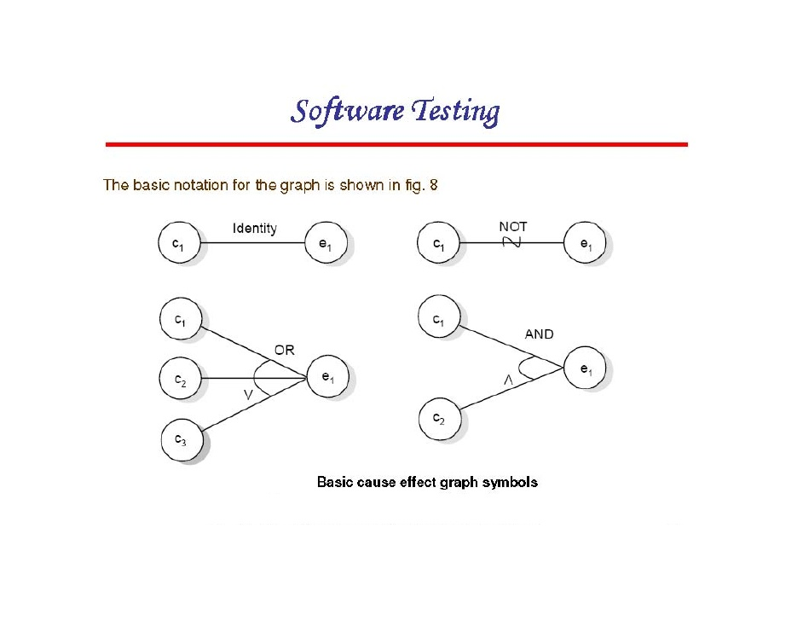
Black Box Testing
iv Cause-Effect Graph
Basic symbols used in Cause-effect graphs are as under:
Consider each node as having the value 0 or 1 where 0 represents the 'absent state (FALSE)' and 1 represents the‘ present state(TRUE)'. Then the identity function states that if c1 is 1, e1 is 1 or we can say if c0 is 0, e0 is 0.
The NOT function states that if C1 is 1, e1 is 0 and vice-versa. Similarly,
OR function states that if C1 or C2 or C3 is 1, e1 is 1 else e1 is 0.
The AND function states that if both C, and C2 are 1, e1 is 1; else e1 is 0.
The AND and OR functions are allowed to have any number of input

Slide 5
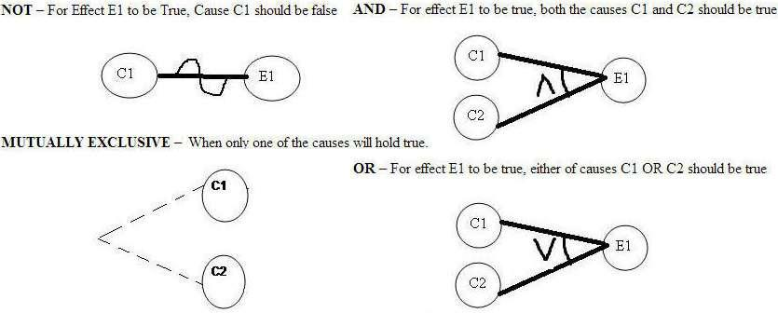
Black Box Testing
iv Cause-Effect Graph
In addition to the basic relationships, under the assumption of a, b
being cause nodes and e, f being effect nodes, the constraints explained below and shown in Figure
Exclusive Or (E): At most one of the variables a and b can be true.
Inclusive Or (I): At least one of the variables a and b must be true.
Only-one (O): One and only one of the variables a and b must be true.
Required (R): In order to variable a to be true, variable b must be true.
Masking (M): When the effect e is true, effect f must be false.

Slide 6
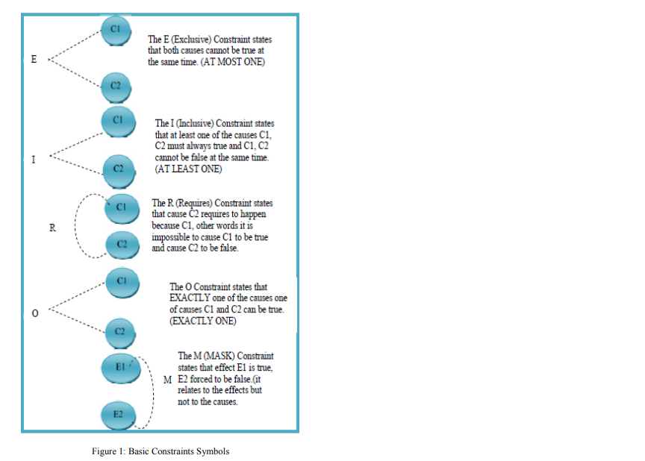
Black Box Testing
iv Cause-Effect Graph

Slide 7
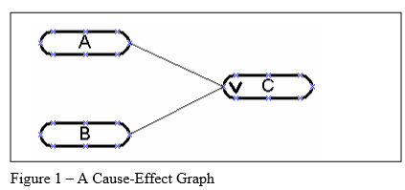
Black Box Testing
A Simple Cause-Effect Graphing Example 1
The starting point for the Cause-Effect Graph is the requirements document. The requirements describe “what” the system is intended to do.
The requirements can describe real time systems, events, data driven systems, state transition diagrams, object oriented systems, graphical user interface standards, etc.
Any type of logic can be modeled using a Cause-Effect diagram. Each cause (or input) in the requirements is expressed in the cause-effect graph as a condition, which is either true or false.
Each effect (or output) is expressed as a condition, which is either true or false.
I have a requirement that says: “If A OR B, then C.”
The following rules hold for this requirement:
• If A is true and B is true, then C is true.
• If A is true and B is false, then C is true.
• If A is false and B is true, then C is true.
• If A is false and B is false, then C is false.
The cause-effect graph that represents this requirement is provided in Figure 1.
The cause-effect graph shows the relationship between the causes and effects.

Slide 8
iv Cause-Effect Graph
Black Box Testing
In Figure 1, A, B and C are called nodes. Nodes A and B are the causes, while Node C is an effect. Each node can have a true or false condition. The lines, called vectors, connect the cause nodes A and B to the effect node C.
All requirements are translated into nodes and relationships on the cause-effect graph. There are only four possible relationships among nodes, and they are indicated by the following symbols MENTION ABOVE:

Slide 9
Black Box Testing
iv Cause-Effect Graph
Example:2
Let’s draw a cause and effect graph based on a situation:
Situation:
The “Print message” is software that read two characters and, depending of their values, messages must be printed.
The first character must be an “A” or a “B”.
The second character must be a digit.
If the first character is an “A” or “B” and the second character is a digit, the file must be updated.
If the first character is incorrect (not an “A” or “B”), the message X must be printed.
If the second character is incorrect (not a digit), the message Y must be printed.

Slide 10
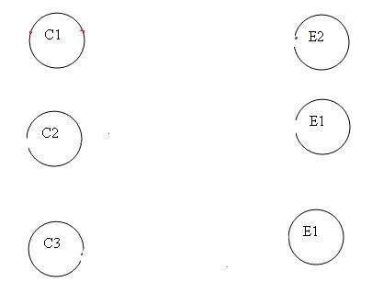
Black Box Testing
iv Cause-Effect Graph
The causes (Inputs) for this situation are:
C1 – First character is A
C2 – First character is B
C3 – Second character is a digit
The effects (results) for this situation are
E1 – Update the file
E2 – Print message “X”
E3 – Print message “Y”
LET’S START!! First draw the causes and effects as shown below

Slide 11
Black Box Testing
iv Cause-Effect Graph
Key – Always go from effect to cause (left to right). That means, to get effect “E” ,what causes should be true. In this example, let’s start with Effect E1. Effect E1 is to update the file. The file is updated when – First character is “A” and second character is a digit – First character is “B” and second character is a digit – First character can either be “A” or “B” and cannot be both. Now let’s put these 3 points in symbolic form:
For E1 to be true – following are the causes: – C1 and C3 should be true – C2 and C3 should be true – C1 and C2 cannot be true together.
The causes (Inputs) for this situation are:
C1 – First character is A
C2 – First character is B
C3 – Second character is a digit
The effects (results) for this situation are
E1 – Update the file
E2 – Print message “X”
E3 – Print message “Y”
LET’S START!! First draw the causes and effects as shown below

Slide 12
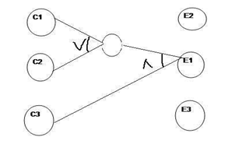
Black Box Testing
iv Cause-Effect Graph
Key – Always go from effect to cause (left to right). That means, to get effect “E” ,what causes should be true. In this example, let’s start with Effect E1. Effect E1 is to update the file. The file is updated when – First character is “A” and second character is a digit – First character is “B” and second character is a digit – First character can either be “A” or “B” and cannot be both. Now let’s put these 3 points in symbolic form:
For E1 to be true – following are the causes: – C1 and C3 should be true – C2 and C3 should be true – C1 and C2 cannot be true together..
The causes (Inputs) for this situation are:
C1 – First character is A
C2 – First character is B
C3 – Second character is a digit
The effects (results) for this situation are
E1 – Update the file
E2 – Print message “X”
E3 – Print message “Y”
LET’S START!! First draw the causes and effects as shown below

Slide 13
Black Box Testing
iv Cause-Effect Graph
Key – Always go from effect to cause (left to right). That means, to get effect “E” ,what causes should be true. In this example, let’s start with Effect E1. Effect E1 is to update the file. The file is updated when – First character is “A” and second character is a digit – First character is “B” and second character is a digit – First character can either be “A” or “B” and cannot be both. Now let’s put these 3 points in symbolic form:
For E1 to be true – following are the causes: – C1 and C3 should be true – C2 and C3 should be true – C1 and C2 cannot be true together.
The causes (Inputs) for this situation are:
C1 – First character is A
C2 – First character is B
C3 – Second character is a digit
The effects (results) for this situation are
E1 – Update the file
E2 – Print message “X”
E3 – Print message “Y”
LET’S START!! First draw the causes and effects as shown below

Slide 14
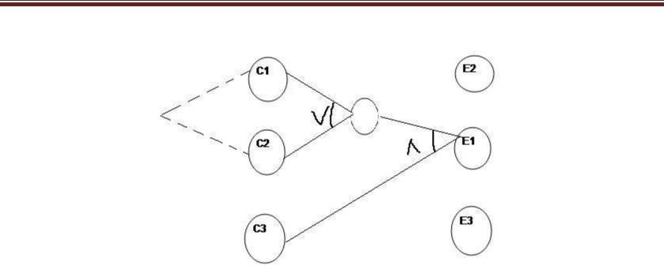
Black Box Testing
iv Cause-Effect Graph
So as per the above diagram, for E1 to be true the condition is (C1 C2) C3 The circle in the middle is just an interpretation of the middle point to make the graph less messy. There is a third condition where C1 and C2 are mutually exclusive. So the final graph for effect E1 to be true is shown below:
Let’s move to Effect E2:
E2 states to print message “X”. Message X will be printed when First character is neither A nor B.
Which means Effect E2 will hold true when either C1 OR C2 is invalid. So the graph for Effect E2 is shown as (In blue line)

Slide 15
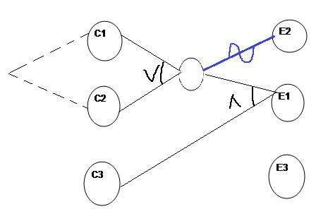
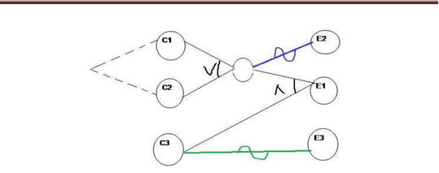
Black Box Testing
iv Cause-Effect Graph
Let’s move to Effect E2:
E2 states to print message “X”. Message X will be printed when First character is neither A nor B.
Which means Effect E2 will hold true when either C1 OR C2 is invalid. So the graph for Effect E2 is shown as (In blue line)
For Effect E3:
E3 states to print message “Y”. Message Y will be printed when Second character is incorrect. Which means Effect E3 will hold true when C3 is invalid. So the graph for Effect E3 is shown as (In Green line)
This completes the Cause and Effect graph for the above situation.
Now let’s move to draw the Decision table based on the above graph.

Slide 16


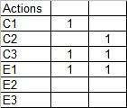
Black Box Testing
iv Cause-Effect Graph
Writing Decision table based on Cause and Effect graph First write down the Causes and Effects in a single column shown below
Key is the same. Go from bottom to top which means traverse from effect to cause. Start with Effect E1. For E1 to be true, the condition is: (C1 C2) C3 . Here we are representing True as 1 and False as 0
First put Effect E1 as True in the next column as
Now for E1 to be “1” (true), we have the below two conditions – C1 AND C3 will be true C2 AND C3 will be true

Slide 17
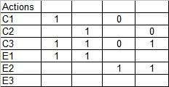
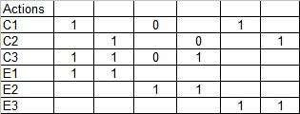
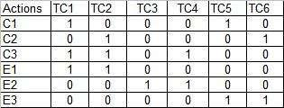
Black Box Testing
iv Cause-Effect Graph
For E2 to be True, either C1 or C2 has to be false shown as
For E3 to be true, C3 should be false
So it’s done. Let’s complete the graph by adding 0 in the blank column and including the test case identifier.

Slide 18
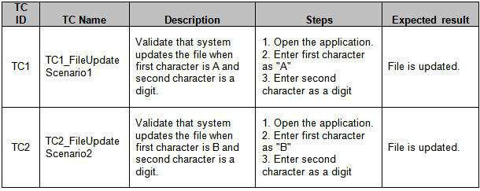
Black Box Testing
iv Cause-Effect Graph
Writing Test cases from the decision table I am writing a sample test case for test case 1 (TC1) and Test Case 2 (TC2).
In a similar fashion, you can create other test cases. (A test case contains many other attributes like preconditions, test data, severity, priority, build, version, release, environment etc. I assume all these attributes to be included when you write the test cases in actual situation The columns in the decision table are converted into

Slide 19
Black Box Testing
iv Cause-Effect Graph
EXAMPLE: 3 In the following example. Withdrawing money at an Automated Teller Machine (ATM) shall illustrate how to prepare a Cause Effect Graph.
The following conditions must be fulfilled in order to get money from the machine,
• The bankcard is valid
• The PIN must be correctly entered
• The maximum number of PIN Inputs is three
• There is money in the machine, and in the account
The following actions/Effects are possible at the machine:
• Reject Card ,
• Ask for another PIN input ,
• “Held” the card.
• Ask for an alternate dollar amount
• Pay the requested amount of Money
Step 1: For a module, identify the input conditions (causes) and actions (effect).
Step 2: Develop a cause-effect graph.

Slide 20
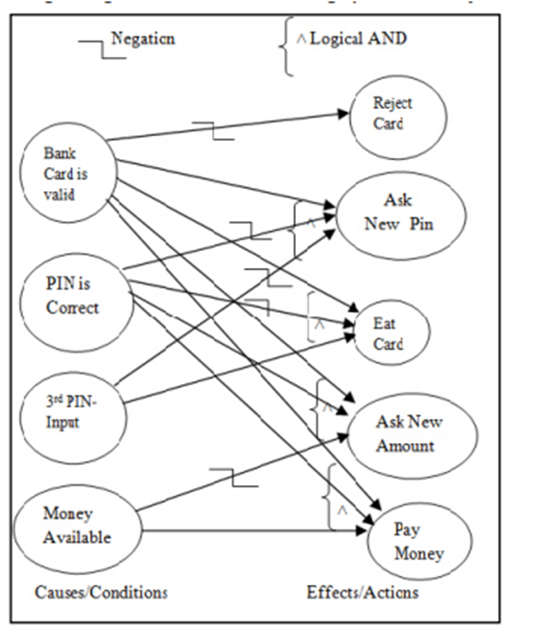
EXAMPLE: 3
C1 The bankcard is valid
C2 The PIN must be correctly entered
C3 The maximum number of PIN Inputs is three
C4 There is money in the machine, and in the account
The following actions are possible at the machine:
E1 Reject Card , C1=0 -> E1=1
E2 Ask for another PIN input , (C1=1^ C2=0 ^C3=0) True
cond for E2
E3 “Held” the card. (C1=1^C2=0 ^C3=1)→ E3=1
E4 Ask for an alternate dollar amount
E5 Pay the requested amount of Money
(C1=1^C2=1 ^C4=1)→ E5=1
Step 3: Transform cause-effect graph into a decision table
Step 4: Convert decision table rules to test cases. Each column of the decision table represents a test case Write down the test cases according to decision table.

Slide 21
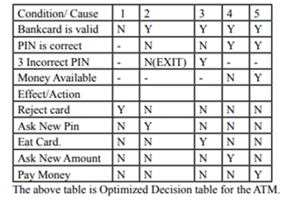
EXAMPLE: 3
C1 The bankcard is valid
C2 The PIN must be correctly entered
C3 The maximum number of PIN Inputs is three
C4 There is money in the machine, and in the account
The following actions are possible at the machine:
E1 Reject Card , C1=0 -> E1=1
E2 Ask for another PIN input , (C1=1^ C2=0 ^C3=0) True cond for E2
E3 “Held” the card. (C1=1^C2=0 ^C3=1)→ E3=1
E4 Ask for an alternate dollar amount
E5 Pay the requested amount of Money
(C1=1^C2=1 ^C4=1)→ E5=1
Step 3: Transform cause-effect graph into a decision table
Step 4: Convert decision table rules to test cases. Each column of the decision table represents a test case Write down the test cases according to decision table.

Slide 22
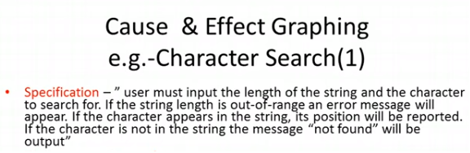
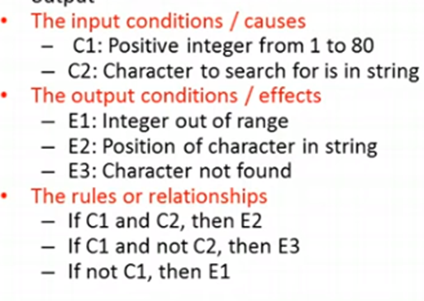
Black Box Testing
iv Cause-Effect Graph
_{Example:4}
_{Example:4}

Slide 23
Black Box Testing
v. State Transition
State transition testing is a black box testing technique and is used where some aspect of the system can be described in what is called a “finite state machine”. This simply means that the system can be in a (finite) number of different states, and the transitions from one state to another are determined by the rules of the “machine”.
This is the model on which the system and the tests are based. Any system where you get a different output for the same input, depending on what has happened before, is a finite state system.
State Transition testing, a black box testing technique, in which outputs are triggered by changes to the input conditions or changes to 'state' of the system. In other words, tests are designed to execute valid and invalid state transitions.

Slide 24
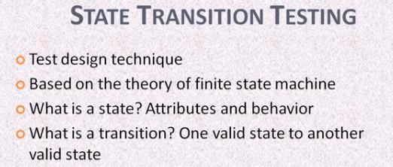
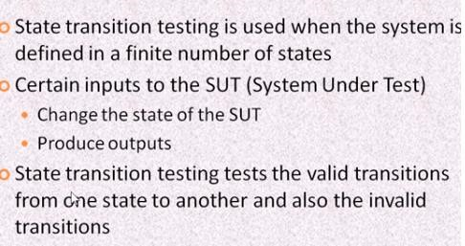
Black Box Testing
v. State Transition

Slide 25
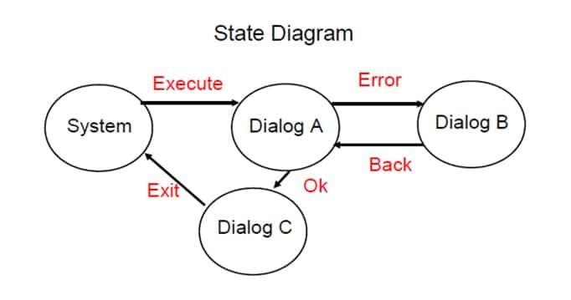
Black Box Testing
v. State Transition
State Transition Testing Technique is helpful where you need to test different system transitions.
State Transition Testing Example: If you request to withdraw
$100 from a bank ATM, you may be given cash. Later you may make exactly the same request but be refused the money (because your balance is insufficient).
This later refusal is because the state of your bank account had changed from having sufficient funds to cover the withdrawal to having insufficient funds. The transaction that caused your account to change its state was probably the earlier withdrawal.

Slide 26
Black Box Testing
v. State Transition
State Transition Testing Technique is helpful where you need to test different system transitions.
State Transition Testing Example: If you request to withdraw
$100 from a bank ATM, you may be given cash. Later you may make exactly the same request but be refused the money (because your balance is insufficient).
This later refusal is because the state of your bank account had changed from having sufficient funds to cover the withdrawal to having insufficient funds. The transaction that caused your account to change its state was probably the earlier withdrawal.

Slide 27
Black Box Testing
v. State Transition
When to use?
This can be used when a tester is testing the application for a finite set of input values.
When the system under test has a dependency on the events/values in the past.
When we have sequence of events that occur and associated conditions that apply to those events
It is used for real time systems with various states and transitions involved

Slide 28



Black Box Testing
v. State Transition
Four Parts of State Transition Model:
There are 4 main components of the State Transition Model as below
States: The states that the software may occupy (open/closed or funded/insufficient funds);
Transition from one state to another: The transitions from one state to another (not all transitions are allowed);
3) Events that causes a transition like closing a file or withdrawing money
4. Actions that results from a transition (an error message or being given the cash.)

Slide 29
Black Box Testing
v. State Transition
Deriving Test cases:
Understand the various state and transition and mark each valid and invalid state
Defining a sequence of an event that leads to an allowed test ending state
Each one of those visited state and traversed transition should be noted down
Steps 2 and 3 should be repeated until all states have been visited and all transitions traversed
For test cases to have a good coverage, actual input values and the actual output values have to be generated
State Transition Diagram and State Transition Table
There are two main ways to represent or design state transition
State transition diagram,
state transition table.

Slide 30
Black Box Testing
v. State Transition
State Transition Diagram and State Transition Table
There are two main ways to represent or design state transition,
State transition diagram ,
State transition table.
In state transition diagram the states are shown in boxed texts, and the transition is represented by arrows. It is also called State Chart or Graph. It is useful in identifying valid transitions.
In state transition table all the states are listed on the left side, and the events are described on the top. Each cell in the table represents the state of the system after the event has occurred. It is also called State Table. It is useful in identifying invalid transitions.

Slide 31
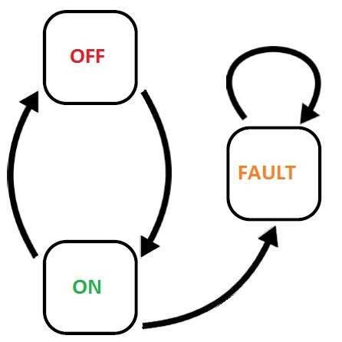
Black Box Testing
v. State Transition
Example 1:
A System's transition is represented as shown in the below diagram:

Slide 32
Black Box Testing
v. State Transition
Example 1:
A System's transition is represented as shown in the below diagram:
The tests are derived from the above state and transition and below are the possible scenarios that need to be tested
Tests | Test 1 | Test 2 | Test 3
Start State | Off | On | On
Input /Event | Switch ON | Switch Off | Switch off
Output /Action | Light ON | Light Off | Fault
Finish State | ON | OFF | On
Tests | Input ON | Input OFF | Input OFF
Start State | Off | On | On
Finish State | ON | OFF | Fault

Slide 33
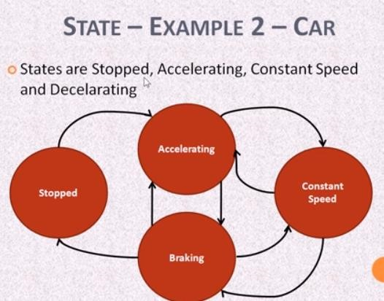
Black Box Testing
v. State Transition

Slide 34
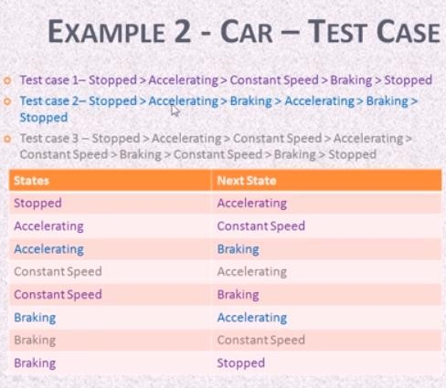
Black Box Testing
v. State Transition

Slide 35
Black Box Testing
v. State Transition

Slide 36
Black Box Testing
v. State Transition
Example 3:
Let's consider an ATM system function where if the user enters the invalid password three times the account will be locked.
In this system, if the user enters a valid password in any of the first three attempts the user will be logged in successfully. If the user enters the invalid password in the first or second try, the user will be asked to re-enter the password. And finally, if the user enters incorrect password 3rd time, the account will be blocked.

Slide 37
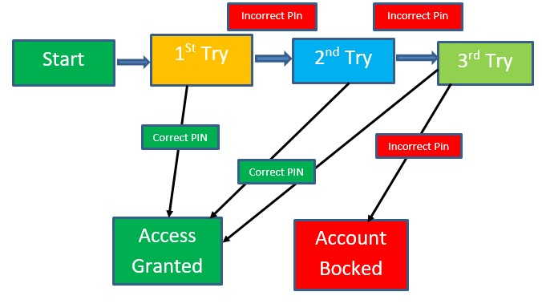
Black Box Testing
v. State Transition
1.In this system, if the user enters a valid password in any of the first three attempts the user will be logged in successfully.
2. If the user enters the invalid password in the first or second try, the user will be asked to re-enter the password.
And finally,
3. if the user enters incorrect password 3rd time, the account will be blocked.

Slide 38
Black Box Testing
v. State Transition
In the diagram whenever the user enters the correct PIN he is moved to Access granted state,
and if he enters the wrong password he is moved to next try and if he does the same for the
3rd time the account blocked state is reached.
 |  |  | Correct PIN | Incorrect PIN
 | State
 | S1) Start
 | S2) 1st attempt
 | S3) 2nd attempt
 | S4) 3rd attempt
 | S5) Access Granted |  | - | -
 | S6) Account blocked |  | - | -

Slide 39
Black Box Testing
v. State Transition
In the diagram whenever the user enters the correct PIN he is moved to Access granted state,
and if he enters the wrong password he is moved to next try and if he does the same for the
3rd time the account blocked state is reached.
 |  |  | Correct PIN | Incorrect PIN
 | State
 | S1) Start |  | 1st attempt (s2)
 | S2) 1st attempt |  | S5
 | S3) 2nd attempt
 | S4) 3rd attempt
 | S5) Access Granted |  | - | -
 | S6) Account blocked |  | - | -
In the table when the user enters the correct PIN, state is transitioned to S5 which
is Access granted. And if the user enters a wrong password he is moved to next state. If he does the same 3rdtime, he will reach the account blocked state.

Slide 40
Black Box Testing
v. State Transition
In the diagram whenever the user enters the correct PIN he is moved to Access granted state,
and if he enters the wrong password he is moved to next try and if he does the same for the
3rd time the account blocked state is reached.
 |  |  | Correct PIN | Incorrect PIN
 | State
 | S1) Start |  | 1st attempt (s2) | S2
 | S2) 1st attempt |  | S5 | S3
 | S3) 2nd attempt
 | S4) 3rd attempt
 | S5) Access Granted |  | - | -
 | S6) Account blocked |  | - | -

Slide 41
Black Box Testing
v. State Transition
In the diagram whenever the user enters the correct PIN he is moved to Access granted state,
and if he enters the wrong password he is moved to next try and if he does the same for the
3rd time the account blocked state is reached.
 |  |  | Correct PIN | Incorrect PIN
 | State
 | S1) Start |  | 1st attempt (s2) | S2
 | S2) 1st attempt |  | S5 | S3
 | S3) 2nd attempt |  | S5 | S4
 | S4) 3rd attempt
 | S5) Access Granted |  | - | -
 | S6) Account blocked |  | - | -
 |  |  | Correct PIN | Incorrect PIN
 | State
 | S1) Start |  | 1st attempt (s2) | S2
 | S2) 1st attempt |  | S5 | S3
 | S3) 2nd attempt |  | S5 | S4
 | S4) 3rd attempt |  | S5 | S6
 | S5) Access Granted |  | - | -
 | S6) Account blocked |  | - | -

Slide 42
Black Box Testing
v. State Transition
In the diagram whenever the user enters the correct PIN he is moved to Access granted state,
and if he enters the wrong password he is moved to next try and if he does the same for the
3rd time the account blocked state is reached.
 |  |  | Correct PIN | Incorrect PIN
 | State
 | S1) Start |  | 1st attempt (s2) | S2
 | S2) 1st attempt |  | S5 | S3
 | S3) 2nd attempt |  | S5 | S4
 | S4) 3rd attempt |  | S5 | S6
 | S5) Access Granted |  | - | -
 | S6) Account blocked |  | - | -

Slide 43
Black Box Testing
v. State Transition
Advantages:
Allows testers to familiarize with the software design and enables them to design tests effectively.
It also enables testers to cover the unplanned or invalid states.
Disadvantages:
The main disadvantage of this testing technique is that we can't rely in this technique every time. For example, if the system is not a finite system (not in sequential order), this technique cannot be used.
Another disadvantage is that you have to define all the possible states of a system. While this is all right for small systems, it soon breaks down into larger systems as there is an exponential progression in the number of states.

Slide 44
Black Box Testing
v. State Transition
Summary:
State Transition testing is defined as the testing technique in which changes in input conditions cause's state changes in the Application under Test.
State Transition Testing Technique is helpful where you need to test different system transitions.
Two main ways to represent or design state transition, State transition diagram, and State transition table.
In state transition diagram the states are shown in boxed texts, and the transition is represented by arrows.
In state transition table all the states are listed on the left side, and the events are described on the top.
This main advantage of this testing technique is that it will provide a pictorial or tabular representation of system behavior which will make the tester to cover and understand the system behavior efficiently.
The main disadvantage of this testing technique is that we can't rely in this technique every time.

Slide 45
THANKYOU ☺

