Slide 1

WELCOME
TO
12TH LECTURE
OF
Software Testing Techniques and Strategies
COURSE CODE :SE-484

Slide 2
WHITE BOX TESTING:
If we go by the definition, “White box testing” (also known as clear, glass box or structural testing) is a testing technique which evaluates the code and the internal structure of a program.
The term "white box" was used because of the see-through box concept. The clear box or white box name symbolizes the ability to see through the software's outer shell (or "box") into its inner workings. Likewise, the "black box" in "Black Box Testing" symbolizes not being able to see the inner workings of the software so that only the end-user experience can be tested
White box testing involves looking at the structure of the code.
When you know the internal structure of a product, tests can be conducted to ensure that the internal operations performed according to the specification. And all internal components have been adequately exercised.

Slide 3
WHITE BOX TESTING:
Definition by ISTQB:
White-box testing: Testing based on an analysis of the internal structure of the component or system.
White-box test design technique: Procedure to derive and/or select test cases based on an analysis of the internal structure of a component or system.
Example:
White Box Testing is like the work of a mechanic who examines the engine to see why the car is not moving

Slide 4
WHITE BOX TESTING:
Why we perform WBT?
To ensure:
That all independent paths within a module have been exercised at least once.
All logical decisions verified on their true and false values.
All loops executed at their boundaries and within their operational bounds internal data structures validity
b. To discover the following types of bugs:
Logical error tend to creep into our work when we design and implement functions, conditions or controls that are out of the program
The design errors due to difference between logical flow of the program and the actual implementation
Typographical errors and syntax checking

Slide 5
Steps to Perform WBT
Step #1 –
Understand the functionality of an application through its source code. Which means that a tester must be well versed with the programming language and the other tools as well techniques used to develop the software.
Step #2– Create the tests and execute them.
When we discuss the concept of testing, “coverage” is considered to be the most important factor.
Performed by:
White box testing technique is used by both the developers as well as testers. It helps them to understand which line of code is actually executed and which is not. This may indicate that there is either a missing logic or a typo, which eventually can lead to some negative consequences.
Levels Applicable To
White Box Testing method is applicable to the following levels of software testing:
Unit Testing: For testing paths within a unit.
Integration Testing: For testing paths between units.
System Testing: For testing paths between subsystems.
However, it is mainly applied to Unit Testing/ Integration Testing.

Slide 6
ADVANTAGES OF WHITE BOX TESTING:
Testing can be commenced at an earlier stage.
One need not wait for the GUI to be available.
Testing is more thorough, with the possibility of covering most paths.
Code optimization by finding hidden errors.
White box tests cases can be easily automated.

Slide 7
DISADVANTAGES OF WHITE BOX TESTING:
White box testing can be quite complex and expensive
Since tests can be very complex, highly skilled resources are required, with a thorough knowledge of programming and implementation.
White-box testing is time-consuming, bigger programming applications take the time to test fully
Developers who usually execute white box test cases detest it. The white box testing by developers is not detailed can lead to production errors.
White box testing requires professional resources, with a detailed understanding of programming and implementation
Test script maintenance can be a burden if the implementation changes too frequently.
Since this method of testing is closely tied to the application being tested, tools to cater to every kind of implementation/platform may not be readily available.

Slide 8
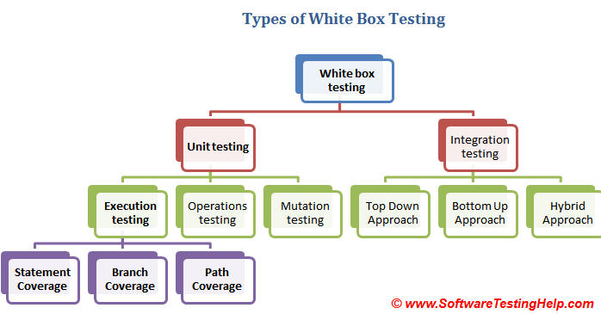
WHITE BOX TESTING:

Slide 9
White Box Testing Techniques:
White Box Testing is coverage of the specification in the code:
i. Statement Coverage/Line Coverage –
Write enough test cases to execute every statement at least once.
Statement Testing = (Number of Statements Exercised / Total Number of Statements) x 100 %
ii. Branch Coverage /Decision Coverage-
This technique is running a series of tests to ensure that all branches are tested at least once.
Branch Testing = (Number of decisions outcomes tested / Total Number of decision Outcomes) x 100 %
iii. Condition Coverage: is also known as Predicate Coverage
Condition coverage is seen for Boolean expression, condition coverage ensures whether all the Boolean expressions have been evaluated to both TRUE and FALSE.
iv. Path Coverage -
This technique corresponds to testing all possible paths which means that each statement and branch is covered.
Path Coverage = (Number paths exercised / Total Number of paths in the program) x 100 %

Slide 10
WHITE BOX TESTING:
  LINE COVERAGE OR STATEMENT COVERAGE:
In a programming language, a statement is nothing but the line of code or instruction for the computer to understand and act accordingly. A statement becomes an executable statement when it gets compiled and converted into the object code and performs the action when the program is in a running mode.
Hence “Statement Coverage”, as the name itself suggests, it is the method of validating whether each and every line of the code is executed at least once.
Statement coverage is also known as line coverage.
Ensure that each code statement is executed once.
Relatively weak criterion
Weakest white-box criterion
The formula to calculate statement coverage is:
Statement Coverage = (Number of statements exercised/Total number of statements in Program)*100
Studies in the software industry have shown that black-box testing may actually achieve only 60% to 75% statement coverage, this leaves around 25% to 40% of the statements untested.

Slide 11
WHITE BOX TESTING:
  LINE COVERAGE OR STATEMENT COVERAGE:
Consider the below simple pseudocode: Test case 1
INPUT A & B A=40
C = A + B B=70
IF C>100 C=110
PRINT “ITS DONE”
For Statement Coverage –We would only need one test case to check all the lines of the code.
That means:
If I consider TestCase_01 to be (A=40 and B=70), then all the lines of code will be executed
Statement Testing = (Number of Statements Exercised / Total Number of Statements) x 100 %
Statement Coverage=(4/4)*100=100%

Slide 12
WHITE BOX TESTING:
  LINE COVERAGE OR STATEMENT COVERAGE:
Now the question arises:
Is that sufficient?
What if I consider my Test case as A=35 and B=45?
C=90
Because Statement coverage will only cover the true side, for the pseudo code, only one test case would NOT be sufficient to test it. As a tester, we have to consider the negative cases as well.
Hence for maximum coverage, we need to consider “Branch Coverage”, which will evaluate the “FALSE” conditions.
In the real world, you may add appropriate statements when the condition fails
INPUT A & B
C = A + B
IF C>100
PRINT “ITS DONE”

Slide 13
WHITE BOX TESTING:
  LINE COVERAGE OR STATEMENT COVERAGE:
Example 2: Test data 1
Print Sum (int a int b) contains value of A=3 , B=2
Int result = a+b;
If (result>0)
Print color (“red”, result); Test data 2
Else if (result<0) contain value A= -1 ,B=0
Print color (“blue”, result);
}
Statement Testing = (Number of Statements Exercised / Total Number of Statements) x 100 %
Tet data 1= Statement Coverage=(5/7)*100=71%
Test data 2= Statement Coverage=(7/7)*100=100%

Slide 14
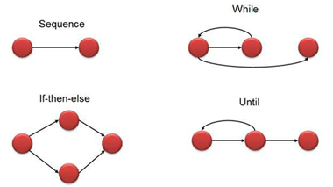
WHITE BOX TESTING:
Control Flow Graph:
A control flow graph (CFG) is the graphical representation of control flow or computation during the execution of programs or applications. Control flow graphs are mostly used in static analysis as well as compiler applications, as they can accurately represent the flow inside of a program unit.
Flow graph notation for a program:
Flow Graph notation for a program is define as several nodes connected through the edges. Below are flow diagrams for statements like if-else, While, until and normal sequence of flow.
Flow graph notation for a program:
Flow Graph notation for a program is define as several nodes connected through the edges. Below are flow diagrams for statements like if-else, While, until and normal sequence of flow.
Nodes represent entries, exits, decisions and each statement of code.
Edges represent non-branching and branching links between nodes.

Slide 15
WHITE BOX TESTING:
  LINE COVERAGE OR STATEMENT COVERAGE:
100% Statement Coverage Tip:
You need to find out the shortest number of paths following which all the nodes will be covered
You can say you have achieved 100% statement coverage if your test cases executes every statement in the code at-least once. ..

Slide 16
WHITE BOX TESTING:
  LINE COVERAGE OR STATEMENT COVERAGE:
Example 3:
Let's solve a problem on statement coverage so that you know how to solve such question when asked in exam.
How many test case are required to achieve 100% statement coverage?
Switch PC on
Start "outlook"
IF outlook appears THEN
Send an email
Close outlook

Slide 17
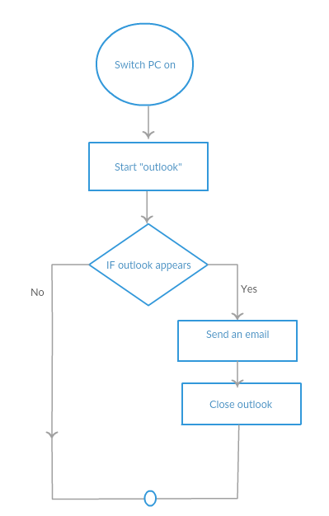
WHITE BOX TESTING:
  LINE COVERAGE OR STATEMENT COVERAGE:
Example 3:
i. Switch PC on
ii. Start "outlook"
iii. IF outlook appears THEN
iv. Send an email
v. Close outlook

Slide 18
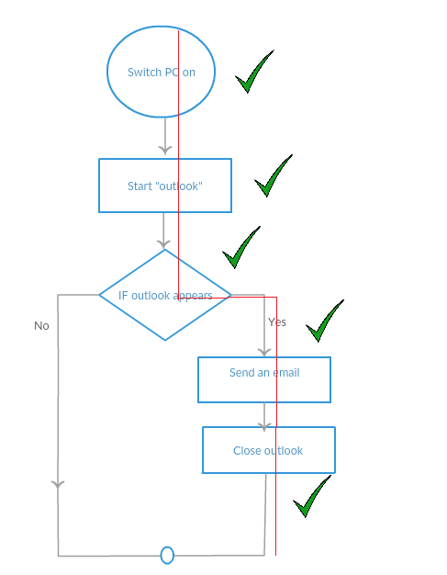
WHITE BOX TESTING:
  LINE COVERAGE OR STATEMENT COVERAGE:
Example 3:
i. Switch PC on Node: A
ii. Start "outlook“ Node :B
iii. IF outlook appears THEN C
iv. Send an email Node: D
v. Close outlook Node : E
Solution:
As you seen in diagram below in one path we can cover all statements.
So 1 test case is enough to achieve 100% statement coverage
Path: A->B->C->D->E

Slide 19
THANKYOU
☺

