Slide 1

WELCOME TO 14TH LECTURE OF
Software Testing Techniques and Strategies
COURSE CODE :SE-484

Slide 2
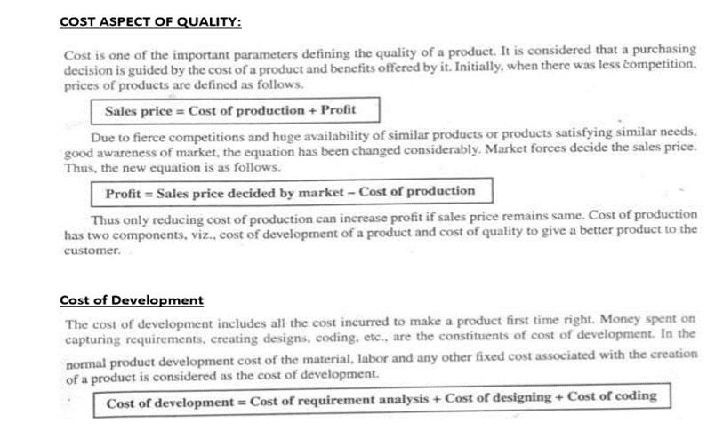

Slide 3
WHITE BOX TESTING:
Cost of Quality:
DEFINITION:
Cost of Quality (COQ) is a measure that quantifies the cost of control/conformance and the cost of failure of control/non-conformance. In other words, it sums up the costs related to prevention and detection of defects and the costs due to occurrences of defects.
Definition by ISTQB: cost of quality: The total costs incurred on quality activities and issues and often split into prevention costs, appraisal costs, internal failure costs and external failure costs.
Definition by QAI: Money spent beyond expected production costs (labor, materials, and equipment) to ensure that the product the customer receives is a quality (defect free) product. The Cost of Quality includes prevention, appraisal, and correction or repair costs.

Slide 4
EXPLANATION:
• Cost of Control (Also known as Cost of Conformance)
i . Prevention Cost
The cost arises from efforts to prevent defects.
Example: Quality Assurance costs o Appraisal Cost
The cost arises from efforts to detect defects.
Example: Quality Control costs
• Cost of Failure of Control (Also known as Cost of Non-Conformance)
i . Internal Failure Cost
The cost arises from defects identified internally and efforts to correct them.
Example: Cost of Rework (Fixing of internal defects and retesting)
External Failure Cost
The cost arises from defects identified by the client or end-users and efforts to correct them.
Example: Cost of Rework (Fixing of external defects and retesting) and any other costs due to external defects (Product service/liability/recall, etc):

Slide 5
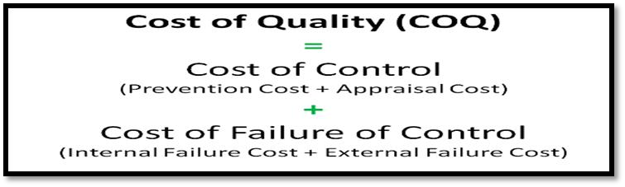
WHITE BOX TESTING:
FORMULA :
Cost of Quality (COQ) = Cost of Control + Cost of Failure of Control
where
Cost of Control = Prevention Cost + Appraisal Cost
and
Cost of Failure of Control = Internal Failure Cost + External Failure Cost
Cost of production=Cost od development+ Cost of Quality
{ (requirement+design+coding ) +(Cost of Control +Cost of failure control )}
{ (requirement+design+coding ) +(Prevention Cost + Appraisal Cost +Internal Failure Cost + External Failure Cost

Slide 6
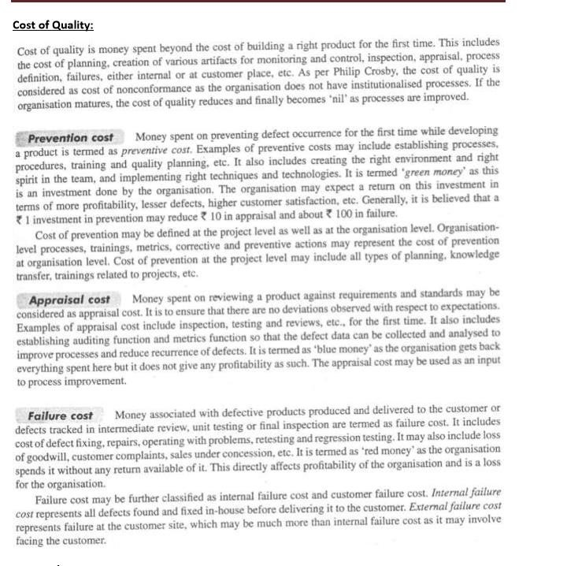

Slide 7
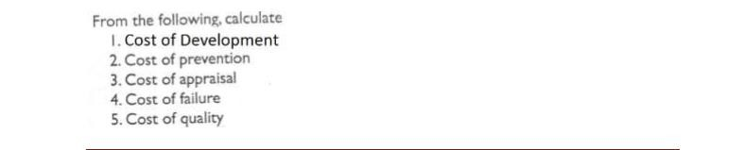
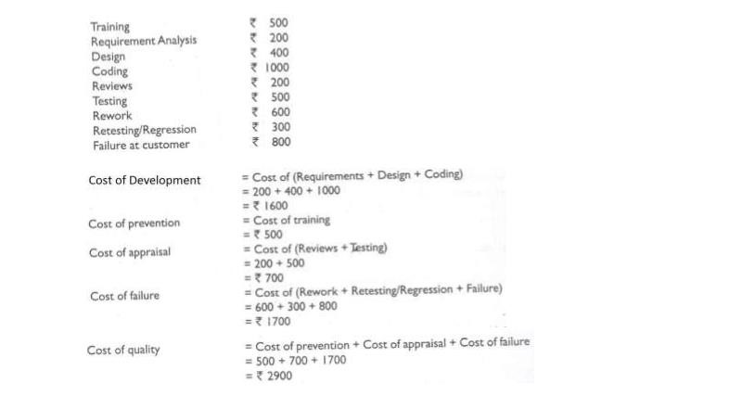
WHITE BOX TESTING:

Slide 8
Conclusion:
In its simplest form, COQ can be calculated in terms of effort (hours/days).
A better approach will be to calculate COQ in terms of money (converting the effort into money and adding any other tangible costs like test environment setup).
The best approach will be to calculate COQ as a percentage of total cost. This allows for comparison of COQ across projects or companies.
To ensure impartiality, it is advised that the Cost of Quality of a project/product be calculated and reported by a person external to the core project/product team (Say, someone from the Accounts Department).
It is desirable to keep the Cost of Quality as low as possible. However, this requires a fine balancing of costs between Cost of Control and Cost of Failure of Control. In general, a higher Cost of Control results in a lower Cost of Failure of Control. But, the law of diminishing returns holds true here as well

Slide 9
Problem reporting, tracking and analyses
SOFTWARE DEFECTS MANAGEMENT
Defect or Bug
When a tester executes the test cases, he might come across the test result which is contradictory to expected result. This variation in the test result is referred as a defect. These defects or variation are referred by different names in a different organization like issues, problem, bug or incidents.
Debugging:
Identify and remove errors from program (code) is known as debugging.
Bug reports
Reports detailing bugs in software are known as bug reports.
Why Bugs Occur in the Software?
Plentiful studies have been on very little projects to extremely large ones and the analysis shows various causes of bugs in the software, few of them are listed below:
One of the extreme causes is the specification. In several cases, specifications are the largest producer of bugs. Either specifications are not written, specifications are not thorough enough, constantly changing or not communicated well to the development team.
Another bigger reason is that software is always created by human beings. They know numerous things but are not expert and might make mistakes.
Further, there are deadlines to deliver the project on time. So increasing pressure and workload conduct in no time to check, compromise on quality and incomplete systems. So this leads to occurrence of Bugs.

Slide 10
Problem reporting, tracking and analysis
SOFTWARE DEFECTS MANAGEMENT
Types of Program Error
There are three basic categories of program errors:
Syntax Errors
Run-time Errors
Logic Errors
In the Syntax and Rum-time errors, when an error occurs, the computer displays an 'Error Message', which describes the error, and its cause. Unfortunately, error messages are often difficult to interpret, and are sometimes misleading. In the logical errors , the program will not show an error message.

Slide 11
Syntax Errors
These errors are the easiest to find because they are highlighted by the compiler. Error messages are given. This type of error is caused by the failure of the programmer to use the correct grammatical rules of the language.
Syntax errors are detected, and displayed, by the compiler as it attempts to translate your program, i.e the Source code into the Object code. If a program has a syntax error it cannot be translated, and the program will not be executed.
The compiler tries to highlight syntax errors where there seems to be a problem, however, it is not perfect and sometimes the compiler will indicate the next line of code as having the problem rather than the line of code where the problem actually exists.
Run-Time Errors
• Run-time errors are detected by the computer and displayed during
execution of a program.
• They will halt the program when they occur but they often do not show up for some time.
• A run illegal operation, eg:-time error occurs when the user directs th e computer to perform an
Dividing a number by zero
Assigning a variable to the wrong type of variable
Using a variable in a program before assigning a value to it.
• When a run-time error occurs, the computer stops executing your program, and displays a diagnostic message that
indicates the line where the error occurred.
Logic Errors
• These are the hardest errors to find as they do not halt the program. They arise from faulty thinking on behalf of the
programmer. They can be very troublesome.
• These are mistakes in a program's logic.
• Programs with logic errors will often compile, execute, and output results. However, at least some of the time the
output will be incorrect. Error messages will generally not appear if a logic error occurs, this makes logic errors very
difficult to locate and correct.

Slide 12
SOFTWARE DEFECTS MANAGEMENT
User Interface or Cosmetic Bug:
These types of errors are the result of incorrect formatting.
The software functionality is least affected by these kind of errors.
For example: Spelling mistake (typographical error),
incorrect color in any specific field,
incorrect width / height / length of any field etc.
Cosmetic errors with the logo of a company or incorrect name of the company in the software could lead to huge monetary losses.
Such errors least affect the software functionality but they could lead to copyright / patent / legal issues
Defects/Bug Severity and Priority
There are two key things in defects/bug of the software testing.
1. Severity
2. Priority

Slide 13
Defect Severity:
Severity of a defect is related to how severe a bug is. Or It is defined as the degree of impact that a defect has on the functionality of the product/ system. For example: If an application or web page crashes when a remote link is clicked, in this case clicking the remote link by an user is rare but the impact of application crashing is severe. So the severity is high but priority is low. Defect severity can be categorized into four types as follows:
Critical: The defect that results in the termination of the complete system or one or more component of the system and causes extensive corruption of the data. The failed function is unusable and there is no acceptable alternative method to achieve the required results then the severity will be stated as critical.
Major: The defect that results in the termination of the complete system or one or more component of the system and causes extensive corruption of the data. The failed function is unusable but there exists an acceptable alternative method to achieve the required results then the severity will be stated as major.
Moderate: The defect that does not result in the termination, but causes the system to produce incorrect, incomplete or inconsistent results then the severity will be stated as moderate.
Cosmetic/ Low: The defect that is related to the enhancement of the system where the changes are related to the look and feel of the application then the severity is stated as cosmetic.
SOFTWARE DEFECTS MANAGEMENT

Slide 14
SOFTWARE DEFECTS MANAGEMENT
Defect Priority:
Priority of a defect is related to how quickly a bug should be fixed and deployed to live servers
Or
Priority defines the order in which we should resolve a defect. Should we fix it now, or can it wait?
This priority status is set by the tester to the developer mentioning the time frame to fix the defect.
If high priority is mentioned then the developer has to fix it at the earliest.
The priority status is set based on the customer requirements.
For example: If the company name is misspelled in the home page of the website, then the priority is high and severity is low but the developer has to fix it.
Priority can be of following types:

Slide 15
SOFTWARE DEFECTS MANAGEMENT
Defect Priority:
Low: The defect is an irritant which should be repaired, but repair can be deferred until after more serious defect has been fixed.
Medium: The defect should be resolved in the normal course of development activities. It can wait until a new build or version is created
High: The defect must be resolved as soon as possible because the defect is affecting the application or the product severely. The system cannot be used until the repair has been done.
Few very important scenarios related to the severity and priority which are asked during the interview:
High Priority & High Severity: An error which occurs on the basic functionality of the application and will not allow the user to use the system. (Eg. A site maintaining the student details, on saving record if it, doesn’t allow to save the record then this is high priority and high severity bug)
High Priority & Low Severity: The spelling mistakes that happens on the cover page or heading or title of an application.
High Severity & Low Priority: An error which occurs on the functionality of the application (for which there is no workaround) and will not allow the user to use the system but on click of link which is rarely used by the end user.
Low Priority and Low Severity: Any cosmetic or spelling issues which is within a paragraph or in the report (Not on cover page, heading, title).
Priority can be of following types:

Slide 16
DEFECT/BUG LIFE CYCLE OR A BUG LIFECYCLE IN SOFTWARE TESTING
Defect life cycle is a cycle which a defect goes through during its lifetime.
It starts when defect is found and ends when a defect is closed, after ensuring it’s not reproduced.
Defect life cycle is related to the bug found during testing.

Slide 17
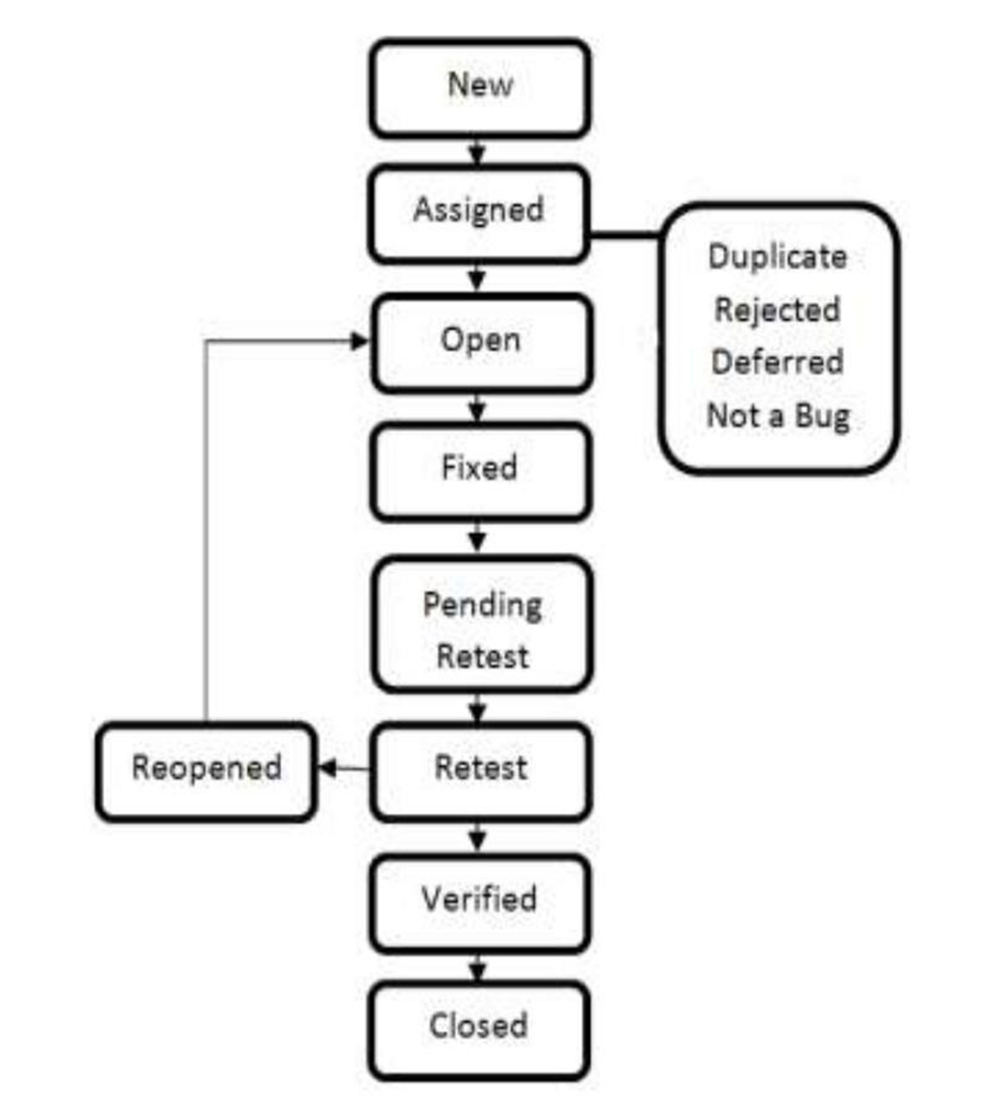
DEFECT/BUG LIFE CYCLE OR A BUG LIFECYCLE IN SOFTWARE TESTING
Bug or defect life cycle includes following steps or status:
New: When a defect is logged and posted for the first time. Its state is given as new.
Assigned: After the tester has posted the bug, the lead of the tester approves that the bug is genuine and he assigns the bug to corresponding developer and the developer team. Its state given as assigned.
Open: At this state the developer has started analyzing and working on the defect fix.
Fixed: When developer makes necessary code changes and verifies the changes then he/she can make bug status as ‘Fixed’ and the bug is passed to testing team.
Pending retest: After fixing the defect the developer has given that particular code for retesting to the tester. Here the testing is pending on the testers end. Hence its status is pending retest.
Retest: At this stage the tester do the retesting of the changed code which developer has given to him to check whether the defect got fixed or not.
Verified: The tester tests the bug again after it got fixed by the developer. If the bug is not present in the software, he approves that the bug is fixed and changes the status to “verified”.

Slide 18
DEFECT/BUG LIFE CYCLE OR A BUG LIFECYCLE IN SOFTWARE TESTING
Reopen: If the bug still exists even after the bug is fixed by the developer, the tester changes the status to “reopened”. The bug goes through the life cycle once again.
Closed: Once the bug is fixed, it is tested by the tester. If the tester feels that the bug no longer exists in the software, he changes the status of the bug to “closed”. This state means that the bug is fixed, tested and approved.
Duplicate: If the bug is repeated twice or the two bugs mention the same concept of the bug, then one bug status is changed to “duplicate“.
Rejected: If the developer feels that the bug is not genuine, he rejects the bug. Then the state of the bug is changed to “rejected”.
Deferred: The bug, changed to deferred state means the bug is expected to be fixed in next releases. The reasons for changing the bug to this state have many factors. Some of them are priority of the bug may be low, lack of time for the release or the bug may not have major effect on the software.
Not a bug: The state given as “Not a bug” if there is no change in the functionality of the
Application. For an example: If customer asks for some change in the look and field of the application like change of color of some text then it is not a bug but just some change in the looks of the application.

Slide 19
DEFECT/BUG LIFE CYCLE OR A BUG LIFECYCLE IN SOFTWARE TESTING
Defect report or Bug report consists of the following information:
1. Bug ID – Every bug or defect has it’s unique identification number
2. Bug Description – This includes the abstract of the issue.
Product Version – This includes the product version of the application in which the defect is found.
Detail Steps – This includes the detailed steps of the issue with the screenshots attached so that
developers can recreate it.
5. Date Raised – This includes the Date when the bug is reported
6. Reported By – This includes the details of the tester who reported the bug like Name and ID
Status – This field includes the Status of the defect like New, Assigned, Open, Retest,
Verification, Closed, Failed, Deferred, etc.
8. Fixed by – This field includes the details of the developer who fixed it like Name and ID
9. Date Closed – This includes the Date when the bug is closed
Severity – Based on the severity (Critical, Major or Minor) it tells us about impact of the defect
or bug in the software application
Priority – Based on the Priority set (High/Medium/Low) the order of fixing the defect can be
made.
Bug | Bug | Product | Detail | Date | Reported | Status | Fixed | Date | Severity | Priority
ID | Desc. | Vision | Steps | Raised | By |  | by | Closed

Slide 20

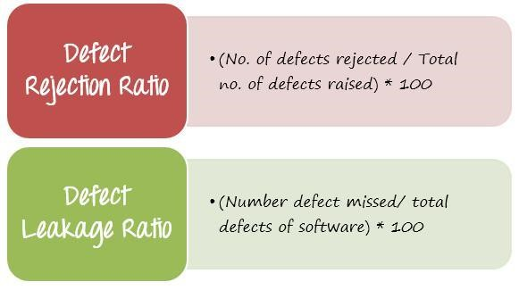
Defect Metrics
Important Defect Metrics
Back the above scenario. The developer and test teams have reviews the defects reported. Here is the result of that discussion
Q. How to measure and evaluate the quality of the test execution?
This is a question which every
Test Manager wants to know.
There are 2 parameters which you
can consider as following

Slide 21
Defect Metrics
Important Defect Metrics
Back the above scenario. The developer and test teams have reviews the defects reported.
Here is the result of that discussion
Q. How to measure and evaluate the quality of the test execution?
This is a question which every
Test Manager wants to know.
There are 2 parameters which you
can consider as following

Slide 22

Defect Metrics
In the given scenario, you can calculate the
defection rejection ratio (DRR) is 20/84 =
0.238 (23.8 %).
Another example, supposed the Bank website has total 64 defects, but your testing team only detect 44defects i.e. they missed 20 defects.
Therefore, you can calculate the defect leakage ratio (DLR) is 20/64 = 0.312(31.2 %).

Slide 23
Defect Metrics
Conclusion, the quality of test execution is evaluated via following two parameters
The smaller value of DRR and DLR is, the better quality of test execution is.
Q. What is the ratio range which is acceptable?
This range could be defined and accepted base in the project target or you may refer the metrics of similar projects.
In this project, the recommended value of acceptable ratio is 5 ~ 10%. It means the quality of test execution is low. You should find countermeasure to reduce these ratios such as
Improve the testing skills of member.
Spend more time for testing execution, especially for reviewing the test execution results.

Slide 24
Defect Density
Defect Density is the number of defects confirmed in software/module during a specific period of operation or development divided by the size of the software/module. It enables
the one, to decide if a piece of software is ready to be released.
Defect density is counted per thousand lines of code also known as KLOC. Formula to measure Defect Density:
Defect Density = Defect count/ size of the release
Example 1:
Suppose 10 bugs are found in 1 KLOC Therefore DD is 10/KLOC
For better understanding, consider the following example.
Example 2:
Suppose you have a software product which has been integrated with the 4 modules and you found the following bugs in each of the modules.
Module 1 = 20 bugs
Module 2 = 30 bugs
Module 3 = 50 bugs
Module 4 = 60 bugs
And the total line of code for each module is

Slide 25
Defect Density
Example 2:
And the total line of code for each module is
Module 1 = 1200 LOC
Module 2 = 3023 LOC
Module 3 = 5034 LOC
Module 4 = 6032 LOC
Total Size of module = 15289 LOC
Then, we calculate defect density as : Defect Density = Defect count/ size of the release
Defect Density = 160/15289 = 0.01046504 defects/loc = 10.465 defects/Kloc
We can use defect density to calculate the following:
1. We can predict the remaining defect in the software product by using the defect density.
2. We can determine whether our testing is sufficient before the release.
3. We can ensure a database of standard defect densities.
Suppose you have a software product which has been integrated with the 4 modules and you found the following bugs in each of the modules.
Module 1 = 20 bugs
Module 2 = 30 bugs
Module 3 = 50 bugs
Module 4 = 60 bugs
Total bugs = 20+30+50+60 = 160

Slide 26
Difference between Defect Priority and Defect Severity
Defect Priority | Defect Severity
Priority defines the order in which the | It is defined as the degree of impact that a defect has
developer should resolve a defect | on the operation of the product
Priority is categorized into three types | Severity are categorized into four types
1. Low | 1. Critical
2. Medium | 2. Major
3. High | Moderate Cosmetic
Priority is associated with scheduling | Severity is associated with functionality or standards
Priority indicates how soon the bug should be | Severity indicates the seriousness of the defect on the
fixed | product functionality
Priority of defects is decided in consultation | QA engineer determines the severity level of the
with the manager/client | defect
Priority is driven by business value | Severity is driven by functionality
Its value is subjective and can change over a period of time depending on the change in the project situation | Its value is objective and less likely to change
High priority and low severity status indicates, | High severity and low priority status indicates defect
defect have to be fixed on immediate bases but does not affect the application | have to be fixed but not on immediate bases
Priority status is based on the customer requirements | Severity status is based on the technical aspect of the product
During UAT the development team fix defects | During SIT, the development team will fix defects
based on priority | based on the severity and then priority

Slide 27
THANKYOU ☺

