Slide 1

WELCOME TO THIRD LECTURE OF
Software Testing Techniques and Strategies
COURSE CODE :SE-484
Course Instructor :Simra Najm

Slide 2
Dynamic Testing?
Under Dynamic Testing code is executed. Dynamic execution is applied as a technique to detect defects and to determine quality attributes of the code
It checks for functional behavior of software system , memory/cpu usage and overall performance of the system. Hence the name "Dynamic"
Main objective of this testing is to confirm that the software product works in conformance with the business requirements. This testing is also called as Execution technique or Validation testing.

Slide 3
Dynamic Testing?
Dynamic testing executes the software and validates the output with the expected outcome. Dynamic testing is performed at all levels of testing and it can be either black or white box testing.
Dynamic Testing and Static Testing are complementary methods, as they tend to find
different types of defects effectively and efficiently. But as it does not start early in
the Software Development Life Cycle hence it definitely increases the cost of fixing defects.
It is done during Validation Process evaluating the finished product.

Slide 4
Levels of Software Testing:
In Software development, both developers and testers work together to release a high-quality product. To release a high-quality product,
every product goes through various testing processes. Coming to testing, testers use various levels of testing in the process of releasing a quality product.
There are different levels of software testing. Each of these levels of software testing has a specific purpose. We will see each software testing level in detail.
Levels of Software Testing:
Let’s see what are the levels of software testing:
Different levels of software testing are as follows.
1. Unit Testing 2. Integration Testing 3. System Testing 4. Acceptance Testing

Slide 5
FEATURES OF Dynamic TESTING
Testing is done by executing the program
It helps detect defects in the software.
Determines the quality attributes of the code.
Assists the team in identifying bugs and bottlenecks of the software.
Validating the consistency of the software product.
It is a more formal approach for test case identification, coverage consideration, test execution, and reporting.
Dynamic testing involves both functional and non-functional testing.
It is executed during the validation stage of the software testing
Therefore, the reasons for performing dynamic testing are:
Measuring the impact of various environmental stresses on the software product, such as hardware, network,
To find errors and defects in the software.
The team executes the code to test the performance of the software product in a run-time environment.
To check the functional behavior of the software with the expectations and requirements of the client as well as the end user.
Assists the team in evaluating and validating the output with the expected output.
Most importantly, it helps the team to validate the overall performance of the software

Slide 6
Dynamic Techniques
Dynamic Techniques are subdivided into three more categories:
Specification Based Testing : is also known as Behavior Based Testing and Black Box Testing techniques because in this testers view the software as a black-box. Tester have no knowledge of the code and how the system or component is structured inside the box This includes both Functional Testing and Non Functional Testing.
Structure Based Testing techniques use the internal structure of a software to derive test cases. They are commonly called 'white-box' or 'glass-box' techniques. Structure-based techniques can also be used at all levels of testing
Experience Based Testing techniques involve the knowledge and experience of the testers and other stakeholders. They derive the test conditions by applying their knowledge in application and technologies. This testing technique is usually used when there is insufficient information and time in the project

Slide 7
Advantages of Dynamic Testing
1. Considered High Level Exercise: It can always find errors that static testing cannot find and that is the reason why it is considered as high level exercise.
2. Improves Quality: Executing the software leads to the chances of finding more bugs in the application, so it ensures error free software to some extent.

Slide 8
Disadvantages of Dynamic TestinG
Time Consuming: It is a time consuming task because its aim is to execute the application or software and as a result more test cases are needed to execute.
Increases cost of Product: It can not done early in the software life cycle and hence bugs fixed in later stages result in more cost.
Costly: It requires more man power to complete the task

Slide 9
Example to differentiate between Static Testing and Dynamic Testing:
Software Application: Online Shopping Cart
Static Test Techniques:
Review the requirement documents, design documents initially
Checking the GUI of the application
Checking the database structure of the application.
Dynamic Testing Techniques:
Testing the functionality of the different page.
Checking the checkout process and payment methods.
Testing the interfaces between different pages.

Slide 10
Cleanroom Approach Cleanroom Software Engineering is an engineering process for development of high quality software with certified reliability with the emphasis on design with no defects and test based on software reliability engineering concepts. CSE focuses on defect prevention instead of defect correction and certified the reliability for the intended environment use.

Slide 11
:
Cleanroom Approach
.
The Cleanroom Process
From "Cleanroom Software Engineering for Zero-Defect Software," by R. C. Linger. Proceedings Fifteenth International Conference on Software Engineering, May 17�21. © 1993 IEEE. Reprinted with permission.

Slide 12
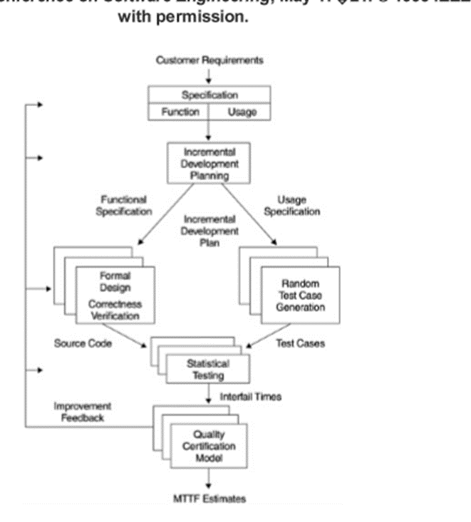

Slide 13
Cleanroom Software Engineering approaches software development as an engineering process with mathematical foundations rather than a trial-and-error programming process (Linger and Hausler, 1992).
This kind of testing depends heavily on walkthroughs, inspection, and formal verification.
The programmers don’t seem to be allowed to check any of their code by corporal punishment the code apart from doing a little syntax testing employing a compiler.
The computer code development philosophy relies on avoiding computer code defects by employing a rigorous examination method. the target of this computer code is that the zero-defect computer code.

Slide 14
The Cleanroom process proclaims that statistical testing can replace coverage and path testing.
In Cleanroom, all testing is based on anticipated customer usage.
Test cases are designed to rehearse the more frequently used functions.
Therefore, errors that are likely to cause frequent failures to the users are likely to be found first.
In terms of measurement, software quality is certified in terms of mean time to failure (MTTF).

Slide 15
The clean room approach to computer code development relies on 5 characteristics:
Formal specification: The computer code to be developed is formally given. A state-transition model that shows system responses to stimuli is employed to precise the specification.
Incremental development: Structured programming: Static verification: The developed computer code is statically verified mistreatment rigorous computer code inspections. there’s no unit or module testing method for code parts.
Statistical testing of the system: Note: The main drawback with this approach is that testing effort is augmented as walkthroughs, inspection, and verification area unit time- overwhelming.

Slide 16
Sr. No. | Key | Static Testing | Dynamic Testing
1 | Definition | Static testing is the testing in which code written for application is not executed during testing phase and only review of code is performed and on the basis of which defects and code quality has been examined. | On other hand during Dynamic testing there is execution of code written for the application and then defects and application behaviour has been examined.
2 | Nature of testing | As name states static testing does the static verification process in which the requirement and corresponding written code has been verified. | Dynamic testing on other hand does the validation process which examines the expected behaviour of the application based on dynamic inputs provided to the application.
3 | Testing target | As mentioned above static testing targets to the assessment of code and documentation. | On other Dynamic testing targets the runtime bugs/bottlenecks in the software system.
4 | Prerequisite | For static testing check-list of application process and documentation is required. | On other hand for dynamic testing test cases for execution has been developed.
5 | Stage of testing | Static testing generally get performed before compilation of code. | While Dynamic testing mostly performed after compilation of code.
6 | Cost to Company | In Static testing cost of finding defects and fixing is less also return on investment will be high as this testing involved at an early stage. | On other hand in case of Dynamic testing cost of finding and fixing defects is high and also return on investment will be low as this process involves after the development phase
It includes walkthroughs, code review, inspection etc. | It involves functional and nonfunctional
Static testing prevents the defects. | Dynamic testing finds and fixes the defects.

Slide 17

Validation is the process of checking whether the specification captures the customer’s needs.
"building the right product" refers back to the user's needs.
Verification is the process of checking that the software meets the specification/requirements you have written.
While
building the product right " checks that the specifications are correctly implemented by the system

Slide 18
Difference between Verification and Validation
Verification | Validation
1. Verification is a static practice of verifying documents, design, code and program. | 1. Validation is a dynamic mechanism of validating and testing the actual product.
2. It does not involve executing the code. | 2. It always involves executing the code.
3. It is human based checking of documents and files. | 3. It is computer based execution of program.
4. Verification uses methods like inspections, reviews, walkthroughs, etc. | 4. Validation uses methods like black box (functional) testing, gray box testing, and white box (structural) testing etc.
5. Verification is to check whether the software conforms to specifications. | 5. Validation is to check whether software meets the customer expectations and requirements.
6. It can catch errors that validation cannot catch. It is low level exercise. | 6. It can catch errors that verification cannot catch. It is High Level Exercise.
7. Target is requirements specification, application and software architecture, high level, complete design, and database design etc. | 7. Target is actual product-a unit, a module, a bent of integrated modules, and effective final product.
8. Verification is done by QA team to ensure that the software is as per the specifications in the SRS document. | 8. Validation is done by QC team and carried out with the involvement of testing team.
9. It generally comes first-done before validation. | 9. It generally follows after verification.

Slide 19
Conclusion on difference BETWEEN Verification and Validation in software testing:
Both Verification and Validation are essential and balancing to each other.
Different error filters are provided by each of them.
Both are used to finds a defect in different way, Verification is used to identify the errors in requirement specifications & validation is used to find the defects in the implemented Software application.

Slide 20

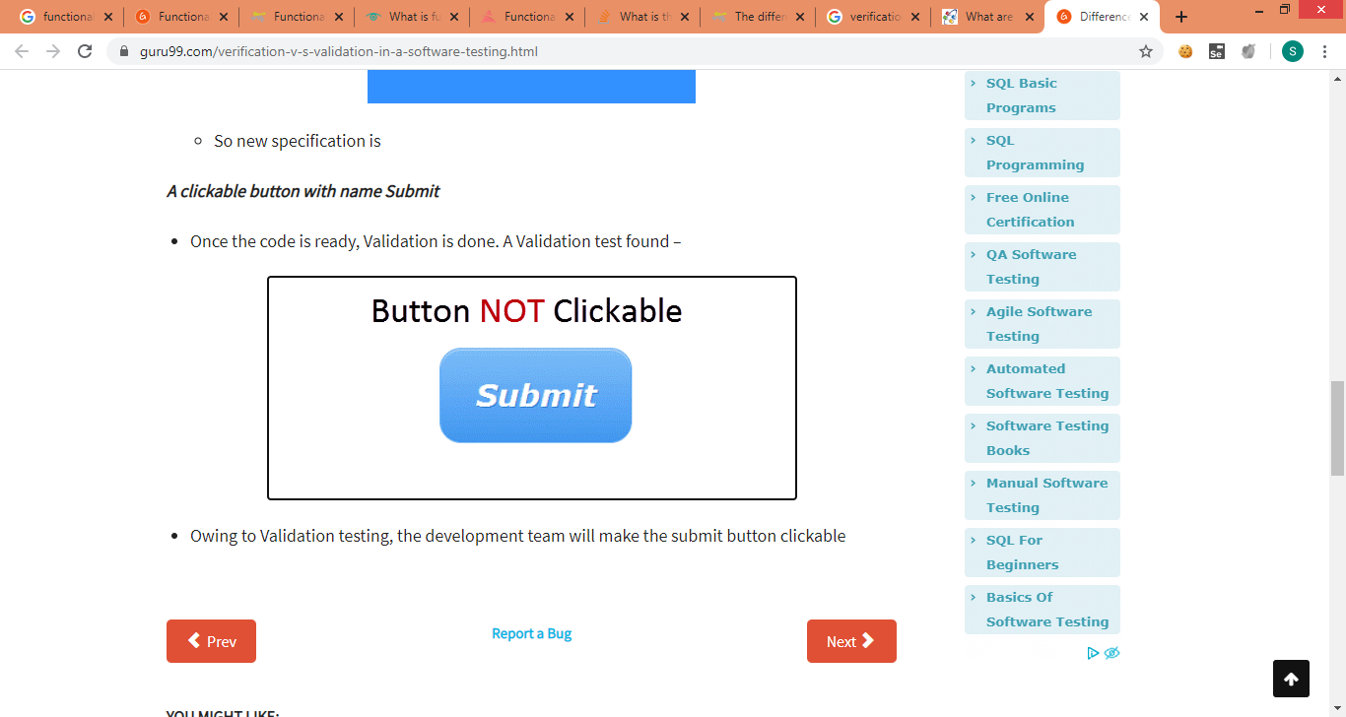
Example
Verification would check the design doc and correcting the spelling mistake.
Otherwise, the development team will create a button like
So new specification is
A clickable button with name Submit
Once the code is ready, Validation is done. A Validation test found –
Owing to Validation testing, the development team will make the submit button clickable

Slide 21
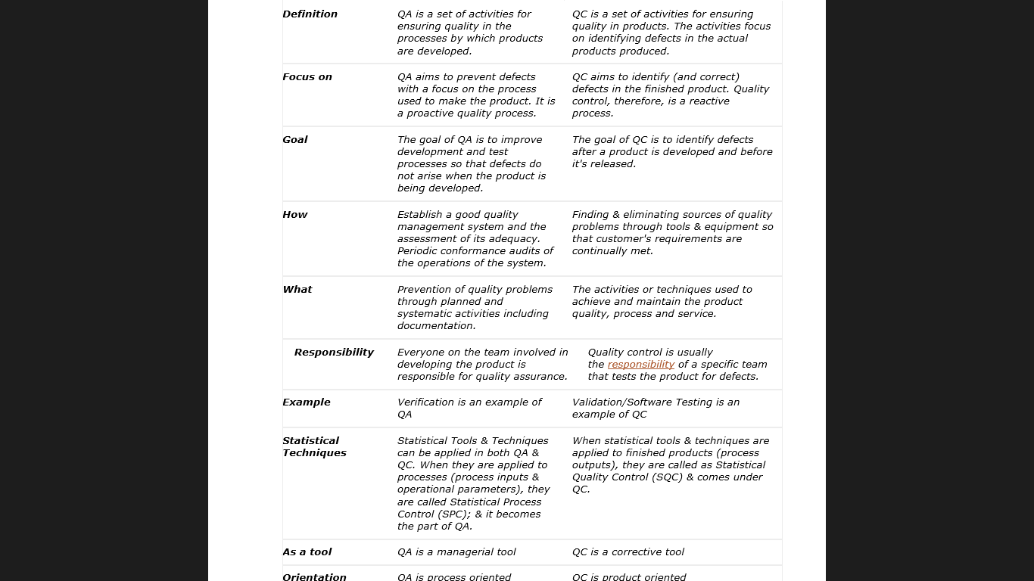
Quality Assurance /Quality control:

Slide 22
What is a Functional Requirement?
Any requirement which specifies what the system should do.
In other words, a functional requirement will describe a particular behaviour of function of the system when certain conditions are met,
It describes the functions a software must perform.
A function is nothing but inputs, its behavior, and outputs.
It can be a calculation, data manipulation, business process, user interaction, or any other specific functionality which defines what function a system is likely to perform.
Functional software requirements help you to capture the intended behavior of the system.
This behavior may be expressed as functions, services or tasks or which system is required to perform.
For example: “Send email when a new customer signs up” or “Open a new account”.

Slide 23
Typical functional requirements include
Business Rules
Transaction corrections, adjustments and cancellations
Administrative functions
Authentication
Authorization levels
Audit Tracking
External Interfaces
Certification Requirements
Reporting Requirements
Historical Data
Legal or Regulatory Requirements

Slide 24
What is functional testing?
Functional Testing is a type of black box testing whereby each part of the system is tested against functional specification/requirements. For instance, seek answers to the following questions,
Are you able to login to a system after entering correct credentials?
Does your payment gateway prompt an error message when you enter incorrect card number?
Does your “add a customer” screen adds a customer to your records successfully?
Well, the above questions are mere samples to perform full-fledged functional testing of a system

Slide 25
Typically Testing is classified into three categories.
1.Functional Testing
Functional tests are processes designed to confirm that all of the components of a piece of code or software operate correctly. Functional testing focuses on testing the interface of the application to ensure that all user requirements are met.
. When we talk about delivering quality software, functional testing has the highest ROI since it is done with real data. Functional testing verifies that the software performs its stated functions in a way that the users expect.
2. Non Functional Testing
3. Maintenance

Slide 26
Function testing Goals
In functional testing, we can describe goals as intended outputs of the software testing process. The main goal of functional testing is to check how closely the feature is working as per the specifications. For better understanding, we can divide functional testing goals into two parts: validation testing and defect testing.
Validation testing:
To demonstrate the developer and client that the software meets the requirements.
A successful test should show that the system works as intended.
Defect testing:
To discover the defects in the functionality in terms of the user interface, error messages and text handling.
A successful test should expose the defects when the functionality does not work as expected.
For example, from the testing of the checkout process :

Slide 27
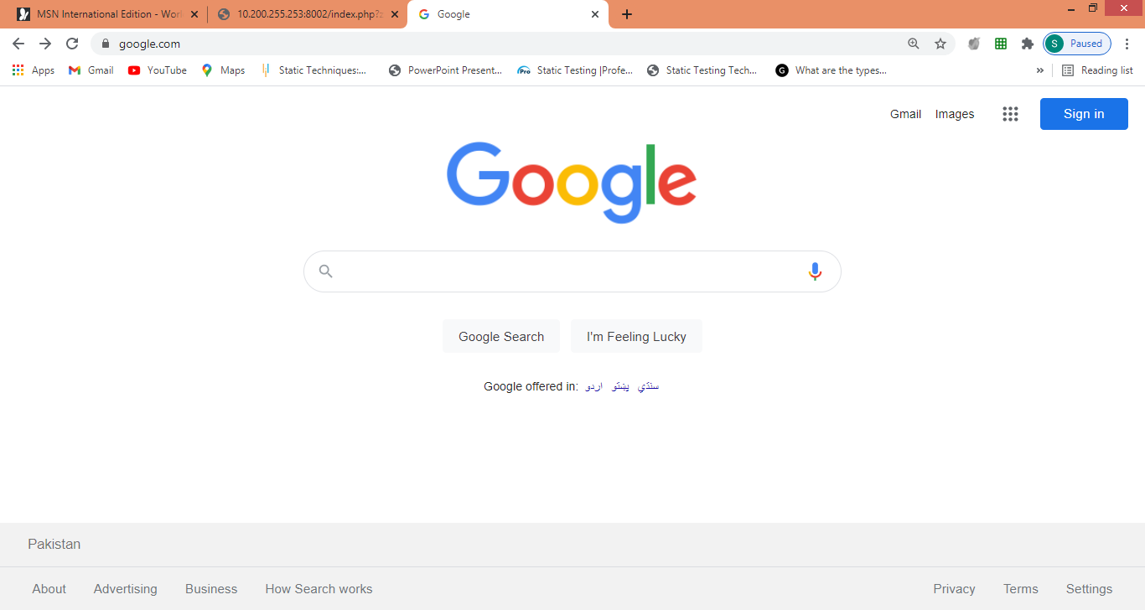

Slide 28
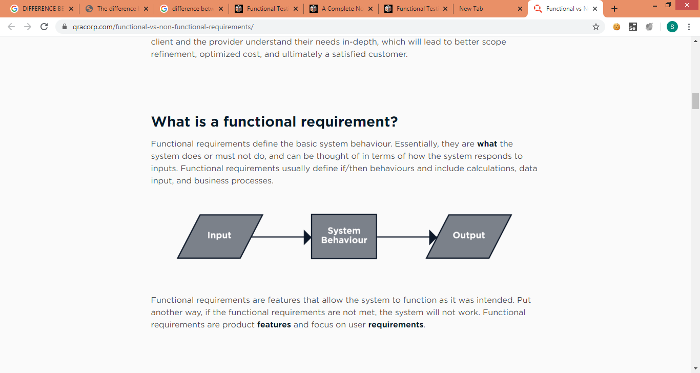
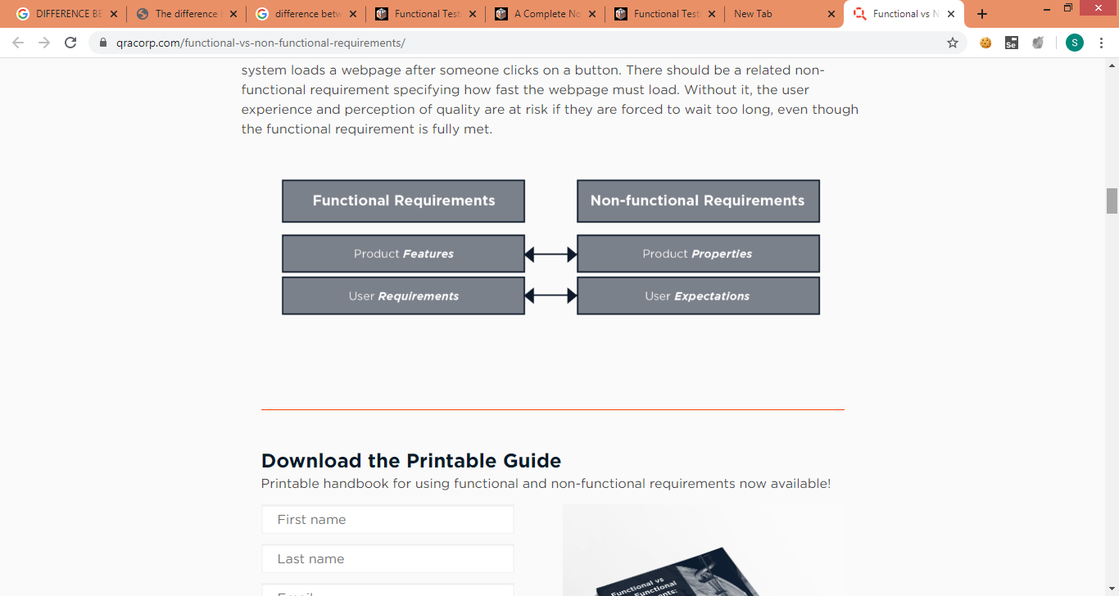

Slide 29
What is Non-Functional Requirement?
A non-functional requirement defines the quality attribute of a software system. They represent a set of standards used to judge the specific operation of a system. Example, how fast does the website load?
A non-functional requirement is essential to ensure the usability and effectiveness of the entire software system. Failing to meet non-functional requirements can result in systems that fail to satisfy user needs.
Non-functional Requirements allows you to impose constraints or restrictions on the design of the system across the various agile backlogs.
Example, the site should load in 3 seconds when the number of simultaneous users are > 10000.
Description of non-functional requirements is just as critical as a functional requirement.

Slide 30
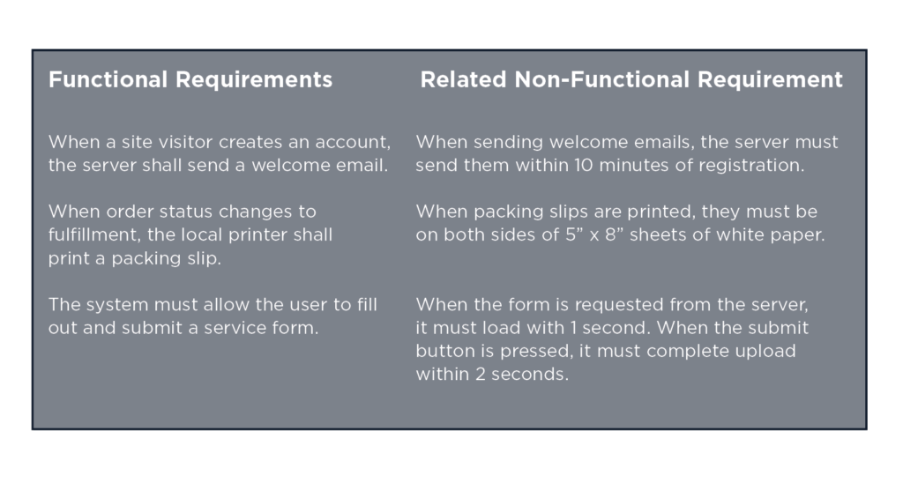

Slide 32
Typical non-functional requirements include
Performance – for example: response time, throughput, utilization, static volumetric
Scalability
Capacity
Availability
Reliability
Recoverability
Maintainability
Serviceability
Security
Regulatory
Manageability
Environmental
Data Integrity
Usability
Interoperability

Slide 33
Types of Function testing
The process of functional testing involves a series of tests: Smoke, Sanity, Integration, Regression, Interface, System and finally User Acceptance Testing. Tests are conducted on each feature of the software to determine its behavior, using a combination of inputs simulating normal operating conditions, and deliberate anomalies and errors.
Thus after rigorous functional testing, you receive software with the consistent user interface, proper integration with business processes, well-designed API having robust security and network features.
Smoke Testing:
This type of testing is performed before the actual system testing to check if the critical functionalities are working fine in order to carry out further extensive testing. We are testing the environment setup for testing

Slide 34

Sanity Testing:
It is a type of testing where only a specific functionality or a bug which is fixed is tested to check whether the functionality is working fine and see if there are no other issues due to the changes in the related components. It is a specific way of testing the application.
Integration Testing is performed when two or more functions or components of the software are integrated to form a system. It basically checks the proper functioning of the software when the components are merged to work as a single unit.
Regression testing is carried out on receiving the build of the software after fixing the bugs that were found in the initial round of testing. It verifies whether the bugs are fixed and checks if the entire software is working fine with the changes.
Localization Testing:
It is a testing process to check the software’s functioning when it is transformed into an application using a different language as required by the client.
In User Acceptance testing the application is tested based on the user’s comfort and acceptance by considering their ease of use.

Slide 35
Functional Testing Best Practices
.
Start writing testing cases early in the requirement analysis & design phase
If you start writing test cases during an early phase of the Software Development Life Cycle then you will understand whether all requirement is testable or not. While writing test cases first consider Valid/Positive test cases which cover all expected behavior of the application under test. After that, you can consider invalid conditions/negative test cases.

Slide 36
2.Non-Functional Testing or Performance Testing
Non-functional testing is a type of testing to check non-functional aspects (performance, usability, reliability, etc) of a software application. It is designed to test the readiness of a system as per nonfunctional parameters which are never addressed by functional testing.
An excellent example of non-functional test would be to check how many people can simultaneously login into a software.
Non-functional testing is equally important as functional testing and affects client satisfaction.
3.Maintenance (Regression and Maintenance)

Slide 37
Non-functional Aspects
Tthe name itself depicts, this testing concentrates on the non-functional aspect of the application. So what are the non-functional aspects? Or should I say what are the features which are not related to the functionality of the application?
Well, here are the answers to those:
How does the application perform under normal circumstances?
How does the application behave when too many users login concurrently?
Can the application handle stress?
How secure is the application?
Can the application recover from any disaster?
Can the application behave in the same way in a different environment or OS?
How easy is to port the application in a different system?
Are the documents/user manual provided with the application easy to understand?

Slide 38
TYPE OF NON FUNCTIONAL TETSING
1) Load Testing: An application which is expected to handle a particular workload is tested for its response time in a real environment depicting a particular workload. It is tested for its ability to function correctly in a stipulated time and is able to handle the load.
#2) Stress Testing: In Stress testing, the application is stressed with an extra workload to check if it works efficiently and is able to handle the stress as per the requirement.
Example: Consider a website which is tested to check its behavior when the user accesses is at its peak. There could be a situation where the workload crosses beyond the specification. In this case, the website may fail, slow down or even crash.
#3) Volume Testing: Under Volume testing the application’s ability to handle data in the volume is tested by providing a real-time environment. The application is tested for its correctness and reliability under adverse conditions.
#4) Endurance Testing: In Endurance testing the durability of the software is tested with a repeated and consistent flow of load in a scalable pattern. It checks the endurance power of the software when loaded with a consistent workload.
Usability Testing: In this type of testing the User Interface is tested for its ease of use and see how user-friendly it is.
Security Testing is to check how secure the software is regarding the data over the network from malicious attack. The key areas to be tested in this testing include authorization, authentication of users and their access to the data based on the roles such as admin, moderator, composer, and user l

Slide 39
Checklist for Performance Testing
The response time of the application should be verified i.e. how long does it take to load the application, any input given to the application provides the output in how much time, refreshing the browser, etc.
Throughput should be verified for the number of transactions completed during a load test.
Environment set up should be the same as the live environment or else the results would not be the same.
Process time – Process activities like import & export of excel, any calculations in the application should be tested.
Interoperability should be verified i.e. a software should be able to inter-operate with the other software’s or systems.
ETL time should be verified i.e. the time taken in extracting, transforming and loading the data from one database to another.
Increasing Load on the application should be verified.

Slide 40
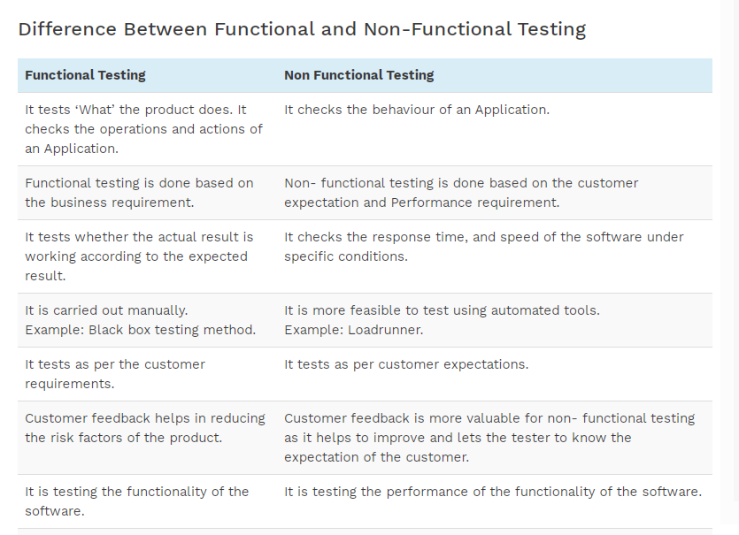

Slide 41
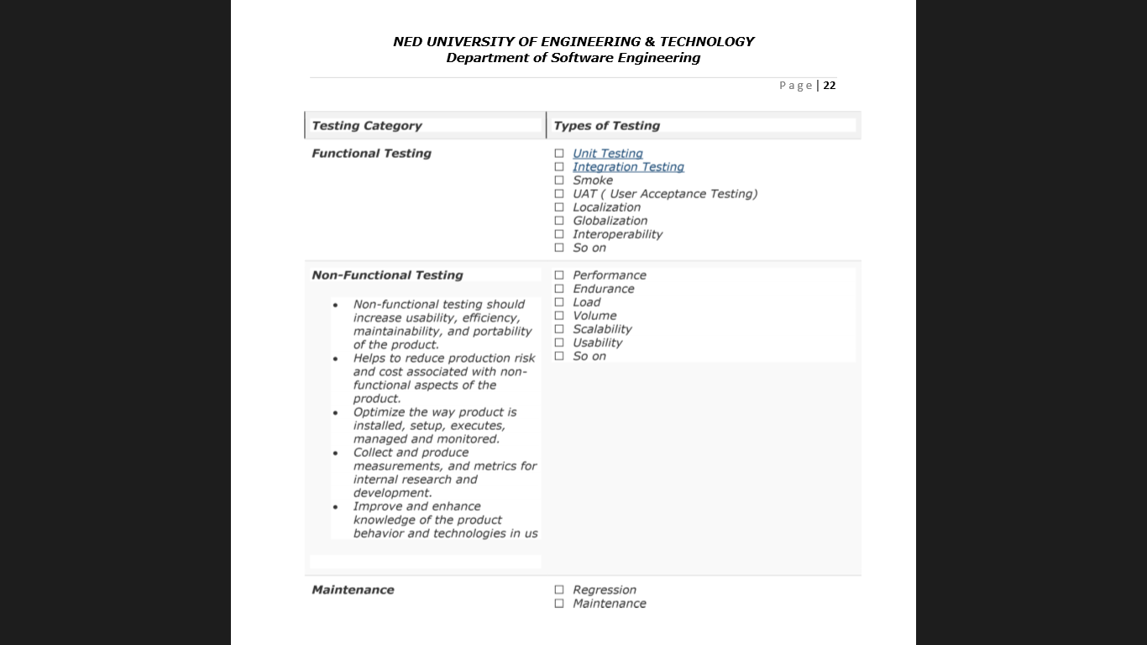

Slide 42
This is not the complete list as there are more than 150 types of testing types and still adding. Also, note that not all testing types are applicable to all projects but depend on nature & scope of the project.

